Slide 1
离散数据及其应用 Discrete Mathematics and Its Applications （Eighth Edition/Kenneth H.Rosen） 郭少勇 (syguo@bupt.edu.cn) 北京邮电大学 2022.6
Notes:
1

Slide 2
Trees
11.1 树的概念/Introduction of Trees
11.2 树的应用/Applications of Trees
11.3 树的遍历/Tree Traversal
11.4 生成树/Spanning Trees
11.5 最小生成树/ minimum Spanning Trees

Slide 3
11.1 Introduction to Trees
A tree is a connected undirected graph with no simple circuits.
Theorem: There is a unique simple path between any two of its nodes.
An undirected graph without simple circuits is called a forest.
You can think of it as a set of trees having disjoint sets of nodes.

Slide 4
11.1 Introduction to Trees
Examples of Trees and Graphs that are not Trees
G1
G2
G3
G4

Slide 5
11.1 Introduction to Trees
给定图T，以下关于树的定义是等价的:
1) 无回路的连通图；
2) 无回路且e = v – 1；
3) 连通且e = v – 1；
4) 无回路,但增加一条新边,得一个且仅一个回路；
5) 连通但删去后便不连通；
6) 每一对结点间有一条且仅有一条路。

Slide 6
11.1 Introduction to Trees
[定义]树：一个无简单回路的连通无向图称为一棵树/Tree，记为Ｔ
[定义]林： 无简单回路的无向图是林/Forests

Slide 7
11.1 Introduction to Trees
[定理1]树的基本性质：
（1）树是平面图；
（2）树中任二顶点间都有唯一道路；
（3）去掉树的任一边，成了林；
（4）在树上任添一条边，产生唯一回路；
（5）设Ｔ＝（Ｖ，Ｅ），｜Ｖ｜＝ｖ，｜Ｅ｜＝ｅ，则ｖ＝ｅ＋１。

Slide 8
11.1 Introduction to Trees
树是平面图，且无回路，区域数γ＝１，满足欧拉公式ｖ－ｅ＋γ＝２，即ｖ＝ｅ＋１。
也可用强归纳法证：（对Ｖ归纳）
（1）ｖ≤２，显然成立
（2）假设ｖ＜ｐ时成立，ｖ＝ｐ时，先移去一条边，成了两棵树Ｔ₁和Ｔ₂，
有ｖ₁＝ｅ₁ ＋１，ｖ₂＝ｅ₂ ＋１，且ｅ₁ ＋ｅ₂ ＝ｅ－１，
故ｖ＝ｖ₁ ＋ｖ₂ ＝ｅ₁ ＋１＋ｅ₂ ＋１＝（ｅ₁ ＋ｅ₂ ＋１）＋１＝ｅ＋１。

Slide 9
11.1 Introduction to Trees
Rooted Trees（有根树）
A rooted tree is a tree in which one node has been designated the root.
Every edge is (implicitly or explicitly) directed away from the root.
You should know the following terms about rooted trees:
Parent, child, siblings, ancestors, descendents, leaf, internal node, subtree.

Slide 10
11.1 Introduction to Trees
[定义]有向树：如果有向图Ｇ＝（Ｖ，Ｅ）对应的无向图是树，称Ｇ为有向树/directed tree
[定义]有根树：如果有向树存在唯一一个入次为０的顶点，其余顶点入次均为１，称此有向树为有根树/rooted tree
[定义] 根：有根树中入次为０的顶点称为根/root
[定义] 叶：有根树中出次为０的顶点称为叶/leaf
[定义]枝点：有根树中除叶以外的顶点均为枝点/internal vertices

Slide 11
11.1 Introduction to Trees
Level 0
树根root
Level 1
树叶 leave
双亲Parent
Level 2
孩子offspring
Level 3
兄弟 sibling
Level 4
Height（高度）:the largest level number of the tree

Slide 12
11.1 Introduction to Trees
[定义] 父亲，儿子，兄弟：
有根树Ｇ＝（Ｖ,Ｅ），若（ａ，ｂ）∈Ｅ，则称ａ是ｂ的父亲/parent，ｂ是ａ的儿子/child
若（ａ，ｂ₁）∈Ｅ，（ａ，ｂ₂）∈Ｅ，称ｂ₁与ｂ₂互为兄弟/siblings
[定义] 祖先，后裔：
有根树中，若ａ到ｃ有道路存在，则称ａ是ｃ的祖先/ancestors，ｃ是ａ的后裔descendants

Slide 13
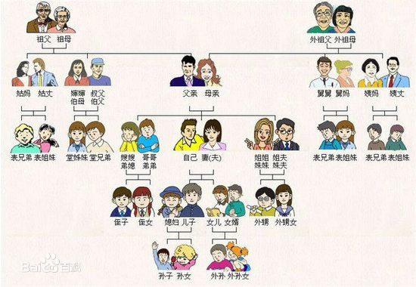
11.1 Introduction to Trees

Slide 14
11.1 Introduction to Trees
[定义]子树：有根树Ｔ＝（Ｖ，Ｅ），ａ是Ｔ的枝点，Ｖ_{a}是ａ及其后裔的集合，Ｅ_{a}是ａ到各后裔道路上边的集合，则Ｔ_{a}＝（Ｖ_{a}，Ｅ_{a}）称为Ｔ的以ａ为根的子树/subtree
注: 以ａ为根的子树,包含根顶点ａ
ａ的子树:以ａ的儿子为根的子树
[定义]有序树：对枝点的儿子规定一个次序，如长子，次子等，则此有根树称为有序树/ordered tree

Slide 15
11.1 Introduction to Trees
[定义]有序树中的
左儿子/left child：枝点的左边儿子
右儿子/right child ：枝点的右边儿子
左子树/left subtree ：左儿子为根的子树
右子树/right subtree ：右儿子为根的子树

Slide 16
11.1 Introduction to Trees
如下图
作为有根树：同构
作为有序树：不同构

Slide 17
11.1 Introduction to Trees
[定义]n元树：每个枝点最多有n个儿子的有根树称为n元树/n-ary tree
[定义]n元正规树：每个枝点恰有n个儿子的有根树称为n元正规树/full n-ary tree
[定义]n元树n=2时称为二元树或二叉树/binary tree
例：
算术表达式的树表示(二元树)：
（（ａ＋ｂ×ｃ）×ｄ－ｅ）／（ｆ＋ｇ）＋ｈ×ｉ×ｊ

Slide 18
11.1 Introduction to Trees
+
÷
*
-
+
*
j
*
h
i
e
f
g
+
d
a
*
b
c

Slide 19
11.1 Introduction to Trees
n-ary trees（n叉树）
A rooted tree is called n-ary if every internal vertex has no more than n children
It is full if every internal vertex has exactly n children.
A 2-ary tree is called a binary tree（二元树）

Slide 20
11.1 Introduction to Trees
n叉树： 每个结点的出度小于或等于n的根树；
完全n叉树：每个结点的出度恰好等于n或零的根树；
正则n叉树：所有树叶层次相同的完全n叉树。

Slide 21
11.1 Introduction to Trees
[定义]顶点道路长度和层：顶点ａ的道路长或顶点的层/level是指从根到ａ的边的条数，记为l（ａ）；
[定义]树高：有根树的树高/height指到根最远的顶点ａ的道路长度
即 ｈ＝ｍａｘ[ l(ａ) ] ａ∈Ｖ
性质：n元树高度为ｈ，最多能有n^{h}片叶
[定义]n元完全树：如果树高为ｈ的n元树有n^{h}片叶，称此树为n元完全树/complete n-ary tree
注： 完全树当然是正规的

Slide 22
11.1 Introduction to Trees
Ordered Rooted Tree（有序有根树）
A rooted tree where the children of each internal node are ordered.
In ordered binary trees, we can define:
left child, right child
left subtree, right subtree
For n-ary trees with n>2, can use terms like “leftmost”, “rightmost,” etc.

Slide 23
11.1 Introduction to Trees
Trees as Models
Can use trees to model the following:
Saturated hydrocarbons
Organizational structures
Computer file systems
In each case, would you use a rooted or a non-rooted tree?

Slide 24
11.1 Introduction to Trees
树：连通且无回路的无向图
树叶：树中度数为1的结点
分枝或内点：度数大于1的结点
森林：每个连通分支是树的无向图

Slide 25
11.1 Introduction to Trees
甲烷
乙烷
丙烷
化学同分异构物
丁烷
异丁烷

Slide 26
11.1 Introduction to Trees

Slide 27
11.1 Introduction to Trees

Slide 28
11.1 Introduction to Trees
家族树
图书十进制分类
一个组织结构的层次体系
各种运算表达式
判断树

Slide 29
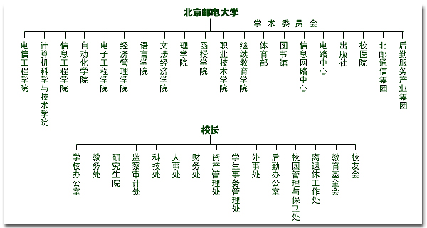
11.1 Introduction to Trees

Slide 30
11.1 Introduction to Trees
Training Dataset
This follows an example from Quinlan’s ID3

Slide 31
11.1 Introduction to Trees
Output: A Decision Tree for “buys_computer”
age?
<=30
overcast
>40
30..40
student?
yes
credit rating?
no
yes
excellent
fair
no
yes
no
yes

Slide 32
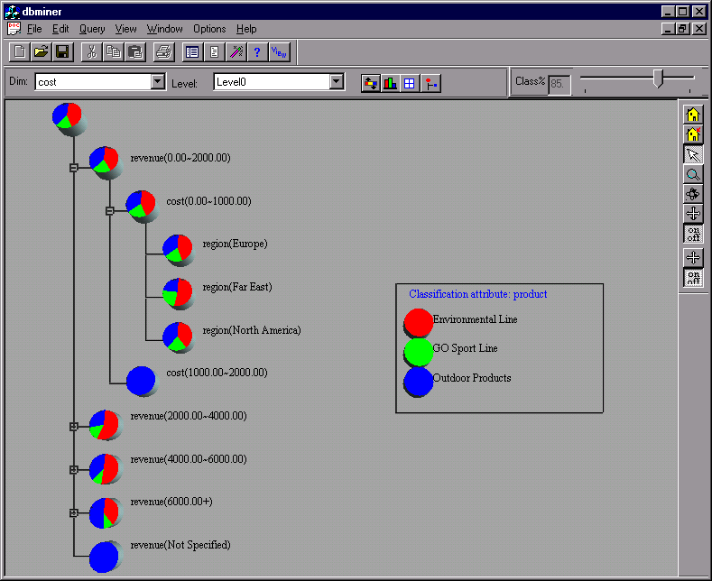
11.1 Introduction to Trees
Presentation of Classification Results

Slide 33
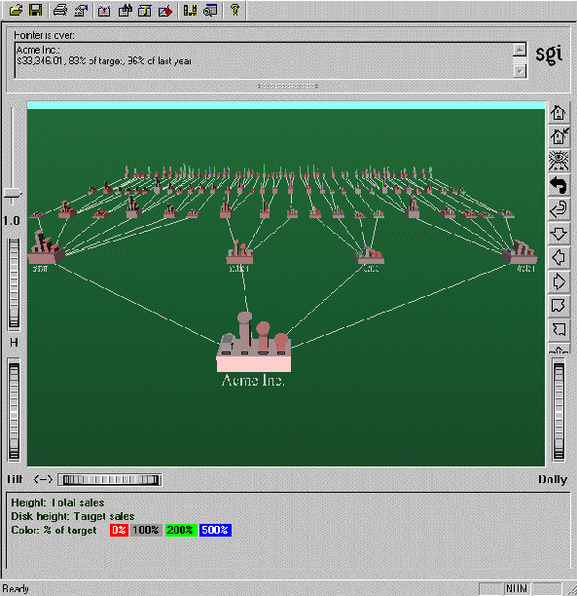
11.1 Introduction to Trees
Visualization of a Decision Tree in SGI/MineSet 3.0

Slide 34
11.1 Introduction to Trees
Some Tree Theorems
A tree with n nodes has n−1 edges.
A full m-ary tree with i internal nodes has n=mi+1 nodes, and  =(m−1)i+1 leaves.
Proof: There are mi children of internal nodes，plus the root. And,  = n−i = (m−1)i+1. □
Thus, given m, we can compute any of i, n, and  from any of the others.

Slide 35
11.1 Introduction to Trees
More Theorems
Definition: The level of a node is the length of the simple path from the root to the node.
The height of a tree is maximum node level.
A rooted m-ary tree with height h is balanced if all leaves are at levels h or h−1.

Slide 36
11.1 Introduction to Trees
More Theorems
Theorem: There are at most m^{h} leaves in an m-ary tree of height h.
Corollary: An m-ary tree with  leaves has height h≥⎡log_{m} ⎤ . If m is full and balanced then h=⎡log_{m}⎤

Slide 37
11.1 Introduction to Trees
定理：设有完全m叉树，其树叶leaves为t，分支点nonleaves数为i，则（m - 1）i = t - 1

Slide 38
11.1 Introduction to Trees
Example:
28盏灯拟用一个电源插座,问需要多少块四插座接线板?
Solution:
(4-1)i = 28-1
i = 9
需要9个接线板

Slide 39
11.1 Introduction to Trees
[定理]：若Ｔ为ｍ元树，则（ｍ－１）ｉ≥ｔ－１，其中ｉ为枝点数，ｔ为叶数

Slide 40
11.1 Introduction to Trees
Example:
一台三地址计算机，用一个加法指令可求三个数之和，现要计算１２个数之和，至少要几次加法指令？
Solution:
(m-1)i ≥ t-1
(3-1)I ≥ 12-1 = 11
i ≥ 11/2 = 5.5
i = 6
但这种树不唯一，见图示

Slide 41
11.1 Introduction to Trees
Solution:

Slide 42
11.1 Introduction to Trees
Solution:

Slide 43
balanced
11.1 Introduction to Trees
A rooted m-ary tree of height h is balanced if all leaves are at levels h or h-1.

Slide 44
11.2: Applications of Trees
Binary search trees
Decision trees
Minimum comparisons in sorting algorithms
8 硬币问题
Prefix codes
Huffman coding
Game trees

Slide 45
11.2.2 Binary Search Trees
Form a binary tree for the words:
Mathematics , physics , geography , zoology , meteorology,
Geology ,psychology , and chemistry ( using alphabetical order)

Slide 46
11.2.3 Decision Trees
Minimum comparisons in sorting algorithms
8 硬币问题

Slide 47
11.2.4 Prefix Codes
Huffman Coding

Slide 48
11.2.4 Prefix Codes
前缀码/Prefix Codes
1. 计算机是用０和１序列来表示和存储信息。通讯编码也是这样处理的。
如２６个英文字母(a-z)，用v位则可表示 ２^{v},由于２⁴=16＜２６＜２⁵=32，故要用５位二进制才能区分２６个字母。
2. 是否能用不同位数的二进制数来表示信息，尽量缩短通讯时序列的长度。这是可行的，但要注意:如００表示Ａ，０１表示Ｂ，０００１表示ｚ，那么收到０００１是代表ＡＢ还是ｚ？
怎样避免二义性？

Slide 49
11.2.4 Prefix Codes
[定义]前缀：ａ，ｂ，ｃ均为二进制序列，如果ｂ＝ａ并列ｃ，ｃ不是空序列，则称ａ是ｂ的前缀/prefix。即ａ是ｂ的前面一部分。
[定义] 前缀码：一个二进制序列集合，如果这些二进制序列互不为前缀，则称此集合为前缀码/prefix code。
例：二元有序加权树
每枝点左边对应权为0，右边对应权1，叶对应一个码（即每片叶都有一条从根到叶的路径，路径上的权排成序即为叶的码，也称作叶的名。

Slide 50
11.2.4 Prefix Codes
二元前缀码
设$a_{1},a_{2},⋯,a_{n−1}$, $a_{n}$是长为n的符号串, $a_{1},a_{1},a_{2}⋯,a_{1}$, $a_{2}⋯a_{n−1}$均为该符号串的前缀，它们的长度分别为 1,2, $⋯$, n-1。

Slide 51
11.2.4 Prefix Codes
A={$β_{1}$, $β_{2}$, $⋯$, $β_{m}$}为一个符号串集合,对于任意的$β_{i},β_{j}∈A(i≠j)$, $β_{i}与β_{j}$互不为前缀，则称A为前缀码
若符号串$β_{i}$(i=1,2, $⋯$, m)中出现0,1两个符号，则称A为二元前缀码。

Slide 52
11.2.4 Prefix Codes
√
√
×
√
×

Slide 53
11.2.4 Prefix Codes
定理
任意一棵二叉树都可产生一 个前缀码。
定理
任何一个前缀码都对应一棵二叉树。

Slide 54
11.2.4 Prefix Codes

Slide 55
11.2.4 Prefix Codes

Slide 56
11.2.4 Prefix Codes

Slide 57
11.2.4 Prefix Codes
由于枝点才可能是叶的前缀，而枝点不对应一个码，故这样一棵树所有叶对应的码构成前缀码。
二元完全树的叶只有２^{h}片（ｈ为树高），用二元树的前缀码，最长码长是树高ｈ，最多不超过２^{h}片。
如上例２６个字母，就可构造树高为5的二元树,然后用相应的前缀码分别表示各个字母，将常用的字母用较短的编码表示，可缩短整个通讯序列的长度，提高效率，即：

Slide 58
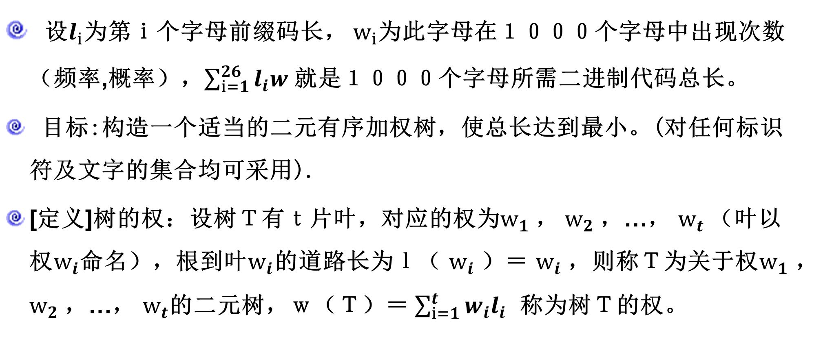
11.2.4 Prefix Codes
设$l_{i}$为第ｉ个字母前缀码长， $w_{i}$为此字母在１０００个字母中出现次数（频率,概率），$\sum_{i=1}^{26}{l_{i}w}$ 就是１０００个字母所需二进制代码总长。
目标:构造一个适当的二元有序加权树，使总长达到最小。(对任何标识符及文字的集合均可采用).
[定义]树的权：设树Ｔ有ｔ片叶，对应的权为$w_{1}$， $w_{2}$，…， $w_{t}$（叶以权$w_{i}$命名），根到叶$w_{i}$的道路长为ｌ（ $w_{i}$）＝ $w_{i}$，则称Ｔ为关于权$w_{1}$， $w_{2}$，…， $w_{t}$的二元树，ｗ（Ｔ）＝ $\sum_{i=1}^{t}{w_{i}l_{i}}$ 称为树Ｔ的权。

Slide 59

11.2.4 Prefix Codes
最优树问题
带权二叉树: 每片树叶都带权的二叉树.
带权二叉树的权:
其中 为带权$w_{i}$的树叶的通路长度.

Slide 60
11.2.4 Prefix Codes
最优树: 在所有带权$w_{1}$， $w_{2}$，…， $w_{t} 的$二叉树中，ｗ(T)最小的那棵树
定理 T为带权 $w_{1}≤w_{2}≤$… $≤ w_{t}$的最优树，则
a) 带权$w_{1} ,w_{2}$的树叶$V_{W_{1}} ,V_{W_{2}}$是兄弟.
b) 以树叶$V_{W_{1}} ,V_{W_{2}}$为儿子的分枝点,其通路长最长.
定理 T为带权 $w_{1}≤w_{2}≤$… $≤ w_{t}$的最优树，若将以带权$w_{1},w_{2}$的树叶为儿子的分枝点该为带权$w_{1}+w_{2}$的树叶得到一新树T`,也是最优树.

Slide 61
11.2.4 Prefix Codes
例题
求带权7,10,11,13,17的最优树.
解
求解过程如下

Slide 62
11.2.4 Prefix Codes

Slide 63
11.2.4 Prefix Codes
例题
有权 2,3,5,7,11,13,17,19,23，29,31,37,41求相应的最优树.

Slide 64
11.2.4 Prefix Codes

Slide 65
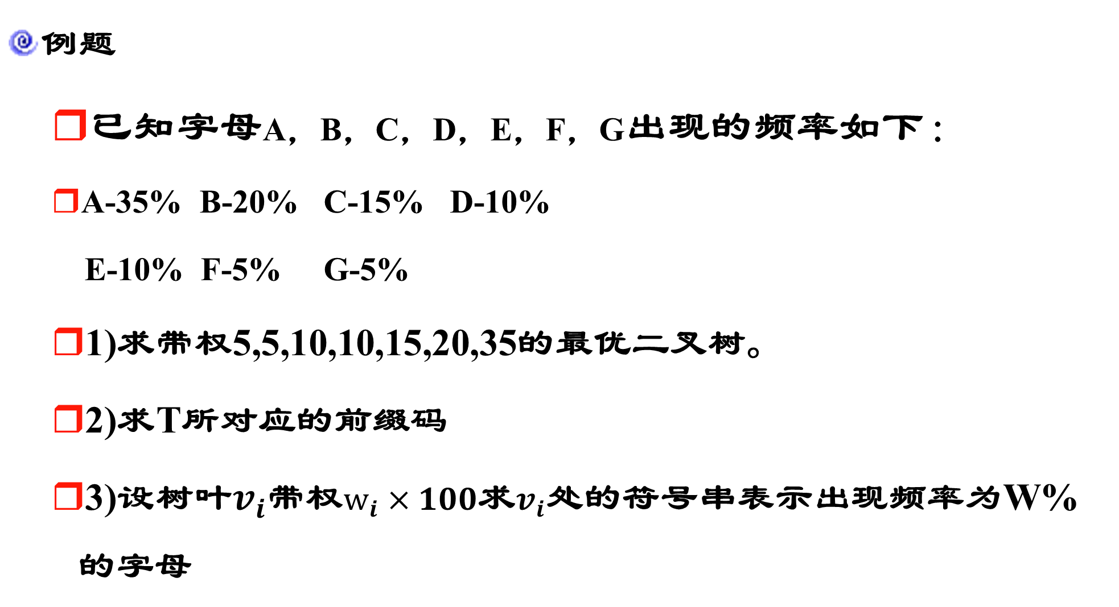
11.2.4 Prefix Codes
例题
已知字母A，B，C，D，E，F，G出现的频率如下：
A-35% B-20% C-15% D-10%
E-10% F-5% G-5%
1)求带权5,5,10,10,15,20,35的最优二叉树。
2)求T所对应的前缀码
3)设树叶$v_{i}$带权$w_{i}×100$求$v_{i}$处的符号串表示出现频率为W%的字母

Slide 66
11.2.4 Prefix Codes

Slide 67
11.2.4 Prefix Codes

Slide 69
11.2.4 Prefix Codes

Slide 70
11.2.4 Prefix Codes
[定义]最优树：对于确定的权ｗ₁，ｗ₂，…，ｗ_{t}，若Ｔ中取到合适的ｌ₁，ｌ₂，…，ｌ_{t}，使ｗ（Ｔ）达到最小，则称Ｔ为关于权ｗ₁，ｗ₂，…，ｗ_{t}的最优树。
注：如果对ｗ₁，ｗ₂，…，ｗ_{t}作出一棵最优的二元有序加权树，则从根到叶的路径上的权序列集合就是前缀码。

Slide 71
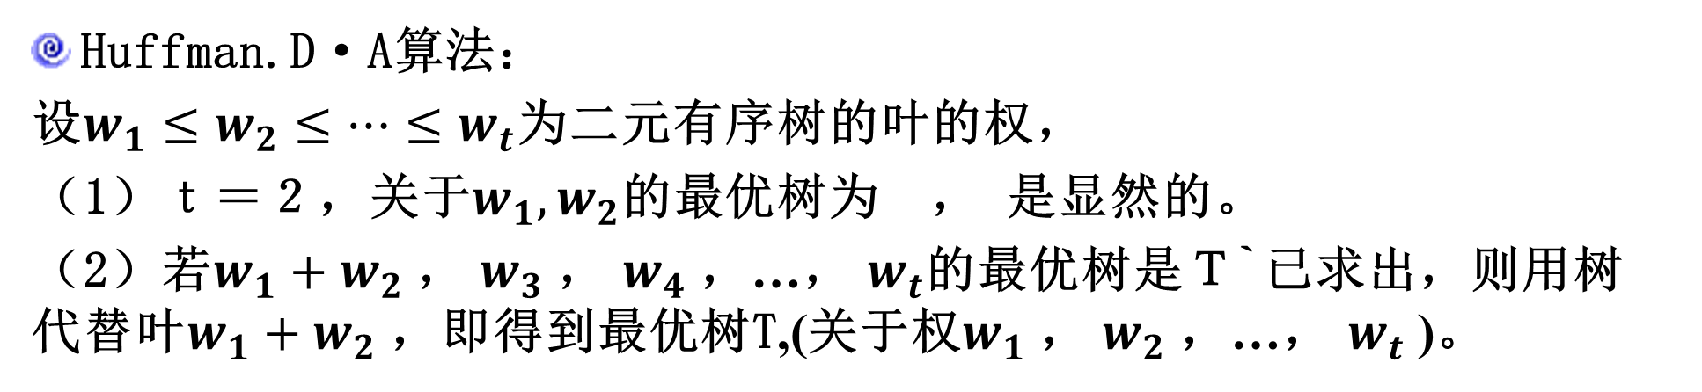
11.2.4 Prefix Codes
Huffman.D·A算法：
设$w_{1}≤w_{2}≤…≤w_{t}$为二元有序树的叶的权，
（1）ｔ＝２，关于$w_{1},w_{2}$的最优树为 ， 是显然的。
（2）若$w_{1}+w_{2}$， $w_{3}$， $w_{4}$，…， $w_{t}$的最优树是Ｔ`已求出，则用树 代替叶$w_{1}+w_{2}$，即得到最优树T,(关于权$w_{1}$， $w_{2}$，…， $w_{t}$ )。

Slide 72
11.2.4 Prefix Codes
例：构造关于权｛２，３，４，４，５，５，７｝的最优树。
解：
（1）｛２，３，４，４，５，５，７｝
（2）｛４，４，５，５，５，７｝
（3）｛５，５，５，７，８｝
（4）｛５，７，８，１０｝
（5）｛８，１０，１２｝
（6）｛１２，１８｝
１２ １８

Slide 73
11.2.4 Prefix Codes
（7）倒推回去：

Slide 74
11.2.4 Prefix Codes

Slide 75
11.2.4 Prefix Codes

Slide 76
11.2.4 Prefix Codes
另
外
构
造
：

Slide 77
11.3 Tree Traversal
Tree Traversal
Universal address systems/通信地址系统
ordered rooted tree/有序根树
0
1
2
3
4
5
1.1
1.2
1.3
3.1
3.2
4.1
5.1
5.2
5.3
3.1.2
3.1.3
3.1.1
5.1.1
3.1.2.4
3.1.2.1
3.1.2.2
3.1.2.3
0<1<1.1<1.2<1.3<2<3<3.1<3.1.1<3.1.2<3.1.2.1<3.1.2.2<3.1.2.3<3.1.2.4<3.1.3<3.2<4<4.1<5<5.1<5.1.1<5.2<5.3

Slide 78
11.3 Tree Traversal
Traversal Algorithms
Definition 1:Let T be an ordered rooted tree with root r. If T consists only of r, then r is the preorder traversal(前序遍历) of T. Otherwise, suppose that T₁,T₂,….,T_{n} are subtrees at r from left to right in T. The preorder traversal begins by visiting r. It continues by traversing T₁ in preorder, then T₂ in preorder, and so on, until T_{n} is traversed in preorder.

Slide 79
11.3 Tree Traversal
preorder traversal
a
b
d
c
e
f
g
i
h
j
k
l
m
n
o
p
ａ）前序：a,b,e,j,k,n,o,p,f, c,d,g,l,m,h,i

Slide 80
11.3 Tree Traversal
Traversal Algorithms
Definition 2:Let T be an ordered rooted tree with root r. If T consists only of r, then r is the inorder traversal(中序遍历) of T. Otherwise, suppose that T₁,T₂,….,T_{n} are subtrees at r from left to right in T. The inorder traversal begins by traversing T₁ in inorder , then visiting r. It continues by traversing T₂ in inorder, and so on, until T_{n} is traversed in inorder.

Slide 81
11.3 Tree Traversal
inorder traversal
a
b
d
c
e
f
g
i
h
j
k
l
m
n
o
p
ｂ）中序：j,e,n,k,o,p,b,f,a,c,l,g,m,d,h,i

Slide 82
11.3 Tree Traversal
Traversal Algorithms
Definition 3:Let T be an ordered rooted tree with root r. If T consists only of r, then r is the postorder traversal(后序遍历) of T. Otherwise, suppose that T₁,T₂,….,T_{n} are subtrees at r from left to right in T. The postorder traversal begins by traversing T₁ in postorder. then T₂ in postorder, and so on, then T_{n} is traversed in postorder, and ends by visiting r.

Slide 83
11.3 Tree Traversal
postorder traversal
a
b
d
c
e
f
i
g
h
j
k
l
m
n
o
p
ｃ）后序：j,n,o,p,k,e,f,b,c,l,m,g,h,i,d,a

Slide 84
11.3 Tree Traversal
二元树的遍历问题:
（或周游/traversal：即访问一遍所有顶点）
有三种访问方法：
1. 前序周游/preorder traversal：
先游根，
再左子树，
后右子树。
2. 中序周游/inorder traversal：
先游左子树，
再根，
后右子树。
3. 后序周游/postorder traversal：
先游左子树，
再右子树，
最后游根。

Slide 85
11.3 Tree Traversal
Visiting: performing appropriate tasks at a vertex.
Searching or tree search(树搜索):the process of visiting each vertex of a tree in some specific order.(walking or traversing（遍历）)
Left subtree（左子树）:T(v_{L})
Right subtree （右子树） :T(v_{R})

Slide 86
11.3 Tree Traversal
Preorder search（前序遍历）
Algorithm preorder
Step 1 visit v.
Step 2 if v_{L} exists, then apply this algorithm to (T(v_{L}), v_{L}).
Step 3 if v_{R} exists, then apply this algorithm to (T(v_{R}), v_{R}).
end of algorithm

Slide 87
11.3 Tree Traversal
Inorder（中序遍历）
Algorithm inorder
Step 1 search the left subtree(T(v_{L}), v_{L}), if it exists.
Step 2 visit the root v.
Step 3 search the right subtree(T(v_{R}), v_{R}), if it exists.
end of algorithm

Slide 88
11.3 Tree Traversal
Postorder（后序遍历）
Algorithm postorder
Step 1 search the left subtree(T(v_{L}), v_{L}), if it exists.
Step 2. search the right subtree(T(v_{R}), v_{R}), if it exists.
Step 3. visit the root v.
end of algorithm

Slide 89
11.3 Tree Traversal
a
b
d
c
e
f
g
i
h
j
k
l
m
n
o
p
ａ）前序：a,b,e,j,k,n,o,p,f, c,d,g,l,m,h,i
ｂ）中序：j,e,n,k,o,p,b,f,a,c,l,g,m,d,h,i
ｃ）后序：j,n,o,p,k,e,f,b,c,l,m,g,h,i ,d,a

Slide 90
11.3 Tree Traversal
Infix, Prefix, and Postfix Notation
中缀、前缀和后缀记法
A Binary Three Representing((x+y)^2+((x-4)/3)
+
/
^
+
-
2
3
x
y
x
4
ａ）Prefix：+^+xy²/-x43
ｂ）Infix：x+y²+x-4/3
ｃ）Postfix：xy+2^x⁴-3/+

Slide 91
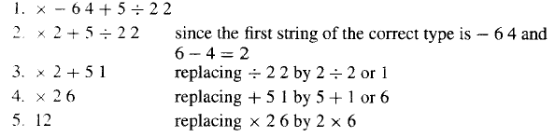
11.3 Tree Traversal
Prefix(Polish Form) （前缀表达式（波兰式））
Unambiguously without parentheses
from left to right Fxy
operation symbol precedes the argument

Slide 92
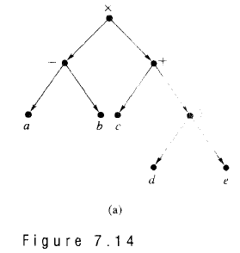
11.3 Tree Traversal
Infix notation（中缀表示法）
Ambiguous
/

Slide 93
11.3 Tree Traversal
Postfix（后缀表达式）
ab-cde/+*
a=2,b=1,c=3

Slide 94
11.3 Tree Traversal
Searching general trees
Define a B(T)

Slide 95
11.3 Tree Traversal
Define a binary positional tree B(T) :
If v in A, then the left offspring of V_{L} of v in B(T) is the first offspring of v in T, if it exists.
The right offspring of V_{R} of V in B(T) is the next sibling of v in T, if it exists.

Slide 96
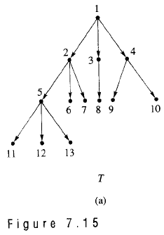
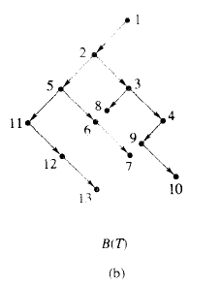
11.3 Tree Traversal
Searching general trees

Slide 97
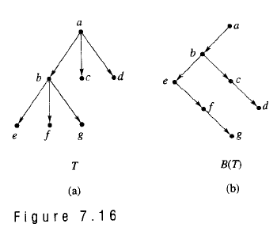
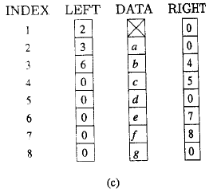
11.3 Tree Traversal
Linked-list representation of T

Slide 98
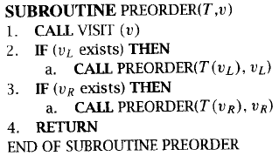
11.3 Tree Traversal
Pseudocode versions（伪码）

Slide 99
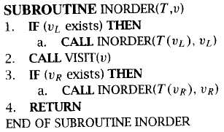
11.3 Tree Traversal
Pseudocode versions

Slide 100
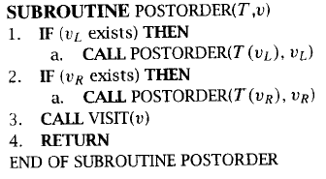
11.3 Tree Traversal
Pseudocode versions

Slide 101
11.3 Tree Traversal
ａ）前序：ａ，ｂ，ｄ，ｇ，ｅ，ｈ，ｉ，ｃ，ｆ
ｂ）中序：ｇ，ｄ，ｂ，ｈ，ｅ，ｉ，ａ，ｃ，ｆ
ｃ）后序：ｇ，ｄ，ｈ，ｉ，ｅ，ｂ，ｆ，ｃ，ａ

Slide 102
11.3 Tree Traversal
二元树的遍历问题的应用
公式的三种表示方法：
1. Infix notation
2. Prefix notation
Polish notation
3. Postfix notation
reverse Polish notation

Slide 103
11.4 Spanning Trees
Spanning Trees （生成树）
Let G be a simple graph. A spanning tree of G is a subgraph of G that is a tree containing every vertex of G.
T is a tree with exactly the same vertices as G
T can be obtained from G by deleting some edges of G.

Slide 104
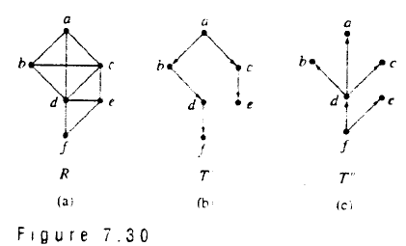
11.4 Spanning Trees
Example:
Spanning trees are not unique.

Slide 105
11.4 Spanning Trees
定义 G的生成树:G的是一棵树的生成子图.
树枝: 生成树T中的边;
弦: G的不在生成树中的边;
生成树T的补: 所有弦的集合.
定理 连通图至少有一棵生成树.

Slide 106
11.4 Spanning Trees
一个连通图可有多棵生成树.

Slide 107
11.4 Spanning Trees
[定义]生成树：无向简单图Ｇ＝（Ｖ，Ｅ）的生成子图Ｔ是树，则称Ｔ为Ｇ的生成树/spanning tree.
Ｔ＝（Ｖ，Ｅ’）, Ｅ’⊆Ｅ
[定理一]：
无向简单图Ｇ＝（Ｖ，Ｅ）存在生成树的充要条件是Ｇ是连通的。
证明: 必要性：Ｔ是生成子图，包含Ｇ的所有顶点，Ｔ是树，Ｔ连通，则Ｇ连通。

Slide 108
11.4 Spanning Trees
充分性：若Ｇ是连通的,
(1）若G无回路，则Ｇ本身是树，即生成树。
(2) 若存在回路，去掉回路中任一边，不影响连通性，也不减少顶点.
所有回路都移去一条边，剩下的子图包含所有顶点，又是无回路的连通图，即为生成树。
注： ① 移去边时可随意，故生成树不唯一。
② 生成树是Ｇ的最小连通生成子图，若将Ｇ＝（Ｖ，Ｅ）看成是各顶点间的通讯联络图，则生成树Ｔ＝（Ｖ，Ｅ’）即为各顶点间直接或间接联络的最小通讯联络图。

Slide 109
11.4 Spanning Trees
IP Multicasting
目前，使用得最为广泛的组播技术是IP Multicast。IP组播技术是一种为优化使用网络资源而产生的技术，通常用于多点工作方式下的应用程序中，它是标准IP网络层协议技术的一个扩展。 从Steve Deering于1989年提出的IETF的RFC1112"Host Extension for IP Multicast"中的定义我们可以得知：IP组播的核心思想是--通过一个IP地址向一组主机发送数据（UDP包）。发送者仅仅向一个组地址发送信息，接收者只需加入到这个分组就可以接收信息，所有的接收者接收的是同一个数据流，组中成员是动态的，可以根据自己的意愿随时随意加入或退出。每一台主机都可以同时加入到多个组中，每一个组播地址可以在不同的端口或者不同的套接字（Socket）上有多个数据流，同时许多实际应用可以共享一个组地址。IP组播技术可以有效地避免重复发送可能引起的广播风暴，并且能够突破路由器的限制，将数据包传送到其它网段。

Slide 110
11.4 Spanning Trees
Depth-first search深度优先
Build a spanning tree for a connected simple graph using a depth-first search.

Slide 111
11.4 Spanning Trees
Depth-first search深度优先
i
j
d
f
a
e
h
k
c
b
g
Tree edges back edges

Slide 112
11.4 Spanning Trees
Breadth-first search广度优先
Produce a spanning tree of a simple graph by the use of a breadth-first search.

Slide 113
11.4 Spanning Trees
Breadth-first search广度优先
c
b
l
a
e
f
g
d
h
i
j
m
k

Slide 114
11.4 Spanning Trees
Backtracking 回溯法
Graph Colorings
The n-Queens Problem
In directed graphs

Slide 115

11.4 Spanning Trees
Web spiders
What is a Spider or Search Engine Spider?
Description: A Spider or Search Engine Spider is a program that automatically traverses the Web and requests documents from URLs. A spider usually starts from a historical list of URLs and retrieves referenced documents. As it visits new Internet websites it checks to see if the site is already listed in its database. If the site is already listed it usually updates any changes it finds. Spiders are also commonly known as Robots or Crawlers. Other names sometimes used: Webwalkers, Wanderers, or *Worms

Slide 116
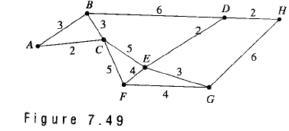
11.5 Minimal Spanning Trees
Weighted graph（加权图）
Definition: a weighted graph is a graph for which each edge is labeled with a numerical value called its weight（权值） .
Example 1：

Slide 117
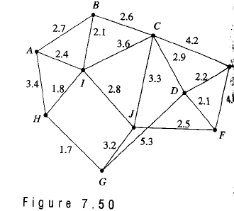
11.5 Minimal Spanning Trees
Example 2：
E
4.4

Slide 118
11.5 Minimal Spanning Trees
The weight of an edge (v_{i},v_{j}) is some times referred to as the distance between vertice(顶点之间的距离) v_{i} and v_{j}.
A vertex u is a nearest neighbor of vertex v(顶点 v 的最近邻) if u and v are adjacent and no other vertex is joined to v by an edge of lesser weight than(u,v).
Note v may have more than one nearest neighbor.

Slide 119
11.5 Minimal Spanning Trees
Example 3：

Slide 120
11.5 Minimal Spanning Trees
A vertex v is a nearest neighbor of a set of vertices(一组顶点的最近邻) V={v₁,v₂,…v_{k}} in a graph if v is adjacent to some member v_{i} of V and no other vertex adjacent to a member of V is joined by an edge of lesser weight than (v,v_{i}).
This vertex v may belong to V.

Slide 121
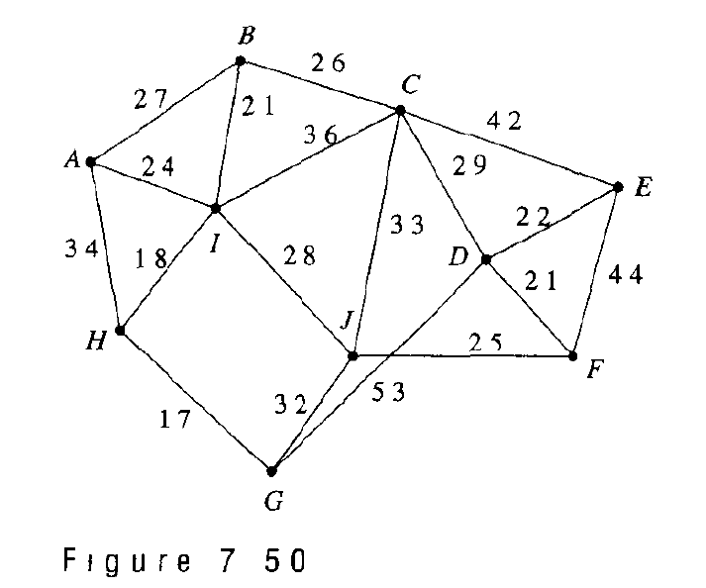
11.5 Minimal Spanning Trees
Example 4：
V={C,E,J}
D is the nearest neighbor of V.

Slide 122
11.5 Minimal Spanning Trees
Minimal spanning tree （最小生成树）
Definition: an undirected spanning tree of a weighted graphs, for which the total weight of the edges in the tree is as small as possible. Such a spanning tree is called a minimal spanning tree.

Slide 123
11.5 Minimal Spanning Trees
Prim’s algorithm
Procedure Prim(G:weighted connected undirected graph with n vertices)
T:= a minimum-weighted edge
For i:=1 to n-2
Begin
e:=an edge of minimum weight incident to a vertex in T and not forming a simple circuit in T if added to T
T:= T with e added
End{T is a minimum spanning tree of G}

Slide 124
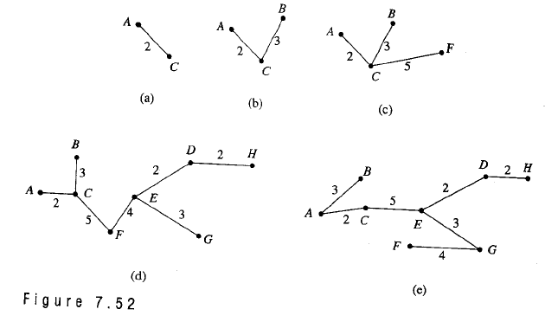
11.5 Minimal Spanning Trees
Example 5：

Slide 125
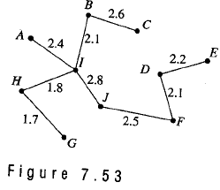
11.5 Minimal Spanning Trees
Example 6：

Slide 126
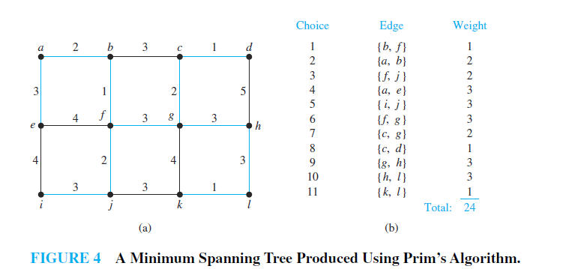
11.5 Minimal Spanning Trees

Slide 127
11.5 Minimal Spanning Trees
Theorem 1
Prim’s algorithm produces a minimal spanning tree for the graph G.
Proof
Let G have n vertex. Let T be the spanning tree for G produced by Prim’s algorithm.
Suppose that the edges of T are t₁, t₂,…, t_{n-1} in the order of they were selected.
we define T_{i} (i=1 to n-1) to be the tree with t₁, t₂,…, t_{i} and T₀={}Then T₀ T₁ … T_{n-1}=T.
We now proved that each T_{i} is contained in a minimal spanning tree for G by mathematical induction.

Slide 128
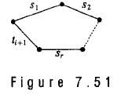
11.5 Minimal Spanning Trees
Basis step: Clearly P(0):T₀={} is contained in every minimal spanning tree for G
Induction Step:
suppose P(k):T_{k} is contained in a minimal spanning tree T’ for G.
By definition {t₁, t₂,…,t_{k}} T’. If t_{k+1}also belongs to T’,then T_{k+1} T’ and we have P(k+1) is true.
If t_{k+1}does not belongs to T’,then T’ {t_{k+1} }must contain a cycle.
This cycle would be for some edges s₁, s₂,…,s_{k} in T’
The edges of this cycle cannot all be fromT_{k} or T_{k+1} would contain this cycle.

Slide 129
11.5 Minimal Spanning Trees
Let s_{l} be the edge with smallest index l that is not in T_{k}.when t_{k+1} was chosen by Prim‘s algorithm, s_{l} was also available.thus the weight of s_{l} is at least as large as that of t_{k+1}.
The spanning tree (T’-{s_{l}}) {t_{k+1} }contains T_{k+1}. The weight of this tree is less than or equal to the weight of T’,so it is a minimal tree for G.
P(k+1) is true. So T_{n-1}=T is contained in a minimal spanning tree and must in fact be that minimal spanning tree.
Q.E.D

Slide 130
11.5 Minimal Spanning Trees
Kruskal’s algorithm
Let G be a weighted connected undirected graph with n vertices and let S={e₁, e₂,…, e_{k}} be the set of weighted edges of G.
Step 1 Choose an edge e₁ in S of least weight. Let E={e₁} Replace S with S-{e₁}.
Step 2 Choose an edge e_{i} in S of least weight that will not make a cycle with members of E.Replace E with E {e_{i} }and S with S-{e_{i} }.
Step 3 Repeat step 2 until |E|=n-1.
End of algorithm

Slide 131
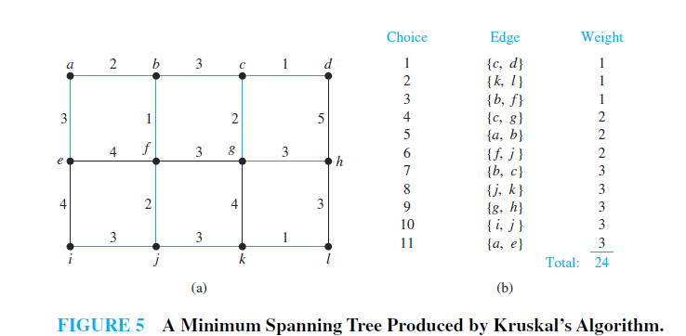
11.5 Minimal Spanning Trees

Slide 132
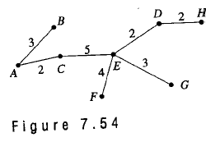
11.5 Minimal Spanning Trees
Example 7：

Slide 133
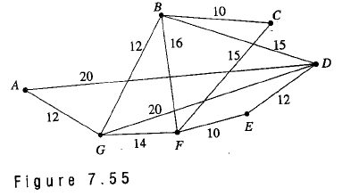
11.5 Minimal Spanning Trees
Example 7：
Use Kruskal’s algorithm to find a minimal spanning tree for the graph

Slide 134
11.5 Minimal Spanning Trees
最小生成树/minimum spanning tree
城市通讯网图中，最小生成树就是能保证通讯费用最小的通讯网。

Slide 135
11.5 Minimal Spanning Trees
Ｋｒｕｓｋａｌ算法：
设Ｇ＝（Ｖ，Ｅ，Ｗ）是连通图
1.各边以权由小到大排序。
2.选Ｅ中最小边ｅ₁，令Ｇ₁＝（Ｖ，Ｓ₁），
Ｓ₁＝｛ｅ₁｝，ｉ＝１
3.设Ｓ_{i}＝｛ｅ₁，ｅ₂，…，ｅ_{i}｝，Ｇ_{i}＝（Ｖ，
Ｓ_{i}）选出s_{i+1,}从Ｅ－Ｓ_{i}中选一条边ｅ_{i+1}，
满足：
(1）Ｓ_{i}∪｛ｅ_{i+1}｝中不含回路；
(2)ｅ_{i+1}是满足(1）的最小权的边。令
Ｓ_{i+1}＝｛ｅ₁，ｅ₂，…，ｅ_{i}，ｅ_{i+1}｝，
Ｇ_{i+1}＝（Ｖ，Ｓ_{i+1}）；
４．ｉ＝ｉ＋１，若ｉ＝ｖ－１，则Ｇ_{i}＝Ｇ_{v-1}为最小生成树，否则转３继续。

Slide 136
11.5 Minimal Spanning Trees

Slide 137
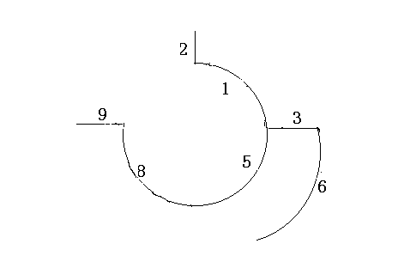
11.5 Minimal Spanning Trees
解题过程：
(1）边排序:(v1,v2),(v2,v7),(v1,v6),(v6,v7)
(v1,v4),(v5,v6),(v4,v5),(v3,v4),(v3,v8)
(v5,v8),(v2,v3),(v7,v8)
(2) 选s1={e1} e1=(v1,v2)
(3) 选e2=(v2,v7)
(4) e3=(v1,v6)
(5) e4=(v1,v4)=5
(6) e5=(v5,v6)=6
(7) e6=(v3,v4)=8
(8) e7=(v3,v8)

Slide 138
作业
11.1-11.5
§11.1 – 4, 16, 20, 28, 44
§11.2 – 6, 16, 30
§11.3 – 6, 18, 22, 34
§11.4 – 12, 14, 22, 24, 50, 54
§11.5 – 4, 8, 10, 14, 18

Slide 139
11.1-11.5
单词表
forests（森林）
Rooted Trees(有根树).
siblings(兄弟)
descendants(后代)
internal vertices(内点)
ordered rooted tree(有序根树)
binary tree（二叉树）
BALANCED m-ARY TREES（平衡的m叉树）
binary search tree(二叉搜索树)
decision tree(决策树)
Prefix Codes（前缀码）
Huffman coding(哈夫曼编码)

Slide 140
11.1-11.5
单词表
preorder traversal(前序遍历)
inorder traversal(中序遍历)
postorder traversal(后序遍历)
tree search(树搜索)
spanning trees(生成树)
minimal spanning tree(最小生成树)

