Slide 1
Web服务框架Sanic
Python程序设计

Slide 2
Sanic
Sanic is a Python 3.6+ web server and web framework that’s written to go fast. It allows the usage of the async/await syntax added in Python 3.5, which makes your code non-blocking and speedy.
from sanic import Sanic
from sanic.response import json
app = Sanic("App Name")
@app.route("/")
async def test(request):
return json({"hello": "world"})
if __name__ == "__main__":
app.run(host="0.0.0.0", port=8000)
Open the address http://0.0.0.0:8000 in your web browser. You should see the message Hello world!.
Notes:
from sanic import Sanic
from sanic.response import json
app = Sanic("App Name")
@app.route("/")
async def test(request):
return json({"hello": "world"})
if __name__ == "__main__":
app.run(host="0.0.0.0", port=8000)

Slide 3
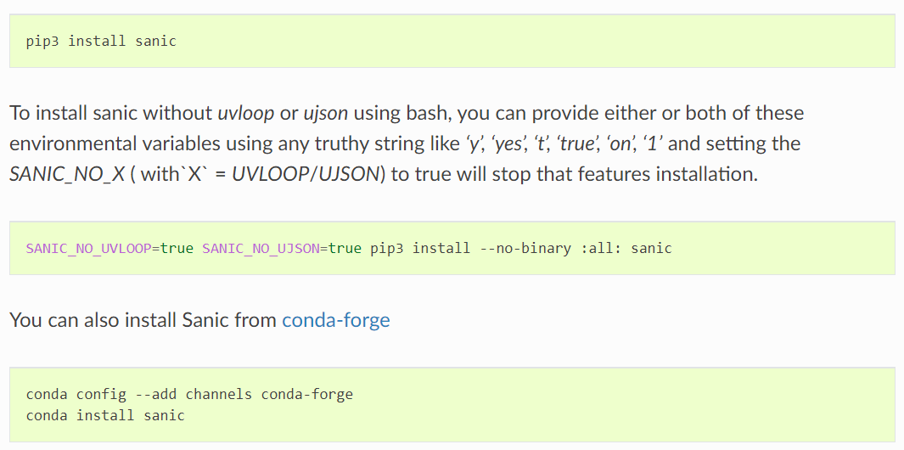
安装Sanic

Slide 4
Configuration
app = Sanic('myapp')
app.config.DB_NAME = 'appdb'
app.config.DB_USER = 'appuser'
config对象本质是一个dictionary，所以可以使用update方法进行更新。
db_settings = {
'DB_HOST': 'localhost',
'DB_NAME': 'appdb',
'DB_USER': 'appuser'
}
app.config.update(db_settings)
从Python文件加载配置
app = Sanic('myapp')
app.config.from_pyfile('/path/to/config_file')
# config_file
DB_HOST = 'localhost'
DB_NAME = 'appdb'
DB_USER = 'appuser'

Slide 5
内置的配置取值
Variable | Default | Description
REQUEST_MAX_SIZE | 100000000 | How big a request may be (bytes)
REQUEST_BUFFER_QUEUE_SIZE | 100 | Request streaming buffer queue size
REQUEST_TIMEOUT | 60 | How long a request can take to arrive (sec)
RESPONSE_TIMEOUT | 60 | How long a response can take to process (sec)
KEEP_ALIVE | True | Disables keep-alive when False
KEEP_ALIVE_TIMEOUT | 5 | How long to hold a TCP connection open (sec)
WEBSOCKET_MAX_SIZE | 2^20 | Maximum size for incoming messages (bytes)
WEBSOCKET_MAX_QUEUE | 32 | Maximum length of the queue that holds incoming messages
WEBSOCKET_READ_LIMIT | 2^16 | High-water limit of the buffer for incoming bytes
WEBSOCKET_WRITE_LIMIT | 2^16 | High-water limit of the buffer for outgoing bytes
WEBSOCKET_PING_INTERVAL | 20 | A Ping frame is sent every ping_interval seconds.
WEBSOCKET_PING_TIMEOUT | 20 | Connection is closed when Pong is not received after ping_timeout seconds
GRACEFUL_SHUTDOWN_TIMEOUT | 15.0 | How long to wait to force close non-idle connection (sec)
ACCESS_LOG | True | Disable or enable access log

Slide 6
Request Data
JSON数据
from sanic.response import json
@app.route("/json")
async def post_json(request):
return json({ "received": True, "message": request.json })
args(dict) - Query string variables. A query string is the section of a URL that resembles ?key1=value1&key2=value2
from sanic.response import json
@app.route("/query_string")
async def query_string(request):
return json({ "parsed": True, "args": request.args, "url": request.url, "query_string": request.query_string })
query_args (list) - On many cases you would need to access the url arguments in a less packed form. query_args is the list of (key, value) tuples.

Slide 7
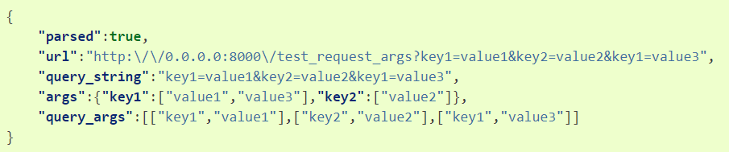
args vs. query_args
from sanic import Sanic
from sanic.response import json
app = Sanic(__name__)
@app.route("/test_request_args")
async def test_request_args(request):
return json({
"parsed": True,
"url": request.url,
"query_string": request.query_string,
"args": request.args,
"query_args": request.query_args,
})
if __name__ == '__main__':
app.run(host="0.0.0.0", port=8000)

Slide 8
Request Data – files, form
files (dictionary of File objects) – List of files that have a name, body, and type.
from sanic.response import json
@app.route("/files")
async def post_json(request):
test_file = request.files.get('test')
file_parameters = {
'body': test_file.body,
'name': test_file.name,
'type': test_file.type,
}
return json({ "received": True, "file_names": request.files.keys(), "test_file_parameters": file_parameters })
form(dict) – Posted form variables.
@app.route("/form")
async def post_json(request):
return json({ "received": True, "form_data": request.form, "test": request.form.get('test') })

Slide 9
Request Data - body
body (bytes) – Posted raw body. This property allows retrieval of the request’s raw data, regardless of content type.
from sanic.response import text
@app.route("/users", methods=["POST",])
async def create_user(request):
return text("You are trying to create a user with the following POST: %s" % request.body)

Slide 10
Request Data - misc
headers (dict) - A case-insensitive dictionary that contains the request headers.
method (str) - HTTP method of the request (ie GET, POST).
ip (str) - IP address of the requester.
port (str) - Port address of the requester.
socket (tuple) - (IP, port) of the requester.
app - a reference to the Sanic application object that is handling this request. This is useful when inside blueprints or other handlers in modules that do not have access to the global app object.
url: The full URL of the request, ie: http://localhost:8000/posts/1/?foo=bar
scheme: The URL scheme associated with the request: ‘http|https|ws|wss’ or arbitrary value given by the headers.
host: The host associated with the request(which in the Host header): localhost:8080
server_name: The hostname of the server, without port number. the value is seeked in this order: config.SERVER_NAME, x-forwarded-host header, Request.host()
server_port: Like server_name. Seeked in this order: x-forwarded-port header, Request.host(), actual port used by the transport layer socket.
path: The path of the request: /posts/1/
query_string: The query string of the request: foo=bar or a blank string ‘’
token: The value of Authorization header: Basic YWRtaW46YWRtaW4=

Slide 11
Response
Plain Text
from sanic import response
@app.route('/text')
async def handle_request(request):
return response.text('Hello world!')
HTML
from sanic import response
@app.route('/html')
async def handle_request(request):
return response.html('<p>Hello world!</p>')
JSON
from sanic import response
@app.route('/json')
async def handle_request(request):
return response.json({'message': 'Hello world!'})

Slide 12
Response
File
from sanic import response
@app.route('/file')
async def handle_request(request):
return await response.file('/srv/www/whatever.png')
Streaming
from sanic import response
@app.route("/streaming")
async def index(request):
async def streaming_fn(response):
await response.write('foo')
await response.write('bar')
return response.stream(streaming_fn, content_type='text/plain')

Slide 13
Response Streaming
@app.route("/")
async def index(request):
async def stream_from_db(response):
conn = await asyncpg.connect(database='test')
async with conn.transaction():
async for record in conn.cursor('SELECT generate_series(0, 10)'):
await response.write(record[0])
return stream(stream_from_db)
File Streaming
from aiofiles import os as async_os
from sanic.response import file_stream
@app.route("/")
async def index(request):
file_path = "/srv/www/whatever.png"
file_stat = await async_os.stat(file_path)
headers = {"Content-Length": str(file_stat.st_size)}
return await file_stream(
file_path,
headers=headers,
chunked=False,
)

Slide 14
Request Streaming
Request Streaming：以stream流的方式上传数据
from sanic import Sanic
from sanic.response import stream, text
@app('/put_stream', stream=True)
async def app_put_handler(request):
result = ''
while True:
body = await request.stream.read()
if body is None:
break
result += body.decode('utf-8').replace('1', 'A')
return text(result)

Slide 15
Routing
Request parameters
from sanic.response import text
@app.route('/tag/<tag>')
async def tag_handler(request, tag):
return text('Tag - {}'.format(tag))
@app.route('/int/<integer_arg:int>')
async def integer_handler(request, integer_arg):
return text('Integer - {}'.format(integer_arg))
@app.route('/person/<name:[A-z]+>')
async def person_handler(request, name):
return text('Person - {}'.format(name))
supported types:
string
int
number：包括整数和浮点数
alpha：只包含字母
path
uuid
regex expression：正则表达式

Slide 16
Routing – HTTP method
HTTP Methods
from sanic.response import text
@app.route('/post', methods=['POST'])
async def post_handler(request):
return text('POST request - {}'.format(request.json))
@app.route('/get', methods=['GET'])
async def get_handler(request):
return text('GET request - {}'.format(request.args))
缩写形式
from sanic.response import text
@app.post('/post')
async def post_handler(request):
return text('POST request - {}'.format(request.json))
@app.get('/get')
async def get_handler(request):
return text('GET request - {}'.format(request.args))

Slide 17
Static Files
# Serves files from the static folder to the URL /static
app.static('/static', './static')
# use url_for to build the url, name defaults to 'static' and can be ignored
app.url_for('static', filename='file.txt') == '/static/file.txt'
app.url_for('static', name='static', filename='file.txt') == '/static/file.txt'
# Serves the file /home/ubuntu/test.png when the URL /the_best.png is requested
app.static('/the_best.png', '/home/ubuntu/test.png', name='best_png')
# you can use url_for to build the static file url
# you can ignore name and filename parameters if you don't define it
app.url_for('static', name='best_png') == '/the_best.png'
app.url_for('static', name='best_png', filename='any') == '/the_best.png'
# you need define the name for other static files
app.static('/another.png', '/home/ubuntu/another.png', name='another')
app.url_for('static', name='another') == '/another.png'
app.url_for('static', name='another', filename='any') == '/another.png'

Slide 18
Exceptions
Throwing an exception
from sanic.exceptions import ServerError
@app.route('/killme')
async def i_am_ready_to_die(request):
raise ServerError("Something bad happened", status_code=500)
@app.route('/youshallnotpass')
async def no_no(request):
abort(401)
# this won't happen
text("OK")
Handling exceptions
from sanic.response import text
from sanic.exceptions import NotFound
@app.exception(NotFound)
async def ignore_404s(request, exception):
return text("Yep, I totally found the page: {}".format(request.url))
Useful exceptions
NotFound: called when a suitable route for the request isn’t found.
ServerError: called when something goes wrong inside the server. This usually occurs if there is an exception raised in user code.

Slide 19
Middleware
There are two types of middleware: request and response. Both are declared using the @app.middleware decorator, with the decorator’s parameter being a string representing its type: ‘request’ or ‘response’.
Request middleware receives only the request as an argument and are executed in the order they were added.
Response middleware receives both the request and response and are executed in reverse order.
@app.middleware('request')
async def add_key(request):
# Arbitrary data may be stored in request context:
request.ctx.foo = 'bar'
@app.middleware('response')
async def custom_banner(request, response):
response.headers["Server"] = "Fake-Server"
@app.middleware('response')
async def prevent_xss(request, response):
response.headers["x-xss-protection"] = "1; mode=block"
@app.get("/")
async def index(request):

Slide 20
Listeners
before_server_start
after_server_start
before_server_stop
after_server_stop
@app.listener('before_server_start')
async def setup_db(app, loop):
app.db = await db_setup()
@app.listener('after_server_start')
async def notify_server_started(app, loop):
print('Server successfully started!')
@app.listener('before_server_stop')
async def notify_server_stopping(app, loop):
print('Server shutting down!')
@app.listener('after_server_stop')
async def close_db(app, loop):
await app.db.close()
async def notify_server_started_after_five_seconds(app):
await asyncio.sleep(5)
print(app.name)
app.add_task(notify_server_started_after_five_seconds(app))
Notes:
If you want to schedule a background task to run after the loop has started, Sanic provides the add_task method to easily do so.
Sanic will attempt to automatically inject the app, passing it as an argument to the task.
Or you can pass the app explicitly for the same effect.

Slide 21
WebSocket
from sanic.response import json
from sanic.websocket import WebSocketProtocol
app = Sanic("websocket_example")
@app.get('/')
async def root(req):
return json({"hello": "world"})
@app.websocket('/feed')
async def feed(request, ws):
while True:
data = 'hello!'
print('Sending: ' + data)
await ws.send(data)
data = await ws.recv()
print('Received: ' + data)
if __name__ == "__main__":
app.run(host="0.0.0.0", port=8000)
app.config.WEBSOCKET_MAX_SIZE = 2 ** 20
app.config.WEBSOCKET_MAX_QUEUE = 32
app.config.WEBSOCKET_READ_LIMIT = 2 ** 16
app.config.WEBSOCKET_WRITE_LIMIT = 2 ** 16
app.config.WEBSOCKET_PING_INTERVAL = 20
app.config.WEBSOCKET_PING_TIMEOUT = 20

Slide 22
Handler Decorators
from functools import wraps
from sanic.response import json
def authorized():
def decorator(f):
@wraps(f)
async def decorated_function(request, *args, **kwargs):
# run some method that checks the request
# for the client's authorization status
is_authorized = check_request_for_authorization_status(request)
if is_authorized:
# the user is authorized.
# run the handler method and return the response
response = await f(request, *args, **kwargs)
return response
else:
# the user is not authorized.
return json({'status': 'not_authorized'}, 403)
return decorated_function
return decorator
@app.route("/")
@authorized()
async def test(request):
return json({'status': 'authorized'})

Slide 23
SSL - HTTPS
Optionally pass in an SSLContext:
import ssl
context = ssl.create_default_context(purpose=ssl.Purpose.CLIENT_AUTH)
context.load_cert_chain("/path/to/cert", keyfile="/path/to/keyfile")
app.run(host="0.0.0.0", port=8443, ssl=context)
You can also pass in the locations of a certificate and key as a dictionary:
ssl = {'cert': "/path/to/cert", 'key': "/path/to/keyfile"}
app.run(host="0.0.0.0", port=8443, ssl=ssl)

Slide 24
Deploying
Running via Sanic webserver
host (default `”127.0.0.1”`): Address to host the server on.
port (default `8000`): Port to host the server on.
unix (default `None`): Unix socket name to host the server on (instead of TCP).
debug (default `False`): Enables debug output (slows server).
ssl (default `None`): SSLContext for SSL encryption of worker(s).
sock (default `None`): Socket for the server to accept connections from.
workers (default `1`): Number of worker processes to spawn.
loop (default `None`): An asyncio-compatible event loop. If none is specified, Sanic creates its own event loop.
protocol (default `HttpProtocol`): Subclass of asyncio.protocol.
access_log (default `True`): Enables log on handling requests (significantly slows server).
app.run(host='0.0.0.0', port=1337, access_log=False, workers=4)
Running via command
sanic server.app --host=0.0.0.0 --port=1337 --workers=4
python -m sanic server.app --host=0.0.0.0 --port=1337 --workers=4

Slide 25
Deploying – asyncio support & sharing loop
serv_coro = app.create_server(host="0.0.0.0", port=8000, return_asyncio_server=True)
loop = asyncio.get_event_loop()
serv_task = asyncio.ensure_future(serv_coro, loop=loop)
server = loop.run_until_complete(serv_task)
server.after_start()
try:
loop.run_forever()
except KeyboardInterrupt as e:
loop.stop()
finally:
server.before_stop()
# Wait for server to close
close_task = server.close()
loop.run_until_complete(close_task)
# Complete all tasks on the loop
for connection in server.connections:
connection.close_if_idle()
server.after_stop()

Slide 26
Extensions（部分） https://github.com/mekicha/awesome-sanic
Authentication
Sanic-JWT: Authentication extension for JSON Web Tokens (JWT).
Sanic-JWT-Extended: Port of flask-jwt-extended, provides access/refresh token with fresh, easy custom claim insertion, and role-based access control
Sanic-OAuth: OAuth Library with many provider and OAuth1/OAuth2 support.
Sanic-Token-Auth: Simple token-based authentication.
Sanic-HTTPAuth: Fork of Flask-HTTPAuth, provides Basic, Digest and Token HTTP authentication for Sanic routes
Frontend
sanja: This module aims to make bringing Jinja templates to Sanic easy.
Jinja2-sanic: a jinja2 template renderer for Sanic.
Sanic-Babel: Adds i18n/l10n support to Sanic applications with the help of the Babel library
Sanic-CORS: A port of flask-cors.
Sanic-Jinja2: Support for Jinja2 template.
Sanic-Sass: Compile Sass & SCSS to CSS for Sanic.
Requests and Responses
Python-Sanicargs: Parse query args in Sanic using type annotations and a decorator.
Sanic Brogz: Allows you to easily gzip Sanic responses. A port of Flask-Compress.
Sanic Gzip: Add compression to your Sanic endpoints with a decorator
Sanic-Limiter: Rate limiting for sanic.
Sanic-UserAgent: Add user_agent to request
Sanic-SSLify: Forces SSL on your Sanic app. A port of Flask-SSLify.
TuSanic: TuSanic is a tus.io (simple resumable uploads) server-side implementation for sanic
Caching
Sanic-redis-extension: Redis (via aioredis) support for Sanic framework

Slide 27
结束

