Slide 1
PyQt5 Python图形界面编程
Python程序设计

Slide 2
内容
安装PyQt5
Hello World
Widgets
Layout
Signals & Slots
QString
QTcpSocket
QProcess

Slide 3
安装PyQt5
直接使用pip安装
pip install PyQt5
PyQt包括：
QtCore
QtGui
QtWidgets
QtNetwork
很多其他的modules
使用参考资料来源：
https://www.riverbankcomputing.com/static/Docs/PyQt5/index.html
https://doc.qt.io/qt-5/index.html

Slide 4
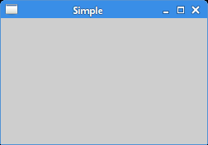
Hello World
import sys
from PyQt5.QtWidgets import QApplication, QWidget
def main():
app = QApplication(sys.argv)
w = QWidget()
w.resize(250, 150)
w.move(300, 300)
w.setWindowTitle('Simple')
w.show()
sys.exit(app.exec_())
if __name__ == '__main__':
main()

Slide 5
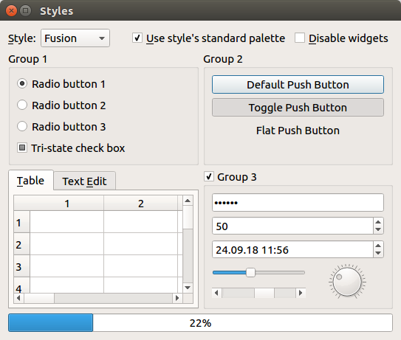
Widgets
Everything you see in a (Py)Qt app is a widget: Buttons, labels, windows, dialogs, progress bars etc. Like HTML elements, widgets are often nested. For example, a window can contain a button, which in turn contains a label.
The following screenshot shows the most common Qt widgets:
QLabel
QComboBox
QCheckBox
QRadioButton
QPushButton
QTableWidget
QLineEdit
QSlider
QProgressBar

Slide 6
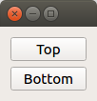
Layouts
from PyQt5.QtWidgets import QApplication, QWidget, QPushButton, QVBoxLayout
app = QApplication([])
window = QWidget()
layout = QVBoxLayout()
layout.addWidget(QPushButton('Top'))
layout.addWidget(QPushButton('Bottom'))
window.setLayout(layout)
window.show()
app.exec_()

Slide 7


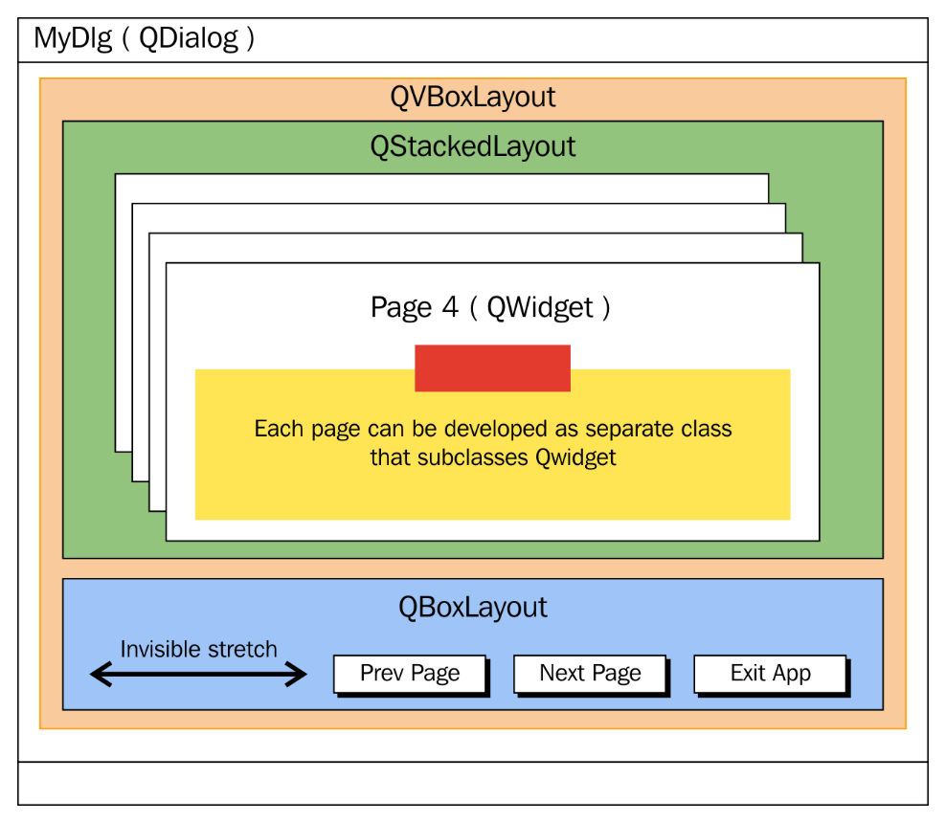
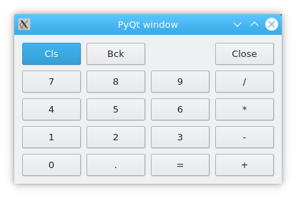
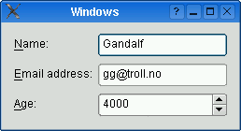
Layout
QHBoxLayout
QVBoxLayout
QGridLayout
QStackedLayout
QFormLayout

Slide 8
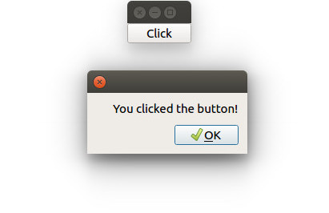
Signals and Slots
from PyQt5.QtWidgets import *
app = QApplication([])
button = QPushButton('Click')
def on_button_clicked():
alert = QMessageBox()
alert.setText('You clicked the button!')
alert.exec_()
button.clicked.connect(on_button_clicked)
button.show()
app.exec_()

Slide 9
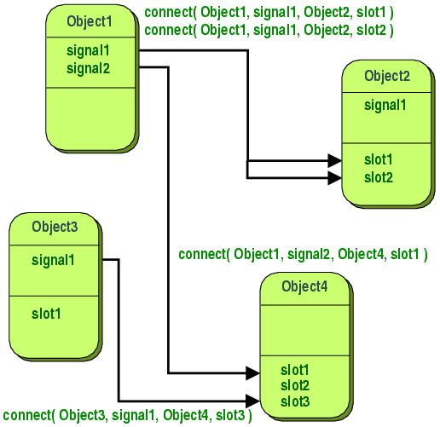
Signals and Slots

Slide 10
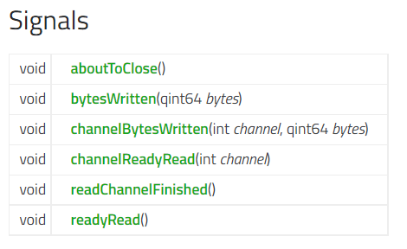
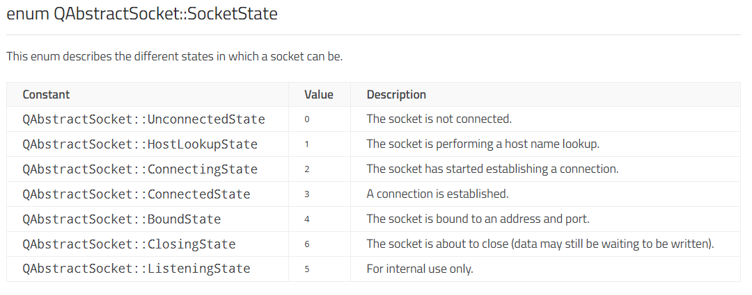
Signals and Slots

Slide 11
使用pyqtSlot
from PyQt5.QtCore import QObject, pyqtSlot class Foo(QObject): @pyqtSlot()
def foo(self):
""" C++: void foo() """
@pyqtSlot(int, str)
def foo(self, arg1, arg2):
""" C++: void foo(int, QString) """
@pyqtSlot(int, name='bar')
def foo(self, arg1):
""" C++: void bar(int) """
@pyqtSlot(int, result=int)
def foo(self, arg1):
""" C++: int foo(int) """
@pyqtSlot(int, QObject)
def foo(self, arg1):
""" C++: int foo(int, QObject *) """

Slide 12
自定义Signal
from PyQt5.QtCore import QObject, pyqtSignal
class Foo(QObject):
# Define a new signal called 'trigger' that has no arguments.
trigger = pyqtSignal()
def connect_and_emit_trigger(self):
# Connect the trigger signal to a slot.
self.trigger.connect(self.handle_trigger)
# Emit the signal.
self.trigger.emit()
def handle_trigger(self):
# Show that the slot has been called.
print "trigger signal received"

Slide 13
asyncio 与 PyQt 互通
使用IPC（Inter-Process Communication）
Named Pipe
WebSocket

Slide 14
结束

