Slide 1

Chapter 13
Data Storage Structures
DataBase System Concepts

Slide 2


Slide 3
DataBase System Concepts
Storage Access
File Organization
Organization of Records in Files
Data-Dictionary Storage

Slide 4
Storage Access
DataBase System Concepts
A database file is partitioned into fixed-length storage units called blocks（块）. Blocks are units of both storage allocation and data transfer.
Database system seeks to minimize the number of block transfers between the disk and memory. keep as many blocks as possible in main memory.
Buffer – portion of main memory available to store copies of disk blocks.
Buffer manager – subsystem responsible for allocating buffer space in main memory.

Slide 5
Buffer Manager
DataBase System Concepts
  If the block is already in the buffer, the requesting program is given the address of the block in main memory
  If the block is not in the buffer,
    the buffer manager allocates space in the buffer for the block, replacing (throwing out) some other block, if required, to make space for the new block.
    The block that is thrown out is written back to disk only if it was modified since the most recent time that it was written to/fetched from the disk.
    Once space is allocated in the buffer, the buffer manager reads the block from the disk to the buffer, and passes the address of the block in main memory to requester.

Slide 6
Buffer-Replacement Policies
DataBase System Concepts
Most operating systems replace the block least recently used (LRU strategy)
Queries have well-defined access patterns (such as sequential scans), and a database system can use the information in a user’s query to predict future references
  LRU can be a bad strategy for certain access patterns involving repeated scans of data
  e.g. when computing the join of 2 relations r and s by a nested loops
  for each tuple tr of r do
  for each tuple ts of s do
  if the tuples tr and ts match …

Slide 7
Buffer-Replacement Policies
DataBase System Concepts
Pinned block(钉住的块） – memory block that is not allowed to be written back to disk.
Pin done before reading/writing data from a block
Unpin done when read /write is complete
Multiple concurrent pin/unpin operations possible
forced output（强制写出）
Toss-immediate（立即丢弃） strategy – frees the space occupied by a block as soon as the final tuple of that block has been processed

Slide 8
DataBase System Concepts
Most recently used (MRU) strategy –
Buffer manager can use statistical information regarding the probability that a request will reference a particular relation
  E.g., the data dictionary is frequently accessed. Heuristic: keep data-dictionary blocks in main memory buffer
Buffer managers also support forced output of blocks for the purpose of recovery

Slide 9
Shared and exclusive locks
on buffer
DataBase System Concepts
Needed to prevent concurrent operations from reading page contents as they are moved/reorganized, and to ensure only one move/reorganize at a time.
Readers get shared lock, updates to a block require exclusive lock
Locking rules:
Only one process can get exclusive lock at a time
Shared lock cannot be concurrently with exclusive lock
Multiple processes may be given shared lock concurrently

Slide 10
File Organization
DataBase System Concepts
The database is stored as a collection of files. Each file is a sequence of records. A record is a sequence of fields;
Files are provided as a basic construct in OS;
The records are mapped onto disk blocks;
Fixed-length records
Variable-length records

Slide 11
Fixed-Length Records
DataBase System Concepts
Simple approach:
  Store record i starting from byte n ∗ (i – 1), where n is the size of each record.
  Record access is simple but records may cross blocks
    Modification: do not allow records to cross block boundaries
Deletion of record i: alternatives:
  move records i + 1, . . ., n to i, . . . , n – 1
  move record n to i
  do not move records, but link all free records on a free list

Slide 12

DataBase System Concepts

Slide 13

Deleting record 3 and compacting

Slide 14

Deleting record 3 and moving last record

Slide 15
Free Lists
DataBase System Concepts
Store the address of the first deleted record in the file header.
Use this first record to store the address of the second deleted record, and so on.
Can think of these stored addresses as pointers since they “point” to the location of a record.
More space efficient representation: reuse space for normal attributes of free records to store pointers. (No pointers stored in in-use records.)

Slide 16

DataBase System Concepts

Slide 17
Variable-Length Records
DataBase System Concepts
Variable-length records arise in database systems in several ways:
  Storage of multiple record types in a file.
  Record types that allow variable lengths for one or more fields.
  Record types that allow repeating fields
Byte string representation
  Attach an end-of-record (⊥) control character to the end of each record
  Difficulty with deletion
  Difficulty with growth

Slide 18
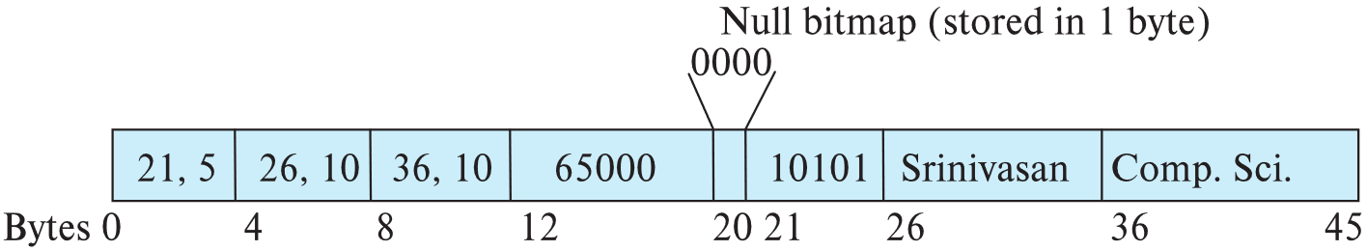
Variable-Length Records
DataBase System Concepts
Attributes are stored in order
Variable length attributes represented by fixed size (offset, length), with actual data stored after all fixed length attributes
Null values represented by null-value bitmap

Slide 19
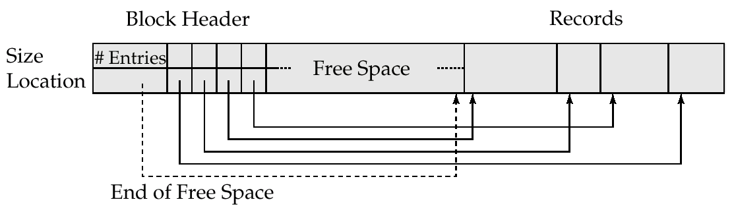
Slotted Page Structure
DataBase System Concepts
Slotted page header contains:
  number of record entries
  end of free space in the block
  location and size of each record
Records can be moved around within a page to keep them contiguous with no empty space between them; entry in the header must be updated.
Pointers should not point directly to record — instead they should point to the entry for the record in header.

Slide 20
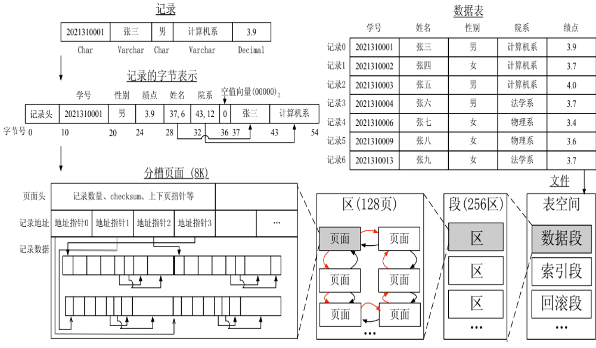

Slide 21
Storing Large Objects
DataBase System Concepts
E.g., blob/clob types
Records must be smaller than pages
Alternatives:
  Store as files in file systems
  Store as files managed by database
  Break into pieces and store in multiple tuples in separate relation
    PostgreSQL TOAST

Slide 22
Organization of Records in Files
DataBase System Concepts
Heap（堆） – a record can be placed anywhere in the file where there is space
Sequential （顺序）– store records in sequential order, based on the value of the search key of each record
Hashing（哈希） – a hash function computed on some attribute of each record; the result specifies in which block of the file the record should be placed
B+-tree file organization
Records of each relation may be stored in a separate file. In a clustering file organization（聚集） records of several different relations can be stored in the same file
  Motivation: store related records on the same block to minimize I/O

Slide 23
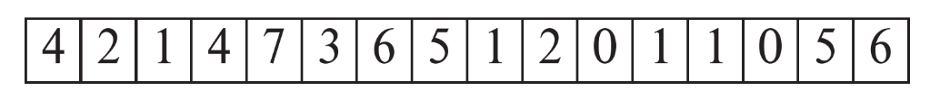
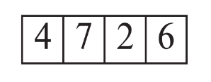
Heap File Organization
DataBase System Concepts
Records can be placed anywhere in the file where there is free space
Records usually do not move once allocated
Important to be able to efficiently find free space within file
Free-space map
  Array with 1 entry per block. Each entry is a few bits to a byte, and records fraction of block that is free
  In example below, 3 bits per block, value divided by 8 indicates fraction of block that is free
  Can have second-level free-space map
  In example below, each entry stores maximum from 4 entries of first-level free-space map

Slide 24
Sequential File Organization
DataBase System Concepts
Suitable for applications that require sequential processing of the entire file
The records in the file are ordered by a search-key
Deletion – use pointer chains
Insertion –locate the position where the record is to be inserted
  If there is free space insert there
  if no free space, insert the record in an overflow block
  In either case, pointer chain must be updated
Need to reorganize the file from time to time to restore sequential order

Slide 25


Insertion Example
DataBase System Concepts

Slide 26



Multitable Clustering File Organization
DataBase System Concepts
store several relations in one file using a clustering file organization
department
instructor
multitable clustering
of department and
instructor

Slide 27

DataBase System Concepts
good for queries involving department instructor, and for queries involving one single department and its instructors
bad for queries involving only department
results in variable size records
Can add pointer chains to link records of a particular relation

Slide 28
Data Dictionary Storage
DataBase System Concepts
Data dictionary (also called system catalog) stores metadata: that is, data about data, such as
Information about relations
  names of relations
  names and types of attributes of each relation
  names and definitions of views
  integrity constraints
User and accounting information, including passwords
Statistical and descriptive data
  number of tuples in each relation

Slide 29
Data Dictionary Storage(2)
DataBase System Concepts
Physical file organization information
  How relation is stored (sequential/hash/…)
  Physical location of relation
    operating system file name or
    disk addresses of blocks containing records of the relation
Information about indices (Chapter 15)

Slide 30
Data Dictionary Storage(3)
DataBase System Concepts
Catalog structure: can use either
  specialized data structures designed for efficient access
  a set of relations, with existing system features used to ensure efficient access
  The latter alternative is usually preferred
Relation-metadata = (relation-name, number-of-attributes,
storage-organization, location)
Attribute-metadata = (attribute-name, relation-name, domain- type, position, length)
User-metadata = (user-name, encrypted-password, group)
Index-metadata = (index-name, relation-name, index-type,
index-attributes)
View-metadata = (view-name, definition)

Slide 31

Relational Representation of System Metadata
DataBase System Concepts
Relational representation on disk
Specialized data structures designed for efficient access, in memory

Slide 32
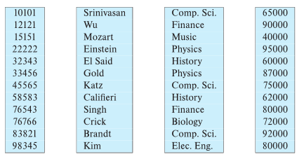
Column-Oriented Storage
DataBase System Concepts
Also known as columnar representation
Store each attribute of a relation separately
Example：instructor

Slide 33
Column-Oriented Storage
DataBase System Concepts
Benefits:
  Reduced IO if only some attributes are accessed
  Improved CPU cache performance
  Improved compression
  Vector processing on modern CPU architectures
Drawbacks
  Cost of tuple reconstruction from columnar representation
  Cost of tuple deletion and update
  Cost of decompression
Columnar representation found to be more efficient for decision support than row-oriented representation
Traditional row-oriented representation preferable for transaction processing
Some databases support both representations

Slide 34
Storage Organization in Main-Memory Databases
DataBase System Concepts
Can store records directly in memory without a buffer manager
Column-oriented storage can be used in-memory for decision support applications
  Compression reduces memory requirement

Slide 35
Summary
DataBase System Concepts
Buffer Management and replacement policies
File organization
Variable-length records
Heap file, Sequential file
Hashing file , Clustering file
Data dictionary Storage
Column-Oriented Storage

