Slide 1

Chapter 14 Indexing
DataBase System Concepts

Slide 2
DataBase System Concepts
Basic Concepts
Ordered Indices: Primary index, Secondary index
B⁺-Tree Index
Hash Indices
Index Definition in SQL

Slide 3
Basic Concepts
DataBase System Concepts
Indexing mechanisms used to speed up access to desired data.
Search Key – An attribute or set of attributes used to look up records in a file.
An index file consists of records (called index entries) of the form
Index files are typically much smaller than the original file
Two basic kinds of indices:
  Ordered indices: search keys are stored in sorted order
  Hash indices: search keys are distributed uniformly across “buckets” using a “hash function”.
search-key
pointer

Slide 4
Index Evaluation Metrics
DataBase System Concepts
Access types supported efficiently.
  records with a specified value in the attribute
  or records with an attribute value falling in a specified range of values.
Access time
Insertion time
Deletion time
Space overhead

Slide 5
Ordered Indices
DataBase System Concepts
In an ordered index, index entries are stored sorted on the search key value:
Primary index（主索引）: in a sequentially ordered file, the index whose search key specifies the sequential order of the file.
  Also called clustering index（聚集索引）
  The search key of a primary index is usually but not necessarily the primary key.
Index-sequential file: ordered sequential file with a primary index.
Secondary index（辅助索引）: an index whose search key specifies an order different from the sequential order of the file. Also called non-clustering index.

Slide 6

Dense Indices(稠密索引）
DataBase System Concepts
Dense index — Index record appears for every search-key value in the file.
E.g. index on ID attribute of instructor relation

Slide 7

Dense Indices
DataBase System Concepts
Dense index on dept_name, with instructor file sorted on dept_name

Slide 8

Sparse Indices（稀疏索引）
DataBase System Concepts
Sparse Index: contains index records for only some search-key values.
  Applicable when records are sequentially ordered on search-key

Slide 9
Sparse Indices(2)
DataBase System Concepts
To locate a record with search-key value K we:
  Find index record with largest search-key value < K
  Search file sequentially starting at the record to which the index record points
Less space and less maintenance overhead for insertions and deletions.
Generally slower than dense index for locating records.
Good tradeoff: sparse index with an index entry for every block in file, corresponding to least search-key value in the block.

Slide 10
Multilevel Index
DataBase System Concepts
If primary index does not fit in memory, access becomes expensive.
To reduce number of disk accesses to index records, treat primary index kept on disk as a sequential file and construct a sparse index on it.
  outer index – a sparse index of primary index
  inner index – the primary index file
If even outer index is too large to fit in main memory, yet another level of index can be created, and so on.
Indices at all levels must be updated on insertion or deletion from the file.

Slide 11
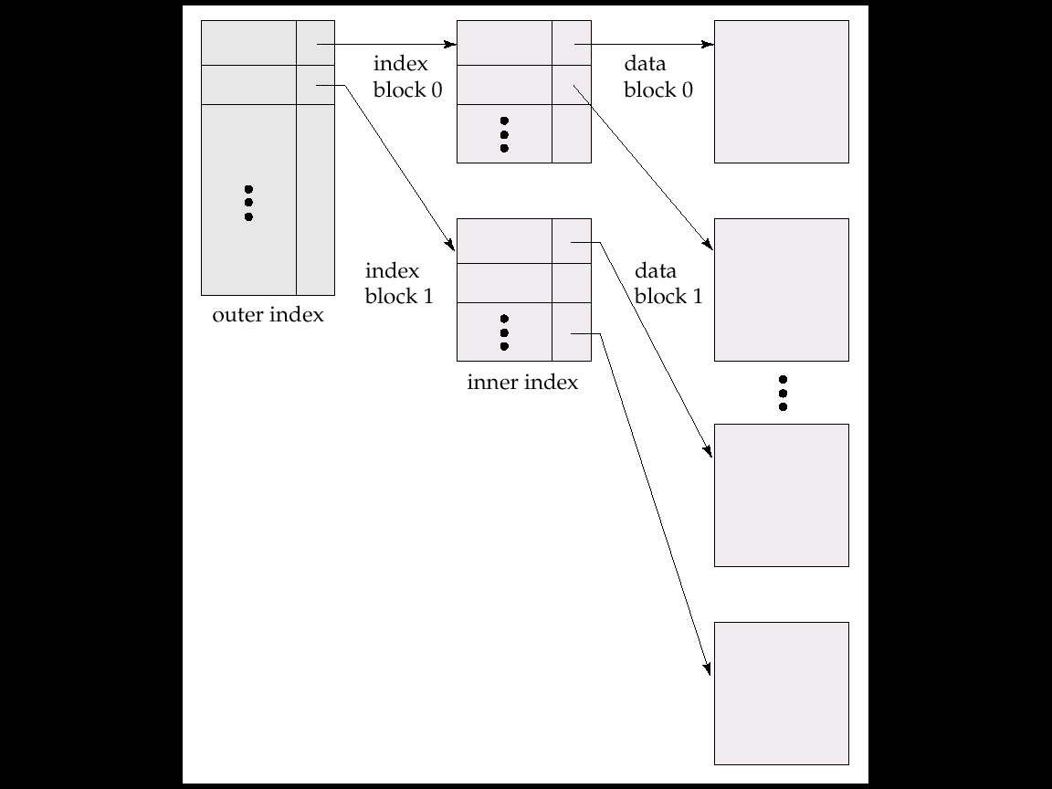
Example
DataBase System Concepts

Slide 12
Index Update: Deletion
DataBase System Concepts
If deleted record was the only record in the file with its particular search-key value, the search-key is deleted from the index also.
Single-level index deletion:
  Dense indices –
  Delete the pointers(stores pointers to all records);
  Update the pointer (stores pointers to the first record);
  Sparse indices – Nothing done;
        replace with next search-key value;
        updates the pointer;
Multilevel deletion algorithms are simple extensions of the single-level algorithms.

Slide 13
Index Update: Insertion
DataBase System Concepts
Single-level index insertion:
  Perform a lookup using the search-key value appearing in the record to be inserted.
  Dense indices –insert index/add pointer/update pointer
  Sparse indices – no change / insert index / update pointer
Multilevel insertion algorithms are simple extensions of the single-level algorithms

Slide 14

Secondary Indices
DataBase System Concepts
Secondary index on salary field of instructor

Slide 15
Primary and Secondary Indices
DataBase System Concepts
Secondary indices have to be dense.
Indices offer substantial benefits when searching for records.
When a file is modified, every index on the file must be updated, Updating indices imposes overhead on database modification.
Sequential scan using primary index is efficient, but a sequential scan using a secondary index is expensive
  each record access may fetch a new block from disk

Slide 16
B⁺-Tree Index Files
DataBase System Concepts
A B⁺-tree is a rooted tree satisfying the following properties:
All paths from root to leaf are of the same length
Each node that is not a root or a leaf has between [n/2] and n children.
A leaf node has between [(n–1)/2] and n–1 values
Special cases:
  If the root is not a leaf, it has at least 2 children.
  If the root is a leaf (that is, there are no other nodes in the tree), it can have between 0 and (n–1) values.

Slide 17
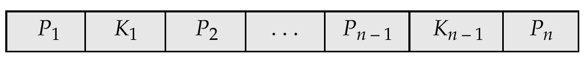
B⁺- Tree Node Structure
DataBase System Concepts
Typical node:
  K_{i} are the search-key values
  P_{i} are pointers to children (for non-leaf nodes) or pointers to records or buckets of records (for leaf nodes).
The search-keys in a node are ordered
K₁ < K₂ < K₃ < . . . < K_{n–1}

Slide 18
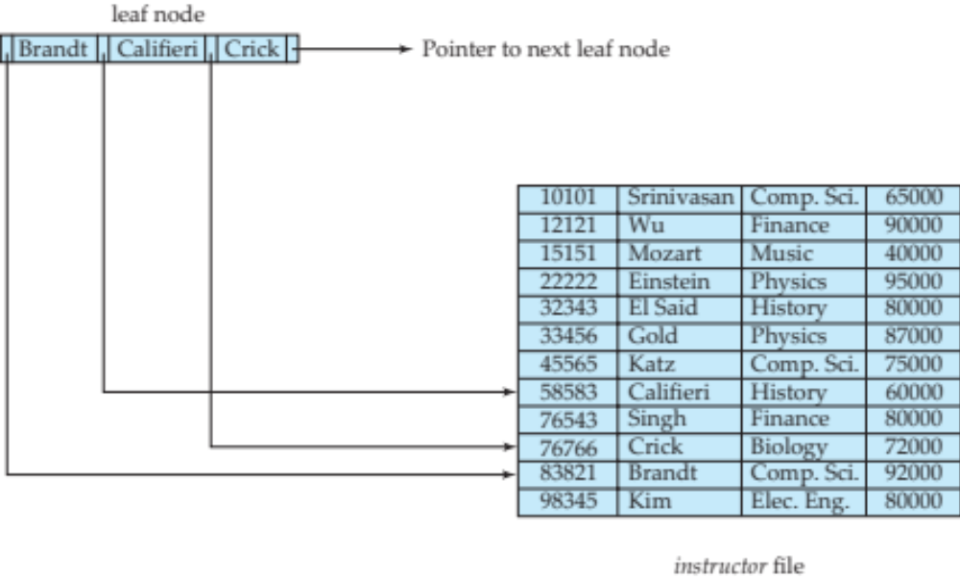
Leaf Nodes in B+-Trees
DataBase System Concepts
For i = 1, 2, . . ., n–1, pointer P_{i} points to a file record with search-key value K_{i},
If L_{i}, L_{j} are leaf nodes and i < j, L_{i}’s search-key values are less than or equal to L_{j}’s search-key values
P_{n} points to next leaf node in search-key order

Slide 19
Non-Leaf Nodes in B+-Trees
DataBase System Concepts
Non leaf nodes form a multi-level sparse index on the leaf nodes. For a non-leaf node with m pointers:
  All the search-keys in the subtree to which P₁ points are less than K₁
  For 2 ≤ i ≤ n – 1, all the search-keys in the subtree to which P_{i} points have values greater than or equal to K_{i–1} and less than K_{i}
  All the search-keys in the subtree to which P_{n} points have values greater than or equal to K_{n–1}
  General structure:

Slide 20
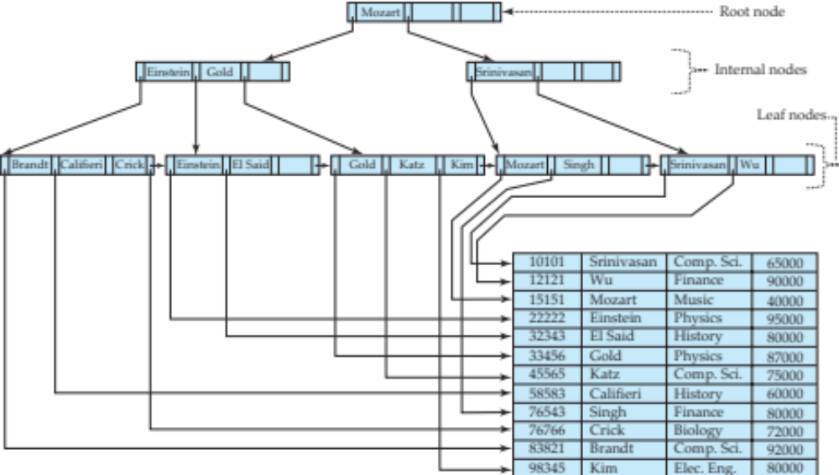
Example of B+-tree
DataBase System Concepts

Slide 21
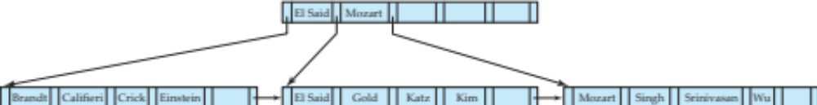
Example of B+-tree
DataBase System Concepts
B⁺-tree for instructor file (n = 6)：
Leaf nodes must have between 3 and 5 values
(⎡(n–1)/2⎤ and n –1, with n = 6).
Non-leaf nodes other than root must have between 3 and 6 children (⎡(n/2⎤ and n with n =6).
Root must have at least 2 children.

Slide 22
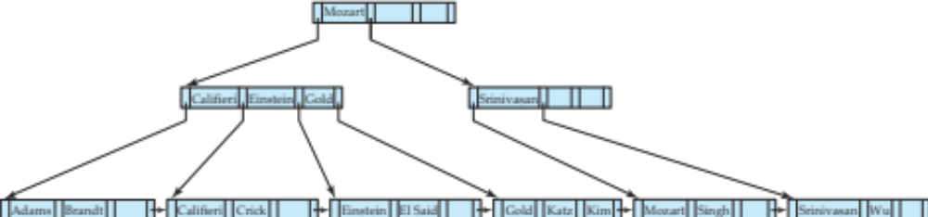
Queries on B+-Trees
DataBase System Concepts
function find(v)
  1. C=root
  2. while (C is not a leaf node)
    Let i be least number s.t. V ≤ K_{i}.
    if there is no such number i then
    Set C = last non-null pointer in C
    else if (v = C.K_{i} ) Set C = P_{i +1}
    else set C = C.P_{i}
  3. if for some i, K_{i} = V then return C.P_{i}
  4. else return null /* no record with search-key value v exists. */

Slide 23
Queries on B+-Trees
DataBase System Concepts
If there are K search-key values in the file, the height of the tree is no more than ⎡log_{⎡n/2⎤}(K)⎤.
A node is generally the same size as a disk block, typically 4 kilobytes
  and n is typically around 100 (40 bytes per index entry).
With 1 million search key values and n = 100
  at most log₅₀(1,000,000) = 4 nodes are accessed in a lookup traversal from root to leaf.
Contrast this with a balanced binary tree with 1 million search key values — around 20 nodes are accessed in a lookup
  above difference is significant since every node access may need a disk I/O, costing around 20 milliseconds

Slide 24

DataBase System Concepts

Slide 25
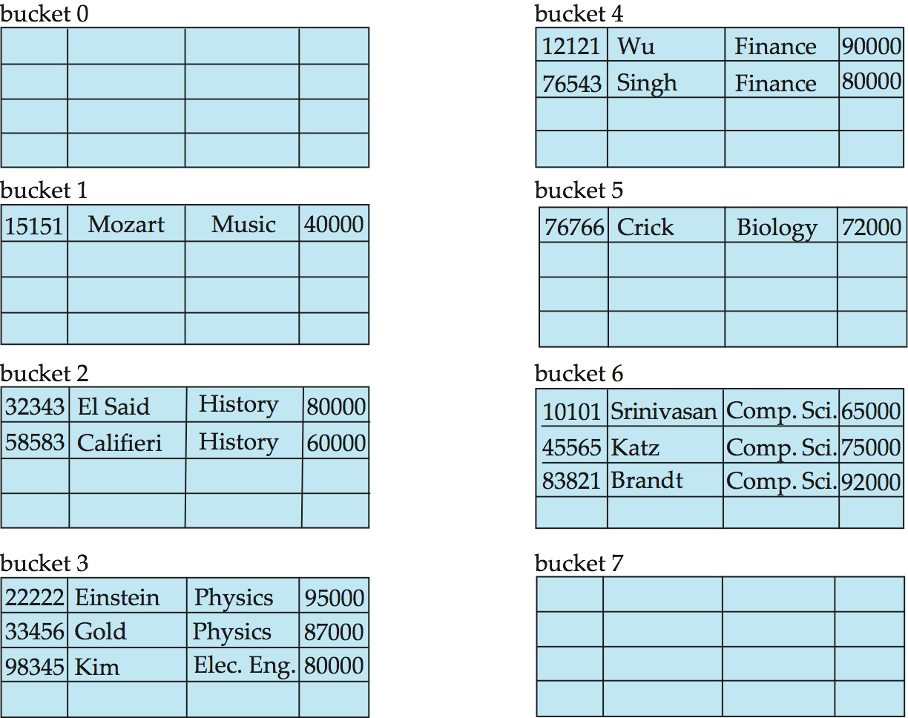
Hash File Organization Example
DataBase System Concepts
Hash file organization of instructor file, using dept_name as key

Slide 26
Hash Functions
DataBase System Concepts
Typical hash functions perform computation on the internal binary representation of the search-key.
An ideal hash function is uniformi.e., each bucket is assigned the same number of search-key values from the set of all possible values.
Ideal hash function is random
  so each bucket will have the same number of records assigned to it irrespective of the actual distribution of search-key values in the file.

Slide 27
Handling of Bucket Overflows(1)
DataBase System Concepts
Bucket overflow can occur because of
  Insufficient buckets
  Skew in distribution of records.
    multiple records have same search-key value;
    chosen hash function produces non-uniform distribution of key values;
Although the probability of bucket overflow can be reduced, it cannot be eliminated; it is handled by using overflow buckets.

Slide 28
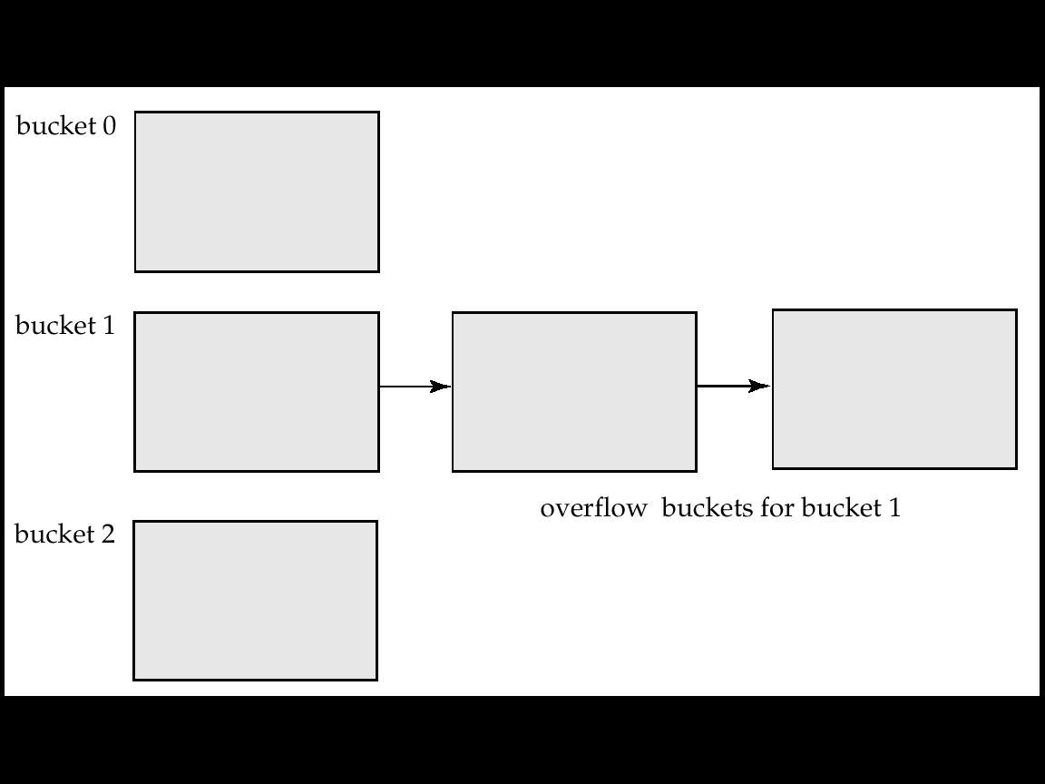
Handling of Bucket Overflows(2)
DataBase System Concepts
Overflow chaining/ closed hashing – the overflow buckets of a given bucket are chained together in a linked list.
An alternative, called open hashing, which does not use overflow buckets, is not suitable for database applications.

Slide 29
Hash Indices
DataBase System Concepts
Hashing can be used not only for file organization, but also for index-structure creation.
A hash index organizes the search keys, with their associated record pointers, into a hash file structure.
Strictly speaking, hash indices are always secondary indices
  if the file itself is organized using hashing, a separate primary hash index on it using the same search-key is unnecessary.
  However, we use the term hash index to refer to both secondary index structures and hash organized files.

Slide 30
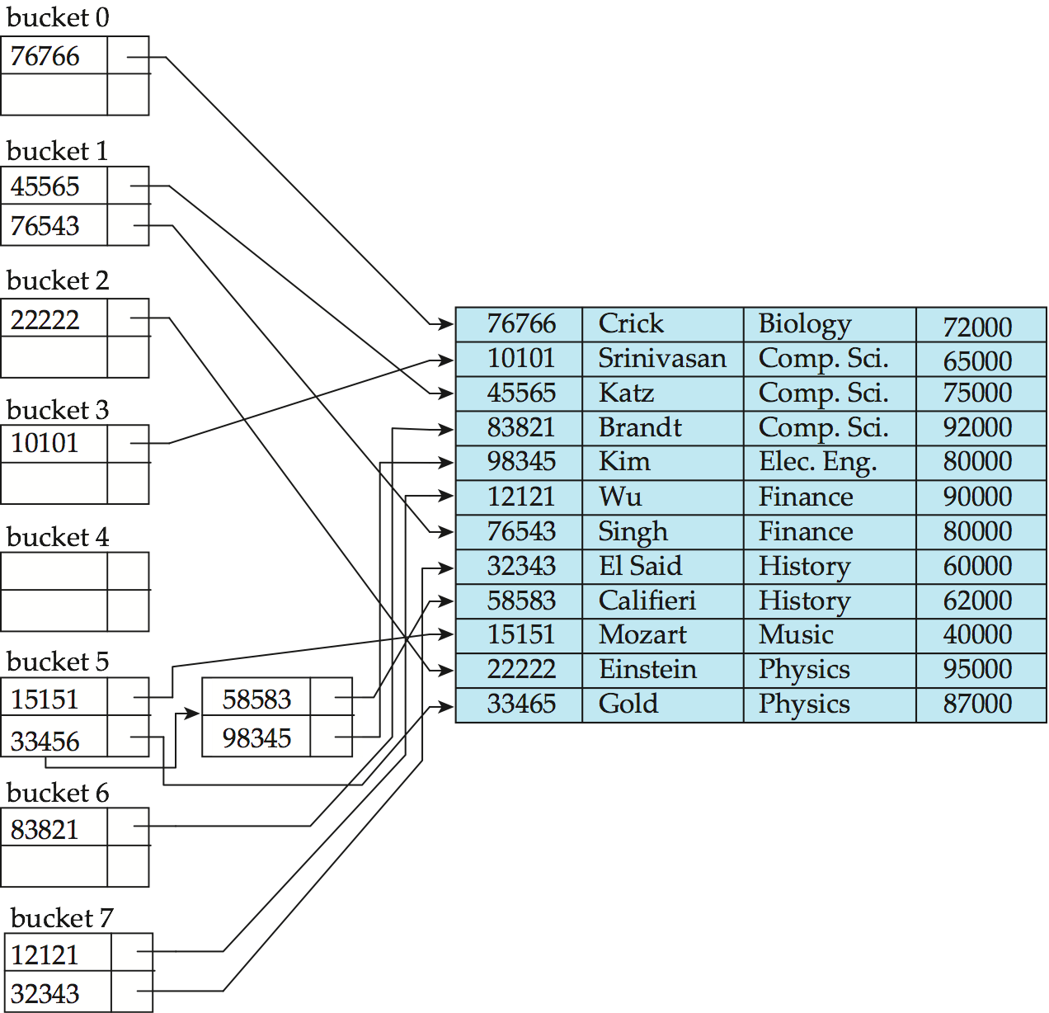
Hash Indices Example
DataBase System Concepts
hash index on instructor, on attribute ID

Slide 31
Deficiencies of Static Hashing
DataBase System Concepts
In static hashing, function h maps search-key values to a fixed set of B of bucket addresses.
  Databases grow with time. If initial number of buckets is too small, performance will degrade due to too much overflows.
  If file size at some point in the future is anticipated and number of buckets allocated accordingly, significant amount of space will be wasted initially.
  If database shrinks, again space will be wasted.
  One option is periodic re-organization of the file with a new hash function, but it is very expensive.

Slide 32
Index Definition in SQL
DataBase System Concepts
Create an index
  create [unique] index <index-name> on <relation-name>
  <attribute-list>)
  E.g.: create index b-index on branch(branch-name)
create cluster index
create noncluster index
create unique index
To drop an index
  drop index <index-name>

Slide 33
Multiple-Key Access
DataBase System Concepts
Use multiple single-key indices for certain types of queries.
  select account-number
  from account
  where branch-name = “Perryridge” and balance =1000
Possible strategies for processing query using indices on single attributes:
  1. Use index on branch-name to find branch with name of Perryridge; test balance = 1000.
  2. Use index on balance to find accounts with balances of $1000; test branch-name = “Perryridge”.
  3. Use branch-name index to find pointers to all records pertaining to the Perryridge branch. Similarly use index on balance. Take intersection of both sets of pointers obtained.

Slide 34
Indices on Multiple Attributes
DataBase System Concepts
Suppose we have an index on combined search-key
(branch-name, balance).
With the where clause
where branch-name = “Perryridge” and balance = 1000
the index on the combined search-key will fetch only records that satisfy both conditions.
Using separate indices in less efficient — we may fetch many records (or pointers) that satisfy only one of the conditions.
Can also efficiently handle
where branch-name = “Perryridge” and balance < 1000
But cannot efficiently handle
where branch-name < “Perryridge” and balance = 1000
May fetch many records that satisfy the first but not the second condition.

Slide 35
DataBase System Concepts
Suppose we have an index on combined search-key
(dept_name, salary).
With the where clause
where dept_name = “Finance” and salary = 80000
the index on (dept_name, salary) can be used to fetch only records that satisfy both conditions.
Can also efficiently handle
where dept_name = “Finance” and salary < 80000
Can also efficiently handle
where dept_name = “Finance”

Slide 36
DataBase System Concepts
But cannot efficiently handle
1.
where dept_name < “Finance” and salary = 80000
  may fetch many records that satisfy the first but not the second condition
  the index is not used efficiently
2.
where salary = 80000
  the index is not used for query

Slide 37
Indices
index file
hash function
Ordered indices
Hashing indices
Primary indices
Secondary indices
dense
index
sparse
index
multi-level
index
balance-tree
index
dense
index
稀疏索引
B-tree
index
B⁺-tree
index
static
hashing
dynamic
hashing
顺序索引， 散列索引
主索引（聚集索引），辅助索引（非聚集索引）

Slide 38
ordered indices
hash indices
{索引项}
index entry
r(R), R (A, B, S, …. , , D)
a₁
b₁
s₁
…
d₁
a₂
b₂
s₂
…
d₂
h(s₁)
s₁
s₂
s₃
.
.
s_{i}
.
.
s_{j}
.
s_{n}
a₃
b₃
s₃
…
d₃
s₁
s₂
s₃
.
.
s_{i}
.
.
s_{j}
.
s_{n}
s₁
s₂
s₃
…
s_{i}
…
s_{m}
…
…
…
…
…
…
a_{i}
b_{i}
s_{i}
…
d_{i}
…
…
…
…
…
h(s_{i})
散列
函数H
a_{j}
b_{j}
s_{j}
…
d_{j}
…
…
…
…
…
…
…
a_{m}
b_{m}
s_{m}
…
d_{m}
…
…
…
…
…
…
a_{n-1}
b_{n-1}
s_{n-1}
…
d_{n-1}
h(s_{n})
a_{n}
b_{n}
s_{n}
…
d_{n}
搜索键
(search key)
索引文件
(index file)
数据文件
（主文件、被索引文件indexed file）
索引及其分类

Slide 39
Summary
DataBase System Concepts
Ordered index
Primary index
Clustering index
Secondary index
Dense index
Sparse index
B+-Tree index, B- Tree index
Hash index
Index Definition

Slide 40
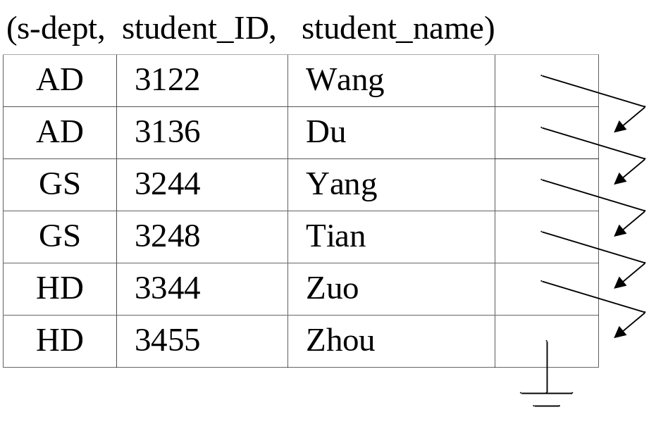
Give the data file teacher(s_dept, student_ID, student_name) as shown below, which is organized as a sequential file, taking the attributes s_dept as the search key,
(1) Define a dense and clustering index for the indexed file teacher on attribute student_name. It is required that the index file and index entries in the index file should be figured out.
(2) If a tuple (BD, 3188, Ren) is inserted into the indexed file, depict the indexed file and the index file.

Slide 41
Consider the following tables in the database University:
Student(sid, name, department, age)
Department(dname, building, budget)
Consider the following SQL query. In addition to the existing primary indices on the primary keys of the tables, on which attributes in the tables the indices can be further defined to speed up the query?
select department, sum(sid)
from Student as A, Department as B
where building=‘T3’ and age>20 and A.department= B.dname
group by department
(2) For the following query
update Student
set age=age+2
where sid between 211301 and 211318
A nonclustered index has been defined on the attribute age.
Does this index speed up or slow down the operation, and why?

