Slide 1

Chapter 15
Query Processing
DataBase System Concepts

Slide 2
DataBase System Concepts
Basic Steps in Query Processing
Measures of Query Cost

Slide 3

Basic Steps in Query Processing
DataBase System Concepts
1. Parsing and translation
2. Optimization
3. Evaluation

Slide 4
Basic Steps in Query Processing(2)
DataBase System Concepts
Parsing and translation（语法分析与翻译）
  translate the query into its internal form. This is then translated into relational algebra.
  Parser checks syntax, verifies relations
Query Optimization（查询优化）: Amongst all equivalent evaluation plans choose the one with lowest cost.
Evaluation（执行）
  The query-execution engine takes a query-evaluation plan, executes that plan, and returns the answers to the query.

Slide 5
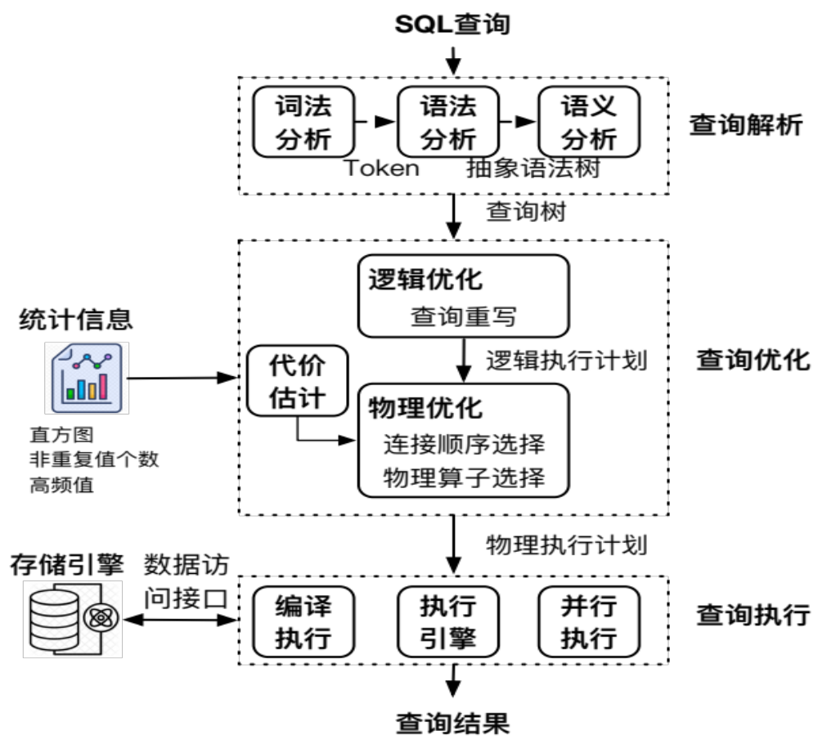
启发式代数优化

Slide 6
Optimization
DataBase System Concepts
A relational algebra expression may have many equivalent expressions
  E.g., σ_{salary<75000}(∏_{salary}(instructor)) is equivalent to
  ∏_{salary}(σ_{salary<75000}(instructor))
Each relational algebra operation can be evaluated using one of several different algorithms
  Correspondingly, a relational-algebra expression can be evaluated in many ways.
Annotated expression specifying detailed evaluation strategy is called an evaluation-plan.
  E.g., can use an index on salary to find instructors with salary < 75000,
  or can perform complete relation scan and discard instructors with salary ≥ 75000

Slide 7
DataBase System Concepts
In this chapter
  How to measure query costs
  Algorithms for evaluating relational algebra operations
  How to combine algorithms for individual operations in order to evaluate a complete expression
In Next Chapter
  how to optimize queries, that is, how to find an evaluation plan with lowest estimated cost

Slide 8
Measures of Query Cost
DataBase System Concepts
Cost is generally measured as total elapsed time for answering query
Many factors contribute to time cost
  disk accesses, CPU, or even network communication
Typically disk access is the predominant cost, and is also relatively easy to estimate. Measured by taking into account
  Number of seeks * average-seek-cost
  Number of blocks read * average-block-read-cost
  Number of blocks written * average-block-write-cost

Slide 9
Measures of Query Cost(2)
DataBase System Concepts
For simplicity we just use number of block transfers from disk and the number of seeks as the cost measures
  ignore CPU costs for simplicity
t_{T} – time to transfer one block
t_{S} – time for one seek
Cost for b block transfers plus S seeks
b * t_{T} + S * t_{S}

Slide 10
DataBase System Concepts
Costs depends on the size of the buffer in main memory
  Having more memory reduces need for disk access
  We often use worst case estimates, assuming only the minimum amount of memory needed for the operation is available
Real systems take CPU cost into account
We do not include cost to writing output to disk in our cost
formulae

Slide 11
Selection Operation
DataBase System Concepts
File scan – search algorithms that locate and retrieve records that fulfill a selection condition.
Algorithm A1 (linear search). Scan each file block and test all records to see whether they satisfy the selection condition.
  Cost estimate = b_{r} * t_{T} + t_{S}
    b_{r} denotes number of blocks containing records from relation r
  If selection is on a key attribute, can stop on finding record
    cost = (b_{r} /2) * t_{T} + t_{S}
  Linear search can be applied regardless of
    selection condition or
    ordering of records in the file, or
    availability of indices

Slide 12
Selection Operation (Cont.)
DataBase System Concepts
A2 (binary search). Applicable if selection is an equality comparison on the attribute on which file is ordered.
  Assume that the blocks of a relation are stored contiguously
  Cost estimate (number of disk blocks to be scanned):
    cost of locating the first tuple by a binary search on the blocks
      ⎡log₂(b_{r})⎤ * (t_{T} + t_{S})
    If there are multiple records satisfying selection
      Add transfer cost of the number of blocks containing records that satisfy selection condition

Slide 13
Selections Using Indices
DataBase System Concepts
Index scan – search algorithms that use an index
  selection condition must be on search-key of index.
A3 (primary index on candidate key, equality). Retrieve a single record that satisfies the corresponding equality condition
  Cost = (h_{i} + 1) * (t_{T} + t_{S})
A4 (primary index on nonkey, equality) Retrieve multiple records.
  Records will be on consecutive blocks
    Let b = number of blocks containing matching records
  Cost = h_{i} * (t_{T} + t_{S}) + t_{S} + t_{T} * b

Slide 14
Selections Using Indices (Cont.)
DataBase System Concepts
A5 (equality on search-key of secondary index).
  Retrieve a single record if the search-key is a candidate key
    Cost = (h_{i} + 1) * (t_{T} + t_{S})
  Retrieve multiple records if search-key is not a candidate key
    each of n matching records may be on a different block
    Cost = (h_{i} + n) * (t_{T} + t_{S})
      Can be very expensive!

Slide 15
Selections Involving Comparisons
DataBase System Concepts
Can implement selections of the form σ_{A≤V} (r) or σ_{A ≥ V}(r) by using
  a linear file scan or binary search,
  or by using indices in the following ways:
A6 (primary index, comparison). (Relation is sorted on A)
    For σ_{A ≥ V}(r) use index to find first tuple ≥ v and scan relation sequentially from there
    For σ_{A≤V} (r) just scan relation sequentially till first tuple > v; do not use index

Slide 16
DataBase System Concepts
A7 (secondary index, comparison).
    For σ_{A ≥ V}(r) use index to find first index entry ≥ v and scan index sequentially from there, to find pointers to records.
    For σ_{A≤V} (r) just scan leaf pages of index finding pointers to records, till first entry > v
    In either case, retrieve records that are pointed to
      requires an I/O for each record
      Linear file scan may be cheaper

Slide 17
Implementation of Complex Selections
DataBase System Concepts
Conjunction: σ_{θ1}∧ _{θ2}∧. . . _{θn}(r)
A8 (conjunctive selection using one index).
  Select a combination of θ_{i} and algorithms A1 through A7 that results in the least cost for σ_{θi} (r).
  Test other conditions on tuple after fetching it into memory buffer.
A9 (conjunctive selection using multiple-key index).
  Use appropriate composite (multiple-key) index if available.

Slide 18
DataBase System Concepts
A10 (conjunctive selection by intersection of identifiers).
  Requires indices with record pointers.
  Use corresponding index for each condition, and take intersection of all the obtained sets of record pointers.
  Then fetch records from file
  If some conditions do not have appropriate indices, apply test in memory.

Slide 19
Algorithms for Complex Selections
DataBase System Concepts
Disjunction:σ_{θ1}∨ _{θ2} ∨. . . _{θn} (r).
A11 (disjunctive selection by union of identifiers).
  Applicable if all conditions have available indices.
    Otherwise use linear scan.
  Use corresponding index for each condition, and take union of all the obtained sets of record pointers.
  Then fetch records from file
Negation: σ_{¬θ}(r)
  Use linear scan on file
  If very few records satisfy ¬θ, and an index is applicable to θ
    Find satisfying records using index and fetch from file

