Slide 1

Chapter 17
Transactions
DataBase System Concepts

Slide 2
DataBase System Concepts
Transaction State
Implementation of Atomicity and Durability
Concurrent Executions
Serializability
Recoverability
Implementation of Isolation
Transaction Definition in SQL
Testing for Serializability.

Slide 3
Transaction
DataBase System Concepts
The term transaction refers to a collection of operations that form a single logical unit of work.
A transaction is a unit of program execution that accesses and possibly updates various data items.

Slide 4
DataBase System Concepts
E.g. transaction to transfer $50 from account A to account B:
        1. read(A)
        2. A := A – 50
        3. write(A)
        4. read(B)
        5. B := B + 50
        6. write(B)
Two main issues to deal with:
  Failures of various kinds, such as hardware failures and system crashes
  Concurrent execution of multiple transactions

Slide 5
Transaction Example
DataBase System Concepts
Atomicity requirement
  if the transaction fails after step 3 and before step 6, money will be “lost” leading to an inconsistent database state
    Failure could be due to software or hardware
  the system should ensure that updates of a partially executed transaction are not reflected in the database
Durability requirement — once the user has been notified that the transaction has completed (i.e., the transfer of the $50 has taken place), the updates to the database by the transaction must persist even if there are software or hardware failures.

Slide 6
Transaction Example(2)
DataBase System Concepts
Consistency requirement in above example:
  the sum of A and B is unchanged by the execution of the transaction
  A transaction must see a consistent database.
  During transaction execution the database may be temporarily inconsistent.
  When the transaction completes successfully the database must be consistent
    Erroneous transaction logic can lead to inconsistency

Slide 7
Transaction Example(3)
DataBase System Concepts
Isolation requirement — if between steps 3 and 6, another transaction T2 is allowed to access the partially updated database, it will see an inconsistent database (the sum A + B will be less than it should be).
T1 T2
  1. read(A)
  2. A := A – 50
  3. write(A)
  read(A), read(B), print(A+B)
  4. read(B)
  5. B := B + 50
  6. write(B )
Isolation can be ensured trivially by running transactions serially
  that is, one after the other.
However, executing multiple transactions concurrently has significant benefits, as we will see later.

Slide 8
ACID Properties
DataBase System Concepts
Atomicity（原子性）： Either all operations of the transaction are properly reflected in the database or none are. Transaction-management component
Consistency（一致性）： Execution of a transaction in isolation preserves the consistency of the database.
Isolation（隔离性）：each transaction must be unaware of other concurrently executing transactions. Intermediate transaction results must be hidden from other concurrently executed transactions.
Concurrency-control schemes
Durability（保持性）： After a transaction completes successfully, the changes it has made to the database persist, even if there are system failures.
recovery-management component

Slide 9
Transaction State
DataBase System Concepts
Active the initial state; the transaction stays in this state while it is executing
Partially committed after the final statement has been executed.
Failed after the discovery that normal execution can no longer proceed.
Aborted Two options after it has been aborted: restart the transaction – only if no internal logical error kill the transaction
Committed after successful completion.

Slide 10

Transaction State
DataBase System Concepts

Slide 11
Why Concurrent Executions
DataBase System Concepts
  increased processor and disk utilization, leading to better transaction throughput(吞吐量）: one transaction can be using the CPU while another is reading from or writing to the disk
  reduced average response time for transactions: short transactions need not wait behind long ones.
Concurrency control schemes – mechanisms to achieve isolation to prevent them from destroying the consistency of the database.

Slide 12
Schedules
DataBase System Concepts
Schedules – a sequences that specify the chronological order in which instructions of concurrent transactions are executed.
  a schedule for a set of transactions must consist of all instructions of those transactions.
  must preserve the order in which the instructions appear in each individual transaction.
    serial schedule(串行调度）
    concurrent schedule（并发调度）

Slide 13




DataBase System Concepts

Slide 14
Serializability
DataBase System Concepts
Basic Assumption – Each transaction preserves database consistency.
Thus serial execution of a set of transactions preserves database consistency.
A (possibly concurrent) schedule is serializable if it is equivalent to a serial schedule.
  conflict serializability
  view serializability

Slide 15
Conflict Serializability
DataBase System Concepts
Conflict Operations:
1. l_{i} = read(Q), l_{j} = write(Q). They conflict.
2. l_{i} = write(Q), l_{j} = read(Q). They conflict
3. l_{i} = write(Q), l_{j} = write(Q). They conflict 4. l_{i} = read(Q), l_{j} = read(Q). l_{i} and l_{j} don’t conflict 5. Operations on different data items, don’t conflict
If a schedule S can be transformed into a schedule S´ by a series of swaps of non-conflicting instructions, we say that S and S´ are conflict equivalent.
We say that a schedule S is conflict serializable if it is conflict equivalent to a serial schedule.

Slide 16


DataBase System Concepts

Slide 17
Testing for Conflict Serializability
DataBase System Concepts
Precedence graph :
G(V,E), where V is a set of vertices and E is a set of edges. The set of vertices a direct consists of all the transactions participating in the schedule. the set of edges consists of all the edges T_{i} →T_{j} for which one of three conditions holds:
1 T_{i} executes write(Q) before T_{j} executes read(Q);
2 T_{i} executes read(Q) before T_{j} executes write(Q);
3 T_{i} executes write(Q) before T_{j} executes write(Q);
A schedule is conflict serializable if and only if its precedence graph is acyclic.

Slide 18
DataBase System Concepts
If precedence graph is acyclic, the serializability order can be obtained by a topological sorting of the graph. This is a linear order consistent with the partial order of the graph.
T1
T2
T3
T4
T2
Write(Y)
Read(X)
T1
T4
Read(Y)
Write(X)
T3
Write(X)
Write(Z)
Read(Z)
Write(X)

Slide 19
DataBase System Concepts
T2
T1
T4
T3
T1
→
T3
→
T2
→
T4

Slide 20
T1 T2 T3 T4
read(A)
read(A)
read(B)
read(C)
read(B)
write(B)
read(A)
write(A)
write(C)
write(C)
write(A)
write(B)

Slide 21
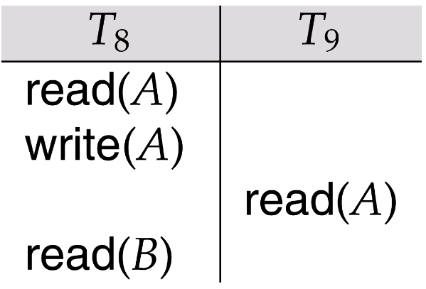
Recoverability
DataBase System Concepts
Recoverable schedule — if a transaction T_{j} reads a data items previously written by a transaction T_{i} , the commit operation of T_{i} appears before the commit operation of T_{j}.
The following schedule (Schedule 11) is not recoverable if T₉ commits immediately after the read

Slide 22
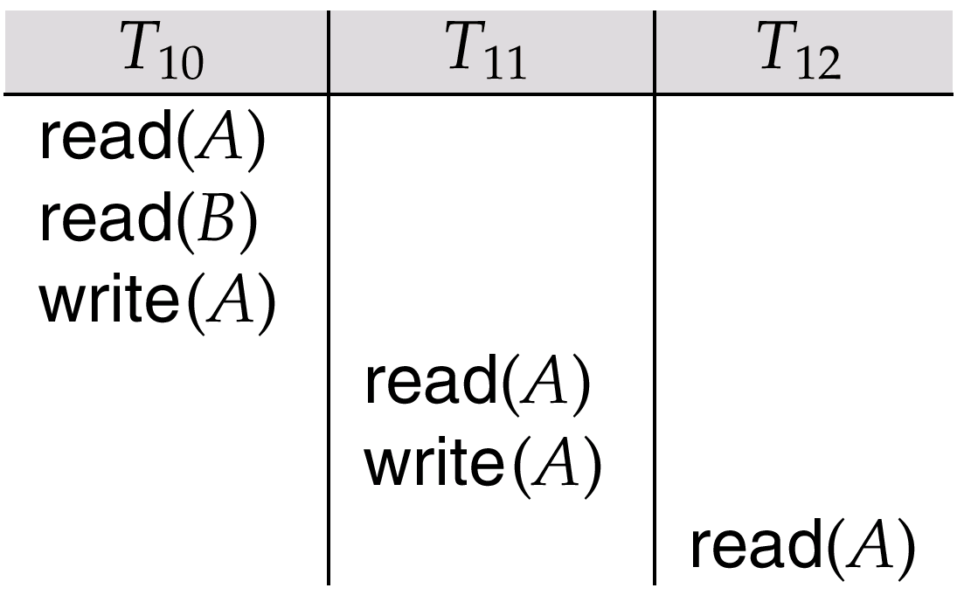
Cascading rollback
DataBase System Concepts
Cascading rollback – a single transaction failure leads to a series of transaction rollbacks
If T₁₀ fails, T₁₁ and T₁₂ must also be rolled back.
Can lead to the undoing of a significant amount of work.

Slide 23
Cascadeless schedules
DataBase System Concepts
Cascadeless schedules — cascading rollbacks cannot occur; for each pair of transactions T_{i} and T_{j} such that T_{j} reads a data item previously written by T_{i}, the commit operation of T_{i} appears before the read operation of T_{j}.
Every cascadeless schedule is also recoverable
It is desirable to restrict the schedules to those that are cascadeless

Slide 24
Concurrency Control
DataBase System Concepts
A database must provide a mechanism that will ensure that all possible schedules are
  either conflict or view serializable
  are recoverable and preferably cascadeless
A policy in which only one transaction can execute at a time generates serial schedules, but provides a poor degree of concurrency
  Are serial schedules recoverable/cascadeless?
Testing a schedule for serializability after it has executed is a little too late!
Goal – to develop concurrency control protocols that will assure serializability.

Slide 25
Concurrency Control Protocol
DataBase System Concepts
Concurrency-control protocols allow concurrent schedules, but ensure that the schedules are conflict/view serializable, and are recoverable and cascadeless .
Different concurrency control protocols provide different tradeoffs between the amount of concurrency they allow and the amount of overhead that they incur.
Tests for serializability help us understand why a concurrency control protocol is correct.

Slide 26
Levels of Isolation in SQL-92
DataBase System Concepts
Serializable（可串行化） — 隔离最高级别
Repeatable read(可重复读） — only committed records to be read. 在开始读取数据（事务开启）时，不再允许修改操作
  Repeated reads of same record must return same value.
  However, a transaction may not be serializable – it may find some records inserted by a transaction but not find others.
Read committed（已提交读） — only committed records can be read.一个事务要等另一个事务提交后才能读取数据。
  Successive reads of record may return different (but committed) values.
Read uncommitted （未提交读）— even uncommitted records may be read.

Slide 27
可能导致的问题：
DataBase System Concepts
脏读：读到了别的事务回滚前的脏数据。
不可重复读：当前事务先进行了一次数据读取，然后再次读取到的数据是别的事务修改成功的数据，导致两次读取到的数据不匹配。
幻读：事务A首先根据条件查询得到N条数据，事务B改变了这N条数据之外的M条或者增添了M条符合事务A查询条件的数据，导致事务A再次搜索发现有N+M条数据了，就产生了幻读。
当前事务读第一次取到的数据比后来读取到数据条目不一致。

Slide 28
四种隔离级别可能导致的问题：
DataBase System Concepts
Serializable (可串行化)：最严格的级别，事务串行执行，资源消耗最大;
REPEATABLE READ(重复读) ：避免了“脏读取”和“不可重复读取”的情况，但不能避免“幻读”。
READ COMMITTED (提交读)：避免了“脏读”，但不能避免“幻读”和“不可重复读取”。
Read Uncommitted(未提交读) ：会导致“脏读”、“幻读”和“不可重复读取”。

Slide 29
Transaction Definition in SQL
DataBase System Concepts
In SQL, a transaction begins implicitly.
A transaction in SQL ends by:
  Commit work commits current transaction and begins a new one.
  Rollback work causes current transaction to abort.

Slide 30
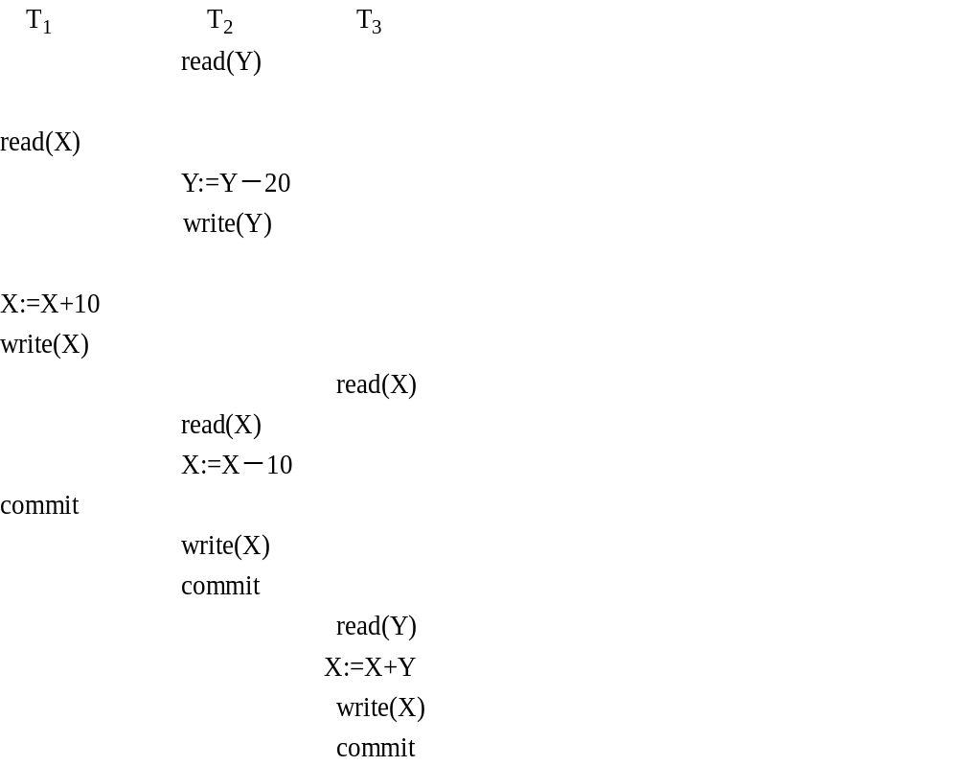

Slide 31
Is S a recoverable schedule? and why？
Is S a cascadeless schedule? and why？

Slide 32
T₁ | T₂ | T₃ | T₄
begin_transaction
 | begin_transaction
update Student set stuName=’Li’ where stuID=10
 |  | begin_transaction
 | update Student set age=age+1 where stuID=20
 |  | select age from Student where stuID=50
 |  |  | begin_transaction
 |  |  | update Student set height=height+5 where stuID=30
update Grade set grade=grade+1 where stuID=40 AND CosID=10
 | select stuName from Student where stuID=10
 | commit
commit
 |  |  | select stuID, grade from Grade where stuID=40 AND CosID=10
 |  |  | commit
 |  | Select height from Student where stuID=30
 |  | commit

Slide 33
Construct the precedence graph for S.
Is S a serializable schedule? If not, give the reason. If it is, give a serial schedule that is equivalent to S.
(3) Is S a recoverable schedule, and why?
(4) Is S a cascadeless schedule, and why?

