Slide 1

Chapter 18
Concurrency Control
DataBase System Concepts

Slide 2
DataBase System Concepts
Concurrency Control Protocol
Deadlock Handling

Slide 3
Concurrency Control Protocol
DataBase System Concepts
Concurrency control protocols assure serializability of schedules.
Testing a schedule for serializability after it has executed is a little too late!
Lock-Based Protocols
Timestamp-Based Protocols

Slide 4

Locks
DataBase System Concepts
Data items can be locked in two modes :
1. exclusive (X) mode. The Transaction which obtained an exclusive-mode lock on item Q can both read and write Q.
2. shared (S) mode. The Transaction which obtained a shared-mode lock on item Q can read but cannot write Q.
Lock-compatibility matrix:

Slide 5
DataBase System Concepts
A transaction may be granted a lock on an item if the requested lock is compatible with locks already held on the item by other transactions
Any number of transactions can hold shared locks on an item, but if any transaction holds an exclusive on the item no other transaction may hold any lock on the item.
If a lock cannot be granted, the requesting transaction is made to wait till all incompatible locks held by other transactions have been released. The lock is then granted.

Slide 6
Lock-Based Protocols
DataBase System Concepts
A locking protocol is a set of rules followed by all transactions while requesting and releasing locks.
T₂: lock-S(A);
read (A);
unlock(A);
lock-S(B);
read (B);
unlock(B);
display(A+B)
Locking as above is not sufficient to guarantee serializability — if A and B get updated in-between the read of A and B, the displayed sum would be wrong.

Slide 7

Pitfalls of Lock-Based Protocols
DataBase System Concepts
Locking protocols restrict the set of possible schedules.
A transaction may be waiting for an X-lock on an item, while a sequence of other transactions request and are granted an S-lock on the same item.
deadlock.

Slide 8
Starvation
DataBase System Concepts
Starvation is also possible if concurrency control manager is badly designed. For example:
  A transaction may be waiting for an X-lock on an item, while a sequence of other transactions request and are granted an S-lock on the same item.
  The same transaction is repeatedly rolled back due to deadlocks.
Concurrency control manager can be designed to prevent starvation.

Slide 9
The Two-Phase Locking Protocol
DataBase System Concepts
Phase 1: Growing Phase
  transaction may obtain locks
  transaction may not release locks
Phase 2: Shrinking Phase
  transaction may release locks
  transaction may not obtain locks
The protocol assures conflict serializability. It can be proved that the transactions can be serialized in the order of their lock points(the point where a transaction acquired its final lock,the end of its growing phase).
.
Two-phase locking does not ensure freedom from deadlocks

Slide 10

DataBase System Concepts
Cascading roll-back is possible under two-phase locking.

Slide 11
DataBase System Concepts
Cascading roll-back is possible under two-phase locking. To avoid this, follow a modified protocol called strict two-phase locking. Here a transaction must hold all its exclusive locks till it commits/aborts.
Rigorous two-phase locking is even stricter: here all locks are held till commit/abort. In this protocol transactions can be serialized in the order in which they commit.

Slide 12
Lock Conversions
DataBase System Concepts
Two-phase locking with lock conversions:
– First Phase:
  can acquire a lock-S on item
  can acquire a lock-X on item
  can convert a lock-S to a lock-X (upgrade)
– Second Phase:
  can release a lock-S
  can release a lock-X
  can convert a lock-X to a lock-S (downgrade)
This protocol assures serializability.

Slide 13

DataBase System Concepts

Slide 14
DataBase System Concepts
The operation read(D) is processed as:
if T_{i} has a lock on D
then
read(D)
else
begin
if necessary wait until no other
transaction has a lock-X on D
grant T_{i} a lock-S on D;
read(D)
end

Slide 15
DataBase System Concepts
write(D) is processed as:
if T_{i} has a lock-X on D
then
write(D)
else
begin
if necessary wait until no other trans. has any lock on D,
if T_{i} has a lock-S on D
then
upgrade lock on D to lock-X
else
grant T_{i} a lock-X on D
write(D)
end;
All locks are released after commit or abort

Slide 16
T1
T2
T1
T2
Lock-X(a1)
Read(a1)
A1:=a1+1
Write(a1)
Unlock(a1)
Lock-X(A)
Read(A)
Lock-S(B)
Read(B)
Write(A)
Unlock(A)
Lock-S(a1)
Read(a1)
Lock-X(A)
Read(A)
A=:A+1
Write(A)
Unlock(A)
Lock-X(a2)
Read(a2)
Unlock(a2)
Unlock(B)
Unlock(a1)

Slide 17
Multiple Granularity
DataBase System Concepts
Allow data items to be of various sizes and define a hierarchy of data granularities, where the small granularities are nested within larger ones
Can be represented graphically as a tree (but don't confuse with tree-locking protocol)
When a transaction locks a node in the tree explicitly, it implicitly locks all the node's descendents in the same mode.
Granularity of locking (level in tree where locking is done):
  fine granularity (lower in tree): high concurrency, high locking overhead
  coarse granularity (higher in tree): low locking overhead, low concurrency

Slide 18
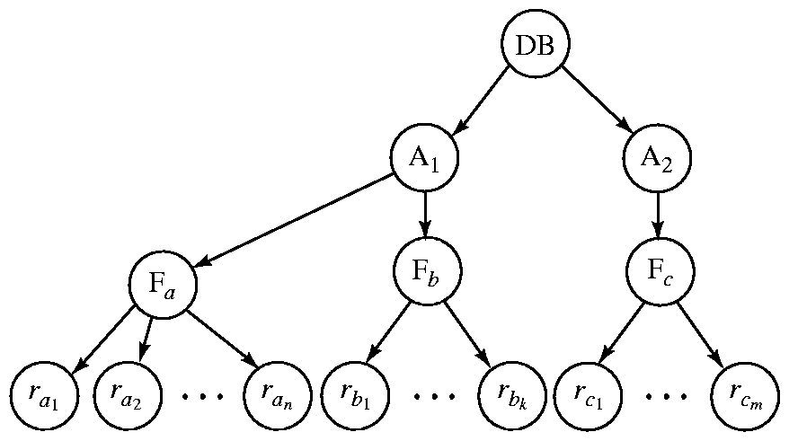
DataBase System Concepts
The highest level in the example hierarchy is the entire database.
The levels below are of type area, file and record in that order.

Slide 19
Intention Lock Modes
DataBase System Concepts
There are three additional lock modes with multiple granularity:
  intention-shared (IS): indicates explicit locking at a lower level of the tree but only with shared locks.
  intention-exclusive (IX): indicates explicit locking at a lower level with exclusive or shared locks
  shared and intention-exclusive (SIX): the subtree rooted by that node is locked explicitly in shared mode and explicit locking is being done at a lower level with exclusive-mode locks.
intention locks allow a higher level node to be locked in S or X mode without having to check all descendent nodes.

Slide 20
Compatibility Matrix
DataBase System Concepts
IS
IX
S
S IX
X
IS
✓
✓
✓
✓
×
IX
✓
✓
×
×
×
S
✓
×
✓
×
×
S IX
✓
×
×
×
×
X
×
×
×
×
×

Slide 21
Locking Scheme
DataBase System Concepts
Transaction T_{i} can lock a node Q, using the following rules:
1. The lock compatibility matrix must be observed.
2. The root of the tree must be locked first, and may be locked in any mode, locks are acquired in root-to-leaf order.
3. A node Q can be locked by T_{i} in S or IS mode only if the parent of Q is currently locked by T_{i} in either IX or IS mode.
4. A node Q can be locked by T_{i} in X, SIX, or IX mode only if the parent of Q is currently locked by T_{i} in either IX or SIX mode.
5. T_{i} can lock a node only if it has not previously unlocked any node (that is, T_{i} is two-phase).
6. T_{i} can unlock a node Q only if none of the children of Q are currently locked by T_{i}.
Locks are released in leaf-to-root order.

Slide 22
DB
IX
√
IS
S
r_{k}
IX
√
T1
T2
×
X
T1: update
T2: select

Slide 23







IX
X
S
IS
T₁
T₂
①
USE StuDB
Update S
Set S#=S#+1
Where age>22
Select *
From S
Where age<15
unlock
unlock
unlock
unlock
√
②
USE StuDB
Select *
From S
Where
age=25 or
age=10
unlock
unlock
unlock
StuDB
③
④
√
⑤
⑦
⑧
×
⑥
√
table S

Slide 24
Deadlock Handling
DataBase System Concepts
System is deadlocked if there is a set of transactions such that every transaction in the set is waiting for another transaction in the set,and none of the transactions can ever proceed with its normal executions.
T₁
T₂
lock-X on X
write (X)
lock-X on Y
write (X)
wait for lock-X on X
wait for lock-X on Y

Slide 25
Deadlock Prevention Strategies
DataBase System Concepts
Deadlock prevention protocols ensure that the system will never enter into a deadlock state.
Require that each transaction locks all its data items before it begins execution (predeclaration).
Impose partial ordering of all data items and require that a transaction can lock data items only in the order specified by the partial order (graph-based protocol).
Timeout-Based Schemes :
  a transaction waits for a lock only for a specified amount of time. After that, the wait times out and the transaction is rolled back.

Slide 26
Following schemes use transaction timestamps for the sake of deadlock prevention alone:
wait-die scheme
  If TS(Ti) < TS(Tj) then Ti Waits Else RollBack Ti Restart Ti with the same TS(Ti) Endif
wound-wait scheme
  If TS(Ti) > TS(Tj) then Ti Waits Else RollBack Tj Restart Tj with the same TS(Tj) Endif

Slide 27
DataBase System Concepts
wait-die scheme — non-preemptive
  older transaction may wait for younger one to release data item. Younger transactions never wait for older ones; they are rolled back instead.
  a transaction may die several times before acquiring needed data item
wound-wait scheme — preemptive
  older transaction wounds (forces rollback) of younger transaction instead of waiting for it. Younger transactions may wait for older ones.
  may be fewer rollbacks than wait-die scheme.

Slide 28
Deadlock Detection
DataBase System Concepts
Deadlocks can be described as a wait-for graph, which consists of a pair G = (V,E),
  V is a set of vertices (all the transactions in the system)
  E is a set of edges; each element is an ordered pair T_{i} →T_{j}.
If T_{i} → T_{j} is in E, then there is a directed edge from T_{i} to T_{j}, implying that T_{i} is waiting for T_{j} to release a data item.
The system is in a deadlock state if and only if the wait-for graph has a cycle. Must invoke a deadlock-detection algorithm periodically to look for cycles.

Slide 29


DataBase System Concepts

Slide 30
Deadlock Recovery
DataBase System Concepts
When deadlock is detected :
  Some transaction will have to rolled back (made a victim) to break deadlock. Select that transaction as victim that will incur minimum cost.
  Rollback -- determine how far to roll back transaction
    Total rollback: Abort the transaction and then restart it.
    More effective to roll back transaction only as far as necessary to break deadlock.
  Starvation happens if same transaction is always chosen as victim. Include the number of rollbacks in the cost factor to avoid starvation

Slide 31
Insert and Delete Operations
DataBase System Concepts
If two-phase locking is used :
  A delete operation may be performed only if the transaction deleting the tuple has an exclusive lock on the tuple to be deleted.
  A transaction that inserts a new tuple into the database is given an X-mode lock on the tuple
If the timestamp-ordering protocol is used:
  A delete operation: a test similar to that for a write must be performed;
  Transaction Ti Performs insert(Q),the values R-timestamp(Q) and W-timestamp(Q) are set to TS(Ti).

Slide 32
T1 | T2 | T3
Lock-X(Y) Read(Y) Y:=Y*5 Write(Y) Lock_S(Z) Read(Z) Unlock (Y) Unlock (Z) | Lock_X(Z) Read(Z) Z:=Z/2 Write(Z) Lock_X(X) Read(X) X:=X-50 Write(X) Unlock (Z) Unlock (X) | Lock-S(X) Read(X) Lock_S(Y) Read (Y) Unlock (X) Unlock(Y)

Slide 33
T₁ | T₂ | T₃ | T₄
Lock_X(A) Read(A)
 | Lock_X(B)
A:=A+10
 | Read(B)
 |  | Lock_X(C) Read(C)
Write(A)
 | B:=B+50 Write(B)
 |  | C:=C+30
 | Unlock(B) commit
Lock_X(B) Unlock(A) Read(B)
 |  | Lock_X(A) Write(C) Unlock(C) Read(A)
 |  |  | Lock_X(C) Read(C)
B:=B+10 Write(B)
 |  | A:=A+100 Write(A)
 |  |  | C:=C*100
Unlock(B) Commit
 |  | Unlock(A) Commit | Write(C)
 |  |  | Unlock(C) Commit

Slide 34
Is S conflict serializable? and why？
Is S a cascading or cascadeless schedule? and why?
Is S obey the two-phase locking protocol? and why?
Is S obey the rigorous two-phase locking protocol? and why?

