Slide 1
NAS网络文件系统
网络存储技术

Slide 2
NAS
Network Attached Storage
主流协议
AFP：Apple Filing Protocol
NFS：Network File System
SMB：Server Message Block
FTP：File Transfer Protocol
SFTP：SSH File Transfer Protocol
HTTP
WebDAV：Web Distributed Authoring and Versioning

Slide 3
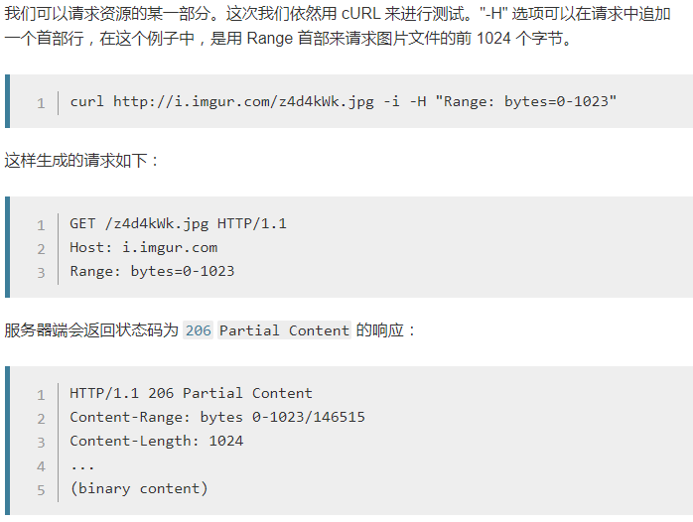
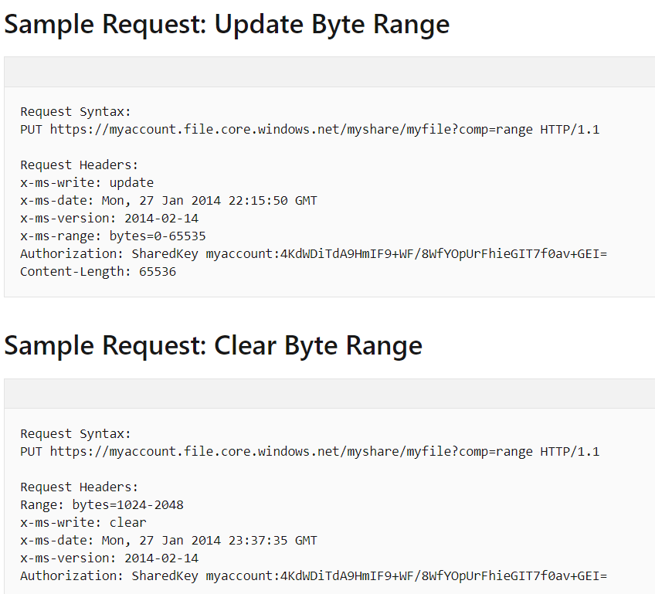
HTTP支持Range请求

Slide 4
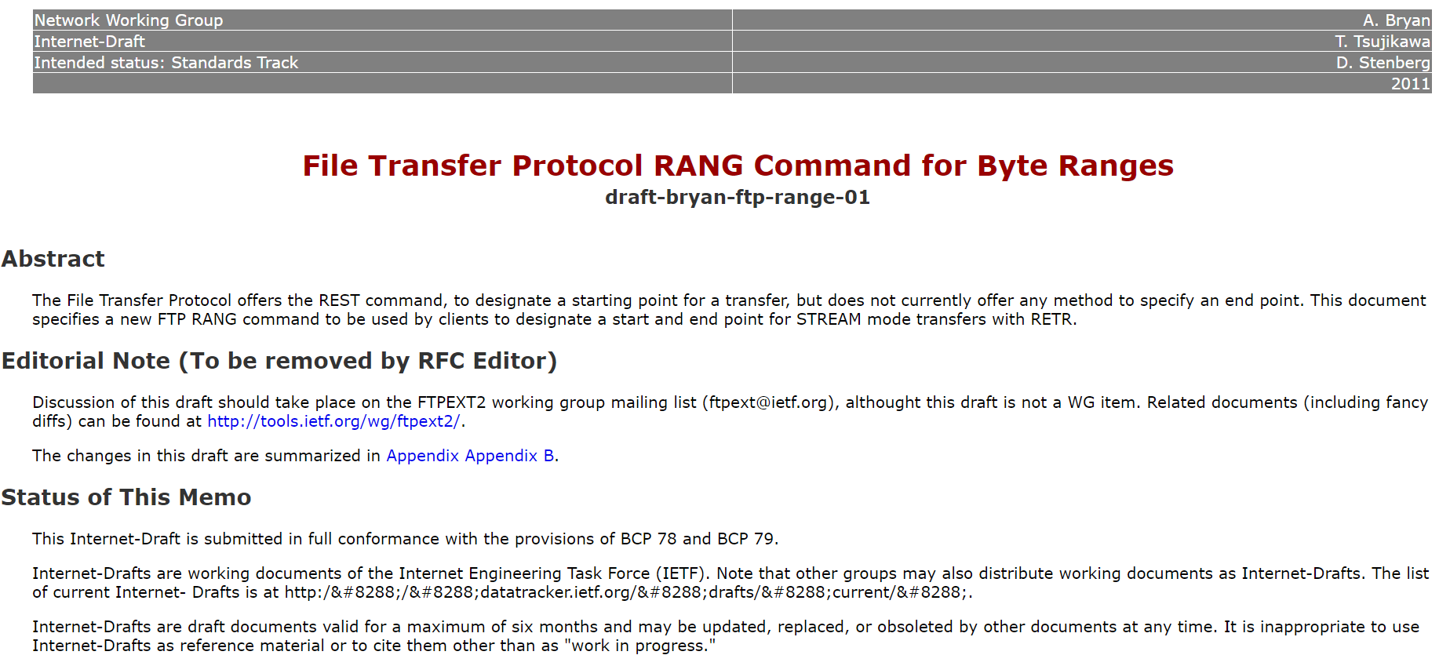
FTP支持Range

Slide 5
WebDAV
IETF标准化RFC定义
扩展了HTTP的method方法
COPY
copy a resource from one URI to another
LOCK
put a lock on a resource. WebDAV supports both shared and exclusive locks.
MKCOL
create collections（a.k.a a directory）
MOVE
move a resource from one URI to another
PROPFIND
retrieve properties, stored as XML, from a web resource.
PROPPATCH
change and delete multiple properties on a resource in a single atomic act
UNLOCK
remove a lock from a resource

Slide 6
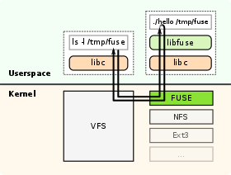
FUSE：Filesystem in Userspace
用于开发运行在用户空间的文件系统
Linux操作系统内置
libfuse用于开发
macOS：OSXFUSE
Windows：Dokan

Slide 7
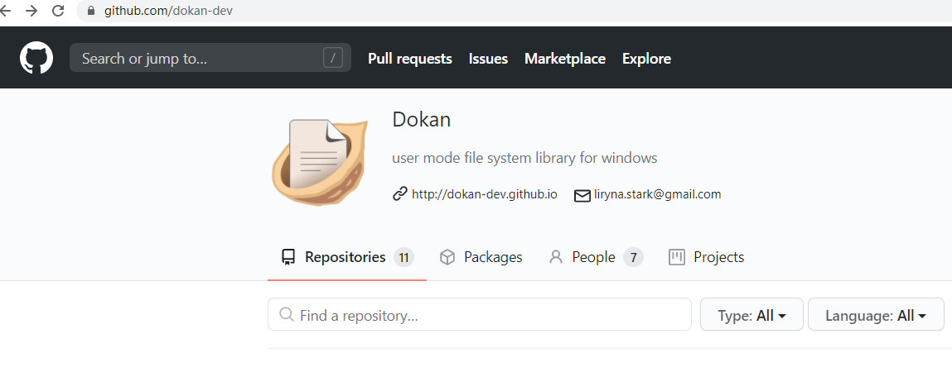
Dokan: user mode file system library for windows

Slide 8
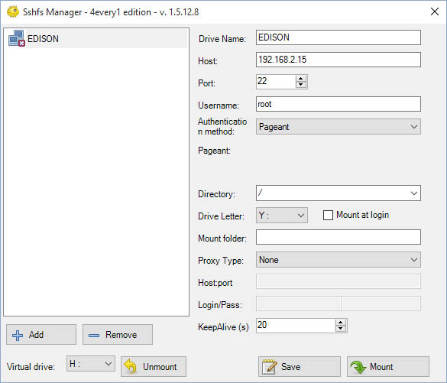
dokan-sshfs, win-sshfs
Dokan contains LGPL and MIT licensed programs.
user-mode library (dokan1.dll) LGPL
driver (dokan1.sys) LGPL
network library (dokannp1.dll) LGPL
fuse library (dokanfuse1.dll) LGPL
installer (DokanSetup.exe) LGPL
control program (dokanctl.exe) MIT
samples (mirror.exe / memfs.exe) MIT

Slide 9
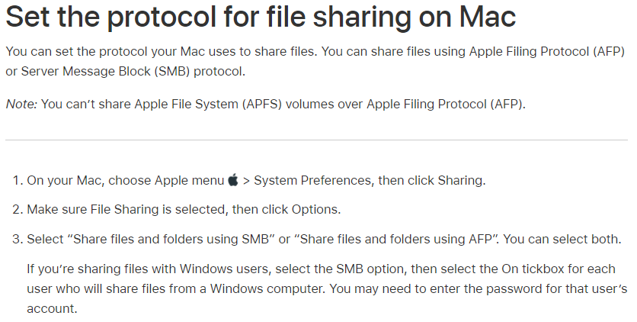
AFP：Apple Filing Protocol
早期为AppleTalk Filing Protocol，私有协议
AFP version 3.0使用TCP端口548

Slide 10
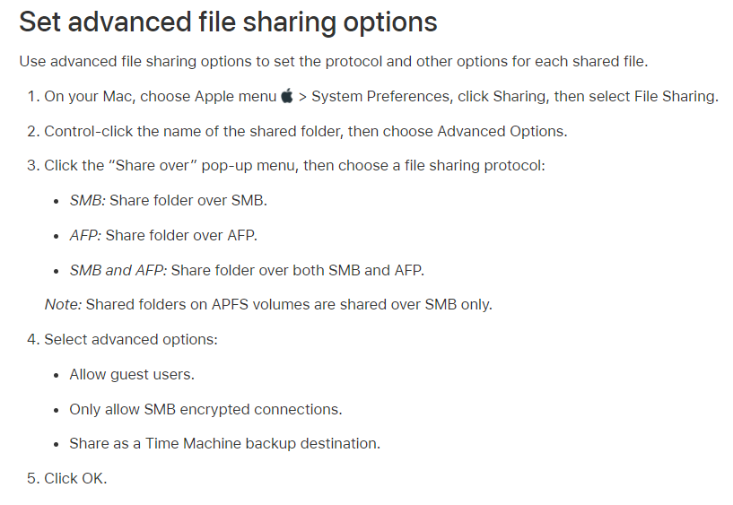
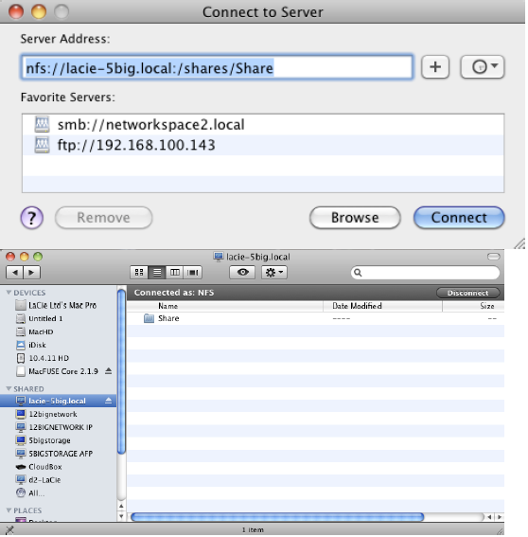
macOS访问其他NAS协议

Slide 11
NFS
NFSv2：RFC 1094，1989年
NFSv2是第一个以RFC形式发布的版本，实现了基本的功能。
NFSv3：RFC 1813，1995年
(1) NFSv2对每次读写操作中传输数据的最大长度进行了限制，上限值为8192字节，NFSv3取消了这个限制。
(2) NFSv3对文件名称长度进行了限制，上限值为255字节，NFSv3取消了这个限制。
(3) NFSv2对文件长度进行了限制，上限值为0x7FFFFFFF，NFSv3取消了这个限制。
(4) NFSv2中文件句柄长度固定为32字节，NFSv3中文件句柄长度可变，上限值是64字节。
(5) NFSv2只支持同步写，如果客户端向服务器端写入数据，服务器必须将数据写入磁盘中才能发送应答消息。NFSv3支持异步写操作，服务器只需要将数据写入缓存中就可以发送应答信息了。NFSv3增加了COMMIT请求，COMMIT请求可以将服务器缓存中的数据刷新到磁盘中。
(6) NFSv3增加了ACCESS请求，ACCESS用来检查用户的访问权限。因为服务器端可能进行uid映射，因此客户端的uid和gid不能正确反映用户的访问权限。NFSv2的处理方法是不管访问权限，直接返送请求，如果没有访问权限就出错。NFSv3中增加了ACCESS请求，客户端可以检查是否有访问权限。
NFSv4：RFC 3530，2000年
(1) NFSv4设计成了一种有状态的协议，自身实现了文件锁功能和获取文件系统根节点功能，不需要NLM和MOUNT协议协助了。
(2) NFSv4增加了安全性，支持RPCSEC-GSS身份认证。
(3) NFSv4只提供了两个请求NULL和COMPOUND，所有的操作都整合进了COMPOUND中，客户端可以根据实际请求将多个操作封装到一个COMPOUND请求中，增加了灵活性。
(4) NFSv4文件系统的命令空间发生了变化，服务器端必须设置一个根文件系统(fsid=0)，其他文件系统挂载在根文件系统上导出。
(5) NFSv4支持delegation。
NFSv4.1：RFC 5561，2010年
与NFSv4.0相比，NFSv4.1最大的变化是支持并行存储了
NFSv4.2：RFC 7862，2016年
客户端都会持续不断地回报有关底层基础架构的性能指标。这些指标可用于优化服务水平。
ACL可以与Windows ACL兼容，使得在Linux和Windows平台上安全地共享数据变得简单。

Slide 12
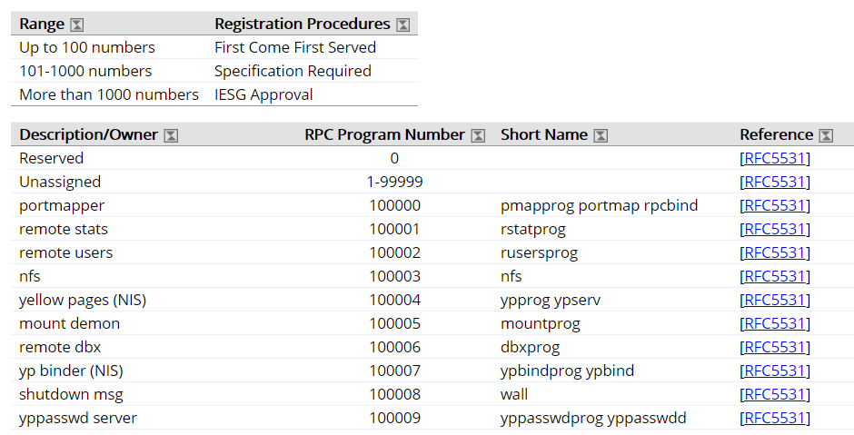
Remote Procedure Call（RPC）Program Number
https://www.iana.org/assignments/rpc-program-numbers/rpc-program-numbers.xhtml

Slide 13
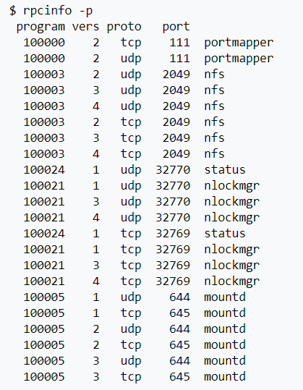
portmap
Version 2: rpc.portmap, portmap
Version 3 and 4 也称为rpcbind协议
使用TCP或UDP端口111
映射program numer/version到某个端口

Slide 14
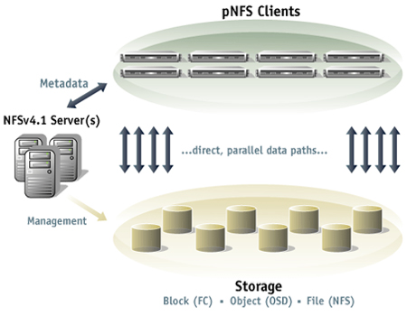
NFSv4 - pNFS
pNFS如何修改了NFS结构，消除了性能瓶颈。实质上的变化是NFS服务器移动到了带外，变成了一个元数据服务器。
Client首先与NFS服务器联系寻找所要数据的布局图和读/修改/写这些数据的授权书。一旦客户端有了这两部分，它存取数据时就直接与存储设备联系。使用传统的NFS时数据的每个比特都要通过NFS服务器，使用pNFS时NFS服务器从主数据通路中移出来了，允许客户端自由地和快速地存取数据。当然所有的NFS的优点都继续保留，但现在消除了瓶颈，数据能够以并行方式以非常快的吞吐率被访问，系统容量能够容易的扩展而不影响总性能。

Slide 15
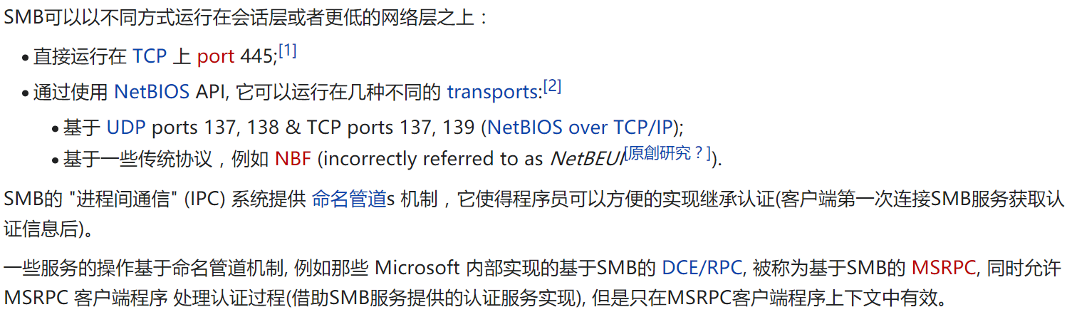
SMB：Server Message Block

Slide 16
SMB
SMB版本 | 年代 | 相应操作系统版本 | 重要协议特性
SMB 3.1.1 | 2015 | Windows 10 Windows Server 2016 | - 传输加密算法协商 - 预认证完整性检查(pre-authentication integrity)
SMB 3.0.2 | 2013 | Windows 8.1 Windows Server 2012 R2 | - 客户端直读直写请求 - SMB Direct（RDMA）性能改进
SMB 3.0 | 2012 | Windows 8 Windows Server 2012 | - 目录级元数据客户端缓存(directory lease) - 持久句柄(persistent handle) - 基于AES-CCM算法的数据传输加密 - 消息签名(message signing)改用AES-CMAC算法 - SMB Direct（RDMA）支持 - 多通道(multi-channel)
SMB 2.1 | 2009 | Windows 7 Windows Server 2008 R2 | - 基于Lease的文件数据客户端缓存 - 多协议版本支持协商(multi-protocol negotiate) - 弹性句柄(resilient handle)
SMB 2.0.2 | 2008 | Windows Vista SP1 Windows Server 2008 | - SMB指令数量减至19个 - 基于信用点(credit)的流控机制 - 改进复合请求机制(request compounding) - 耐用句柄(durable handle) - 消息签名(message signing)改用SHA-256算法 - 支持软链接(symbolic link) - 提升最大数据块尺寸(maximum block size)
SMB 2.0 | 2007 | Windows Vista
======================== 时代的分割线 ========================
SMB 1.0/CIFS | 2000 | Windows 2000 | - 包含100+指令的指令集 - 打开(open)、读(read)、修改(modify)、关闭(close)等文件操作 - 取消(cancel)操作 - 直接运行于TCP/IP协议之上(Direct hosting of SMB over TCP/IP) - 查询、设定文件和卷属性(attributes) - 基于NTLM、Kerbeors等协议的用户认证 - 基于MD5算法的消息签名(message signing) - 基于机会锁（opportunistic lock / oplock）的文件数据客户端缓存

Slide 17
NFS配置

Slide 18
在Linux上设置NFS
OS：Ubuntu 16.04
Server：192.168.1.10
Client：192.168.1.20
步骤
下载安装模块
在Server上创建共享目录
在Server上配置NFS导出配置
在Server上修改防火墙参数
在Client上创建挂载点
在Client上挂载NFS

Slide 19
下载安装NFS模块
Server运行
sudo apt-get update
sudo apt-get install nfs-kernel-server
On the server host, we will install the nfs-kernel-server package, which will allow us to share our directories. Since this is the first operation that we’re performing with apt in this session, we’ll refresh our local package index before the installation:
Client运行
sudo apt-get update
sudo apt-get install nfs-common
On the client host, we need to install a package called nfs-common, which provides NFS functionality without including unneeded server components. Again, we will refresh the local package index prior to installation to ensure that we have up-to-date information.

Slide 20
创建共享目录
Server运行
sudo mkdir /var/nfs/general -p
ls -la /var/nfs/general
输出
4 drwxr-xr-x 2 root root 4096 Jul 25 15:26 .
Server运行
sudo chown nobody:nogroup /var/nfs/general
NFS will translate any root operations on the client to the nobody:nogroup credentials as a security measure. Therefore, we need to change the directory ownership to match those credentials.

Slide 21
配置NFS导出
server运行
sudo nano /etc/exports
文件内容
/var/nfs/general 192.168.0.20(rw,sync,no_subtree_check)
/home 192.168.0.20(rw,sync,no_root_squash,no_subtree_check)
rw：This option gives the client computer both read and write access to the volume.
sync：This option forces NFS to write changes to disk before replying. This results in a more stable and consistent environment since the reply reflects the actual state of the remote volume. However, it also reduces the speed of file operations.
no_subtree_check：This option prevents subtree checking, which is a process where the host must check whether the file is actually still available in the exported tree for every request. This can cause many problems when a file is renamed while the client has it opened. In almost all cases, it is better to disable subtree checking.
no_root_squash：By default, NFS translates requests from a root user remotely into a non-privileged user on the server. This was intended as security feature to prevent a root account on the client from using the file system of the host as root. no_root_squash disables this behavior for certain shares.
sudo systemctl restart nfs-kernel-server

Slide 22
调整Server防火墙
Server运行
sudo ufw allow from 192.168.0.20 to any port nfs
sudo ufw status
验证防火墙配置
Status: active
To Action From
-- ------ ----
OpenSSH ALLOW Anywhere
2049 ALLOW 192.168.0.20
OpenSSH (v6) ALLOW Anywhere (v6)
This confirms that UFW will only allow NFS traffic on port 2049 from our client machine.

Slide 23
创建挂载点
Client运行
sudo mkdir -p /nfs/general
sudo mkdir -p /nfs/home
Note: If there are files and directories in your mount point, as soon as you mount the NFS share, they’ll be hidden. Be sure if you mount in a directory that already exists that the directory is empty.

Slide 24
手动挂载NFS共享
Client运行
sudo mount 192.168.0.10:/var/nfs/general /nfs/general
sudo mount 192.168.0.10:/home /nfs/home
df -h
查看挂载状态
Filesystem Size Used Avail Use% Mounted on
udev 238M 0 238M 0% /dev
tmpfs 49M 628K 49M 2% /run
/dev/vda1 20G 1.2G 18G 7% /
tmpfs 245M 0 245M 0% /dev/shm
tmpfs 5.0M 0 5.0M 0% /run/lock
tmpfs 245M 0 245M 0% /sys/fs/cgroup
tmpfs 49M 0 49M 0% /run/user/0
192.168.0.10:/home 20G 1.2G 18G 7% /nfs/home
192.168.0.10:/var/nfs/general 20G 1.2G 18G 7% /nfs/general
Both of the shares we mounted appear at the bottom. Because they were mounted from the same file system, they show the same disk usage. To see how much space is actually being used under each mount point, use the disk usage command du and the path of the mount. The -s flag will provide a summary of usage rather than displaying the usage for every file. The -h will print human readable output.

Slide 25
启动时挂载远程NFS共享目录
Client运行编辑配置文件
sudo nano /etc/fstab
文件内容
192.168.0.10:/var/nfs/general /nfs/general nfs auto,nofail,noatime,nolock,intr,tcp,actimeo=1800 0 0
192.168.0.10:/home /nfs/home nfs auto,nofail,noatime,nolock,intr,tcp,actimeo=1800 0 0
The client server will automatically mount the remote partitions at boot, although it may take a few moments for the connection to be made and the shares to be available.

Slide 26
卸载远程NFS共享
Client运行
sudo umount /nfs/home
sudo umount /nfs/general
Client运行查看卸载后的文件系统
df -h
命令输出
Filesystem Size Used Avail Use% Mounted on
/dev/vda 59G 1.3G 55G 3% /
none 4.0K 0 4.0K 0% /sys/fs/cgroup
udev 2.0G 12K 2.0G 1% /dev
tmpfs 396M 320K 396M 1% /run
none 5.0M 0 5.0M 0% /run/lock
none 2.0G 0 2.0G 0% /run/shm
none 100M 0 100M 0% /run/user

Slide 27
Samba配置

Slide 28
配置Samba步骤
安装Samba
设置全局选项
创建用户
配置共享目录
测试

Slide 29
安装Samba
Server运行
sudo apt-get update
sudo apt-get install samba
This command will install and start both the Samba server smbd and the Samba NetBIOS server nmbd. nmbd is not required for this tutorial, so in the interests of security you can stop and disable it with systemctl:
sudo systemctl stop nmbd.service
sudo systemctl disable nmbd.service
To avoid security issues that can arise from running an unconfigured, network-enabled service, let’s stop the Samba server until configuration details are in place
sudo systemctl stop smbd.service

Slide 30
设置全局选项
Server运行
sudo mv /etc/samba/smb.conf /etc/samba/smb.conf.orig
Check host lo is the loopback interface and eth0 is the external network interface, though your external interface may differ. Take note of both: you’ll include them with the interfaces directive in the [global] section of the smb.conf file.
sudo nano /etc/samba/smb.conf
The [global] section of this file will define the server’s name, role, and other details, including network interfaces:
[global]
server string = samba_server
server role = standalone server
interfaces = lo eth0
bind interfaces only = yes
disable netbios = yes
smb ports = 445
log file = /var/log/samba/smb.log
max log size = 10000

Slide 31
创建用户
Server运行
sudo mkdir /samba/
sudo chown :sambashare /samba/
Next, create david’s home directory under the /samba/ directory:
sudo mkdir /samba/david
Now, add david as a system user with the following command:
sudo adduser --home /samba/david --no-create-home --shell /usr/sbin/nologin --ingroup sambashare david
Now that the system user david exists, you can set the ownership and permissions on his Samba home directory:
sudo chown david:sambashare /samba/david/
sudo chmod 2770 /samba/david/
Setting the permissions of the directory to 2770 means that new files or directories created under /samba/david/ will inherit the group ownership of the parent directory rather than the primary group of the user that created the file or directory. This means, for example, that if the admin user were to create a new directory in david’s share, david would be able to read and write to it.
Notes:
设置目录权限为2770，其中第一个数字2（分别可以为4：SUID、2：SGID、1：SBIT）：
文件具有SUID的特殊权限时，代表当使用者运行此一binary程序时，在运行过程中使用者会暂时具有程序拥有者的权限
目录具有SGID的特殊权限时，代表使用者在这个目录底下新建的文件之群组都会与该目录的群组名称相同。
目录具有SBIT的特殊权限时，代表在该目录下使用者创建的文件只有自己与root能够删除！

Slide 32
设置用户密码
Next, add david to the Samba server. Samba keeps its own database of users and passwords, which it uses to authenticate logins. In order to log in, all users must be added to the Samba server and enabled. Execute the following smbpasswd commands to accomplish both of these tasks:
sudo smbpasswd -a david
sudo smbpasswd -e david
The options used here do the following:
-a - This adds the user to the Samba server without enabling them.
-e - This enables a previously-added user.
The user david now exists as a system user without the ability to SSH into the server. He has a home directory at /samba/david, and is registered and enabled as a Samba user.

Slide 33
创建共享管理员
To create the admin user, run through the following commands, changing the home directory to /samba/everyone/:
sudo mkdir /samba/everyone
sudo adduser --home /samba/everyone --no-create-home --shell /usr/sbin/nologin --ingroup sambashare admin
sudo chown admin:sambashare /samba/everyone/
sudo chmod 2770 /samba/everyone/
sudo smbpasswd -a admin
sudo smbpasswd -e admin
In addition to creating the admin user, let’s create a group called admins to make the management of the server easier. With read and write permissions to each share, this group can simplify the work of adding and deleting users. For example, if individual users function as admin users and then leave the organization, they need to be individually removed from each share. New administrators also need to be manually added to every share. Creating an admins group and giving this group read-write access to the shares means adding and removing users requires only a single command.
Execute the following commands to create a new group called admins and add the user admin to this group:
sudo groupadd admins
sudo usermod -G admins admin

Slide 34
配置Samba共享目录
Each share will have its own section in the main Samba configuration file, /etc/samba/smb.conf, following the global parameters. These sections will define how each share will work.
sudo nano /etc/samba/smb.conf
Add the following share configuration block for david, defining his home directory, the permissions for this directory’s group ownership, and the users that should have access to his share:
[global]
...
[everyone]
path = /samba/everyone
browseable = yes
read only = no
force create mode = 0660
force directory mode = 2770
valid users = @sambashare @admins
[david]
path = /samba/david
browseable = no
read only = no
force create mode = 0660
force directory mode = 2770
valid users = david @admins

Slide 35
启动Samba服务
Test the configuration again:
testparm
This will produce output that looks like the following:
Load smb config files from /etc/samba/smb.conf
rlimit_max: increasing rlimit_max (1024) to minimum Windows limit (16384)
Processing section "[david]"
Processing section "[everyone]"
Loaded services file OK.
Server role: ROLE_STANDALONE
Press enter to see a dump of your service definitions
With the configuration check complete, let’s start the Samba server with systemctl:
sudo systemctl start smbd.service

Slide 36
结束
NAS网络文件系统

