Slide 1
Mathematical Structures （数学结构）

Slide 2
Mathematical structure
A collection of objects with operations defined on them and the accompanying properties form a mathematical structure or system.
In this book we deal only with discrete mathematical structures.

Slide 3
Example 1
The collection of sets with the operations of union, intersection, and complement and their accompanying properties is a (discrete) mathematical structure. We denote this structure by [sets, ∪, ∩, ].

Slide 4
Example 2
The collection of 3 × 3 matrices with the operations of addition, multiplication, and transpose（转置） is a mathematical structure denoted by [ 3 × 3 matrices, +, ∗, ^{T} ].

Slide 5
Closure（封闭性）
A structure is closed with respect to an operation if that operation always produces another member of the collection of objects.

Slide 6
Examples
The structure [5 × 5 matrices, +, *, ^{T}] is closed with respect to addition because the sum of two 5 × 5 matrices is another 5 × 5 matrix.
The structure [odd integers, +, *] is not closed with respect to addition.
The sum of two odd integers is an even integer.
This structure does have the closure property for multiplication, since the product of two odd numbers is an odd number.

Slide 7
Binary operation（二元运算）
An operation that combines two objects is a binary operation.
An operation that requires only one object is a unary operation（一元运算）.
Binary operations often have similar properties, as we have seen earlier.
Example
(a) Set intersection is a binary operation since it combines two sets to produce a new set.
Producing the transpose of matrix is a unary operation.

Slide 8
Commutative （交换性）
Common properties have been given names.
For example, if the order of the objects does not affect the outcome of a binary operation, we say that the operation is commutative.
That is, if x y = y x, where is some binary operation, is commutative .
Example
(a) Join and meet for Boolean matrices are commutative operations.
A∨B=B ∨ A and A∧B=B ∧ A.
(b) Ordinary matrix multiplication is not a commutative operation AB≠BA.

Slide 9
Note
an operation has a property means the statement of the property is true when the operation is used with any objects in the structure.
If there is even one case when the statement is not true, the operation does not have that property.

Slide 10
Associative（结合性）
If is a binary operation, then is associative or has the associative property if (x y) z =x (y z).
Example
Set union is an associative operation, since (A ∪ B) ∪ C = A ∪(B ∪ C) is always true.

Slide 11
Distributive （分配）property
If a mathematical structure has two binary operations, say and ∇, a distributive property has the following pattern:
x (y ∇ z)= (x y) ∇(x z).
Example
(a) We are familiar with the distributive property for real numbers; if a, b, and c are real numbers, then a ⋅ (b + c) = a ⋅ b + a ⋅ c.
(b) The structure [sets, ∪, ∩, ] has two distributive properties: A ∪(B ∩ C)=(A ∪ B) ∩(A ∪ C) and A ∩(B ∪ C)=(A ∩ B) ∪(A ∩ C) .

Slide 12
De Morgan‘s laws（德.摩根律）
Several of the structures we have seen have a unary operation and two binary operations.
If the unary operation is * and the binary operations are and ∇. then De Morgan's laws are (x y)* =x* ∇ y* and (x ∇ y)* =x* y*.
Example 9
(a) (A ∪B )= A ∩ B and (A ∩ B ) = A ∪B .
(b) The structure [real numbers, +, *, ] does not satisfy De Morgan's laws. since

Slide 13
Identity(单位元） for an operation
A structure with a binary operation may contain a distinguished object e, with the property x e = e x = x for all x in the collection.
We call e an identity for .
In fact, an identity for an operation must be unique.

Slide 14
Theorem 1
If e is an identity for a binary operation , then e is unique.
Proof
Assume another object i also has the identity property, so x i = i x = x.
Then e i = e,but since e is an identity for , i e = e i = i.
Thus, i = e.
There is at most one object with the identity property for .

Slide 15
Example 10
For [n × n matrices, +, *, ^{T}] ,I_{n} is the identity for matrix multiplication and the n × n zero matrix is the identity for matrix addition.

Slide 16
Inverse（逆元）
If a binary operation has an identity e, we say y is a -inverse of x if x y=y x=e.
Theorem 2
If is an associative operation and x has a -inverse y, then y is unique.
Proof
Assume there is another -inverse for x, say z.
Then (z x) y = e y = y and z (x y) = z e = z.
Since is associative, (z x) y = z (x y) and so y=z.

Slide 17
Example 11
(a) In the structure [3 × 3 matrices, +, *,^{T}] each matrix A = [ a_{ij} ] has a +-inverse, or additive inverse, -A = [ - a_{ij} ].
(b) In the structure [integers, +, *], only the integers l and -l have multiplicative inverses.

Slide 18

Example 12
Let ,∇ and * be defined for the set {0, l} by the following tables.
Thus 1 0 = l, 0 ∇ 1 = 0, and 1* = 0. Determine if each of the following is true for [{0, l}, , ∇, *].
(a) is commutative.
(b) ∇ is associative.
(c) De Morgan's laws hold.
(d) Two distributive properties hold for the structure.

Slide 19
Example 12
Solution
(a) The statement x y = y x must be true for all choices of x and y. Since both 0 l and l 0 are l, is commutative.
(b) The eight possible cases to be checked are left as an exercise.
(c) (0 0)*=0* = l 0 * ∇ 0*=1 ∇ 1= l.
(0 1)*=1* = 0 0 * ∇ 1*=1 ∇ 0= 0.
(1 1)*=0* = l 1 * ∇ 1*=0 ∇ 0= 0.
The last pair shows that De Morgan's laws do not hold in this structure.

Slide 20
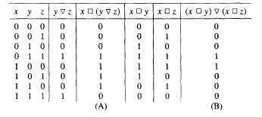
(d) One possible distributive property is x (y ∇ z) = (x y) ∇ (x z).
all possible cases must be checked.
We can show it in a table.

Slide 21
Binary operations (二元运算)
A binary operation on a set A is an everywhere defined function f:A×A →A.
A binary operation must satisfy:
f assigns an element f(a,b) of A to each ordered pair (a,b) in A×A.
Only one element of A is assigned to each ordered pair.

Slide 22
Note
It’s customary to denote binary operations by a symbol such as , instead of f, and to denote the element assigned to (a, b) by ab [instead of (a, b)].
A is closed(封闭的) under the operation  , if a and b are elements in A, ab∈A.

Slide 23
Example 1,2
Let A = Z. Define ab as a + b.
 is a binary operation on Z.
Let A = R. Define ab as a/b.
 is not a binary operation.
For example, 30 is not defined.

Slide 24
Example 3
Let A = Z⁺. Define ab as a-b.
 is not a binary operation .
it does not assign an element of A to every ordered pair of elements of A; for example,25∉ A.

Slide 25
Example 4
Let A = Z. Define ab as a number less than both a and b.
 is not a binary operation, since it does not assign a unique element of A to each ordered pair of elements of A; for example, 86 could be 5, 4, 3, l, and so on.
in this case,  would be a relation from A×A to A, but not a function

Slide 26
Example 5,6
Let A = Z. Define ab as max{a, b}.
 is a binary operation;
for example,24 = 4, -3(-5)=-3.
Let A = P(S), for some set S. If V and W are subsets of S, define VW as VW.
 is a binary operation on A.
if we define V ' W as VW, then ' is another binary operation on A.
Note: It’s possible to define many binary operations on the same set.

Slide 27
Example 7,8
Let M be the set of all n×n Boolean matrices for a fixed n. Define AB as AB
 is a binary operation.
This is also true of AB.
Let L be a lattice. Define ab as ab.
 is a binary operation on L.
This is also true of ab

Slide 28


多选题
1分
Determine which description of * is a valid definition of a binary operation on the set.
A
on R,where a*b is ab
B
on Z,where a*b is a^{b}
C
on Z⁺,where a*b is a^{b}
D
on R,where a*b is a$\sqrt{b}$
提交

Slide 29
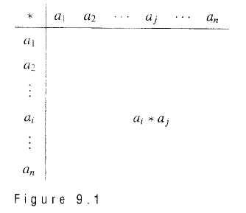
Tables – 运算表
If A = {a_{l}, a₂,..., a_{n}} is a finite set, we can define a binary operation on A by means of a table

Slide 30
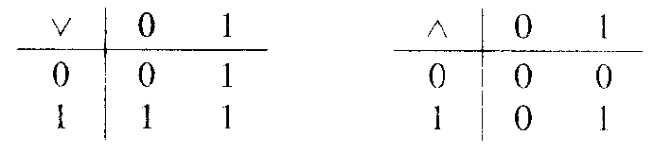
Example 9
Let A = {0, l }.
Define binary operations  and  by the following tables:

Slide 31
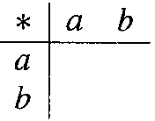
How many operations?
If A = {a, b}, how many binary operations can be defined on A.
Every binary operation  on A can be described by a table
There are 2222 = 2⁴ or 16 ways to complete the table.

Slide 32
Properties of Binary Operations（二元运算的性质）
For all elements a, b, and c in A
Commutative(可交换的)
a*b = b*a
Associative(可结合的)
a*(b*c) = (a*b)*c
Idempotent(幂等的)
a*a = a

Slide 33
Commutative –可交换的
A binary operation on a set A is said to be commutative if a*b = b*a for all elements a and b in A.
Example:
The binary operation of addition on Z
The binary operation of subtraction on Z.

Slide 34
Commutative
A binary operation that is described by a table is commutative
if and on1y if
The entries in the table are symmetric with respect to the main diagonal.

Slide 35
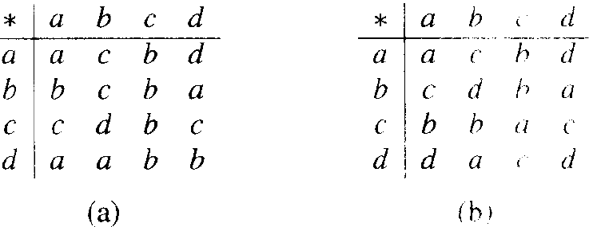
Example 12
Which of the fol1owing binary operations on A = {a, b, c, d} are commutative?

Slide 36
Associative – 可结合的
A binary operation * on a set A is said to be associative if a*(b*c) = (a*b)*c for all elements a, b, and c in A.
Example:
The binary operation of addition on Z
The binary operation of subtraction on Z
2-(3-5)≠(2-3)-5.

Slide 37
Example 15
Let L be a lattice. The binary operation defined by a*b = ab is
commutative and
associative.
It also satisfies the idempotent property aa = a.

Slide 38
Example 16
Let * be a binary operation on a set A, and suppose that * satisfies the following properties for any a, b, and c in A:
a = a*a
a*b = b*a
a*(b*c) = (a*b)*c
Define a relation ≤ on A by
a ≤ b if and only if a = a*b.
Show that (A, ≤) is a poset, and for all a, b in A, GLB(a, b ) = a*b.

Slide 39
Example 16: Solution
We must show that
≤ is reflexive, antisymmetric and transitive.
a*b = ab for all a and b in A.

Slide 40
≤ is reflexive
a ≤ b if and only if a = a*b
Since a = a*a,
a ≤ a for all a in A, and
≤ is reflexive.

Slide 41
≤ is antisymmetric
a ≤ b if and only if a = a*b
Now suppose that
a ≤ b and b ≤ a.
Then, by definition and property 2,
a = a*b = b*a = b,
so a = b.
Thus ≤ is antisymmetric.

Slide 42
≤ is transitive
a ≤ b if and only if a = a*b
If a ≤ b and b ≤ c,
then a = a*b = a*(b*c) = (a*b)*c = a*c,
so a ≤ c and
≤ is transitive.

Slide 43
a*b = ab, for all a and b in A
a ≤ b if and only if a = a*b
We have
a*b = a*(b*b) =(a*b)*b,
so a*b ≤ b.
In a similar way a*b ≤a.
so a*b is a lower bound for a and b.
Now, if c ≤ a and c ≤ b.
then c = c*a and c = c*b by definition.
Thus c = (c*a)*b = c*(a*b).
so c ≤ a*b.
This shows that a*b is the greatest lower bound of a and b.

Slide 44
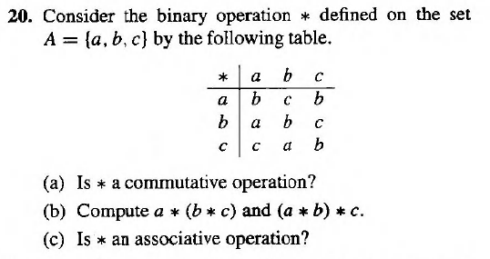
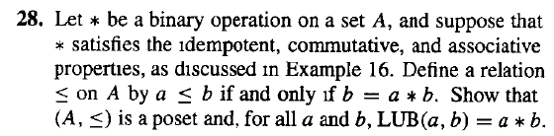

Homework
20@323
24, 28 @324

