Slide 1
Groups – 群

Slide 2
Definition
A group (G, *) is a set together with a binary operation * on G such that, for any elements a, b, and c in G
(a*b)*c = a*(b*c).
a unique element e in G such that
a*e = e*a=a for any a∈G
an element a' ∈ G, called an inverse of a and written as a⁻¹, such that
a*a' = a'*a = e or aa' = a'a = e or aa⁻¹ = a⁻¹a = e

Slide 3
Abelian – 阿贝尔群
A group G is said to be Abelian if ab = ba for all elements a and b in G.

Slide 4
Example 4
Let
G be the set of all nonzero real numbers and
a*b = ab/2.
Show
(G, *) is an Abelian group.

Slide 5
Example 4 - Solution
* is a binary operation
If a and b are elements of G,
then ab/2 is a nonzero real number and
hence is in G.
associativity
(a*b)*c = (ab/2)*c = (ab)c/4
a*(b*c) = a*(bc/2) = a(bc)/4= (ab)c/ 4.
* is associative.

Slide 6
Example 4 - Solution
2 is the identity
a*2 = (a)(2)/2 = a = (2)(a)/2 = 2*a.
a' = 4/a is an inverse of a
a*a' = a*4/a = a(4/a)/2 = 2 = (4/a)(a)/2 = (4/a)*a = a' *a.
Abelian
a*b = ab/2 = ba/2 = b*a
So, G is an Abelian group.

Slide 7

多选题
1分
Which of the following set together with the binary operation is a group?
A
Z⁺,under the operation of addition.
B
The real numbers that are not equal to -1,where a*b=a+b+ab.
C
The set of all rational numbers under the operation of addition.
提交

Slide 8
Theorem 1
Let G be a group. Each element a in G has only one inverse in G.
Proof
Let
a' and a" be inverses of a.
Then
a' = a'e = a'(aa") = (a'a)a" = ea" = a".

Slide 9
Theorem 2
Let
G be a group and
a, b, and c be elements of G.
Then
left cancellation – 左消去律
ab = ac implies that b = c
right cancellation – 右消去律
ba = ca implies that b = c

Slide 10
Theorem 2 - Proof
Left cancellation
Suppose that ab = ac.
a⁻¹(ab) = a⁻¹(ac)
(a⁻¹a)b = (a⁻¹a)c by associativity
eb = ec by the definition of an inverse
b = c by definition of an identity.
Right cancellation
The proof is similar to above.

Slide 11
Theorem 3
Let
G be a group and
a and b be elements of G.
Then
(a⁻¹)⁻¹ = a.
(ab)⁻¹ = b⁻¹a⁻¹

Slide 12
Theorem 3 - Proof
(a⁻¹)⁻¹ = a
a⁻¹a = aa⁻¹ = e
the inverse of an element is unique,
So, (a⁻¹)⁻¹ = a
(ab)⁻¹ = b⁻¹a⁻¹
(ab)(b^{-l}a⁻¹) = a(b(b^{-l}a⁻¹)) = a((bb^{-l}) a⁻¹) = a(ea⁻¹) = aa⁻¹ = e
similarly, (b^{-l}a⁻¹)(ab) = e
so (ab)⁻¹ = b⁻¹a⁻¹

Slide 13
Theorem 4
Let
G be a group, and
a and b be elements of G
Then
The equation ax = b has a unique solution in G.
The equation ya = b has a unique solution in G.
Proof is omitted

Slide 14
Finite group – 有限群
If G is a group that has a finite number of elements, G is said to be a finite group, and the order(阶) of G is the number of elements |G| in G.
A finite group can be represented in the form of the multiplication table.

Slide 15
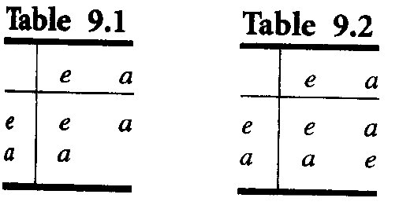
Group of order 1, 2
If G is a group of order 1, then
G = {e}, and ee = e.
Let G = {e, a} be a group of order 2.
The blank can be filled in by e or by a?

Slide 16
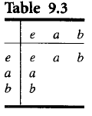
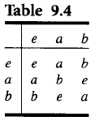
Nonisomorphic groups of order 3
Let G = {e, a, b} be a group of order 3.

Slide 17
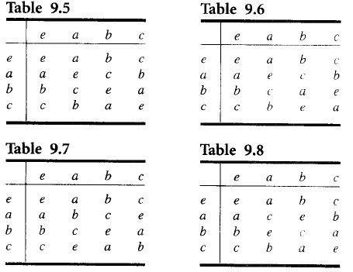
Groups of order 4
Let G = {e, a, b, c} be a group of order 4
34
35

Slide 18

Example 5
Let B = {0, l }, and let + be the operation defined on B as follows:
Then B is a group.

Slide 19
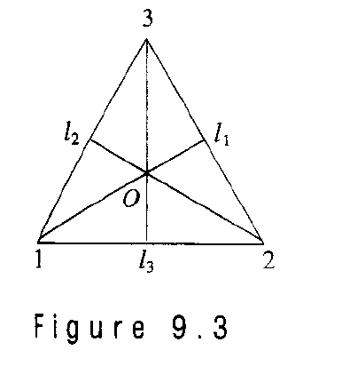
An important group
Given the equilateral triangle with vertices l, 2, and 3
Consider it’s symmetries.

Slide 20
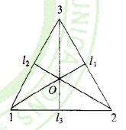
Symmetries of the triangle
There are counter-clockwise rotations f₂, f₃, f₁ of the triangle about O through 120º, 240º, 360º(or 0º) respectively.
f₁, f₂, f₃ can be written as the permutations.

Slide 21
Symmetries of the triangle
Three additional symmetries of the triangle are g₁, g₂, and g₃, by reflecting about the lines l₁, l₂, and l₃, respectively.
Denote these reflections as the following permutations:

Slide 22
Group of symmetries of the triangle
Let S₃ = {f₁, f₂, f₃, g₁, g₂, g₃} and introduce the operation *, followed by, on the set S₃
26

Slide 23
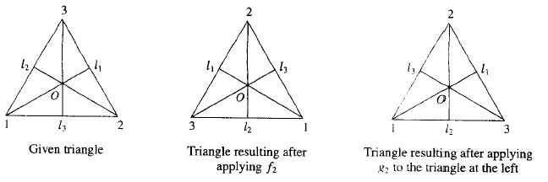
Compute f₂*g₂ geometrically

Slide 24
Compute f₂*g₂ algebraically
To compute f₂*g₂ algebraically, we compute f₂□g₂.
So f₂*g₂ = g_{l}.

Slide 25
Example 7
The set of all permutations of n elements is a group of order n! under the operation of composition.
This group is called the symmetric group on n letters (n次对称群) and is denoted by S_{n}.
由部分置换构成的群称为置换群(permutation group)。

Slide 26
Subgroup – 子群
Let H be a subset of a group G such that
(a) The identity e of G belongs to H.
(b) If a and b belong to H, then ab ∈ H.
(c) If a ∈ H, then a^{-l} ∈ H.
Then H is called a subgroup of G.

Slide 27
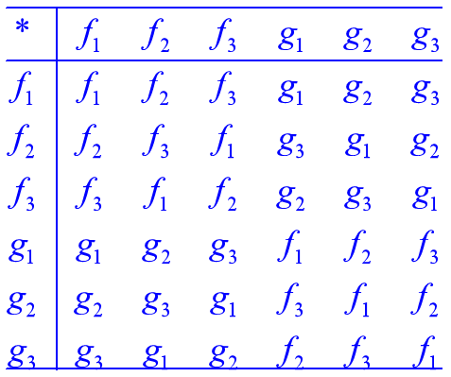
Examples
Let G be a group. Then G and H = {e} are subgroups of G, called the trivial subgroups (平凡子群) of G.
Consider S₃, the group of symmetries of the equilateral triangle. It is easy to verify that H = {f₁, f₂, f₃} is a subgroup of S_{3.}
Can you find all subgroup of S₃?
{f₁},{f₁, g₁},{f₁, g₂},{f₁, g₃},{f₁, f₂, f₃},S₃

Slide 28
Example 12
Let
G be a group and
a ∈ G.
Define
a^{n} as aa...a (n factors), for n ∈ Z⁺ and
a⁰ as e.
a^{-n} as a^{-l}a^{-l...} a^{-l} (n factors).
if n and m are any integers, then a^{n}a^{m} = a^{n+m}.
It is easy to show that
H = {a^{i}|i ∈ Z} is a subgroup of G. (generated by a)

Slide 29
Theorem 5
Let
(G, *) and (G', *') be two groups, and
f: G→G' be a homomorphism from G to G'.
Then
(a) If e is the identity in G and e' is the identity in G', then f(e) = e'.
(b) If a ∈ G, then f(a⁻¹) = (f(a))⁻¹.
(c) If H is a subgroup of G, then f(H) = {f(h)|h ∈ H} is a subgroup of G'.

Slide 30
Proof - (a)
If e is the identity in G and e' is the identity in G', then f(e) = e'.
Let
x = f(e)
Then
x *' x = f(e)*'f(e) = f(e*e) = f(e) = x
so x *' x = x
x =x*'x*'x^{-l} = x*'x^{-l} = e'
Thus f(e) = e'

Slide 31
Proof - (b)
If a ∈ G, then f(a⁻¹) = (f(a))⁻¹.
Let
a ∈ G
Then
a * a⁻¹ = e
so f(a*a⁻¹) = f(e) = e'
f(a) *' f(a⁻¹) = e'
Similarly, f(a⁻¹) *' f(a) = e'
Hence
f(a⁻¹) =(f(a))⁻¹

Slide 32
Proof - (c)
If H is a subgroup of G, then f(H) = {f(h)|h ∈ H} is a subgroup of G'.
This follows from Theorem 4 of Section 9.2 and parts (a) and (b).
Q.E.D.

Slide 33
单选题
1分
Let H₁,H₂ be subgroups of a group G. Determine whether H₁∩H₂ is a subgroups of the group G.
A
YES
B
NO
提交

Slide 34
Note
Remember that an isomorphism preserves all properties defined in terms of the group operations.
Example 16
The groups S₃ and Z₆ are both of order 6. However, S₃ is not Abelian and Z₆ is Abelian. Hence they are not isomorphic.

Slide 35
Example 17
The groups with multiplication Tables 9.6, 9.7, and 9.8 are isomorphic. (see slide 16)
The group with multiplication Table 9.5 is called the Klein 4 group(克莱因四元素群) and it is denoted by V.
Tables 9.5 and 9.6 are not isomorphic groups?
Observe that if x is any element in the group determined by Table 9.5, then x² = e

Slide 36
Cyclic group – 循环群
Recall the subgroup generated by a. Now Check Table 9.7
a⁰ = e
a¹ = a
a² = b
a³ = c
So G = {a⁰, a¹, a², a³}
Such group is called cyclic group.

Slide 37
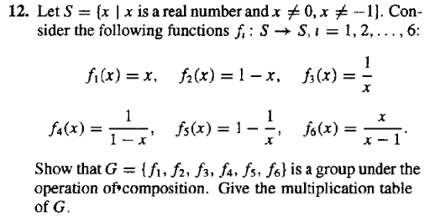
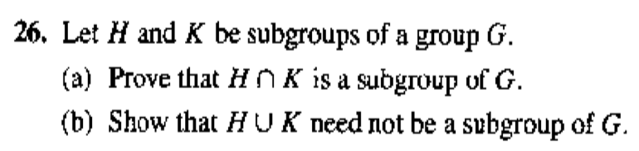
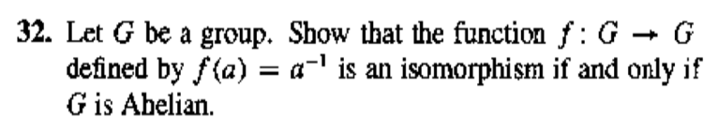

Homework
12,16 @348 26,32@349

Slide 38
Products and Quotients of Groups

Slide 39
Theorem 1
If
G₁ and G₂ are groups,
then
G = G₁×G₂
is a group with binary operation defined by
(a_{l}, b_{l})(a₂, b₂) = (a₁a₂, b_{l}b₂).

Slide 40
Proof
By Theorem 1, Section 9.3, we have that G is a semigroup.
The existence of an identity and inverses is easy to verify.
Q.E.D.

Slide 41
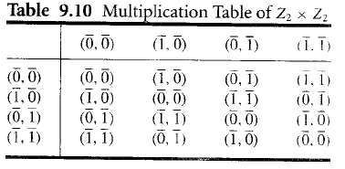
Example 1
Let G₁ and G₂ be the group Z₂. For simplicity of notation, we shall write the elements of Z₂ as ‾0 and ‾l, respectively, instead of [0] and [l]. Then the multiplication table of G = G₁× G₂ is given in Table.

Slide 42
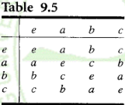
Example 1
Since G is a group of order 4, it must be isomorphic to V or to Z₄ , the only groups of order 4.
The function
f: V→ Z₂ × Z₂ defined by
f(e) = ([0], [0]), f(a) = ([1],[0]), f(b) = ([0], [1]), and f(c) = ([1], [1])
is an isomorphism.

Slide 43
Note
If we repeat Example 1 with Z₂ and Z₃, we find that Z₂×Z₃≅Z₆.
It can be shown, in general, that
Z_{m}×Z_{n} ≅ Z_{mn}
if and only if
GCD(m, n) = l.

Slide 44

Example 2
Let B ={0, l } be the group, where + is defined as above
Then B^{n} = B×B × ... × B (n factors) is a group with operation ⊕ defined by
(x₁, x₂,... x_{n}) ⊕ (y₁, y₂,... y_{n})
= (x₁+y₁, x₂+y₂,.... x_{n}+y_{n} ).
The identity of B^{n} is (0, 0,..., 0), and every element is its own inverse.

Slide 45
Theorem 2
Let R be a congruence relation on the group (G, *).
Then the semigroup (G/R, ) is a group, where the operation  is defined on G/R by
[a][b] = [a*b]
Proof
Since a group is a monoid, G/R is a monoid.
Let [a] ∈ G/R.
Then [a⁻¹] ∈ G/R, and
[a]  [a⁻¹] = [a*a⁻¹] = [e].
So [a]⁻¹ = [a⁻¹].
Hence (G/R, ) is a group.

Slide 46
Corollary 1
If R is a congruence relation on a group G, then the function
f_{R}: G→G/R
given by
f_{R}(a) = [a]
is a group homomorphism.

Slide 47
Corollary 2
If
f: G→G' is a homomorphism from the group (G, *) onto the group (G', *'), and
R is the relation defined on G by
a R b if and only if f(a) = f(b), for a and b in G
Then
R is a congruence relation.
The function f: G/R →G', given by f([a]) = f(a) is an isomorphism from the group (G/R, ) onto the group (G', *' ).

Slide 48
Definition
Let
H be a subgroup of a group G
a ∈ G
The left coset(左陪集) of H in G determined by a is the set
aH = {ah| h ∈ H}
The right coset (右陪集) of H in G determined by a is the set
Ha = {ha | h ∈ H}
A subgroup H of G is normal(正规子群) if
aH = Ha, for all a in G

Slide 49
Warning
If Ha = aH, it does not follow that, for h ∈ H and a ∈ G, ha = ah.
But ha = ah', where h' is some element in H.

Slide 50
Note
If H is a subgroup of G, we shall need in some applications to compute all the left cosets of H in G.
First, suppose that a ∈ H. Then aH ⊆ H, since H is a subgroup of G;
Moreover, if h ∈ H, then h = ah', where h' = a⁻¹h ∈ H, so that H ⊆ aH.
Thus, if a ∈ H, then aH = H.

Slide 51
Example 3
Let
G be the symmetric group S₃.
The subset H = {f_{l}, g₂} is a subgroup of G.
Compute all the distinct left cosets of H in G.

Slide 52
Example 3
Solution
If a ∈ H, then aH = H. Thus
f_{l} H = g₂H = H.
f₂H = {f₂, g₁}
f₃H = {f₃, g₃}
g₁H = {g₁, f₂}= f₂H
g₃H = {g₃, f₃}= f₃H
The distinct left cosets of H in G are
H, f₂H, and f₃H.

Slide 53
Theorem 3
Let
R be a congruence relation on a group G
H = [e], the equivalence class containing the identity.
Then
H is a normal subgroup of G
[a] = aH = Ha, for each a ∈ G

Slide 54
Proof
[a] = aH , for each a ∈ G
Let
a and b be any elements in G.
Then
b ∈ [a] if and only if [b] = [a].
R is an equivalence relation
if and only if [e] = [a]⁻¹[b] = [a⁻¹] [b] = [a⁻¹b].
G/R is a group
if and only if H = [e] = [a⁻¹b].
if and only if a⁻¹b ∈ H or b ∈ aH.
So [a] = aH for every a ∈ G.

Slide 55
Proof
[a] = Ha, for each a ∈ G
Similarly,
b ∈ [a] if and only if H = [e] = [b][a]⁻¹ = [ba⁻¹].
[a] = Ha.
Thus [a] = aH = Ha, and H is normal.
Q.E.D.

Slide 56
Note
Combining Theorem 3 with Corollary 1, we see that in this case the quotient group G/R consists of all the left cosets of N = [e]. The operation in G/R is given by
(aN)(bN) = [a][b] = [ab] = abN
and the function f_{R}: G →G/R, defined by
f_{R}(a) = aN
is a homomorphism from G onto G/R. For this reason, we will often write G/R as G/N.

Slide 57
Theorem 4
Let
N be a normal subgroup of a group G
R be the following relation on G
a R b if and only if a⁻¹b ∈ N.
Then
(a) R is a congruence relation on G.
(b) N is the equivalence class [e] relative to R, where e is the identity of G.

Slide 58
Proof (a)
N be a normal subgroup of a group G
R be the following relation on G
a R b if and only if a⁻¹b ∈ N.
(a) R is a congruence relation on G.
R is an equivalence relation
Let a ∈ G.
a R a, since a⁻¹a = e ∈ N,
R is reflexive.
Suppose that a R b
a⁻¹b ∈ N.
(a⁻¹b)⁻¹ = b⁻¹a ∈ N,
b R a.
R is symmetric.
Suppose that a R b and b R c.
a^{-l}b ∈ N and b⁻¹c ∈ N.
(a^{-l}b)(b^{-l}c) = a^{-l}c ∈ N,
a R c.
R is transitive.

Slide 59
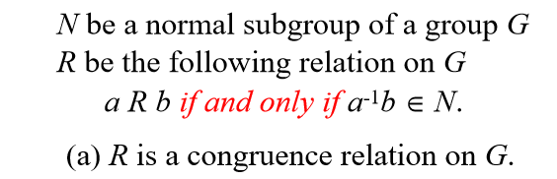
Proof (a)
R is a congruence relation on G.
Suppose that a R b and c R d.
Then a⁻¹b ∈ N and c⁻¹d ∈ N
Since N is normal, Nd = dN
since a^{-l}b ∈ N , then a⁻¹bd= dn for some n ∈ N.
(ac)⁻¹bd = (c⁻¹a⁻¹)(bd) = c⁻¹ ( a⁻¹b)d = (c⁻¹d) n ∈ N
so ac R bd.
Hence R is a congruence relation on G.

Slide 60
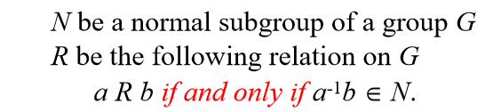
Proof (b)
(b) N is the equivalence class [e] relative to R, where e is the identity of G.
Suppose that x ∈ N.
x⁻¹e= x⁻¹ ∈ N
x R e
x ∈ [e]
N⊆ [e]
Conversely, if x ∈ [e],
x R e
x⁻¹e= x⁻¹ ∈ N
x ∈ N
[e] ⊆N
Hence N = [e].

Slide 61
Note
Following three are equivalent
a congruence relation R on G
a normal subgroup H of G
a homomorphism from G to G/R or G'

Slide 62
Corollary 2
Let
f be a homomorphism from a group (G, *) onto a group (G', *')
the kernel(核) of f, ker(f), be defined by ker(f) = {a ∈ G| f(a) = e'}.
Then
ker(f) is a normal subgroup of G.
The quotient group G/ker(f) is isomorphic to G'.

Slide 63
Example 6
Consider the homomorphism f from Z onto Z_{n} defined by f(m) = [r], where r is the remainder when m is divided by n. Find ker(f).
Solution
An integer m in Z belongs to ker(f)
if and only if f(m) = [0]
if and only if m is a multiple of n
Hence ker(f) = nZ.

Slide 64

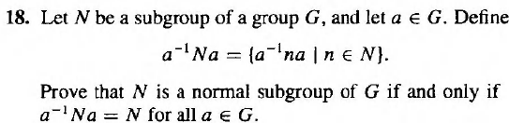

Homework
4 @353 18, 30@354

Slide 65
Tips for proof
Direct proof
Substructure
Iso- and homomorphism

Slide 66
Key ideas for review
Binary operation
Commutative, Associative
Semigroup, Monoid, Group
Subsemigroup, Submonoid, Subgroup
Isomorphism, Homomorphism
Congruence relation R on semigroup (S, *)
Quotient semigroup S/R,
Order of group, S_{n} , Z_{n},置换群, 循环群
Left and right coset, Normal subgroup

Slide 67
多选题
1分
Let G=Z₄. Determine all the left cosets of H={[0],[2]} in G.
A
{[0],[2]}
B
{[1],[3]}
C
{[0],[1],[2],[3]}
提交

Slide 68
Please feel free
to ask questions!
((( )))

