Slide 1
离散数据及其应用 Discrete Mathematics and Its Applications （Eighth Edition/Kenneth H.Rosen） 郭少勇 (syguo@bupt.edu.cn) 北京邮电大学 2022.9
Notes:
1

Slide 2
Semigroup and Groups
9.1(补) 二元运算/Binary Operations Revisited
9.2 (补) 半群/Semigroups
9.3 (补) 乘积半群与商半群/Products and Quotients of Semigroups
9.4 (补) 群/Groups
9.5 (补) 乘积群与商群/Products and Quotients of Groups

Slide 3
9.2(补) Semigroups
复习
Special Properties of Binary Relations
Reflexive and Irreflexive（自反、反自反）
A relation R on a set A is called reflexive if (a, a) ∈ R for every element a ∈ A
Symmetric, Asymmetric, and Antisymmetric（对称、非对称、反对称）
A relation R on a set A is called symmetric if (b, a) ∈ R whenever (a, b) ∈ R, for all a, b ∈ A.
A relation R is called asymmetric if (a, b) ∈ R implies that(b, a) ∉ R.
A relation R on a set A such that for all a, b ∈ A, if (a, b) ∈ R and (b, a) ∈ R, then a = b is called antisymmetric.
Transitive（传递）
A relation R on a set A is called transitive if whenever (a, b) ∈ R and (b, c) ∈ R, then (a, c) ∈ R, for all a, b, c ∈ A

Slide 4
9.2(补) Semigroups
Semigroups
In this section we define a simple mathematical structure, consisting of a set together with a binary operation, that has many important applications.

Slide 5
9.2(补) Semigroups
A semigroup is a nonempty（非空） set S together with an associative binary operation * defined on S.
Denote the semigroup by (S, *) or S.
a*b is referred as the product of a and b. The semigroup (S, *) is said to be commutative（可交换的） if * is a commutative operation.

Slide 6
9.2(补) Semigroups
Example 1:
(Z, +) is a commutative semigroup.
Example 2:
The set P(S), where S is a set, together with the operation of union is a commutative semigroup.
Example 3:
The set Z with the binary operation of subtraction is not a semigroup, since subtraction is not associative.

Slide 7
9.2(补) Semigroups
Example 4:
Let S be a fixed nonempty set, and let S^{s} be the set of all functions f: S→S. If f and g are elements of S^{s}, we define f *g as f○g, the composite function.
* is a binary operation on S^{s}
* is associative.
(S^{s}, *) is a semigroup.
The semigroup S^{s} is not commutative.

Slide 8
9.2(补) Semigroups
复习
A lattice(格) is a poset in which every subset {a,b} consisting of two elements has a least upper bound and a greatest lower bound.
denote LUB({a,b}) by a∨b and call it the join（并） of a and b.
denote GLB({a,b}) by a∧b and call it the meet（交） of a and b.

Slide 9
9.2(补) Semigroups
Example 5:
Let (L, ≤) be a lattice. Define a binary operation on L by a*b = a∨b.
Then L is a semigroup.

Slide 10
9.2(补) Semigroups
Example 6:
Let
A = {a₁, a₂,..., a_{n}} be a nonempty set.
A* is the set of all finite sequences of elements of A.
α and β be elements of A*.
The catenation is a binary operation • on A*.
if α = a₁a₂...a_{n} and β = b₁b₂...b_{k}
α • β = a₁a₂...a_{n}b₁b₂...b_{k}
if α, β, and γ are any elements of A*,
α • ( β • γ ) = ( α • β ) • γ

Slide 11
9.2(补) Semigroups
Example 6:
So that • is an associative binary operation, and (A*, •) is a semigroup.
The semigroup (A*, • ) is called the free semigroup generated by A(由A生成的自由半群).
In a semigroup (S, *) we can establish the following generalization of the associative property; we omit the proof．

Slide 12
9.2(补) Semigroups
Theorem 1
If a1, a2,..., an, n ≥3, are arbitrary elements of a semigroup, then all products of the elements a1, a2,..., an that can be formed by inserting meaningful parentheses arbitrarily are equal.

Slide 13
Example 7:
Theorem 1 shows that the products
((a₁ * a₂)* a₃)* a₄
a₁ *(a₂ *(a₃ * a₄))
(a₁ *(a₂ * a₃))* a₄
are all equal.
If a₁, a₂,..., an are elements in a semigroup (S, *), then the product can be written as
a₁ * a₂ *... * a_{n}
9.2(补) Semigroups

Slide 14
9.2(补) Semigroups
Identity – 单位元、幺元
An element e in a semigroup (S, *) is called an identity element
if e*a = a*e = a
for all a∈S, As shown by Thorem 1, Section 1.6, an identity element must be unique.

Slide 15
9.2(补) Semigroups
Example 8:
The number 0 is an identity in the semigroup (Z, +).
Example 9:
The semigroup (Z⁺, +) has no identity element.

Slide 16
9.2(补) Semigroups
Example 10:
The semigroup P(S) defined in Example 2 has the identity ∅, since for any element A∈P(S).
∅ *A = ∅ ∪A = A = A∪ ∅ = A* ∅
Hence P(S) is a monoid（幺半群）.

Slide 17
9.2(补) Semigroups
Example 11:
The semigroup S^{s} defined in Example 4 has the identity l_{s}, since l_{s}* f = l_{s} ○f = f ○ l_{s} = f * l_{s} for any element f ∈ S^{s} , we see that S^{s} is a monoid.

Slide 18
9.2(补) Semigroups
Example 12:
The semigroup A* defined in Example 6 has the identity Λ, the empty sequence, since α • Λ = Λ • α = α for all α∈A* .
Example 13:
The set of all relations on set A is a monoid under the operation of composition. The identity element is the equality relation Δ.

Slide 19
9.2(补) Semigroups
Subsemigroup – 子半群
Let
(S, *) be a semigroup and
T be a subset of S.
If T is closed under the operation *, then
(T, *) is called a subsemigroup(子半群) of (S, *).

Slide 20
9.2(补) Semigroups
Submonoid – 子独异点
Let
(S, *) be a monoid with identity e, and
T be a nonempty subset of S.
If T is closed under the operation * and e ∈ T, then
(T, *) is called a submonoid(子独立点) of (S, *).

Slide 21
9.2(补) Semigroups
The associative property holds in any subset of a semigroup so that a subsemigroup (T, *) of a semigroup (S, *) is itself a semigroup.
Similarly, a submonoid of a monoid is itself a monoid.

Slide 22
9.2(补) Semigroups
Example 14:
If T is the set of all even integers, then (T,×) is a subsemigroup of the monoid (Z, ×), where × is ordinary multiplication, but it is not a submonoid since the identity of Z, the number 1, does not belong to T.
Example 15:
If (S, *) is a semigroup, then (S, *) is a subsemigroup of (S, *).
Similarly, let (S,*) be a monoid, then (S, *) is a submonoid of (S, *), and if T = {e}, then (T, *) is also a submonoid of (S, *)

Slide 23
9.2(补) Semigroups
Powers of a
Suppose
(S, *) is a semigroup, a ∈ S, n ∈ Z⁺
Define the powers of an recursively as follows:
a¹ = a, a^{n} = a^{n-1} * a, n ≥2.
a⁰ = e, if (S, *) is a monoid
if m and n are nonnegative integers, then
a^{m} * a^{n} = a^{m+n}

Slide 24
9.2(补) Semigroups
Example 16:
If (S, *) is a semigroup, a∈S, and
T = {a^{i} | i∈Z+},
then (T, *) is a subsemigroup of (S, *).
If (S, *) is a monoid, a∈S, and
T = {a^{i} | i∈Z⁺ or i = 0},
then (T, *) is a submonoid of (S, *).

Slide 25
9.2(补) Semigroups
Isomorphism – 同构映射
Let (S, *) and (T, *') be two semigroups.
A function f : S→T is called an isomorphism(同构映射) from (S, *) to (T, *') if it is a one-to-one correspondence from S to T, and if
f(a*b) = f(a)*'f(b) for all a and b in S.
for all a and b in S.

Slide 26
9.2(补) Semigroups
If f is an isomorphism from (S, *) to (T, *'), then, since f is a one-to-one correspondence, f⁻¹ exists and is a one-to-one correspondence from T to S.

Slide 27
9.2(补) Semigroups
Let a' and b' be any elements of T.
Since f is onto, there exist a and b in S such that
f(a) = a' and f(b) = b'.
Then a = f⁻¹(a') and b = f⁻¹(b').
f⁻¹(a' *' b') = f⁻¹(f(a)*'f(b))= f⁻¹(f(a*b)) = (f⁻¹○f) (a*b) = a*b = f⁻¹(a') * f⁻¹(b').
Hence f⁻¹ is an isomorphism.

Slide 28
9.2(补) Semigroups
If f is an isomorphism from (S, *) to (T, *'), the semigroups (S, *) and (T *') are said to be isomorphic and write as S ≌ T

Slide 29
9.2(补) Semigroups
Isomorphic
STEP 1: Define a function f :S → T with Dom(f) = S.
STEP 2: Show that f is one-to-one.
STEP 3: Show that f is onto.
STEP 4: Show that f(a*b) = f(a)*'f(b)

Slide 30
9.2(补) Semigroups
Example 17:
Let T be the set of all even integers. Show that the semigroups (Z ,+) and (T, +) are isomorphic.
Solution:
Step 1: define the function f : Z →T by
f(a) = 2a.
Step 2: f is one-to-one.
Suppose that f(a₁) =f(a₂).
Then 2a₁ = 2a₂, so a₁ = a₂.
Hence f is one-to-one

Slide 31
9.2(补) Semigroups
Solution:
Step 3: f is onto.
Suppose that b is any even integer.
Then a = b/2 ∈ Z and
f(a) = f(b/2) = 2(b/2) = b,
so f is onto.
Step 4: f(a+b) = 2(a+b) = 2a+2b = f(a)+f(b) .
Hence (Z, +) and (T, +) are isomorphic semigroups

Slide 32
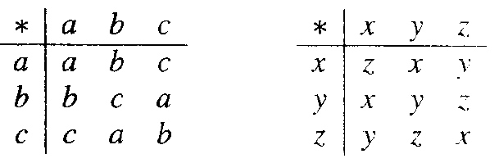
9.2(补) Semigroups
Example 18:
Let
S = {a, b, c} and T = {x, y, z}.
It is easy to verify that S and T are semigroup.
Let
f(a) = y
f(b) = x
f(c) = z
Replacing the elements in S by their images and rearranging the table, we obtain exactly the table for T. Thus S and T are isomorphic

Slide 33
9.2(补) Semigroups
Theorem 2
Let
(S, *) and (T, *') be monoids with identities e and e', respectively.
f :S→T be an isomorphism.
Then
f(e) = e'.

Slide 34
9.2(补) Semigroups
Proof
Let b be any element of T.
Since f is onto, there is an element a in S such that
f(a) = b.
Since a = a*e,
b = f(a) = f(a*e) = f(a)*'f(e)= b*'f(e).

Slide 35
9.2(补) Semigroups
Proof
Similarly, a = e*a,
b = f(e)*'b.
Thus for any b ∈ T,
b = b *' f(e) = f(e) *' b,
which means that f(e) is an identity for T.
the identity is unique,
f(e) = e'

Slide 36
9.2(补) Semigroups
If (S, *) and (T, *') are semigroups such that S has an identity and T does not, it then follows from Theorem 2 that (S, *) and (T, *') cannot be isomorphic.

Slide 37
9.2(补) Semigroups
Example 19:
Let T be the set of all even integers and let * be ordinary multiplication.
Then the semigroups (Z,×) and (T, × ) are not isomorphic, since Z has an identity and T does not.

Slide 38
9.2(补) Semigroups
Homomorphism – 同态
Let (S, *) and (T, *') be two semigroups.
An everywhere-defined function f :S → T is called a homomorphism from (S, *) to (T, *')
If f(a*b) = f(a) *' f(b) for all a and b in S.
If f is also onto, we say that T is a homomorphic image(同态像) of S.

Slide 39
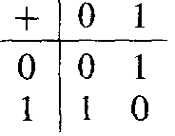
9.2(补) Semigroups
Example 20:
Let
A = {0, 1}
(A*, • ), • is the catenation operation
(A, +), + is defined by the table above
Define the function f : A*→A by
It is easy to verify that if α and β are any elements of A*, then f(α• β) = f(α)+f(β). Thus f is a homomorphism.
Note：For both an isomorphism and a homomor-phism, the image of a product is the product of the images.

Slide 40
9.2(补) Semigroups
Theorem 3
Let
(S, *) and (T, *') be monoids with identities e and e', respectively.
f :S →T be a homomorphism from (S, *) onto (T, *').
Then
f(e) = e'
Proof: similarly to the proof of theorem 2.

Slide 41
9.2(补) Semigroups
Theorem 4
Let
f be a homomorphism from a semigroup (S, *) to a semigroup (T. *').
If S' is a subsemigroup of (S, *),
Then
f(S') = {t ∈ T | t = f(s) for some s ∈ S'}, the image of S' under f, is a subsemigroup of (T, *').

Slide 42
9.2(补) Semigroups
Proof
Let t₁ and t₂ are any elements of f(S'),
there exist s₁ and s₂ in S' with t₁ = f(s₁) and t₂ = f(s₂).
t₁ *' t₂ = f(s₁) *' f(s₂) = f(s₁ * s₂) = f(s₃).
Hence t₁ *' t₂ ∈ f(S').
Thus f(S') is closed under the operation *'.
Since the associative property holds in T, it holds in f(S').
So f(S') is a subsemigroup of (T. *’)

Slide 43
9.2(补) Semigroups
Theorem 5
If f is a homomorphism from a commutative semigroup (S, *) onto a semigroup (T, *'), then (T, *') is also commutative.

Slide 44
9.2(补) Semigroups
Proof
Let t₁ and t₂ be any elements of T.
There exist s₁ and s₂ in S such that
t₁ = f(s₁) and t₂ = f(s₂)
Therefore
t₁ *' t₂ = f(s₁)*'f(s₂) = f(s₁*s₂) = f(s₂*s₁) = f(s₂)*'f(s₁) = t₂ *'t₁.
Hence (T, *') is also commutative.

Slide 45
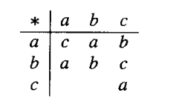
9.2(补) Semigroups
P331-17
Complete the following table to obtain a semigroup.

Slide 46
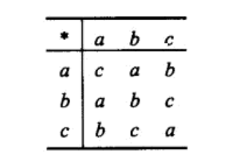
9.2(补) Semigroups
P331-17
Solution:

Slide 47
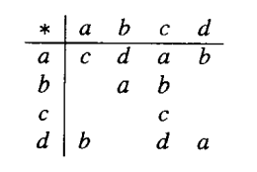
9.2(补) Semigroups
P331-18
Complete the following table so that it defines a monoid.

Slide 48




9.2(补) Semigroups
P331-18
Solution:

Slide 49
9.3 (补) Products and Quotients of Semigroups
Products and Quotients of semigroups
Products semigroups 乘积半群
Congruence relation 同余关系
Quotients of semigroups 商半群
Fundamental Homomorphism Theorem 基本同态定理

Slide 50
9.2(补) Semigroups
复习
A relation R on a set A is an equivalence relation (等价关系) iff R is
Reflexive（自反）
Symmetric（对称）
Transitive（传递）
equivalence class（等价类）
Let P be a partition of a set A. Define the relation R on A as follows:
a R b If and only if a and b are members of the same block.
Then R is an equivalence relation on A
Let R be an equivalence relation on A, and let P be the collection of all distinct relative sets R(a) for a in A.
Then P is a partition of A, and R is the equivalence relation determined by P

Slide 51
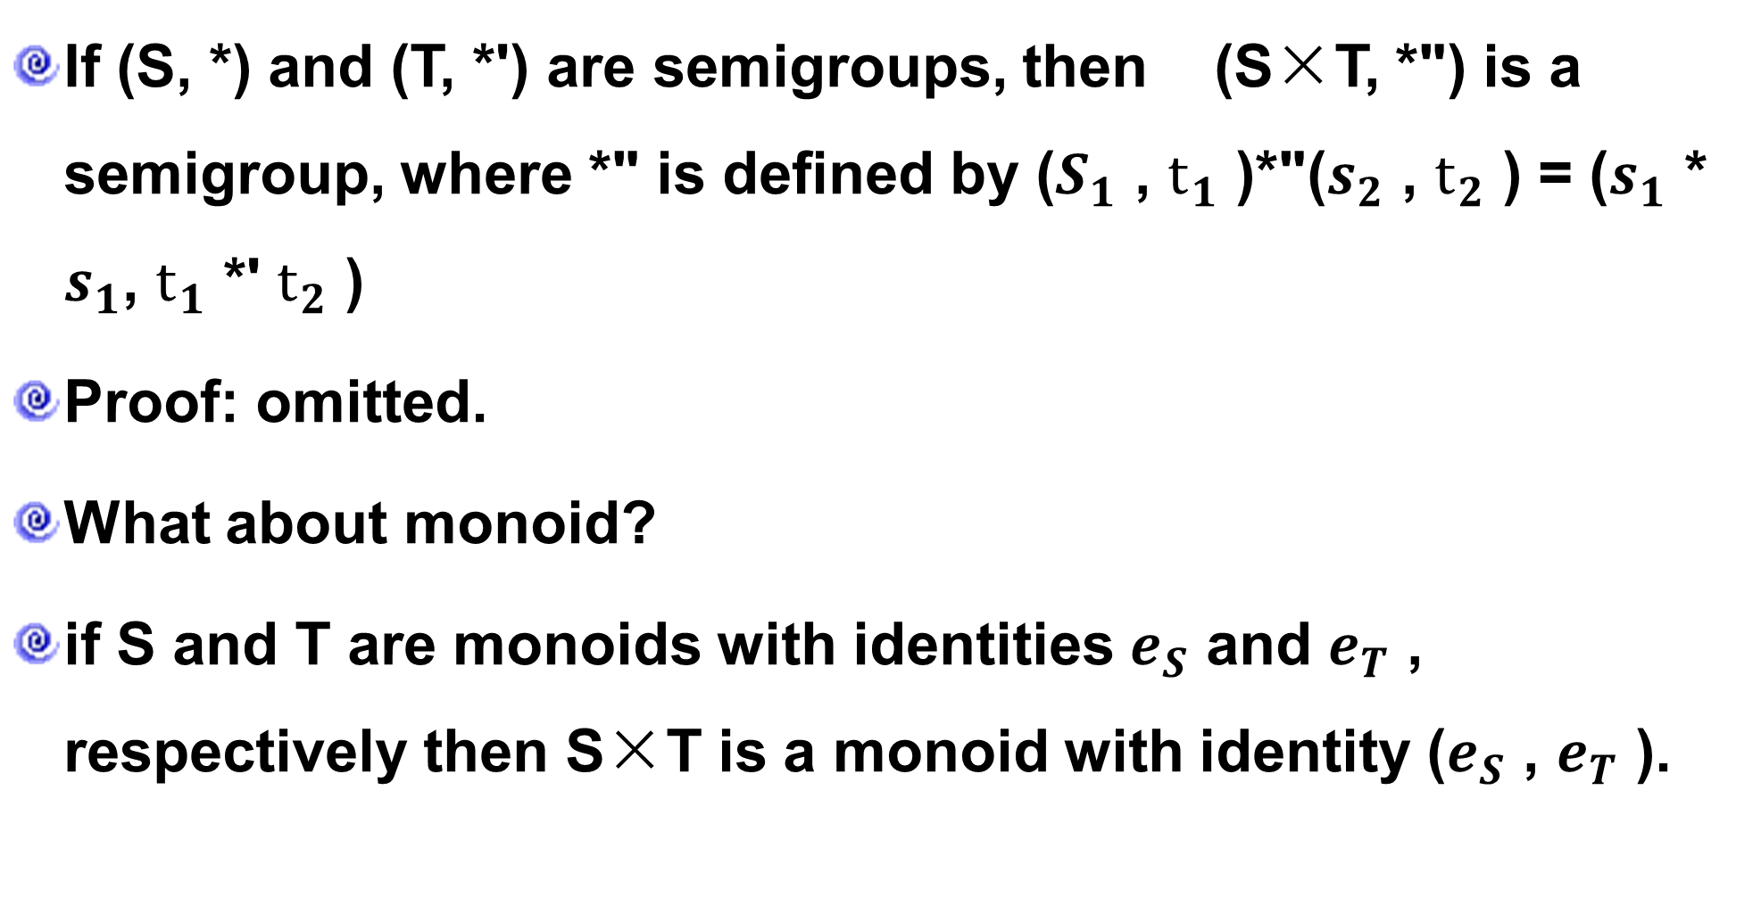
9.3 (补) Products and Quotients of Semigroups
Theorem 1
If (S, *) and (T, *') are semigroups, then (S×T, *") is a semigroup, where *" is defined by ($S_{1}$ , $t_{1}$ )*"($s_{2}$ , $t_{2}$ ) = ($s_{1}$ * $s_{1}$, $t_{1}$ *' $t_{2}$ )
Proof: omitted.
What about monoid?
if S and T are monoids with identities $e_{S}$ and $e_{T}$ , respectively then S×T is a monoid with identity ($e_{S}$ , $e_{T}$ ).

Slide 52
9.3 (补) Products and Quotients of Semigroups
Congruence relation – 同余关系
An equivalence relation R on the semigroup (S, *) is called a congruence relation
if a R a' and b R b' Imply (a*b) R (a'*b')

Slide 53
9.3 (补) Products and Quotients of Semigroups
Example 1:
Consider the semigroup (Z, +) and the equivalence relation R on Z defined by
a R b if and only if a≡ b (mod 2).
If a ≡ b (mod 2), then 2|(a-b).
Show that this relation is a congruence relation.

Slide 54
9.3 (补) Products and Quotients of Semigroups
Solution:
R is an equivalence relation (omitted).
R is a congruence relation
If a ≡ b (mod 2) and c ≡ d (mod 2)
2 | a-b and 2 | c-d.
So a-b = 2m and c-d = 2n, where m and n are integers.
(a-b) + (c-d) = 2m + 2n
(a+c) - (b+d) = 2(m+n),
so a+c ≡ b+d (mod 2).
Hence the relation is a congruence relation.

Slide 55
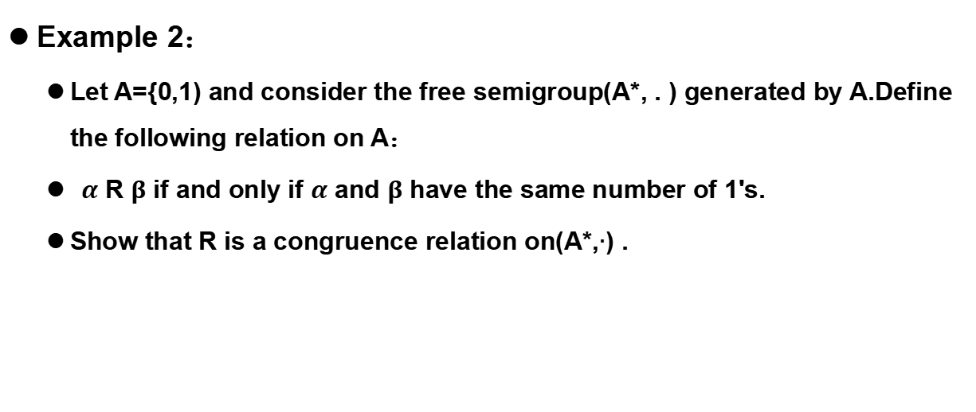
9.3 (补) Products and Quotients of Semigroups
Example 2：
Let A={0,1) and consider the free semigroup(A*, . ) generated by A.Define the following relation on A：
$α$ R $β$ if and only if $α$ and $β$ have the same number of 1's.
Show that R is a congruence relation on(A*,$∙$) .

Slide 56
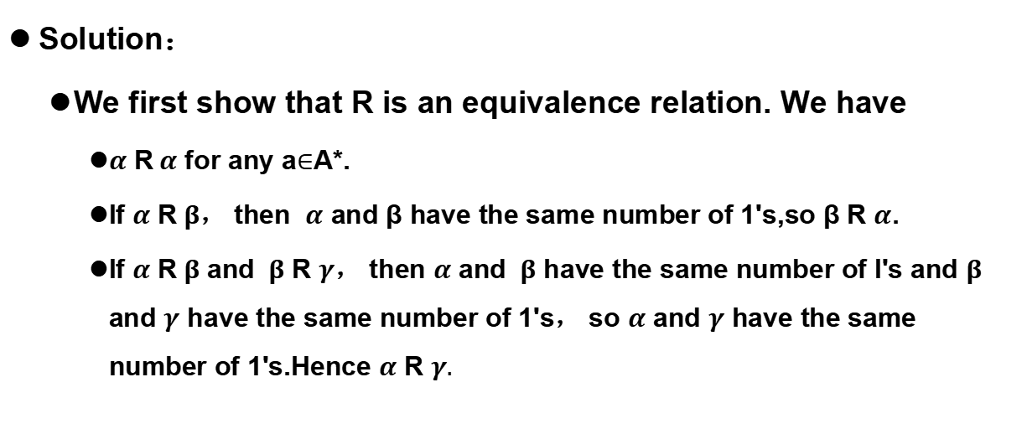
9.3 (补) Products and Quotients of Semigroups
Solution：
We first show that R is an equivalence relation. We have
$α$ R$α$ for any a$∈$A*.
If $α$ R$β$， then $α$ and β have the same number of 1's,so β R $α$.
If $α$ R$β$ and $β$ R $γ$， then $α$ and $β$ have the same number of I's and $β$ and $γ$ have the same number of 1's， so $α$ and $γ$ have the same number of 1's.Hence $α$ R $γ.$

Slide 57
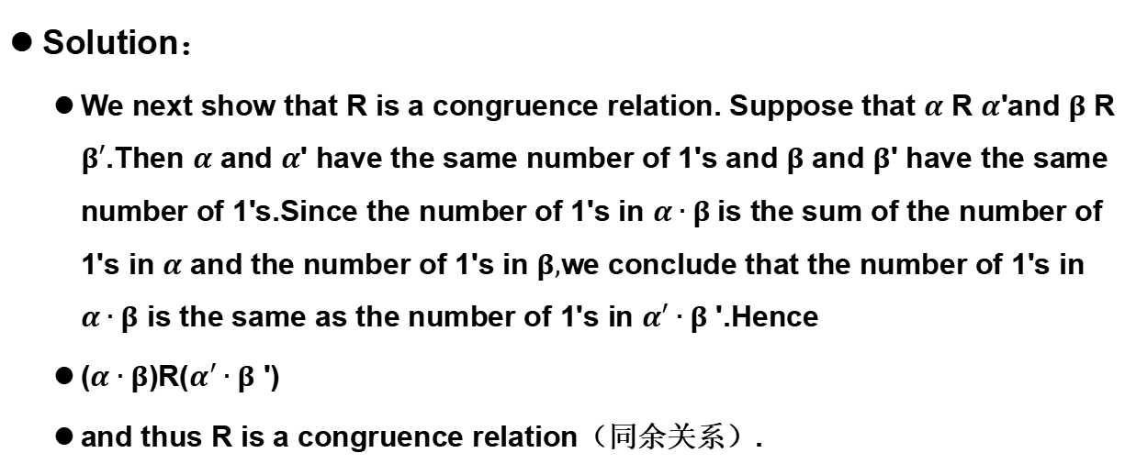
9.3 (补) Products and Quotients of Semigroups
Solution：
We next show that R is a congruence relation. Suppose that $α$ R $α$'and $β$ R $β′$.Then $α$ and $α$' have the same number of 1's and $β$ and $β$' have the same number of 1's.Since the number of 1's in $α∙β$is the sum of the number of 1's in $α$ and the number of 1's in $β,$we conclude that the number of 1's in $α∙β$ is the same as the number of 1's in $α′∙β$ '.Hence
($α∙β$)R($α′∙β$ ')
and thus R is a congruence relation（同余关系）.

Slide 58
9.3 (补) Products and Quotients of Semigroups
Example 3：
Consider the semigroup (Z, +)
f(x) =x²-x-2.
Define
a R b if and only if f(a) = f(b).
It is easy to verify that R is an equivalence relation, but R is not a congruence relation
-1 R 2, since f(-1) = f(2) = 0
-2 R 3, since f(-2) = f(3) = 4
but (-1 +-2) R(2 + 3), since f(-3) = 10 and f(5) = 18

Slide 59
9.3 (补) Products and Quotients of Semigroups
Recall that an equivalence relation R on the semigroup (S, *) determines a partition of S.
Let [a] = R(a) be the equivalence class containing a .
S/R denote the set of all equivalence classes.
Note

Slide 60
9.3 (补) Products and Quotients of Semigroups
Theorem 2
Let R be a congruence relation on the semigroup (S, *).
Consider the relation ⊙ from S/R × S/R to S/R in which the ordered pair ([a], [b]) is, for a and b in S, related to [a*b].
⊙([a], [b]) = [a]⊙[b] = [a*b], is a function from S/R×S/R to S/R
(S/R, ⊙) is a semigroup. S/R is called the quotient semigroup(商半群) or factor semigroup

Slide 61
9.3 (补) Products and Quotients of Semigroups
Proof
⊙ is a binary operation
Suppose that ([a], [b]) = ([a'], [b']).
a R a' and b R b',
a*b R a'*b', since R is a congruence relation.
Thus [a*b] = [a'*b'];
⊙ is a function, is a binary operation on S/R.
⊙ is an associative
[a]⊙([b]⊙[c]) = [a]⊙[b*c] = [a*(b*c)] = [(a*b)*c] = [a*b]⊙[c] = ([a]⊙[b])⊙[c].
Hence S/R is a semigroup.

Slide 62
9.3 (补) Products and Quotients of Semigroups
Corollary 1
Let R be a congruence relation on the monoid (S, *). If we define the operation ⊙ in S/R by [a]⊙[b] = [a*b], then (S/R, ⊙) is a monoid.
Proof
If e is the identity in (S, *), then it is easy to verify that [e] is the identity in (S/R, ⊙).

Slide 63
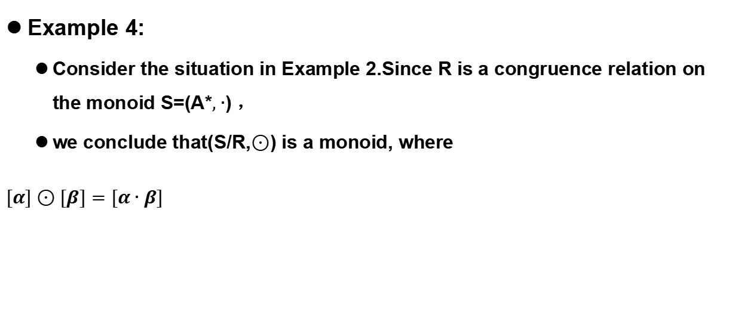
9.3 (补) Products and Quotients of Semigroups
Example 4:
Consider the situation in Example 2.Since R is a congruence relation on the monoid S=(A*$,∙$) ，
we conclude that(S/R,$⊙$) is a monoid, where
$$[α]⊙[β]=[α∙β]$$

Slide 64
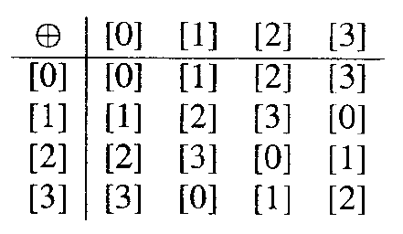
9.3 (补) Products and Quotients of Semigroups
Example 5：
(Z, +)
a R b if and only if a ≡ b (mod n).
R is an equivalence relation
≡(mod 4) is a congruence relation
[0] = {..., -8, -4, 0, 4, 8, l2,… } = [4] = [8] =…
[1] = {..., -7, -3, l, 5, 9, l3,… } = [5] = [9] =…
[2] = {..., -6, -2, 2, 6,10, l4,… } = [6] = [10] =...
[3] = {..., -5, -l, 3, 7, 11, 15, …}= [7] = [11] =…
Z/ ≡ (mod 4) or Z₄ is a monoid with identity [0] and operation [a]*[b] = [a+b].

Slide 65
9.3 (补) Products and Quotients of Semigroups
Theorem 3
Let
R be a congruence relation on a semigroup (S, *), and (S/R, ⊙) be the corresponding quotient semigroup.
Then the function
f_{R}: S →S/R
defined by
f_{R}(a) = [a]
is an onto homomorphism, called the natural homomorphism(自然同态).

Slide 66
9.3 (补) Products and Quotients of Semigroups
Proof
If [a] ∈ S/R, then
f_{R}(a) = [a],
so f_{R} is an onto function.
if a and b are elements of S, then
f_{R}(a*b) = [a*b] = [a]⊙[b] = f_{R}(a)⊙f_{R}(b)
so f_{R} is a homomorphism.

Slide 67
9.3 (补) Products and Quotients of Semigroups
Theorem 4-Fundamental Homomorphism Theorem – 同态基本定理
Let
f: S→T be a homomorphism of the semigroup (S, *) onto the semigroup (T, *').
R be the relation on S defined by
a R b if and only if f(a) = f(b), for a and b in S.
Then
(a) R is a congruence relation.
(b) (T, *') and the quotient semigroup (S/R, ⊙) are isomorphic.

Slide 68
9.3 (补) Products and Quotients of Semigroups
Proof
R is an equivalence relation
a R a for every a ∈ S, since f(a) = f(a).
if a R b, then f(a) = f(b), so b R a.
if a R b and b R c,
f(a) = f(b) and f(b) = f(c),
so f(a) = f(c) and a R c.
Hence R is an equivalence relation.

Slide 69
9.3 (补) Products and Quotients of Semigroups
Proof
R is a congruence relation.
Suppose that a R a₁ and b R b₁.
f(a) = f(a₁) and f(b) = f(b₁).
f(a*b) = f(a)*'f(b) = f(a₁)*'f(b₁) = f(a₁*b₁), since f is a homomorphism,
Hence (a*b) R (a₁*b₁)

Slide 70
9.3 (补) Products and Quotients of Semigroups
Proof
Define a relation f = {([a], f(a)) | [a] ∈ S/R} from S/R to T, then
f is a function.
Suppose that [a] = [a'].
a R a', so f(a) = f(a'), which implies that f is a function.
write f: S/R→T, where f([a]) = f(a) for [a] ∈ S/R.
f is one to one.
Suppose that f([a]) = f([a']).
f(a) = f(a'), so a R a', which implies that [a] = [a'].
Hence f is one to one.

Slide 71
9.3 (补) Products and Quotients of Semigroups
Proof
f is onto.
Suppose that b ∈ T.
f(a) = b for some element a in S, since f is onto,
f([a]) = f(a) = b, so f is onto.

Slide 72
9.3 (补) Products and Quotients of Semigroups
Proof
f is an isomorphism.
f([a]⊙[b])
= f([a*b])
= f(a*b)
= f(a)*'f(b)
= f([a])*'f([b]).
Q.E.D.

Slide 73
9.3 (补) Products and Quotients of Semigroups
Example 6:
A={0,1}
(A*, • ) (N,+)
f: A* → N
f(α)= the number of 1’s in α.
R: αRβ if and only if f(α ) = f(β )
A* /R ≌N f :A* /R →N
f
A*
N
f_{R}
f
A*/R
f_{R}(α)=[α]
f([α]) =f(α)

Slide 74
9.3 (补) Products and Quotients of Semigroups
Note
Theorem 4(b) can be described by the diagram above
f_{R} is the natural homomorphism.
It follows from the definitions of f_{R} and f that
f□f_{R} = f
since
(f□f_{R} )(a) = f(f_{R}(a)) = f([a]) = f(a)
f
S
T
f_{R}
f
S/R

Slide 75
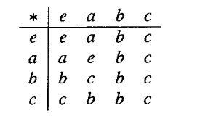
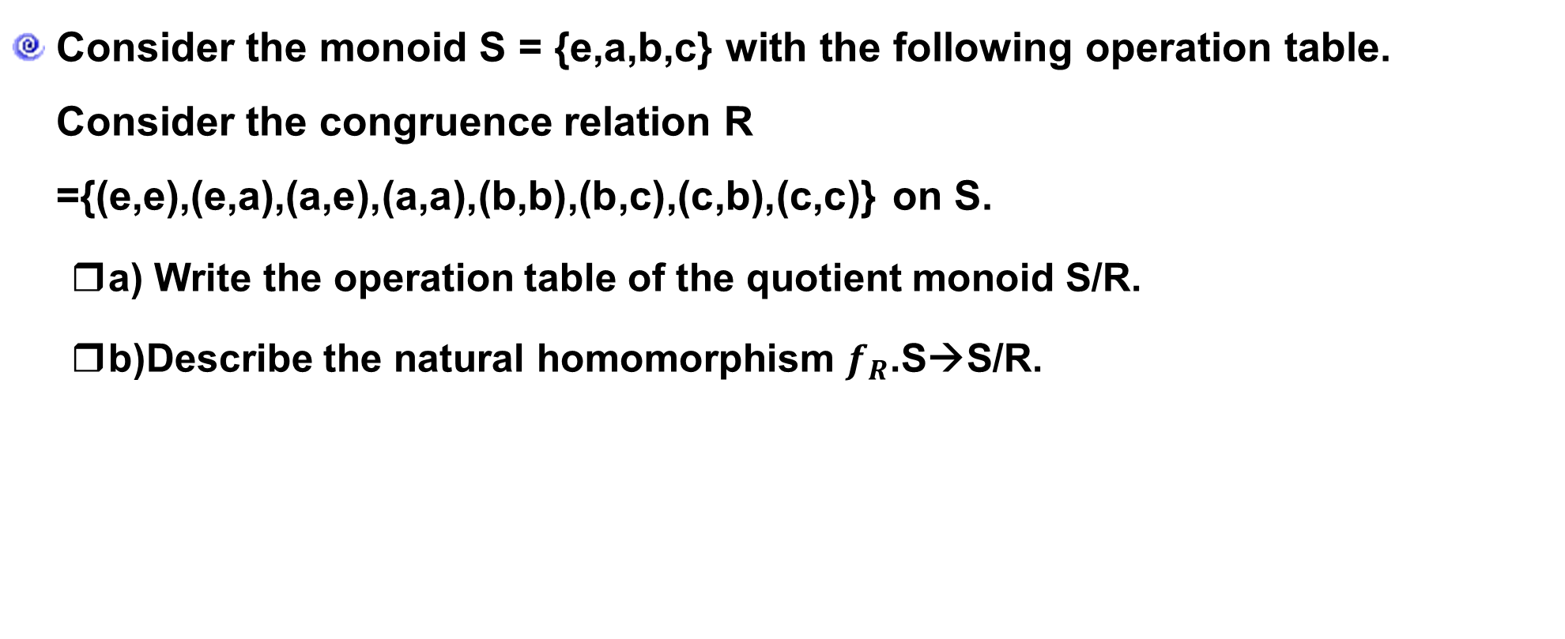
9.3 (补) Products and Quotients of Semigroups
P338-23
Consider the monoid S = {e,a,b,c} with the following operation table. Consider the congruence relation R ={(e,e),(e,a),(a,e),(a,a),(b,b),(b,c),(c,b),(c,c)} on S.
a) Write the operation table of the quotient monoid S/R.
b)Describe the natural homomorphism $f_{R}$.S→S/R.

Slide 76
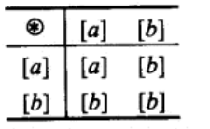
9.3 (补) Products and Quotients of Semigroups
P338-23
a)
b) $f_{R}\left(e\right)=\left[a\right]=f_{R}\left(a\right),f_{R}\left(b\right)=\left[b\right]=f_{R}\left(c\right)$

Slide 77
9.3 (补) Products and Quotients of Semigroups
Homework
20, 22, 28 P331
4, 12, 20, 22, 24 P338

