Slide 1
离散数据及其应用 Discrete Mathematics and Its Applications （Eighth Edition/Kenneth H.Rosen） 郭少勇 (syguo@bupt.edu.cn) 北京邮电大学 2022.10
Notes:
1

Slide 2
Semigroup and Groups
9.1(补) 二元运算/Binary Operations Revisited
9.2 (补) 半群/Semigroups
9.3 (补) 乘积半群与商半群/Products and Quotients of Semigroups
9.4 (补) 群/Groups
9.5 (补) 乘积群与商群/Products and Quotients of Groups

Slide 3
9.4(补) Groups
Groups
A group(群) (G, *) is a monoid, with identity e, that has the additional property that for every element a e G there exists an element a' ∈ G such that a*a'= a' *a =e. Thus a group is a set together with a binary operation * on G such that
1. (a*b) *c = a* (b*c) for any elements a, b, and c in G.
2. There is a unique element e in G such that a*e= e*a for any a ∈ G.
3. For every a ∈ G, there is an element a‘ e G, called an inverse(逆) of a, such that a*a' = a'*a = e.

Slide 4
9.4(补) Groups
Groups
Observe that if (G, *) is a group, then * is a binary operation, so G must be closed under *; that is,
a*b ∈ G for any elements a and b in G.
we shall write the product a * b of the elements a and b in the group (G, *) simply as ab, and we shall also refer to (G, *) simply as G．
A group G is said to be Abelian(阿贝尔) if ab = ba for all elements a and b in G.

Slide 5
9.4(补) Groups
Example 1:
The set of all integers Z with the operation of ordinary addition(+) is an Abelian group If a ∈ Z. then an inverse of a is its opposite -a.
Example 2:
The set Z⁺ under the operation of ordinary multiplication(*) is not a group since, for example, the element 2 in Z⁺ has no inverse. However, this set together with the given operation is a monoid.
Example 3:
The set of all nonzero real numbers under the operation of ordinary multiplication is a group. An inverse of a ≠ 0 is 1/a.

Slide 6

9.4(补) Groups
Example 4:
Let G be the set of all nonzero real numbers and let
$$a∗b=\frac{ab}{2}$$
Show that (G, *) is an Abelian group.

Slide 7
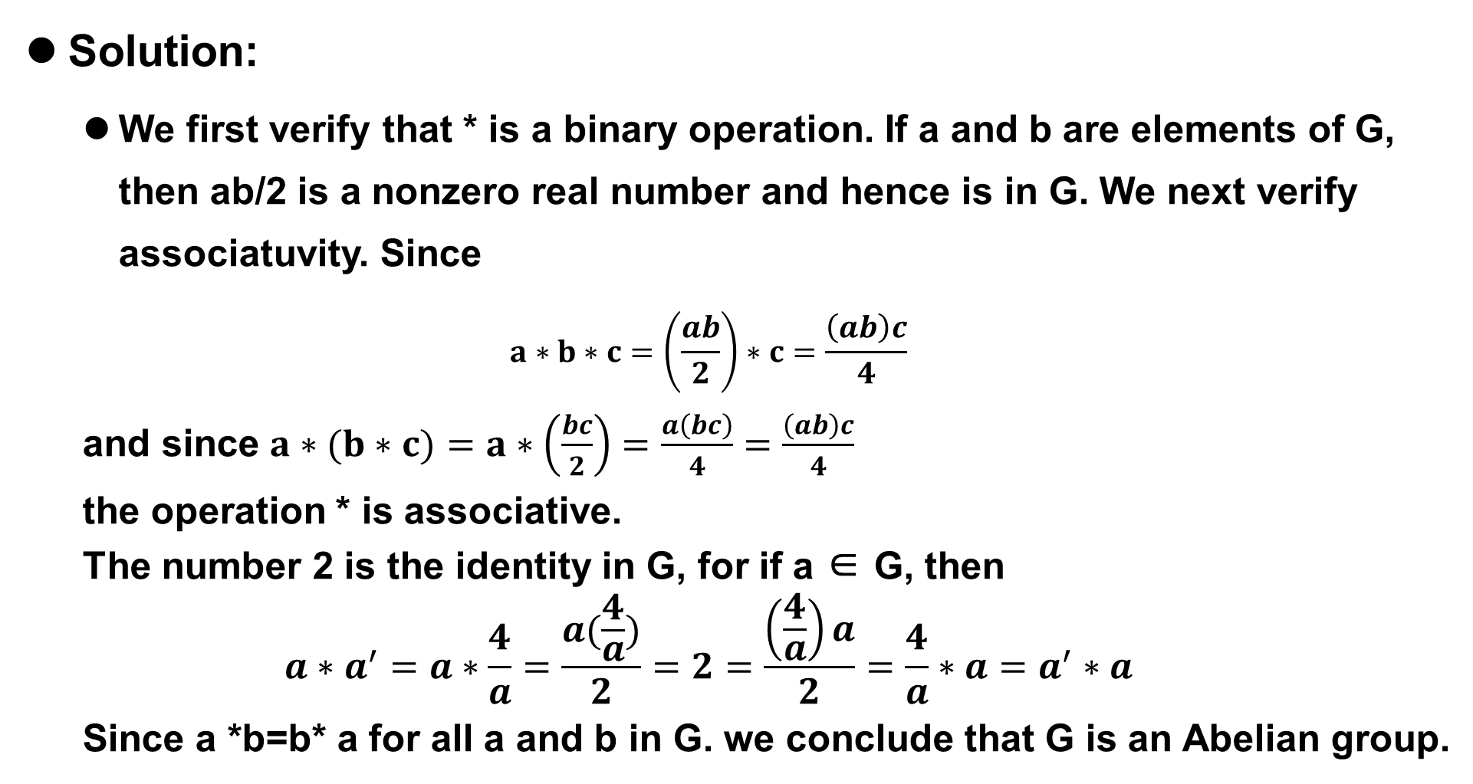
9.4(补) Groups
Solution:
We first verify that * is a binary operation. If a and b are elements of G, then ab/2 is a nonzero real number and hence is in G. We next verify associatuvity. Since
$$a∗b∗c=\left(\frac{ab}{2}\right)∗c=\frac{\left(ab\right)c}{4}$$
and since $a∗(b∗c)=a∗\left(\frac{bc}{2}\right)=\frac{a\left(bc\right)}{4}$ $=\frac{\left(ab\right)c}{4}$
the operation * is associative.
The number 2 is the identity in G, for if a ∈ G, then
$$a∗a^{′}=a∗\frac{4}{a}=\frac{a(\frac{4}{a})}{2}=2=\frac{\left(\frac{4}{a}\right)a}{2}=\frac{4}{a}∗a=a^{′}∗a$$
Since a *b=b* a for all a and b in G. we conclude that G is an Abelian group.

Slide 8
9.4(补) Groups
Theorem 1
Let G be a group. Each element a in G has only one inverse in G.
Proof: Let a' and a“ be inverses of a. Then
a'(aa") = a'e = a
And (a'a)a"= ea"= a".
Hence, by associativity, a'=a".
From now on we shall denote the inverse of a by a⁻¹. Thus in a group G we have aa⁻¹ = a⁻¹a = e.

Slide 9
9.4(补) Groups
Theorem 2
Let G be a group and let a, b, and c be elements of G. Then
(a) ab = ac implies that b = c (left cancellation property左消去律).
(b) ba = ca implies that b = c (right cancellation property右消去律)

Slide 10
9.4(补) Groups
Proof
Suppose that
ab = ac.
Multiplying both sides of this equation by a⁻¹ on the left, we obtain
a⁻¹(ab) = a⁻¹(ac)
(a⁻¹a)b = (a⁻¹a)c by associativity
eb = ec by the definition of an inverse
b = c by definition of an identity.
(b) The proof is similar to that of part (a)

Slide 11
9.4(补) Groups
Theorem 3
Let G be a group and let a and b be elements of G. Then
(a) (a⁻¹⁾⁻¹ = a.
(b) (ab)⁻¹ = b⁻¹a⁻¹

Slide 12
9.4(补) Groups
Proof
We show that a acts as an inverse for a⁻¹.
a⁻¹a = aa⁻¹ = e
Since the inverse of an element is unique, we conclude that (a⁻¹⁾⁻¹ = a.
(b) We easily verify that
(ab)(b⁻¹a⁻¹) = a(b(b⁻¹a⁻¹)) = a((bb⁻¹a⁻¹) = a(ea⁻¹) = aa⁻¹ = e
and, similarly,
(b⁻¹a⁻¹)(ab) = e.
So (ab)⁻¹ = b⁻¹a⁻¹.

Slide 13
9.4(补) Groups
Theorem 4
Let G be a group, and let a and b be elements of G. Then
(a) The equation ax = b has a unique solution in G.
(b) The equation ya = b has a unique solution in G.

Slide 14
9.4(补) Groups
Proof
The element x = a⁻¹b is a solution of the equation ax = b, since
a(a⁻¹b) = (aa⁻¹)b = eb = b.
Suppose now that x1 and x2 are two solutions of the equation ax =b.
Then ax1 = b and ax2 = b.
Hence ax1 = ax2.
Theorem 2 implies that x1 = x2.
(b) The proof is similar to that of part (a)

Slide 15
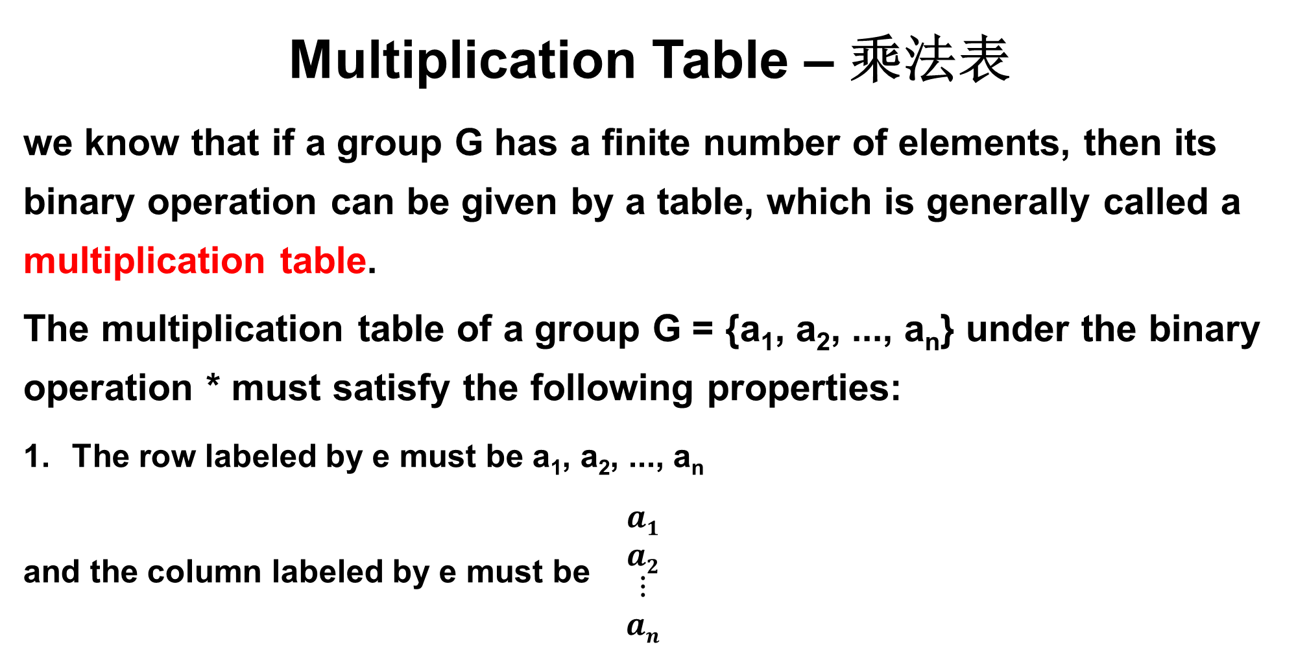
9.4(补) Groups
Multiplication Table – 乘法表
we know that if a group G has a finite number of elements, then its binary operation can be given by a table, which is generally called a multiplication table.
The multiplication table of a group G = {a₁, a₂, ..., a_{n}} under the binary operation * must satisfy the following properties:
The row labeled by e must be a₁, a₂, ..., a_{n}
and the column labeled by e must be $\begin{matrix}a1 \\ a2 \\ \begin{aligned}⋮ \\ an\end{aligned}\end{matrix}$

Slide 16
9.4(补) Groups
Multiplication Table – 乘法表
2. From Theorem 4, it follows that each element b of the group must appear exactly once in each row and column of the table. Thus each row and column is a permutation of the elements a₁, a₂, ..., a_{n} of G, and each row (and each column) determines a different permutation.

Slide 17
9.4(补) Groups
Finite Group– 有限群
If G is a group that has a finite number of elements, we say that G is a finite group, and the order(阶) of G is the number of elements IGI in G. We shall now determine the multiplication tables of all nonisomorphic groups(非同构群) of orders 1, 2, 3 and 4.

Slide 18

9.4(补) Groups
Group of order 1, 2
If G is a group of order 1, then G = {e}, and we have ee =e. Now let G= {e, a} be a group of order 2.
Then we obtain a multiplication table (Table 1) where we need to fill in the blank. The blank can be filled in by e or by a.
Table 1
Table 2

Slide 19
9.4(补) Groups
Group of order 1, 2
Since there can be no repeats in any row or column, we must write e in the blank.
The multiplication table shown in Table 2 satisfies the associativity property and the other properties of a group, so it is the multiplication table of a group of order 2.
Table 1
Table 2

Slide 20
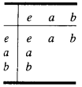
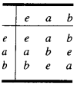
9.4(补) Groups
Nonisomorphic groups of order 3
Next, let G = {e, a, b} be a group of order 3.
We have a multiplication table (Table 3) where we must fill in four blanks.
A little experimentation shows that we can only complete the table as shown in Table 4.
Table 3
Table 4

Slide 21
9.4(补) Groups
Nonisomorphic groups of order 3
It can be shown (a tedious task) that Table 4 satisfies the associative property and the other properties of a group.
Thus it is the multiplication table of a group of order 3.
Observe that the groups of orders 1, 2, and 3 are also Abelian and that there is just one group of each order for a fixed labeling of the elements.
Table 3
Table 4

Slide 22
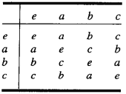
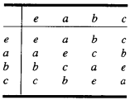
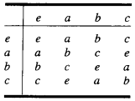
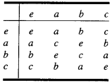
9.4(补) Groups
Groups of order 4
We next come to a group G = {e, a, b, c} of order 4. It is not difficult to show that the possible multiplication table for G can be completed as shown in Tables 5 through 8.
It can be shown that each of these tables satisfies the associative property and the other properties of a group. Thus there are four possible multiplication tables for a group of order 4.
Table 5
Table 6
Table 7
Table 8

Slide 23
9.4(补) Groups
Groups of order 4
Again, observe that a group of order 4 is Abelian.
We shall return to groups of order 4 toward the end of this section, where we shall see that there are only two and not four different nonisomorphic groups of order 4.
Table 5
Table 6
Table 7
Table 8

Slide 24

9.4(补) Groups
Example 5:
Let B= {0, 1), and let + be the operation defined on B as follows:
Then B is a group. In this group, every element is its own inverse.

Slide 25
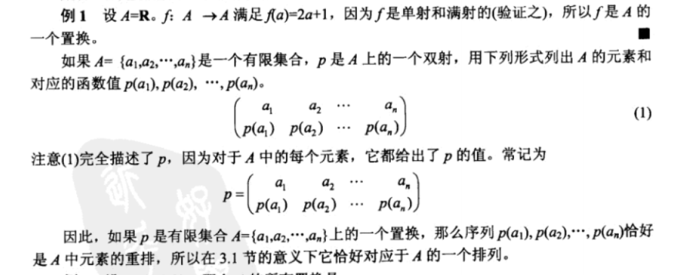
9.4(补) 置换函数
定义：集合A到他自身的一个双射称作A的一个置换。

Slide 26
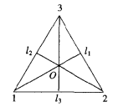
9.4(补) Groups
Example 6:
Consider the equilateral triangle shown in Figure with vertices 1, 2, and 3. A symmetry of the triangle (or of any geometrical figure) is a one-to-one correspon-dence from the set of points forming the triangle (the geometrical figure) to itself that preserves the distance between adjacent points. Since the triangle is determined by its vertices, a symmetry of the triangle is merely a permutation of the vertices that preserves the distance between adjacent points. Let l₁, l₂, and l₃ be the angle bisectors of the corresponding angles as shown in Figure, and let O be their point of intersection.

Slide 27


9.4(补) Groups
Solution:
We now describe the symmetries of this triangle. First, there is a counter-clockwise rotation f₂ of the triangle about O through 120º. Then f₂ can be written as the permutation
We next obtain a counterclockwise rotation f3 about O through 240 º, which can be written as the permutation

Slide 28


9.4(补) Groups
Finally, there is a counterclockwise rotation fi about O through 360º, which can be written as the permutation：
Of course, f1 can also be viewed as the result of rotating the triangle about O through 0°,We may also obtain three additional symmetries of the triangle, g₁, g₂, and g₃ , by reflecting about the lines l₁, l₂, and l₃, respectively. We may denote these reflections as the following permutations:

Slide 29
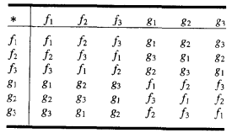
9.4(补) Groups
Observe that the set of all symmetries of the triangle is described by the set of permutations of the set {1, 2, 3}, which is considered in Section 5.3 and is denoted by S3. Thus S3 ={g₁, g₂, g₃ , f₁, f₂, f₃}.
We now introduce the operation *, followed by, on the set S₃, and we obtain the multiplication table shown in Table 9.
Table 9

Slide 30

9.4(补) Groups
Note
Each of the entries in this table can be obtained in one of two ways: algebraically or geometrically. For example, suppose that we want to compute f₂ * g₂. Geometrically, we proceed as in Figure.. Note that “followed by” here refers to the eometric order. To compute f2 * 82 algebraically, we compute f₂○g₂.
and find that f₂*g₂ = g₁.

Slide 31
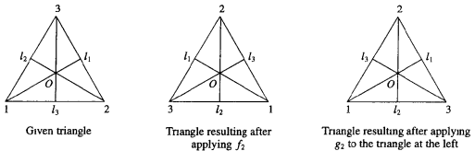
9.4(补) Groups
Note
Since composition of functions is always associative, we see that * is an associative operation on S3. Observe that f is the identity in S3 and that every element of S} has a unique inverse in S3. For example, fz⁻¹ =f3. Hence S is a group called the group of symmetries of the triangle(三角形的对称群). Observe that S3 is the first example that we have given of a group that is not Abelian.

Slide 32
9.4(补) Groups
Example 7:
The set of all permutations of n elements is a group of order n! under the operation of composition. This group is called the symmetric group on n letters(n 次对称群) and is denoted by S.
由部分置换构成的群称为置换群(permutation group)。

Slide 33
9.4(补) Groups
Example 8:
Let[a]∈ Zn. Then we may assume that 0 ≤ a ≤ n. Moreover，[n-a] ∈ Zn and since
[a] [n-a] = [a +n-a] = [n] = [0]，
we conclude that [n-a] is the inverse of [a].Thus，if n is 6，then [2] is the inverse of [4].Observe that Zn is an Abelian group.

Slide 34
9.4(补) Groups
Subgroup – 子群
Let H be a subset of a group G such that
(a) The identity e of G belongs to H.
(b) If a and b belong to H, then ab∈ H.
(c) If a ∈ H, then a⁻¹ ∈ H.4
Then H is called a subgroup of G.

Slide 35
9.4(补) Groups
Example 9:
Let G be a group.Then G and H = (e) are subgroups of G, called the trivial subgroups(平凡子群) of G.
Example 10:
Consider S₃. the group of symmetries of the equilateral triangle, whose multiplication table is shown in Table 9.9. It is easy to verify that H = {f₁,f₂,f₃} is a subgroup of S₃.

Slide 36
9.4(补) Groups
Example 11:
Let A_{n} be the set of all even permutations (see Section 5.4) in the group S_{n}. It can be shown from the definition of even permutation that A_{n} is a subgroup of S_{n,} called the alternating group on n letters(n元交错群).
补充：
A bijection from a set A to itself is called a permutation(置换) of A.
A permutation of a finite set is called even (偶置换) if it can be written as a product of an even number of transpositions.

Slide 37
9.4(补) Groups
Example 12:
Let G be a group and let a∈G. Since a group is a monoid, we have already defined, in Section 9.2, a^{n} for n∈Z⁺ as aa...a (n factors), and a⁰ as e. If n is a negative integer, we now define a^{-n} as a⁻¹,a⁻¹...a⁻¹ (n factors). Then, if n and m are any integers, we have
a^{n}a^{m} = a^{n+m}
It is easy to show that
H = {a^{i} | i∈Z}
is a subgroup of G.

Slide 38
9.4(补) Groups
Let(G,*) and (G',*') be two groups. Since groups are also semigroups, we can consider isomorphisms and homomorphisms from (G,*) to (G',*’).
Since an isomorphism must be a one-to-one and onto function, it follows that two groups whose orders are unequal cannot possibly be isomorphic

Slide 39
9.4(补) Groups
Example 13:
Let G be the group of real numbers under additon, and let G' be the group of positive real numbers under multiplication. Let f:G → G' be defined by f(x)= e^{x}. We now show that f is an isomorphism.
If f(a) = f(b), so that eª = e^{b}, then a = b.Thus f is one to one. If c∈G', then Inc∈G and
f(Inc) =e^{lnc} =c
so f is onto. Finally,
f(a+b)=e^{a+b} = eªe^{b} = f(a)f(b).
Hence f is an isomorphism

Slide 40
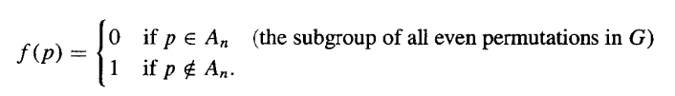
9.4(补) Groups
Example 14:
Let G be the symmetric group of n letters, and let G' be the group B defined in Example 5. Let f:G → G' be defined as follows: for p∈G,
Then f is a homomorphism.
Example 5:
Let B= {0, 1), and let + be the operation defined on B as follows:
Then B is a group. In this group, every element is its own inverse.

Slide 41
9.4(补) Groups
Example 15:
Let G be the group of integers under addition, and let G' be the group Z_{n} as discussed in Example 8. Let f:G→G' be defined as follows: If m∈G, then f(m) = [r], where r is the remainder when m is divided by n. We now show that f is a homomorphism of G onto G’.
Let [r]∈Z_{n}. Then we may assume that 0 ≤ r < n, so
r = 0·n+r
which means that the remainder when r is divided by n is r. Hence
f(r) = [r]
and thus f is onto.

Slide 42
9.4(补) Groups
Example 15:
Next, let a and b be elements of G expressed as
A = q₁n + r₁, where 0 ≤ r₁ < n, and r₁ and q₁ are integers (1)
B = q₂n + r₂, where 0 ≤ r₂ < n, and r₂ and q₂ are integers (2)
so that
f(a) = [r₁] and f(b) = [r₂].
Then
f(a) + f(b) = [r₁] + [r₂]=[r₁ + r₂]
To find [r₁ + r₂], we need the remainder when r₁ + r₂ is divided by n. Write
r₁ + r₂ = q₃n + r₃， where 0 ≤ r₃ < n,and r₃ and q₃ are integers.

Slide 43
9.4(补) Groups
Example 15:
Thus
f(a) + f(b) = [r₃]
Adding, we have
a+b = q₁n + q₂n + r₁ + r₂ = (q₁ + q₂ + q₃)n + r₃
So
f(a+b) = [r₁ + r₂] = [r₃]
Hence
f(a+b) = f(a) + f(b)
which implies that f is a homomorphism.
Note that when n is 2, f assigns each even integer to [0] and each odd integer to [1].

Slide 44
9.4(补) Groups
Theorem 5
Let(G,*) and (G',*') be two groups, and let f:G → G' be a homomorphism from G to G’.
(a)If e is the identity in G and e' is the identity in G',then f(e)=e'
(b)If a∈G, then f(a⁻¹) = (f(a))⁻¹
(c)If H is a subgroup of G,then
f(H) = { f(h) l h∈H }
is a subgroup of G'.

Slide 45
9.4(补) Groups
Proof
(a) Let x = f(e).Then
x *' x = f(e) *' f(e) = f(e*e) = f(e) = x
so x *' x = x. Multiplying both sides by x⁻¹ on the right, we obtain
x = x *' x *' x⁻¹ = x *' x⁻¹ = e'
Thus f(e) =e'

Slide 46
9.4(补) Groups
Proof
(b) a * a⁻¹ = e, so
f(a * a⁻¹)) = f(e) = e' by part(a)
or
f(a) *' f(a⁻¹) = e' since f is a homomorphism
Similarly,
f(a⁻¹) *' f(a) = e'.
Hence f(a⁻¹) = (f(a))⁻¹.

Slide 47
9.4(补) Groups
Proof
(c)This follows from Theorem 4 of Section 9.2 and parts (a) and (b).

Slide 48
9.4(补) Groups
Example 16:
The groups S₃ and Z₆ are both of order 6. However, S₃ is not Abelian and Z₆ is Abelian. Hence they are not isomorphic. Remember that an isomorphism preserves all properties defined in terms of the group operations.

Slide 49
9.4(补) Groups
Example 17:
Earlier in this section we found four possible multiplication tables (Tables 9.5 through 9.8) for a group or order 4. We now show that the groups with multipli cation Tables 9.6, 9.7, and 9.8 are isomorphic as follows. Let G = (e,a,b,c} be the group whose multiplication table is Table 9.6, and let G' = (e', a', b', c'} be the group whose multiplication table is Table 9.7, where we put primes on every entry in this last table. Let f:G → G' be defined by f(e) = e',f(a) = b’, f(b) = a'，f(c) = c'.

Slide 50
9.4(补) Groups
Example 17:
We can then verify that under this renaing of elements the two tables become identical, so the corresponding groups are isomorphic. Similarly, let G" = {e",a", b",c") be the group whose multiplication table is Table 9.8, where we put double primes on every entry in this last table. Let g:G → G" be defined by g(e) =e",g(a)=c",g(b) = b",g(c) = a". We can then verify that under this renaming of elements the two tables become identical, so the corresponding groups are isomorphic. That is, the groups given by Tables 9.6,9.7, and 9.8 are isomorphic.

Slide 51
9.4(补) Groups
Example 17:
Now,how can we be sure that Tables 9.5 and 9.6 do not yield isomorphic groups? Observe that if x is any element in the group determined by Table 9.5, then x² = e. If the groups were isomorphic, then the group determined by Table 9.6 would have the same property. Since it does not, we conclude that these groups are not isomorphic. Thus there are exactly two nonisomorphic groups of order 4.
The proup with multiplicaton Table 9.5 is called the Klein 4 group(Klein四元群) and it is denoted by V.The one with multiplication Table 9 6,9.7,or 9.8 is denoted by Z₄ since a relabeling of the elements of Z₄ results in this multiplication table.

Slide 52
9.4(补) Groups
Homework
9.4 (补)
12,16 P348
26,32 P349

Slide 53
9.5(补) Products and Quotients of Groups
In this section, we shall obtain new groups from other groups by using the ideas of product（积） and quotient（商）. Since a group has more structure than a semigroup,our results will be deeper than analogous results for semigroups as discussed in Section9.3.

Slide 54
9.5(补) Products and Quotients of Groups
Theorem 1
If G₁ and G₂ are groups, then G = G₁ x G₂ is a group with binary operation defined by
(a₁, b₁)(a₂, b₂) = (a₁a₂, b₁b₂)

Slide 55
9.5(补) Products and Quotients of Groups
Proof
By Theorem 1, Section 9.3, we have that G is a semigroup. The existence of an identity and inverses is easy to verify.

Slide 56
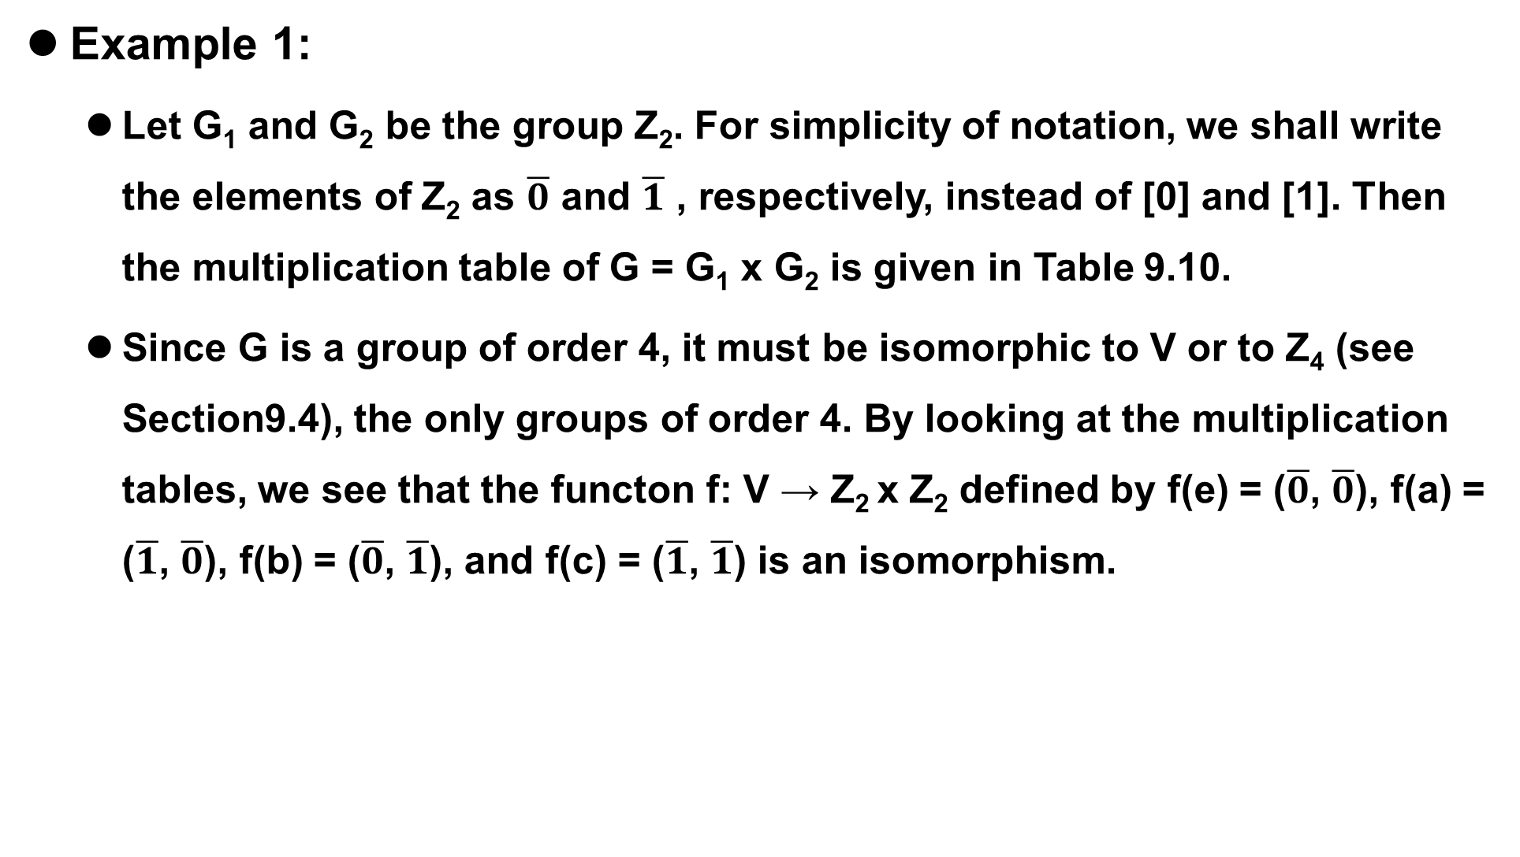
9.5(补) Products and Quotients of Groups
Example 1:
Let G₁ and G₂ be the group Z₂. For simplicity of notation, we shall write the elements of Z₂ as $\overline{0}$ and $\overline{1}$ , respectively, instead of [0] and [1]. Then the multiplication table of G = G₁ x G₂ is given in Table 9.10.
Since G is a group of order 4, it must be isomorphic to V or to Z₄ (see Section9.4), the only groups of order 4. By looking at the multiplication tables, we see that the functon f: V → Z₂ x Z₂ defined by f(e) = ($\overline{0}$, $\overline{0}$), f(a) = ($\overline{1}$, $\overline{0}$), f(b) = ($\overline{0}$, $\overline{1}$), and f(c) = ($\overline{1}$, $\overline{1}$) is an isomorphism.

Slide 57
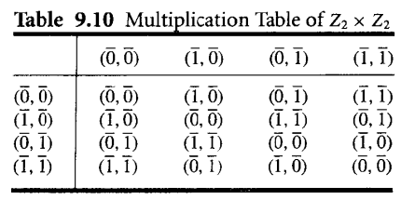
9.5(补) Products and Quotients of Groups
Example 1:

Slide 58
9.5(补) Products and Quotients of Groups
If we repeat Example 1 with Z₂ and Z₃ we find that Z₂ x Z₃ ⋍ Z_{6.} It can be shown, in general, that Z_{m} x Z_{n} ⋍ Z_{mn} if and only if GCD(m,n) = 1, that is, if and only if m and n are relatively prime.
Theorem 1 can obviously be extended to show that if G₁, G₂ ..., G_{n} are groups, then G = G₁ x G₂ x ... G_{n} is also a group.

Slide 59
9.5(补) Products and Quotients of Groups
Example 2:
Let B = {0, 1} be the group defined in Example 5 of Section 9.4, where + is defined as follows:
Then B^{n} = B x B x ... x B (n factors) is a group with operation ⊕ defined by
(x₁, x₂, ..., x_{n}) ⊕ (y₁, y₂, ..., y_{n}) = (x₁ + y_{1,} x₂ + y₂, ..., x_{n} + y_{n})
The identity of B^{n} is (0,0,....0), and every element is its own inverse. This group is essentially the same as the Boolean algebra Bn, defined in Section 6.4, but the binary operation is very different from ⋀ and ⋁.

Slide 60
9.5(补) Products and Quotients of Groups
A congruence relation on a group is simply a congruence relation on the group when it is viewed as a semigroup. We now discuss quotient structures determined by a congruence relation on a group.

Slide 61

9.5(补) Products and Quotients of Groups
Theorem 2
Let R be a congruence relation on the group (G,*). Then the semigroup (G/R, ) is a group, where the operation
is defined on G/R by
[a] [b] = [a*b] (see Section 9.3).

Slide 62
9.5(补) Products and Quotients of Groups
Proof
Since a group is a monoid, we know from Corollary 1 of Section 9.3 that G/R is a monoid. We need to show that each element of G/R has an inverse.Let [a]∈G/R.
Then[a⁻¹]∈G/R, and
[a]o[a⁻¹]=[a* a⁻¹]=[e].
So [a]⁻¹ = [a⁻¹]. Hence (G/R, ) is a group.

Slide 63
9.5(补) Products and Quotients of Groups
Since the definitions of homomorphism, isomorphism, and congruence for groups involve only the semigroup and monoid structure of groups, the following corollary is an immediate consequence of Theorems 3 and 4 of Section 9.3.

Slide 64
9.5(补) Products and Quotients of Groups
Corollary 1
(a) If R is a congruence relation on a group G, then the function f_{R}:G → G/R, given by f_{R}(a) = [a], is a group homomorphism
(b) If f:G→ G' is a homomorphism from the group (G,*) onto the group(G', *’), and R is the relation defined on G by a R b if and only if f(a) = f(b) for a and b in G, then

Slide 65

9.5(补) Products and Quotients of Groups
Corollary 1
1. R is a congruence relation.
2. The function $\overline{f}$:G/R → G’, given by $\overline{f}$([a]) = f(a), is an isomorphism from the group (G/R, ) onto the group (G’, *').

Slide 66
9.5(补) Products and Quotients of Groups
Congruence relations on groups have a very special form, which we will now develop.Let H be a subgroup of a group G, and let a∈G. The left coset(左陪集) of H in G determined by a is the set aH = {ah | h∈H). The right coset(右陪集) of H in G determined by a is the set Ha = (ha | h∈ H). Finally, we will say that a subgroup H of G is normal if aH = Ha for all a m G.
normal subgroup(正规子群)

Slide 67
9.5(补) Products and Quotients of Groups
Warning: If Ha = aH, it does not follow that, for h∈H and a∈G ha = ah. It does follows that ha = ah', where h' is some element in H.

Slide 68
9.5(补) Products and Quotients of Groups
If H is a subgroup of G, we shall need in some apphcations to compute all the left cosets of H in G. First, suppose that a∈H. Then aH ⊆ H, since H is a subgroup of G; moreover, if h∈H, then h = ah‘, where h’ = a⁻¹h∈H, so that H ⊆ aH. Thus, if a∈H, then aH = H. This means that, when finding all the cosets of H, we need not compute aH for a∈H, since it will always be H.

Slide 69

9.5(补) Products and Quotients of Groups
Example 3:
Let G be the symmetric group S₃ discussed in Example 6 of Section 9.4. The subsct H = [f₁, g₂] is a subgroup of G. Compute all the distinct left cosets of H in G.
Solution:
If a∈H, then aH = H. Thus
f₁H = g₂H = H

Slide 70
9.5(补) Products and Quotients of Groups
Solution:
Also,
f₂H = {f_{2,} g₁}
f₃H = {f_{3,} g₃}
g₁H = {g_{1,} f₂} = f₂H
g₃H = {g_{3,} f₃} = f₃H
The distinct left cosets of H in G are H, f₂H, and f₃H

Slide 71
9.5(补) Products and Quotients of Groups
Example 4:
Let G and H be as in Example 3 Then the right coset Hf₂ = {f_{2,} g₃}. In Example 3 we saw that f₂H = {f_{2,} g₁}. It follows that H is not a normal subgroup of G.
Example 5:
Show that if G is an Abelian group, then every subgroup of G is a normal subgroup.
Solution:
Let H be a subgroup of G and let a∈G and h∈H. Then ha = ah, so Ha = aH, which implies that H is a normal subgroup of G.

Slide 72
9.5(补) Products and Quotients of Groups
Theorem 3
Let R be a congruence relation on a group G, and let H = [e], the equivalence class containing the identity. Then H is a normal subgroup of G and, for each a∈G, [a] = aH = Ha.

Slide 73
9.5(补) Products and Quotients of Groups
Proof
Let a and b be any elements in G. Since R is an equivalence relation, b∈[a] if and only if [b] = [a]. Also, G/R is a group by Theorem 2. Therefore, [b] = [a] if and only if [e] = [a]⁻¹[b] = [a⁻¹b]. Thus b∈[a] if and only if H = [e] = [a⁻¹b]. That is, b∈[a] if and only if a⁻¹b∈H or b∈ aH. This proves that [a] = aH for every a∈G. We can show similarly that b∈[a] if and only if H =[e] = [b][a]⁻¹ = [ba⁻¹]. This is equivalent to the statement [a] = Ha. Thus [a] = aH = Ha, and H is normal.

Slide 74
9.5(补) Products and Quotients of Groups
Combining Theorem 3 with Corollary 1, we see that in this case the quotient group G/R consists of all the left cosets of N = [e]. The operation in G/R is given by
(aN)(bN) = [a] [b] = [ab] = abN
and the function f_{R}:G → G/R, defined by f_{R}(a) = aN, is a homomorphism from G onto G/R. For this reason, we will often write G/R as G/N.

Slide 75
9.5(补) Products and Quotients of Groups
We next consider the question of whether every normal subgroup of a group G is the equivalence class of the identity of G for some congruence relation.

Slide 76
9.5(补) Products and Quotients of Groups
Theorem 4
Let N be a normal subgroup of a group G, and let R be the following relation on G:
a R b if and only if a⁻¹b∈N
Then
(a) R is a congruence relation on G
(b) N is the equivalence class [e] relative to R, where e is the identity of G.

Slide 77
9.5(补) Products and Quotients of Groups
Proof
(a) Let a∈G. Then a R a, since a⁻¹a = e∈N, so R is reflexive. Next suppose that a R b, so that a⁻¹b∈N. Then (a⁻¹b) ⁻¹ = b⁻¹a∈N, so b R a. Hence R is symmetric. Finally, suppose that a R b and b R c Then a⁻¹b∈N and b⁻¹c∈N. Then(a⁻¹b)(b⁻¹c) = a⁻¹c∈N, so a R c. Hence R is transitive. Thus R is an equivalence relation on G.

Slide 78
9.5(补) Products and Quotients of Groups
Proof
Next we show that R is a congruence rclation on G. Suppose that a R b and c R d. Then a⁻¹b∈N and c⁻¹d∈N. Since N is normal, Nd = dN; that is, for any n₁∈N, n₁d = dn₂ for some n₂∈N. In particular,since a⁻¹b∈N, we have a⁻¹bd = dn₂ for some n₂∈N. Then (ac)⁻¹bd = (c⁻¹a⁻¹)(bd) = c⁻¹ (a⁻¹b)d = (c⁻¹d)n₂∈N, so ac R bd. Hence R is a congruence relation on G.

Slide 79
9.5(补) Products and Quotients of Groups
Proof
(b)Suppose that x∈N. Then x⁻¹e = x⁻¹∈N since N is a subgroup, so x R e and therefore x∈[e]. Thus N⊆[e]. Conversely, if x∈[e], then x R e, so x⁻¹e = x⁻¹∈N. Then x∈N and [e]⊆N. Hence N = [e].

Slide 80
9.5(补) Products and Quotients of Groups
We see, thanks to Theorems 3 and 4, that if G is any group, then the equivalence classes with respect to a congruence relation on G are always the cosets of ome normal subgroup of G. Conversely, the cosets of any normal subgroup of G are just the equivalence classes with respect to some congruence relation on G. We may now, therefore,translate Corollary 1(b) as follows:

Slide 81
9.5(补) Products and Quotients of Groups
Let f be a homomorphism from a group(G,*) onto a group (G‘, *’), and let the kernel(核) of f, ker(f), be defined by
ker(f) = {a∈G | f(a) = e'}
Then
(a) ker(f) is a normal subgroup of G.
(b) The quotient group G/ker(f) is isomorphic to G'.

Slide 82
9.5(补) Products and Quotients of Groups
This follows from Corollary 1 and Theorem 3, since if R is the congruence relation on G given by
a R b if and only if f(a) = f(b),
then it is easy to show that ker(f) = [e].

Slide 83
9.5(补) Products and Quotients of Groups
Example 6:
Consider the homomorphism f from Z onto Z_{n} defined by
f(m) = [r]
where r is the remainder when m is divided by n. (See Example 15 of Section 9.4.) Find ker(f).
Solution:
An integer m in Z belongs to ker(f) if and only if f(m) = [0], that is, if and only if m is a multiple of n.Hence ker(f) = nZ.

Slide 84
9.5(补) Products and Quotients of Groups
Homework
9.5(补)
4 P353
18,30 P354

Slide 85
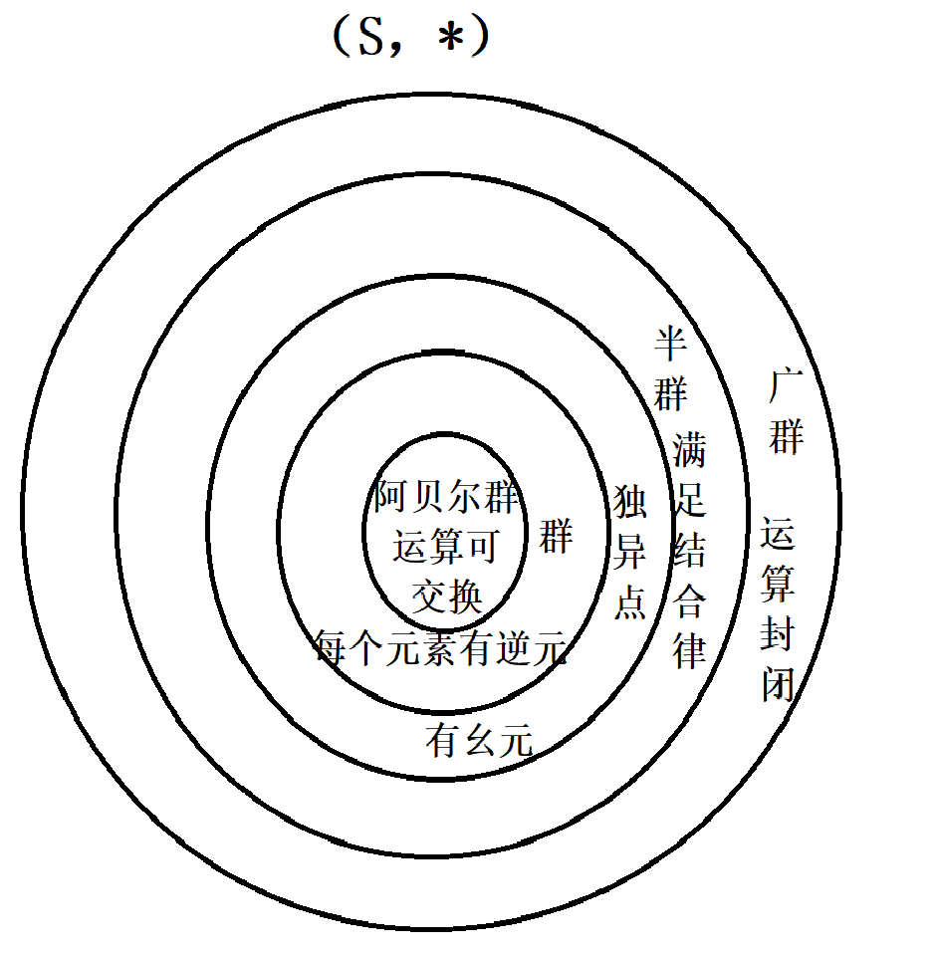

Slide 86
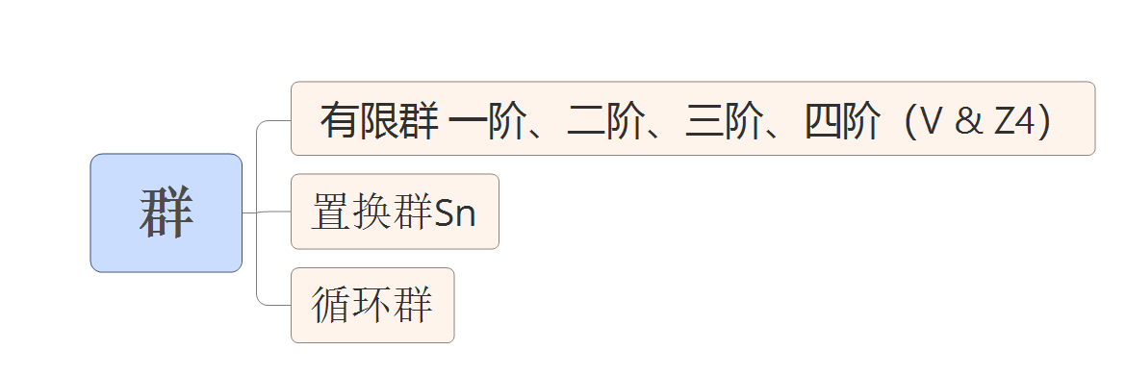
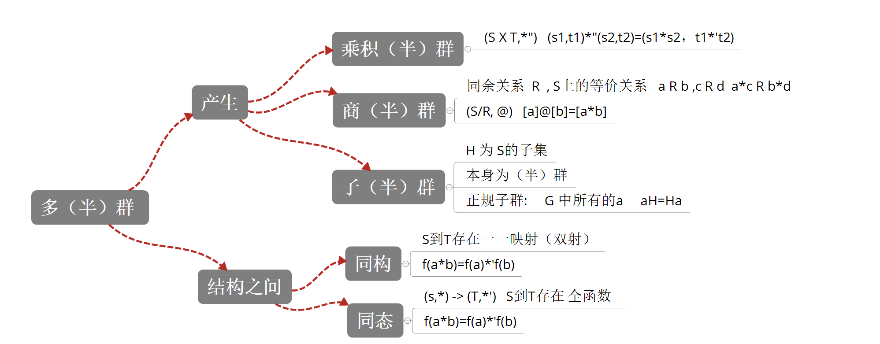

Slide 87
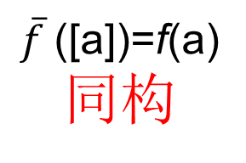
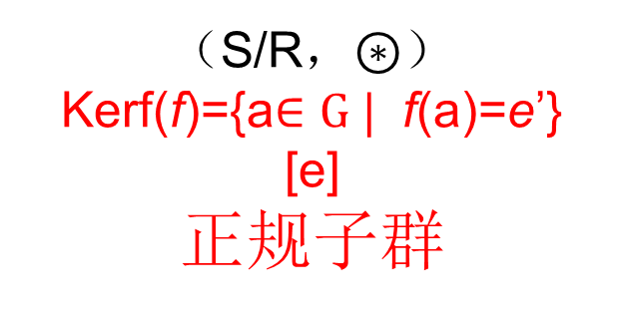
同态基本定理
满同态函数 f
（S，*）
（T，*’）
a R b if and only if f(a)=f(b)
同余关系
f_{R}(a)=[a]
自然同态

Slide 88
9.4（补） – 9.5（补）
单词表
group（群）
inverse（逆）
abelian（阿贝尔）
left/right cancellation property（左/右 消去律）
multiplication table（乘法表）
finite group（有限群）
order（阶）
nonisomorphic groups（非同构群）
group of symmetries of the triangle（三角形的对称群）
symmetric group on n letters（n次对称群）

Slide 89
9.4（补） – 9.5（补）
单词表
permutation group（置换群）
subgroup（子群）
trivial subgroups（平凡子群）
alternating group on n letters（n元交错群）
even（偶置换）
Klein 4 group（Klein四元群）
left/right coset（左/右 陪集）
normal subgroup（正规子群）
kernel（核）

