Slide 1
离散数据及其应用 Discrete Mathematics and Its Applications （Eighth Edition/Kenneth H.Rosen） 郭少勇 (syguo@bupt.edu.cn) 北京邮电大学 2021.10
Notes:
1

Slide 2
Semigroup and Groups
9.5 (补) 乘积群与商群/Products and Quotients of Groups
11.1 (补) 群与编码/Groups and Coding

Slide 3
9.5(补) Products and Quotients of Groups
In this section, we shall obtain new groups from other groups by using the ideas of product and quotient. Since a group has more structure than a semigroup,our results will be deeper than analogous results for semigroups as discussed in Section9.3.

Slide 4
9.5(补) Products and Quotients of Groups
Theorem 1
If G₁ and G₂ are groups, then G = G₁ x G₂ is a group with binary operation defined by
(a₁, b₁)(a₂, b₂) = (a₁a₂, b₁b₂)

Slide 5
9.5(补) Products and Quotients of Groups
Proof
By Theorem 1, Section 9.3, we have that G is a semigroup. The existence of an identity and inverses is easy to verify.

Slide 6
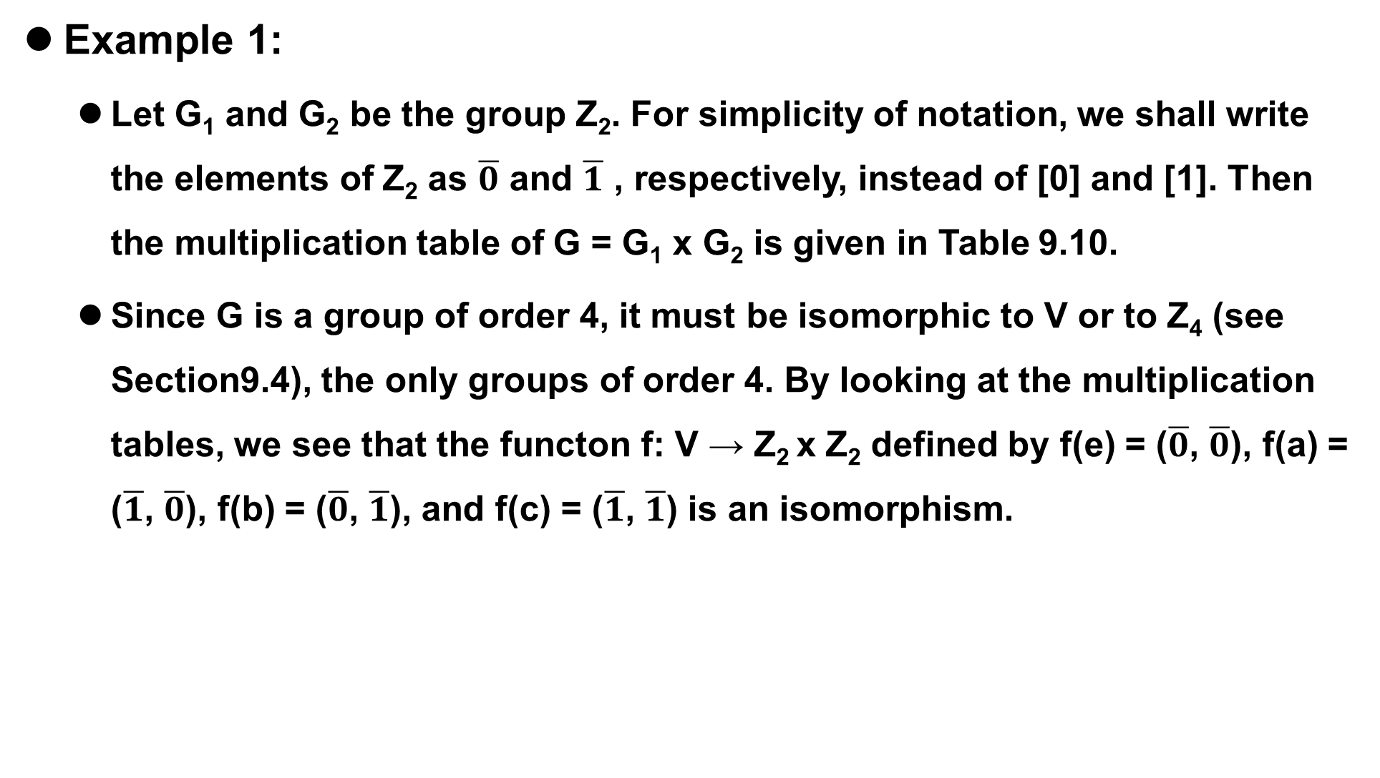
9.5(补) Products and Quotients of Groups
Example 1:
Let G₁ and G₂ be the group Z₂. For simplicity of notation, we shall write the elements of Z₂ as $\overline{0}$ and $\overline{1}$ , respectively, instead of [0] and [1]. Then the multiplication table of G = G₁ x G₂ is given in Table 9.10.
Since G is a group of order 4, it must be isomorphic to V or to Z₄ (see Section9.4), the only groups of order 4. By looking at the multiplication tables, we see that the functon f: V → Z₂ x Z₂ defined by f(e) = ($\overline{0}$, $\overline{0}$), f(a) = ($\overline{1}$, $\overline{0}$), f(b) = ($\overline{0}$, $\overline{1}$), and f(c) = ($\overline{1}$, $\overline{1}$) is an isomorphism.

Slide 7
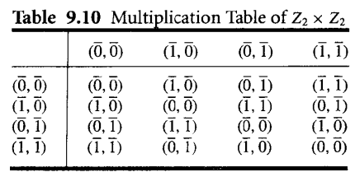
9.5(补) Products and Quotients of Groups
Example 1:

Slide 8
9.5(补) Products and Quotients of Groups
If we repeat Example 1 with Z₂ and Z₃ we find that Z₂ x Z₃ ⋍ Z_{6.} It can be shown, in general, that Z_{m} x Z_{n} ⋍ Z_{mn} if and only if GCD(m,n) = 1, that is, if and only if m and n are relatively prime.
Theorem 1 can obviously be extended to show that if G₁, G₂ ..., G_{n} are groups, then G = G₁ x G₂ x ... G_{n} is also a group.

Slide 9
9.5(补) Products and Quotients of Groups
Example 2:
Let B = {0, 1} be the group defined in Example 5 of Section 9.4, where + is defined as follows:
Then B^{n} = B x B x ... x B (n factors) is a group with operation ⊕ defined by
(x₁, x₂, ..., x_{n}) ⊕ (y₁, y₂, ..., y_{n}) = (x₁ + y_{1,} x₂ + y₂, ..., x_{n} + y_{n})
The identity of B^{n} is (0,0,....0), and every element is its own inverse. This group is essentially the same as the Boolean algebra Bn, defined in Section 6.4, but the binary operation is very different from ⋀ and ⋁.

Slide 10
9.5(补) Products and Quotients of Groups
A congruence relation on a group is simply a congruence relation on the group when it is viewed as a semigroup. We now discuss quotient structures determined by a congruence relation on a group.

Slide 11
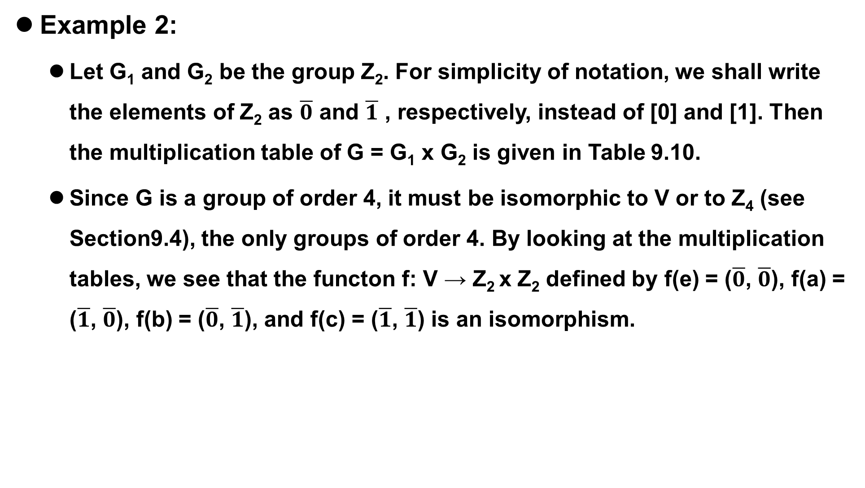
9.5(补) Products and Quotients of Groups
Example 2:
Let G₁ and G₂ be the group Z₂. For simplicity of notation, we shall write the elements of Z₂ as $\overline{0}$ and $\overline{1}$ , respectively, instead of [0] and [1]. Then the multiplication table of G = G₁ x G₂ is given in Table 9.10.
Since G is a group of order 4, it must be isomorphic to V or to Z₄ (see Section9.4), the only groups of order 4. By looking at the multiplication tables, we see that the functon f: V → Z₂ x Z₂ defined by f(e) = ($\overline{0}$, $\overline{0}$), f(a) = ($\overline{1}$, $\overline{0}$), f(b) = ($\overline{0}$, $\overline{1}$), and f(c) = ($\overline{1}$, $\overline{1}$) is an isomorphism.

Slide 12

9.5(补) Products and Quotients of Groups
Theorem 2
Let R be a congruence relation on the group (G,*). Then the semigroup (G/R, ) is a group, where the operation
is defined on G/R by
[a] [b] = [a*b] (see Section 9.3).

Slide 13
9.5(补) Products and Quotients of Groups
Proof
Since a group is a monoid, we know from Corollary 1 of Section 9.3 that G/R is a monoid. We need to show that each element of G/R has an inverse.Let [a]∈G/R.
Then[a⁻¹]∈G/R, and
[a]o[a-i]=[a*a-/]=[e].
So [a]⁻¹ = [a⁻¹]. Hence (G/R, ) is a group.

Slide 14
9.5(补) Products and Quotients of Groups
Since the definitions of homomorphism, isomorphism, and congruence for groups involve only the semigroup and monoid structure of groups, the following corollary is an immediate consequence of Theorems 3 and 4 of Section 9.3.

Slide 15
9.5(补) Products and Quotients of Groups
Corollary 1
(a) If R is a congruence relation on a group G, then the function f_{R}:G → G/R, given by f_{R}(a) = [a], is a group homomorphism
(b) If f:G→ G' is a homomorphism from the group (G,*) onto the group(G', *’), and R is the relation defined on G by a R b if and only if f(a) = f(b) for a and b in G, then

Slide 16

9.5(补) Products and Quotients of Groups
Corollary 1
1. R is a congruence relation.
2. The function $\overline{f}$:G/R → G’, given by $\overline{f}$([a]) = f(a), is an isomorphism from the group (G/R, ) onto the group (G’, *').

Slide 17
9.5(补) Products and Quotients of Groups
Congruence relations on groups have a very special form, which we will now develop.Let H be a subgroup of a group G, and let a∈G. The left coset(左陪集) of H in G determined by a is the set aH = {ah | h∈H). The right coset(右陪集) of H in G determined by a is the set Ha = (ha | h∈ H). Finally, we will say that a subgroup H of G is normal if aH = Ha for all a m G.
normal subgroup(正规子群)

Slide 18
9.5(补) Products and Quotients of Groups
Warning: If Ha = aH, it does not follow that, for h∈H and a∈G ha = ah. It does follows that ha = ah', where h' is some element in H.

Slide 19
9.5(补) Products and Quotients of Groups
If H is a subgroup of G, we shall need in some apphcations to compute all the left cosets of H in G. First, suppose that a∈H. Then aH ⊆ H, since H is a subgroup of G; moreover, if h∈H, then h = ah‘, where h’ = a⁻¹h∈H, so that H ⊆ aH. Thus, if a∈H, then aH = H. This means that, when finding all the cosets of H, we need not compute aH for a∈H, since it will always be H.

Slide 20
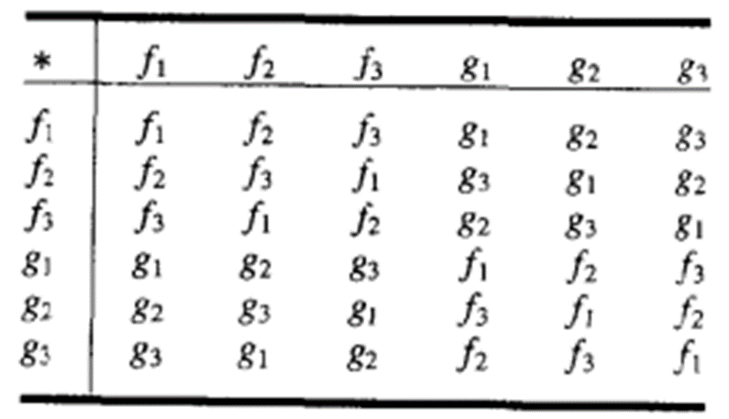
9.5(补) Products and Quotients of Groups
Example 3:
Let G be the symmetric group S₃ discussed in Example 6 of Section 9.4. The subsct H = [f₁, g₂] is a subgroup of G. Compute all the distinct left cosets of H in G.
Solution:
If a∈H, then aH = H. Thus
f₁H = g₂H = H

Slide 21
9.5(补) Products and Quotients of Groups
Solution:
Also,
f₂H = {f_{2,} g₁}
f₃H = {f_{3,} g₃}
g₁H = {g_{1,} f₂} = f₂H
g₃H = {g_{3,} f₃} = f₃H
The distinct left cosets of H in G are H, f₂H, and f₃H

Slide 22
9.5(补) Products and Quotients of Groups
Example 4:
Let G and H be as in Example 3 Then the right coset Hf₂ = {f_{2,} g₃}. In Example 3 we saw that f₂H = {f_{2,} g₁}. It follows that H is not a normal subgroup of G.
Example 5:
Show that if G is an Abelian group, then every subgroup of G is a normal subgroup.
Solution:
Let H be a subgroup of G and let a∈G and h∈H. Then ha = ah, so Ha = aH, which implies that H is a normal subgroup of G.

Slide 23
9.5(补) Products and Quotients of Groups
Theorem 3
Let R be a congruence relation on a group G, and let H = [e], the equivalence class containing the identity. Then H is a normal subgroup of G and, for each a∈G, [a] = aH = Ha.

Slide 24
9.5(补) Products and Quotients of Groups
Proof
Let a and b be any elements in G. Since R is an equivalence relation, b∈[a] if and only if [b] = [a]. Also, G/R is a group by Theorem 2. Therefore, [b] = [a] if and only if [e] = [a]⁻¹[b] = [a⁻¹b]. Thus b∈[a] if and only if H = [e] = [a⁻¹b]. That is, b∈[a] if and only if a⁻¹b∈H or b∈ aH. This proves that [a] = aH for every a∈G. We can show similarly that b∈[a] if and only if H =[e] = [b][a]⁻¹ = [ba⁻¹]. This is equivalent to the statement [a] = Ha. Thus [a] = aH = Ha, and H is normal.

Slide 25
9.5(补) Products and Quotients of Groups
Combining Theorem 3 with Corollary 1, we see that in this case the quotient group G/R consists of all the left cosets of N = [e]. The operation in G/R is given by
(aN)(bN) = [a] [b] = [ab] = abN
and the function f_{R}:G → G/R, defined by f_{R}(a) = aN, is a homomorphism from G onto G/R. For this reason, we will often write G/R as G/N.

Slide 26
9.5(补) Products and Quotients of Groups
We next consider the question of whether every normal subgroup of a group G is the equivalence class of the identity of G for some congruence relation.

Slide 27
9.5(补) Products and Quotients of Groups
Theorem 4
Let N be a normal subgroup of a group G, and let R be the following relation on G:
a R b if and only if a⁻¹b∈N
Then
(a) R is a congruence relation on G
(b) N is the equivalence class [e] relative to R, where e is the identity of G.

Slide 28
9.5(补) Products and Quotients of Groups
Proof
(a) Let a∈G. Then a R a, since a⁻¹a = e∈N, so R is reflexive. Next suppose that a R b, so that a⁻¹b∈N. Then (a⁻¹b) ⁻¹ = b⁻¹a∈N, so b R a. Hence R is symmetric. Finally, suppose that a R b and b R c Then a⁻¹b∈N and b⁻¹c∈N. Then(a⁻¹b)(b⁻¹c) = a⁻¹c∈N, so a R c. Hence R is transitive. Thus R is an equivalence relation on G.

Slide 29
9.5(补) Products and Quotients of Groups
Proof
Next we show that R is a congruence rclation on G. Suppose that a R b and c R d. Then a⁻¹b∈N and c⁻¹d∈N. Since N is normal, Nd = dN; that is, for any n₁∈N, n₁d = dn₂ for some n₂∈N. In particular,since a⁻¹b∈N, we have a⁻¹bd = dn₂ for some n₂∈N. Then (ac)⁻¹bd = (c⁻¹a⁻¹)(bd) = c⁻¹ (a⁻¹b)d = (c⁻¹d)n₂∈N, so ac R bd. Hence R is a congruence relation on G.

Slide 30
9.5(补) Products and Quotients of Groups
Proof
(b)Suppose that x∈N. Then x⁻¹e = x⁻¹∈N since N is a subgroup, so x R e and therefore x∈[e]. Thus N⊆[e]. Conversely, if x∈[e], then x R e, so x⁻¹e = x⁻¹∈N. Then x∈N and [e]⊆N. Hence N = [e].

Slide 31
9.5(补) Products and Quotients of Groups
We see, thanks to Theorems 3 and 4, that if G is any group, then the equivalence classes with respect to a congruence relation on G are always the cosets of ome normal subgroup of G. Conversely, the cosets of any normal subgroup of G are just the equivalence classes with respect to some congruence relation on G. We may now, therefore,translate Corollary 1(b) as follows:

Slide 32
9.5(补) Products and Quotients of Groups
Let f be a homomorphism from a group(G,*) onto a group (G‘, *’), and let the kernel(核) of f, ker(f), be defined by
ker(f) = {a∈G | f(a) = e'}
Then
(a) ker(f) is a normal subgroup of G.
(b) The quotient group G/ker(f) is isomorphic to G'.

Slide 33
9.5(补) Products and Quotients of Groups
This follows from Corollary 1 and Theorem 3, since if R is the congruence relation on G given by
a R b if and only if f(a) = f(b),
then it is easy to show that ker(f) = [e].

Slide 34
9.5(补) Products and Quotients of Groups
Example 6:
Consider the homomorphism f from Z onto Z_{n} defined by
f(m) = [r]
where r is the remainder when m is divided by n. (See Example 15 of Section 9.4.) Find ker(f).
Solution:
An integer m in Z belongs to ker(f) if and only if f(m) = [0], that is, if and only if m is a multiple of n.Hence ker(f) = nZ.

Slide 35
9.5(补) Products and Quotients of Groups
Homework
9.5(补)
4 P353
18,30 P354

Slide 36
11.1(补) Groups and Coding
Coding theory
In today’s modern world of communication, data items are constantly being transmitted from point to point. The basic problem in transmission of data is that of receiving the data as sent and not receiving a distorted piece of data.
Coding theory has developed techniques for introducing redundant information(引入冗余信息) in transmitted data that help in detecting, and sometimes in correcting, errors.

Slide 37
11.1(补) Groups and Coding
Unit of information
The basic unit of information, called a message(消息), is a finite sequence of characters from a finite alphabet. We shall choose as our alphabet the set B = {0, 1}. Every character or symbol that we want to transmit is now represented as a sequence of melements from B. That is, every character or symbol is represented in binary form.
Our basic unit of information, called a word(字), is a sequence of m O's and 1's.

Slide 38
11.1(补) Groups and Coding
Groups
The set B is a group under the binary operation + (mod 2 addition )
It follows that B^{m} = B×B × … × B (n factors) is a group under the operator ⊕ defined by
(x₁, x₂,…, x_{m}) ⊕ (y₁, y₂ ,…, y_{m})
= (x₁ + y₁, x₂ + y₂ , …, x_{m} + y_{m})
An element in Bm will be written as (b₁,b₂,..., b_{m}) or more simply as b₁b₂...b_{m}

Slide 39

11.1(补) Groups and Coding
Transmission channel and Noise - 传输通道和噪音
An element x ∈ B^{m} is sent through the transmission channel and is received as an element x_{t} ∈ B^{m}.
Noise(噪声) in the transmission channel may cause a 0 to be received as a l, or vice versa, lead x ≠ x_{t}

Slide 40
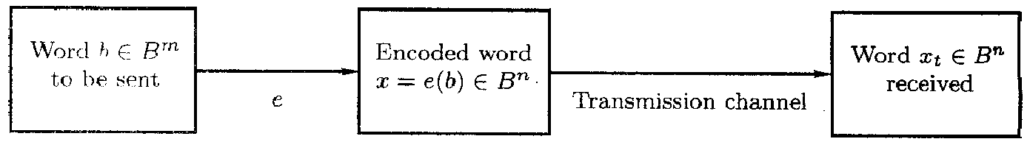
11.1(补) Groups and Coding
Encoding function - 编码函数
Choose: an integer n>m and a one-to-one function e:
B^{m} → B^{n}
e is called an (m, n) encoding function, representing every word in B^{m} as a word in B^{n}.
If b ∈ B^{m}, then e(b) is called the code word(码字) representing b.

Slide 41
11.1(补) Groups and Coding
Encoding function - 编码函数
If the transmission channel is noiseless, then x_{t} = x for all x in B^{n}.
In this case x = e(b) is received for each b ∈ B^{m}, and since e is a known function, b may be identified.

Slide 42
11.1(补) Groups and Coding
Encoding function - 编码函数
In general, errors in transmission do occur.
We will say that the code word x = e(b) has been transmitted with k or fewer errors(k 或更少的错误) if x and x_{t} differ in at least 1 but no more than k positions.

Slide 43
11.1(补) Groups and Coding
Error detect - 差错检测
Let e: B^{m} → B^{n} be an (m, n) encoding function.
e detects k or fewer errors(检测 k 或更少的错误) if whenever x = e(b) is transmitted with k or fewer errors, then x_{t} is not a code word (thus x_{t} could not be x and therefore could not have been correctly transmitted).
For b ∈ B^{n}, the number of l‘s in x is called the weight(权) of x and is denoted by |x|.

Slide 44
11.1(补) Groups and Coding
Example 1:
Find the weight of each of the following words in B5.
1.x=01000; 2.x=11100; 3.x=00000; 4. x=11111
Solution:
1. |x|=1; 2. |x|=3; 3.|x|=0; 4.|x|=5

Slide 45
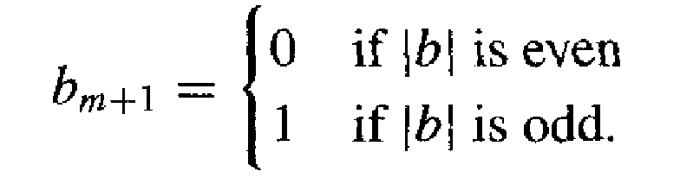
11.1(补) Groups and Coding
parity check code - 奇偶校验码
Example 2:
The following encoding function e: B^{m} → B^{m+1} is called the parity (m, m+1) check code: If b = b₁b₂…b_{m} ∈ B^{m}, define
e(b) = b₁b₂…b_{m} b_{m+1}
where

Slide 46
11.1(补) Groups and Coding
Solution:
For a concrete illustration of this encoding function, Let m = 3. Then
e(000) = 0000
e(001) = 0011
e(010) = 0101
e(011) = 0110
e(100) = 1001
e(101) = 1010
e(110) = 1100
e(111) = 1111
Suppose now that b = 111. Then x = e(b) = 1111, If the transmission channel transmits x as x, =1101, then |xi =3, and we know that an odd number of errors (at least one) has occurred.

Slide 47
11.1(补) Groups and Coding
Example 3:
Consider the (m, 3m) encoding function e: B^{m} → B^{3m}.
If b = b₁b₂…b_{m} ∈ B^{m}, define
e(b) = b₁b₂…b_{m}b₁b₂…b_{m}b₁b₂…b_{m}

Slide 48
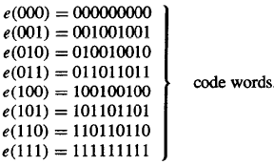
11.1(补) Groups and Coding
Solution:
That is, the encoding function e repeats each word of B"three times. For a concrete example, let m =3. Then
Suppose now that b = 011,Then e(011) = 011011011.
Assume now we receive the word 011111011. This is not a code word, so we have detected the error.

Slide 49
11.1(补) Groups and Coding
Hamming distance - 海明距离
Let x and y be words in B^{m}. The Hamming distance δ(x, y) between x and y is the weight, |x ⊕ y|, of x ⊕ y.
The distance between x = x₁x₂…x_{m} and y = y₁y₂…y_{m} is the number of various of i such that x_{i} ≠ y_{i}, that is, the number of positions in which x and y differ.
Using the weight of x ⊕ y is a convenient way to count the number of different positions.

Slide 50
11.1(补) Groups and Coding
Example 4:
Find the distance between x and y:
(a) x = 110110, y = 000101
(b) x = 001100, y = 010110.
Solution:
(a) x ⊕ y = 110011, so | x ⊕ y | = 4
(b) x ⊕ y = 011010, so | x ⊕ y | = 3

Slide 51
11.1(补) Groups and Coding
Theorem 1
Let x, y, and z be elements of B^{m}. Then
(a) δ(x, y) = δ(y, x)
(b) δ(x, y)≥0
(c) δ(x, y) = 0 if and only if x = y
(d) δ(x, y) ≤ δ(x, z) + δ(z, y)
Proof of (d)
δ(x, y) = | x ⊕ y | = | x ⊕ 0 ⊕ y |
= | x ⊕ z ⊕ z ⊕ y | ≤ | x ⊕ z |+| z ⊕ y | = δ(x, z) + δ(z, y)

Slide 52
11.1(补) Groups and Coding
Minimum distance - 最小距离
The minimum distance of an encoding function e:
B^{m} → B^{n} is the minimum of the distances between all distinct pairs of code words; that is,
min{δ(e(x), e(y)) | x, y ∈ B^{m}}

Slide 53

11.1(补) Groups and Coding
Example 5:
Consider the following (2, 5) encoding function e:
Solution:
The minimum distance is 2, as can be checked by computing the minimum of the distances between all six distinct pairs of code words.

Slide 54
11.1(补) Groups and Coding
Theorem 2
An (m, n) encoding function e: B^{m} → B^{n} can detect k or fewer errors if and only if its minimum distance is at least k + 1.

Slide 55
11.1(补) Groups and Coding
Proof
⇐ the minimum distance is at least k + 1
Let b ∈ B^{m} , and let x = e(b) ∈ B^{n} be the code word representing b.
x is transmitted and is received as x_{t} If x_{t} were a code word different from x, then δ(x, x_{t}) ≥ k+1, so x would be transmitted with k + l or more errors. Thus, if x is transmitted with k or fewer errors, then x_{t} cannot be a code word. This means that e can detect k or fewer errors.

Slide 56
11.1(补) Groups and Coding
Proof
e can detect k or fewer errors ⇒
Suppose that the minimum distance between code words is r ≤ k
Let x and y be code words with δ (x, y) = r.
If x = y, that is, if x is transmitted and is mistakenly received as y, then r ≤ k errors have been committed and have not been detected.
Thus it contradict with e can detect k or fewer errors.

Slide 57
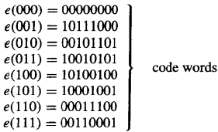
11.1(补) Groups and Coding
Example 6:
Consider the (3, 8) encoding function e: B³ → B⁸ defined by
How many errors will e detect?

Slide 58
11.1(补) Groups and Coding
Solution:
The minimum distance of e is 3, as can be checked by computing the minimum of the distances between all 28 distinct pairs of code words. By Theorem 2, the code will detect k or fewer errors if and only if its minimum distance is at least k + 1. Since the minimum distance is 3, we have 3 ≥ k+1or k < 2. Thus the code will detect two or fewer errors.

Slide 59
11.1(补) Groups and Coding
Group Codes - 群码
An (m, n) encoding function e: B^{m} → B^{n} is called a group code if
e(B^{m}) = {e(b) | e(b) ∈ B^{n} } = Ran(e)
is a subgroup of B^{n}

Slide 60
11.1(补) Groups and Coding
Group
Recall from the definition of subgroup give in Section 9.4 that N is a subgroup of B^{n} if
(a) the identity of B^{n} is in N,
(b) if x and y belong to N, then x ⊕ y ∈ N, and
(c) if x is in N, then its inverse is in N.

Slide 61
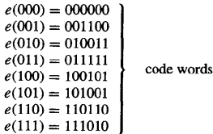
11.1(补) Groups and Coding
Example 7:
Consider the (3, 6) encoding function e: B³ → B⁶ defined by
Show that this encoding function is a group code.

Slide 62
11.1(补) Groups and Coding
Solution:
We must show that the set of all code words
N = {000000, 001100, 010011, 011111, 100101, 101001, 110110, 111010}
is a subgroup of B⁶. This is done by first noting that the identity of B⁶ belongs to N. Next we verify，by trying all possibilities，that if x and y are elements in N，then x y is in N. Hence N is a subgroup of B6，and the given encoding function is a group code.

Slide 63
11.1(补) Groups and Coding
Theorem 3
Let e: B^{m} → B^{n} be a group code. The minimum distance of e is the minimum weight of a nonzero code word.

Slide 64
11.1(补) Groups and Coding
Proof
Let δ be the minimum distance of the group code, and suppose that δ = δ(x, y), where x and y are distinct code words.
Also, let η be the minimum weight of a nonzero code word and suppose that η = |z| for a code word z.

Slide 65
11.1(补) Groups and Coding
Proof
Since e is a group code, x ⊕ y is a nonzero code word. Thus
δ = δ(x, y) = |x ⊕ y| ≥ η.
On the other hand, since 0 and z are distinct code words,
η = |z| = |z ⊕ 0 | = δ(z, 0) ≥ δ
Hence η = δ.

Slide 66
11.1(补) Groups and Coding
Example 8:
The minimum distance of the group code in Example 7 is 2, since by Theorem 3: this distance is equal to the smallest number of 1's in any of the seven nonzero code words. To check this directly would require 28 different calculations.

Slide 67
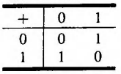
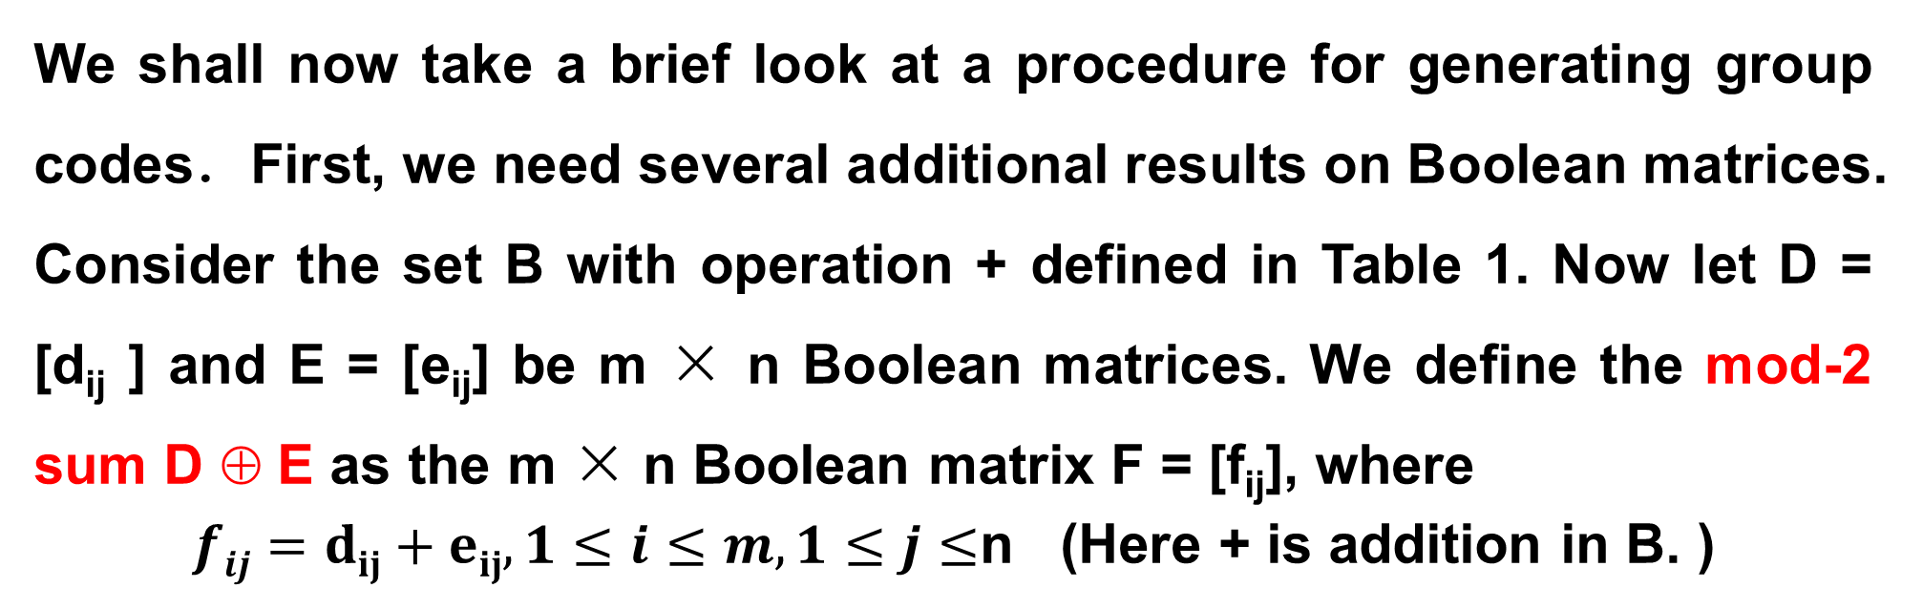
11.1(补) Groups and Coding
We shall now take a brief look at a procedure for generating group codes．First, we need several additional results on Boolean matrices. Consider the set B with operation + defined in Table 1. Now let D = [d_{ij} ] and E = [e_{ij}] be m × n Boolean matrices. We define the mod-2 sum D ⊕ E as the m × n Boolean matrix F = [f_{ij}], where
$fij=dij+eij,1≤i≤m,1≤j≤$n (Here + is addition in B. )
Table 1

Slide 68
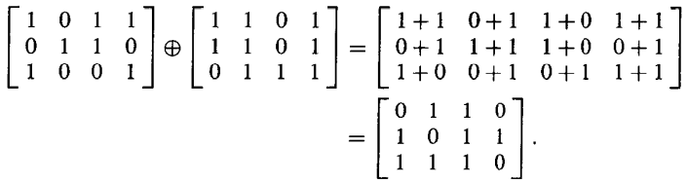
11.1(补) Groups and Coding
Example 9:
We have
Observe that if F = D ⊕ E, then f_{ij}, is zero when both d_{ij} and e_{ij} are zero or both are one.

Slide 69
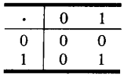
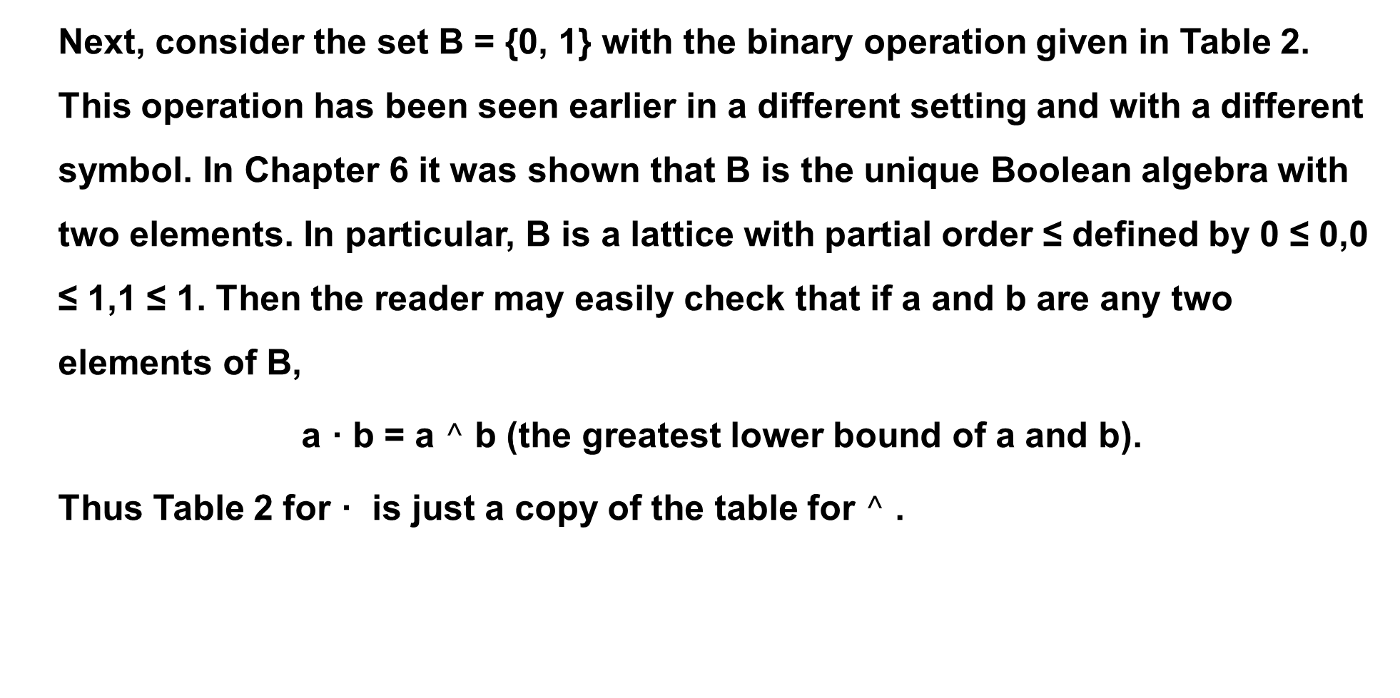
11.1(补) Groups and Coding
Next, consider the set B = {0, 1} with the binary operation given in Table 2. This operation has been seen earlier in a different setting and with a different symbol. In Chapter 6 it was shown that B is the unique Boolean algebra with two elements. In particular, B is a lattice with partial order ≤ defined by 0 ≤ 0,0 ≤ 1,1 ≤ 1. Then the reader may easily check that if a and b are any two elements of B,
a · b = a $^$ b (the greatest lower bound of a and b).
Thus Table 2 for · is just a copy of the table for $^$ .
Table 2

Slide 70
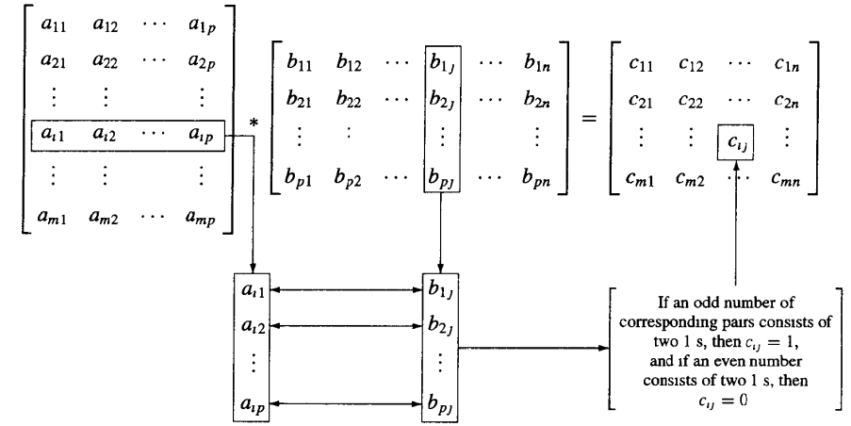

11.1(补) Groups and Coding
Let D =[ d_{ij} ] be an m × p Boolean matrix, and let E =[ e_{ij} ] be a p × n Boolean matrix. We define the mod-2 Boolean product D * E(布尔乘积) as the m x n matrix F=[ f_{ij} ], where
$fij=di1·e1j+di2·e2j+…+dip·epj,1≤i≤m,1≤j≤$n
This type of multiplication is illustrated in Figure 1.
Figure 1

Slide 71
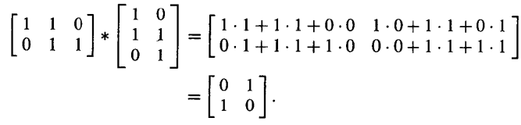
11.1(补) Groups and Coding
Example 10:
We have
The proof of the following theorem is left as an exercise.

Slide 72
11.1(补) Groups and Coding
Example 10:
We have
The proof of the following theorem is left as an exercise.

Slide 73
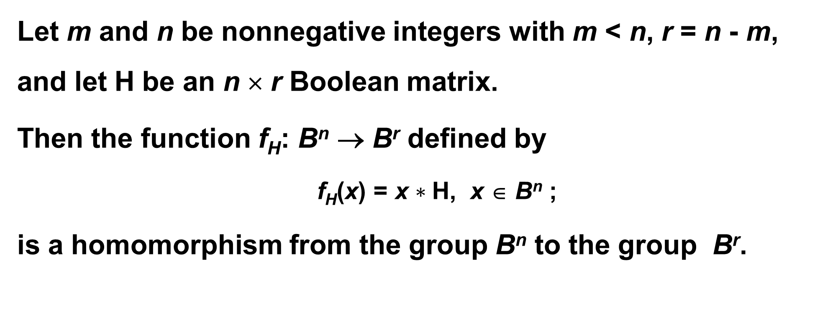
11.1(补) Groups and Coding
Theorem 5
Let m and n be nonnegative integers with m < n, r = n - m, and let H be an n × r Boolean matrix.
Then the function f_{H}: B^{n} → B^{r} defined by
f_{H}(x) = x $∗$H, x ∈ B^{n} ;
is a homomorphism from the group B^{n} to the group B^{r}.

Slide 74
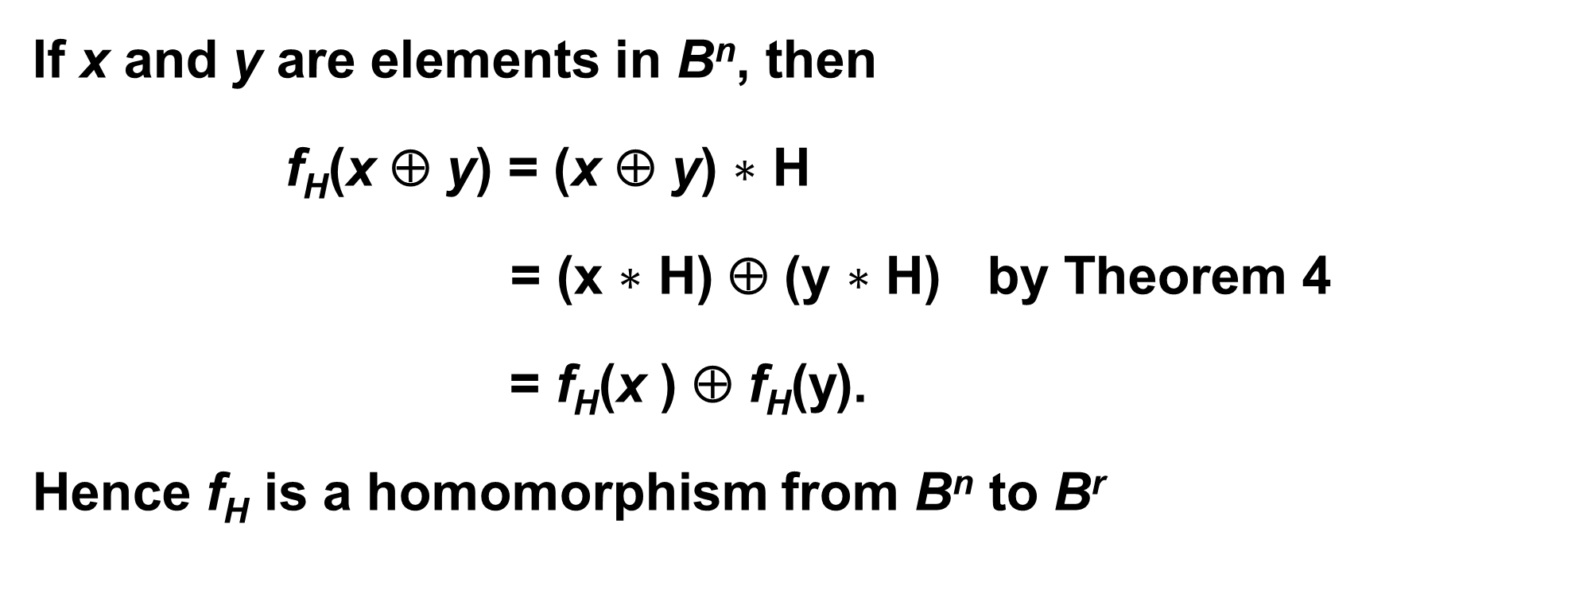
11.1(补) Groups and Coding
Proof
If x and y are elements in B^{n}, then
f_{H}(x ⊕ y) = (x ⊕ y) $∗$ H
= (x $∗$ H) ⊕ (y $∗$ H) by Theorem 4
= f_{H}(x ) ⊕ f_{H}(y).
Hence f_{H} is a homomorphism from B^{n} to B^{r}

Slide 75
11.1(补) Groups and Coding
Corollary 1
Let m, n, r, H, and f_{H} be as in Theorem 5. Then
N = {x ∈ B^{n} | x * H = 0}
is a normal subgroup of B^{n}.
Proof:
N is the kernel of the homomorphism f_{H}, so it is a normal subgroup of B^{n}.

Slide 76
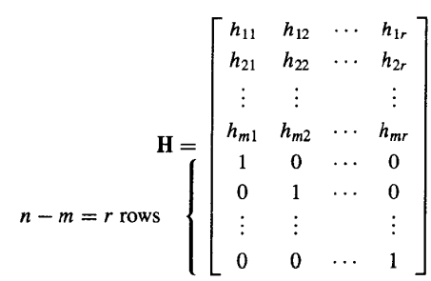
11.1(补) Groups and Coding
Parity check matrix - 一致性检验矩阵
Let m < n and r = n - m. the following n × r Boolean matrix is called a parity check matrix.

Slide 77
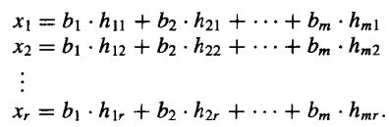
11.1(补) Groups and Coding
Parity check matrix - 一致性检验矩阵
Define an encoding function e_{H}: B^{m} → B^{n}
If b = b₁b₂…b_{m}, let x = e_{H}(b) = b₁b₂…b_{m} x₁x₂…x_{r}, where

Slide 78
11.1(补) Groups and Coding
Theorem 6
Let x = y₁y₂…y_{m}x₁… x_{r} ∈ B^{n}. Then
x * H = 0
if and only if
x = e_{H}(b) for some b ∈ B^{m}.

Slide 79
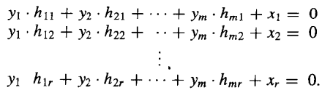
11.1(补) Groups and Coding
Proof
Suppose that x * H = 0

Slide 80
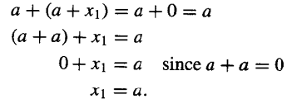
11.1(补) Groups and Coding
Proof
The first equation is of the form
Adding a to both sides, we obtain
This can be done for each row; therefore,

Slide 81
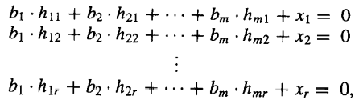
11.1(补) Groups and Coding
Proof
Letting b₁ = y₁, b₂ = y₂,..., b_{m} = y_{m}, we see that x₁, x₂,..., x_{r} satisfy the equations in (l). Thus b = b₁b₂…b_{m} ∈ B^{m} and x = e_{H}(b).
Conversely if x = e_{H}(b), the equations in (1) can be rewritten by adding x_{i} to both sides of the ith equation, i = l, 2,..., n, as
which shows x * H = 0.

Slide 82
11.1(补) Groups and Coding
Corollary 2
e_{H}(B^{m} ) = {e_{H}(b) | b ∈ B^{m}} is a subgroup of B^{n}
Proof :
The result follows from the observation that
e_{H}(B^{m} ) = ker(f_{H})
and from Corollary 1,Thus e_{H} is a group code.

Slide 83
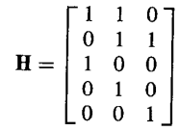
11.1(补) Groups and Coding
Corollary 2
Example 11:
Let m = 2, n = 5, and
Determine the group code e_{H}: B²→ B⁵.

Slide 84
11.1(补) Groups and Coding
Corollary 2
Solution:
We have B2=(00, 10, 01, 11). Then
e(00) = 00x₁x₂x₃,
where x₁, x₂, and x₃ are determined by the equations in (1). Thus
x₁ = x₂ = x₃ = 0
And
e(00) = 00000.
Next
e(10) = 10x₁x₂x₃.

Slide 85
11.1(补) Groups and Coding
Corollary 2
Using the equations in (1) with b₁ = 1 and b₂ = 0, we obtain
x₁ = 1·1 + 0·0 = 1
x₂ = 1·1 + 0·1 = 1
x₃ = 1·0 + 0·1 = 0.
Thus x₁ = 1, x₂ = 1, and x₃ = 0, so
e(10) = 10110.
Similarly (verify),
e(01) = 01011
e(11) = 11101.

Slide 86
9.5(补) Products and Quotients of Groups
Homework
11.1(补)
19,23,25,27 P412

