Slide 1
离散数据及其应用 Discrete Mathematics and Its Applications （Eighth Edition/Kenneth H.Rosen） 郭少勇 (syguo@bupt.edu.cn) 北京邮电大学 2021.10
Notes:
1

Slide 2
11.2(补) Decoding and Error Correction
Consider an (m, n) encoding function e: B^{m}→B^{n}. Once the encoded word x = e(b)∈B^{n}, for b∈B^{m}, is received as the word x_{t}, we are faced with the problem of identifying the word b that was the original message.

Slide 3
11.2(补) Decoding and Error Correction
An onto function d: B^{n}→B^{m} is called an (n, m) decoding function associated with e(与e关联的译码函数) if d(x_{t}) = b' ∈ B^{m} is such that when the transmission channel has no noise, then b' = b, that is,
d o e = 1_{Bm}
Where 1_{Bm} is the identity function on B^{m}

Slide 4
11.2(补) Decoding and Error Correction
The decoding function d is required to be onto so that every received word can be decoded to give a word in Bm. It decodes properly received words correctly, but the decoding of improperly received words may or may not be correct.

Slide 5
11.2(补) Decoding and Error Correction
Example 1:
Consider the parity check code that is defined in Example 2 of Section 11.1. We now define the decoding function d: B^{m+1}→B^{m}. If y = y₁ y₂ … y_{m} y_{m+1}∈ B^{m+1}, then
d(y) = y₁ y₂ … y_{m}
Observe that if b = b₁ b₂ … b_{m}∈ B^{m}, then
(d o e)(b) = d(e(b)) = b
so d o e = 1_{Bm}
For a concrete example, let m = 4. Then d(10010) = 1001 and d(11001) = 1100

Slide 6
11.2(补) Decoding and Error Correction
Let e be an (m, n) encoding function and let d be an (n, m) decoding function associated with e. We say that the pair (e, d) corrects k or fewer errors if whenever x = e(b) is transmitted correctly or with k or fewer errors and x_{t} is received, then d(x_{t}) = b. Thus x_{t} is decoded as the correct message b.

Slide 7

11.2(补) Decoding and Error Correction
Example 2:
Consider the (m, 3m) encoding function defined in Example 3 of Section 11.1. Define the decoding function d: B_{m}→B_{3m}.Let
y = y₁ y₂ … y_{m} y_{m+1} … y_{2m} y_{2m+1} … y_{3m},
Then
d(y) = z₁ z₂ … z_{m}
where
E.g. x_{t} = 011011111, then d(x_{t}) = 011

Slide 8
11.2(补) Decoding and Error Correction
Given an (m,n) encoding function e: B^{m}→B^{n}, we often need to determine an (n,m) decoding function d: B^{n}→B^{m} associated with e. We now discuss a method, called the maximum likelihood technique(极大似然方法), for determining a decoding function d for a given e.
Since B^{m} has 2^{m} elements, there are 2^{m} code words in B^{n}. We first list the code words in a fixed order:
x⁽¹⁾, x⁽²⁾, ..., x^{(2m)}

Slide 9

11.2(补) Decoding and Error Correction
If the received word is x_{t}, we compute δ(x^{(i)}, x_{t}) for 1 ≤ i ≤ 2^{m} and choose the first code word, say it is x^{(s)}, such that
That is, x^{(s)} is a code word that is closest to x_{t} and the first in the list. If x^{(s)} = e(b), we define the maximum likelihood decoding function(最大似然译码函数) d associated with e by
d(x_{t})=b

Slide 10
11.2(补) Decoding and Error Correction
Observe that d depends on the particular order in which the code words in e(B^{n}) are listed. If the code words are listed in a different order, we may obtain a different maximum likelihood decoding function d associated with e.

Slide 11
11.2(补) Decoding and Error Correction
Theorem 1
Suppose that e is an (m, n) encoding function and d is a maximum likelihood decoding function associated with e. Then (e, d) can correct k or fewer errors if and only if the minimum distance of e is at least 2k + 1.

Slide 12
11.2(补) Decoding and Error Correction
Proof
Assume that the minimum distance of e is at least 2k + 1. Let b∈B^{m} and x = e(b)∈B^{n}. Suppose that x is transmitted with k or fewer errors, and x_{t} is received. This means that δ(x, x_{t})≤ k. If z is any other code word, then
2k+1 ≤ δ(x, z) ≤ δ(x, x_{t}) + δ(x_{t}, z) ≤ k + d(x_{t}, z).
Thus δ(x_{t}, z) ≥ 2k+1-k = k+1.This means that x is the unique code word that is closest to x_{t}, so d(x_{t}) = b. Hence (e, d) corrects k or fewer errors.

Slide 13
11.2(补) Decoding and Error Correction
Proof
Conversely, assume that the minimum distance between code words is r ≤ 2k, and let x = e(b) and x’ = e(b’) be code words with δ(x, x’) = r. Suppose that x’ precedes x in the list of code words used to define d. Write x = b₁b₂...b_{n}, x’ = b’₁ b’₂ ... b’_{n}. Then b_{t} ≠ b’_{t} for exactly r integers i between 1 and n. Assume, for simplicity, that b₁ ≠ b’₁, b₂ ≠ b’₂, ..., b_{r} ≠ b’_{r}, but b_{t} ≠ b’_{t} , when i > r. Any other case is handled in the same way.

Slide 14
11.2(补) Decoding and Error Correction
Proof
(a)Suppose that r ≤ k. lf x is transmitted as x_{t} = x’, then r≤k errors have been committed, but d(x_{t}) = b’; so (e, d) has not corrected the r errors.
(b) Suppose that k +1 ≤ r ≤ 2k, and let
y = b’₁ b’₂ ... b’_{k} b_{k+1} ... b_{n}.
If x is transmitted as x_{t} = y, then δ(x_{t}, x’) = r-k ≤ k and δ(x_{t}, x) > k. Thus x' is at least as close to x_{t} as x is, and x' precedes x in the list of code words; so d(x_{t}) ≠ b.Then we have committed k errors, which (e,d) has not corrected.

Slide 15
11.2(补) Decoding and Error Correction
Example 3:
Let e be the (3, 8) encoding function defined in Example 6 of Section 11.1, and let d be an (8,3) maximum likelihood decoding function associated with e. How many errors can (e,d) correct?
Solution:
Since the minimum distance ofe is 3, we have 3 ≥ 2k +1, so k ≤1. Thus (e,d) can correct one error.

Slide 16
11.2(补) Decoding and Error Correction
We now discuss a simple and effective technique for determining a maximum likelihood decoding function associated with a given group code. First, we prove the following result.

Slide 17
11.2(补) Decoding and Error Correction
Theorem 2
If K is a finite subgroup of a group G, then every left coset of K in G has exactly as many elements as K.

Slide 18
11.2(补) Decoding and Error Correction
Proof
Let aK be a left coset of K in G, where a∈G. Consider the function f: K→aK defined by
f(k) = ak, for k∈K.
We show that f is one to one and onto.
To show that f is one to one, we assume that
f(k₁) = f(k₂), k₁, k₂∈K.

Slide 19
11.2(补) Decoding and Error Correction
Proof
Then
ak₁ = ak₂
By Theorem 2 of Section 9.4, k₁ = k₂. Hence f is one to one.
To show that f is onto, let b be an arbitrary element in aK. Then b = ak for some k∈K. We now have
f(k) = ak = b
so f is onto. Since f is one to one and onto, K and aK have the same number of elements.

Slide 20
11.2(补) Decoding and Error Correction
Let e: B^{m}→B^{n} be an (m, n) encoding function that is a group code. Thus the set N of code words in Bn is a subgroup of B^{n} whose order is 2^{m}, say N = {x⁽¹⁾, x⁽²⁾, ..., x^{(2m)} }.
Suppose that the code word x = e(b) is transmitted and that the word x_{t} is received. The left coset of x_{t} is
x_{t} ⨁ N = {ɛ₁, ɛ₂,..., ɛ_{2m}}
where ɛ_{i} = x_{t} ⨁ x^{(i)}

Slide 21
11.2(补) Decoding and Error Correction
The distance from x_{t} to code word x^{(i)} is just |ɛ_{i}|, the weight of ɛ_{i}.Thus, if ɛ_{j} is a coset member with smallest weight, then x^{(j)} must be a code word that is closest to x_{t}. In this case, x^{(j)} = Ō ⨁ x^{(j)} = x_{t} ⨁ x_{t} ⨁ x^{(j)} = x_{t} ⨁ ɛ_{j.} An element ɛ_{j}, having smallest weight, is called a coset leader(陪集首部). Note that a coset leader need not be unique.

Slide 22
11.2(补) Decoding and Error Correction
If e:B^{m}→B^{n} is a group code, we now state the following procedure for obtaining a maximum likelihood decoding function associated with e.

Slide 23
11.2(补) Decoding and Error Correction
Step 1: Determine all the left cosets of N = e(B^{m}) in B^{n}
Step 2: For each coset, find a coset leader (a word of least weight).
Step 3: If the word x_{t} is received, determine the coset of N to which x_{t} belongs.
Step 4: Let ɛ be a coset leader for the coset determined in Step 3. Compute x = x_{t} ⨁ ɛ. If x = e(b), we let d(x_{t}) = b. That is, we decode x_{t} as b.

Slide 24
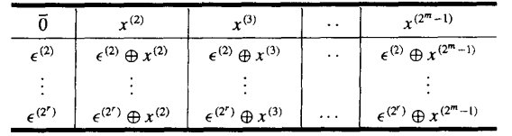
11.2(补) Decoding and Error Correction
Decoding table(译码表)
Constructing a decoding table, each row is a left coset of N with the first element ɛ^{(i)} the coset leader.

Slide 25
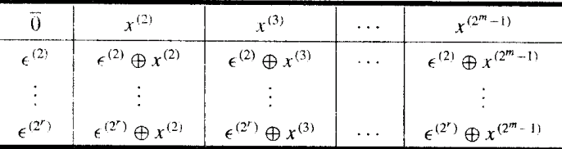
11.2(补) Decoding and Error Correction
Decoding table(译码表)
If we receive the word x_{t}, we locate it in the table. If x is the element of N that is at the top of the column containing x_{t}, then x is the code word closest to x_{t}.
if x = e(b), then d(x_{t}) = b.

Slide 26
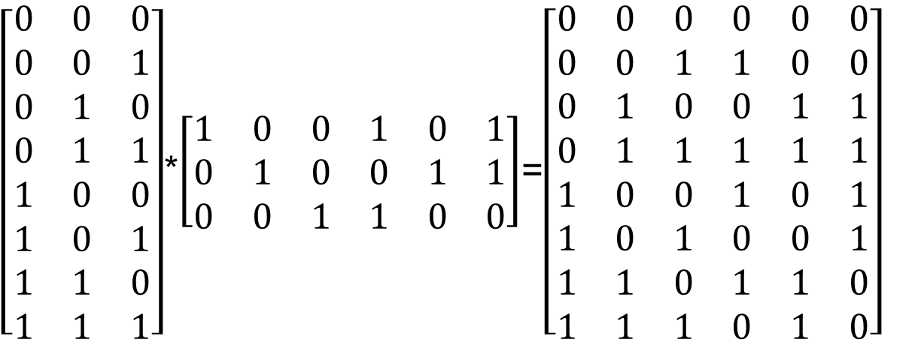
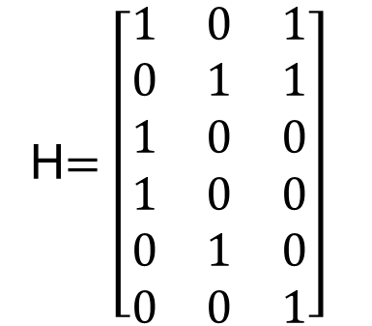
11.2(补) Decoding and Error Correction
Example 4
Consider the (3, 6) group code
N = {000000, 001100, 010011, 011111, 100101, 101001, 110110, 111010}
= {x⁽¹⁾, x⁽²⁾,..., x⁽⁸⁾}.

Slide 27
11.2(补) Decoding and Error Correction
Constructing decoding table:
==============================================================
000000 001100 010011 011111 100101 101001 110110 111010
--------------------------------------------------------------
000001 001101 010010 111110 100100 101000 110111 111011
000010 001110 010001 011101 100111 101011 110100 111000
000100 001000 010111 011011 100001 101101 110010 111110
010000 011100 000011 001111 110101 111001 100110 101010
100000 101100 110011 111111 000101 001001 010110 011010
000110 001010 010101 011001 100011 101111 110000 111100
010100 011000 000111 001011 110001 111101 100010 101110
==============================================================
001010 000110 011001 010101 101111 100011 111100 110000

Slide 28
11.2(补) Decoding and Error Correction
Simplified decoding technique
Suppose that the (m, n) group code is e_{H}: B^{m} → B^{n} , where H is a given parity check matrix.
Then the function f_{H}: B^{n} → B^{r} defined by f_{H}(x) = x*H, x ∈ B^{n} is a homomorphism from the
group B^{n} to the group B^{r}.

Slide 29
11.2(补) Decoding and Error Correction
Theorem 3
If m, n, r, H, and f_{H} are as defined, then
f_{H} is onto.
Proof
Let b = b₁b₂…b_{r} be any element in B^{r}.
Letting x = 0₁…0_{m}b₁b₂…b_{r}
Then x*H = b.
Thus f_{H}(x) = b, so f_{H} is onto.

Slide 30
11.2(补) Decoding and Error Correction
It follows from Corollary l of Section 9.5 that B^{r} and B^{n}/N are isomorphic, where
N = {x ∈ B^{n} | x*H = 0} = ker(f_{H}) = e_{H}(B^{m} )
under the isomorphism g: B^{n}/N → B^{r} defined by g(xN) = f_{H}(x) = x*H
The element x*H is called the syndrome of x

Slide 31
11.2(补) Decoding and Error Correction
Theorem 4
Let x and y be elements in B^{n}. Then x and y lie in the same left coset of N in B^{n} if and only if f_{H}(x) = f_{H}(y)
if and only if they have the same syndrome.

Slide 32
11.2(补) Decoding and Error Correction
Proof
It follows from Theorem 4 of Section 9.5 that x and y lie in the same left coset of N in B^{n} if and only if x ⊕ y = (-x) ⊕ y ∈ N.
Since N = ker(f_{H}), x ⊕ y ∈ N if and only if
f_{H}(x ⊕ y) = 0_{Br}
f_{H}(x) ⊕ f_{H}(y) = 0_{Br}
f_{H}(x) = f_{H}(y)

Slide 33
11.2(补) Decoding and Error Correction
Decoding procedure
Suppose that we compute the syndrome of each coset leader. If the word x_{t} is received, we also compute f_{H}(x_{t}), the syndrome of x_{t}. By comparing f_{H}(x_{t}) and the syndromes of the coset leaders, we find the coset in which x_{t} lies. Suppose that a coset leader of this coset is ε. We now compute x = x_{t} ⊕ ε. If x = e(b), we then decode x_{t} as b.

Slide 34
11.2(补) Decoding and Error Correction
New procedure
Step 1: Determine all left cosets of N = e_{H}(B^{m} ) in B^{n}.
Step 2: For each coset, find a coset leader, and compute the syndrome of each leader
Step 3: If x_{t} is received, compute the syndrome of x_{t} and find the coset leader ε having the same syndrome. Then x_{t} ⊕ ε = x is a code word e_{H}(b), and d(x_{t}) = b.

Slide 35
11.2(补) Decoding and Error Correction
Example 5
Consider the parity check matrix and the (3, 6) group code e_{H}: B³ → B⁶.

Slide 36
11.2(补) Decoding and Error Correction
Example 5
N = {000000, 001011, 010101, 011110, 100110, 101101, 110011, 111000}
Syndrome of Coset Leader | Coset leader
--------------------------+-------------------
000 | 000000
001 | 000001
010 | 000010
011 | 001000
100 | 000100
101 | 010000
110 | 100000
111 | 001100
--------------------------+-------------------

Slide 37
11.2(补) Decoding and Error Correction
Example 5
If x_{t} = 001110, then f_{H}(x_{t}) = x_{t} * H = 101, same as ε=010000.
x = x_{t} ⊕ ε = 001110 ⊕ 01000 = 011110 = e(011), so decode 001110 as 011.
Syndrome of Coset Leader | Coset leader
--------------------------+-------------------
000 | 000000
001 | 000001
010 | 000010
011 | 001000
100 | 000100
101 | 010000
110 | 100000
111 | 001100
--------------------------+-------------------

Slide 38
11.2(补) Decoding and Error Correction
Key ideas for review
Message, word
(m, n) encoding function, one-to-one
Code word, parity check code
Detect, correct, k or fewer errors
Hamming distance
Properties of distance
Group code and parity check matrix
Minimum distance of a group code
Maximum likelihood technique
Maximum likelihood decoding function
Syndrome and decoding procedure for group code

Slide 39
11.2(补) Decoding and Error Correction
Homework
11.2(补)
14, 18, 22 P421
24 P422

