Slide 1


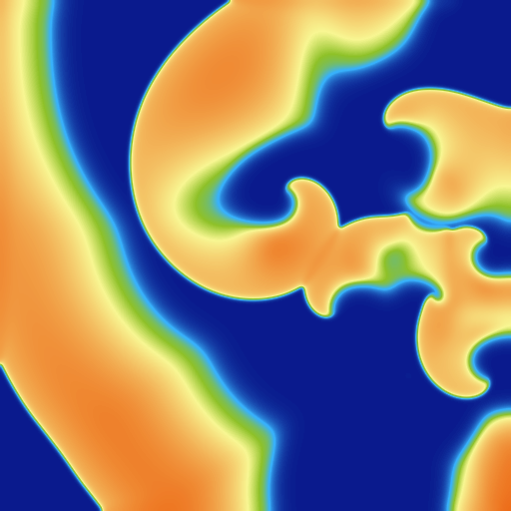
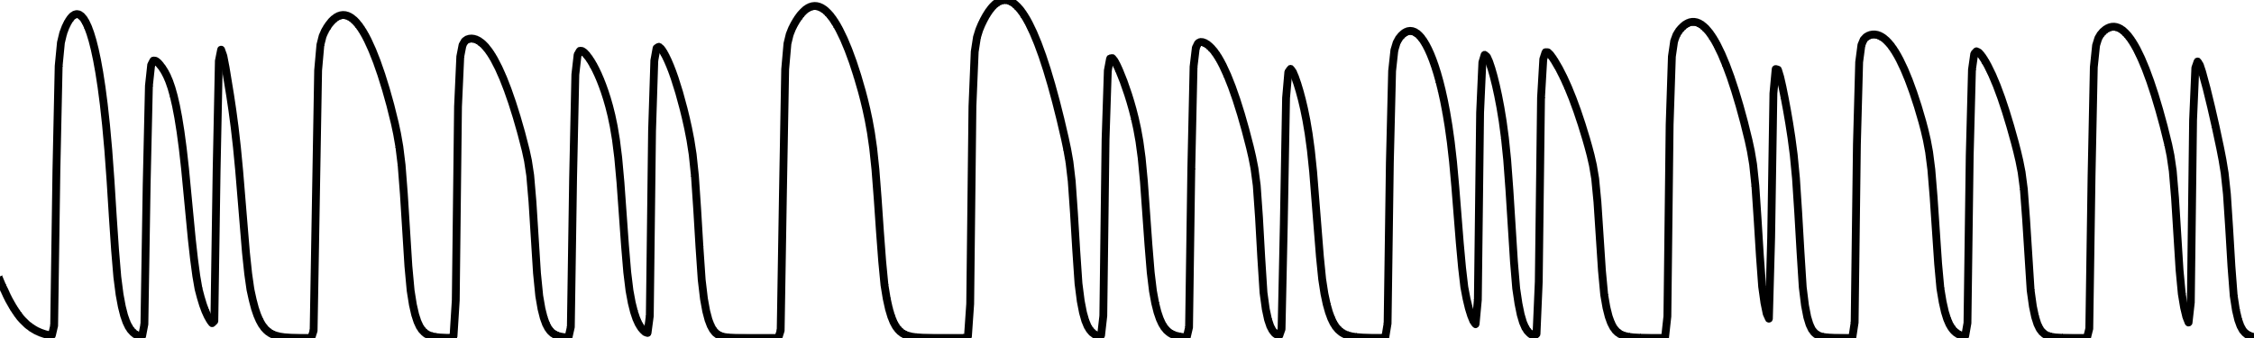
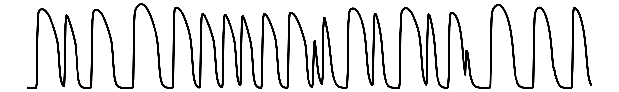
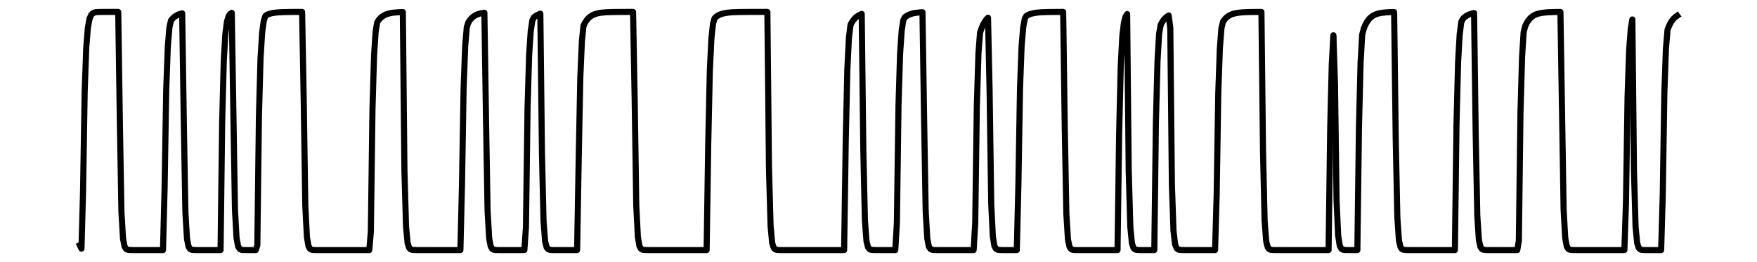
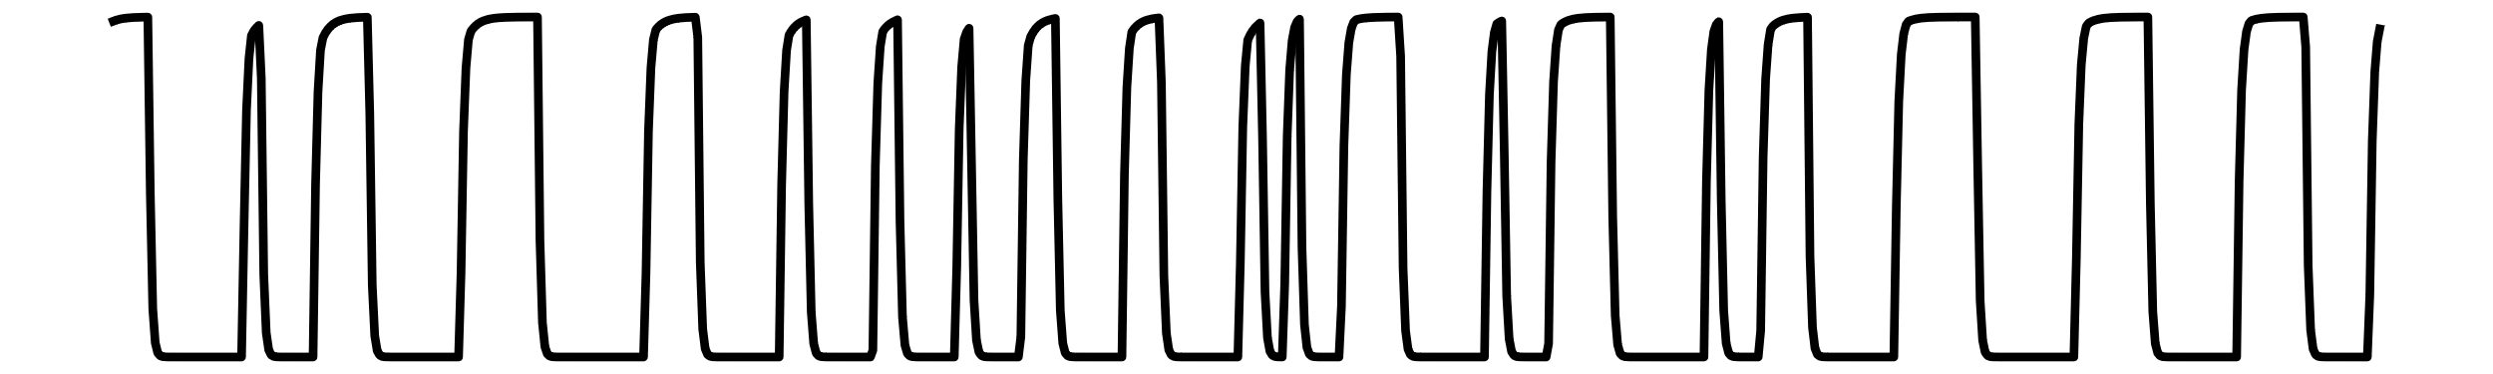
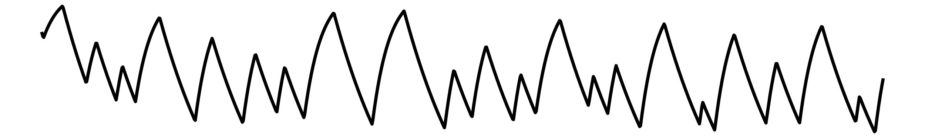
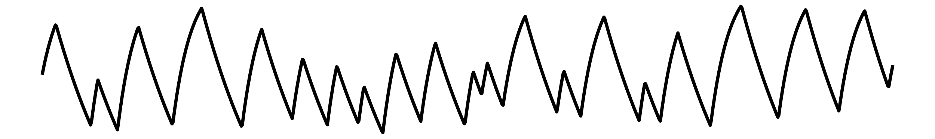
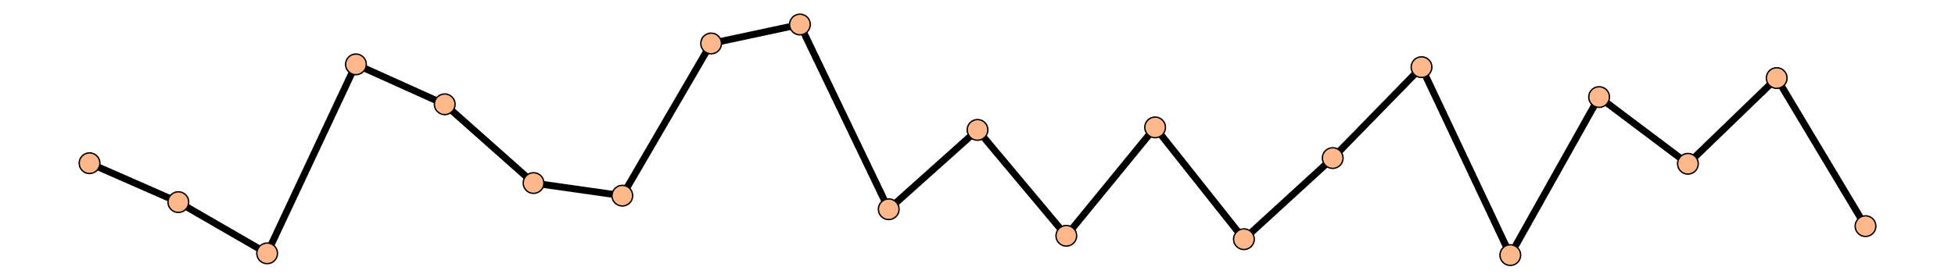
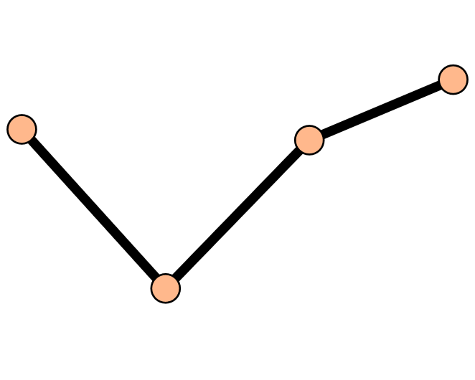
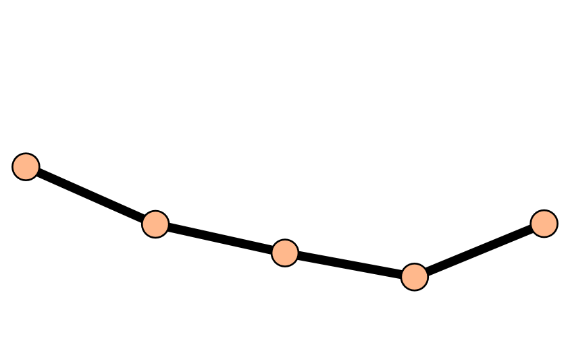
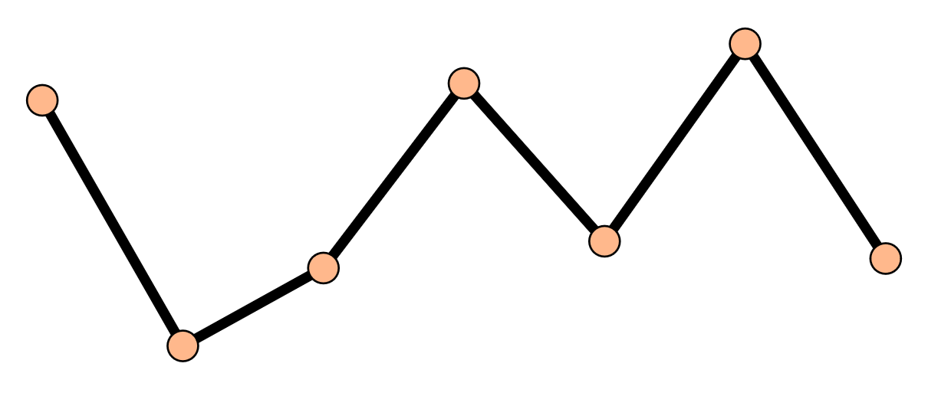
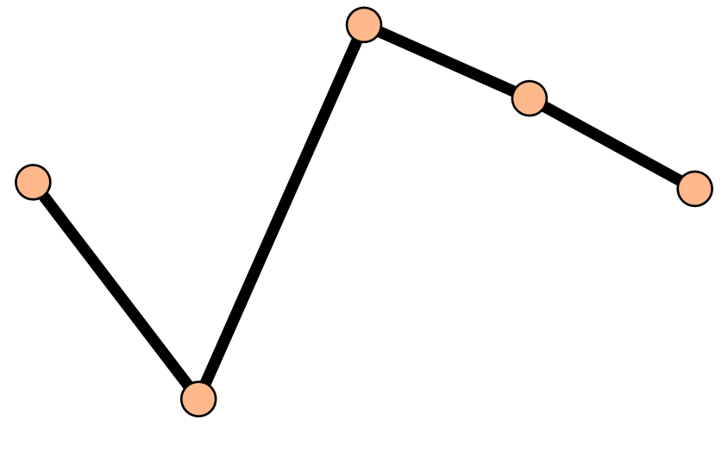
















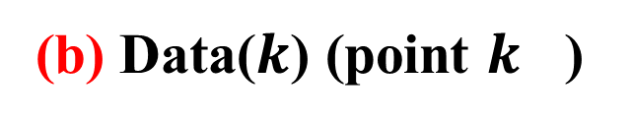




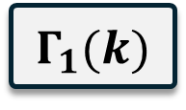




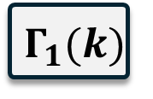




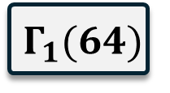

(a) Simulation
(d) Phase Space Reconstructor (PSR)
(e) Temporal Calculator (TC)
$$k$$
APD
● ● ●
$$Γ_{1}(0)$$
TLE
$${LE}_{i}^{1}$$
AVG
$$LE^{1}$$
AVG
$${ λ}^{T}$$
● ● ●
● ● ●
● ● ●
● ● ●
$$m=3 τ=1$$
$$Γ_{1}(k)$$
TLE
$${ LE}_{i+1}^{1}$$
$$LE^{5}$$
$${ \text{APD}}^{m,τ}$$
● ● ●
● ● ●
● ● ●
● ● ●
$$Γ_{1}(64)$$
TLE
$${LE}_{N}^{1}$$
(b) Data($k$) (point $k$ )
(f) Spatial Calculator (SC)
Voltage(u)
● ● ●
● ● ●
● ● ●
● ● ●
● ● ●
$$Γ_{1}(0)$$
● ● ●
SLE
$$LE^{1}$$
AVG
v
● ● ●
● ● ●
● ● ●
● ● ●
● ● ●
$$Γ_{1}(k)$$
$${ λ}^{S}$$
● ● ●
● ● ●
w
● ● ●
● ● ●
● ● ●
● ● ●
● ● ●
$$Γ_{1}(64)$$
$$LE^{5}$$
APD
● ● ●
● ● ●
● ● ●
● ● ●
● ● ●
(g) Temporal LE (TLE)
(h) Spatial LE (SLE)
Time step
0
Transient
52e4
$$Γ_{1}(k)$$
$$Γ_{2}(k)$$
$$Γ_{3}(k)$$
$$Γ_{4}(k)$$
$$Γ_{5}(k)$$
183e4
$$Γ_{1}(0)$$
● ● ●
(c) LE Calculation
$$Γ_{1}(k)$$
$$Γ_{1}(k)$$
$$[u,v,w]$$
TC
$${ λ}^{T}(uvw)$$
● ● ●
● ● ●
$$Γ_{1}(64)$$
Data
APD
PSR
$${ \text{APD}}^{m,τ}$$
SC
$${ λ}^{S}(\text{APD})$$
Observe Divergence Of Similar Pairs in Time Series
Observe Divergence Of Similar Pairs in Space
TC
$${ λ}^{T}(\text{APD})$$

