Slide 1


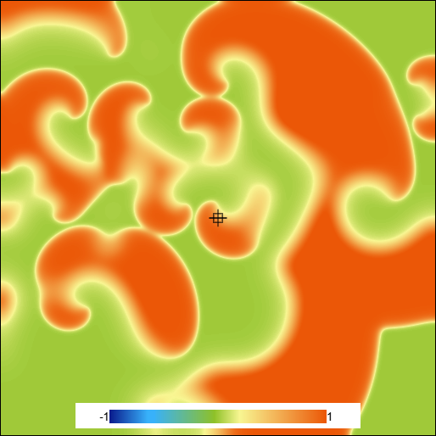
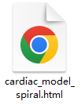


I want a heart simulation with defibrillation shown
Execute a cardiac simulation using the FK 3V-SIM model, initiating … with the S1-S2 …to induce chaotic spiral wave…
User
Clarify Agent
Parameter Agent
Model: FK model
Parameters: Default (set 4)
dt,ds: Default
Skills to use: S1-S2, screenshot, simulation running
Simulation Agent
Coding Agent
Learn Skills
Base_model.html
Plot_tip.js
S1_S2_init.js

Slide 2

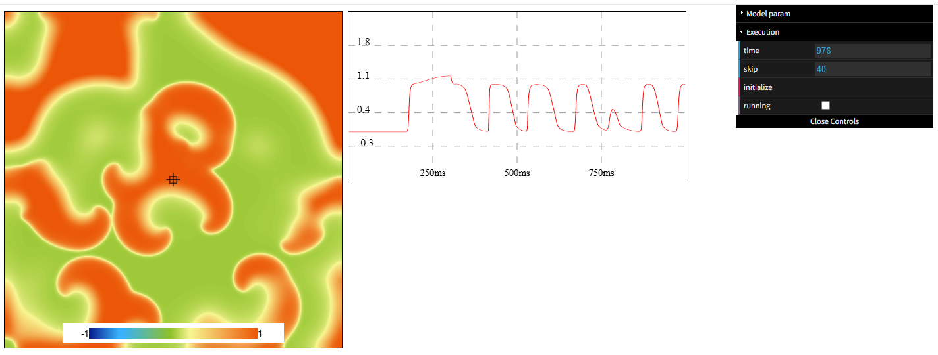
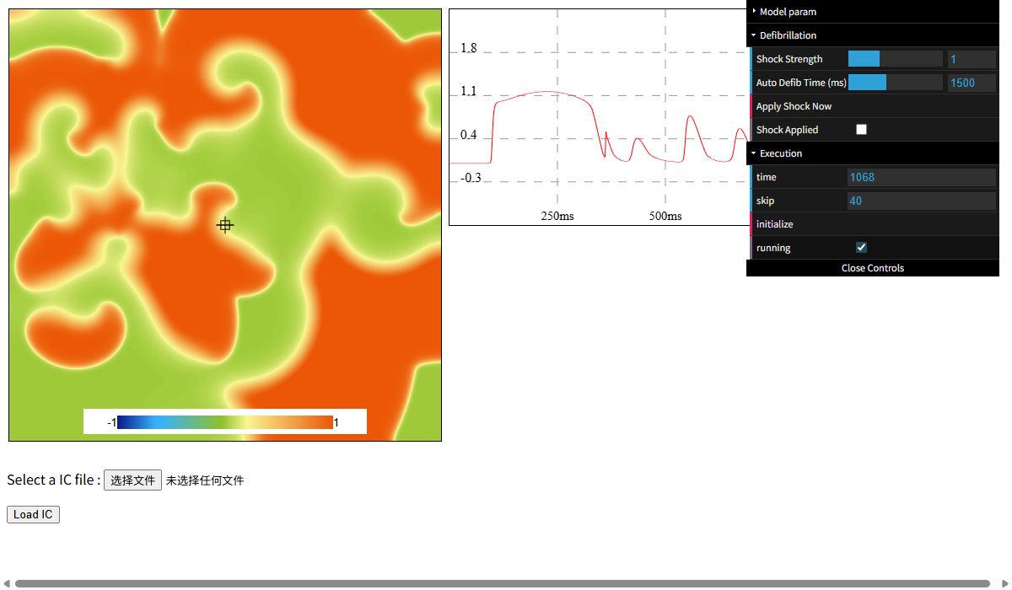
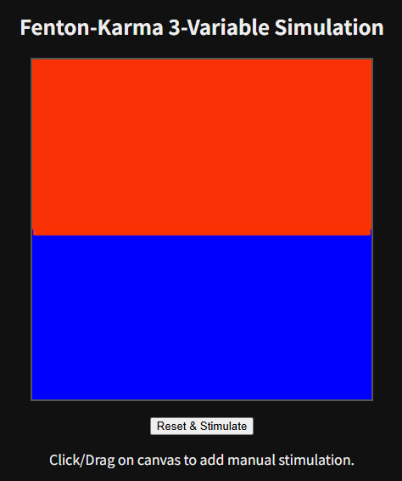
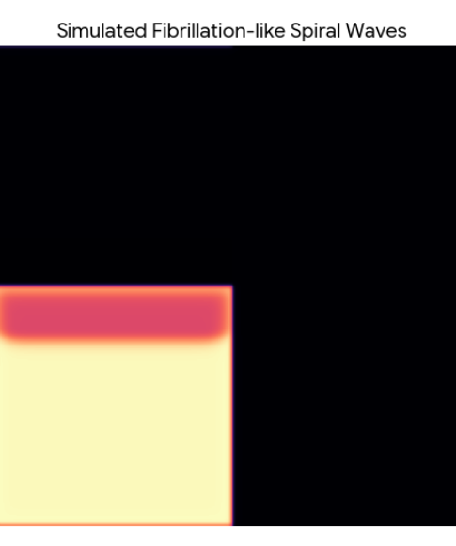
 | Multi-Agent Workflow | Original Gemini
I want you to code the 2D FK 3V-SIM model where i can stimulate tissue by clicking it. give me the html file so i can run it in browser
I want to see the fibrillation in FK 3V-SIM model, give me a simulation html file which can generate fibrillation and show me the pic
I want you to replicate the Fig 1D in the paper I upload.

