Slide 1
Recitation 10: Malloc Lab
Instructors
Nov. 5, 2018
Notes:
This recitation has fewer questions. Get to the GDB part 1 without spending too long quizzing people on the previous slides.

Slide 2
Administrivia
Malloc checkpoint due Thursday, Nov. 8! wooooooooooo
Malloc final due the week after, Nov. 15! wooooooooooo
Malloc Bootcamp Sunday, Nov. 11 at Rashid Auditorium, 7-8:30PM
We will cover ✨fun and flirty✨ ways to succeed post-malloc checkpoint!
Tell your friends to come (if they’re in 213 (if they want to come (don’t force your friends to do things they don’t want to do that’s not what friends are for)))

Slide 3
Outline
Concept
How to choose blocks
Metadata
Debugging / GDB Exercises

Slide 4
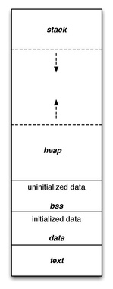
What is malloc?
A function to allocate memory during runtime (dynamic memory allocation).
More useful when the size or number of allocations is unknown until runtime (e.g. data structures)
The heap is a segment of memory addresses reserved almost exclusively for malloc to use.
Your code directly manipulates the bytes of memory in this section.

Slide 5
Malloc Internals
The heap consists of blocks of memory
(heap)
free
free
malloc’d
malloc’d
free
malloc’d
malloc’d

Slide 6
Concept
Overall, malloc does three things:
Organizes all blocks and stores information about them in a structured way.
Uses the structure made to choose an appropriate location to allocate new memory.
Updates the structure when the user frees a block of memory.
This process occurs even for a complicated algorithm like segregated lists.

Slide 7
Concept (Implicit list)
Organizes all blocks and stores information about them in a structured way.
(heap)
free (size = 25)
free (size = 8)
malloc’d (size = 7)
m(3)
f(3)
m(5)
m(4)

Slide 8
Concept (Implicit list)
Uses the structure made to choose an appropriate location to allocate new memory.
(heap)
free (size = 25)
free (size = 8)
malloc’d (size = 7)
malloc(8)
m(3)
f(3)
m(5)
m(4)
(heap)
free (size = 25)
malloc’d (size = 8)
malloc’d (size = 7)
m(3)
f(3)
m(5)
m(4)

Slide 9
Concept (Implicit list)
Updates the structure when the user frees a block of memory.
(heap)
free (size = 25)
free(that block)
malloc’d (size = 8)
malloc’d (size = 7)
m(3)
f(3)
m(5)
m(4)
(heap)
free (size = 25)
malloc’d (size = 8)
malloc’d (size = 7)
m(3)
free (size = 8)
m(4)

Slide 10
Goals
Run as fast as possible
Waste as little memory as possible
Seemingly conflicting goals, but with the library malloc call cleverness you can do very well in both areas!
The simplest implementation is the implicit list. mm-baseline uses this method.
Unfortunately…

Slide 11
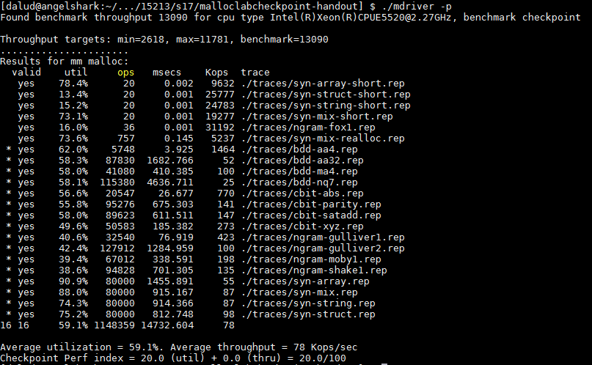
This is pretty slow… most explicit list implementations get above 10000 Kops/sec

Slide 12
Allocation methods in a nutshell
Implicit list: a list is implicitly formed by jumping between blocks, using knowledge about their sizes.
Explicit list: Free blocks explicitly point to other blocks, like in a linked list.
Understanding explicit lists requires understanding implicit lists
Segregated list: Multiple linked lists, each containing blocks in a certain range of sizes.
Understanding segregated lists requires understanding explicit lists
Allocated | Free | Allocated | Free | Allocated
 | Free |  | Free
 | Free |  | Free

Slide 13
Choices
What kind of implementation to use?
Implicit list, explicit list, segregated lists, binary tree methods, etc.
You can use specialized strategies depending on the size of allocations
Adaptive algorithms are fine, though not necessary to get 100%.
Don’t directly test for which trace file is running.
What fit algorithm to use?
Best fit: choose the smallest block that is big enough to fit the requested allocation size
First fit / next fit: search linearly starting from some location, and pick the first block that fits.
Which is faster? Which uses less memory?
“Good enough” fit: a blend between the two
This lab has many more ways to get an A+ than, say, Cache Lab Part 2

Slide 14
Finding a Best Block
Suppose you have implemented the explicit list approach
You were using best fit with explicit lists
You experiment with using segregated lists instead. Still using best fits.
Will your memory utilization score improve? Note: you don’t have to implement seglists and run mdriver to answer this. That’s, uh, hard to do within one recitation session.
What other advantages does segregated lists provide?
Losing memory because of the way you choose your free blocks is called external fragmentation.
Notes:
Memory util is the same, but throughput may be faster.
If you decide to switch to a “good enough” fit policy, you may be able to get an increase on both fronts.

Slide 15
Metadata
All blocks need to store some data about themselves in order for malloc to keep track of them (e.g. headers)
This takes memory too…
Losing memory for this reason is called internal fragmentation.
What data might a block need?
Does it depend on the malloc implementation you use?
Is it different between free and allocated blocks?
Can we use the extra space in free blocks?
Or do we have to leave the space alone?
How can we overlap two different types of data at the same location?
Notes:
Yes, yes, yes (can use the space)
Unions! (See textbook)

Slide 16
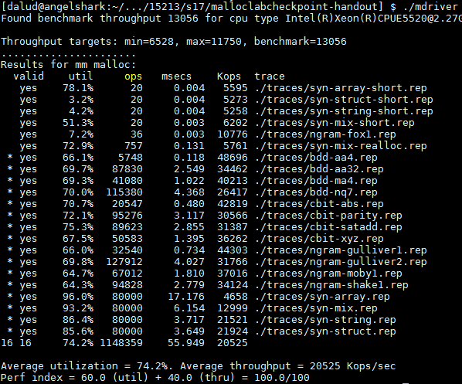
In a perfect world…
Setting up the blocks, metadata, lists… etc (500 LoC)
+ Finding and allocating the right blocks (500 LoC)
+ Updating your heap structure when you free (500 LoC) =

Slide 17

In reality…
Setting up the blocks, metadata, lists… etc (500 LoC)
+ Finding and allocating the right blocks (500 LoC)
+ Updating your heap structure when you free (500 LoC)
+ One bug, somewhere lost in those 1500 LoC =

Slide 19
Common errors you might see
Garbled bytes
Problem: overwriting data in an allocated block
Solution: remembering data lab and the good ol’ days finding where you’re overwriting by stepping through with gdb
Overlapping payloads
Problem: having unique blocks whose payloads overlap in memory
Solution: literally print debugging everywhere finding where you’re overlapping by stepping through with gdb
Segmentation fault
Problem: accessing invalid memory
Solution: crying a little finding where you’re accessing invalid memory by stepping through with gdb

Slide 20
GDB Practice
Using GDB well in malloclab can save you HOURS^{1, 2} of debugging time
Average 20 hours using GDB for “B” on malloclab
Average 23 hours not using GDB for “B” on malloclab
Form pairs
Login to a shark machine
wget http://www.cs.cmu.edu/~213/activities/rec11.tar
tar xf rec11.tar
cd rec11
make
Two buggy mdrivers
1. Average time is based on Summer 2016 survey results
2. As the TA making these slides, I realize that there’s really no way for me to confirm that these stats are true, so by the power of anecdotal evidence, let me tell you about how I was too stubborn to use GDB and didn’t even finish malloc while another TA Niko mastered GDB in two weeks and cruised to a 100%. Use GDB!!!

Slide 21


First things first
Try running $ make
If you look closely, our code compiles your malloc implementation with the -O3 flag.
This is an optimization flag. -O3 makes your code run as efficiently as the compiler can manage, but also makes it horrible for debugging (almost everything is “optimized out”).

Slide 22
Debugging mdriver
$ gdb --args ./mdriver -c traces/syn-mix-short.rep
(gdb) run
(gdb) backtrace
(gdb) list
Optional: Type Ctrl-X Ctrl-A to see the source code. Don’t linger there for long, since this visual mode is buggy. Type that key combination again to go back to console mode.
1) What function is listed on the top of backtrace?
2) What line of code crashed?
3) How did that line cause the crash?

Slide 23
Debugging mdriver
(gdb) x /10gx block
Shows the memory contents within the block
In particular, look for the header.
Remember the output from (gdb) bt?
(gdb) frame 1
Jumps to the function one level down the call stack (aka the function that called write_footer)
Ctrl-X, Ctrl-A again if you want to see visuals
What was the caller function? What is its purpose?
Was it writing to block or block_next when it crashed?

Slide 24
Thought process while debugging
write_footer crashed because it got the wrong address for the footer…
The address was wrong because the header of the block was some garbage value
Since write_footer uses get_size(block) after all
But why in the world does the header contain garbage??
The crash happened in place, which basically splits a free block into two and uses the first one to store things.
Hm, block_next would be the new block created after the split? The one on the right?
The header would be in the middle of the original free block actually. Wait, but I wrote a new header before I wrote the footer!
Right? …Oh, I didn’t. Darn.

Slide 25
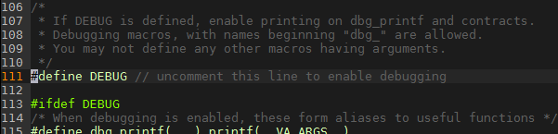
Heap consistency checker
mm-2.c activates debug mode, and so mm_checkheap runs at the beginning and end of many of its functions.
The next bug will be a total nightmare to find without this heap consistency checker*.
*Even though the checker in mm-2.c is short and buggy

Slide 26
Now you try debugging this
$ gdb --args ./mdriver-2 -c traces/syn-array-short.rep
mm_checkheap will fail. What reason does it cite?
Where’s the footer? Use x /gx and some arithmetic
Track changes in the header and the footer:
(gdb) watch *[header address]
(gdb) watch *[footer address]
When does the footer’s value turn inconsistent? What function was running at the time? Which part of that function was wrong? Use backtrace on each frame.
Notes:
This problem is tricky.
Coalesce returns the wrong block in case 3.

Slide 27
MallocLab Checkpoint
Due this Thursday!
Checkpoint should take a bit less than half of the time
Read the write-up. Slowly. Carefully.
Use GDB
Ask us for debugging help
Only after you implement mm_checkheap though

Slide 28
Appendix: Advanced GDB Usage
backtrace: Shows the call stack
frame: Lets you go to one of the levels in the call stack
list: Shows source code
print <expression>:
Runs any valid C command, even something with side effects like mm_malloc(10) or mm_checkheap(1337)
watch <expression>:
Breaks when the value of the expression changes
break <function / line> if <expression>:
Only stops execution when the expression holds true
Ctrl-X Ctrl-A for visualization

Slide 29
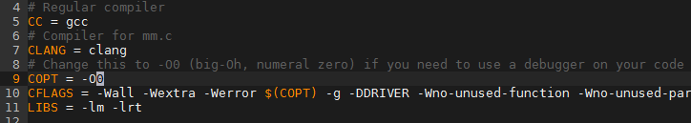
Appendix: Building O0
Edit the file named Makefile and make it use -O0
Then run $ make –B
Alternative: $ make clean $ make
Just running make won’t work because it’ll say nothing new needs to be compiled. So we force it to recompile.
Remember to set it back to –O3 when you’re done to test throughput, since -O0 makes your code much slower.

Slide 30
Appendix: hprobe()
Function to view what’s on the heap
Can be used to look at a block’s leading structures, can also be used for the emulated addresses

