Slide 1
Recitation 14: Proxy Lab Part 2
Instructor: TA(s)

Slide 2
Outline
Proxylab
Threading
Threads and Synchronization
PxyDrive Demo

Slide 3
ProxyLab
Checkpoint is worth 1%, due Thursday, Nov. 29th
Final is worth 7%, due Thursday, Dec 6th
You may use at most one grace / late day for each phase
Last day to submit checkpoint: Friday, Nov. 30th
Last day to submit final: Friday, Dec 7th
There will be no extensions!
You are submitting an entire project
Modify the makefile
Split source file into separate pieces
Submit regularly to verify proxy builds on Autolab
A proxy is a server process
It is expected to be long-lived
To not leak resources
To be robust against user input

Slide 4
Proxies and Threads
Network connections can be handled concurrently
Three approaches were discussed in lecture for doing so
Your proxy should (eventually) use threads
Threaded echo server is a good example of how to do this
Multi-threaded cache design
Need to have multiple readers or one writer
Be careful how you use mutexes – you do not want to serialize your readers
Be careful how you maintain your object age
Tools
Use PxyDrive !

Slide 5
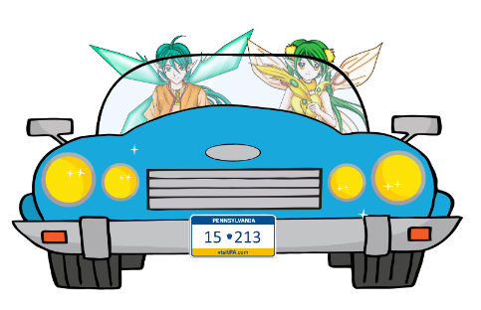


Slide 6
Some practice
Get the tarball
$ wget http://www.cs.cmu.edu/~213/ activities/pxydrive-tutorial2.tar
$ tar –xvf pxydrive-tutorial.tar
$ cd pxydrive-tutorial

Slide 7
PxyDrive Tutorial 1
What happens when you haven’t implemented a concurrent proxy and are expected to handle multiple requests?
Open basic-concurrency.cmd

Slide 8
PxyDrive Tutorial 1
>generate random-text1.txt 2K
Generates a 2K text file called random-text1.txt
>generate random-text2.txt 4K
Generates a 4K text file called random-text2.txt
>serve s1
Launches a server called s1
>request r1 random-text1.txt s1
Requests r1 from s1
>request r2 random-text2.txt s1
Requests r2 from s1
>wait *
Waits for all transactions to finish
Needed in the trace, not in the command-line

Slide 9
PxyDrive Tutorial 1
>respond r2
Respond to client with r2 (Out of order)
>respond r1
Respond to client with r1
>trace r1
Traces the transaction r1
>check r1
Checks the transaction r1
>trace r2
Traces the transaction r2
>check r2
Checks the transaction r2

Slide 10
PxyDrive Tutorial 1
Run trace with –f option:
$ ./pxy/pxydrive –p ./serial-proxy –f basic-concurrency.cmd

Slide 11
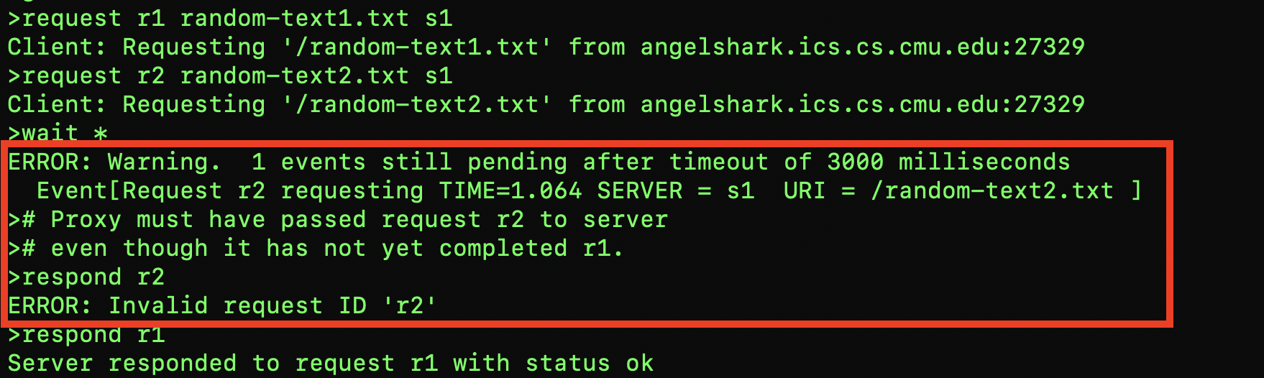
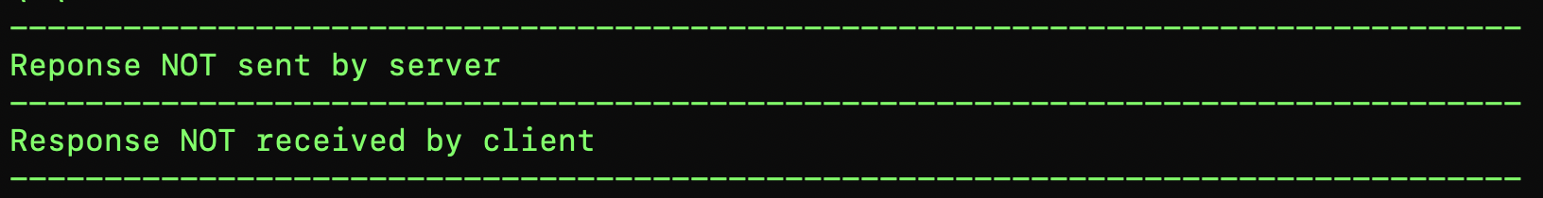
What went wrong?
Notes:
Answer: Response was clobbered.

Slide 12
Join / Detach
Does the following code terminate? Why or why not?
int main(int argc, char** argv)
{
…
pthread_create(&tid, NULL, work, NULL);
if (pthread_join(tid, NULL) != 0) printf(“Done.\n”);
…
void* work(void* a)
{
pthread_detatch(pthread_self());
while(1);
}
Notes:
It depends. There is a race. – Pthread_join causes main to wait until work is complete. So if that runs first, main never terminates.
12

Slide 13
Join / Detach cont.
Does the following code terminate now? Why or why not?
int main(int argc, char** argv)
{
…
pthread_create(&tid, NULL, work, NULL); sleep(1);
if (pthread_join(tid, NULL) != 0) printf(“Done.\n”);
…
void* work(void* a)
{
pthread_detach(pthread_self());
while(1);
}
Notes:
It depends. There is a race. This will probably terminate as the worker thread will detach before the call to pthread_join.
13

Slide 14
When should threads detach?
In general, pthreads will wait to be reaped via pthread_join.
When should this behavior be overridden?
When termination status does not matter.
pthread_join provides a return value
When result of thread is not needed.
When other threads do not depend on this thread having completed

Slide 15
Threads
What is the range of value(s) that main will print?
A programmer proposes removing j from thread and just directly accessing count. Does the answer change?
int main(int argc, char** argv)
{
pthread_t tid[2];
for(int i = 0; i < 2; i++)
pthread_create(&tid[i], NULL,
thread, NULL);
for (int i = 0; i < 2; i++)
pthread_join(tid[i]);
printf(“%d\n”, count);
return 0;
}
volatile int count = 0;
void* thread(void* v)
{
int j = count;
j = j + 1;
count = j;
}
Notes:
1 or 2 because if j is initialized to 0 when both threads start, then writes to count overwrite (1), if they serialize (2)
No, ++ is not atomic, so just using count does not change anything
15

Slide 16
PxyDrive Tutorial 2
What happens when we pass a statically allocated connected descriptor to the peer thread in our proxy?
connfd = Accept(listenfd, (SA *)&clientaddr, &clientlen);
Pthread_create(&tid, NULL, thread, &connfd);
$ ./pxy/pxydrive –f mixed-concurrency.cmd –p ./static-concurrent-proxy

Slide 17
What went wrong?
This can happen due to a race condition between the assignment statement in the peer thread and the accept statement in the main thread!
This can result if the local connfd variable in the peer thread gets the descriptor number of the next connection
Make sure to dynamically allocate memory for each connected descriptor returned by accept!
Notes:
Answer: Response was clobbered.

Slide 18
Synchronization
Is not cheap
100s of cycles just to acquire without waiting
Is also not that expensive
Recall your malloc target of 15000kops => ~100 cycles
May be necessary
Correctness is always more important than performance

Slide 19
Which synchronization should I use?
Counting a shared resource, such as shared buffers
Semaphore
Exclusive access to one or more variables
Mutex
Most operations are reading, rarely writing / modifying
RWLock

Slide 20
Threads Revisited
Which lock type should be used?
Where should it be acquired / released?
int main(int argc, char** argv)
{
pthread_t tid[2];
for(int i = 0; i < 2; i++)
pthread_create(&tid[i], NULL,
thread, NULL);
for (int i = 0; i < 2; i++)
pthread_join(tid[i]);
printf(“%d\n”, count);
return 0;
}
volatile int count = 0;
void* thread(void* v)
{
int j = count;
j = j + 1;
count = j;
}
Notes:
Mutex – acquire it before critical region (j -> count)
20

Slide 21
Associating locks with data
Given the following key-value store
Key and value have separate RWLocks: klock and vlock
When an entry is replaced, both locks are acquired.
Describe why the printf may not be accurate.
typedef struct _data_t {
int key;
size_t value;
} data_t;
#define SIZE 10
data_t space[SIZE];
int search(int k)
{
for(int j = 0; j < SIZE; j++)
if (space[j].key == k) return j;
return -1;
}
...
pthread_rwlock_rdlock(klock);
match = search(k);
pthread_rwlock_unlock(klock);
if (match != -1)
{
pthread_rwlock_rdlock(vlock);
printf(“%zd\n”, space[match]);
pthread_rwlock_unlock(vlock);
}
Notes:
T1: Search …… print
T2: … Replace entry …
While T2 blocks T1 from printing, it replaces the entry that T1 was going to print.
21

Slide 22
Locks gone wrong
RWLocks are particularly susceptible to which issue:
a. Starvation b. Livelock c. Deadlock
If some code acquires rwlocks as readers: LockA then LockB, while other readers go LockB then LockA. What, if any, order can a writer acquire both LockA and LockB?
No order is possible without a potential deadlock.
Design an approach to acquiring two semaphores that avoids deadlock and livelock, while allowing progress to other threads needing only one semaphore.
Notes:
#3 – Trylock inside a loop is one valid approach
22

Slide 23
PxyDrive Tutorial 3
Debugging a proxy that suffers race conditions
Remember that one of the shared resource for all the proxy threads is the cache
$ ./pxy/pxydrive –f caching.cmd –p ./race-proxy
Do take some time understanding the trace file for this tutorial

Slide 24
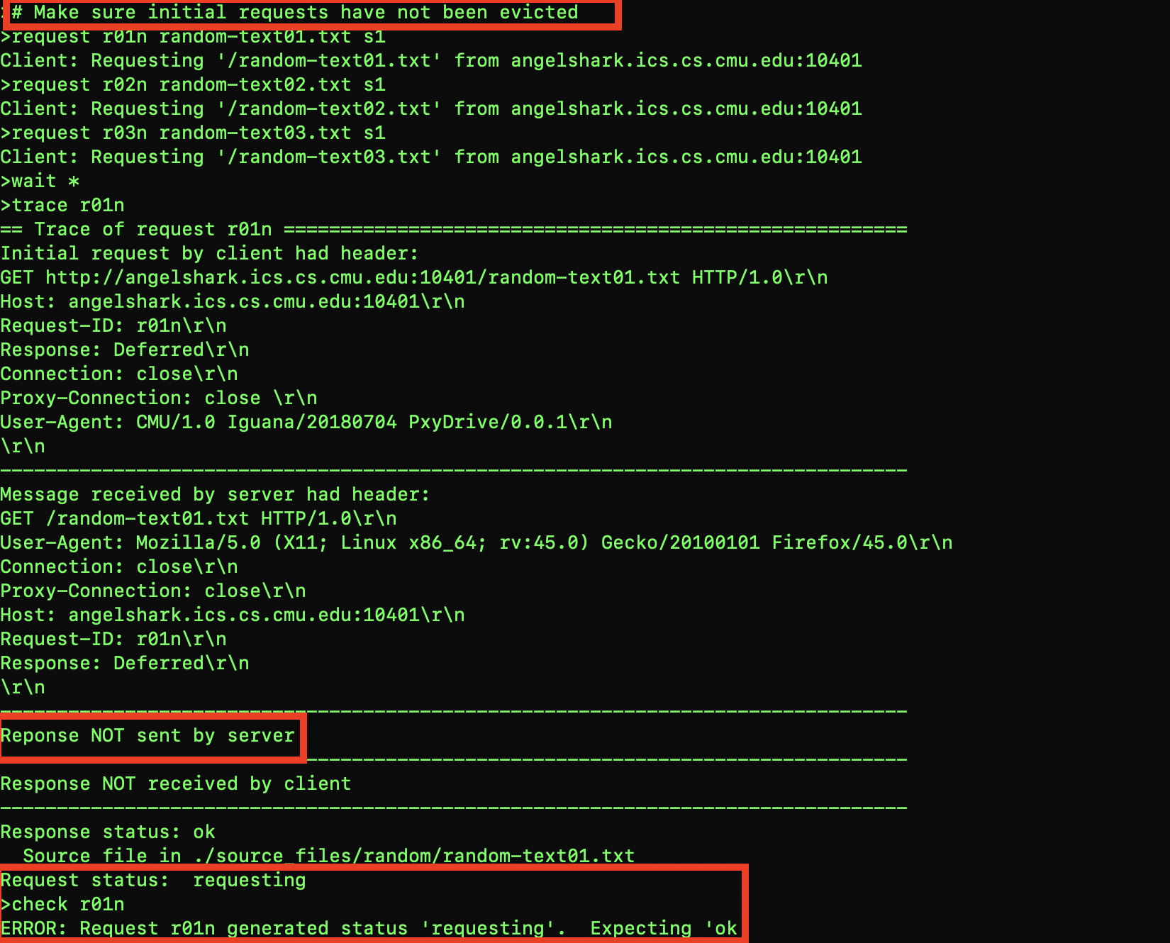
What went wrong?
Notes:
Answer: Response was clobbered.

Slide 25
What went wrong?
We realize that resources r01n (may be different in your case), was expected to be cached
Let’s understand this scenario with two threads running concurrently on the proxy.
T1: At the time of check, T1 sees that it has cached the requested object.
Another thread, say T2: Is trying to add a new object to the cache and is performing an eviction. This thread could possibly delete the object from the cache after the time of check but before T1 sends the cached object to the requesting client ( time-of-use)
This is an example of the Time-of-check Time-of-use race condition
Notes:
Answer: Response was clobbered.

Slide 26
PxyDrive Tutorial 4
Debugging a proxy that suffers a deadlock
Run the same trace but with another faulty proxy
$ ./pxy/pxydrive –f caching.cmd –p ./deadlocked-proxy

Slide 27
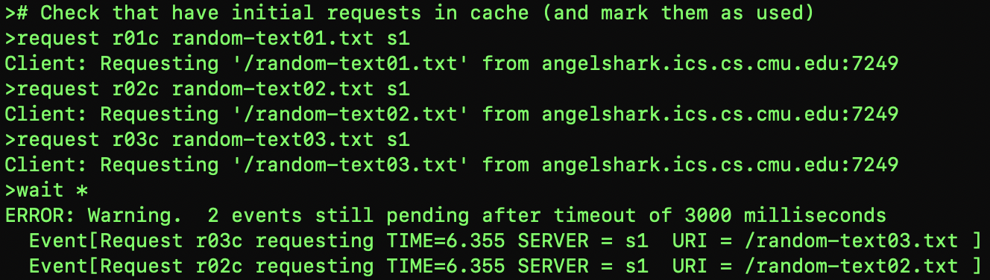
What went wrong?
Notes:
Answer: Response was clobbered.

Slide 28
What went wrong?
We can notice a few timeout events and also some threads were waiting for the event that caused timeout.
Let’s consider two proxy threads T1 and T2 as usual.
Suppose T1 holds a lock on a shared resource ( could be the cache in our case) and never releases it. ( you might have missed to perform pthread_unlock ! Or might have messed with the order of locking and unlocking)
Another thread, say T2: Is trying to hold a lock on the same resource. ( worse condition could be that it is already holding a lock on another shared resource that T2 needs). T2 waits for T1 to release the lock on the first resource and T1 in turn waits for T2 to release lock on that another resource.
Notes:
Answer: Response was clobbered.

Slide 29
Proxylab Reminders
Plan out your implementation
“Weeks of programming can save you hours of planning” – Anonymous
Arbitrarily using mutexes will not fix race conditions
Read the writeup
Submit your code (days) early
Test that the submission will build and run on Autolab
Final exam is only a few weeks away!

Slide 30
Appendix
Calling exit() will terminate all threads
Calling pthread_join on a detached thread is technically undefined behavior. Was defined as returning an error.

