Slide 1
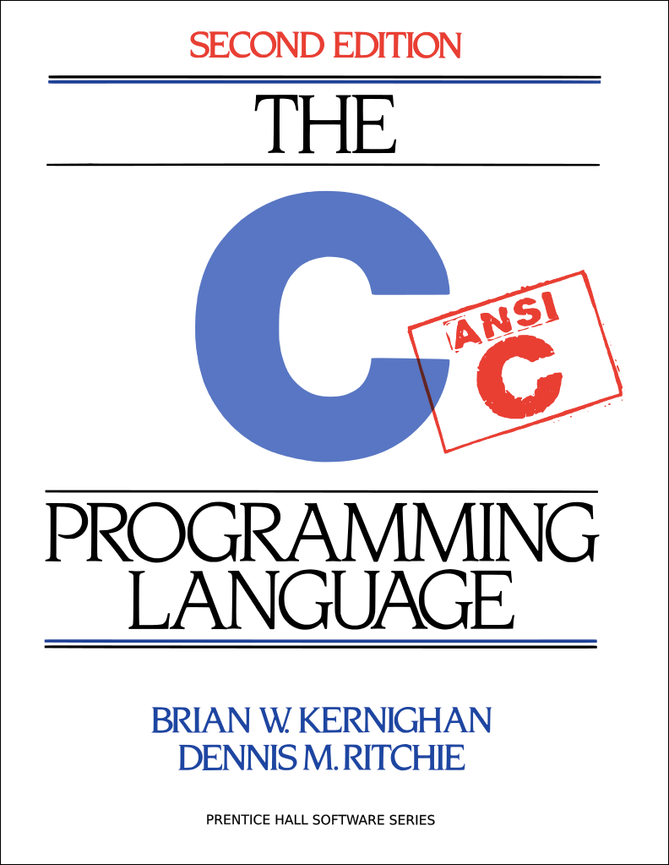
C Boot Camp
September 30, 2018
Notes:
jbiggs

Slide 2
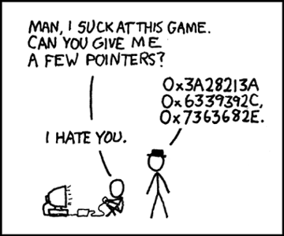
Agenda
C Basics
Debugging Tools / Demo
Appendix
C Standard Library
getopt
stdio.h
stdlib.h
string.h
Notes:
jbiggs

Slide 3
C Basics Handout
ssh <andrewid>@shark.ics.cs.cmu.edu
cd ~/private
wget http://cs.cmu.edu/~213/activities/cbootcamp.tar.gz
tar xvpf cbootcamp.tar.gz
cd cbootcamp
make
Contains useful, self-contained C examples
Slides relating to these examples will have the file names in the top-right corner!
Notes:
jbiggs

Slide 4
C Basics
The minimum you must know to do well in this class
You have seen these concepts before
Make sure you remember them.
Summary:
Pointers/Arrays/Structs/Casting
Memory Management
Function pointers/Generic Types
Strings
GrabBag (Macros, typedefs, header guards/files, etc)
Notes:
Raghav

Slide 5
Pointers
Stores address of a value in memory
e.g. int*, char*, int**, etc
Access the value by dereferencing (e.g. *a).
Can be used to read or write a value to given address
Dereferencing NULL causes undefined behavior (usually a segfault)
Pointer to type A references a block of sizeof(A) bytes
Get the address of a value in memory with the ‘&’ operator
Pointers can be aliased, or pointed to same address
Notes:
Sizeof can be used on both variables and types, returns a size_t

Slide 6
Call by Value vs Call by Reference
./passing_args
Call-by-value: Changes made to arguments passed to a function aren’t reflected in the calling function
Call-by-reference: Changes made to arguments passed to a function are reflected in the calling function
C is a call-by-value language
To cause changes to values outside the function, use pointers
Do not assign the pointer to a different value (that won’t be reflected!)
Instead, dereference the pointer and assign a value to that address
void swap(int* a, int* b) {
int temp = *a;
*a = *b;
*b = temp;
}
int x = 42;
int y = 54;
swap(&x, &y);
printf(“%d\n”, x); // 54
printf(“%d\n”, y); // 42
Notes:
Raghav - deliverable

Slide 7
./pointer_arith
Pointer Arithmetic
Can add/subtract from an address to get a new address
Only perform when absolutely necessary (i.e., malloclab)
Result depends on the pointer type
A+i, where A is a pointer = 0x100, i is an int
int* A: A+i = 0x100 + sizeof(int) * i = 0x100 + 4 * i
char* A: A+i = 0x100 + sizeof(char) * i = 0x100 + 1 * i
int** A: A+i = 0x100 + sizeof(int*) * i = 0x100 + 8 * i
Rule of thumb: explicitly cast pointer to avoid confusion
Prefer ((char*)(A) + i) to (A + i), even if A has type char*
Notes:
Raghav - deliverable

Slide 8
Structs
./structs
Collection of values placed under one name in a single block of memory
Can put structs, arrays in other structs
Given a struct instance, access the fields using the ‘.’ operator
Given a struct pointer, access the fields using the ‘->’ operator
struct inner_s {
int i;
char c;
};
struct outer_s {
char ar[10];
struct inner_s in;
};
outer_s out_inst;
out_inst.ar[0] = ‘a’;
out_inst.in.i = 42;
outer_s* out_ptr = &out_inst;
out_ptr->in.c = ‘b’;
Notes:
jbiggs - deliverable

Slide 9
Unions
When to use
Saving memory
Malloclab!
Tagged Unions
typedef union {
char a;
int b;
} myUnion;
myUnion *u = malloc(sizeof(myUnion))
printf(”size: %zu\n”, sizeof(myUnion));
u->a = ‘A’;
printf(“u->b: %d”, u->b); // UNDEFINED
Notes:
jbiggs - deliverable

Slide 10
Arrays/Strings
Arrays: fixed-size collection of elements of the same type
Can allocate on the stack or on the heap
int A[10]; // A is array of 10 int’s on the stack
int* A = calloc(10, sizeof(int)); // A is array of 10 int’s on the heap
Strings: Null-character (‘\0’) terminated character arrays
Null-character tells us where the string ends
All standard C library functions on strings assume null-termination.
Notes:
jbiggs

Slide 11
Casting
Can convert a variable to a different type
Integer Casting:
Signed <-> Unsigned: Keep Bits - Re-Interpret
Small -> Large: Sign-Extend MSB
Cautions:
Cast Explicitly: int x = (int) y instead of int x = y
Casting Down: Truncates data
Cast Up: Upcasting and dereferencing a pointer causes undefined memory access
Rules for Casting Between Integer Types
Notes:
Nikhil - Deliverable

Slide 12
Malloc, Free, Calloc
Handle dynamic memory allocation on HEAP
void* malloc (size_t size):
allocate block of memory of size bytes
does not initialize memory
void* calloc (size_t num, size_t size):
allocate block of memory for array of num elements, each size bytes long
initializes memory to zero
void free(void* ptr):
frees memory block, previously allocated by malloc, calloc, realloc, pointed by ptr
use exactly once for each pointer you allocate
size argument:
should be computed using the sizeof operator
sizeof: takes a type and gives you its size
e.g., sizeof(int), sizeof(int*)
Notes:
Raghav

Slide 13
mem_mgmt.c
./mem_valgrind.sh
Memory Management Rules
malloc what you free, free what you malloc
client should free memory allocated by client code
library should free memory allocated by library code
Number mallocs = Number frees
Number mallocs > Number Frees: definitely a memory leak
Number mallocs < Number Frees: definitely a double free
Free a malloc’ed block exactly once
Should not dereference a freed memory block
Only malloc when necessary
Persistent, variable sized data structures
Concurrent accesses (we’ll get there later in the semester)
Notes:
Raghav - deliverable

Slide 14
Stack vs Heap vs Data
Local variables and function arguments are placed on the stack
deallocated after the variable leaves scope
do not return a pointer to a stack-allocated variable!
do not reference the address of a variable outside its scope!
Memory blocks allocated by calls to malloc/calloc are placed on the heap
Globals, constants are placed in data section
Example:
// a is a pointer on the stack to a memory block on the heap
int* a = malloc(sizeof(int));
Notes:
jbiggs

Slide 15
Typedefs
./typedefs
Creates an alias type name for a different type
Useful to simplify names of complex data types
Be careful when typedef-ing away pointers!
struct list_node {
int x;
};
typedef int pixel;
typedef struct list_node* node;
typedef int (*cmp)(int e1, int e2); // you won’t use this in 213
pixel x; // int type
node foo; // struct list_node* type
cmp int_cmp; // int (*cmp)(int e1, int e2) type
Notes:
jbiggs - deliverable

Slide 16
Macros
./macros
A way to replace a name with its macro definition
No function call overhead, type neutral
Think “find and replace” like in a text editor
Uses:
defining constants (INT_MAX, ARRAY_SIZE)
defining simple operations (MAX(a, b))
122-style contracts (REQUIRES, ENSURES)
Warnings:
Use parentheses around arguments/expressions, to avoid problems after substitution
Do not pass expressions with side effects as arguments to macros
#define INT_MAX 0x7FFFFFFFF
#define MAX(A, B) ((A) > (B) ? (A) : (B))
#define REQUIRES(COND) assert(COND)
#define WORD_SIZE 4
#define NEXT_WORD(a) ((char*)(a) + WORD_SIZE)
Notes:
jbiggs - deliverable

Slide 17
Generic Types
void* type is C’s provision for generic types
Raw pointer to some memory location (unknown type)
Can’t dereference a void* (what is type void?)
Must cast void* to another type in order to dereference it
Can cast back and forth between void* and other pointer types
// stack usage:
int x = 42; int y = 54;
stack S = stack_new():
push(S, &x);
push(S, &y);
int a = *(int*)pop(S);
int b = *(int*)pop(S);
// stack implementation:
typedef void* elem;
stack stack_new();
void push(stack S, elem e);
elem pop(stack S);
Notes:
jbiggs

Slide 18
Header Files
Includes C declarations and macro definitions to be shared across multiple files
Only include function prototypes/macros; implementation code goes in .c file!
Usage: #include <header.h>
#include <lib> for standard libraries (eg #include <string.h>)
#include “file” for your source files (eg #include “header.h”)
Never include .c files (bad practice)
// list.h
struct list_node {
int data;
struct list_node* next;
};
typedef struct list_node* node;
node new_list();
void add_node(int e, node l);
// list.c
#include “list.h”
node new_list() {
// implementation
}
void add_node(int e, node l) {
// implementation
}
// stacks.h
#include “list.h”
struct stack_head {
node top;
node bottom;
};
typedef struct stack_head* stack
stack new_stack();
void push(int e, stack S);
Notes:
Nikhil - Part of Linked List

Slide 19
Header Guards
Double-inclusion problem: include same header file twice
//grandfather.h
//father.h
#include “grandfather.h”
//child.h
#include “father.h”
#include “grandfather.h”
Error: child.h includes grandfather.h twice
Solution: header guard ensures single inclusion
//grandfather.h
#ifndef GRANDFATHER_H
#define GRANDFATHER_H
#endif
//father.h
#ifndef FATHER_H
#define FATHER_H
#endif
//child.h
#include “father.h”
#include “grandfather.h”
Okay: child.h only includes grandfather.h once
Notes:
Nikhil - Part of Linked List

Slide 20
Debugging
GDB, Valgrind

Slide 21
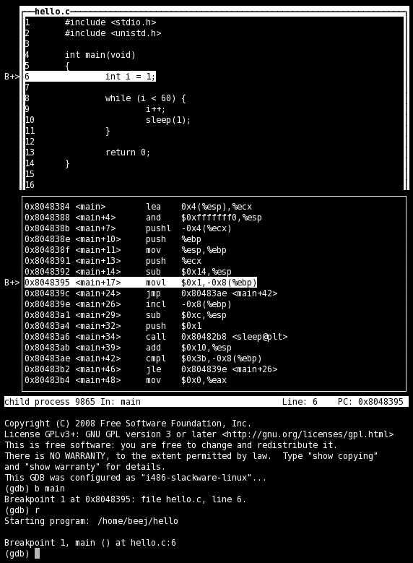
GDB
No longer stepping through assembly! Some GDB commands are different:
si / si → step / next
break file.c:line_num
disas → list
print <any_var_name> (in current frame)
Use TUI mode (layout src)
Nice display for viewing source/executing commands
Buggy, so only use TUI mode to step through lines (no continue / finish)
Notes:
Nikhil

Slide 22
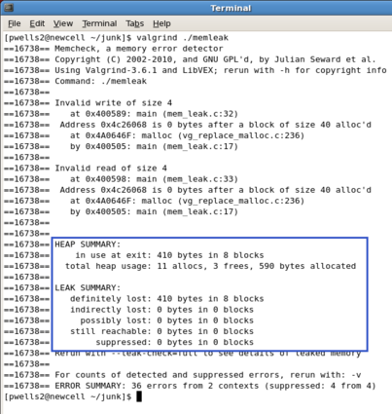
Valgrind
Find memory errors, detect memory leaks
Common errors:
Illegal read/write errors
Use of uninitialized values
Illegal frees
Overlapping source/destination addresses
Typical solutions
Did you allocate enough memory?
Did you accidentally free stack variables/something twice?
Did you initialize all your variables?
Did use something that you just free’d?
--leak-check=full
Memcheck gives details for each definitely/possibly lost memory block (where it was allocated
Notes:
Nikhil

Slide 23
Appendix

Slide 24
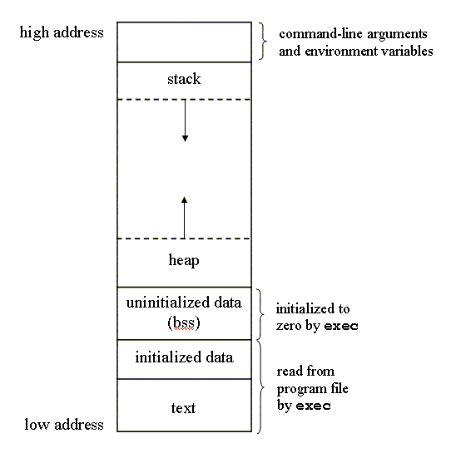
C Program Memory Layout

Slide 25
Variable Declarations & Qualifiers
Global Variables:
Defined outside functions, seen by all files
Use “extern” keyword to use a global variable defined in another file
Const Variables:
For variables that won’t change
Data stored in read-only data section
Static Variables:
For locals, keeps value between invocations
USE SPARINGLY
Note: static has a different meaning when referring to functions
Volatile Variables:
Compiler will not make assumptions about current value, useful for asynchronous reads/writes, i.e. interrupts
“volatile” == “subject to change at any time”

Slide 26
C Libraries

Slide 27
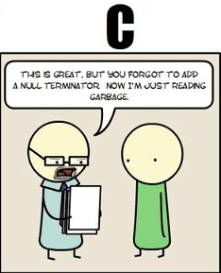
string.h: Common String/Array Methods
One the most useful libraries available to you
Used heavily in shell/proxy labs
Important usage details regarding arguments:
prefixes: str -> strings, mem -> arbitrary memory blocks.
ensure that all strings are ‘\0’ terminated!
ensure that dest is large enough to store src!
ensure that src actually contains n bytes!
ensure that src/dest don’t overlap!

Slide 28
string.h: Common String/Array Methods
Copying:
void *memcpy (void *dest, void *src, size_t n) Copy n bytes of src into dest, return dest
char *strcpy(char *dest, char *src) Copy src string into dest, including the NUL terminator, return dest. Make sure dest is large enough to contain src.
char *strncpy(char *dest, char *src, size_t count) Copy src string into dest, including the NUL terminator, return dest. Copies at most count bytes. Make sure dest is large enough to contain src.
Notes:
You can do a lot of these things with strings because you are guaranteed a null terminator character- you cannot do a lot of these things with memory because memory can just be anything

Slide 29
string.h: Common String/Array Methods (Continued)
Concatenation:
char *strncat (char *dest, char *src, size_t n) Append copy of src to end of dest reading at most n bytes, return dest
char *strcat (char *dest, char *src) Works for arbitrary length strings, but has the safety issues you’ve seen in attacklab
Notes:
You can do a lot of these things with strings because you are guaranteed a null terminator character- you cannot do a lot of these things with memory because memory can just be anything

Slide 30
string.h: Common String/Array Methods (Continued)
Comparison:
int strncmp (char *str1, char *str2, size_t n) Compare at most n bytes of str1, str2 by character (based on ASCII value of each character, then string length), return comparison result -1 if str1 < str2 0 if str1 == str2 1 if str1 > str2
int strcmp(char *str1, char *str2) Compare str1 to str2. Make sure each string is long enough to be safely compared.
Notes:
You can do a lot of these things with strings because you are guaranteed a null terminator character- you cannot do a lot of these things with memory because memory can just be anything

Slide 31
string.h: Common String/Array Methods (Continued)
Searching:
char *strstr (char *str1, char *str2) Return pointer to first occurrence of str2 in str1, else NULL
char *strtok (char *str, char *delimiters) Tokenize str according to delimiter characters provided in delimiters. Return the one token for each strtok call, using str = NULL

Slide 32
string.h: Common String/Array Methods (Continued)
Other:
size_t strlen (const char *str) Return length of the string (up to, but not including the ‘\0’ character)
void *memset (void *ptr, int val, size_t n) Set first n bytes of memory block addressed by ptr to val. Use for setting bytes only. Don’t use it to set or initialize int arrays, for example.

Slide 33
stdlib.h: General Purpose Functions
Dynamic memory allocation:
malloc, calloc, free
String conversion:
int atoi(char *str): parse string into integral value (return 0 if not parsed)
System Calls:
void exit(int status): terminate calling process, return status to parent process
void abort(): aborts process abnormally
Searching/Sorting:
provide array, array size, element size, comparator (function pointer)
bsearch: returns pointer to matching element in the array
qsort: sorts the array destructively
Integer arithmetic:
int abs(int n): returns absolute value of n
Types:
size_t: unsigned integral type (store size of any object)
In a format string, print with %zu

Slide 34
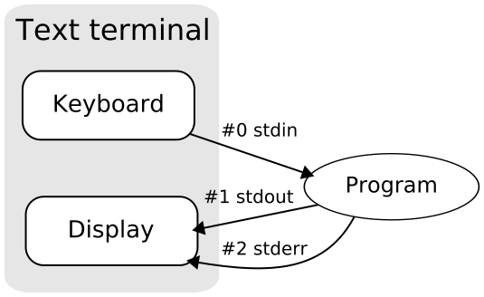
stdio.h
Another really useful library.
Used heavily in cache/shell/proxy labs
Used for:
argument parsing
file handling
input/output
printf, a fan favorite, comes from this library!

Slide 35
stdio.h: Common I/O Methods
FILE *fopen (char *filename, char *mode): open the file with specified filename in specified mode (read, write, append, etc), associate it with stream identified by returned file pointer
int fscanf (FILE *stream, char *format, ...): read data from the stream, store it according to the parameter format at the memory locations pointed at by additional arguments.
int fclose (FILE *stream): close the file associated with stream
int fprintf (FILE *stream, char *format, ... ): write the C string pointed at by format to the stream, using any additional arguments to fill in format specifiers.

Slide 36
Getopt
Need to include unistd.h to use
Used to parse command-line arguments.
Typically called in a loop to retrieve arguments
Switch statement used to handle options
colon indicates required argument
optarg is set to value of option argument
Returns -1 when no more arguments present
See recitation 6 slides for more examples
int main(int argc, char **argv)
{
int opt, x;
/* looping over arguments */
while((opt=getopt(argc,argv,“x:"))>0){
switch(opt) {
case 'x':
x = atoi(optarg);
break;
default:
printf(“wrong argument\n");
break;
}
}
}

Slide 37
Note about Library Functions
These functions can return error codes
malloc could fail
int x;
if ((x = malloc(sizeof(int))) == NULL)
printf(“Malloc failed!!!\n”);
a file couldn’t be opened
a string may be incorrectly parsed
Remember to check for the error cases and handle the errors accordingly
may have to terminate the program (eg malloc fails)
may be able to recover (user entered bad input)

