Slide 1
15-213 Recitation: Attack Lab
24 Sep 2018

Slide 2
Agenda
Reminders
Stacks
Attack Lab Activities

Slide 3
Reminders
Bomb lab is due tomorrow (25 Sept, 2018) !
“But if you wait until the last minute, it only takes a minute!” – NOT!
Don’t waste your grace days on this assignment!
Attack lab will be released tomorrow!

Slide 4
Stacks
Last-in, first-out
x86 stack grows down
lowest address is “top”
$rsp contains the address of the topmost element in the stack
Uses the pushq and popq instructions to push and pop registers/constants onto and off the stack

Slide 5
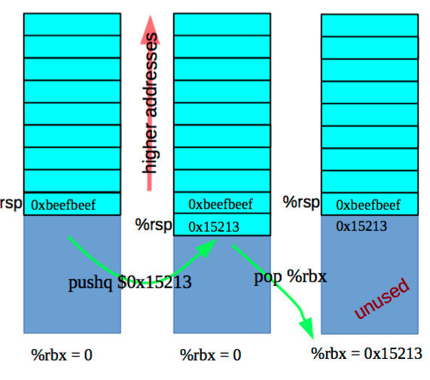
Stack – pushq & popq
Stack “bottom”
pushq {value} is equivalent to
sub $8, %rsp
mov {value}, (%rsp)
popq {reg} is equivalent to
mov (%rsp), {reg}
add $8, %rsp
Stack “top”

Slide 6
Stack – Caller vs. Callee
Function A calls function B
A is the caller
B is the callee
Stack space is allocated in “frames”
Represents the state of a single function invocation
Frame used primarily for two things:
Storing callee saved registers
Storing the return address of a function

Slide 7
Registers – Caller-saved vs. Callee-saved
Caller-saved
Registers used for function arguments are always caller-saved
$rax is also caller-saved
Called function may do as it wishes with the registers
Must save/restore register in caller’s stack frame if it still needs the value after a function call
Callee-saved
If the function wants to change the register, it must save the original value in its stack frame and restore it before returning
The calling function may store temporary values in callee-saved registers

Slide 8
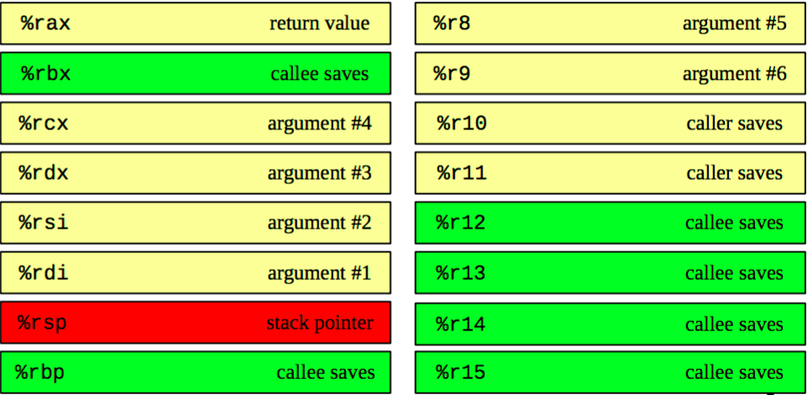
x86-64 Register Usage Conventions

Slide 9
Registers – Caller-saved vs. Callee-saved
Before function call
rdi = first argument
rsi = second argument
rax = some temporary value
rbx = some important number to use later (15213)
rsp = pointer to some important buffer (0x7fffffffaaaa)
After function call
rdi = garbage
rsi = garbage
rax = return value
rbx = some important number to use later (15213)
rsp = pointer to some important buffer (0x7fffffffaaaa)

Slide 10
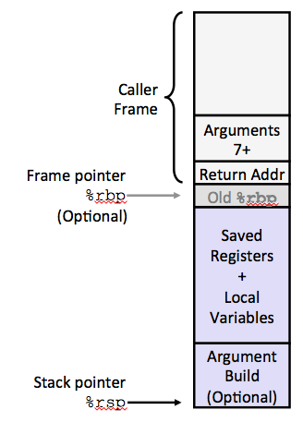

x86-64/Linux Stack Frame
Stack “bottom”
Current Stack Frame (“Top” to Bottom)
“Argument build:” - Parameters for function about to call
Local variables - If can’t keep in registers
Saved register context
Old frame pointer (optional)
Caller Stack Frame
Return address
- Pushed by call instruction
Arguments for this call
Stack “top”

Slide 11
Stack Maintenance
Functions free their frame before returning
Return instruction looks for the return address at the top of the stack
…What if the return address has been changed?

Slide 12
Attack Lab
We’re letting you hijack programs by running buffer overflow attacks on them.
Is that not justification enough?
To understand stack discipline and stack frames
To defeat relatively secure programs with return oriented programming

Slide 13
Attack Lab Activities
Three activities
Each relies on a specially crafted assembly sequence to purposefully overwrite the stack
Activity 1 – Overwrites the return addresses
Activity 2 – Writes an assembly sequence onto the stack
Activity 3 – Uses byte sequences in libc as the instructions

Slide 14
Attack Lab Activities
One student needs a laptop
Login to a shark machine
$ wget http://www.cs.cmu.edu/~213/activities/rec5.tar
$ tar xf rec5.tar
$ cd rec5
$ make
$ gdb act1

Slide 15
Activity 1
(gdb) break clobber
(gdb) run
(gdb) x $rsp
(gdb) backtrace
Q. Does the value at the top of the stack match any frame?

Slide 16
Activity 1 Continued
(gdb) x /2gx $rdi // Here are the two key values
(gdb) stepi // Keep doing this until
(gdb)
clobber () at support.s:16
16 ret
(gdb) x $rsp
Q. Has the return address changed?
(gdb) finish // Should exit and print out “Hi!”

Slide 17
Activity 1 Post
Clobber overwrites part of the stack with memory at $rdi, including the all-important return address
In act1 it writes two new return addresses:
0x400500: address of printHi()
0x400560: address in main
Call clobber()
Clobber executes
In printHi()
In main()
0x7fffffffe338
0x000000400553
0x000000400560
0x000000400500
ret
ret
0x000000400560

Slide 18
Activity 2
$gdb act2
(gdb) break clobber
(gdb) run
(gdb) x $rsp
Q. What is the address of the stack and the return address?
(gdb) x /4gx $rdi
Q. What will the new return address be? (i.e., what is the first value?)

Slide 19
Activitity 2 Continued
(gdb) x/5i $rdi + 8 // Display as instructions
Q. Why rdi + 8?
Q. What are the three addresses?
(gdb) break puts
(gdb) break exit
Q. Do these addresses look familiar?

Slide 20
Activity 2 Post
Normally programs cannot execute instructions on the stack
Main used mprotect to disable the memory protection for this activity
Clobber wrote an address that’s on the stack as a return address
Followed by a sequence of instructions
Three addresses show up in the exploit:
0x48644d → “Hi\n” string
0x4022e0 → puts() function
0x4011a0 → exit() function

Slide 21
Activity 3
$gdb act3
(gdb) break clobber
(gdb) run
(gdb) x /5gx $rdi
Q. Which value will be first on the stack?
Q. At the end of clobber, where will the function return to?

Slide 22
Activity 3 Continued
(gdb) x /2i <return address>
Q. What does this sequence do?
Q. Do the same for the other addresses. Note that some are return addresses and some are for data. When you continue, what will the code now do?

Slide 23
Activity 3 Post
It’s harder to stop programs from running existing pieces of code in the executable.
Clobber wrote multiple return addresses (aka gadgets) that each performed a small task, along with data that will get popped off the stack while running the gadgets.
0x457d0c: pop %rdi; retq
0x47fa64: Pointer to the string “Hi\n”
0x429a6a: pop %rax; retq
0x400500: Address of a printing function
0x47f001: callq *%rax

Slide 24
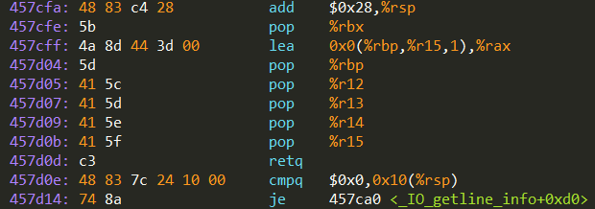

Activity 3 Post
Note that some of the return addresses actually cut off bytes from existing instructions
0x457d0b …0c …0d
-----------------------------------------
pop %r15 retq
41 5f c3
pop %rdi retq
5f c3

Slide 25
Attack Lab Tools
gcc –c test.s; objdump –d test.o > test.asm
Compiles the assembly code in test.s and shows the actual bytes for the instructions
./hex2raw < exploit.txt > converted.txt
Convert hex codes in exploit.txt into raw ASCII strings to pass to targets
See the writeup for more details on how to use this
(gdb) display /12gx $rsp (gdb) display /2i $rip
Displays 12 elements on the stack and the next 2 instructions to run
GDB is also useful to for tracing to see if an exploit is working

Slide 26
If you get stuck
Please read the writeup. Please read the writeup. Please read the writeup. Please read the writeup!
CS:APP Chapter 3
View lecture notes and course FAQ at http://www.cs.cmu.edu/~213
Office hours Sunday through Thursday 5:00-9:00pm in WH 5207
Post a private question on Piazza
man gdb, gdb's help command

