Slide 1
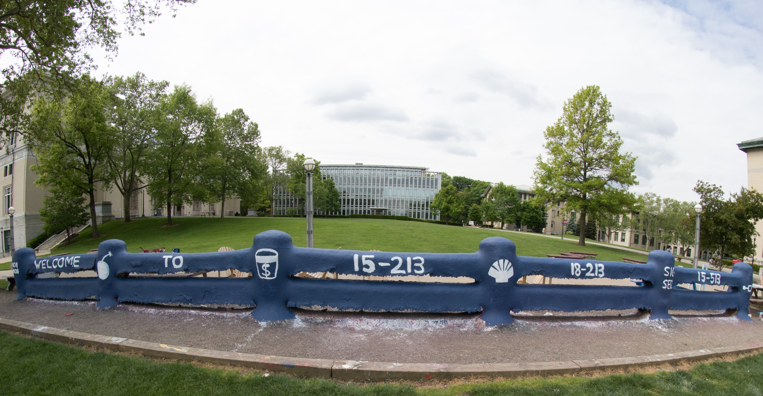

Slide 2
The Memory Hierarchy 15-213/18-213/15-513: Introduction to Computer Systems 11th Lecture, October 2, 2018

Slide 3
Today
Storage technologies and trends
Locality of reference
Caching in the memory hierarchy

Slide 4
Random-Access Memory (RAM)
Key features
RAM is traditionally packaged as a chip.
Basic storage unit is normally a cell (one bit per cell).
Multiple RAM chips form a memory.
RAM comes in two varieties:
SRAM (Static RAM)
DRAM (Dynamic RAM)

Slide 5
SRAM vs DRAM Summary
Trans. Access Needs Needs
per bit time refresh? EDC? Cost Applications
SRAM 4 or 6 1x No Maybe 100x Cache memories
DRAM 1 10x Yes Yes 1x Main memories,
frame buffers
EDC: Error detection and correction

Slide 6
Enhanced DRAMs
Basic DRAM cell has not changed since its invention in 1966.
Commercialized by Intel in 1970.
DRAM cores with better interface logic and faster I/O :
Synchronous DRAM (SDRAM)
Uses a conventional clock signal instead of asynchronous control
Allows reuse of the row addresses (e.g., RAS, CAS, CAS, CAS)
Double data-rate synchronous DRAM (DDR SDRAM)
Double edge clocking sends two bits per cycle per pin
Different types distinguished by size of small prefetch buffer:
DDR (2 bits), DDR2 (4 bits), DDR3 (8 bits), DDR4 (16 bits)
By 2010, standard for most server and desktop systems
Intel Core i7 supports DDR3 and DDR4 SDRAM

Slide 7
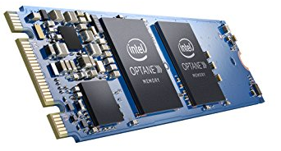
Nonvolatile Memories
DRAM and SRAM are volatile memories
Lose information if powered off.
Nonvolatile memories retain value even if powered off
Read-only memory (ROM): programmed during production
Programmable ROM (PROM): can be programmed once
Eraseable PROM (EPROM): can be bulk erased (UV, X-Ray)
Electrically eraseable PROM (EEPROM): electronic erase capability
Flash memory: EEPROMs, with partial (block-level) erase capability
Wears out after about 100,000 erasings
3D XPoint (Intel Optane) & emerging NVMs
New materials
Uses for Nonvolatile Memories
Firmware programs stored in a ROM (BIOS, controllers for disks, network cards, graphics accelerators, security subsystems,…)
Solid state disks (replace rotating disks in thumb drives, smart phones, mp3 players, tablets, laptops, data centers,…)
Disk caches

Slide 8
Traditional Bus Structure Connecting CPU and Memory
A bus is a collection of parallel wires that carry address, data, and control signals.
Buses are typically shared by multiple devices.
CPU chip
Register file
ALU
System bus
Memory bus
Main
memory
Bus interface
I/O
bridge

Slide 9
Memory Read Transaction (1)
CPU places address A on the memory bus.
Register file
Load operation: movq A, %rax
ALU
%rax
Main memory
I/O bridge
A
0
Bus interface
x
A

Slide 10
Memory Read Transaction (2)
Main memory reads A from the memory bus, retrieves word x, and places it on the bus.
Register file
Load operation: movq A, %rax
ALU
%rax
Main memory
I/O bridge
x
0
Bus interface
x
A

Slide 11
Memory Read Transaction (3)
CPU read word x from the bus and copies it into register %rax.
Register file
Load operation: movq A, %rax
ALU
%rax
x
Main memory
I/O bridge
0
Bus interface
x
A

Slide 12
Memory Write Transaction (1)
CPU places address A on bus. Main memory reads it and waits for the corresponding data word to arrive.
Register file
Store operation: movq %rax, A
ALU
%rax
y
Main memory
I/O bridge
A
0
Bus interface
A

Slide 13
Memory Write Transaction (2)
CPU places data word y on the bus.
Register file
Store operation: movq %rax, A
ALU
%rax
y
Main memory
I/O bridge
y
0
Bus interface
A

Slide 14
Memory Write Transaction (3)
Main memory reads data word y from the bus and stores it at address A.
Register file
Store operation: movq %rax, A
ALU
%rax
y
Main memory
I/O bridge
0
Bus interface
y
A

Slide 15
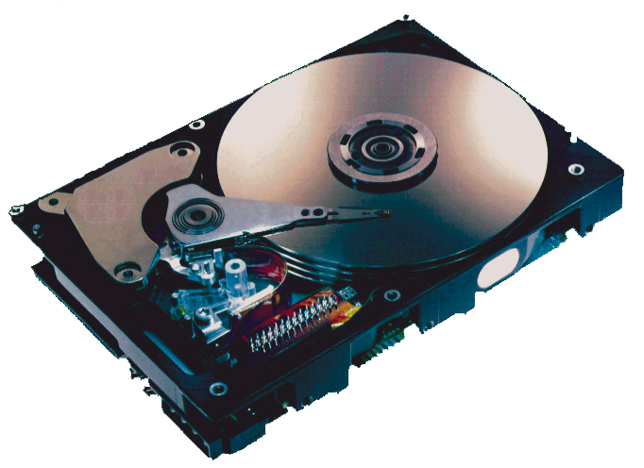
What’s Inside A Disk Drive?
Spindle
Arm
Platters
Actuator
Electronics
(including a
processor
and memory!)
SCSI
connector
Image courtesy of Seagate Technology

Slide 16
Disk Geometry
Disks consist of platters, each with two surfaces.
Each surface consists of concentric rings called tracks.
Each track consists of sectors separated by gaps.
Tracks
Surface
Track k
Gaps
Spindle
Sectors

Slide 17
Disk Geometry (Multiple-Platter View)
Aligned tracks form a cylinder.
Cylinder k
Surface 0
Platter 0
Surface 1
Surface 2
Platter 1
Surface 3
Surface 4
Platter 2
Surface 5
Spindle

Slide 18
Disk Capacity
Capacity: maximum number of bits that can be stored.
Vendors express capacity in units of gigabytes (GB) or terabytes (TB), where 1 GB = 10⁹ Bytes and 1 TB = 10¹² Bytes
Capacity is determined by these technology factors:
Recording density (bits/in): number of bits that can be squeezed into a 1 inch segment of a track.
Track density (tracks/in): number of tracks that can be squeezed into a 1 inch radial segment.
Areal density (bits/in²): product of recording and track density.
Tracks

Slide 19
Computing Disk Capacity
Capacity = (# bytes/sector) x (avg. # sectors/track) x
(# tracks/surface) x (# surfaces/platter) x
(# platters/disk)
Example:
512 bytes/sector
300 sectors/track (on average)
20,000 tracks/surface
2 surfaces/platter
5 platters/disk
Capacity = 512 x 300 x 20,000 x 2 x 5
= 30,720,000,000
= 30.72 GB

Slide 20
Disk Operation (Single-Platter View)
The disk surface
spins at a fixed
rotational rate
The read/write head
is attached to the end
of the arm and flies over
the disk surface on
a thin cushion of air.
spindle
spindle
spindle
spindle
spindle
By moving radially, the arm can position the read/write head over any track.

Slide 21
Disk Operation (Multi-Platter View)
Read/write heads
move in unison
from cylinder to cylinder
Arm
Spindle

Slide 22
Disk Structure - top view of single platter
Surface organized into tracks
Tracks divided into sectors
Notes:
Goal:
Show the inefficeincy of current disk requests.
Conveyed Ideas:
Rotational latency is wasted time that can be used to service tasks
Background Information:
None.
Slide Background:
None.
Kill text and arrows

Slide 23
Disk Access
Head in position above a track
Notes:
Goal:
Show the inefficeincy of current disk requests.
Conveyed Ideas:
Rotational latency is wasted time that can be used to service tasks
Background Information:
None.
Slide Background:
None.
Kill text and arrows

Slide 24
Disk Access
Rotation is counter-clockwise
Notes:
Goal:
Show the inefficeincy of current disk requests.
Conveyed Ideas:
Rotational latency is wasted time that can be used to service tasks
Background Information:
None.
Slide Background:
None.
Kill text and arrows

Slide 25
Disk Access – Read
About to read blue sector
Notes:
Goal:
Show the inefficeincy of current disk requests.
Conveyed Ideas:
Rotational latency is wasted time that can be used to service tasks
Background Information:
None.
Slide Background:
None.
Kill text and arrows

Slide 26
Disk Access – Read
After BLUE read
After reading blue sector
Notes:
Goal:
Show the inefficeincy of current disk requests.
Conveyed Ideas:
Rotational latency is wasted time that can be used to service tasks
Background Information:
None.
Slide Background:
None.
Kill text and arrows

Slide 27
Disk Access – Read
After BLUE read
Red request scheduled next
Notes:
Goal:
Show the inefficeincy of current disk requests.
Conveyed Ideas:
Rotational latency is wasted time that can be used to service tasks
Background Information:
None.
Slide Background:
None.
Kill text and arrows

Slide 28
Disk Access – Seek
After BLUE read
Seek for RED
Seek to red’s track
Notes:
Goal:
Show the inefficeincy of current disk requests.
Conveyed Ideas:
Rotational latency is wasted time that can be used to service tasks
Background Information:
None.
Slide Background:
None.
Kill text and arrows

Slide 29
Disk Access – Rotational Latency
After BLUE read
Seek for RED
Rotational latency
Wait for red sector to rotate around
Notes:
Goal:
Show the inefficeincy of current disk requests.
Conveyed Ideas:
Rotational latency is wasted time that can be used to service tasks
Background Information:
None.
Slide Background:
None.
Kill text and arrows

Slide 30
Disk Access – Read
After BLUE read
Seek for RED
Rotational latency
After RED read
Complete read of red
Notes:
Goal:
Show the inefficeincy of current disk requests.
Conveyed Ideas:
Rotational latency is wasted time that can be used to service tasks
Background Information:
None.
Slide Background:
None.
Kill text and arrows

Slide 31
Disk Access – Service Time Components
After BLUE read
Seek for RED
Rotational latency
After RED read
Data transfer
Seek
Rotational
latency
Data transfer
Notes:
Goal:
Show the inefficeincy of current disk requests.
Conveyed Ideas:
Rotational latency is wasted time that can be used to service tasks
Background Information:
None.
Slide Background:
None.
Kill text and arrows

Slide 32
Disk Access Time
Average time to access some target sector approximated by:
T_{access} = T_{avg seek} + T_{avg rotation} + T_{avg transfer}
Seek time (T_{avg seek})
Time to position heads over cylinder containing target sector.
Typical T_{avg seek} is 3—9 ms
Rotational latency (T_{avg rotation})
Time waiting for first bit of target sector to pass under r/w head.
T_{avg rotation} = 1/2 x 1/RPMs x 60 sec/1 min
Typical T_{avg rotation} = 7,200 RPMs
Transfer time (T_{avg transfer})
Time to read the bits in the target sector.
T_{avg transfer} = 1/RPM x 1/(avg # sectors/track) x 60 secs/1 min.

Slide 33
Disk Access Time Example
Given:
Rotational rate = 7,200 RPM
Average seek time = 9 ms.
Avg # sectors/track = 400.
Derived:
T_{avg rotation} = 1/2 x (60 secs/7200 RPM) x 1000 ms/sec = 4 ms.
T_{avg transfer} = 60/7200 RPM x 1/400 secs/track x 1000 ms/sec = 0.02 ms
T_{access} = 9 ms + 4 ms + 0.02 ms
Important points:
Access time dominated by seek time and rotational latency.
First bit in a sector is the most expensive, the rest are free.
SRAM access time is about 4 ns/doubleword, DRAM about 60 ns
Disk is about 40,000 times slower than SRAM,
2,500 times slower then DRAM.

Slide 34
Logical Disk Blocks
Modern disks present a simpler abstract view of the complex sector geometry:
The set of available sectors is modeled as a sequence of b-sized logical blocks (0, 1, 2, ...)
Mapping between logical blocks and actual (physical) sectors
Maintained by hardware/firmware device called disk controller.
Converts requests for logical blocks into (surface,track,sector) triples.
Allows controller to set aside spare cylinders for each zone.
Accounts for the difference in “formatted capacity” and “maximum capacity”.

Slide 35
I/O Bus
CPU chip
Register file
ALU
System bus
Memory bus
Main
memory
Bus interface
I/O
bridge
I/O bus
Expansion slots for
other devices such
as network adapters.
USB
controller
Graphics
adapter
Disk
controller
Mouse
Keyboard
Monitor
Disk

Slide 36
Reading a Disk Sector (1)
CPU chip
CPU initiates a disk read by writing a command, logical block number, and destination memory address to a port (address) associated with disk controller.
Register file
ALU
Main
memory
Bus interface
I/O bus
USB
controller
Graphics
adapter
Disk
controller
mouse
keyboard
Monitor
Disk

Slide 37
Reading a Disk Sector (2)
CPU chip
Register file
Disk controller reads the sector and performs a direct memory access (DMA) transfer into main memory.
ALU
Main
memory
Bus interface
I/O bus
USB
controller
Graphics
adapter
Disk
controller
Mouse
Keyboard
Monitor
Disk

Slide 38
Reading a Disk Sector (3)
CPU chip
When the DMA transfer completes, the disk controller notifies the CPU with an interrupt (i.e., asserts a special “interrupt” pin on the CPU).
Register file
ALU
Main
memory
Bus interface
I/O bus
USB
controller
Graphics
adapter
Disk
controller
Mouse
Keyboard
Monitor
Disk

Slide 39
Solid State Disks (SSDs)
I/O bus
Requests to read and
write logical disk blocks
Solid State Disk (SSD)
Flash
translation layer
Flash memory
Block 0
Block B-1
…
…
…
Page 0
Page 1
Page P-1
Page 0
Page 1
Page P-1
Pages: 512KB to 4KB, Blocks: 32 to 128 pages
Data read/written in units of pages.
Page can be written only after its block has been erased.
A block wears out after about 100,000 repeated writes.

Slide 40
SSD Performance Characteristics
Sequential read tput 550 MB/s Sequential write tput 470 MB/s
Random read tput 365 MB/s Random write tput 303 MB/s
Avg seq read time 50 us Avg seq write time 60 us
Sequential access faster than random access
Common theme in the memory hierarchy
Random writes are somewhat slower
Erasing a block takes a long time (~1 ms).
Modifying a block page requires all other pages to be copied to new block.
In earlier SSDs, the read/write gap was much larger. Fixed by flash translation layer.
Source: Intel SSD 730 product specification.

Slide 41
SSD Tradeoffs vs Rotating Disks
Advantages
No moving parts → faster, less power, more rugged
Disadvantages
Have the potential to wear out
Mitigated by “wear leveling logic” in flash translation layer
E.g. Intel SSD 730 guarantees 128 petabyte (128 x 10¹⁵ bytes) of writes before they wear out
In 2015, about 30 times more expensive per byte
Applications
MP3 players, smart phones, laptops
Increasingly common in desktops and servers

Slide 42
Quiz Time!
Check out:
https://canvas.cmu.edu/courses/5835

Slide 43
The CPU-Memory Gap
The gap widens between DRAM, disk, and CPU speeds.
Disk
SSD
DRAM
CPU

Slide 44
Locality to the Rescue!
The key to bridging this CPU-Memory gap is a fundamental property of computer programs known as locality.

Slide 45
Today
Storage technologies and trends
Locality of reference
Caching in the memory hierarchy

Slide 46
Locality
Principle of Locality: Programs tend to use data and instructions with addresses near or equal to those they have used recently
Temporal locality:
Recently referenced items are likely to be referenced again in the near future
Spatial locality:
Items with nearby addresses tend to be referenced close together in time

Slide 47
Locality Example
sum = 0;
for (i = 0; i < n; i++)
sum += a[i];
return sum;
Spatial or Temporal
Locality?
Data references
Reference array elements in succession (stride-1 reference pattern).
Reference variable sum each iteration.
Instruction references
Reference instructions in sequence.
Cycle through loop repeatedly.
spatial
temporal
spatial
temporal

Slide 48
Qualitative Estimates of Locality
Claim: Being able to look at code and get a qualitative sense of its locality is a key skill for a professional programmer.
Question: Does this function have good locality with respect to array a?
int sum_array_rows(int a[M][N])
{
int i, j, sum = 0;
for (i = 0; i < M; i++)
for (j = 0; j < N; j++)
sum += a[i][j];
return sum;
}
Hint: array layout is row-major order
Answer: yes

Slide 49
Locality Example
Question: Does this function have good locality with respect to array a?
int sum_array_cols(int a[M][N])
{
int i, j, sum = 0;
for (j = 0; j < N; j++)
for (i = 0; i < M; i++)
sum += a[i][j];
return sum;
}
Answer: no, unless…
M is very small

Slide 50
Locality Example
Question: Can you permute the loops so that the function scans the 3-d array a with a stride-1 reference pattern (and thus has good spatial locality)?
int sum_array_3d(int a[M][N][N])
{
int i, j, k, sum = 0;
for (i = 0; i < N; i++)
for (j = 0; j < N; j++)
for (k = 0; k < M; k++)
sum += a[k][i][j];
return sum;
}
Answer: make j the inner loop

Slide 51
Memory Hierarchies
Some fundamental and enduring properties of hardware and software:
Fast storage technologies cost more per byte, have less capacity, and require more power (heat!).
The gap between CPU and main memory speed is widening.
Well-written programs tend to exhibit good locality.
These fundamental properties complement each other beautifully.
They suggest an approach for organizing memory and storage systems known as a memory hierarchy.

Slide 52
Today
Storage technologies and trends
Locality of reference
Caching in the memory hierarchy

Slide 53
Example Memory Hierarchy
L0:
Regs
CPU registers hold words retrieved from the L1 cache.
Smaller,
faster,
and
costlier
(per byte)
storage
devices
L1:
L1 cache
(SRAM)
L1 cache holds cache lines retrieved from the L2 cache.
L2:
L2 cache
(SRAM)
L2 cache holds cache lines
retrieved from L3 cache.
L3:
L3 cache
(SRAM)
L3 cache holds cache lines
retrieved from main memory.
Larger,
slower,
and
cheaper
(per byte)
storage
devices
L4:
Main memory
(DRAM)
Main memory holds disk blocks retrieved from local disks.
L5:
Local secondary storage
(local disks)
Local disks hold files retrieved from disks
on remote servers.
L6:
Remote secondary storage
(e.g., Web servers)

Slide 54
Caches
Cache: A smaller, faster storage device that acts as a staging area for a subset of the data in a larger, slower device.
Fundamental idea of a memory hierarchy:
For each k, the faster, smaller device at level k serves as a cache for the larger, slower device at level k+1.
Why do memory hierarchies work?
Because of locality, programs tend to access the data at level k more often than they access the data at level k+1.
Thus, the storage at level k+1 can be slower, and thus larger and cheaper per bit.
Big Idea (Ideal): The memory hierarchy creates a large pool of storage that costs as much as the cheap storage near the bottom, but that serves data to programs at the rate of the fast storage near the top.

Slide 55
General Cache Concepts
Smaller, faster, more expensive
memory caches a subset of
the blocks
Cache
8
4
9
14
10
3
Data is copied in block-sized transfer units
4
10
Larger, slower, cheaper memory
viewed as partitioned into “blocks”
Memory
0
1
2
3
4
4
5
6
7
8
9
10
10
11
12
13
14
15

Slide 56
General Cache Concepts: Hit
Request: 14
Data in block b is needed
Block b is in cache:
Hit!
Cache
8
9
14
3
14
Memory
0
1
2
3
4
5
6
7
8
9
10
11
12
13
14
15

Slide 57
General Cache Concepts: Miss
Request: 12
Data in block b is needed
Block b is not in cache:
Miss!
Cache
8
9
14
3
12
Block b is fetched from
memory
12
Request: 12
Block b is stored in cache
Placement policy: determines where b goes
Replacement policy: determines which block gets evicted (victim)
Memory
0
1
2
3
4
5
6
7
8
9
10
11
12
12
13
14
15

Slide 58
General Caching Concepts: 3 Types of Cache Misses
Cold (compulsory) miss
Cold misses occur because the cache starts empty and this is the first reference to the block.
Capacity miss
Occurs when the set of active cache blocks (working set) is larger than the cache.
Conflict miss
Most caches limit blocks at level k+1 to a small subset (sometimes a singleton) of the block positions at level k.
E.g. Block i at level k+1 must be placed in block (i mod 4) at level k.
Conflict misses occur when the level k cache is large enough, but multiple data objects all map to the same level k block.
E.g. Referencing blocks 0, 8, 0, 8, 0, 8, ... would miss every time.

Slide 59
Examples of Caching in the Mem. Hierarchy
Cache Type
What is Cached?
Where is it Cached?
Latency (cycles)
Managed By
Registers
4-8 bytes words
CPU core
0
Compiler
TLB
Address translations
On-Chip TLB
0
Hardware MMU
L1 cache
64-byte blocks
On-Chip L1
4
Hardware
L2 cache
64-byte blocks
On-Chip L2
10
Hardware
Virtual Memory
4-KB pages
Main memory
100
Hardware + OS
Buffer cache
Parts of files
Main memory
100
OS
Disk cache
Disk sectors
Disk controller
100,000
Disk firmware
Network buffer cache
Parts of files
Local disk
10,000,000
NFS client
Browser cache
Web pages
Local disk
10,000,000
Web browser
Web cache
Web pages
Remote server disks
1,000,000,000
Web proxy server

Slide 60
Summary
The speed gap between CPU, memory and mass storage continues to widen.
Well-written programs exhibit a property called locality.
Memory hierarchies based on caching close the gap by exploiting locality.

Slide 61
Supplemental slides

Slide 62
Conventional DRAM Organization
d x w DRAM:
dw total bits organized as d supercells of size w bits
16 x 8 DRAM chip
cols
Memory
controller
0
1
2
3
2 bits
/
0
addr
1
rows
2
supercell
(2,1)
(to/from CPU)
3
8 bits
/
data
Internal row buffer

Slide 63
Reading DRAM Supercell (2,1)
Step 1(a): Row access strobe (RAS) selects row 2.
Step 1(b): Row 2 copied from DRAM array to row buffer.
16 x 8 DRAM chip
Cols
Memory
controller
RAS = 2
0
1
2
3
2
/
0
addr
1
Rows
2
8
/
3
data
Internal row buffer

Slide 64
Reading DRAM Supercell (2,1)
Step 2(a): Column access strobe (CAS) selects column 1.
Step 2(b): Supercell (2,1) copied from buffer to data lines, and eventually back to the CPU.
16 x 8 DRAM chip
Cols
Memory
controller
CAS = 1
0
1
2
3
2
/
0
addr
To CPU
1
Rows
2
supercell
(2,1)
3
8
/
data
supercell
(2,1)
Internal row buffer

Slide 65
Memory Modules
addr (row = i, col = j)
: supercell (i,j)
DRAM 0
64 MB
memory module
consisting of
eight 8Mx8 DRAMs
DRAM 7
bits
56-63
bits
48-55
bits
40-47
bits
32-39
bits
24-31
bits
16-23
bits
8-15
bits
0-7
63
63
56
56
55
55
48
48
47
47
40
40
39
39
32
32
31
31
24
24
23
23
16
16
15
15
8
8
7
7
0
0
Memory
controller
64-bit word main memory address A
64-bit word

Slide 66
Storage Trends
SRAM
Metric 1985 1990 1995 2000 2005 2010 2015 2015:1985
$/MB 2,900 320 256 100 75 60 320 116
access (ns) 150 35 15 3 2 1.5 200 115
DRAM
Metric 1985 1990 1995 2000 2005 2010 2015 2015:1985
$/MB 880 100 30 1 0.1 0.06 0.02 44,000
access (ns) 200 100 70 60 50 40 20 10
typical size (MB) 0.256 4 16 64 2,000 8,000 16.000 62,500
Disk
Metric 1985 1990 1995 2000 2005 2010 2015 2015:1985
$/GB 100,000 8,000 300 10 5 0.3 0.03 3,333,333
access (ms) 75 28 10 8 5 3 3 25
typical size (GB) 0.01 0.16 1 20 160 1,500 3,000 300,000

Slide 67
CPU Clock Rates
Inflection point in computer history
when designers hit the “Power Wall”
1985 1990 1995 2003 2005 2010 2015 2015:1985
CPU 80286 80386 Pentium P-4 Core 2 Core i7(n) Core i7(h)
Clock
rate (MHz) 6 20 150 3,300 2,000 2,500 3,000 500
Cycle
time (ns) 166 50 6 0.30 0.50 0.4 0.33 500
Cores 1 1 1 1 2 4 4 4
Effective
cycle 166 50 6 0.30 0.25 0.10 0.08 2,075
time (ns)
(n) Nehalem processor
(h) Haswell processor

Slide 68
Recording zones
Modern disks partition tracks into disjoint subsets called recording zones
Each track in a zone has the same number of sectors, determined by the circumference of innermost track.
Each zone has a different number of sectors/track, outer zones have more sectors/track than inner zones.
So we use average number of sectors/track when computing capacity.
Sector
Zone
…
Spindle

Slide 69
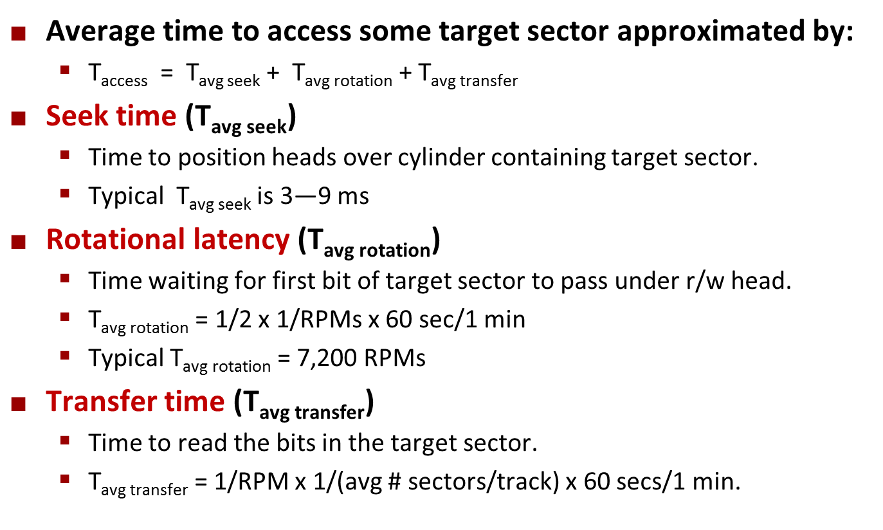
Disk Access Time Example
Given:
Rotational rate = 7,200 RPM
Average seek time = 9 ms.
Avg # sectors/track = 400.
Derived:
T_{avg rotation} =
T_{avg transfer} =
T_{access} =

