Slide 1
Lab 04 - Cachelab

Slide 2
Content
Cache memories
Lab 04

Slide 3
General Cache Organization (S, E, B)
Valid
Tag
0
1
…
B - 1
Set 0
…
Valid
Tag
0
1
…
B - 1
Valid
Tag
0
1
…
B - 1
Set 1
…
S = 2^{s} sets
Valid
Tag
0
1
…
B - 1
…
Valid
Tag
0
1
…
B - 1
Set S -1
…
Valid
Tag
0
1
…
B - 1
3

Slide 4
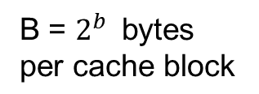
General Cache Organization (S, E, B)
Valid
Tag
0
1
…
B - 1
E lines per set
…
Valid
Tag
0
1
…
B - 1
E = 1 : Direct mapped Caches
1 < E < C/B: Set Associative Caches
E = C/B: Fully Associative Caches
1 valid bit per line
t tag bits per line
B = $2^{b } \text{bytes} \text{per} \text{cache} \text{block}$
Cache size: C = B x E x S data bytes
4

Slide 5
General Cache Organization (S, E, B)
t bits
s bits
b bits
Address:
m - 1
0
Tag
Set index
Block offset
5

Slide 6
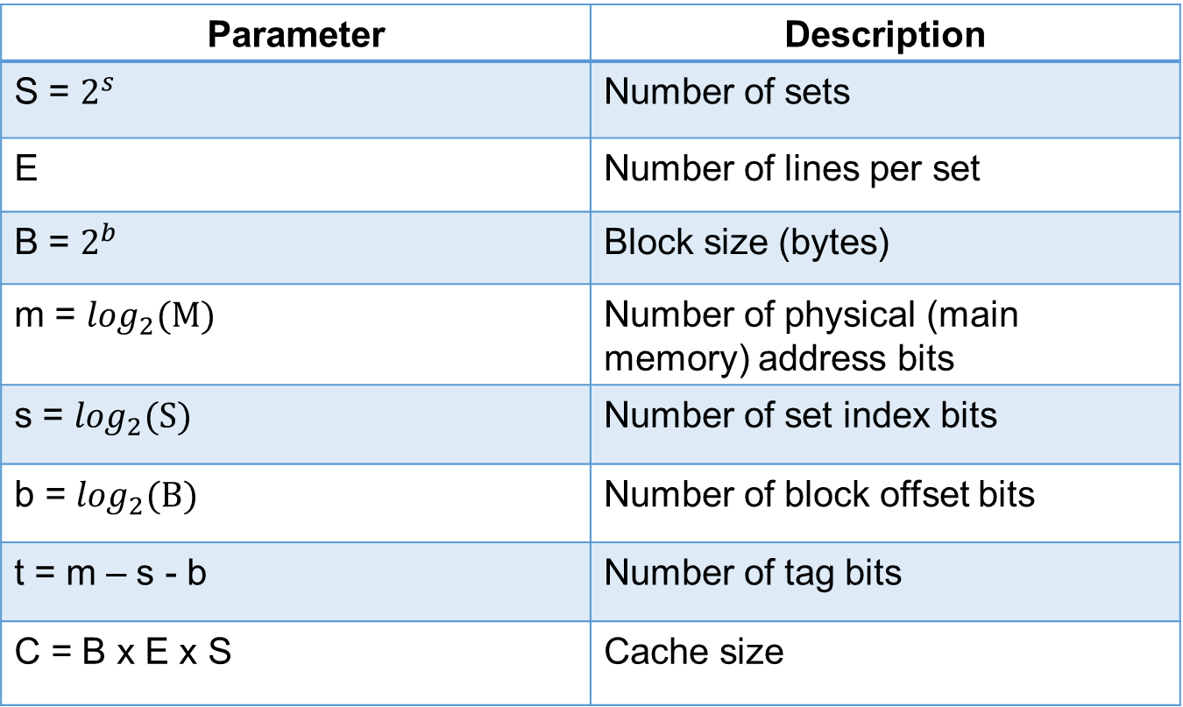
Cache parameters
Parameter | Description
S = $2^{s}$ | Number of sets
E | Number of lines per set
B = $2^{b}$ | Block size (bytes)
m = $\log_{2}(M)$ | Number of physical (main memory) address bits
s = $\log_{2}(S)$ | Number of set index bits
b = $\log_{2}(B)$ | Number of block offset bits
t = m – s - b | Number of tag bits
C = B x E x S | Cache size
6

Slide 7
Set Selection
Set 0
Valid
Tag
0
1
…
B - 1
Set 1
Valid
Tag
0
1
…
B - 1
…
Set S -1
Valid
Tag
0
1
…
B - 1
t bits
s bits
b bits
0110
00001
100
m - 1
0
Tag
Set index
Block offset
7

Slide 8




Line matching and word selection
(1) The valid bit must be set
0 1 2 3 4 5 6 7
1
0110
$$w_{0}$$
$$w_{1}$$
$$w_{2}$$
$$w_{3}$$
(2) Match the tag bits
(3) If (1) and (2) cache hit and block offset selects
t bits
s bits
b bits
0110
i
100
m - 1
0
Tag
Set index
Block offset
8

Slide 9
Example
(S, E, B, m) = (4, 1, 2, 4)
Assume each word is a single byte
Set | Valid | Tag | Block[0] | Block[1]
0 | 0
1 | 0
2 | 0
3 | 0
9

Slide 10
Address (decimal) | Tag bits (t = 1) | Index bits (s = 2) | Offset bits (b = 1) | Block number (decimal)
0 | 0 | 00 | 0 | 0
1 | 0 | 00 | 1 | 0
2 | 0 | 01 | 0 | 1
3 | 0 | 01 | 1 | 1
4 | 0 | 10 | 0 | 2
5 | 0 | 10 | 1 | 2
6 | 0 | 11 | 0 | 3
7 | 0 | 11 | 1 | 3
8 | 1 | 00 | 0 | 4
9 | 1 | 00 | 1 | 4
10 | 1 | 01 | 0 | 5
11 | 1 | 01 | 1 | 5
12 | 1 | 10 | 0 | 6
13 | 1 | 10 | 1 | 6
14 | 1 | 11 | 0 | 7
15 | 1 | 11 | 1 | 7
10

Slide 11
Example
Read word at address 0
Cache miss
Set | Valid | Tag | Block[0] | Block[1]
0 | 1 | 0 | m[0] | m[1]
1 | 0
2 | 0
3 | 0
11

Slide 12
Example
Read word at address 1
Set | Valid | Tag | Block[0] | Block[1]
0 | 1 | 0 | m[0] | m[1]
1 | 0
2 | 0
3 | 0
Cache hit
12

Slide 13
Lab 04
Part A
Part B

Slide 14
Part A
Write a cache simulator in csim.c
Input: valgrind memory trace
Output: the total of hits, misses, and evictions.
Demo file yi.trace

Slide 15
Part B
Write a transpose function in trans.c
Input: N x M matrix A
Output: M x N matrix B

