Slide 1

Sales Strategy
Class 2
Group 2

Slide 2

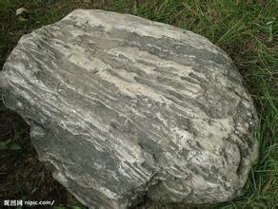
Rocks

Slide 3

Three Reasons
Integrity & Professional
Multi-function
Emotion

Slide 4
First Reason
Integrity & Professional

Slide 5

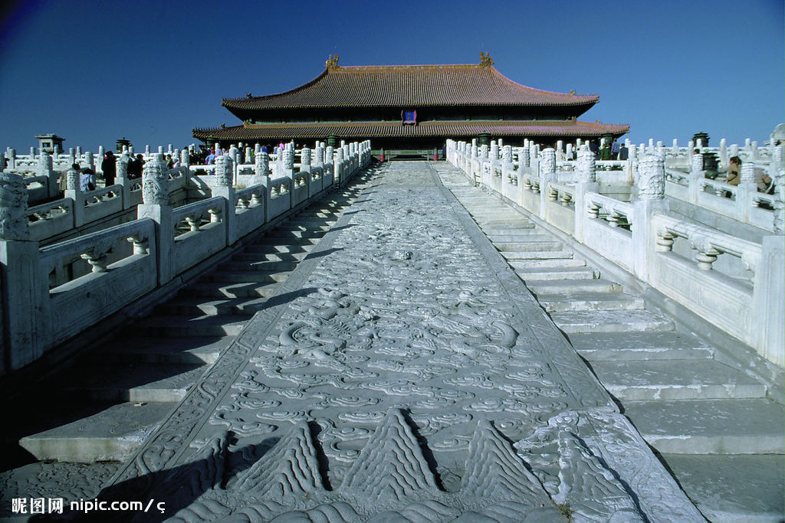
Integrity&Professional

Slide 6

Integrity&Professional
We are reliable.

Slide 7
Second Reason
Multi-function

Slide 8
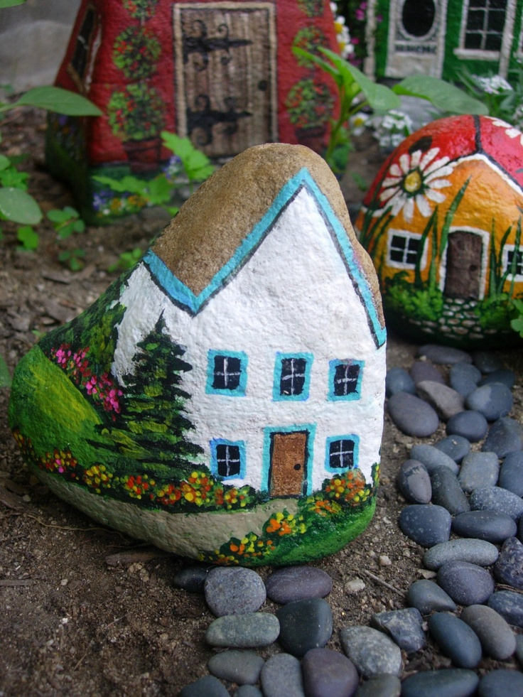
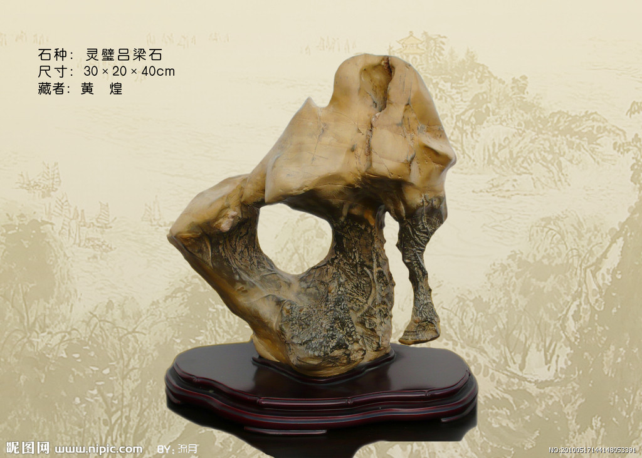
Functions

Slide 9

Functions

Slide 10
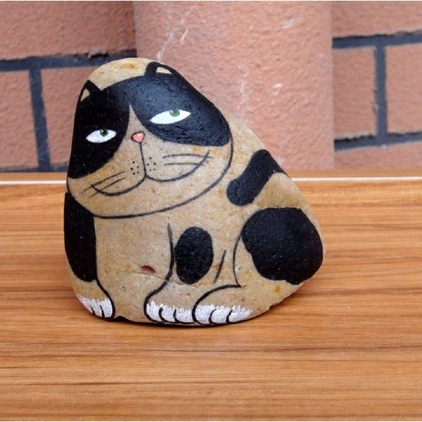
Functions

Slide 11
Third Reason
Emotion

Slide 12

Emotion
Homesick

Slide 13
The End
Buying the rock and changing your life!
Thanks

