Slide 1
Course Introduction
Dr. Sencun Zhu

Slide 2
Course Organization
The course
  Class meeting times: T, Th, 4:35-5:50pm
  Class meeting place: 109 Walker Bldg
The Instructor
  Dr. Sencun Zhu, Associate Prof. CSE&IST
  Emails: szhu@cse.psu.edu (subject including CMPSC443), or Canvas
  Web: http://www.cse.psu.edu/~szhu
  Office: 338F, IST Building
  Tel: 814-865-0995
  Office hours: T: 1:00-3:00pm
Course Assistants
  TA: Sha Liu, sxl81@psu.edu
  Office hours: M, W, 11:15-12:15pm, IST 339

Slide 3
Course Resources
Course Webpage
  http://www.cse.psu.edu/~szhu/teach/CMPSC443/
  Contains basic information about this course
    Course organization, objectives
    Rules for Grading, exams, homeworks, textbooks
    And others…
Canvas
  http://canvas.psu.edu
  Homeworks and Labs
  Slides
  Announcements
  Surveys /feedback
Check often for announcements and updates

Slide 4
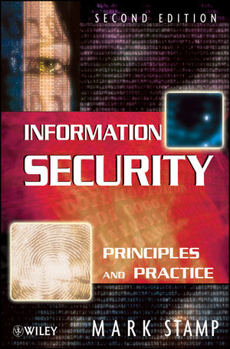
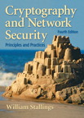
Course Material
Textbook
  Information Security Principles and Practice, Wiley, by Mark Stamp
Reference Book
  Cryptography and Network Security.
Additional Readings
  Slides
  Papers

Slide 5
Course Objectives…
Provide an introduction to the theory and application of security in information and systems
  Develop a basic understanding of cryptography, how it has evolved, and some key encryption techniques used today
  Develop an understanding of information systems security practiced in computer operating systems, distributed systems, networks and representative applications
Gain familiarity with prevalent network and distributed system attacks and defenses against them
Help students to develop the skills necessary to formulate and address the security needs of enterprise and personal environments

Slide 6
Required Knowledge
TCP/IP Networking
  CMPEN 362
Operating Systems
  Basics of systems theory
    File systems
    Distributed systems
Simple Math
Basics of programming language and software
  C, C++, or Java

Slide 7
Your Tasks and Grade Distribution
Attendance and participation (5%)
Five homeworks (20%)
  Printed hardcopy submission only except otherwise specified by the instructor
Six hands-on labs (25%)
  Five 4% labs and one 5% lab
One midterm exam (25%)
  Closed book
One final exam (25%)
  Closed book
Lateness Policy
  10% deduction per day for up to 4 days

Slide 8
Ethics Statement
This course includes topics involving personal and public privacy and security. We will cover technologies whose abuse may infringe on the rights of others. Especially, the hands-on labs may contain practical techniques for launching security attacks, although we will practice them in our isolated lab. Note that our purpose is to know the attacks and defend against them. Any abuse of such technology is at your own risk and responsibility. As an instructor, I rely on the ethical use of these technologies. Unethical use may include circumvention of existing security or privacy measurements for any purpose, or the dissemination, promotion, or exploitation of vulnerabilities of these services. Exceptions to these guidelines may occur in the process of reporting vulnerabilities through public and authoritative channels. Any activity outside the letter or spirit of these guidelines will be reported to the proper authorities and may result in dismissal from the class.
When in doubt, please contact the instructor for advice. Do not undertake any action which could be perceived as technology misuse anywhere and/or under any circumstances unless you have received explicit permission from Professor Sencun Zhu.

Slide 9
Policies
Read course syllabus for other policies
http://www.cse.psu.edu/~sxz16/teach/cmpsc443/index.html

Slide 10
Take it or not?
This is going to be a relatively hard course
  The key to success is sustained effort
  Failure to keep up with readings and assignments will likely result in poor grades
Pay-off
  Security competence is a necessary, rare, valuable skill
  Job market
    Security professionals with management skills
    incident response and forensics; wireless security, identity management and VoIP-related security

Slide 11
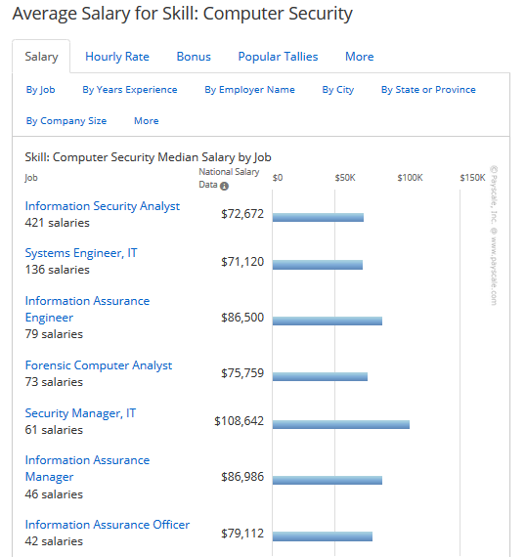

Slide 12

Roadmap (1)
Introduction
  What is security
  Overview of attacks
  Overview of defenses
Elementary Cryptography
  Encryption, authentication, …
  Cryptography is not the whole solution
    We will see why

Slide 13
Roadmap (2)
Network Security
  Authentication and key exchange protocols
  Intrusion detection, Denial-of-service
  Firewall, SSL, IPSec, VPN
System security
  Access control
  OS security
Application Security
  Web-based security
  buffer overflows
  Viruses, worms, and malicious code
  Database security
Law, Privacy and Ethics
Coverage may vary based on our progress!!!

