Slide 1
Basic Concepts
Dr. Sencun Zhu

Slide 2
What is Security
The property that a system behaves as expected
This does not say what a system should or should not do

Slide 3
What is Computer Security (by NIST)
Computer Security: protection afforded to an automated information system in order to attain the applicable objectives of preserving the integrity, availability and confidentiality of information system resources (includes hardware, software, firmware, information/data, and telecommunications).
Notes:
This chapter provides an overview of computer security. We begin with a discussion of what we mean by computer security. The NIST Computer Security Handbook [NIST95] defines the term computer security as shown. This definition introduces three key objectives that are at the heart of computer security as we see on the next slide.

Slide 4
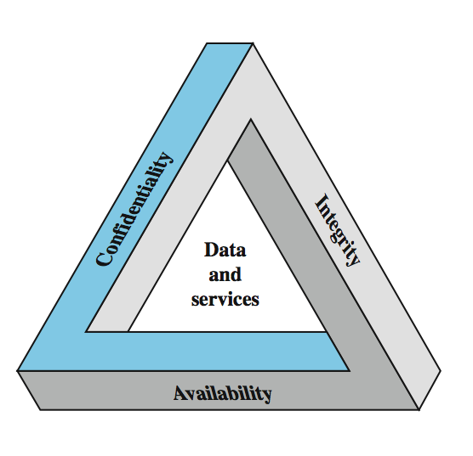
Key Security Concepts (CIA Triad)
Notes:
These three concepts form what is often referred to as the CIA triad (Figure 1.1). The three concepts embody the fundamental security objectives for both data and for information and computing services. FIPS PUB 199 provides a useful characterization of these three objectives in terms of requirements and the definition of a loss of security in each category:
• Confidentiality: Preserving authorized restrictions on information access and disclosure, including means for protecting personal privacy and proprietary information. A loss of confidentiality is the unauthorized disclosure of information.
• Integrity: Guarding against improper information modification or destruction, and includes ensuring information non-repudiation and authenticity. A loss of integrity is the unauthorized modification or destruction of information.
• Availability: Ensuring timely and reliable access to and use of information. A loss of availability is the disruption of access to or use of information or an information system.
Although the use of the CIA triad to define security objectives is well established, some in the security field feel that additional concepts are needed to present a complete picture. Two of the most commonly mentioned are:
• Authenticity: The property of being genuine and being able to be verified and trusted; confidence in the validity of a transmission, a message, or message originator. • Accountability: The security goal that generates the requirement for actions of an entity to be traced uniquely to that entity.

Slide 5
CIA-Three Basic Security Goals
Confidentiality
assets are accessed only by authorized parties
Sometimes called privacy, secrecy
Or, preventing unauthorized disclosure
Integrity
Assets can be modified by authorized parties or only in authorized ways
Availability
Assets are accessible to authorized parties at appropriate times
Security’s next great challenge

Slide 6
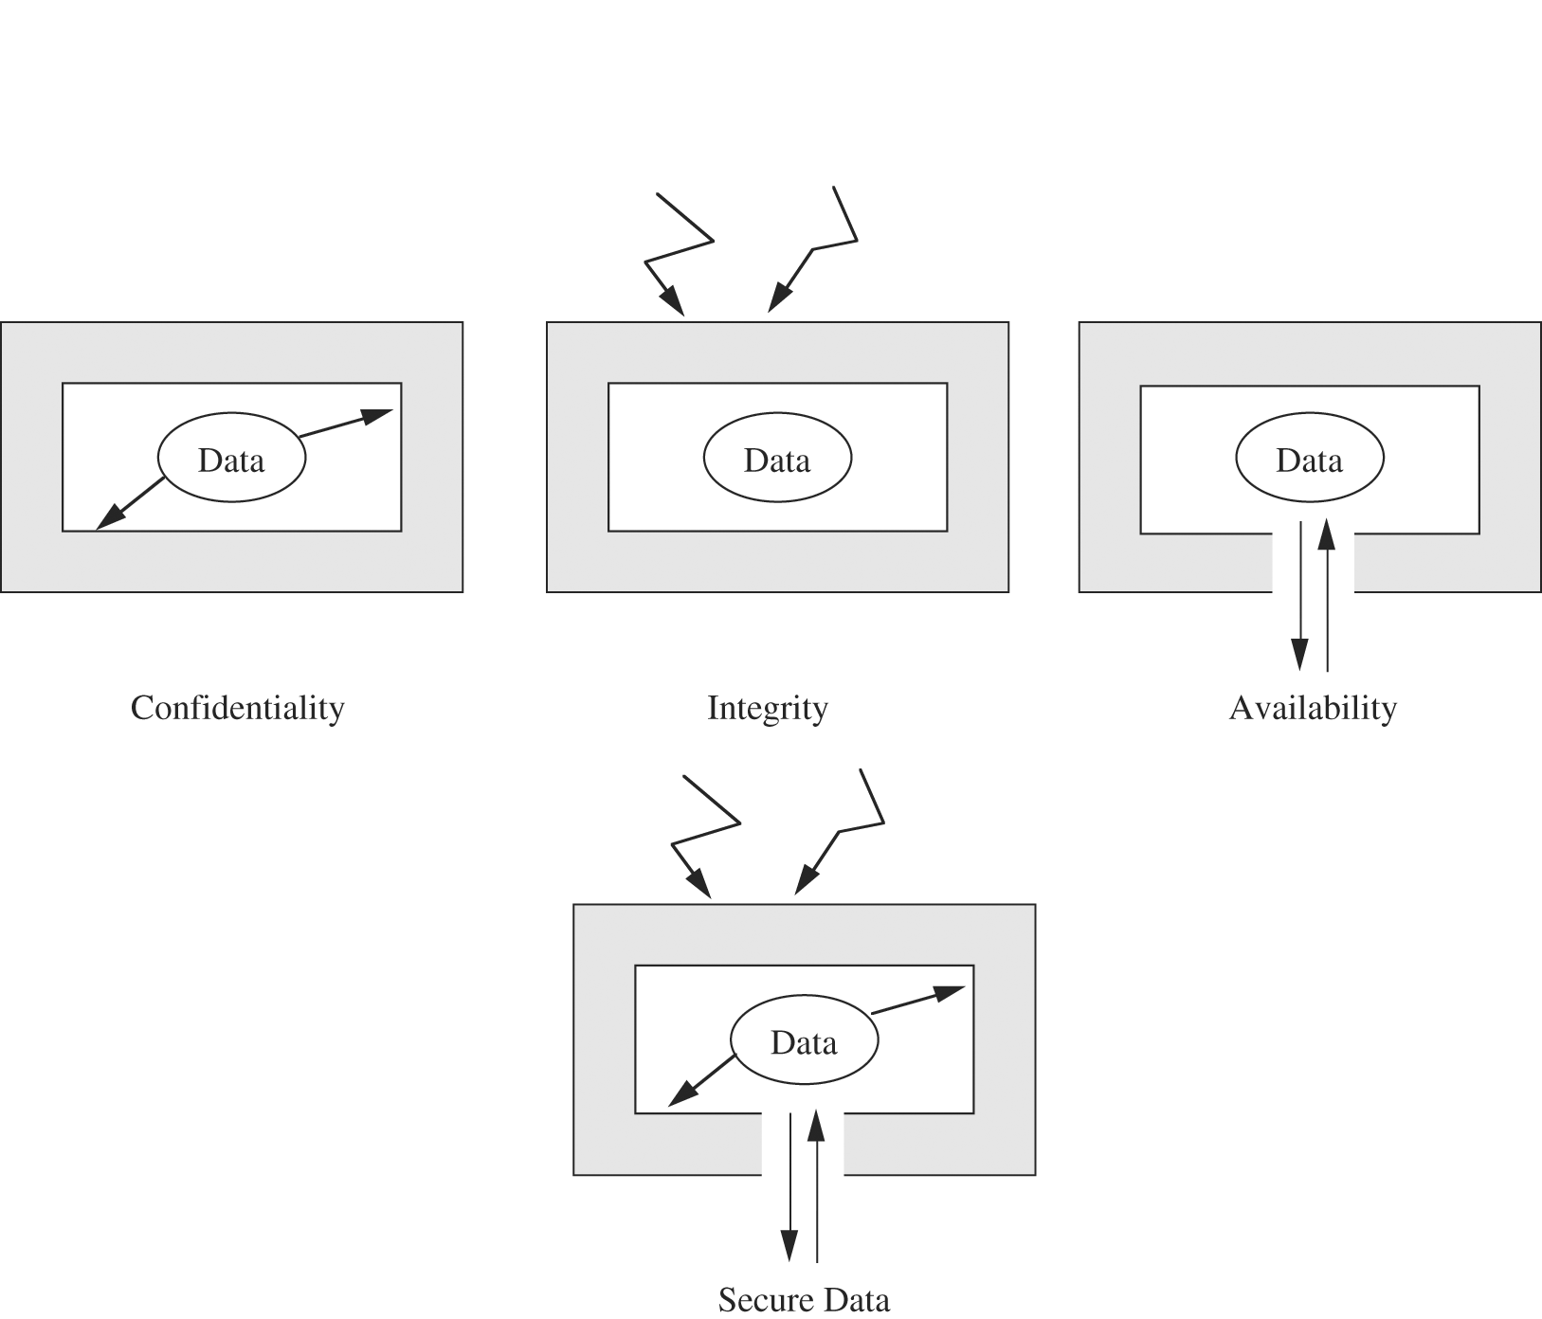
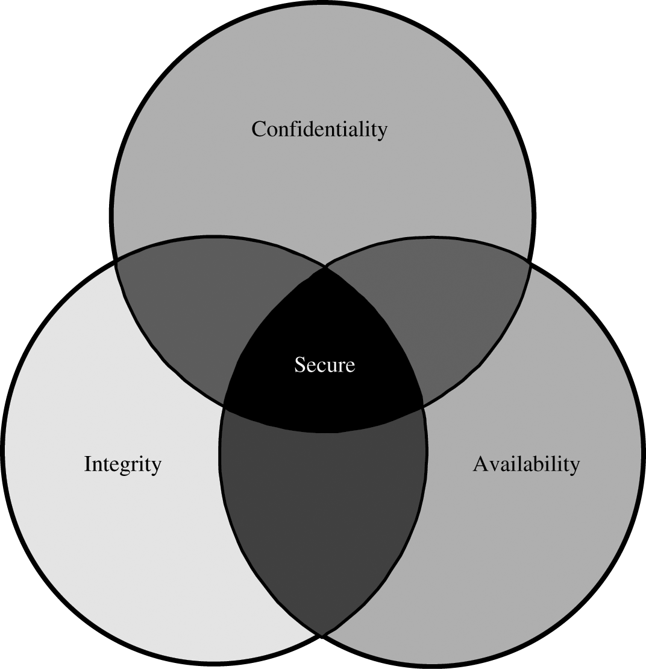
Security is always a tradeoff
Often these are conflicting goals

Slide 7
Computer Security Challenges
not simple
must consider potential attacks
procedures used counter-intuitive
involve algorithms and secret info
must decide where to deploy mechanisms
battle of wits between attacker / admin
not perceived on benefit until fails
requires regular monitoring
too often an after-thought
regarded as impediment to using system
Notes:
Computer security is both fascinating and complex. Some of the reasons follow:
1. Computer security is not as simple as it might first appear to the novice. The requirements seem to be straightforward, but the mechanisms used to meet those requirements can be quite complex and subtle.
2. In developing a particular security mechanism or algorithm, one must always consider potential attacks (often unexpected) on those security features.
3. Hence procedures used to provide particular services are often counterintuitive.
4. Having designed various security mechanisms, it is necessary to decide where to use them.
5. Security mechanisms typically involve more than a particular algorithm or protocol, but also require participants to have secret information, leading to issues of creation, distribution, and protection of that secret information.
6. Computer security is essentially a battle of wits between a perpetrator who tries to find holes and the designer or administrator who tries to close them.
7. There is a natural tendency on the part of users and system managers to perceive little benefit from security investment until a security failure occurs.
8. Security requires regular monitoring, difficult in today's short-term environment.
9. Security is still too often an afterthought - incorporated after the design is complete.
10. Many users / security administrators view strong security as an impediment to efficient and user-friendly operation of an information system or use of information.

Slide 8
“More” security not always better
Security is not a magic bullet
The goal should never be to make a system as secure as possible
Rather “to make the system as secure as possible within certain constraints”
Principle of adequate protection
Computer items must be protected only until they lose their value
The cost of protection should not exceed their value
The likelihood of a particular attack
Risk analysis

Slide 9
Terminology
Vulnerability
Threat
Adversary
Attack
Trust

Slide 10
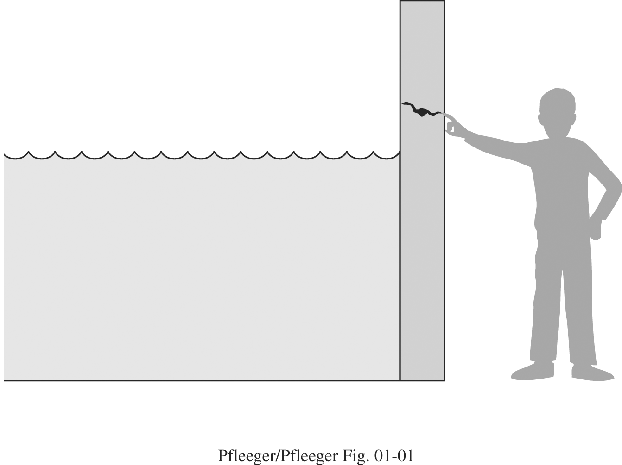
Vulnerabilities
A vulnerability is a weakness in a system that might be exploited to cause loss or harm
E.g. buffer-overflow, WEP key leakage
be corrupted (loss of integrity)
become leaky (loss of confidentiality)
become unavailable (loss of availability)
What could be the sources?
Bad design
Bad implementation
Bad policy/configuration
System misuse

Slide 11
Threats
A threat is a potential for violation of security which could potentially cause loss or harm to a system
Context specific
unauthorized disclosure
deception
disruption
usurpation
A threat model is a collection of threats that are deemed important for a particular environment
E.g. should be addressed
A set of “security requirements” for a system

Slide 12
Adversary
An adversary is a subject who tries to gain unauthorized access by circumventing the security infrastructure in place
Crackers
The curious and otherwise generally clueless
Casual attackers seeking to understand systems
Amateurs
Career criminals
Malicious groups of largely sophisticated users Competitors
Other types
Governments ???
Spammers?
…

Slide 13
Attacks
An attack occurs when an adversary attempts to exploit a vulnerability
Kinds of attacks (next slide)
Passive (e.g., eavesdropping) vs. Active (e.g., password guessing)
Insider vs. outsider
Denial of Service (DoS)
A compromise occurs when an attack is successful
Typically associated with taking over/altering systems
Q: What is the difference between threat and attack?

Slide 14
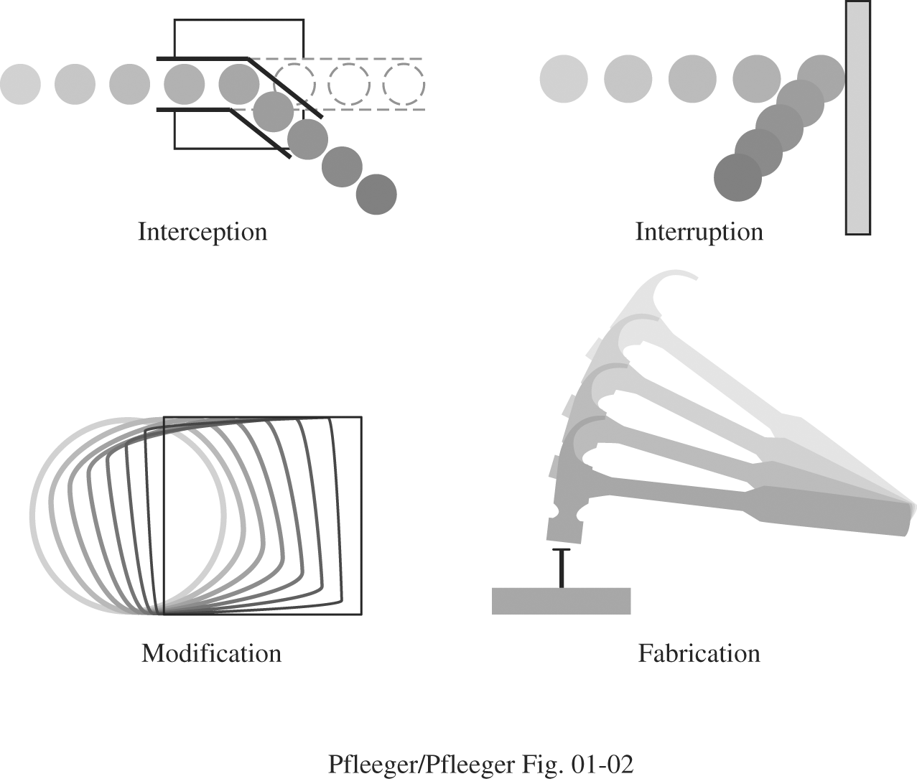
Examples of Attacks/Threats

Slide 15
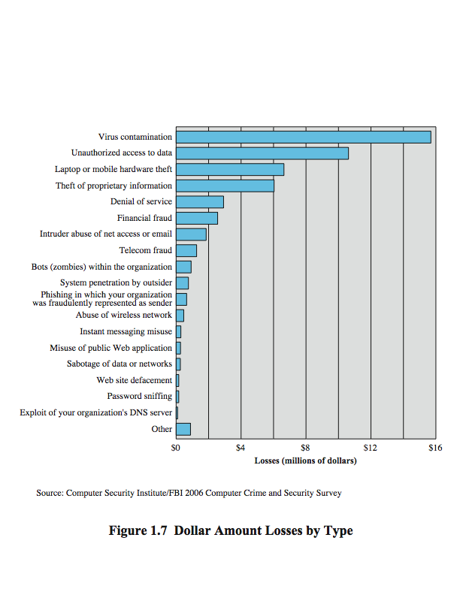
Computer Security Losses
Notes:
Another useful view of trends in computer security is provided by the CSI/FBI Computer Crime and Security Survey for 2006, conducted by the Computer Security Institute, a private organization, and the U.S. Federal Bureau of Investigation (FBI). Figure 1.7 here shows the estimated losses caused by various types of computer security incidents. The top four categories of losses (viruses, unauthorized access, laptop or mobile hardware theft, and theft of proprietary information) accounted for nearly three-quarters of the total loss. Note that these attacks need to be countered by technical measures (in the case of viruses and unauthorized access); physical security measures (laptop or mobile hardware theft); or a combination (theft of proprietary information, which could include electronic as well as paper assets). Other management controls would also come into play.

Slide 16
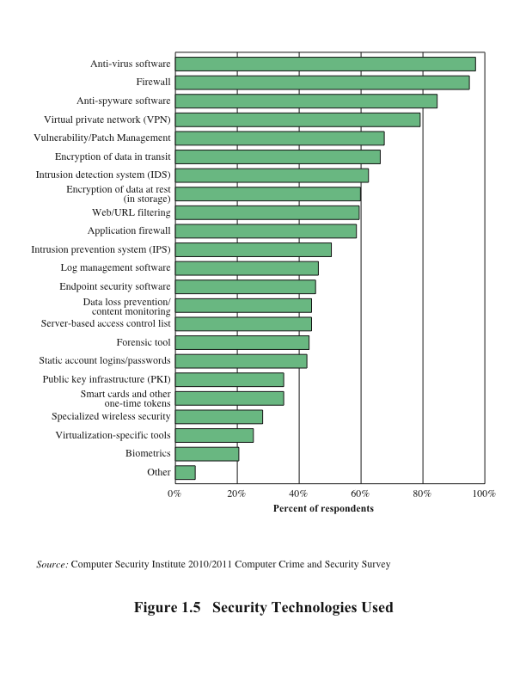
Figure 1.5 Security Technologies Used
Notes:
Figure 1.5 indicates the types of security technology used by organizations to
counter threats. Both firewalls and antivirus software are used almost universally.
This popularity reflects a number of factors:
• The maturity of these technologies means that security administrators are
very familiar with the products and are confident of their effectiveness.
• Because these technologies are mature and there are a number of vendors, costs
tend to be quite reasonable and user-friendly interfaces are available.
• The threats countered by these technologies are among the most significant
facing security administrators.

Slide 17
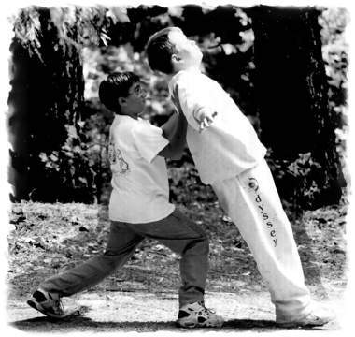
Trust
Trust refers to the degree to which an entity is expected to behave
You make trust decisions every day
What are they and whom do you trust
A trust model describes, for a particular environment, who is trusted to do what?
A trusted third party
Trusted by all parties for some set of actions
Often used as introducer or arbiter

Slide 18
Security Model
A security model is the combination of a threat and a trust model
Every design must have a security model
The single biggest mistake seen in use of security is the lack of a coherent security model
General questions on security models
What are the security concerns?
What are the threats?
Who are our adversaries?
Who do we trust and to do what?
Systems must be explicit about these things to be secure

Slide 19
Case 1: Snapchat
Suppose you are the developer of Snapchat?
What is your security model?
What are the security objectives?
http://mashable.com/2014/10/10/saving-snapchat-photos-easy/
Notes:
Snapchat is primarily used for creating multimedia messages referred to as "snaps"; snaps can consist of a photo or a short video, and can be edited to include filters and effects, text captions, and drawings.^{[26][27]} A feature known as "Geofilters" was added in July 2014, which allows special graphical overlays to be available if the user is within a certain geographical location, such as a city, event, or destination.^{[28][29]} The "Lens" feature, introduced in September 2015, allows users to add real-time effects into their snaps by using face detection technology which is activated by long-pressing on a face within the viewfinder.^{[30]}
An example of a Snapcode, the app's version of a scannable QR code
Snaps can be directed privately to selected contacts, or to a semi-public "Story".^{[19]} The private message photo snaps can be viewed for a user-specified length of time (1 to 10 seconds as determined by the sender) before they become inaccessible.
In 2014, Snapchat settled a complaint made by the Federal Trade Commission. The government agency alleged that the company had exaggerated to the public the degree to which mobile app images and photos could actually be made to disappear. Under the terms of the agreement, Snapchat was not fined, but the app service agreed to have its claims and policies monitored by an independent party for a period of 20 years. The FTC concluded that Snapchat was prohibited from "misrepresenting the extent to which it maintains the privacy, security, or confidentiality of users' information."^{[84]}
Following the agreement, Snapchat updated its privacy page to state that the company "can't guarantee that messages will be deleted within a specific timeframe." ^{[85]} Even after Snapchat deletes message data from their servers, that same data may remain in backup for a certain period of time.^{[85]} In a public blog post, the service warned that "If you've ever tried to recover lost data after accidentally deleting a drive or maybe watched an episode of CSI, you might know that with the right forensic tools, it's sometimes possible to retrieve data after it has been deleted."^{[86]}

Slide 20
Case 2
Yik Yak anonymity
http://www.collegian.psu.edu/news/crime_courts/article_03456bf8-5306-11e4-a0ba-001a4bcf6878.html
Notes:
Yik Yak is a social media smartphone application. It is available for iOS and Android and it allows people to create and view discussion threads within a 5-mile radius (termed "Yaks" by the application).^{[1]} It is similar to other anonymous sharing apps such as Nearby, but differs from others such as Whisper in that it is intended for sharing primarily with those in proximity to the user.^{[2][not in citation given]} All users have the ability to contribute to the stream by writing, responding, and "voting up" or "voting down" (liking or disliking) yaks.

Slide 21
Case 3:
For an antivirus software, what is its security model?

Slide 22
Case 4:
If you are developing a multi-party online game
What is your security model?
What are the security objectives?

Slide 23
Case 5:
Suppose you are hired by Nittany Hospital to secure its patient health records.
What is your security model?
What are the security objectives?

Slide 24
Related Terminology
Reliability
Property of a system that indicates it will continue to function for long periods of time under varying circumstances
Survivability
Ability of a system to maintain function during abnormal or environmentally troubling events
Assurance
Confidence that system meets its security requirements
Security policy
Statement of what is and is not allowed
Security mechanism
Method for enforcing a security policy

Slide 25
Methods of Defense
Prevention
By blocking the attack or closing the vulnerability
Attacks are going to occur
Prevention is not the only solution
Deterrence
By making the attack harder, but not impossible
Notes:
Deterrence is the use of punishment as a threat to deter people from offending. Deterrence is often contrasted with retributivism, which holds that punishment is a necessary consequence of a crime and should be calculated based on the gravity of the wrong done.
The concept of deterrence has two key assumptions: the first is that specific punishments imposed on offenders will "deter" or prevent them from committing further crimes; the second is that fear of punishment will prevent others from committing similar crimes.

Slide 26
Other Defenses
Detection and response
How do you know when you are attacked
How quickly can you stop the attack
Can you prevent the attack from recurring
Recovery
Can be much more important than prevention
Legal issues

Slide 27
Human Factors
E.g., passwords
Outsider vs. insider attacks
Software misconfiguration
Social engineering
Not applying security patches
…

Slide 28
Basic Principles
Principle of the weakest link
Security of a system is as good as the security at its weakest link
Principle of effectiveness
Controls must be used –and used properly –to be effective
They must be efficient, easy to use, and appropriate

