Slide 1
Symmetric Key Encryption
Notes:
Lecture slides prepared by Dr Lawrie Brown (UNSW@ADFA) for “Computer Security: Principles and Practice”, 1/e, by William Stallings and Lawrie Brown, Chapter 19 “Symmetric Encryption and Message Confidentiality”.

Slide 2
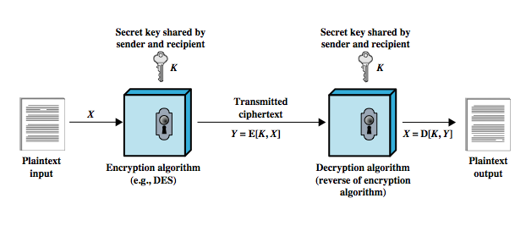
Symmetric Encryption: Block Cipher and Stream Cipher
Alice
Eve
Bob
unsecured channel
Notes:
The universal technique for providing confidentiality for transmitted data is symmetric encryption. Symmetric encryption, also referred to as conventional encryption or single-key encryption, was the only type of encryption in use prior to the introduction of public-key encryption in the late 1970s. Countless individuals and groups, from Julius Caesar to the German U-boat force to present-day diplomatic, military, and commercial users, use symmetric encryption for secret communication. It remains by far the more widely used of the two types of encryption. A symmetric encryption scheme has five ingredients, as shown here in Figure 2.1 from the text.
• Plaintext: This is the original message or data that is fed into the algorithm as input.
• Encryption algorithm: The encryption algorithm performs various substitutions and transformations on the plaintext.
• Secret key: The secret key is also input to the encryption algorithm. The exact substitutions and transformations performed by the algorithm depend on the key.
• Ciphertext: This is the scrambled message produced as output. It depends on the plaintext and the secret key. For a given message, two different keys will produce two different ciphertexts.
• Decryption algorithm: This is essentially the encryption algorithm run in reverse. It takes the ciphertext and the secret key and produces the original plaintext.
There are two requirements for secure use of symmetric encryption:
1. We need a strong encryption algorithm.
2. Sender and receiver must have secure obtained, & keep secure, the secret key.

Slide 3
Block Cipher
Encrypt
Plaintext
block
of length N
Cipher
block
of length N
Secret key
Decrypt
N: 64, 128, 256 bits, for example
Bijection

Slide 4
Block Cipher Structure
have a general iterative block cipher structure
  with a sequence of rounds
  with substitutions / permutations controlled by key
parameters and design features:
  block size
  key size
  number of rounds
  subkey generation algorithm
  round function
  also: fast software en/decrypt, ease of analysis
Notes:
The Feistel structure is particular example of the more general iterative structure used by all symmetric block ciphers, that consists of a sequence of rounds, with each round performing substitutions and permutations conditioned by a secret key value. The exact realization of a symmetric block cipher depends on the choice of the following parameters and design features:
• Block size: Larger block sizes mean greater security but reduced encryption/ decryption speed. A block size of 128 bits is currently a reasonable tradeoff.
• Key size: Larger key size means greater security but may decrease encryption/ decryption speed. The most common key length in modern algorithms is 128 bits.
• Number of rounds: note that a single round offers inadequate security but that multiple rounds offer increasing security. A typical size is 16 rounds.
• Subkey generation algorithm: Greater complexity in this algorithm should lead to greater difficulty of cryptanalysis.
• Round function: greater complexity means greater resistance to cryptanalysis.
There are two other considerations in the design of a symmetric block cipher:
• Fast software encryption/decryption: for use in programs
• Ease of analysis: want algorithm as difficult as possible to cryptanalyze, but have great benefit in making the algorithm easy to analyze. If the algorithm can be concisely and clearly explained, it is easier to analyze that algorithm for cryptanalytic vulnerabilities and therefore develop a higher level of assurance as to its strength.

Slide 5
Feistel Cipher
Feistel cipher refers to a type of block cipher design, not a specific cipher
Split plaintext block into left and right halves: Plaintext = (L₀,R₀)
For each round i=1,2,...,n, compute
L_{i}= R_{i−1}
R_{i}= L_{i−1} ⊕ F(R_{i−1},K_{i})
where F is round function and K_{i} is subkey
Ciphertext = (L_{n},R_{n})

Slide 6
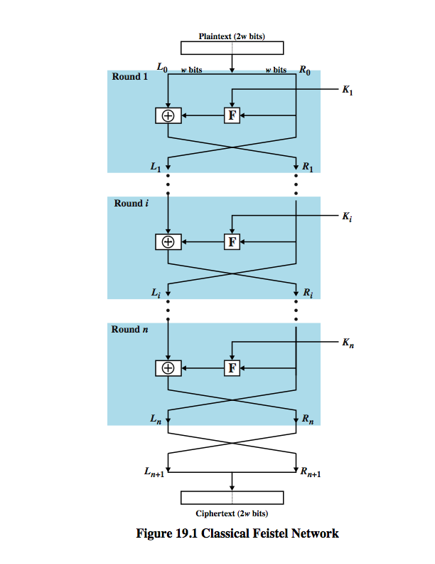
Feistel Cipher Structure

Slide 7
Data Encryption Standard
DES developed in 1970’s
Based on IBM’s Lucifer cipher
DES was U.S. government standard
DES development was controversial
  NSA secretly involved
  Design process was secret
  Key length reduced from 128 to 56 bits
  Subtle changes to Lucifer algorithm

Slide 8
DES Numerology
DES is a Feistel cipher with…
  64 bit block length
  56 bit key length
  16 rounds
  48 bits of key used each round (subkey)
Each round is simple (for a block cipher)
Security depends heavily on “S-boxes”
  Each S-boxes maps 6 bits to 4 bits

Slide 9
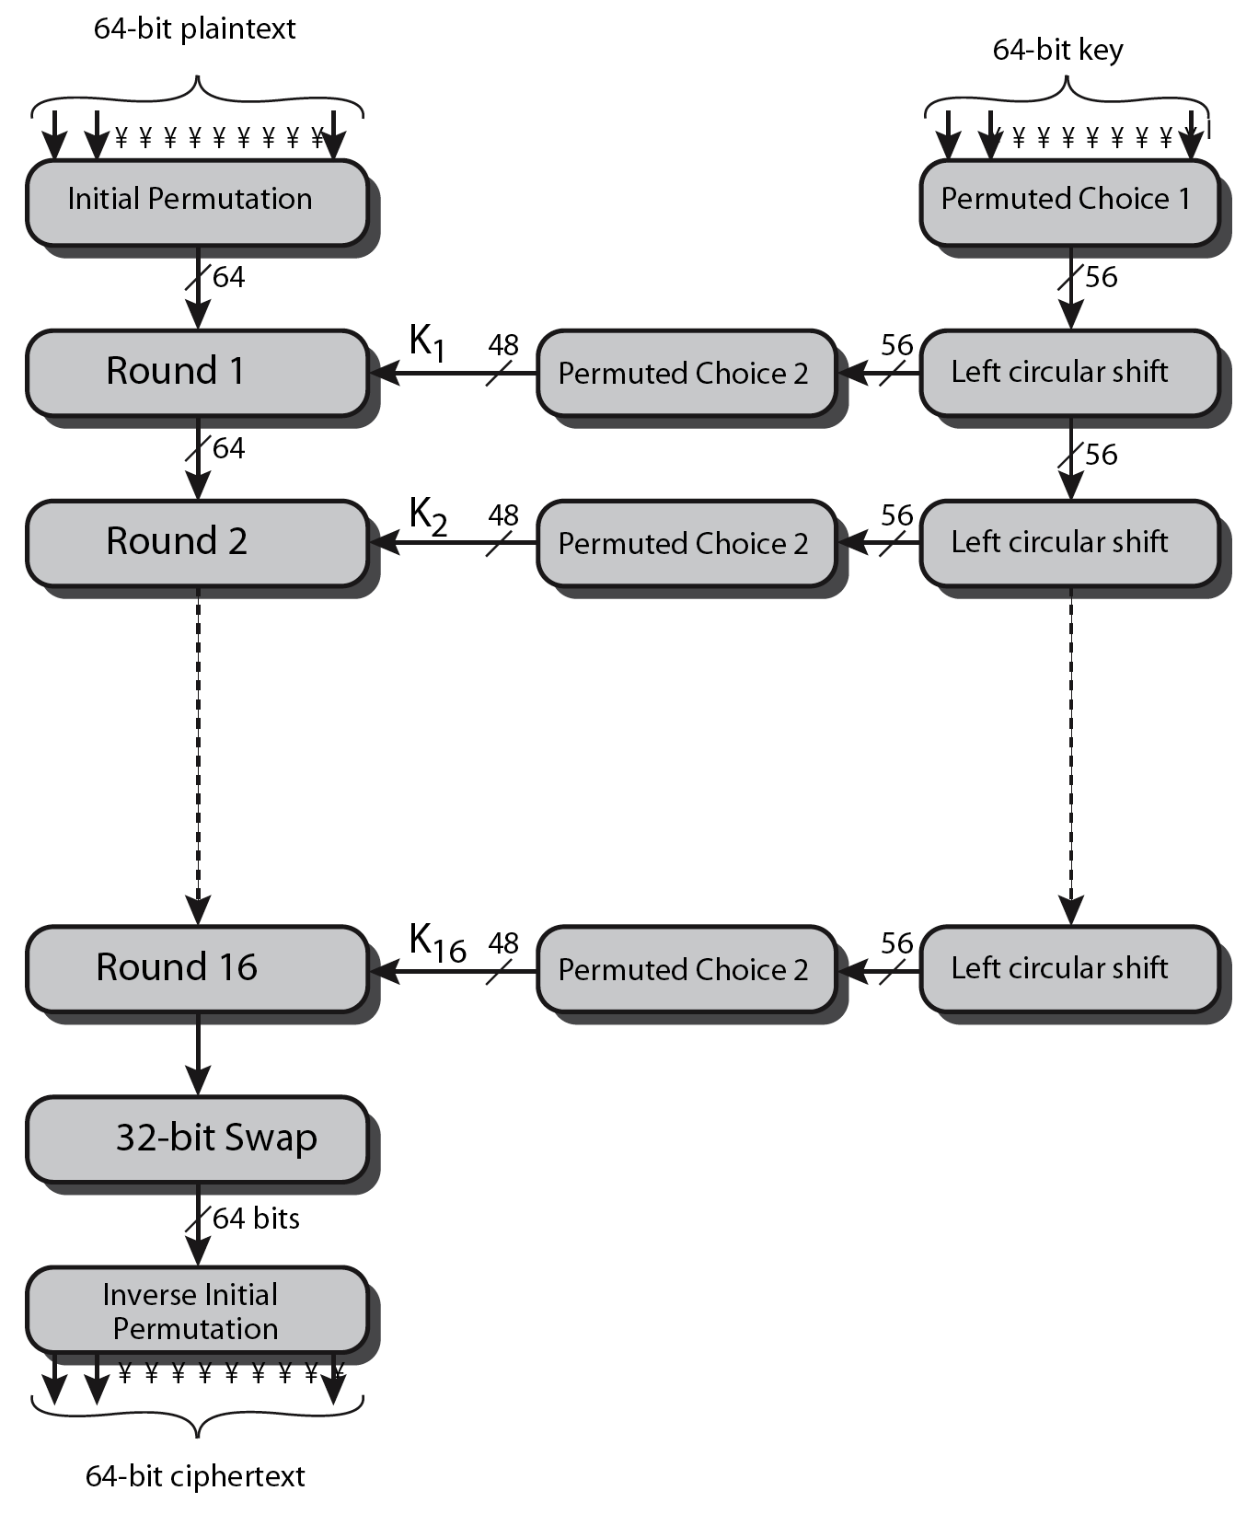
Data Encryption Standard (DES)
Notes:
The most widely used encryption scheme is based on the Data Encryption Standard (DES) adopted in 1977 by the National Bureau of Standards, now the National Institute of Standards and Technology (NIST), as Federal Information Processing Standard 46 (FIPS PUB 46). The algorithm itself is referred to as the Data Encryption Algorithm (DEA).
The DES algorithm can be described as follows. The plaintext is 64 bits in length and the key is 56 bits in length; longer plaintext amounts are processed in 64-bit blocks. The DES structure is a minor variation of the Feistel network shown in Figure 19.1. There are sixteen rounds of processing. From the original 56-bit key, sixteen subkeys are generated, one of which is used for each round.
The process of decryption with DES is essentially the same as the encryption process. The rule is as follows: Use the ciphertext as input to the DES algorithm, but use the subkeys K_{i} in reverse order. That is, use K₁₆ on the first iteration, K₁₅ on the second iteration, and so on until K₁ is used on the 16th and last iteration.

Slide 10
L
R
key
32
28
28
One
Round
of
DES
expand
shift
shift
32
48
28
28
K_{i}
⊕
48
48
compress
S-boxes
28
28
32
P box
32
32
⊕
32
L
R
key

Slide 11
DES Expansion Permutation
Input 32 bits
0 1 2 3 4 5 6 7 8 9 10 11 12 13 14 15
16 17 18 19 20 21 22 23 24 25 26 27 28 29 30 31
Output 48 bits
31 0 1 2 3 4 3 4 5 6 7 8
7 8 9 10 11 12 11 12 13 14 15 16
15 16 17 18 19 20 19 20 21 22 23 24
23 24 25 26 27 28 27 28 29 30 31 0

Slide 12
DES S-box
8 “substitution boxes” or S-boxes
Each S-box maps 6 bits to 4 bits
S-box number 1
input bits (0,5)
↓ input bits (1,2,3,4)
| 0000 0001 0010 0011 0100 0101 0110 0111 1000 1001 1010 1011 1100 1101 1110 1111
------------------------------------------------------------------------------------
00 | 1110 0100 1101 0001 0010 1111 1011 1000 0011 1010 0110 1100 0101 1001 0000 0111
01 | 0000 1111 0111 0100 1110 0010 1101 0001 1010 0110 1100 1011 1001 0101 0011 1000
10 | 0100 0001 1110 1000 1101 0110 0010 1011 1111 1100 1001 0111 0011 1010 0101 0000
11 | 1111 1100 1000 0010 0100 1001 0001 0111 0101 1011 0011 1110 1010 0000 0110 1101

Slide 13
DES P-box
Input 32 bits
0 1 2 3 4 5 6 7 8 9 10 11 12 13 14 15
16 17 18 19 20 21 22 23 24 25 26 27 28 29 30 31
Output 32 bits
15 6 19 20 28 11 27 16 0 14 22 25 4 17 30 9
1 7 23 13 31 26 2 8 18 12 29 5 21 10 3 24

Slide 14
DES Subkey
56 bit DES key, numbered 0,1,2,…,55
Left half key bits, LK
49 42 35 28 21 14 7
0 50 43 36 29 22 15
8 1 51 44 37 30 23
16 9 2 52 45 38 31
Right half key bits, RK
55 48 41 34 27 20 13
6 54 47 40 33 26 19
12 5 53 46 39 32 25
18 11 4 24 17 10 3

Slide 15
DES Subkey
For rounds i=1,2,...,16
  Let LK = (LK circular shift left by r_{i})
  Let RK = (RK circular shift left by r_{i})
  Left half of subkey K_{i} is of LK bits
13 16 10 23 0 4 2 27 14 5 20 9
22 18 11 3 25 7 15 6 26 19 12 1
  Right half of subkey K_{i} is RK bits
12 23 2 8 18 26 1 11 22 16 4 19
15 20 10 27 5 24 17 13 21 7 0 3

Slide 16
DES Subkey
For rounds 1, 2, 9 and 16 the shift r_{i} is 1, and in all other rounds r_{i} is 2
Bits 8,17,21,24 of LK omitted each round
Bits 6,9,14,25 of RK omitted each round
Compression permutation yields 48 bit subkey K_{i} from 56 bits of LK and RK
Key schedule generates subkey

Slide 17
DES Last Word (Almost)
An initial permutation before round 1
Halves are swapped after last round
A final permutation (inverse of initial perm) applied to (R₁₆,L₁₆)
None of this serves security purpose
Part 1 ⎯ Cryptography <number>

Slide 18
Security of DES
Security depends heavily on S-boxes
  Everything else in DES is linear
Thirty+ years of intense analysis has revealed no “back door”
Attacks, essentially exhaustive key search
Inescapable conclusions
  Designers of DES knew what they were doing
  Designers of DES were way ahead of their time

Slide 19
Block Cipher Notation
P = plaintext block
C = ciphertext block
Encrypt P with key K to get ciphertext C
  C = E(P, K)
Decrypt C with key K to get plaintext P
  P = D(C, K)
Note: P = D(E(P, K), K) and C = E(D(C, K), K)
  But P ≠ D(E(P, K₁), K₂) and C ≠ E(D(C, K₁), K₂) when K₁ ≠ K₂

Slide 20
Triple DES (3DES)
first used in financial applications
in DES FIPS PUB 46-3 standard of 1999
uses three keys & three DES executions:
  C = E(K₃, D(K₂, E(K₁, P)))
decryption same with keys reversed
use of decryption in second stage?
effective 168-bit key length, slow, secure
AES will eventually replace 3DES

Slide 21
Advanced Encryption Standard
Replacement for DES
AES competition (late 90’s)
  NSA openly involved
  Transparent process
  Many strong algorithms proposed
  Rijndael Algorithm ultimately selected
    Pronounced like “Rain Doll” or “Rhine Doll”
Iterated block cipher (like DES)
Not a Feistel cipher (unlike DES)

Slide 22
AES Overview
Block size: 128 bits
Key length: 128, 192 or 256 bits (independent of block size)
10 to 14 rounds (depends on key length)
Each round uses 4 functions (in 3 “layers”)
  ByteSub (nonlinear layer)
  ShiftRow (linear mixing layer)
  MixColumn (nonlinear layer)
  AddRoundKey (key addition layer)

Slide 23
Stream Cipher
Pseudo random
number generator
001010100101001110011…
key
Bitwise ⊕
plaintext
101011101101001110011…
ciphertext
100001001000000000000…
En/decrypt messages bit-by-bit
  What advantages?
Examples
  A5/1, RC4, one-time pad

Slide 24
Stream Ciphers
Not as popular today as block ciphers
We’ll discuss two examples
A5/1
  Based on shift registers
  Used in GSM mobile phone system
RC4
  Based on a changing lookup table
  Used many places: SSL, WEP

Slide 25
A5/1
A5/1 consists of 3 shift registers
  X: 19 bits (x₀,x₁,x₂, …,x₁₈)
  Y: 22 bits (y₀,y₁,y₂, …,y₂₁)
  Z: 23 bits (z₀,z₁,z₂, …,z₂₂)

Slide 26
A5/1
At each step: m = maj(x₈, y₁₀, z₁₀)
  Examples: maj(0,1,0) = 0 and maj(1,1,0) = 1
If x₈ = m then X steps
  t = x₁₃ ⊕ x₁₆ ⊕ x₁₇ ⊕ x₁₈
  x_{i} = x_{i−1} for i = 18,17,…,1 and x₀ = t
If y₁₀ = m then Y steps
  t = y₂₀ ⊕ y₂₁
  y_{i} = y_{i−1} for i = 21,20,…,1 and y₀ = t
If z₁₀ = m then Z steps
  t = z₇ ⊕ z₂₀ ⊕ z₂₁ ⊕ z₂₂
  z_{i} = z_{i−1} for i = 22,21,…,1 and z₀ = t
Keystream bit is x₁₈ ⊕ y₂₁ ⊕ z₂₂

Slide 27
A5/1
X
x₀ | x₁ | x₂ | x₃ | x₄ | x₅ | x₆ | x₇ | x₈ | x₉ | x₁₀ | x₁₁ | x₁₂ | x₁₃ | x₁₄ | x₁₅ | x₁₆ | x₁₇ | x₁₈
⊕
Y
y₀ | y₁ | y₂ | y₃ | y₄ | y₅ | y₆ | y₇ | y₈ | y₉ | y₁₀ | y₁₁ | y₁₂ | y₁₃ | y₁₄ | y₁₅ | y₁₆ | y₁₇ | y₁₈ | y₁₉ | y₂₀ | y₂₁
⊕
⊕
Z
z₀ | z₁ | z₂ | z₃ | z₄ | z₅ | z₆ | z₇ | z₈ | z₉ | z₁₀ | z₁₁ | z₁₂ | z₁₃ | z₁₄ | z₁₅ | z₁₆ | z₁₇ | z₁₈ | z₁₉ | z₂₀ | z₂₁ | z₂₂
⊕
Each value is a single bit
Key is used as initial fill of registers
Each register steps or not, based on (x₈, y₁₀, z₁₀)
Keystream bit is XOR of right bits of registers

Slide 28
A5/1
X
1 | 0 | 1 | 0 | 1 | 0 | 1 | 0 | 1 | 0 | 1 | 0 | 1 | 0 | 1 | 0 | 1 | 0 | 1
⊕
Y
1 | 1 | 0 | 0 | 1 | 1 | 0 | 0 | 1 | 1 | 0 | 0 | 1 | 1 | 0 | 0 | 1 | 1 | 0 | 0 | 0 | 1
⊕
⊕
Z
1 | 1 | 1 | 0 | 0 | 0 | 0 | 1 | 1 | 1 | 1 | 0 | 0 | 0 | 0 | 1 | 1 | 1 | 1 | 0 | 0 | 0 | 1
⊕
In this example, m = maj(x₈, y₁₀, z₁₀) = maj(1,0,1) = 1
Register X steps, Y does not step, and Z steps
Keystream bit is XOR of right bits of registers
Here, keystream bit will be 0 ⊕ 1 ⊕ 0 = 1

Slide 29
RC4
A self-modifying lookup table
Table always contains some permutation of 0,1,…,255
Initialize the permutation using key
At each step, RC4
  Swaps elements in current lookup table
  Selects a keystream byte from table
Each step of RC4 produces a byte
  Efficient in software
Each step of A5/1 produces only a bit
  Efficient in hardware

Slide 30
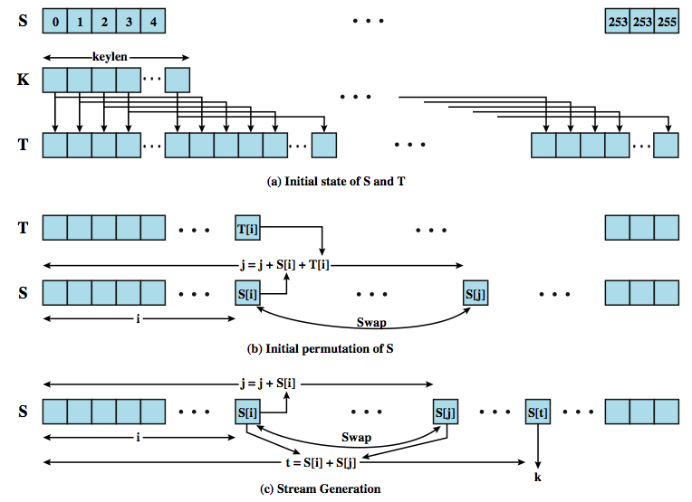
RC4
Notes:
RC4 is a stream cipher designed in 1987 by Ron Rivest for RSA Security. It is a variable key-size stream cipher with byte-oriented operations. The algorithm is based on the use of a random permutation. Analysis shows that the period of the cipher is overwhelmingly likely to be greater than 10¹⁰⁰. Eight to sixteen machine operations are required per output byte, and the cipher can be expected to run very quickly in software. RC4 is used in the SSL/TLS standards that have been defined for communication between Web browsers and servers. It is also used in the WEP protocol and the newer WiFi WPA protocol that are part of the IEEE 802.11 wireless LAN standard. RC4 was originally kept as a trade secret by RSA Security, but in September 1994, the RC4 algorithm was anonymously posted on the Internet.
The RC4 algorithm is remarkably simply and quite easy to explain, and is illustrated in Figure 19.5. A variable-length key of from 1 to 256 bytes (8 to 2048 bits) is used to initialize a 256-byte state vector S, with elements S[0], S[1], …, S[255]. At all times, S contains a permutation of all 8-bit numbers from 0 through 255. A temporary vector, T, is then created from the key K. Next T is used to produce an initial permutation of S. For encryption and decryption, a byte k is generated from S by selecting one of the 255 entries in a systematic fashion. As each value of k is generated, the entries in S are once again permuted. k is then XOR’d with the next byte of plaintext/ciphertext.
A number of papers have been published analyzing methods of attacking RC4, but none of these approaches is practical against RC4 with a reasonable key length, such as 128 bits. There are problems with the way it was used in WEP. This points out the difficulty in designing a secure system that involves both cryptographic functions and protocols that make use of them.

Slide 31
Shift Register Crypto
Shift register-based crypto is efficient in hardware
Harder to implement in software
In the past, very popular
Today, more is done in software due to faster processors
Shift register crypto still used some

Slide 32
Modes of Operation
block ciphers process data in blocks
  e.g. 64-bits (DES, 3DES) or 128-bits (AES)
for longer messages must break up
  and possibly pad end to blocksize multiple
have five modes of operation for this
  defined in NIST SP 800-38A
  modes are: ECB, CBC, CFB, OFB, CTR

Slide 33
Electronic Codebook (ECB)
simplest mode
split plaintext into blocks
encrypt each block using the same key
“codebook” because have unique ciphertext value for each plaintext block
  not secure for long messages, why?

Slide 34

Electronic Code Book (ECB)
M₁ M₂ M₃ M₄
64 64 64 46
pad
ENC
ENC
ENC
ENC
C₁ C₂ C₃ C₄

Slide 35
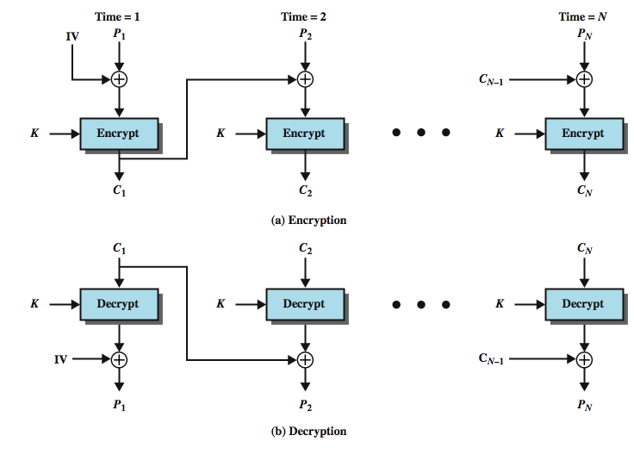
Cipher Block Chaining (CBC)
Notes:
In the cipher block chaining (CBC) mode (Figure 19.6), the input to the encryption algorithm is the XOR of the current plaintext block and the preceding ciphertext block; the same key is used for each block. In effect, we have chained together the processing of the sequence of plaintext blocks. The input to the encryption function for each plaintext block bears no fixed relationship to the plaintext block. Therefore, repeating patterns of b bits are not exposed. CBC is widely used in security applications.
For decryption, each cipher block is passed through the decryption algorithm. The result is XORed with the preceding ciphertext block to produce the plaintext block. To see that this works, we can write:
C_{j} = E(K, [C_{j–1} ⊕ P_{j}])
where E[K, X] is the encryption of plaintext X using key K, and ⊕ is the exclusive-OR operation.
To produce the first block of ciphertext, an initialization vector (IV) is XORed with the first block of plaintext. On decryption, the IV is XORed with the output of the decryption algorithm to recover the first block of plaintext.
The IV must be known to both the sender and receiver. For maximum security, the IV should be protected as well as the key. This could be done by sending the IV using ECB encryption. One reason for protecting the IV is as follows: If an opponent is able to fool the receiver into using a different value for IV, then the opponent is able to invert selected bits in the first block of plaintext.

Slide 36
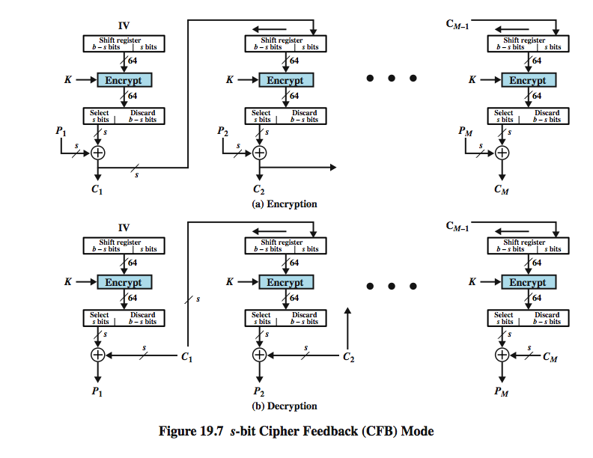
Cipher Feedback (CFB)
Notes:
It is possible to convert any block cipher into a stream cipher by using the cipher feedback (CFB) mode. A stream cipher eliminates the need to pad a message to be an integral number of blocks. It also can operate in real time. Thus, if a character stream is being transmitted, each character can be encrypted and transmitted immediately using a character-oriented stream cipher. One desirable property of a stream cipher is that the ciphertext be of the same length as the plaintext.
Figure 19.7 depicts the CFB scheme. In the figure, it is assumed that the unit of transmission is s bits; a common value is s = 8. As with CBC, the units of plaintext are chained together.
For encryption, the input to the encryption function is a b-bit shift register that is initially set to some initialization vector (IV). The leftmost (most significant) s bits of the output of the encryption function are XORed with the first unit of plaintext P₁ to produce the first unit of ciphertext C₁, which is then transmitted. In addition, the contents of the shift register are shifted left by s bits and C₁ is placed in the rightmost (least significant) s bits of the shift register. This process continues until all plaintext units have been encrypted. Will have:
C₁ = P₁ ⊕ S_{s}[E(K, IV)]
For decryption, the same scheme is used, except that the received ciphertext unit is XORed with the output of the encryption function to produce the plaintext unit. Note that it is the encryption function that is used, not the decryption function. This is easily explained. Let S_{s}(X) be defined as the most significant s bits of X. Then have
P₁ = C₁ ⊕ S_{s}[E(K, IV)]

Slide 37
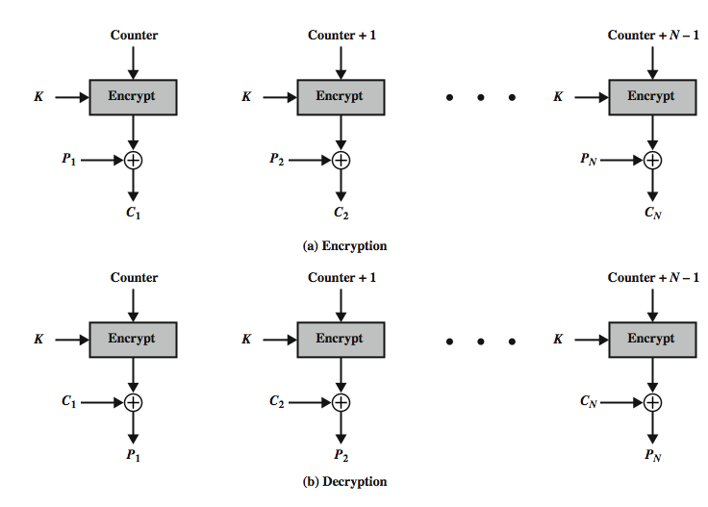
Counter (CTR)
Notes:
Although interest in the counter mode (CTR) has increased recently, with applications to ATM network security and IPSec), this mode was proposed early
Figure 19.8 depicts the CTR mode. A counter, equal to the plaintext block size is used. The only requirement stated in SP 800-38A is that the counter value must be different for each plaintext block that is encrypted. Typically, the counter is initialized to some value and then incremented by 1 for each subsequent block (modulo 2^{b}, where b is the block size). For encryption, the counter is encrypted and then XORed with the plaintext block to produce the ciphertext block; there is no chaining. For decryption, the same sequence of counter values is used, with each encrypted counter XORed with a ciphertext block to recover the corresponding plaintext block.
Some advantages of CTR mode are :
• Hardware efficiency: CTR mode can be done in parallel on multiple blocks of plaintext or ciphertext.
• Software efficiency: have opportunities for parallel execution in CTR mode.
• Preprocessing: can be used to prepare the output of the encryption boxes that feed into the XOR functions in Figure 19.8.
• Random access: The ith block of plaintext or ciphertext can be processed in random-access fashion.
• Provable security: CTR is at least as secure as the other mode.
• Simplicity: CTR mode oly needs the implementation of the encryption algorithm.

Slide 38
Advantages of CTR mode
Hardware efficiency: CTR mode can be done in parallel on multiple blocks of plaintext or ciphertext.
Software efficiency: have opportunities for parallel execution in CTR mode.
Preprocessing: can be used to prepare the output of the encryption boxes that feed into the XOR functions in Figure 19.8.
Random access: The ith block of plaintext or ciphertext can be processed in random-access fashion.
Provable security: CTR is at least as secure as the other mode.
Simplicity: CTR mode oly needs the implementation of the encryption algorithm.

