Slide 1
Public Key Cryptography

Slide 2
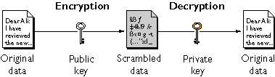
Application: Public-Key Encryption
Alice
Public key is known by everybody
Everybody can use it to send a message to Alice securely
Private key is only known by the key owner Alice
Only Alice can decrypt the message
Notes:
Stallings Fig 9.1

Slide 3
Application: Digital Signature
message
Yes/No
Sign
Digital signature
Verify
Alice’s private key
Alice’s public key
Alice
Bob
Only the party with the private key can create a digital signature
The digital signature is verifiable by anyone who knows the public key.
The signer cannot deny that he/she has done so.

Slide 4
Public Key Cryptography
Two keys
Sender uses recipient’s public key to encrypt
Receiver uses his private key to decrypt
Based on trap door, one way function
Easy to compute in one direction
Hard to compute in other direction
“Trap door” used to create keys
Example: Given p and q, product N=pq is easy to compute, but given N, it is hard to find p and q

Slide 5
Public Key Requirements
computationally ____ to create key pairs
computationally ____ for sender knowing public key to encrypt messages
computationally ____ for receiver knowing private key to decrypt ciphertext
computationally ____ for opponent to determine private key from public key
computationally ____ for opponent to otherwise recover original message
useful if either key can be used for each role

Slide 6
Public Key Algorithms
Public key algorithms
RSA: encryption and digital signature
Diffie-Hellman: key exchange
DSA: digital signature
Elliptic curve: encryption and digital signature
Number theory underlies most of public key algorithms
Prime numbers
The Chinese Remainder Theorem (CRT)
Discrete Logarithms

Slide 7
RSA (Rivest, Shamir, Adleman)
The gold standard in public key crypto
Support both public key encryption and digital signature
Assumption/theoretical basis
Factoring large integers is hard
Factoring problem: given positive integer n, find primes p₁, …, p_{k} such that n=p₁^{e1}p₂^{e2}…p_{k}^{ek}
Variable key length
1024, 2048, 4096 bits (512 bits was broken)
Variable plaintext block size
Plaintext must be “smaller” than the key
Ciphertext block size is the same as the key length

Slide 8
Factoring problem: given positive integer n, find primes p₁, …, p_{k} such that n=p₁^{e1}p₂^{e2}…p_{k}^{ek}

Slide 9
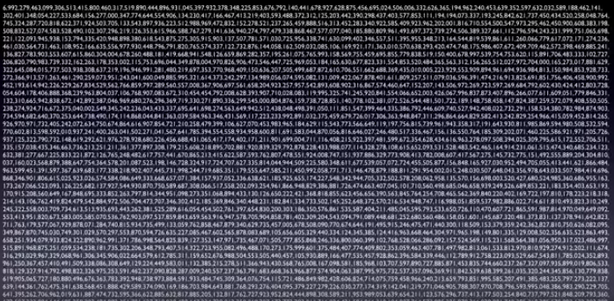
N

Slide 10
RSA
Let p and q be two large prime numbers
Let N = pq be the modulus
Choose e relatively prime to (p−1)(q−1)
Find d s.t. ed = 1 mod (p−1)(q−1)
Based on extended Euclidean algorithm
Public key is (N,e)
Private key is d

Slide 11
RSA
To encrypt message M compute
C = Me mod N
To decrypt C compute
M = C^{d} mod N
Recall that e and N are public
If attacker can factor N, he can use e to easily find d since ed = 1 mod (p−1)(q−1)
Factoring the modulus breaks RSA
It is not known whether factoring is the only way to break RSA
Other attacks: e.g., timing attack, forward search attack.
Notes:
30 82 01 0a 02 82 01 01 00 e3 be 7e 0a 86 a3 cf 6b 6d 3d 2b a1 97 ad 49 24 4d d7 77 b9 34 79 08 a5 9e a2 9e de 47 12 92 3d 7e ea 19 86 b1 e8 4f 3d 5f f7 d0 a7 77 9a 5b 1f 0a 03 b5 19 53 db a5 21 94 69 63 9d 6a 4c 91 0c 10 47 be 11 fa 6c 86 25 b7 ab 04 68 42 38 09 65 f0 14 da 19 9e fa 6b 0b ab 62 ef 8d a7 ef 63 70 23 a8 af 81 f3 d1 6e 88 67 53 ec 12 a4 29 75 8a a7 f2 57 3d a2 83 98 97 f2 0a 7d d4 e7 43 6e 30 78 62 22 59 59 b8 71 27 45 aa 0f 66 c6 55 3f fa 32 17 2b 31 8f 46 a0 fa 69 14 7c 9d 9f 5a e2 eb 33 4e 10 a6 b3 ed 77 63 d8 c3 9e f4 dd df 79 9a 7a d4 ee de dd 9a cc c3 b7 a9 5d cc 11 3a 07 bb 6f 97 a4 01 23 47 95 1f a3 77 fa 58 92 c6 c7 d0 bd cf 93 18 42 b7 7e f7 9e 65 ea d5 3b ca ed ac c5 70 a1 fe d4 10 9a f0 12 04 44 ac 1a 5b 78 50 45 57 4c 6f bd 80 cb 81 5c 2d b3 bc 76 a1 1e 65 02 03 01 00 01

Slide 12

Euler’s Theorem
where φ(n) is Euler's totient function and "... ≡ ... (mod n)" denotes ... congruence ... modulo n.
In number theory, the totient of a positive integer n is defined to be the number of positive integers less than or equal to n that are coprime to n (i.e. having no common positive factors other than 1).
φ(10) =
7²²² (mod 10) = ?.
Notes:
where the product is over the distinct prime numbers dividing n.

Slide 13
Does RSA Really Work?
Given C = Me mod N we must show
M = C^{d} mod N = M^{ed} mod N
We’ll use Euler’s Theorem
If x is relatively prime to n then x^{ϕ(n)} = 1 mod n
Facts:
ed = 1 mod (p − 1)(q − 1)
By definition of “mod”, ed = k(p − 1)(q − 1) + 1
ϕ(N) = (p − 1)(q − 1)
Then ed − 1 = k(p − 1)(q − 1) = kϕ(N)
M^{ed} = M^{(ed − 1) + 1} = M⋅M^{ed − 1} = M⋅M^{kϕ(N)} = M⋅(M^{ϕ(N)})^{k} mod N = M⋅1^{k} mod N = M mod N
Notes:
OiLer
where φ(n) is Euler's totient function.
is an arithmetic function that counts the totatives of n, that is, the positive integers less than or equal to n that are relatively prime to n.

Slide 14
Simple RSA Example
Example of RSA
Select “large” primes p = 11, q = 3
Then N = pq = 33 and (p−1)(q−1) = 20
Choose e = 3 (relatively prime to 20)
Find d such that ed = 1 mod 20, we find that d = 7 works
Public key: (N, e) = (33, 3)
Private key: d = 7

Slide 15
Simple RSA Example
Public key: (N, e) = (33, 3)
Private key: d = 7
Suppose message M = 8
Ciphertext C is computed as
C = Me mod N = 8³ = 512 = 17 mod 33
Decrypt C to recover the message M by
M = C^{d} mod N = 17⁷ = 410,338,673 = 12,434,505 ∗ 33 + 8 = 8 mod 33

Slide 16
More Efficient RSA (1)
Modular exponentiation example
5²⁰ = 95367431640625 = 25 mod 35
A better way: repeated squaring
20 = 10100 base 2
(1, 10, 101, 1010, 10100) = (1, 2, 5, 10, 20)
Note that 2 = 1⋅ 2, 5 = 2 ⋅ 2 + 1, 10 = 2 ⋅ 5, 20 = 2 ⋅ 10
5¹= 5 mod 35
5²= (5¹)² = 5² = 25 mod 35
5⁵= (5²)² ⋅ 5¹ = 25² ⋅ 5 = 3125 = 10 mod 35
5¹⁰ = (5⁵)² = 10² = 100 = 30 mod 35
5²⁰ = (5¹⁰)² = 30² = 900 = 25 mod 35
No huge numbers and it’s efficient!

Slide 17
More Efficient RSA (2)
Use e = 3 for all users (but not same N or d)
Public key operations only require 2 multiplies
Private key operations remain expensive
If M < N^{1/3} then C = Me = M³ and cube root attack
For any M, if C₁, C₂, C₃ sent to 3 users, cube root attack works (uses Chinese Remainder Theorem)
Can prevent cube root attack by padding message with random bits
Note: e = 2¹⁶ + 1 also used (“better” than e = 3)

Slide 18
Diffie-Hellman

Slide 19
Diffie-Hellman
Invented by Williamson (GCHQ) and, independently, by D and H (Stanford)
A “key exchange” algorithm
Used to establish a shared symmetric key
Not for encrypting or signing
Security rests on difficulty of discrete log problem: given g, p, and g^{k} mod p find k

Slide 20
Diffie-Hellman
Let p be prime, let g be a generator
For any x ∈ {1,2,…,p-1} there is n s.t. x = g^{n} mod p
Alice selects secret value a
Bob selects secret value b
Alice sends gª mod p to Bob
Bob sends g^{b} mod p to Alice
Both compute shared secret g^{ab} mod p
Shared secret can be used as symmetric key

Slide 21
Diffie-Hellman
Suppose that Bob and Alice use g^{ab} mod p as a symmetric key
Trudy can see gª mod p and g^{b} mod p
Note gª g^{b} mod p = g^{a+b} mod p ≠ g^{ab} mod p
If Trudy can find a or b, system is broken
If Trudy can solve discrete log problem, then she can find a or b

Slide 22
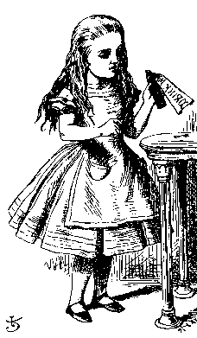
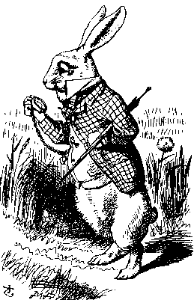
Diffie-Hellman
Public: g and p
Secret: Alice’s exponent a, Bob’s exponent b
gª mod p
g^{b} mod p
Alice, a
Bob, b
Alice computes (g^{b})ª = g^{ba} = g^{ab} mod p
Bob computes (gª)^{b} = g^{ab} mod p
Could use K = g^{ab} mod p as symmetric key

Slide 23
Exercises
have
prime number p= 5
primitive root g = 2
X_{A} = 3
X_{B} = 2
what is
Y_{A}, Y_{B}, K?

Slide 24
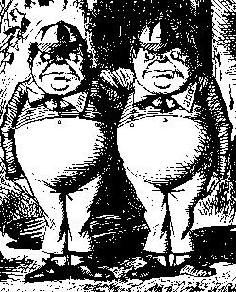
Diffie-Hellman
Subject to man-in-the-middle (MiM) attack
gª mod p
g^{t} mod p
g^{t} mod p
g^{b} mod p
Alice, a
Trudy, t
Bob, b
Trudy shares secret g^{at} mod p with Alice
Trudy shares secret g^{bt} mod p with Bob
Alice and Bob don’t know Trudy exists!

Slide 25
Diffie-Hellman
How to prevent MiM attack?
Encrypt DH exchange with symmetric key
Encrypt DH exchange with public key
Sign DH values with private key
Other?
You MUST be aware of MiM attack on Diffie-Hellman

Slide 26
Uses for Public Key Crypto

Slide 27
Uses for Public Key Crypto
Confidentiality
Transmitting data over insecure channel
Secure storage on insecure media
Authentication (later)
Digital signature provides integrity and non-repudiation
No non-repudiation with symmetric keys

Slide 28
Non-non-repudiation
Alice orders 100 shares of stock from Bob
Alice computes MAC using symmetric key
Stock drops, Alice claims she did not order
Can Bob prove that Alice placed the order?

Slide 29
Non-repudiation
Alice orders 100 shares of stock from Bob
Alice signs order with her private key
Stock drops, Alice claims she did not order
Can Bob prove that Alice placed the order?

Slide 30
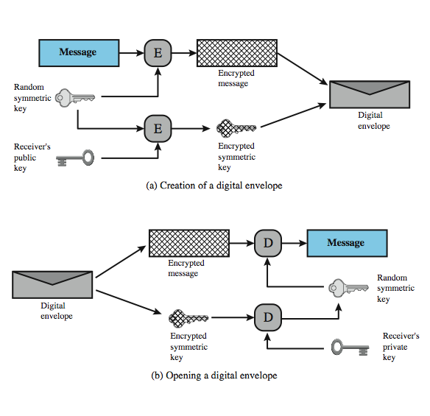
Digital Envelopes

Slide 31
Sign and Encrypt vs Encrypt and Sign

Slide 32
Public Key Notation
Sign message M with Alice’s private key: [M]_{Alice}
Encrypt message M with Alice’s public key: {M}_{Alice}
Then
{[M]_{Alice}}_{Alice} = M
[{M}_{Alice}]_{Alice} = M

Slide 33
Confidentiality and Non-repudiation
Suppose that we want confidentiality and non-repudiation
Can public key crypto achieve both?
Alice sends message to Bob
Sign and encrypt {[M]_{Alice}}_{Bob}
Encrypt and sign [{M}_{Bob}]_{Alice}
Can the order possibly matter?

Slide 34
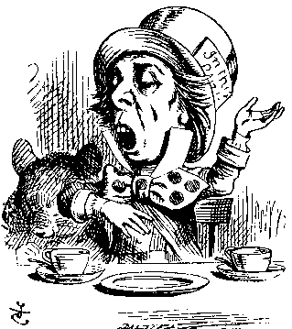
Sign and Encrypt
M = “I love you”
{[M]_{Alice}}_{Bob}
{[M]_{Alice}}_{Charlie}
Alice
Bob
Charlie
Q: What is the problem?
A:

Slide 35
Encrypt and Sign
M = “My theory, which is mine….”
[{M}_{Bob}]_{Alice}
[{M}_{Bob}]_{Charlie}
Alice
Charlie
Bob
Note that Charlie cannot decrypt M
Q: What is the problem?

Slide 36
Public Key Infrastructure

Slide 37
PKI
Public Key Infrastructure (PKI) consists of all pieces needed to securely use public key cryptography
Key generation and management
Certificate authorities
Certificate revocation (CRLs), etc.
No general standard for PKI
We consider a few “trust models”

Slide 38
PKI
Overview
Binding a public key to an identity
Involving a trusted certificate authority (CA)
CA signs the public key of a user
“I, the CA, have verified that public key P_{A} belongs to Alice”
Everybody knows the public key of the CA
Often a hierarchy providing multilevel certificates (or certificate chain)

Slide 39
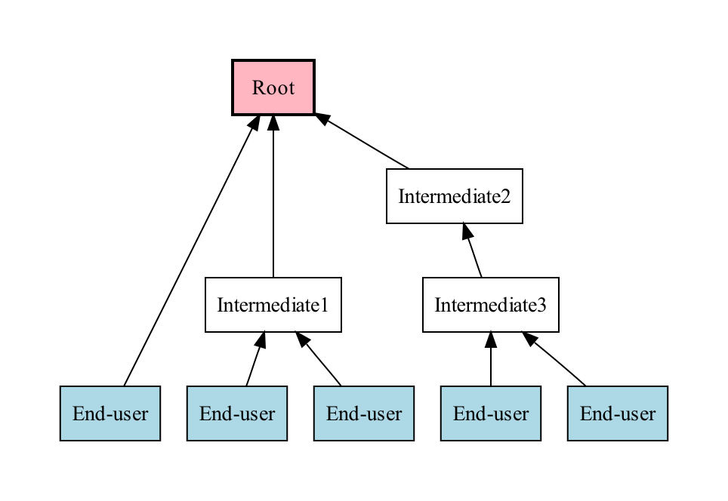
Example of A CA Hierarchy

Slide 40
Public Key Certificate
Contains name of user and user’s public key (and possibly other info)
Certificate is signed by the issuer (such as VeriSign) who vouches for it
Signature on certificate is verified using signer’s public key
Certificates are public!
Common format for certificates is X.509

Slide 41
Certificate Content
Content of a certificate
A unique sequence number
Identity of principal (who uses it)
Corresponding public key
Timestamp
when issued and when to expire
Other information
Can this principle issue certificates to others
What is the purpose of the public key
Encryption or signature

Slide 42
Certificate Revocation
The hardest problem to solve in PKI
how do you know if a presented certificate is still valid?
Why revocation before expiration?
Public/private key compromise
Change your company / fired
CA made a mistake
And so on…

Slide 43
Solutions
Fast expiration
Use a short expiration time, say minutes or hours
Ask for a new certificate after it is expired
Problem?
Certificate Revocation List (CRL)
Publish the list of the revoked certificates
Signed by CA
Stored in some directory services
trust on directory services?

Slide 44
PKI Trust Models
Monopoly model
One universally trusted organization is the CA for the known universe
Favored by VeriSign (for obvious reasons)
Big problems if CA is ever compromised
Big problem if you don’t trust the CA!

Slide 45
PKI Trust Models
Oligarchy
Multiple trusted CAs
This approach used in browsers today
Browser may have 80 or more certificates, just to verify signatures!
User can decide which CAs to trust

Slide 46
PKI Trust Models
Anarchy model
Everyone is a CA!
Users must decide which “CAs” to trust
This approach used in PGP (Web of trust)
Why do they call it “anarchy”? Suppose cert. is signed by Frank and I don’t know Frank, but I do trust Bob and Bob says Alice is trustworthy and Alice vouches for Frank. Should I trust Frank?
Many other PKI trust models

Slide 47
Confidentiality in the Real World

Slide 48
Symmetric Key vs Public Key
Symmetric key +’s
Speed
No public key infrastructure (PKI) needed
Public Key +’s
Signatures (non-repudiation)
No shared secret

Slide 49
Notation Reminder
Public key notation
Sign message M with Alice’s private key
[M]_{Alice}
Encrypt message M with Alice’s public key
{M}_{Alice}
Symmetric key notation
Encrypt plaintext P with symmetric key K
C = E(P,K)
Decrypt ciphertext C with symmetric key K
P = D(C,K)

Slide 50
Real World Confidentiality
Hybrid cryptosystem
Public key crypto to establish a key
Symmetric key crypto to encrypt data
Consider the following
{K}_{Bob}
E(Bob’s data, K)
E(Alice’s data, K)
Alice
Bob
Can Bob be sure he’s talking to Alice?

