Slide 1
Software and Security
(buffer overflow)
(modified based on Mark Stamp’s slides)

Slide 2
Why Software?
Why is software as important to security as crypto, access control and protocols?
Virtually all of information security is implemented in software
If your software is subject to attack, your security is broken
  Regardless of strength of crypto, access control or protocols
Software is a poor foundation for security

Slide 3
Bad Software
Bad software is everywhere!
NASA Mars Lander (cost $165 million)
  Crashed into Mars
  Error in converting English and metric units of measure
Denver airport
  Buggy baggage handling system
  Delayed airport opening by 11 months
  Cost of delay exceeded $1 million/day
MV-22 Osprey
  Advanced military aircraft
  Lives have been lost due to faulty software
Notes:
Measurements are ways that we tell others how much of an item we have. There are two systems of measuring things—English and Metric. English measurements are used only in the United States, while metric measurements are used in nearly every other country. Measurements are used to give number values to distance (length, width, and height), weight, time, volume (liquid measurements), and temperature.
To get you used to these measurements, we’re providing a list of commonly used English and metric measurements, and their equivalents.
Common English Measures
Distance Inches (in) 12 in = 1 ft Feet (ft) 3 ft = 1 yd Yards (yd) 1760 yd = 1 mi Miles (mi) 1 mi = 5280 ft Weight Ounces (oz) 16 oz = 1 lb Pounds (lb) 2000 lb = 1 t Tons (t) 1 t = 2000 lb Volume Teaspoons (tsp) 3 tsp = 1 tbsp Tablespoons (tbsp) 1 tbsp = 3 tsp Fluid ounces (fl oz) 8 fl oz = 1 cup Cups (c) 2 cups = 1 pt Pints (pt) 2pt = 1qt, 8 pt = 1 gal Quarts (qt) 4 qt = 1 gal Gallons (gal) 2 gal = 1 peck Pecks 4 pecks = 1 bushel Bushels 1 bushel = 4 pecks Temperature Degrees Fahrenheit (°F) Speed Miles per hour (mph) Common Metric Measures
The metric system is also divided into different categories of measurement, but it has a base unit for each category. A base unit means that that is what the category is usually (but not always) measured in, and all the other terms of measurement in that category are built from the base unit.
Distance Millimeter (mm) 1000 mm = 1 m Centimeter (cm) 100 cm = 1 m Meter (m) base unit (1) Kilometer (km) 1000 m = 1 km Weight Milligrams (mg) 1000 mg = 1 g Grams (g) base unit (1) Kilograms (kg) 1000g = 1 kg, 1000 kg = 1 t Metric ton (t) 1000 kg = 1 t Volume Milliliters (mL) 1000 mL = 1 L Liters (L) base unit (1) Temperature Degrees Celsius (°C) Speed Meters per second (m/s) Universal Measures
Time Seconds (sec) 60 sec = 1 min Minutes (min) 60 min = 1 hr Hours (hr) 24 hr = 1 day Days 7 days = 1 wk Weeks (wk) (about) 4 wk = 1 mo Months (mo) 12 mo = 1 yr Years (yr) 1 yr = 365 days Decades 1 decade = 10 yr Centuries 1 century = 100 yr Millennium 1 millennium = 1000 yr

Slide 4
Software Issues
“Normal” users
Find bugs and flaws by accident
Hate bad software…
…but must learn to live with it
Must make bad software work
Attackers
Actively look for bugs and flaws
Like bad software…
…and try to make it misbehave
Attack systems thru bad software

Slide 5
Complexity
“Complexity is the enemy of security”, Paul Kocher, Cryptography Research, Inc.
system
Lines of code (LOC)
Netscape | 17,000,000
Space shuttle | 10,000,000
Debian 2.2 (2000) | 55-59,000,000
Windows XP (2000) | 40,000,000
Microsoft Office 2007 | 60,000,000
Boeing 777 | 7,000,000
A new car contains more LOC than was required to land the Apollo astronauts on the moon

Slide 6
Lines of Code and Bugs
Conservative estimate: 5 bugs/1000 LOC
Do the math
  Typical computer: 3,000 exe’s of 100K each
  Conservative estimate of 50 bugs/exe
  About 150k bugs per computer
  30,000 node network has 4.5 billion bugs
  Suppose that only 10% of bugs security-critical and only 10% of those remotely exploitable
  Then “only” 4.5 million critical security flaws!

Slide 7
Software Security Topics
Program flaws (unintentional)
  Buffer overflow
Malicious software (intentional)
  Viruses
  Worms
  Other breeds of malware
Attack of the past and current decade!

Slide 8
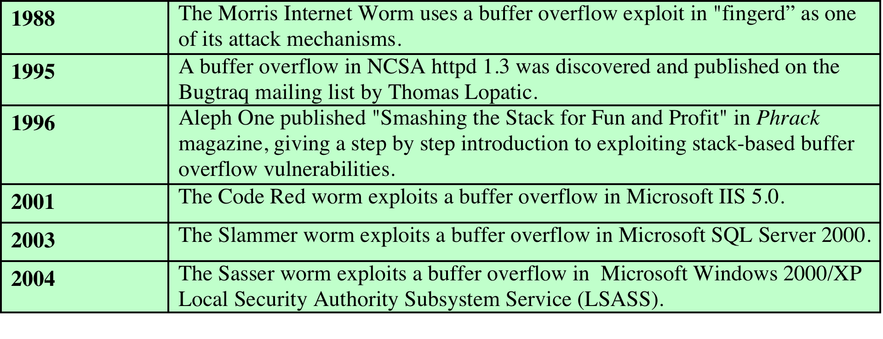
Brief History of
Buffer Overflow Attacks
Notes:
Table 10.1 provides a brief history
of some of the more notable incidents in the history of buffer overflow exploits.

Slide 9
Example
char array[10];
for(i = 0; i < 10; ++i)
array[i] = `A`;
array[10] = `B`;
This program has an error
This error might cause a fault
  Incorrect internal state
If a fault occurs, it might lead to a failure
  Program behaves incorrectly (external)
We use the term flaw for all of the above

Slide 10
Buffer Overflow
int main(){
int buffer[10];
buffer[20] = 37;}
Q: What happens when this is executed?
A: Depending on what resides in memory at location “buffer[20]”
  Might overwrite user data or code
  Might overwrite system data or code
Notes:
Stack buffer overflow were exploited in the morris Internet worm in 1988, unchecked use of C gets() in the fingerrd daemon.

Slide 11

Simple Buffer Overflow
Consider boolean flag for authentication
Buffer overflow could overwrite flag allowing anyone to authenticate!
Boolean flag
buffer
F
O
U
R
S
C
…
T
F

Slide 12
Memory Organization
low
address
Text == code
Data == static variables
Heap == dynamic data
Stack == “scratch paper”
  Dynamic local variables
  Parameters to functions
  Return address
text
data
heap
↓
↑
SP
stack
high
address
Notes:
Here data is global data
This is for a program loaded into process memory. The bottom of memory is process control block (PCB)
Segmentation fault
Common unsafe C routines: gets, sprintf, stract, strcpy, vsprintf

Slide 13
Simplified Stack Example
low →
:
:
void f(int a, int b){
char buffer[10];
}
void main(){
f(1, 2);
}
SP
buffer
SP
ret
return
address
a
SP
high →
b
SP

Slide 14
Smashing the Stack
low →
What happens if buffer overflows?
???
:
:
Program “returns” to wrong location
buffer
SP
overflow
SP
A crash is likely
ret
ret…
NOT!
overflow
a
SP
high →
b
SP

Slide 15
Smashing the Stack
low →
Trudy has a better idea…
:
:
Code injection
Trudy can run code of her choosing!
SP
evil code
ret
ret
SP
a
SP
high →
b
SP

Slide 16
Smashing the Stack
:
:
Trudy needs to know
  Address of evil code
  Location of ret on stack
Solutions
  Precede evil code with NOP “landing pad”
  Insert lots of new ret
  Where to find?
NOP
:
NOP
evil code
ret
ret
ret
:
ret
:
:

Slide 17
Stack Smashing Summary
A buffer overflow must exist in the code
Not all buffer overflows are exploitable
  Things must line up just right
If exploitable, attacker can inject code
Trial and error likely required
  Lots of help available online
  Smashing the Stack for Fun and Profit, Aleph One
Also heap overflow, integer overflow, etc.
Stack smashing is “attack of the decade”
Notes:
iOS jailbreaking often uses heap overflows to gain arbitrary code execution, usually for kernel exploits to achieve the ability to replace the kernel with the one jailbreak provides.

Slide 18
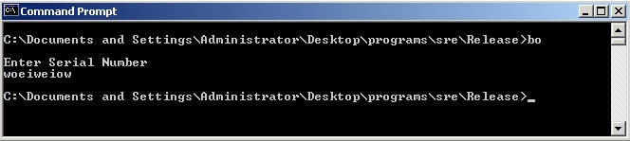
Stack Smashing Example
Program asks for a serial number that the attacker does not know
Attacker does not have source code
Attacker does have the executable (exe)
Program quits on incorrect serial number

Slide 19
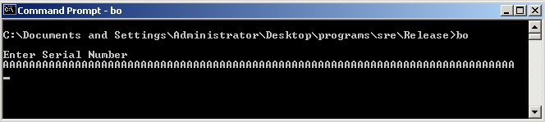
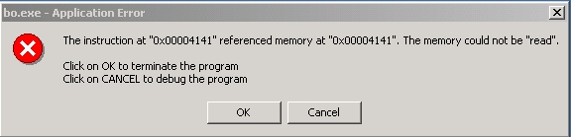
Example
By trial and error, attacker discovers an apparent buffer overflow
What are your observations?

Slide 20
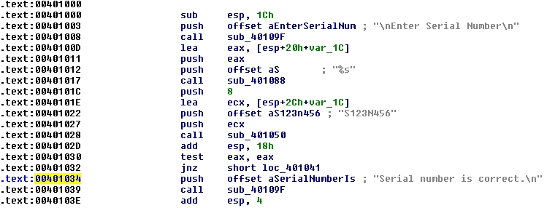
Example
Next, disassemble bo.exe to find
What is your next goal is?

Slide 21
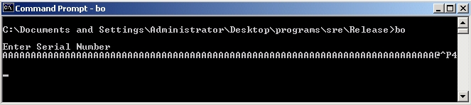
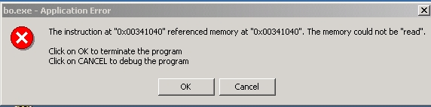
Example
Find that 0x401034 is “@^P4” in ASCII
Byte order is reversed? Why?

Slide 22
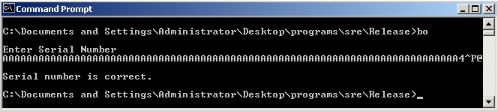
Example
Reverse the byte order to “4^P@” and…
Success! We’ve bypassed serial number check by exploiting a buffer overflow
Overwrote the return address on the stack

Slide 23
Example
Attacker did not require access to the source code
Only tool used was a disassembler to determine address to jump to
Can find address by trial and error
  Necessary if attacker does not have exe
  For example, a remote attack

Slide 24
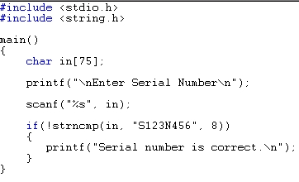
Example
Source code of the buffer overflow
Flaw easily found by attacker
Even without the source code!

Slide 25
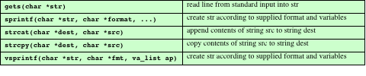
Common Unsafe C Standard Library Routines
Notes:
This shows that when looking for buffer overflows, all possible places where
externally sourced data are copied or merged have to be located. Note that these do
not even have to be in the code for a particular program, they can (and indeed do)
occur in library routines used by programs, including both standard libraries and
third-party application libraries. Thus, for both attacker and defender, the scope of
possible buffer overflow locations is very large. A list of some of the most common
unsafe standard C Library routines is given in Table 10.2 . 9 These routines are all
suspect and should not be used without checking the total size of data being transferred
in advance, or better still by being replaced with safer alternatives.

Slide 26
Shellcode
code supplied by attacker
  often saved in buffer being overflowed
  traditionally transferred control to a user command-line interpreter (shell)
machine code
  specific to processor and operating system
  traditionally needed good assembly language skills to create
  more recently a number of sites and tools have been developed that automate this process
Metasploit Project
  provides useful information to people who perform penetration, IDS signature development, and exploit research
Notes:
An essential component of many buffer overflow attacks is the transfer of execution
to code supplied by the attacker and often saved in the buffer being overflowed.
This code is known as shellcode , because traditionally its function was to transfer
control to a user command-line interpreter, or shell, which gave access to any program
available on the system with the privileges of the attacked program. On UNIX
systems this was often achieved by compiling the code for a call to the execve
(”/bin/sh”) system function, which replaces the current program code with that
of the Bourne shell (or whichever other shell the attacker preferred). On Windows
systems, it typically involved a call to the system(”command.exe”) function
(or ”cmd.exe” on older systems) to run the DOS Command shell. Shellcode then
is simply machine code, a series of binary values corresponding to the machine
instructions and data values that implement the attacker’s desired functionality.
This means shellcode is specific to a particular processor architecture, and indeed
usually to a specific operating system, as it needs to be able to run on the targeted
system and interact with its system functions. This is the major reason why buffer
overflow attacks are usually targeted at a specific piece of software running on a
specific operating system. Because shellcode is machine code, writing it traditionally
required a good understanding of the assembly language and operation of the
targeted system. Indeed many of the classic guides to writing shellcode, including
the original [LEVY96], assumed such knowledge. However, more recently a number
of sites and tools have been developed that automate this process (as indeed has
occurred in the development of security exploits generally), thus making the development
of shellcode exploits available to a much larger potential audience. One site
of interest is the Metasploit Project, which aims to provide useful information to
people who perform penetration testing, IDS signature development, and exploit
research. It includes an advanced open-source platform for developing, testing, and
using exploit code, which can be used to create shellcode that performs any one of
a variety of tasks and that exploits a range of known buffer overflow vulnerabilities.

Slide 27
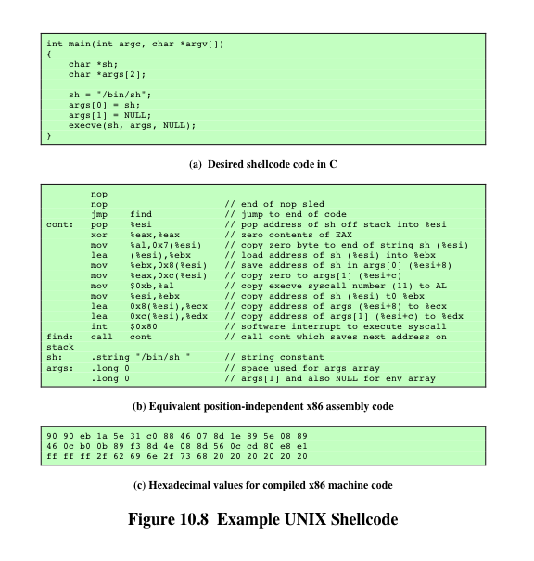
Example Shellcode
Notes:
To highlight the basic structure of shellcode, we
explore the development of a simple classic shellcode attack, which simply launches
the Bourne shell on an Intel Linux system. The shellcode needs to implement
the functionality shown in Figure 10.8a . The shellcode marshals the necessary
arguments for the execve() system function, including suitable minimal argument
and environment lists, and then calls the function. To generate the shellcode,
this high-level language specification must first be compiled into equivalent
machine language. However, a number of changes must then be made. First,
execve(sh,args,NULL) is a library function that in turn marshals the supplied
arguments into the correct locations (machine registers in the case of Linux) and
then triggers a software interrupt to invoke the kernel to perform the desired system
call. For use in shellcode, these instructions are included inline, rather than relying
on the library function.
There are also several generic restrictions on the content of shellcode. First, it
has to be position independent . That means it cannot contain any absolute address
referring to itself, because the attacker generally cannot determine in advance exactly
where the targeted buffer will be located in the stack frame of the function in which
it is defined. These stack frames are created one below the other, working down
from the top of the stack as the flow of execution in the target program has functions
calling other functions. The number of frames and hence final location of the buffer
will depend on the precise sequence of function calls leading to the targeted function.
This function might be called from several different places in the program, and there
might be different sequences of function calls, or different amounts of temporary local
values using the stack before it is finally called. So while the attacker may have an
approximate idea of the location of the stack frame, it usually cannot be determined
precisely. All of this means that the shellcode must be able to run no matter where in
memory it is located. This means that only relative address references, offsets to the
current instruction address, can be used. It also means that the attacker is not able to
precisely specify the starting address of the instructions in the shellcode.
Another restriction on shellcode is that it cannot contain any NULL values.
This is a consequence of how it is typically copied into the buffer in the first place.
All the examples of buffer overflows we use in this chapter involve using unsafe
string manipulation routines. In C, a string is always terminated with a NULL character,
which means the only place the shellcode can have a NULL is at the end, after
all the code, overwritten old frame pointer, and return address values.

Slide 28
Stack Smashing Prevention
1st choice: employ non-executable stack and address space layout randomization
  “No execute” NX bit (most OSs support it) –MMU tag pages of virtual memory
  ASLR and DEP in Windows 7
  Seems like the logical thing to do, but some real code executes on the stack (Java does this)
2nd choice: use safe languages (Java, C#)
3rd choice: use safer C functions
  For unsafe functions, there are safer versions
  For example, strncpy instead of strcpy
Notes:
Address space layout randomization (ASLR) is a computer security technique which involves randomly arranging the positions of key data areas, usually including the base of the executable and position of libraries, heap, and stack, in a process's address space.
Data Execution Prevention (DEP) is a security feature included in modern operation systems. It is available in Linux, Mac OS X and the newer Microsoft Windows operating systems and is intended to prevent an application or service from executing code from a non-executable memory region. This helps prevent certain exploits that store code via a buffer overflow, for example.^{[1]} DEP runs in two modes: hardware-enforced DEP for CPUs that can mark memory pages as nonexecutable, and software-enforced DEP with a limited prevention for CPUs that do not have hardware support. Software-enforced DEP does not protect from execution of code in data pages, but instead from another type of attack (SEH overwrite).
• Compile-time defenses, which aim to harden programs to resist attacks in new
programs
• Run-time defenses, which aim to detect and abort attacks in existing
programs

Slide 29

Stack Smashing Prevention
low →
Canary
  Instrument the function entry and exit code and later check for corruption
  Run-time stack check
  Push canary onto stack
  Canary value:
    Constant 0x000aff0d
    Or value depends on ret
:
:
buffer
overflow
canary
overflow
ret
a
high →
b
Notes:
Stackguard:
Canary: name after miner’s canary used to detect poisnous air in a mine and thus warn the miners in time for them to escape.
The entire linux has been recompiled with stackguard, problem is needing recompiling old code, some compatiblity issue
In Return address defender and stackshield, added code will copy the return address to a safe region of memory.

Slide 30
Microsoft’s Canary
Microsoft added buffer security check feature to C++ with /GS compiler flag
Uses canary (or “security cookie”)
Q: What to do when canary dies?
A: Check for user-supplied handler
Handler may be subject to attack
  Claimed that attacker can specify handler code
  If so, “safe” buffer overflows become exploitable when /GS is used!
Notes:
kernary

Slide 31
Run-Time Defenses:
Address Space Randomization
manipulate location of key data structures
  stack, heap, global data
  using random shift for each process
  large address range on modern systems means wasting some has negligible impact
randomize location of heap buffers
random location of standard library functions
Notes:
Another run-time technique that can be used
to thwart attacks involves manipulation of the location of key data structures in a
processes address space. In particular, recall that in order to implement the classic
stack overflow attack, the attacker needs to be able to predict the approximate
location of the targeted buffer. The attacker uses this predicted address to determine
a suitable return address to use in the attack to transfer control to the shellcode. One
technique to greatly increase the difficulty of this prediction is to change the address
at which the stack is located in a random manner for each process. The range of
addresses available on modern processors is large (32 bits), and most programs only
need a small fraction of that. Therefore, moving the stack memory region around by
a megabyte or so has minimal impact on most programs but makes predicting the
targeted buffer’s address almost impossible. This amount of variation is also much
larger than the size of most vulnerable buffers, so there is no chance of having a large
enough NOP sled to handle this range of addresses. Again this provides a degree of
protection for existing programs, and while it cannot stop the attack proceeding, the
program will almost certainly abort due to an invalid memory reference.
Related to this approach is the use of random dynamic memory allocation (for
malloc() and related library routines). As we discuss in Section 10.3 , there is a
class of heap buffer overflow attacks that exploit the expected proximity of successive
memory allocations, or indeed the arrangement of the heap management data
structures. Randomizing the allocation of memory on the heap makes the possibility
of predicting the address of targeted buffers extremely difficult, thus thwarting
the successful execution of some heap overflow attacks.
Another target of attack is the location of standard library routines. In an
attempt to bypass protections such as nonexecutable stacks, some buffer overflow
variants exploit existing code in standard libraries. These are typically loaded at
the same address by the same program. To counter this form of attack, we can use
a security extension that randomizes the order of loading standard libraries by a
program and their virtual memory address locations. This makes the address of any
specific function sufficiently unpredictable as to render the chance of a given attack
correctly predicting its address, very low.
The OpenBSD system includes versions of all of these extensions in its technological
support for a secure system.

Slide 32
Buffer Overflow
The “attack of the decade” for 90’s
Will be the attack of the decade for 00’s
Can be prevented
  Use safe languages/safe functions
  Educate developers, use tools, etc.
Buffer overflows will exist for a long time
  Legacy code
  Bad software development

