Slide 1
User Authentication

Slide 2
User Authentication
fundamental security building block
basis of access control & user accountability
is the process of verifying an identity claimed by or for a system entity
has two steps:
identification - specify identifier
verification - bind entity (person) and identifier
distinct from message authentication

Slide 3
Means of User Authentication
How to authenticate a human to a machine?
Can be based on…
Something you know
For example, a password
Something you have
For example, a smartcard
Something you are
For example, your fingerprint

Slide 4
Something You Know
Passwords
Lots of things act as passwords!
PIN
Social security number
Mother’s maiden name
Date of birth
Name of your pet, etc.

Slide 5
Trouble with Passwords
“Passwords are one of the biggest practical problems facing security engineers today.”
“Humans are incapable of securely storing high-quality cryptographic keys, and they have unacceptable speed and accuracy when performing cryptographic operations. (They are also large, expensive to maintain, difficult to manage, and they pollute the environment. It is astonishing that these devices continue to be manufactured and deployed.)”

Slide 6
Other Password Issues
Too many passwords to remember
Results in password reuse
Why is this a problem?
Who suffers from bad password?
Login password vs ATM PIN
Failure to change default passwords
Social engineering
Error logs may contain “almost” passwords
Bugs, keystroke logging, spyware, etc.

Slide 7
Why Passwords?
Why is “something you know” more popular than “something you have” and “something you are”?
Cost: passwords are free
Convenience: easier for SA to reset pwd than to issue user a new thumb

Slide 8
Keys vs Passwords
Crypto keys
Spse key is 64 bits
Then 2⁶⁴ keys
Choose key at random
Then attacker must try about 2⁶³ keys
Passwords
Spse passwords are 8 characters, and 256 different characters
Then 256⁸ = 2⁶⁴ pwds
Users do not select passwords at random
Attacker has far less than 2⁶³ pwds to try (dictionary attack)

Slide 9
Good and Bad Passwords
Bad passwords
frank
Fido
password
4444
Pikachu
102560
AustinStamp
Good Passwords?
jfIej,43j-EmmL+y
09864376537263
P0kem0N
FSa7Yago
0nceuP0nAt1m8
PokeGCTall150

Slide 10
Password Experiment
Three groups of users ⎯ each group advised to select passwords as follows
Group A: At least 6 chars, 1 non-letter
Group B: Password based on passphrase
Group C: 8 random characters
Results
Group A: About 30% of pwds easy to crack
Group B: About 10% cracked
Passwords easy to remember
Group C: About 10% cracked
Passwords hard to remember
winner →

Slide 11
Password Experiment
User compliance hard to achieve
In each case, 1/3rd did not comply (and about 1/3rd of those easy to crack!)
Assigned passwords sometimes best
If passwords not assigned, best advice is
Choose passwords based on passphrase
Use pwd cracking tool to test for weak pwds
Require periodic password changes?

Slide 12
Attacks on Passwords
Attacker could…
Target one particular account
Target any account on system
Target any account on any system
Common attack path
Outsider → normal user → administrator
May only require one weak password!

Slide 13
Password File
Bad idea to store passwords in a file
But need a way to verify passwords
Cryptographic solution: hash the passwords
Store y = h(password)
Can verify entered password by hashing
If attacker obtains password file, he does not obtain passwords
But attacker with password file can guess x and check whether y = h(x)
If so, attacker has found password!

Slide 14
Dictionary Attack
Attacker pre-computes h(x) for all x in a dictionary of common passwords
Suppose attacker gets access to password file containing hashed passwords
Attacker only needs to compare hashes to his pre-computed dictionary
Same attack will work each time
Can we prevent this attack? Or at least make attacker’s job more difficult?

Slide 15
Password File
Store hashed passwords
Better to hash with salt
Given password, choose random s, compute
y = h(password, s)
and store the pair (s,y) in the password file
Note: The salt s is not secret
Easy to verify password
Attacker must recompute dictionary hashes for each user ⎯ lots more work!

Slide 16
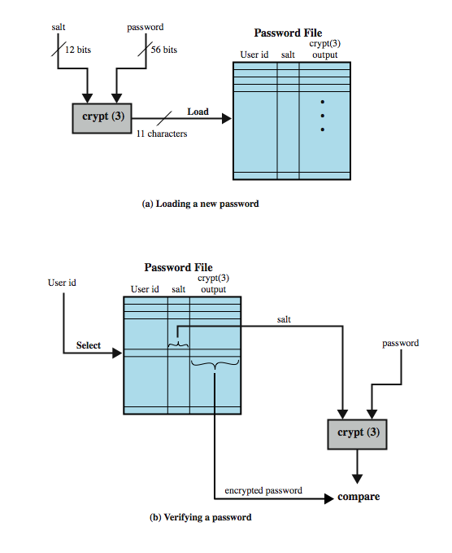
Use of Hashed Passwords
Notes:
A widely used password security technique is the use of hashed passwords and a salt value. This scheme is found on virtually all UNIX variants as well as on a number of other operating systems. The procedure shown here in Figure 3.1a from the text is used. To load a new password into the system, the user selects or is assigned a password.This password is combined with a fixed-length salt value (so the same user password can create multiple hash values, depending on which salt is used. to make attacks harder). In older implementations, the salt is related to the time the password is assigned to the user. Newer implementations use a pseudorandom or random number. The password and salt serve as inputs to a hashing algorithm to produce a fixed-length hash code. The hash algorithm is designed to be slow to execute to thwart attacks. The hashed password is then stored, together with a plaintext copy of the salt, in the password file for the corresponding user ID. The hashed-password method has been shown to be secure against a variety of cryptanalytic attacks. When a user attempts to log on to a system, the user provides an ID and a password (as shown in Figure 3.1b). The operating system uses the ID to index into the password file and retrieve the plaintext salt and the encrypted password. The salt and user-supplied password are used as input to the encryption routine. If the result matches the stored value, the password is accepted. There are two threats to this password scheme. First, a user can gain access on a machine using a guest account or by some other means and then run a password guessing program, called a password cracker, on that machine. In addition, if an opponent is able to obtain a copy of the password file, then a cracker program can be run on another machine at leisure. This enables the opponent to run through millions of possible passwords in a reasonable period.

Slide 17
UNIX Implementation
original scheme
8 character password form 56-bit key
12-bit salt used to modify DES encryption into a one-way hash function
0 value repeatedly encrypted 25 times(attacker need more time)
output translated to 11 character sequence
now regarded as woefully insecure
e.g. supercomputer, 50 million tests, 80 min
sometimes still used for compatibility

Slide 18
Improved Implementations
have other, stronger, hash/salt variants
many systems now use MD5
with 48-bit salt
password length is unlimited
is hashed with 1000 times inner loop
produces 128-bit hash
OpenBSD uses Blowfish block cipher based hash algorithm called Bcrypt
uses 128-bit salt to create 192-bit hash value

Slide 19
The Password File
Lists all users of the system and attributes
Available on some systems from the path:
/etc/passwd
Execute the following to bring a copy into your home directory and view it:
cp ~chidhkra/passwd . cat passwd

Slide 20
Example Password File
root:5I2ESdPMj6rhc:0:1:Operator:/:/bin/csh
daemon:*:1:1::/:
sys:*:2:2::/:/bin/csh
bin:*:3:3::/bin:
…..
nobody:NoLoginAllowed:-2:-2:Account with no privelege:/tmp:/bin/csh
dao:dn2dbqtIcZ/9I:323:8006:Debbie Ortiz, 090112:/home/sunclass1/dao:/bin/csh
psn:1z.sMh0vow65w:7500:8008:Paul Norris, c-8, 087500:/home/sunclass1/psn:/bin/csh
pam:*:1016:8008:Pat Max:/home/sunclass1/pam:/bin/csh
pav:B7SdcWEcSeKSU:1002:8006:Pat Vucenic:/home/sunclass1/pav:/bin/csh
ths:6q3y/n8TQ:1059:8006:Ted Spitzmiller,081347,8006x33d:/home/sunclass1/ths:/bin/csh

Slide 21
Password File Access Control
can block offline guessing attacks by denying access to encrypted passwords
make available only to privileged users
often using a separate shadow password file
still have vulnerabilities
exploit O/S bug
accident with permissions making it readable
users with same password on other systems
access from unprotected backup media
sniff passwords in unprotected network traffic
Notes:
One way to thwart a password attack is to deny the opponent access to the password file. If the hashed password portion of the file is accessible only by a privileged user, then the opponent cannot read it without already knowing the password of a privileged user. Often, the hashed passwords are kept in a separate file from the user IDs, referred to as a shadow password file. Special attention is paid to making the shadow password file protected from unauthorized access. Although password file protection is certainly worthwhile, there remain vulnerabilities: a hacker may be able to exploit a software vulnerability in the operating system to bypass the access control system long enough to extract the password file; an accident of protection might render the password file readable; some users may use the same password on other less protected or compromised machines; a lack of or weakness in physical security (e.g. of backups) may provide opportunities for a hacker to access a copy of the file; passwords may be captured by sniffing network traffic.

Slide 22
An Example with Shadow File
The “/etc/passwd” file
smithj:x:561:561:Joe Smith:/home/smithj:/bin/bash
The ``/etc/shadow'' file contains password and account expiration information for users, and looks like this:
smithj:Ep6mckrOLChF.:10063:0:99999:7:::

Slide 23
Remote User Authentication
authentication over network more complex
problems of eavesdropping, replay
generally use challenge-response
user sends identity
host responds with random number
user computes f(r,h(P)) and sends back
host compares value from user with own computed value, if match user authenticated
protects against a number of attacks
Notes:
The simplest form of user authentication is local authentication, in which a user attempts to access a system that is locally present, such as a stand-alone office PC or an ATM machine. The more complex case is that of remote user authentication, which takes place over the Internet, a network, or a communications link. Remote user authentication raises additional security threats, such as an eavesdropper being able to capture a password, or an adversary replaying an authentication sequence that has been observed. To counter threats to remote user authentication, systems generally rely on some form of challenge-response protocol. The user first transmits his or her identity to the emote host. The host generates a random number r, often called a nonce, and returns this nonce to the user, known as the challenge. The user’s response is the result of computing a function on the random number and a hash of the password: f(r,h(P)). The host stores the hash function of each register user’s password. When the response arrives, the host compares the incoming vakue to that it calculates. If the quantities match, the user is authenticated. This scheme defends against several forms of attack.The host stores only a hash code of the password, which secures the password from intruders into the host system. Also only a function of the password hash is sent, so it cannot be captured during transmission. Finally, the use of a random number as one of the arguments defends against a replay attack. The text includes details of variants using tokens, static biometrics and dynamic biometrics.

Slide 24
Remote User Authentication

Slide 25
Password Cracking Tools
Popular password cracking tools
Password Crackers
Password Portal
L0phtCrack and LC4 (Windows)
John the Ripper (Unix)
Admins should use these tools to test for weak passwords since attackers will!
Good article on password cracking
Passwords - Conerstone of Computer Security

Slide 26
Password Summary
The bottom line
Password cracking is too easy!
One weak password may break security
Users choose bad passwords
Social engineering attacks, etc.
The bad guy has all of the advantages
All of the math favors bad guys
Passwords are a big security problem

Slide 27
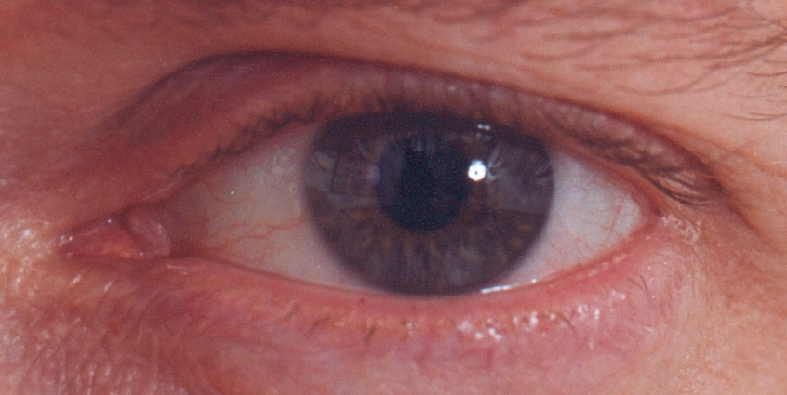
Biometrics

Slide 28
Sept. 2012 News
FBI begins installation of $1 billion face recognition system across America
http://rt.com/usa/fbi-recognition-system-ngi-640/

Slide 29
Something You Are
Biometric
“You are your key” ⎯ Schneier
Examples
Fingerprint
Handwritten signature
Facial recognition
Speech recognition
Gait (walking) recognition
“Digital doggie” (odor recognition)
Many more!
Are
Know
Have

Slide 30
Ideal Biometric
Universal ⎯ applies to (almost) everyone
In reality, no biometric applies to everyone
Distinguishing ⎯ distinguish with certainty
In reality, cannot hope for 100% certainty
Permanent ⎯ physical characteristic being measured never changes
In reality, want it to remain valid for a long time
Collectable ⎯ easy to collect required data
Depends on whether subjects are cooperative
Safe, easy to use, etc., etc.

Slide 31
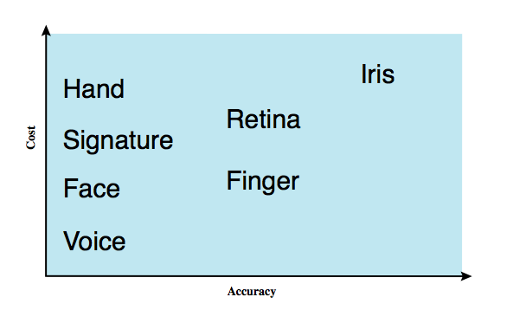
Biometric Authentication
authenticate user based on one of their physical characteristics
Notes:
A biometric authentication system attempts to authenticate an individual based on unique physical characteristics.These include static characteristics, such as fingerprints, hand geometry, facial characteristics, and retinal and iris patterns; and dynamic characteristics, such as voiceprint and signature. Compared to passwords and tokens, biometric authentication is both technically complex and expensive, and have yet to mature as a standard tool for user authentication to computer systems. Figure 3.6 from the text gives a rough indication of the relative cost and accuracy of the most common biometric measures:
• Facial characteristics: define characteristics based on relative location and shape of key facial features, such as eyes, eyebrows, nose, lips, and chin shape.
• Fingerprints: the pattern of ridges and furrows on the surface of the fingertip, believed to be unique across the entire human population. Automated fingerprint systems extract a number of features to use as a surrogate for the full pattern.
• Hand geometry: identify features of hand,: e.g. shape, lengths & widths of fingers.
• Retinal pattern: formed by veins beneath the retinal surface is unique and therefore suitable for identification. Uses a digital image of the retinal pattern by projecting a low-intensity beam of visual or infrared light into the eye.
• Iris: Another unique physical characteristic is the detailed structure of the iris.
• Signature: each individual has a unique style of handwriting, esp in signature.
• Voice: patterns are more closely tied to physical and anatomical characteristics of the speaker, but still have a variation from sample to sample over time from the same speaker,complicating the biometric recognition task.

Slide 32
Biometric Modes
Authentication/Verification ⎯ Is that really you?
Compare one to one
Example: Thumbprint mouse
Identification ⎯ Who goes there?
Compare one to many
Example: The FBI fingerprint database

Slide 33
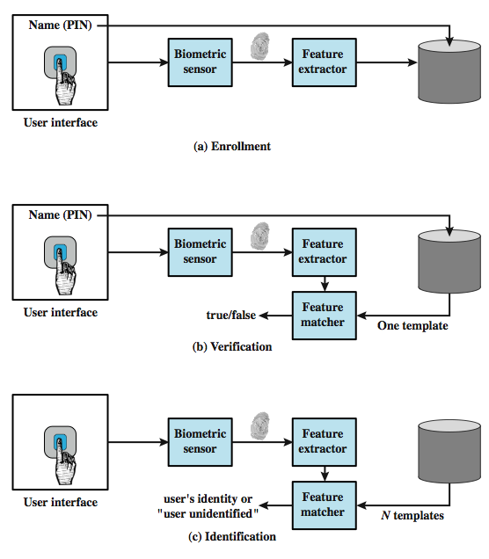
Operation of a Biometric System
Notes:
Figure 3.7 from the text illustrates the operation of a biometric system. Each individual who is to be included in the database of authorized users must first be enrolled in the system. This is analogous to assigning a password to a user .For a biometric system, the user presents a name and, typically, some type of password or PIN to the system. At the same time the system senses some biometric characteristic of this user (e.g. fingerprint of right index finger). The system digitizes the input and then extracts a set of features that can be stored as a number or set of numbers representing this unique biometric characteristic ;this set of numbers is referred to as the user’s template. The user is now enrolled in the system, which maintains for the user a name (ID), perhaps a PIN or password, and the biometric value. Depending on application, user authentication on a biometric system involves either verification or identification. Verification is analogous to a user logging on to a system by using a memory card or smart card coupled with a password or PIN. For biometric verification, the user enters a PIN and also uses a biometric sensor. The system extracts the corresponding feature and compares that to the template stored for this user. If there is a match, then the system authenticates this user. For an identification system, the individual uses the biometric sensor but presents no additional information. The system then compares the presented template with the set of stored templates. If there is a match, then this user is identified. Otherwise, the user is rejected.

Slide 34
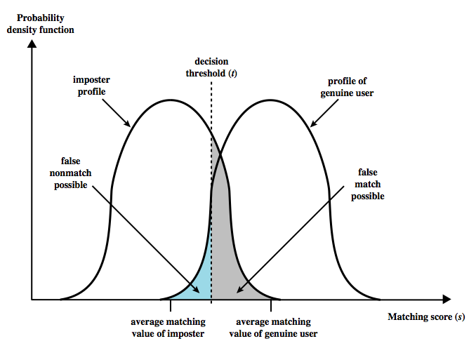
Biometric Accuracy
never get identical templates
problems of false match / false non-match
Notes:
In any biometric scheme, some physical characteristic of the individual is mapped into a digital representation. For each individual, a single digital representation, or template, is stored in the computer. When the user is to be authenticated, the system compares the stored template to the presented template. Given the complexities of physical characteristics, we cannot expect that there will be an exact match between the two templates. Rather, the system uses an algorithm to generate a matching score (typically a single number) that quantifies the similarity between the input and the stored template. Figure 3.8 illustrates the dilemma posed to the system. If a single user is tested by the system numerous times, the matching score swill vary, with a probability density function typically forming a bell curve, as shown. On average, any other individual should have a much lower matching score but again will exhibit a bell-shaped probability density function .The difficulty is that the range of matching scores produced by two individuals, one genuine and one an imposter, compared to a given reference template, are likely to overlap. In Figure 3.8 a threshold value is selected so that if the presented value is s>=t then a match is assumed, and for s< t, a mismatch is assumed. The shaded part to the right of t indicates a range of values for which a false match is possible, and the shaded part to the left indicates a range of values for which a false nonmatch is possible. The area of each shaded part represents to probability of a false match or nonmatch, respectively. By moving the threshold, left or right, the probabilities can be altered, but note that an decrease in false match rate necessarily results in an increase in false nonmatch rate, and vice versa.

Slide 35
Biometric Errors
Fraud rate versus insult rate
Fraud ⎯ Trudy mis-authenticated as Alice
Insult ⎯ Alice not authenticated as Alice
For any biometric, can decrease fraud or insult, but other one will increase
For example
99% voiceprint match ⇒ low fraud, high insult
30% voiceprint match ⇒ high fraud, low insult
Equal error rate: rate where fraud == insult
A way to compare different biometrics

Slide 36
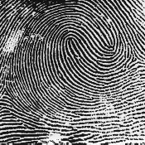
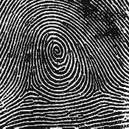
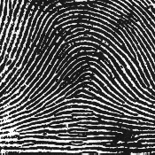
Fingerprint Comparison
Examples of loops, whorls and arches
Minutia extracted from these features
Loop (double)
Whorl
Arch

Slide 37
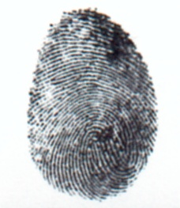
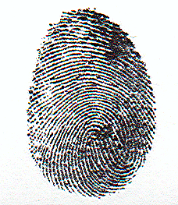
Fingerprint Biometric
Capture image of fingerprint
Enhance image
Identify minutia

Slide 38
Fingerprint Biometric
Extracted minutia are compared with user’s minutia stored in a database
Is it a statistical match?

Slide 39
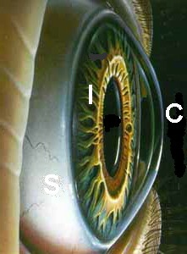

Iris Patterns
Iris pattern development is “chaotic”
Little or no genetic influence
Different even for identical twins
Pattern is stable through lifetime

Slide 40

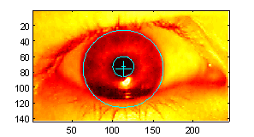
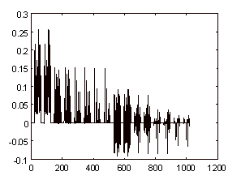
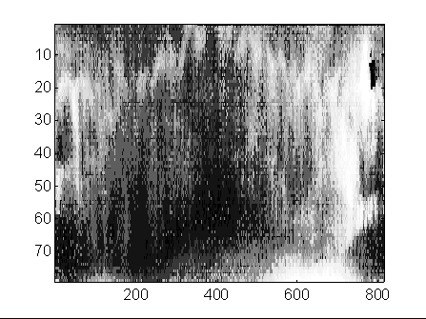
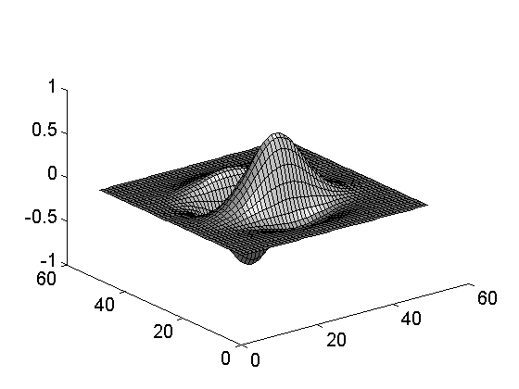
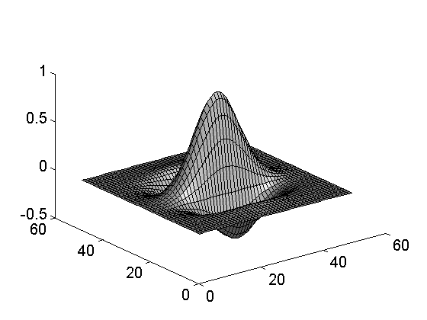
Iris Scan
Scanner locates iris
Take b/w photo
Use polar coordinates…
Find 2-D wavelet trans
Get 256 byte iris code

Slide 41
Equal Error Rate Comparison
Equal error rate (EER): fraud == insult rate
Fingerprint biometric has EER of about 5%
Hand geometry has EER of about 10⁻³
In theory, iris scan has EER of about 10⁻⁶
But in practice, may be hard to achieve
Enrollment phase must be extremely accurate
Most biometrics much worse than fingerprint!
Biometrics useful for authentication…
…but identification biometrics almost useless today

Slide 42
Biometrics: The Bottom Line
Biometrics are hard to forge
But attacker could
Steal Alice’s thumb
Photocopy Bob’s fingerprint, eye, etc.
Subvert software, database, “trusted path”, …
Also, how to revoke a “broken” biometric?
Biometrics are not foolproof!
Biometric use is limited today
That should change in the future…

Slide 43
Something You Have
Something in your possession
Examples include
Car key
Laptop computer
Or specific MAC address
Password generator
We’ll look at this next
ATM card, smartcard, etc.

Slide 44
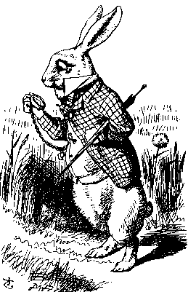
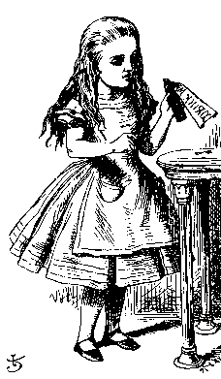
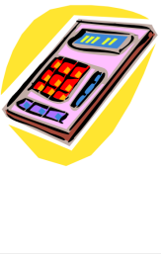
Password Generator
1. “I’m Alice”
3. PIN, R
2. R
4. F(R)
5. F(R)
Password
generator
Alice
Bob
Alice gets “challenge” R from Bob
Alice enters R into password generator
Alice sends “response” back to Bob
Alice has pwd generator and knows PINs

Slide 45
2-factor Authentication
Requires 2 out of 3 of
Something you know
Something you have
Something you are
Examples
ATM: Card and PIN
Credit card: Card and signature
Password generator: Device and PIN
Smartcard with password/PIN

Slide 46
Single Sign-on
A hassle to enter password(s) repeatedly
Users want to authenticate only once
“Credentials” stay with user wherever he goes
Subsequent authentication is transparent to user
Single sign-on for the Internet?
Microsoft: Passport
Everybody else: Liberty Alliance
Security Assertion Markup Language (SAML)

