Slide 1
Intrusion Detection Systems

Slide 2
Intrusion
Intrusions in an information system are the activities that violate the security policy of the system
Intrusion taxonomy
Masquerading
Control bypass
Active resource misuse (change)
Passive resource misuse (read)
Denial-of-service
…

Slide 3
Known versus Unknown
Known intrusions
Well understood attacks
Known indication/signatures - easier to detect
For example, “copy of /etc/passwd by an unprivileged user”
Unknown (newly invented) intrusions
Usually very difficult to detect using existing IDSes

Slide 4
Intrusion Prevention
Want to keep bad guys out
Intrusion prevention is a traditional focus of computer security
Authentication is to prevent intrusions
Firewalls a form of intrusion prevention
Virus defenses also intrusion prevention
Comparable to locking the door on your car

Slide 5
Intrusion Detection
In spite of intrusion prevention, bad guys will sometime get into system
Intrusion detection: the process of identifying intrusions
Intrusion detection systems (IDS)
Detect attacks
Look for “unusual” activity
IDS developed out of log file analysis
IDS is currently a very hot research topic
How to respond when intrusion detected?
We don’t deal with this topic here

Slide 6
Intrusion Detection Systems
Who is likely intruder?
May be outsider who got thru firewall
May be evil insider
What do intruders do?
Launch well-known attacks
Launch variations on well-known attacks
Launch new or little-known attacks
Use a system to attack other systems
Etc.

Slide 7
The Goal of Intrusion Detection Systems (IDS)
Detect a wide variety of intrusions
Detect intrusions in a timely fashion
timely need not be in real time
A tool that discovers intrusions “after the fact” are called forensic analysis tools
E.g., from system logfiles
Present the analysis in a simple, easy-to-understand format
easy user-interface
Be accurate

Slide 8
IDS
Intrusion detection approaches
Signature-based IDS
Anomaly-based IDS
Intrusion detection architectures
Host-based IDS
Network-based IDS
Most systems can be classified as above
In spite of marketing claims to the contrary!
logical components:
sensors - collect data
analyzers - determine if intrusion has occurred
user interface - manage / direct / view IDS

Slide 9
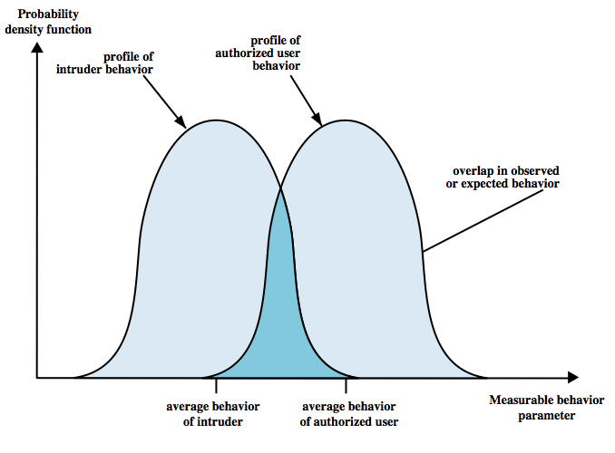
IDS Principles
assume intruder behavior differs from legitimate users
expect overlap as shown
observe deviations
from past history
problems of:
false positives
false negatives
must compromise
Notes:
Intrusion detection is based on the assumption that the behavior of the intruder differs from that of a legitimate user in ways that can be quantified. Of course, we cannot expect that there will be a crisp, exact distinction between an attack by an intruder and the normal use of resources by an authorized user. Rather, we must expect that there will be some overlap, as shown by Figure 6.1. Patterns of legitimate user behavior can be established by observing past history, and significant deviation from such patterns can possibly be detected. Although the typical behavior of an intruder differs from the typical behavior of an authorized user, there is an overlap in these behaviors. Thus, a loose interpretation of intruder behavior, which will catch more intruders, will also lead to a number of false positives, or authorized users identified as intruders. On the other hand, an attempt to limit false positives by a tight interpretation of intruder behavior will lead to an increase in false negatives, or intruders not identified as intruders. Thus, there is an element of compromise and art in the practice of intrusion detection.

Slide 10
Intrusion Detection Systems
Misuse detection (signature detection)
Catch intrusions in terms of the characteristics of known intrusions or system vulnerabilities
Any action that conforms to the pattern of a known attack or vulnerability is considered intrusive.
Anomaly detection
Based on the normal behavior of a subject (e.g., a user)
Any action that significantly deviates from the normal behavior is considered intrusive.

Slide 11
Misuse (Signature) Detection
Profile signatures of known attacks
Monitor operational state for signature
Hypothesis: attacks of the same kind has enough similarity to distinguish from normal behavior
Q: Where do these signatures come from?
Record: recorded progression of known attacks
often by analyzing attack scripts from Internet
Expert: domain knowledge
AI: Learn by negative and positive feedback

Slide 12
Signature Detection Example
Failed login attempts may indicate password cracking attack
IDS could use the rule “N failed login attempts in M seconds” as signature
If N or more failed login attempts in M seconds, IDS warns of attack
Note that the warning is specific
Admin knows what attack is suspected
Admin can verify attack (or false alarm)

Slide 13
Signature Detection
Suppose IDS warns whenever N or more failed logins in M seconds
Must set N and M so that false alarms not common
Can do this based on normal behavior
But if attacker knows the signature, he can try N-1 logins every M seconds!
In this case, signature detection slows the attacker, but might not stop him

Slide 14
Signature Detection
Many techniques used to make signature detection more robust
Goal is usually to detect “almost signatures”
For example, if “about” N login attempts in “about” M seconds
Warn of possible password cracking attempt
What are reasonable values for “about”?
Can use statistical analysis, heuristics, other
Must take care not to increase false alarm rate

Slide 15
Signature Detection
Advantages of signature detection
Simple
Detect known attacks
Know which attack at time of detection
Efficient (if reasonable number of signatures)
Disadvantages of signature detection
Signature files must be kept up to date
Number of signatures may become large
Can only detect known attacks
Variation on known attack may not be detected

Slide 16
Anomaly Detection
Anomaly detection systems look for unusual or abnormal behavior
There are (at least) two challenges
What is normal for this system?
How “far” from normal is abnormal?
Statistics is obviously required here!
The mean defines normal
The variance indicates how far abnormal lives from normal

Slide 17
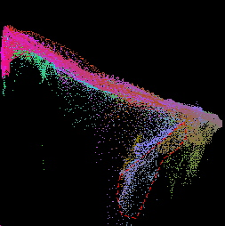
What is Normal?
Consider the scatterplot below
White dot is “normal”
Is red dot normal?
Is green dot normal?
How abnormal is the blue dot?
Stats can be tricky!
y
x

Slide 18
How to Measure Normal?
How to measure normal?
Must measure during “representative” behavior
Must not measure during an attack…
…or else attack will seem normal!
Normal is statistical mean
Must also compute variance to have any reasonable chance of success

Slide 19
How to Measure Abnormal?
Abnormal is relative to some “normal”
Abnormal indicates possible attack
Statistical discrimination techniques:
Bayesian statistics
Linear discriminant analysis (LDA)
Quadratic discriminant analysis (QDA)
Neural nets, hidden Markov models, etc.
Fancy modeling techniques also used
Artificial intelligence
Artificial immune system principles
Many others!

Slide 20
Anomaly Detection (1)
Spse we monitor use of three commands:
open, read, close
Under normal use we observe that Alice
open,read,close,open,open,read,close,…
Of the six possible ordered pairs, four pairs are “normal” for Alice:
(open,read), (read,close), (close,open), (open,open)
Can we use this to identify unusual activity?

Slide 21
Anomaly Detection (1)
We monitor use of the three commands
open, read, close
If the ratio of abnormal to normal pairs is “too high”, warn of possible attack
Could improve this approach by
Also using expected frequency of each pair
Use more than two consecutive commands
Include more commands/behavior in the model
More sophisticated statistical discrimination

Slide 22
Anomaly Detection (2)
Over time, Alice has accessed file F_{n} at rate H_{n}
Recently, Alice has accessed file F_{n} at rate A_{n}
H₀ | H₁ | H₂ | H₃
.10 | .40 | .40 | .10
A₀ | A₁ | A₂ | A₃
.10 | .40 | .30 | .20
Is this “normal” use?
We compute S = (H₀−A₀)²+(H₁−A₁)²+…+(H₃−A₃)² = .02
And consider S < 0.1 to be normal, so this is normal
Problem: How to account for use that varies over time?

Slide 23
Anomaly Detection (2)
To allow “normal” to adapt to new use, we update long-term averages as
H_{n} = 0.2A_{n} + 0.8H_{n}
Then H₀ and H₁ are unchanged, H₂=.2∗.3+.8∗.4=.38 and H₃=.2∗.2+.8∗.1=.12
And the long term averages are updated as
H₀ | H₁ | H₂ | H₃
.10 | .40 | .38 | .12

Slide 24
Anomaly Detection (2)
The updated long term average is
New observed rates are…
H₀ | H₁ | H₂ | H₃
.10 | .40 | .38 | .12
A₀ | A₁ | A₂ | A₃
.10 | .30 | .30 | .30
Is this normal use?
Compute S = (H₀−A₀)²+…+(H₃−A₃)² = .0488
Since S = .0488 < 0.1 we consider this normal
And we again update the long term averages by H_{n} = 0.2A_{n} + 0.8H_{n}

Slide 25
Anomaly Detection (2)
The starting averages were
After 2 iterations, the averages are
H₀ | H₁ | H₂ | H₃
.10 | .40 | .40 | .10
H₀ | H₁ | H₂ | H₃
.10 | .38 | .364 | .156
The stats slowly evolve to match behavior
This reduces false alarms and work for admin
But also opens an avenue for attack…
Suppose Trudy always wants to access F₃
She can convince IDS this is normal for Alice!

Slide 26
Anomaly Detection (2)
To make this approach more robust, must also incorporate the variance
Can also combine N stats as, for example,
T = (S₁ + S₂ + S₃ + … + S_{N}) / N
to obtain a more complete view of “normal”
Similar (but more sophisticated) approach is used in IDS known as NIDES
NIDES includes anomaly and signature IDS

Slide 27
Anomaly Detection Issues
System constantly evolves and so must IDS
Static system would place huge burden on admin
But evolving IDS makes it possible for attacker to (slowly) convince IDS that an attack is normal!
Attacker may win simply by “going slow”
What does “abnormal” really mean?
Only that there is possibly an attack
May not say anything specific about attack!
How to respond to such vague information?
Signature detection tells exactly which attack

Slide 28
Another Categorization
Based on the data source
Host-based intrusion detection
Intrusion detection by analyzing host audit trail
Example: NIDES
Network-based intrusion detection
Intrusion detection by analyzing network traffic
Example: Snort
Distributed intrusion detection
Intrusion detection by analyzing audit trails from multiple hosts and possibly network traffic
Example: EMERALD
Notes:
EMERALD: (SRI international) EMERALD represents state-of-the art in research and development of systems and components for anomaly and misuse detection in computer systems and networks:
Scalable Network Surveillance High-volume Event Analysis Light-weight Distributed Sensors Generic Infrastructure and Pluggable Components Easy Customization to New Targets and Specific Policies
Snort® is an open source network intrusion prevention and detection system utilizing a rule-driven language, which combines the benefits of signature, protocol and anomaly based inspection methods. With millions of downloads to date, Snort is the most widely deployed intrusion detection and prevention technology worldwide and has become the de facto standard for the industry.
Next-Generation Intrusion Detection Expert System (NIDES) (SRI International)
NIDES is a comprehensive intrusion-detection system that performs real-time monitoring of user activity on multiple target systems connected via Ethernet.† NIDES runs on its own workstation (the NIDES host) and analyzes audit data collected from various interconnected systems, searching for activity that may indicate unusual and/or malicious user behavior. Analysis is performed using two complimentary detection units: a rule-based signature analysis subsystem and a statistical profile-based anomaly-detection subsystem.

Slide 29
Host-based IDSs
Monitor activities on hosts for
Known attacks or
Suspicious behavior
Designed to detect attacks such as
Buffer overflow
Escalation of privilege
Using OS auditing mechanisms
E.G., BSM on Solaris: logs all direct or indirect events generated by a user
strace for system calls made by a program
E.G., Analyze system calls made by sendmail
Notes:
BSM (Basic Security Module): All security sensitive kernel system calls will generate an audit record when BSM auditing is enabled.
strace is a system call tracer, i.e. a debugging tool which prints out a trace of all the system calls made by a another process/program.
Sendmail is a mail transfer agent (MTA). Sendmail is a remarkably flexible program, supporting many kinds of mail transfer and delivery including the overwhelmingly popular SMTP.

Slide 30
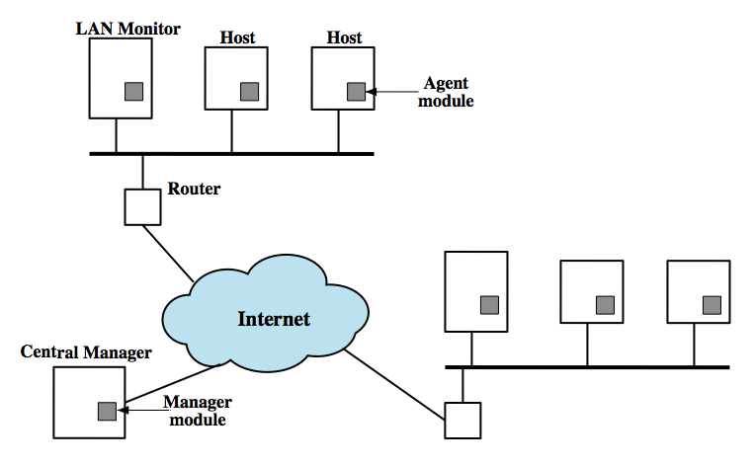
Distributed Host-Based IDS
Notes:
Traditionally, work on host-based IDSs focused on single-system stand-alone facilities. A more effective defense of a distributed collection of hosts supported by a LAN or internetwork can be achieved by coordination and cooperation among IDSs across the network. A good example of a distributed IDS is one developed at the University of California at Davis. The scheme is designed to be independent of any operating system or system auditing implementation. Figure 6.2 here shows the overall architecture, which consists of three main components:
• Host agent module: An audit collection module operating as a background process on a monitored system. Its purpose is to collect data on security-related events on the host and transmit these to the central manager.
• LAN monitor agent module: Operates in the same fashion as a host agent module except that it analyzes LAN traffic and reports the results to the central manager.
• Central manager module: Receives reports from LAN monitor and host agents and processes and correlates these reports to detect intrusion.

Slide 31
Network-Based IDSs
Deploying special sensors at strategic locations
E.G., Packet sniffing via tcpdump at routers
comprises a number of sensors
inline (possibly as part of other net device)
passive (monitors copy of traffic)
Inspecting network traffic
Watch for violations of protocols and unusual connection patterns
Monitoring user activities
Look into the data portions of the packets for malicious command sequences
May be easily defeated by encryption
Data portions and some header information can be encrypted

Slide 32
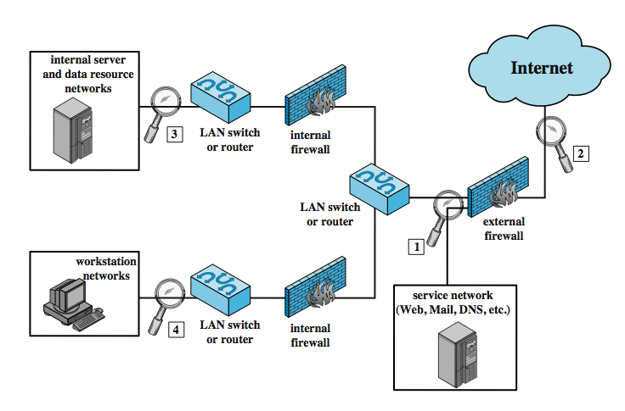
NIDS Sensor Deployment
Notes:
Within a single site, a key decision for the security administrator is the placement of the sensors. Figure 6.5 illustrates a number of possibilities. In general terms, this configuration is typical of larger organizations. All Internet traffic passes through an external firewall that protects the entire facility. Internal firewalls may also be used to provide more specific protection to certain parts of the network.
A common location for a NIDS sensor is just inside the external firewall (location 1 in the figure), where it can attacks, originating from the outside world. Instead of placing a NIDS sensor inside the external firewall, the security administrator may choose to place a NIDS sensor between the external firewall and the Internet or WAN (location 2). In this position, the sensor can monitor all network traffic, unfiltered. A sensor at location 2 has a higher processing burden than any sensor located elsewhere on the site network. In addition to a sensor at the boundary of the network, on either side of the external firewall, the administrator may configure a firewall and one or more sensors to protect major backbone networks, such as those that support internal servers and database resources (location 3). Thus, a sensor at location 3 is able to monitor for both internal and external attacks. Because the sensor monitors traffic to only a subset of devices at the site, it can be tuned to specific protocols and attack types, reducing the processing burden. Finally, the network facilities at a site may include separate LANs that support user workstations and servers specific to a single department. The administrator could configure a firewall and NIDS sensor to provide additional protection for all of these networks or target the protection to critical subsystems, such as personnel and financial networks (location 4). As with a sensor at location 3, a sensor at location 4 can be tuned to specific protocols and attack types, reducing the processing burden.

Slide 33
Network-based Intrusion Detection Techniques
signature detection
at application, transport, network layers; unexpected application services, policy violations
anomaly detection
of denial of service attacks, scanning, worms
when potential violation detected sensor sends an alert and logs information
used by analysis module to refine intrusion detection parameters and algorithms
by security admin to improve protection
Notes:
As with host-based intrusion detection, network-based intrusion detection makes use of signature detection and anomaly detection.
Some examples suitable for signature detection include:
• Application layer reconnaissance and attacks: analyze several dozen application protocols looking for attack patterns identified as targeting these protocols.
• Transport layer reconnaissance and attacks: analyze TCP / UDP / other transport-layer protocols for unusual packet fragmentation, port scans, TCP-specific attacks etc
• Network layer reconnaissance and attacks: typically analyze IPv4, ICMP, and IGMP for spoofed IP addresses, illegal IP header values, etc
• Unexpected application services: to determine if activity consistent with protocol
• Policy violations: such as use of inappropriate Web sites,use forbidden protocols etc
Some examples of types of attacks suitable for anomaly detection are:
• Denial of service (DoS) attacks: involve either significantly increased packet traffic or significantly increase connection attempts, to overwhelm the target system.
• Scanning: occurs when an attacker probes a target network or system by sending different kinds of packets to learn many of the system’s characteristics/vulnerabilities.
• Worms: detected because of use of large amounts of bandwidth, or because they can cause hosts to communicate with other hosts/ports not typically seen.
When a sensor detects a potential violation it sends an alert and logs information related to the event. The NIDS analysis module uses this to refine intrusion detection parameters and algorithms, and by the security admin to design prevention techniques.

Slide 34
An Example for NIDS (Code Red Worm)
GET /default.ida?NNNNNNNNNNNNNNNNNNNNNNNNN NNNNNNNNNNNNNNNNNNNNNNNNNNNNNNNNNNNN NNNNNNNNNNNNNNNNNNNNNNNNNNNNNNNNNNNN NNNNNNNNNNNNNNNNNNNNNNNNNNNNNNNNNNNN NNNNNNNNNNNNNNNNNNNNNNNNNNNNNNNNNNNN NNNNNNNNNNNNNNNNNNNNNNNNNNNNNNNNNNNN NNNNNNNNNNNNNNNNNNN %u9090%u6858%ucbd3%u7801%u9090%u6858%ucbd3%u7801 %u9090%u6858%ucbd3%u7801%u9090%u9090%u8190%u00c3 %u0003%u8b00%u531b%u53ff%u0078%u0000%u00=a HTTP/1.0
Trying to spread itself by looking for more IIS servers on the Internet.
Notes:
Code Red was a computer worm observed on the Internet on July 13, 2001. It attacked computers running Microsoft's IIS web server.
The Code Red worm was first discovered and researched by eEye Digital Security employees Marc Maiffret and Ryan Permeh. They named it "Code Red" because Code Red Mountain Dew was what they were drinking at the time, and because of the phrase "Hacked by Chinese!" with which the worm defaced websites.^{[1]}
Although the worm had been released on July 13, the largest group of infected computers was seen on July 19, 2001. On this day, the number of infected hosts reached 359,000.^{[2]}

Slide 35
Honeypots
are decoy systems
filled with fabricated info
instrumented with monitors / event loggers
divert and hold attacker to collect activity info
without exposing production systems
initially were single systems
more recently are/emulate entire networks
Notes:
A relatively recent innovation in intrusion detection technology is the honeypot. Honeypots are decoy systems that are designed to lure a potential attacker away from critical systems. Honeypots are designed to divert an attacker from accessing critical systems, collect information about the attacker’s activity, and to encourage the attacker to stay on the system long enough for administrators to respond. These systems are filled with fabricated information designed to appear valuable but that a legitimate user of the system wouldn’t access. Thus, any access to the honeypot is suspect. The system is instrumented with sensitive monitors and event loggers that detect these accesses and collect information about the attacker’s activities. Because any attack against the honeypot is made to seem successful, administrators have time to mobilize and log and track the attacker without ever exposing productive systems. Initial efforts involved a single honeypot computer with IP addresses designed to attract hackers. More recent research has focused on building entire honeypot networks that emulate an enterprise, possibly with actual or simulated traffic and data. Once hackers are within the network, administrators can observe their behavior in detail and figure out defenses.

Slide 36
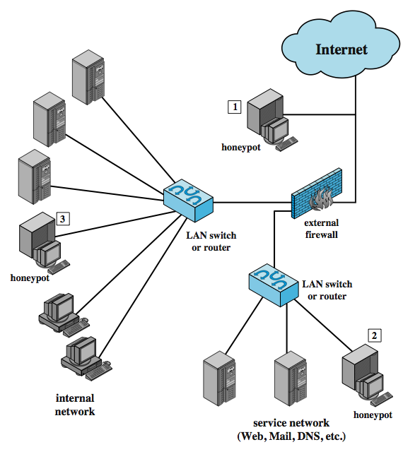
Honeypot Deployment
Notes:
Honeypots can be deployed in a variety of locations, as shown in Figure 6.6. The location depends on a number of factors, such as the type of information the organization is interested in gathering and the level of risk that organizations can tolerate to obtain the maximum amount of data. A honeypot outside the external firewall (location 1) is useful for tracking attempts to connect to unused IP addresses within the scope of the network. A honeypot at this location does not increase the risk for the internal network. The disadvantage of an external honeypot is that it has little or no ability to trap internal attackers, especially if the external firewall filters traffic in both directions. The DMZ is another candidate for locating a honeypot (location 2). The security administrator must assure that the other systems in the DMZ are secure against any activity generated by the honeypot. A disadvantage of this location is that a typical DMZ is not fully accessible, and the firewall typically blocks traffic to the DMZ the attempts to access unneeded services. Thus, the firewall either has to open up the traffic beyond what is permissible, which is risky, or limit the effectiveness of the honeypot. A fully internal honeypot (location 3) has several advantages in that it can catch internal attacks, and can also detect a misconfigured firewall that forwards impermissible traffic from the Internet to the internal network. There are several disadvantages. The most serious of these is if the honeypot is compromised so that it can attack other internal systems. Any further traffic from the Internet to the attacker is not blocked by the firewall because it is regarded as traffic to the honeypot only. Another difficult for this honeypot location is, as with location 2, the firewall must adjust its filtering to allow traffic to the honeypot, complicating firewall configuration and potentially compromising the internal network.

Slide 37
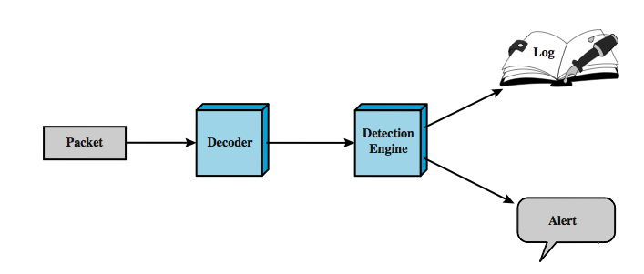
SNORT
lightweight IDS
real-time packet capture and rule analysis
passive or inline
Notes:
Snort is an open source, highly configurable and portable host-based or network-based IDS. Snort is referred to as a lightweight IDS. Snort can perform real-time packet capture, protocol analysis, and content searching and matching. Snort can detect a variety of attacks and probes, based on a set of rules configured by a system administrator. A Snort implementation can be configured as a passive sensor, which monitors traffic but is not in the main transmission path of the traffic, or an inline sensor. In the latter case, Snort can perform intrusion prevention as well as intrusion detection.
A Snort installation consists of four logical components, shown here in Figure 6.7:
• Packet Decoder: efficiently processes each captured packet to identify and isolate protocol headers at the data link, network, transport, and application layers.
• Detection Engine: does actual work of intrusion detection, analyzing each packet using rules defined for this configuration of Snort by the security administrator.
• Logger: of each packet that matches a rule, if specified. The security administrator can then use the log file for later analysis.
• Alerter: can be sent for each detected packet to a file, a UNIX socket, or a database.

Slide 38
SNORT Rules
use a simple, flexible rule definition language
with fixed header and zero or more options
header includes: action, protocol, source IP, source port, direction, dest IP, dest port
many options
example rule to detect TCP SYN-FIN attack:
Alert tcp $EXTERNAL_NET any -> $HOME_NET any \
(msg: "SCAN SYN FIN"; flags: SF, 12; \
reference: arachnids, 198; classtype: attempted-recon;)
Notes:
Snort uses a simple, flexible rule definition language that generates the rules used by the detection engine. Although the rules are simple and straightforward to write, they are powerful enough to detect a wide variety of hostile or suspicious traffic. Each rule consists of a fixed header and zero or more options. The header includes:
• Action: tells Snort what to do when it finds a packet that matches the rule criteria (alert, log, pass, activate, dynamic, drop, reject, sdrop)
• Protocol: if packet protocol matches this field then analysis proceeds
• Source IP address: source of packet
• Source port: for the specified protocol (e.g.,a TCP port).
• Direction: unidirectional (->) or bidirectional (<->).
• Destination IP address: destination of packet.
• Destination port
Following the rule header may be one or more rule options. Each option consists of an option keyword, which defines the option; followed by arguments, which specify the details of the option. Table 6.5 in the text gives examples of options in each category.
The example shown of a Snort rule checks detects a type of attack at the TCP level known as a SYN-FIN attack. It has specified source and destination networks, and checks if the SYN and the FIN bits are set, ignoring reserved bit 1 and reserved bit 2 in the flags octet. The reference option refers to an external definition of this attack, which is of type attempted-recon.

Slide 39
Summary
introduced intruders & intrusion detection
hackers, criminals, insiders
intrusion detection approaches
host-based (single and distributed)
network
honeypots
SNORT example
Notes:
Chapter 6 summary.

