Slide 1

Firewalls

Slide 2


Firewalls
Internal
network
Internet
Firewall
Firewall must determine what to let in to internal network and/or what to let out
Access control for the network

Slide 3
Firewall as Secretary
A firewall is like a secretary
To meet with an executive
First contact the secretary
Secretary decides if meeting is reasonable
Secretary filters out many requests
You want to meet chair of CS department?
Secretary does some filtering
You want to meet President of US?
Secretary does lots of filtering!

Slide 4
Firewall Capabilities & Limits
capabilities:
defines a single choke point
provides a location for monitoring security events
convenient platform for some Internet functions such as NAT, usage monitoring, IPSEC VPNs
limitations:
cannot protect against attacks bypassing firewall
may not protect fully against internal threats
improperly secured wireless LAN
laptop, PDA, portable storage device infected outside then used inside
Notes:
The following capabilities are within the scope of a firewall:
1. A firewall defines a single choke point that keeps unauthorized users out of the protected network, prohibits potentially vulnerable services from entering or leaving the network, and provides protection from various kinds of IP spoofing and routing attacks. The use of a single choke point simplifies security management.
2. A firewall provides a location for monitoring security-related events.
3. A firewall is a convenient platform for several Internet functions that are not security related. These include a network address translator (NAT),, and a network management function that audits or logs Internet usage.
4. A firewall can act as the platform for IPSec to implement virtual private networks.
Firewalls have their limitations, including the following:
1. The firewall cannot protect against attacks that bypass the firewall, e.g. from dial-out, or a modem pool dial-in capability for traveling employees and telecommuters.
2. The firewall may not protect fully against internal threats, such as a disgruntled employee or an employee who unwittingly cooperates with an external attacker.
3. An improperly secured wireless LAN may be accessed from outside the org
4. A laptop, PDA, or portable storage device may be used and infected outside the corporate network and then attached and used internally.

Slide 5
Firewall Terminology
No standard terminology
Types of firewalls
Packet filter ⎯ works at network layer
Stateful packet filter ⎯ transport layer
Application proxy ⎯ application layer
Personal firewall ⎯ for single user, home network, etc.

Slide 6
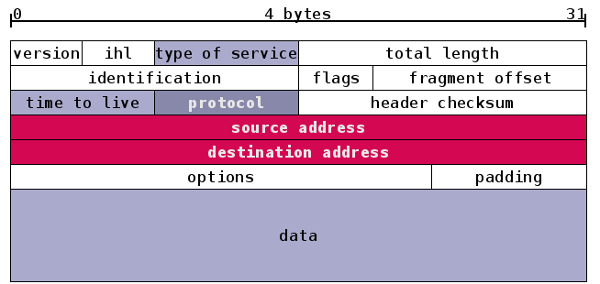
IP Header

Slide 7
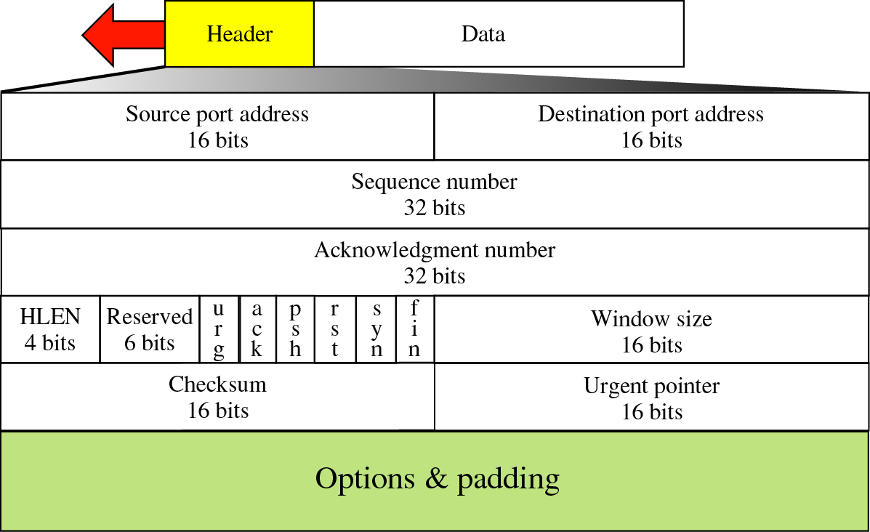
Figure 12-19
TCP segment format

Slide 8
Packet Filter
Operates at network layer
Can filter based on
Source IP address
Destination IP address
Source Port
Destination Port
Flag bits (SYN, ACK, etc.)
Egress or ingress
two default policies:
discard - prohibit unless expressly permitted
more conservative, controlled, visible to users
forward - permit unless expressly prohibited
easier to manage/use but less secure
application
transport
network
link
physical

Slide 9
Packet Filter
Advantage
Disadvantages
application
transport
network
link
physical

Slide 10
Packet Filter
Configured via Access Control Lists (ACLs)
Source
IP
Dest
IP
Source
Port
Dest
Port
Flag
Bits
Action
Protocol
Allow | Inside | Outside | Any | 80 | HTTP
Allow | Outside | Inside | 80 | > 1023 | HTTP
Deny | All | All | All | All | All
Any
ACK
All
Intention is to restrict incoming packets to Web responses

Slide 11
TCP ACK Scan
Attacker sends packet with ACK bit set, without prior 3-way handshake
Violates TCP/IP protocol
ACK packet pass thru packet filter firewall
Appears to be part of an ongoing connection
RST sent by recipient of such packet
Attacker scans for open ports thru firewall

Slide 12
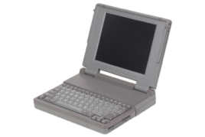
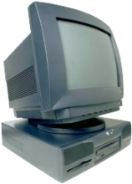

TCP ACK Scan
ACK dest port 1207
ACK dest port 1208
ACK dest port 1209
Trudy
RST
Internal
Network
Packet
Filter
Which port is open?
A stateful packet filter can prevent this (next)
How?

Slide 13
Stateful Packet Filter
Adds state to packet filter
Operates at transport layer
Remembers TCP connections and flag bits
Can even remember UDP packets (e.g., DNS requests)
application
transport
network
link
physical

Slide 14
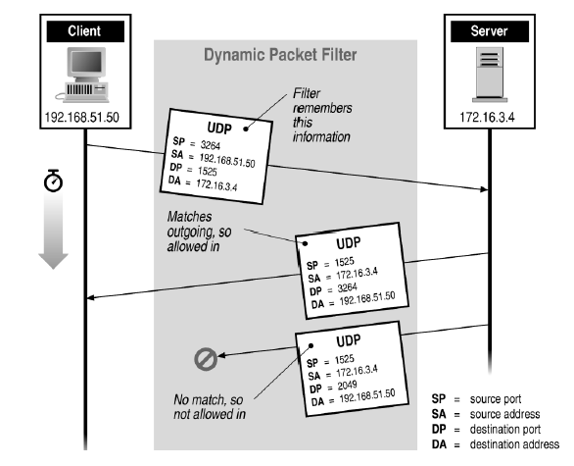
Stateful Filtering

Slide 15
Stateful Packet Filter
Advantages
Can do everything a packet filter can do plus...
Disadvantages
application
transport
network
link
physical

Slide 16
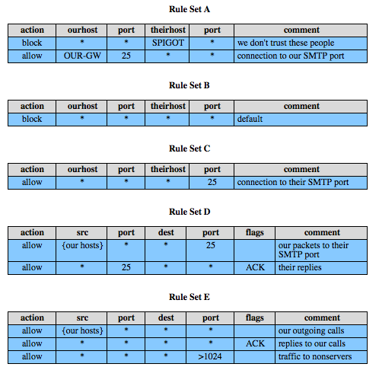
Packet Filter Rules
Notes:
Table 9.1, from the text gives some examples of packet filtering rule sets. In each set, the rules are applied top to bottom. The "*" in a field is a wildcard designator that matches everything. We assume that the default = discard policy is in force.
A. Inbound mail is allowed (port 25 is for SMTP incoming), but only to a gateway host. However, packets from a particular external host, SPIGOT, are blocked.
B. This is an explicit statement of the default policy, usually implicitly the last rule.
C. This rule set is intended to specify that any inside host can send mail to the outside. A TCP packet with a destination port of 25 is routed to the SMTP server on the destination machine. Problem is that 25 as SMTP is only a default; an outside machine could be configured to have some other application linked to port 25.
D. This rule set achieves the intended result that was not achieved in C. This rule set allows IP packets where the source IP address is one of a list of designated internal hosts and the destination TCP port number is 25. It also allows incoming packets with a source port number of 25 that include the ACK flag. This takes advantage of a feature of TCP connections that once set up, the ACK flag of a TCP segment is set to acknowledge segments sent from the other side.
E. This rule set is one approach to handling FTP which uses two TCP connections: a control connection and a data connection for the actual file transfer. The data connection uses a different dynamically assigned port number for the transfer. Most servers, and hence most attack targets, live on low-numbered ports; most outgoing calls tend to use a higher-numbered port, typically above 1023. Rule set E points out the difficulty in dealing with applications at the packet filtering level.

Slide 17
Application Proxy
A proxy is something that acts on your behalf
Application proxy looks at incoming application data
Verifies that data is safe before letting it in
application
transport
network
link
physical

Slide 18
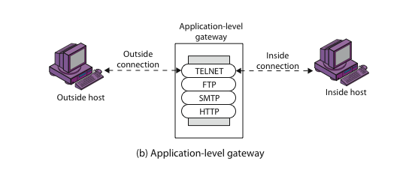
Application Level Gateway (or Application Proxy)

Slide 19
Application-Level Filtering
Has full access to protocol
user requests service from proxy
proxy validates request as legal
then actions request and returns result to user
Need separate proxies for each service
E.g., SMTP (E-Mail)
NNTP (Net news)
DNS (Domain Name System)
NTP (Network Time Protocol)
custom services generally not supported

Slide 20
Application Proxy
Advantages
Disadvantage
application
transport
network
link
physical

Slide 21
Firewalk
Tool to scan for open ports thru firewall
Known: IP address of firewall and IP address of one system inside firewall
TTL set to 1 more than number of hops to firewall and set destination port to N
If firewall does not let thru data on port N, no response
If firewall allows data on port N thru firewall, get “time exceeded” ICMP error message

Slide 22


Firewalk and Proxy Firewall
Packet
filter
Trudy
Router
Router
Router
Dest port 12343, TTL=4
Dest port 12344, TTL=4
Dest port 12345, TTL=4
Time exceeded
This will not work thru an application proxy
The proxy creates a new packet, destroys old TTL
Attacker must talk to proxy and convince it to forward message

Slide 23
Personal Firewall
To protect one user or home network
Can use any of the methods
Packet filter
Stateful packet filter
Application proxy
May be software module on PC

Slide 24





Firewalls and Defense in Depth
Example security architecture
DMZ
FTP server
WWW server
DNS server
Intranet with
Personal
Firewalls
Packet
Filter
Application
Proxy
Internet

Slide 25
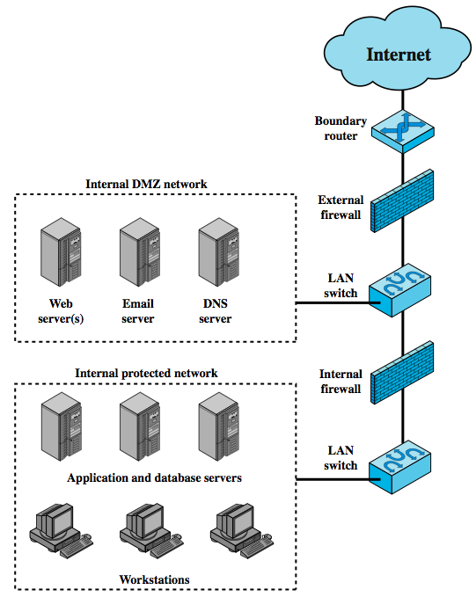
Firewall Locations
Notes:
A firewall is positioned to provide a protective barrier between an external, potentially untrusted source of traffic and an internal network. With that general principal in mind, a security administrator must decide on the location and on the number of firewalls needed. In this section, we look at some common options. Figure 9.3 suggests the most common distinction, that between an internal and an external firewall. An external firewall is placed at the edge of a local or enterprise network. One or more internal firewalls protect the bulk of the enterprise network. Between these two types of firewalls are one or more networked devices in a region referred to as a DMZ (demilitarized zone) network. Systems that are externally accessible but need some protections are usually located on DMZ networks.
The external firewall provides a measure of access control and protection for the DMZ systems consistent with their need for external connectivity. The external firewall also provides a basic level of protection for the remainder of the enterprise network.
In this type of configuration, internal firewalls server three purposes:
1. it adds more stringent filtering capability, compared to the external firewall, in order to protect enterprise servers and workstations from external attack.
2. it provides two-way protection with respect to the DMZ, protecting the remainder of the network from attacks launched from DMZ and protecting DMZ systems from attack from the internal protected network.
3. Multiple internal firewalls can be used to protect portions of the internal network from each other. Figure 6.5 in the text shows a configuration in which the internal servers are protected from internal workstations and vice versa.

Slide 26
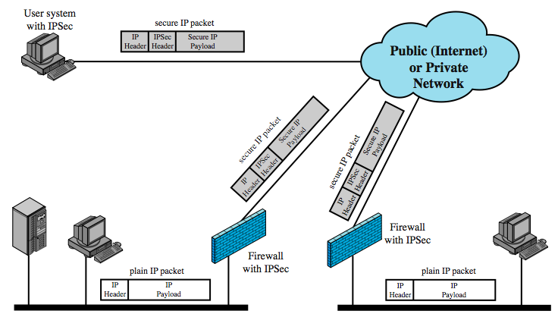
Virtual Private Networks
Notes:
In today's distributed computing environment, the virtual private network (VPN) offers an attractive solution to network managers. In essence, a VPN consists of a set of computers that interconnect by means of a relatively unsecure network. Use of a public network exposes corporate traffic to eavesdropping and provides an entry point for unauthorized users. To counter this problem, a VPN is needed. In essence, a VPN uses encryption and authentication in the lower protocol layers to provide a secure connection through an otherwise insecure network, typically the Internet. VPNs are generally cheaper than real private networks using private lines but rely on having the same encryption and authentication system at both ends. The encryption may be performed by firewall software or possibly by routers. The most common protocol mechanism used for this purpose is at the IP level and is known as IPSec.
Figure 9.4 from the text shows a typical scenario of IPSec usage. An organization maintains LANs at dispersed locations. Nonsecure IP traffic is conducted on each LAN. For traffic offsite, through some sort of private or public WAN, IPSec protocols are used to encrypt and compress all traffic going into the WAN, and decrypt and decompress traffic coming from the WAN; authentication may also be provided. These operations are transparent to workstations and servers on the LAN. A logical means of implementing an IPSec is in a firewall, as shown in Figure 9.4. If IPSec is implemented in a separate box behind (internal to) the firewall, then VPN traffic passing through the firewall in both directions is encrypted. In this case, the firewall is unable to perform its filtering function or other security. IPSec could be implemented in the boundary router, outside the firewall. However, this device is likely to be less secure than the firewall and thus less desirable as an IPSec platform.

Slide 27
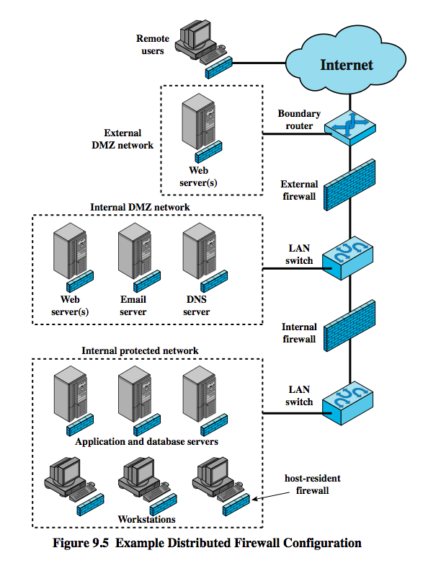
Distributed Firewalls
Notes:
A distributed firewall configuration involves standalone firewall devices plus host-based firewalls working together under a central administrative control. Figure 9.5from the text suggests a distributed firewall configuration. Administrators can configure host-resident firewalls on hundreds of servers and workstation as well as configuring personal firewalls on local and remote user systems. Tools let the network administrator set policies and monitor security across the entire network. These firewalls protect against internal attacks and provide protection tailored to specific machines and applications. Standalone firewalls provide global protection, including internal firewalls and an external firewall, as discussed previously.
With distributed firewalls, it may make sense to establish both an internal and an external DMZ. Web servers that need less protection because they have less critical information on them could be placed in an external DMZ, outside the external firewall. What protection is needed is provided by host-based firewalls on these servers.
An important aspect of a distributed firewall configuration is security monitoring. Such monitoring typically includes log aggregation and analysis, firewall statistics, and fine-grained remote monitoring of individual hosts if needed.

Slide 28
Intrusion Prevention Systems (IPS)
recent addition to security products which
inline net/host-based IDS that can block traffic
functional addition to firewall that adds IDS capabilities
can block traffic like a firewall
using IDS algorithms
may be network or host based
Notes:
A relatively recent addition to the terminology of security products is the intrusion prevention system (IPS). There are two complementary ways of looking at an IPS:
1. An IPS is an inline network-based IDS (NIDS) that has the capability to block traffic by discarding packets as well as simply detect suspicious traffic. For host-based systems, an IPS is a host-based IDS that can discard incoming traffic.
2. An IPS is a functional addition to a firewall that adds IDS types of algorithms to the repertoire of the firewall.
Thus, an IPS blocks traffic, as a firewall does, but makes use of the types of algorithms developed for IDSs. It is a matter of terminology whether an IPS is considered a separate, new type of product or simply another form of firewall. As with an IDS, an IPS can be either host-based or network based.

