Slide 1
Authentication Protocols

Slide 2
Protocol
Human protocols ⎯ the rules followed in human interactions
Example: Asking a question in class
Networking protocols ⎯ rules followed in networked communication systems
Examples: HTTP, FTP, etc.
Security protocol ⎯ the (communication) rules followed in a security application
Examples: SSL, IPSec, Kerberos, etc.

Slide 3
Protocols
Protocol flaws can be very subtle
Several well-known security protocols have serious flaws
Including IPSec, GSM and WEP
Common to find implementation errors
Such as IE implementation of SSL
Difficult to get protocols right…

Slide 4
Ideal Security Protocol
Satisfies security requirements
Requirements must be precise
Efficient
Minimize computational requirement ⎯ in particular, costly public key operations
Minimize delays/bandwidth
Not fragile
Must work when attacker tries to break it
Works even if environment changes
Easy to use and implement, flexible, etc.
Very difficult to satisfy all of these!

Slide 5
Simple Security Protocols

Slide 6
Secure Entry to NSA
Insert badge into reader
Enter PIN
Correct PIN?
Yes? Enter
No? Get shot by security guard

Slide 7
ATM Machine Protocol
Insert ATM card
Enter PIN
Correct PIN?
Yes? Conduct your transaction(s)
No? Machine eats card

Slide 8
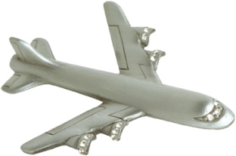


Identify Friend or Foe (IFF)
Russian
MIG
Angola
SAAF
Impala
2. E(N,K)
1. N
Namibia

Slide 9
MIG in the Middle
3. N
SAAF
Impala
4. E(N,K)
Angola
2. N
5. E(N,K)
6. E(N,K)
Russian
MiG
1. N
Namibia

Slide 10
Authentication Protocols

Slide 11
Authentication
Alice must prove her identity to Bob
Alice and Bob can be humans or computers
May also require Bob to prove he’s Bob (mutual authentication)
May also need to establish a session key
May have other requirements, such as
Use only public keys
Use only symmetric keys
Use only a hash function
Anonymity, plausible deniability, etc., etc.

Slide 12
Authentication
Authentication on a stand-alone computer is relatively simple
“Secure path” is the primary issue
Main concern is an attack on authentication software (we discuss software attacks later)
Authentication over a network is much more complex
Attacker can passively observe messages
Attacker can replay messages
Active attacks may be possible (insert, delete, change messages)

Slide 13
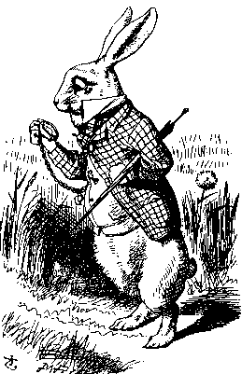
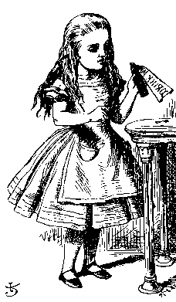
Simple Authentication
“I’m Alice”
Prove it
My password is “frank”
Alice
Bob
Simple and may be OK for standalone system
But insecure for networked system
What are the problems?

Slide 14
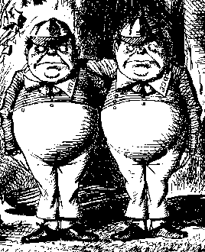
Authentication Attack
“I’m Alice”
Prove it
My password is “frank”
Alice
Bob
Trudy

Slide 15
Authentication Attack
“I’m Alice”
Prove it
My password is “frank”
Trudy
Bob
This is a replay attack
How can we prevent a replay?

Slide 16
Simple Authentication
I’m Alice, My password is “frank”
Alice
Bob
More efficient…
But same problem as previous version

Slide 17
Better Authentication
“I’m Alice”
Prove it
h(Alice’s password)
Alice
Bob
Better since it hides Alice’s password
From both Bob and attackers
But still subject to replay

Slide 18
Challenge-Response
To prevent replay, challenge-response used
Suppose Bob wants to authenticate Alice
Challenge sent from Bob to Alice
Only Alice can provide the correct response
Challenge chosen so that replay is not possible
How to accomplish this?
Password is something only Alice should know…
For freshness, a “number used once” or nonce

Slide 19
Challenge-Response
“I’m Alice”
Nonce
h(Alice’s password, Nonce)
Alice
Bob
Nonce is the challenge
The hash is the response
Nonce prevents replay, insures freshness
Password is something Alice knows
What is the drawback?

Slide 20
Challenge-Response
“I’m Alice”
Nonce
Something that could only be
Alice
from Alice (and Bob can verify)
Bob
What can we use to achieve this?
Hashed pwd works, crypto might be better

Slide 21
Symmetric Key Notation
Encrypt plaintext P with key K
C = E(P,K)
Decrypt ciphertext C with key K
P = D(C,K)
Here, we are concerned with attacks on protocols, not directly on the crypto
We assume that crypto algorithm is secure

Slide 22
Symmetric Key Authentication
Alice and Bob share symmetric key K_{AB}
Key K_{AB} known only to Alice and Bob
Authenticate by proving knowledge of shared symmetric key
How to accomplish this?
Must not reveal key
Must not allow replay attack

Slide 23
Authentication with Symmetric Key
“I’m Alice”
R
E(R,K_{AB})
Alice, K_{AB}
Bob, K_{AB}
Secure method for Bob to authenticate Alice
Alice does not authenticate Bob
Can we achieve mutual authentication?

Slide 24
Mutual Authentication?
“I’m Alice”, R
E(R,K_{AB})
E(R,K_{AB})
Alice
Bob
What’s wrong with this picture?

Slide 25
Mutual Authentication
Since we have a secure one-way authentication protocol…
The obvious thing to do is to use the protocol twice
Once for Bob to authenticate Alice
Once for Alice to authenticate Bob
This has to work…

Slide 26
Mutual Authentication
“I’m Alice”, R_{A}
R_{B}, E(R_{A},K_{AB})
E(R_{B},K_{AB})
Alice
Bob
This provides mutual authentication…
…or does it? See the next slide

Slide 27


Mutual Authentication Attack
1. “I’m Alice”, R_{A}
2. R_{B}, E(R_{A},K_{AB})
5. E(R_{B},K_{AB})
Trudy
Bob
3. “I’m Alice”, R_{B}
4. R_{C}, E(R_{B},K_{AB})
Trudy
Bob

Slide 28
Mutual Authentication
Our one-way authentication protocol not secure for mutual authentication
Protocols are subtle!
The “obvious” thing may not be secure
Also, if assumptions or environment changes, protocol may not work
This is a common source of security failure
For example, Internet protocols

Slide 29
Symmetric Key Mutual Authentication
“I’m Alice”, R_{A}
R_{B}, E(“Bob”,R_{A},K_{AB})
E(“Alice”,R_{B},K_{AB})
Alice
Bob
Do these “insignificant” changes help?

Slide 30
Public Key Notation
Encrypt M with Alice’s public key: {M}_{Alice}
Sign M with Alice’s private key: [M]_{Alice}
Then
[{M}_{Alice} ]_{Alice} = M
{[M]_{Alice} }_{Alice} = M
Anybody can do public key operations
Only Alice can use her private key (sign)

Slide 31
Public Key Authentication
“I’m Alice”
{R}_{Alice}
R
Alice
Bob
Is this secure?

Slide 32
Public Key Authentication
“I’m Alice”
R
[R]_{Alice}
Alice
Bob
Is this secure?

Slide 33
Public Keys
Never use the same key pair for encryption and signing
One key pair for encryption/decryption
A different key pair for signing/verifying signatures

Slide 34
Session Key
Usually, a session key is required
Symmetric key for a particular session
Can we authenticate and establish a shared symmetric key?
Key can be used for confidentiality
Key can be used for integrity
In some cases, we may also require perfect forward secrecy (PFS)
Discussed later…

Slide 35
Authentication & Session Key
“I’m Alice”, R
{R,K}_{Alice}
{R +1,K}_{Bob}
Alice
Bob
Is this secure?
Does it provide mutual authentication?

Slide 36
Public Key Authentication and Session Key
“I’m Alice”, R
[R,K]_{Bob}
[R +1,K]_{Alice}
Alice
Bob
Is this secure?

Slide 37
Public Key Authentication and Session Key
“I’m Alice”, R
{[R,K]_{Bob}}_{Alice}
{[R +1,K]_{Alice}}_{Bob}
Alice
Bob
Is this secure?
Seems to be OK
Mutual authentication and session key!

Slide 38
Public Key Authentication and Session Key
“I’m Alice”, R
[{R,K}_{Alice}]_{Bob}
[{R +1,K}_{Bob}]_{Alice}
Alice
Bob
Is this secure?
Seems to be OK
Anyone can see {R,K}_{Alice} and {R +1,K}_{Bob}

Slide 39
Timestamps
A timestamp T is the current time
Timestamps used in many security protocols (Kerberos, for example)
Timestamps reduce number of messages
Like a nonce that both sides know in advance
But, use of timestamps implies that time is a security-critical parameter
Clocks never exactly the same, so must allow for clock skew ⎯ risk of replay
How much clock skew is enough?

Slide 40
Public Key Authentication and Session Key
Sign and encrypt with nonce…
Secure
Encrypt and sign with nonce…
Secure
Sign and encrypt with timestamp…
Secure
Encrypt and sign with timestamp…
Insecure
Protocols can be subtle!

Slide 41
Zero Knowledge Proofs

Slide 42
Zero Knowledge Proof (ZKP)
Alice wants to prove that she knows a secret without revealing any info about it
Bob must verify that Alice knows secret
Even though he gains no info about the secret
Process is probabilistic
Bob can verify that Alice knows the secret to an arbitrarily high probability
An “interactive proof system”

Slide 43
Bob’s Cave
Alice claims to know secret phrase to open path between R and S (“open sarsparilla”)
Can she convince Bob that she knows the secret without revealing phrase?
P
Q
R
S

Slide 44


Bob’s Cave
Bob: “Alice come out on S side”
P
Alice (quietly): “Open sarsparilla”
Q
If Alice does not know secret…
R
S
…then Alice could come out from the correct side with probability 1/2
If Bob repeats this n times, then Alice (who does not know secret) can only fool Bob with probability 1/2^{n}

Slide 45
Fiat-Shamir Protocol
Cave-based protocols are inconvenient
Can we achieve same effect without a cave?
It is known that finding square roots modulo N is difficult (like factoring)
Suppose N = pq, where p and q prime
Alice has a secret S
N and v = S² mod N are public, S is secret
Alice must convince Bob that she knows S without revealing any information about S

Slide 46
Fiat-Shamir
x = r² mod N
e ∈ {0,1}
y = r∗S^{e} mod N
Alice
secret S
random r
Bob
Public: Modulus N and v = S² mod N
Alice selects random r
Bob chooses e ∈ {0,1}
Bob verifies that y² = r²∗S^{2e} = r²∗(S²)^{e} = x∗v^{e} mod N

