Slide 1
Real-World Protocols
Next, we’ll look at specific protocols
SSH – Secure Shell
SSL ⎯ security on the Web
IPSec ⎯ security at the IP layer
Kerberos ⎯ symmetric key system
GSM ⎯ mobile phone (in)security

Slide 2
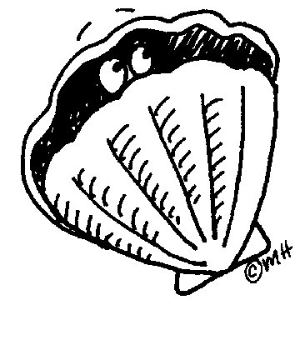
Secure Shell (SSH)

Slide 3
SSH
Creates a “secure tunnel”
Insecure command sent thru SSH tunnel are then secure
SSH used with things like rlogin
Why is rlogin insecure without SSH?
Why is rlogin secure with SSH?
SSH is a relatively simple protocol

Slide 4
SSH
SSH authentication can be based on:
Public keys, or
Digital certificates, or
Passwords
Here, we consider certificate mode
Other modes, see homework problems
We consider slightly simplified SSH…

Slide 5
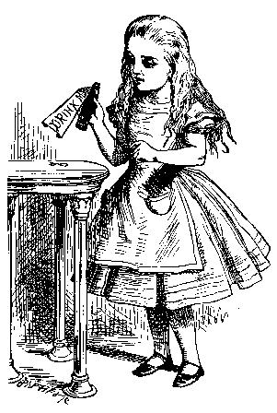
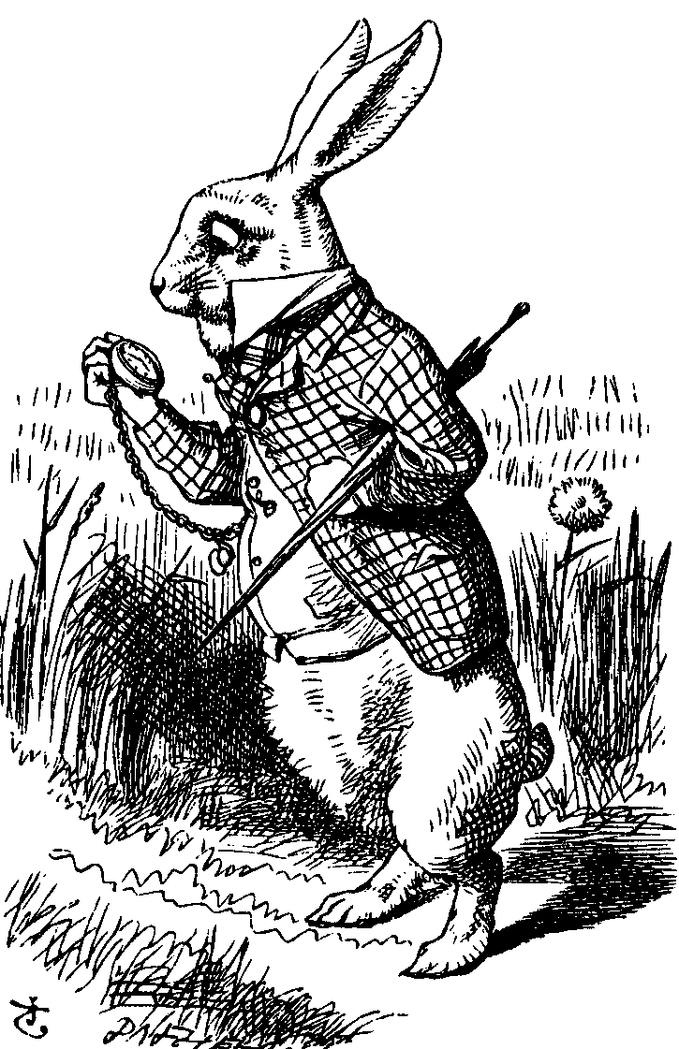
Simplified SSH
Alice, CP, R_{A}
CS, R_{B}
gª mod p
g^{b} mod p, certificate_{B}, S_{B}
Alice
E(Alice, certificate_{A}, S_{A}, K)
Bob
CP = “crypto proposed”, and CS = “crypto selected”
H = h(Alice,Bob,CP,CS,R_{A},R_{B},gª mod p,g^{b} mod p,g^{ab} mod p)
S_{B} = [H]_{Bob}
S_{A} = [H, Alice, certificate_{A}]_{Alice}
K = g^{ab} mod p

Slide 6
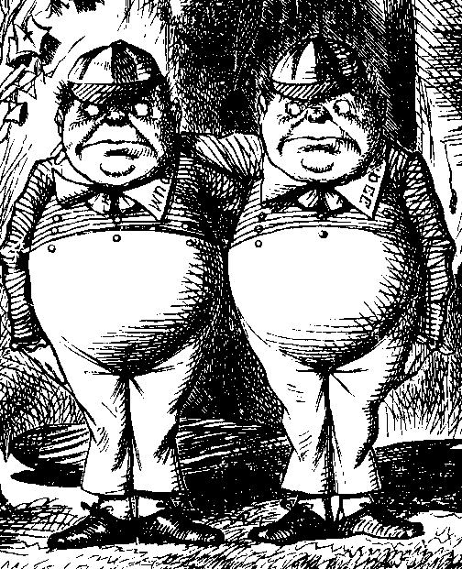
MiM Attack on SSH?
Alice, R_{A}
Alice, R_{A}
R_{B}
R_{B}
gª mod p
g^{t} mod p
g^{t} mod p, cert_{B}, S_{B}
g^{b} mod p, cert_{B}, S_{B}
Alice
E(Alice,cert_{A},S_{A},K)
Trudy
E(Alice,cert_{A},S_{A},K)
Bob
Where does this attack fail?
Alice computes:
H_{a} = h(Alice,Bob,CP,CS,R_{A},R_{B},gª mod p,g^{t} mod p,g^{at} mod p)
But Bob signs:
H_{b} = h(Alice,Bob,CP,CS,R_{A},R_{B},g^{t} mod p,g^{b} mod p,g^{bt} mod p)

Slide 7

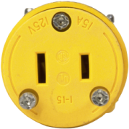
Secure Socket Layer

Slide 8
What is SSL?
SSL is the protocol used for most secure transactions over the Internet
For example, if you want to buy a book at amazon.com…
You want to be sure you are dealing with Amazon (authentication)
Your credit card information must be protected in transit (confidentiality and/or integrity)
As long as you have money, Amazon doesn’t care who you are (authentication need not be mutual)

Slide 9
SSL and TSL Protocols
Secure Socket Layer (SSL)
Originally developed to secure http
Application independent
Can be used for any application protocol
Examples: telnet, pop3, imap, ftp, etc.
Transport Layer Security (TLS)
TLS 1.0 very close to SSL 3.1
Backward compatible with SSL v3.

Slide 10
Socket layer
“Socket layer” lives between application and transport layers
SSL usually lies between HTTP and TCP
Socket
“layer”
application
transport
network
link
physical
User
OS
NIC

Slide 11
SSL Architecture
A two-layered protocol.
Rely on TCP for a reliable communication.
SSL Handshake Protocol | SSL Change Cipher Spec Protocol | SSL Alert Protocol | HTTP and other protocols
SSL Record Protocol
TCP
IP
SSL Protocol Stack

Slide 12
SSL Services
Peer entity authentication
Data confidentiality
Data integrity
Compression/decompression
Generation/distribution of session keys
Integrated to protocol
A different approach from IPSec
Security parameter negotiation.
Notes:
Which problems does SSL target? The main objectives for SSL are:
Authenticating the client and server to each other: the SSL protocol supports the use of standard key cryptographic techniques (public key encryption) to authenticate the communicating parties to each other. Though the most frequent application consists in authenticating the service client on the basis of a certificate, SSL may also use the same methods to authenticate the client.
Ensuring data integrity: during a session, data cannot be either intentionally or unintentionally tampered with.
Securing data privacy: data in transport between the client and the server must be protected from interception and be readable only by the intended recipient. This prerequisite is necessary for both the data associated with the protocol itself (securing traffic during negotiations) and the application data that is sent during the session itself. SSL is in fact not a single protocol but rather a set of protocols that can additionally be further divided in two layers:

Slide 13
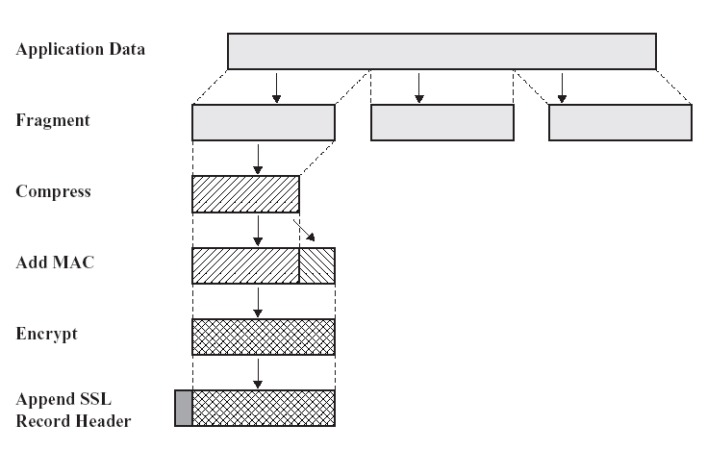
SSL Record Protocol Operation

Slide 14
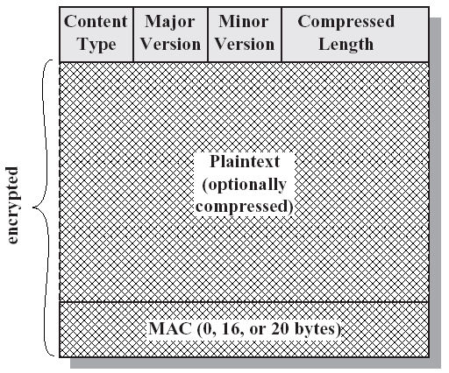
SSL Record Format

Slide 15
Handshake Protocol
Initially SSL session has null compression and encryption algorithm.
Both are set by the handshake protocol at the beginning of session.
Handshake protocol may be repeated during the session.
Four phases
Establish Security Capabilities
Server Authentication and Key Exchange
Client Authentication and Key Exchange
Finish

Slide 16
Application Ports Used with SSL
https 443
smtps 465
nntps 563
ldaps 636
pop3s 995
ftp-datas 889
ftps 990
imaps 991

Slide 17

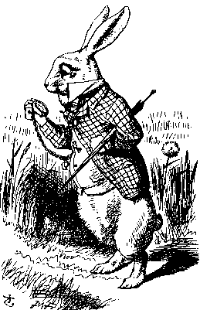
Simple SSL-like Protocol
I’d like to talk to you securely
Here’s my certificate
{K_{AB}}_{Bob}
Alice
protected HTTP
Bob
Is Alice sure she’s talking to Bob?
Is Bob sure he’s talking to Alice?

Slide 18
Simplified SSL Protocol
Can we talk?, cipher list, R_{A}
certificate, cipher, R_{B}
{S}_{Bob}, E(h(msgs,CLNT,K),K)
h(msgs,SRVR,K)
Alice
Data protected with key K
Bob
S is pre-master secret
K = h(S,R_{A},R_{B})
msgs = all previous messages
CLNT and SRVR are constants

Slide 19
SSL Keys
6 “keys” derived from K = hash(S,R_{A},R_{B})
2 encryption keys: send and receive
2 integrity keys: send and receive
2 IVs: send and receive
Why different keys in each direction?
Q: Why is h(msgs,CLNT,K) encrypted (and integrity protected)?
A: ？

Slide 20
SSL Authentication
Alice authenticates Bob, not vice-versa
How does client authenticate server?
Why does server not authenticate client?
Mutual authentication is possible: Bob sends certificate request in message 2
This requires client to have certificate
If server wants to authenticate client, server could instead require (encrypted) password

Slide 21

SSL MiM Attack
R_{A}
R_{A}
certificate_{T}, R_{B}
certificate_{B}, R_{B}
{S₁}_{Trudy},E(X₁,K₁)
{S₂}_{Bob},E(X₂,K₂)
h(Y₁,K₁)
h(Y₂,K₂)
Alice
E(data,K₁)
Trudy
E(data,K₂)
Bob
Q: What prevents this MiM attack?
A: ？
What does Web browser do if sig. not valid?
What does user do if signature is not valid?

Slide 22
SSL Sessions vs Connections
SSL session is established as shown on previous slides
SSL designed for use with HTTP 1.0
HTTP 1.0 usually opens multiple simultaneous (parallel) connections
SSL session establishment is costly
Due to public key operations
SSL has an efficient protocol for opening new connections given an existing session

Slide 23
SSL Connection
session-ID, cipher list, R_{A}
session-ID, cipher, R_{B,}
h(msgs,SRVR,K)
h(msgs,CLNT,K)
Alice
Protected data
Bob
Assuming SSL session exists
So S is already known to Alice and Bob
Both sides must remember session-ID
Again, K = h(S,R_{A},R_{B})
No public key operations! (relies on known S)

Slide 24
OpenSSL HeartBleed Vulnerability
https://www.youtube.com/watch?v=wxsNlnf8l8s

Slide 25
IPSec

Slide 26
IPSec and SSL
IPSec lives at the network layer
IPSec is transparent to applications
application
transport
network
link
physical
User
SSL
OS
IPSec
NIC

Slide 27
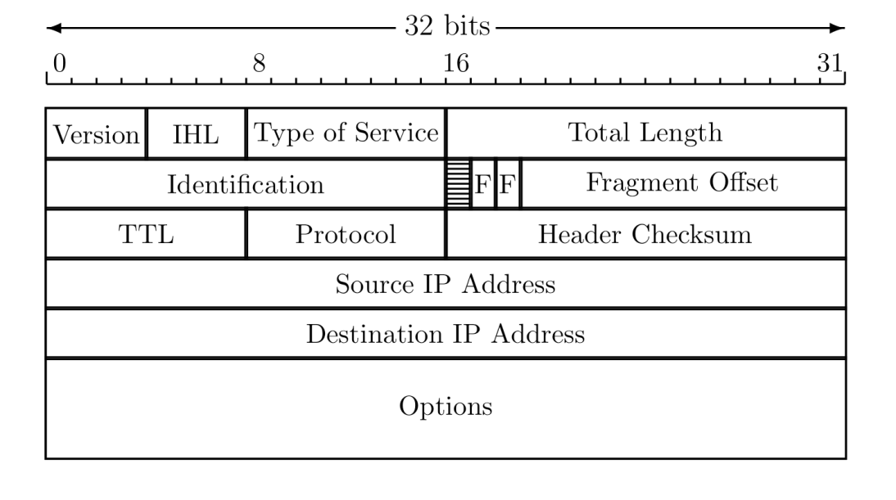
IP Review
IP datagram is of the form
IP header
data
Where IP header is

Slide 28
IP and TCP
Consider HTTP traffic (over TCP)
IP encapsulates TCP
TCP encapsulates HTTP
IP header
data
IP header
TCP hdr
HTTP hdr
app data
IP data includes TCP header, etc.

Slide 29
IPsec Objectives
Why do we need IPsec?
IP V4 has no authentication
IP spoofing
Payload could be changed without detection.
IP V4 has no confidentiality mechanism
Eavesdropping
Denial of service (DOS) attacks
Cannot hold the attacker accountable due to the lack of authentication.

Slide 30
IPsec Objectives (cont’d)
IP layer security mechanism for IPv4 and IPv6
Not all applications need to be security aware
Can be transparent to users
Provide authentication and confidentiality mechanisms.

Slide 31
IPsec Architecture
Two Protocols (Mechanisms)
Authentication Header (AH)
Encapsulating Security Payload (ESP)
IKE Protocol
Internet Key Management
Will not be covered in this course.

Slide 32
IPsec Architecture (Cont’d)
Can be implemented in
Host or gateway
Can work in two modes
Tunnel mode
Transport mode

Slide 33
Hosts & Gateways
Hosts can implement IPsec to connect to:
Other hosts in transport or tunnel mode
Or Gateways in tunnel mode
Gateways to gateways
Tunnel mode

Slide 34
Tunnel Mode
Encrypted Tunnel
Gateway
Gateway
Encrypted
Unencrypted
A
Unencrypted
B
New IP Header
AH or ESP Header
Orig IP Header
TCP
Data

Slide 35
Tunnel Mode (Cont’d)
Outer IP
header
IPsec
header
Inner IP
header
Higher
layer protocol
Destination
IPsec
entity
ESP
Real IP destination
AH
ESP applies only to the tunneled packet
AH can be applied to portions of the outer header

Slide 36
Transport Mode
Encrypted/Authenticated
A
B
New IP Header
AH or ESP Header
TCP
Data

Slide 37
Transport Mode (Cont’d)
IP
header
IP
options
IPsec
header
Higher
layer protocol
ESP
Real IP
destination
AH
ESP protects higher layer payload only
AH can protect IP headers as well as higher layer payload

Slide 38
Authentication Header (AH)
Data integrity
Entire packet has not been tampered with
Authentication
Can “trust” IP address source
Use MAC to authenticate
Anti-replay feature
Integrity check value

Slide 39
Integrity Check Value - ICV
Message authentication code (MAC) calculated over
IP header fields that do not change or are predictable
IP header fields that are unpredictable are set to zero.
IPsec AH header with the ICV field set to zero.
Upper-level data
Code may be truncated to first 96 bits

Slide 40
IPsec Authentication Header
Next Header (TCP/UDP)
Payload Length
6-2=4
Reserved
SPI
Sequence Number
ICV

Slide 41
Encapsulated Security Protocol (ESP)
Confidentiality for upper layer protocol
Partial traffic flow confidentiality (Tunnel mode only)
Data origin authentication and connectionless integrity (optional)

Slide 42
Comparison of IPSec Modes
Transport Mode
Transport Mode
Host-to-host
Tunnel Mode
Firewall-to-firewall
Transport mode not necessary
Transport mode is more efficient
IP header
data
IP header
ESP/AH
data
Tunnel Mode
IP header
data
new IP hdr
ESP/AH
IP header
data

Slide 43
Why Does AH Exist?
The real reason why AH exists
At one IETF meeting “someone from Microsoft gave an impassioned speech about how AH was useless…”
“…everyone in the room looked around and said `Hmm. He’s right, and we hate AH also, but if it annoys Microsoft let’s leave it in since we hate Microsoft more than we hate AH.”

Slide 44
IPSec and Complexity
IPSec is a complex protocol
Over-engineered
Lots of generally useless extra features
Flawed
Some serious security flaws
Interoperability is serious challenge
Defeats the purpose of having a standard!
Complex
Did I mention, it’s complex?

Slide 45
SSL vs IPSec: A Summary
IPSec
Lives at the network layer (part of the OS)
Has encryption, integrity, authentication, etc.
Is overly complex (including serious flaws)
SSL (and IEEE standard known as TLS)
Lives at socket layer (part of user space)
Has encryption, integrity, authentication, etc.
Has a simpler specification

Slide 46
SSL vs IPSec
IPSec implementation
Requires changes to OS, but no changes to applications
SSL implementation
Requires changes to applications, but no changes to OS
SSL built into Web application early on (Netscape)
IPSec used in VPN applications (secure tunnel)
Reluctance to retrofit applications for SSL
Reluctance to use IPSec due to complexity and interoperability issues
Result? Internet less secure than it should be!

Slide 47
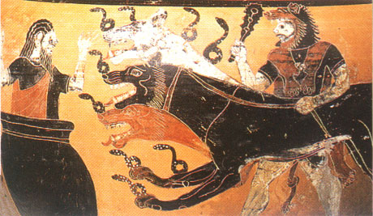
Kerberos

Slide 48
Kerberos
In Greek mythology, Kerberos is 3-headed dog that guards entrance to Hades
“Wouldn’t it make more sense to guard the exit?”
In security, Kerberos is an authentication system based on symmetric key crypto
Originated at MIT
Based on work by Needham and Schroeder
Relies on a trusted third party (TTP)
works on the basis of 'tickets' to provide mutual authentication between client and server
Kerberos protocol messages are protected against eavesdropping and replay attacks.

Slide 49
Kerberos Applications
Windows 2000 and later use Kerberos as their default authentication method (with some additions, documented in RFC 3244).
Kerberos authentication protocol is also the basis for single sign-on (SSO) in Windows 2000 networks.
Many UNIX and UNIX-like operating systems, including FreeBSD, Apple's Mac OS X, Red Hat Enterprise Linux, Oracle's Solaris, IBM's AIX and Z/OS, HP's OpenVMS, and others, include software for Kerberos authentication of users or services.

Slide 50
Client/server model
In a client/server application model
clients are programs acting on behalf of users who need something done. This might be opening and using a file, accessing a mailbox, querying a database, or printing a document.
Servers are programs providing services to clients such as file storage, mail handling, query processing, and print spooling.
Clients initiate action, servers respond. Typically, a server listens at a communications port waiting for clients to connect and ask for service.
Kerberos uses TCP port 88 by default

Slide 51
Motivation for Kerberos
Authentication using public keys
N users ⇒ N key pairs
Authentication using symmetric keys
N users requires about N² keys
Symmetric key case does not scale!
Kerberos based on symmetric keys but only requires N keys for N users
But must rely on TTP
Advantage is that no PKI is required

Slide 52
Kerberos KDC
Kerberos Key Distribution Center or KDC
Acts as a TTP
TTP must not be compromised!
KDC shares symmetric key K_{A} with Alice, key K_{B} with Bob, key K_{C} with Carol, etc.
Master key K_{KDC} known only to KDC
KDC enables authentication and session keys
Keys for confidentiality and integrity
In practice, the crypto algorithm used is DES (in V5, AES is used)
In Windows, Active Directory provides the account database that the Key Distribution Center (KDC) uses to obtain information about users in the domain.

Slide 53
Kerberos Tickets
KDC issues a ticket containing info needed to access a network resource
KDC also issues ticket-granting tickets or TGTs that are used to obtain tickets
Each TGT contains
Session key
User’s ID
Expiration time
Every TGT is encrypted with K_{KDC}
TGT can only be read by the KDC

Slide 54
Kerberized Login
Alice enters her password
Alice’s workstation
Derives K_{A} from Alice’s password
Uses K_{A} to get TGT for Alice from the KDC
Alice can then use her TGT (credentials) to securely access network resources
Plus: Security is transparent to Alice
Minus: KDC must be secure ⎯ it’s trusted!

Slide 55
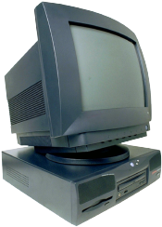

Kerberized Login
Alice wants
Alice’s
a TGT
password
E(S_{A},TGT,K_{A})
Alice
Computer
KDC
Key K_{A} derived from Alice’s password
KDC creates session key S_{A}
Workstation decrypts S_{A}, TGT, forgets K_{A}
TGT = E(“Alice”,S_{A}, K_{KDC})

Slide 56
Alice Requests Ticket to Bob
I want to
talk to Bob
Talk to Bob
REQUEST
REPLY
Alice
Computer
KDC
REQUEST = (TGT, authenticator) where
authenticator = E(timestamp,S_{A})
REPLY = E(“Bob”,K_{AB},ticket to Bob, S_{A})
ticket to Bob = E(“Alice”,K_{AB},K_{B})
KDC gets S_{A} from TGT to verify timestamp

Slide 57
Alice Uses Ticket to Bob
ticket to Bob, authenticator
E(timestamp + 1,K_{AB})
Alice’s
Computer
Bob
ticket to Bob = E(“Alice”,K_{AB}, K_{B})
authenticator = E(timestamp, K_{AB})
Bob decrypts “ticket to Bob” to get K_{AB} which he then uses to verify timestamp

Slide 58
Kerberos
Session key S_{A} used for authentication
Can also be used for confidentiality/integrity
Timestamps used for mutual authentication
Recall that timestamps reduce number of messages
Acts like a nonce that is known to both sides
Note: time is a security-critical parameter!

Slide 59
Kerberos Questions
When Alice logs in, KDC sends E(S_{A},TGT,K_{A}) where TGT = E(“Alice”,S_{A},K_{KDC})
Q: Why is TGT encrypted with K_{A}?
A: Extra work and no added security!
Why is “ticket to Bob” sent to Alice?
Where is replay prevention in Kerberos?

Slide 60
Kerberos Alternatives
Could have Alice’s workstation remember password and use that for authentication
Then no KDC required
But hard to protect password on workstation
Scaling problem
Could have KDC remember session key instead of putting it in a TGT
Then no need for TGTs
But stateless KDC is big feature of Kerberos

Slide 61
Kerberos Keys
In Kerberos, K_{A} = h(Alice’s password)
Could instead generate random K_{A} and
Compute K_{h} = h(Alice’s password)
And workstation stores E(K_{A}, K_{h})
Then K_{A} need not change (on workstation or KDC) when Alice changes her password
But E(K_{A}, K_{h}) subject to password guessing
This alternative approach is often used in applications (but not in Kerberos)

Slide 62
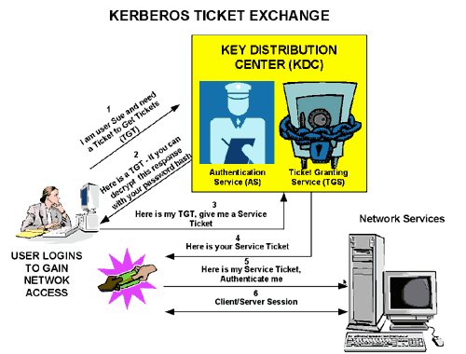
Kerberos Summary (picture from MicroSoft website)

Slide 63

GSM Security

Slide 64
Cell Phones
First generation cell phones
Analog, few standards
Little or no security
Susceptible to cloning
Second generation cell phones: GSM
Began in 1982 as Groupe Speciale Mobile
Now, Global System for Mobile Communications
Third generation?
3rd Generation Partnership Project (3GPP)

Slide 65




GSM System Overview
air
interface
Mobile
Base
Station
AuC
VLR
“land line”
HLR
PSTN
Internet
Etc.
Base
Station
Controller
Home
Network
Visited
Network

Slide 66


GSM System Components
Mobile phone
Contains SIM (Subscriber Identity Module)
SIM is the security module
IMSI (International Mobile Subscriber ID)
User key Ki (128 bits)
Tamper resistant (smart card)
PIN activated (usually not used)
SIM

Slide 67
GSM System Components
Visited network ⎯ network where mobile is currently located
Base station ⎯ one “cell”
Base station controller ⎯ manages many cells
VLR (Visitor Location Register) ⎯ info on all visiting mobiles currently in the network
Home network ⎯ “home” of the mobile
HLR (Home Location Register) ⎯ keeps track of most recent location of mobile
AuC (Authentication Center) ⎯ contains IMSI/Ki

Slide 68
GSM Security Goals
Primary design goals
Make GSM as secure as ordinary telephone
Prevent phone cloning
Not designed to resist an active attack!
At the time this seemed infeasible
Today such an attack is very feasible…
Designers considered biggest threats
Insecure billing
Corruption
Other low-tech attacks

Slide 69
GSM Security Features
Anonymity
Intercepted traffic does not identify user
Not so important to phone company
Authentication
Necessary for proper billing
Very important to phone company!
Confidentiality
Confidentiality of calls over the air interface
Not important to phone company
May be very important for marketing!

Slide 70
GSM: Anonymity
IMSI used to initially identify caller
Then TMSI (Temporary Mobile Subscriber ID) used
TMSI changed frequently
TMSI’s encrypted when sent
Not a strong form of anonymity
But probably sufficient for most uses

Slide 71
GSM: Authentication
Caller is authenticated to base station
Authentication is not mutual
Authentication via challenge-response
Home network generates RAND and computes XRES = A3(RAND, Ki) where A3 is a hash
Then (RAND,XRES) sent to base station
Base station sends challenge RAND to mobile
Mobile’s response is SRES = A3(RAND, Ki)
Base station verifies SRES = XRES
Note: Ki never leaves home network!

Slide 72
GSM: Confidentiality
Data encrypted with stream cipher
Error rate estimated at about 1/1000
Error rate too high for a block cipher
Encryption key Kc
Home network computes Kc = A8(RAND, Ki), where A8 is a hash
Then Kc sent to base station with (RAND,XRES)
Mobile computes Kc = A8(RAND, Ki)
Keystream generated from A5(Kc)
Note: Ki never leaves home network!

Slide 73
GSM Security
1. IMSI
2. IMSI
4. RAND
3. (RAND,XRES,Kc)
5. SRES
Mobile
Base
Station
Home
Network
6. Encrypt with Kc
SRES and Kc must be uncorrelated
Even though both are derived from RAND and Ki
Must not be possible to deduce Ki from known RAND/SRES pairs (known plaintext attack)
Must not be possible to deduce Ki from chosen RAND/SRES pairs (chosen plaintext attack)
With possession of SIM, attacker can choose RAND’s

Slide 74
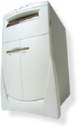
GSM Insecurity (1)
Hash used for A3/A8 is COMP128
Broken by 160,000 chosen plaintexts
With SIM, can get Ki in 2 to 10 hours
Encryption between mobile and base station but no encryption from base station to base station controller
Often transmitted over microwave link
Encryption algorithm A5/1
Broken with 2 seconds of known plaintext
Base
Station
VLR
Base
Station
Controller

Slide 75
GSM Insecurity (2)
Attacks on SIM card
Optical Fault Induction ⎯ can attack SIM with a flashbulb to recover Ki
Partitioning Attacks ⎯ using timing and power consumption, can recover Ki with only 8 adaptively chosen “plaintexts”
With possession of SIM, attacker can recover Ki in seconds

Slide 76

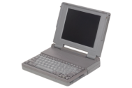
GSM Insecurity (3)
Fake base station exploits two flaws
Encryption not automatic
Base station not authenticated
RAND
SRES
Call to
destination
No
Mobile
Fake
Base Station
encryption
Base Station
Note: The bill goes to fake base station!

Slide 77
GSM Insecurity (4)
Denial of service is possible
Jamming (always an issue in wireless)
Base station can replay triple (RAND,XRES,Kc)
One compromised triple gives attacker a key Kc that is valid forever
No replay protection!

Slide 78
GSM Conclusion
Did GSM achieve its goals?
Eliminate cloning? Yes
Make air interface as secure as PSTN? Perhaps…
But design goals were clearly too limited
GSM insecurities ⎯ weak crypto, SIM issues, fake base station, replay, etc.
PSTN insecurities ⎯ tapping, active attack, passive attack (e.g., cordless phones), etc.
GSM a (modest) security success?

Slide 79
3GPP: 3rd Generation Partnership Project
3G security built on GSM (in)security
3G fixes known GSM security problems
Mutual authentication
Integrity protect signaling (such as “start encryption” command)
Keys (encryption/integrity) cannot be reused
Triples cannot be replayed
Strong encryption algorithm (KASUMI)
Encryption extended to base station controller

Slide 80
Protocols Summary
Generic authentication protocols
Protocols can be very subtle!
SSL
IPSec
Kerberos
GSM

