Slide 1
Attacks on TCP/IP, BGP, DNS
Denial of Service
Modified from Prof. Vitaly Shmatikov’s slides
slide <number>

Slide 2
Internet Is a Network of Networks
backbone
ISP
local network
Internet service
provider (ISP)
  Autonomous system (AS) is a collection of IP networks under control of a single administrator (e.g., ISP)
local network
TCP/IP for packet routing and connections
Border Gateway Protocol (BGP) for route discovery
Domain Name System (DNS) for IP address discovery
slide <number>

Slide 3
OSI Protocol Stack
email, Web, NFS
application
presentation
RPC
session
TCP
transport
IP
network
Ethernet
data link
physical
slide <number>

Slide 4
Data Formats
application
layer
Application data
message
transport
layer
TCP
header
data
TCP
header
data
TCP
header
data
segment
network
layer
IP
header
TCP
header
data
packet
data link
layer
Ethernet
header
IP
header
TCP
header
data
Ethernet
trailer
frame
slide <number>

Slide 5
IP (Internet Protocol)
Connectionless
  Unreliable, “best-effort” protocol
Uses numeric addresses for routing
Typically several hops in the route
Alice’s computer
Bob’s ISP
Alice’s ISP
Packet
Source
128.83.130.239
Dest
171.64.66.201
128.83.130.239
Seq
3
Bob’s computer
171.64.66.201
slide <number>

Slide 6
TCP (Transmission Control Protocol)
Sender: break data into packets
  Sequence number is attached to every packet
Receiver: reassemble packets in correct order
  Acknowledge receipt; lost packets are re-sent
Connection state maintained on both sides
remember received pages
and reassemble
book
mail each
page
slide <number>

Slide 7
ICMP (Control Message Protocol)
Provides feedback about network operation
  “Out-of-band” messages carried in IP packets
Error reporting, congestion control, reachability…
  Destination unreachable
  Time exceeded
  Parameter problem
  Redirect to better gateway
  Reachability test (echo / echo reply)
  Message transit delay (timestamp request / reply)
slide <number>

Slide 8

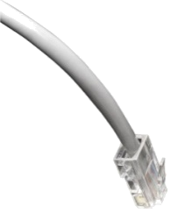

Packet Sniffing
Many applications send data unencrypted
  ftp, telnet send passwords in the clear
Network interface card (NIC) in “promiscuous mode” reads all passing data
network
Solution: encryption (e.g., IPsec, HTTPS), improved routing
slide <number>

Slide 9
“Ping of Death”
If an old Windows machine received an ICMP packet with a payload longer than 64K, machine would crash or reboot
  Programming error in older versions of Windows
  Packets of this length are illegal, so programmers of Windows code did not account for them
Solution: patch OS, filter out ICMP packets
slide <number>

Slide 10
“LAND”
IP packet with source address, port equal to destination address, port; SYN flag set
Triggers loopback in the Windows XP SP2 implementation of TCP/IP stack, locks up CPU
Solution: ingress filtering
slide <number>

Slide 11
“Smurf” Reflector Attack
Looks like a legitimate
“Are you alive?” ping
request from the victim
Stream of ping replies
overwhelms victim
1 ICMP Echo Req
Src: victim’s address
Dest: broadcast address
gateway
victim
Every host on the network
generates a ping (ICMP
Echo Reply) to victim
Solution: reject external packets to broadcast addresses
slide <number>

Slide 12
IP and TCP Headers
0
Version
Header Length
31
Type of Service
Total Length
0
Source Port
Dest port
31
Identification
Flags
SEQ Number
Fragment Offset
ACK Number
Time to Live
Protocol
U
R
G
A
C
K
P
S
H
P
S
R
S
Y
N
F
I
N
Header Checksum
Source Address of Originating Host
Other stuff
Destination Address of Target Host
Options
Padding
IP Data
slide <number>

Slide 13
TCP Handshake
C
S
SYN_{C}
Listening…
Spawn thread,
store data
(connection state, etc.)
SYN_{S}, ACK_{S}
Wait
ACK_{C}
Connected
slide <number>

Slide 14
SYN Flooding Attack
S
SYN_{spoofed} _{source addr 1}
Listening…
SYN_{spoofed} _{source addr 2}
Spawn a new thread,
store connection data
SYN_{spoofed} _{source addr 3}
… and more
SYN_{spoofed} _{source addr 4}
… and more
MS Blaster (August 16, 2003):
every infected machine sent 50 packets per second to port 80 on windowsupdate.com
SYN_{spoofed} _{source addr 5}
… and more
… and more
… and more
slide <number>

Slide 15
SYN Flooding Explained
Attacker sends many connection requests with spoofed source addresses
Victim allocates resources for each request
  New thread, connection state maintained until timeout
  Fixed bound on half-open connections
Once resources exhausted, requests from legitimate clients are denied
This is a classic denial of service pattern
  It costs nothing to TCP initiator to send a connection request, but TCP responder must spawn a thread for each request - asymmetry!
slide <number>

Slide 16
SYN Floods
[Phrack 48, no 13, 1996]
OS | Backlog queue size
Linux 1.2.x | 10
FreeBSD 2.1.5 | 128
WinNT 4.0 | 6
Backlog timeout: 3 minutes
Attacker need only send
128 SYN packets every 3 minutes
low-rate SYN flood
slide <number>

Slide 17
Preventing Denial of Service
DoS is caused by asymmetric state allocation
  If responder opens new state for each connection attempt, attacker can initiate thousands of connections from bogus or forged IP addresses
Cookies ensure that the responder is stateless until initiator produced at least two messages
  Responder’s state (IP addresses and ports of the con-nection) is stored in a cookie and sent to initiator
  After initiator responds, cookie is regenerated and compared with the cookie returned by the initiator
slide <number>

Slide 18
SYN Cookies
[Bernstein and Schenk]
C
S
SYN_{C}
Listening…
Compatible with standard TCP;
simply a “weird” sequence number
Does not store state
SYN_{S}, ACK_{S}
sequence # = cookie
F(source addr, source port,
dest addr, dest port,
coarse time, server secret)
Cookie must be unforgeable
and tamper-proof (why?)
Client should not be able
to invert a cookie (why?)
F=Rijndael or crypto hash
ACK_{C}
sequence # = cookie+1
Recompute cookie,
compare with with the one
received, only establish
connection if they match
More info: http://cr.yp.to/syncookies.html
slide <number>

Slide 19
Anti-Spoofing Cookies: Basic Pattern
Client sends request (message #1) to server
Typical protocol:
  Server sets up connection, responds with message #2
  Client may complete session or not - potential DoS!
Cookie version:
  Server responds with hashed connection data instead of message #2
  Client confirms by returning hashed data
    If source IP address is bogus, attacker can’t confirm
  Need an extra step to send postponed message #2, except in TCP (can piggyback on SYN-ACK in TCP)
slide <number>

Slide 20
Another Defense: Random Deletion
SYN_{C}
half-open connections
121.17.182.45
231.202.1.16
121.100.20.14
5.17.95.155
If SYN queue is full, delete random entry
  Legitimate connections have a chance to complete
  Fake addresses will be eventually deleted
Easy to implement
slide <number>

Slide 21

Prolexic / Verisign
Idea: only forward established TCP connections to site
Lots-of-SYNs
Prolexic
proxy
Lots-of-SYN/ACKs
Few ACKs
Web
site
Forward
to site
slide <number>

Slide 22
Other Junk-Packet Attacks
Proxy must keep floods of these away from website
Attack Packet | Victim Response | Rate: attk/day [ATLAS 2013]
TCP SYN to open port | TCP SYN/ACK | 773
TCP SYN to closed port | TCP RST
TCP ACK or TCP DATA | TCP RST
TCP RST | No response
TCP NULL | TCP RST
ICMP ECHO Request | ICMP ECHO Response | 50
UDP to closed port | ICMP Port unreachable | 387
slide <number>

Slide 23
Stronger Attack: TCP Con Flood
Command bot army to:
  Complete TCP connection to web site
  Send short HTTP HEAD request
  Repeat
Will bypass SYN flood protection proxy but …
  Attacker can no longer use random source IPs
    Reveals location of bot zombies
  Proxy can now block or rate-limit bots
slide <number>

Slide 24
TCP Connection Spoofing
Each TCP connection has associated state
  Sequence number, port number
TCP state is easy to guess
  Port numbers standard, seq numbers predictable
Can inject packets into existing connections
  If attacker knows initial sequence number and amount of traffic, can guess likely current number
  Guessing a 32-bit seq number is not practical, BUT…
  ISNs in some systems are not purely random, and most systems accept large windows of sequence numbers (to handle packet losses), so send a flood of packets with likely sequence numbers
slide <number>

Slide 25



TCP Authentication Attack
1. SYN, SEQ = t (as Trudy)
2. SYN, ACK = t+1, SEQ = b₁
3. SYN, SEQ = t (as Alice)
Trudy
5. ACK = b₂+1, data (as Alice)
Bob
5.
5.
5.
4. SYN, ACK = t+1, SEQ = b₂
Alice
5.
Part 3 ⎯ Protocols <number>

Slide 26

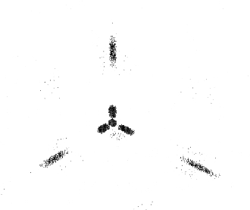
TCP Authentication Attack
Initial SEQ numbers
Mac OS X
Random SEQ numbers
If initial SEQ numbers not very random…
…possible to guess initial SEQ number…
…and previous attack will succeed
Part 3 ⎯ Protocols <number>

Slide 27
“Blind” IP Spoofing Attack
Trusted connection between Alice and Bob
uses predictable sequence numbers
❷ SYN-flood Bob’s queue
Alice
Bob
❶ Open connection to Alice to
get initial sequence number
❸ Send packets to Alice that
resemble Bob’s packets
Can’t receive packets sent to Bob, but can bypass Alice’s IP address-based authentication
  rlogin and other remote access tools, SPF defense against spam
slide <number>
Notes:
Blind Spoofing
This is a more sophisticated attack, because the sequence and acknowledgement numbers are unreachable. In order to circumvent this, several packets are sent to the target machine in order to sample sequence numbers. While not the case today, machines in the past used basic techniques for generating sequence numbers. It was relatively easy to discover the exact formula by studying packets and TCP sessions. Today, most OSs implement random sequence number generation, making it difficult to predict them accurately. If, however, the sequence number was compromised, data could be sent to the target. Several years ago, many machines used host-based authentication services (i.e. Rlogin). A properly crafted attack could add the requisite data to a system (i.e. a new user account), blindly, enabling full access for the attacker who was impersonating a trusted host.

Slide 28
DoS by Connection Reset
If attacker can guess the current sequence number for an existing connection, can send Reset packet to close it
Especially effective against long-lived connections
  For example, BGP route updates
slide <number>

Slide 29
User Datagram Protocol (UDP)
UDP is a connectionless protocol
  Simply send datagram to application process at the specified port of the IP address
  Source port number provides return address
  Applications: media streaming, broadcast
No acknowledgement, no flow control, no message continuation
Denial of service by UDP data flood
slide <number>

Slide 30
NTP Amplification Attack
x206 amplification
“Give me the addresses of the
last 600 machines you talked to”
Spoofed SrcIP: DoS target
(234 bytes)
600 addresses
(49,000 bytes)
DoS
Source
NTP
(Network Time Protocol)
server
DoS
Target
December 2013 – February 2014:
400 Gbps DDoS attacks involving 4,529 NTP servers
7 million unsecured NTP servers on the Internet (Arbor)
slide <number>
Notes:
An NTP amplification attack begins with a server controlled by an attacker on a network that allows source IP address spoofing (e.g., it does not follow BCP38). The attacker generates a large number of UDP packets spoofing the source IP address to make it appear the packets are coming from the intended target. These UDP packets are sent to Network Time Protocol servers (port 123) that support the MONLIST command.
I'd personally be curious to talk with whoever added MONLIST as a command to NTP servers. The command seems of such little practical use -- it returns a list of up to the last 600 IP addresses that last accessed the NTP server -- and yet it can do so much harm. If an NTP server has its list fully populated, the response to a MONLIST request will be 206-times larger than the request. In the attack, since the source IP address is spoofed and UDP does not require a handshake, the amplified response is sent to the intended target. An attacker with a 1Gbps connection can theoretically generate more than 200Gbps of DDoS traffic.

Slide 31
DNS Attacks
slide <number>

Slide 32
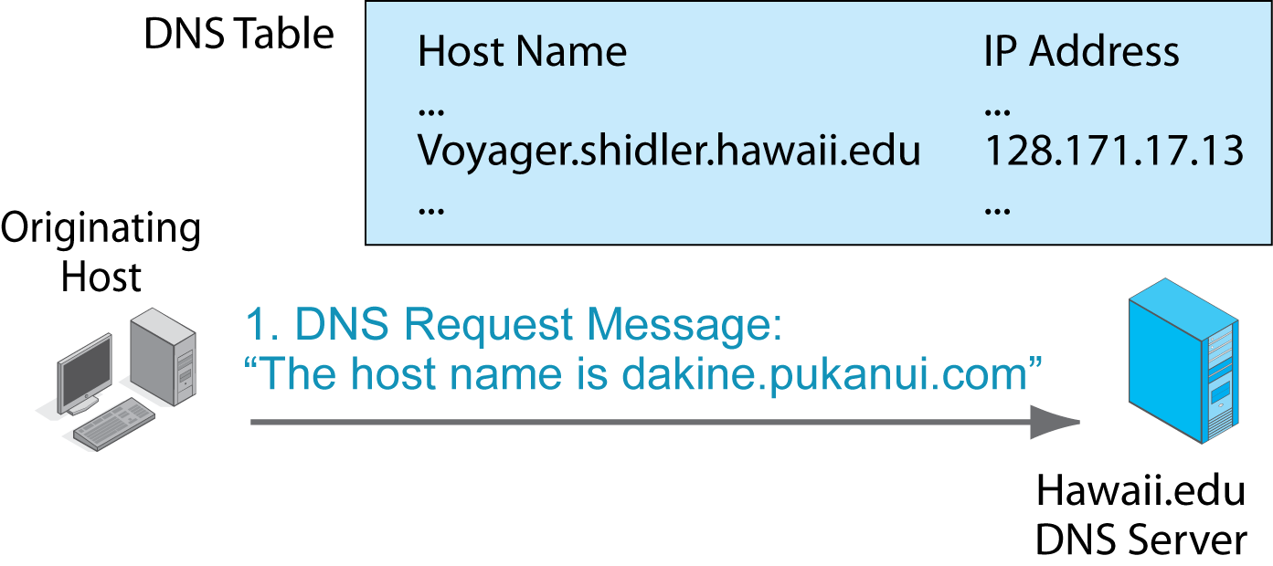
10.4: Domain Name System (DNS) Lookup
© 2011 Pearson Education, Inc. Publishing as Prentice Hall

Slide 33

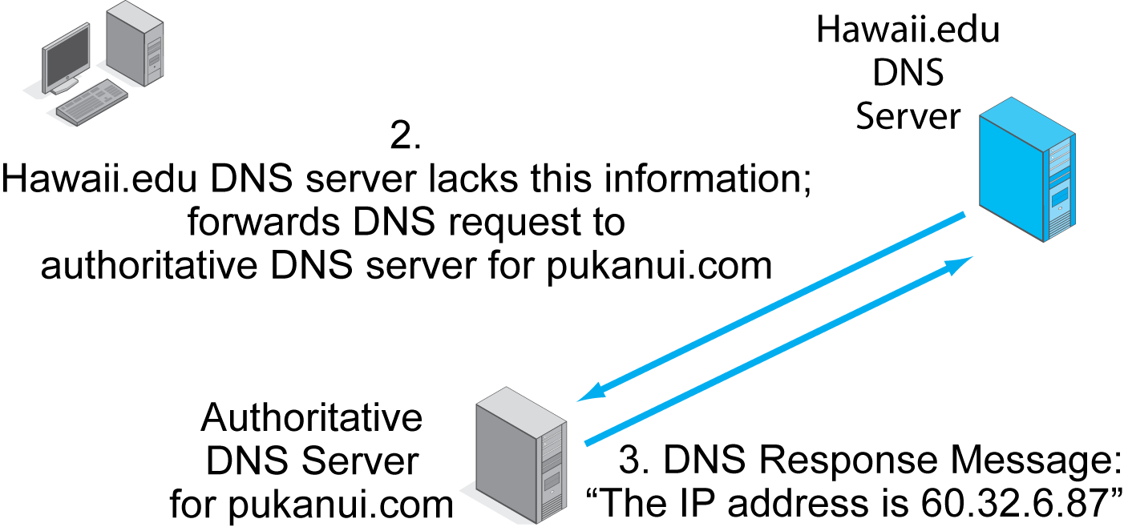
10.4: Domain Name System (DNS) Lookup
© 2011 Pearson Education, Inc. Publishing as Prentice Hall

Slide 34
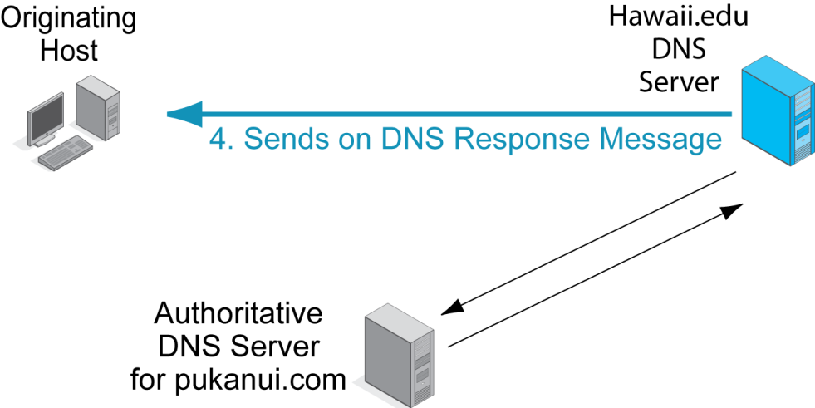
10.4: Domain Name System (DNS) Lookup
© 2011 Pearson Education, Inc. Publishing as Prentice Hall

Slide 35
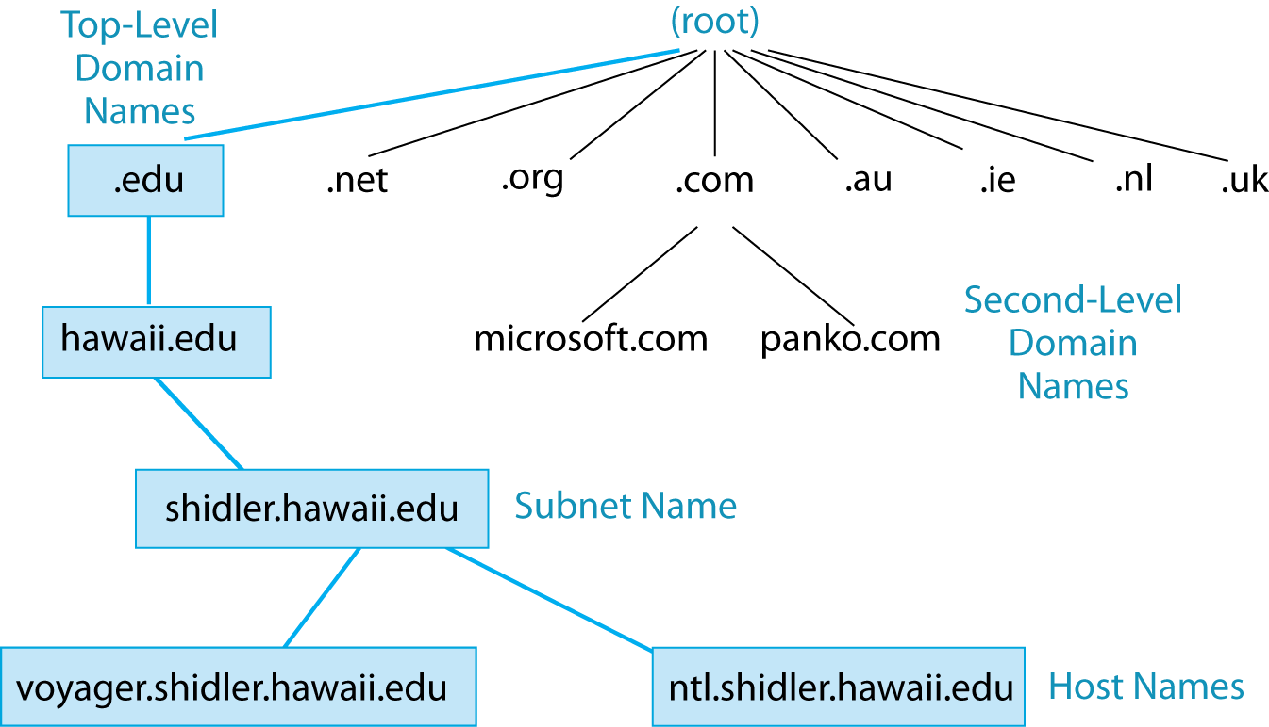
10.5: Domain Name System (DNS) Hierarchy
The DNS really is a general naming system for the Internet.
A domain is a set of resources under the control of an organization.
There is a hierarchy of domains.
© 2011 Pearson Education, Inc. Publishing as Prentice Hall

Slide 36
10.5: Domain Name System (DNS) Hierarchy
The root is all domains.
There are 13 DNS root servers.
© 2011 Pearson Education, Inc. Publishing as Prentice Hall

Slide 37
10.5: Domain Name System (DNS) Hierarchy
There are two kinds of top level domains
Generic top-level domains indicate organization type (.com, .edu, .gov, etc.).
Country top-level domains are specific to a country (.UK, .CA, .CH, etc.).
© 2011 Pearson Education, Inc. Publishing as Prentice Hall

Slide 38
10.5: Domain Name System (DNS) Hierarchy
Companies want Second-Level Domain Names
(Microsoft.com, apple.com, panko.com, etc.).
Competition for these names is fierce.
© 2011 Pearson Education, Inc. Publishing as Prentice Hall

Slide 39
10.5: Domain Name System (DNS) Hierarchy
Most companies divide their organizations into subdomains.
© 2011 Pearson Education, Inc. Publishing as Prentice Hall

Slide 40
10.5: Domain Name System (DNS) Hierarchy
At the bottom of the hierarchy are individual hosts.
© 2011 Pearson Education, Inc. Publishing as Prentice Hall

Slide 41
More Technical Details on DNS (Wikipedia)
Domain name space
  The domain name space consists of a tree data structure. Each node or leaf in the tree has a label and zero or more resource records (RR), which hold information associated with the domain name.
  The tree sub-divides into zones beginning at the root zone. A DNS zone may consist of only one domain, or may consist of many domains and sub-domains, depending on the administrative choices of the zone manager.
slide <number>

Slide 42
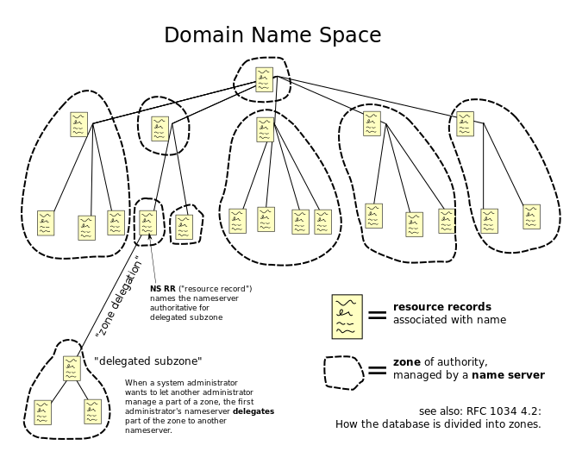
The hierarchical Domain Name System for class Internet
slide <number>
organized into zones, each served by a name server

Slide 43
Authoritative name server (Wikipedia)
An authoritative name server is a name server that only gives answers to DNS queries from data that has been configured by an original source, for example, the domain administrator or by dynamic DNS methods, in contrast to answers obtained via a query to another name server that only maintains a cache of data.
Every DNS zone must be assigned a set of authoritative name servers. This set of servers is stored in the parent domain zone with name server (NS) records.
An authoritative server indicates its status of supplying definitive answers, deemed authoritative, by setting a protocol flag, called the Authoritative Answer (AA) bit in its responses. This flag is usually reproduced prominently in the output of DNS administration query tools, such as dig, to indicate that the responding name server is an authority for the domain name in question.
slide <number>

Slide 44
DNS: Domain Name Service
DNS maps symbolic names to numeric IP addresses
(for example, www.cs.utexas.edu ↔ 128.83.120.155)
root & edu
DNS server
www.cs.utexas.edu
www.cs.utexas.edu
NS utexas.edu
utexas.edu
DNS server
Local
DNS recursive
resolver
NS cs.utexas.edu
Client
www=IPaddr
cs.utexas.edu
DNS server
slide <number>

Slide 45
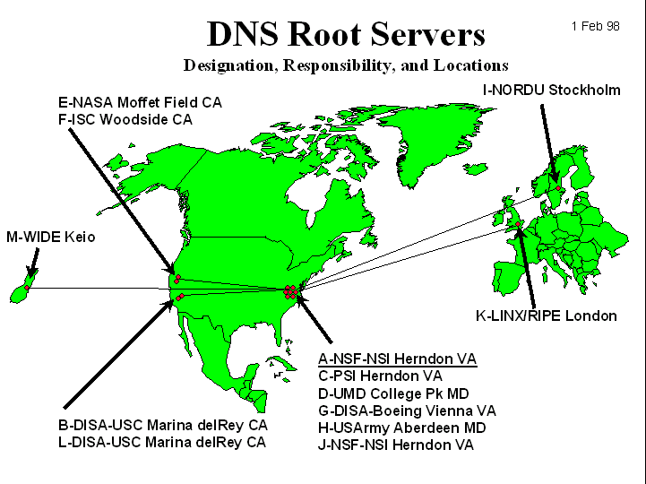
DNS Root Name Servers
Root name servers for top-level domains
Authoritative name servers for subdomains
Local name resolvers contact authoritative servers when they do not know a name
Feb 6, 2007: Botnet DoS attack on
root DNS servers
slide <number>

Slide 46

The hacking group, called Turkguvenligi, targeted the net's Domain Name System (DNS)
Turkguvenligi revealed that it got access to the files using a well-established attack method known as SQL injection
slide <number>

Slide 47
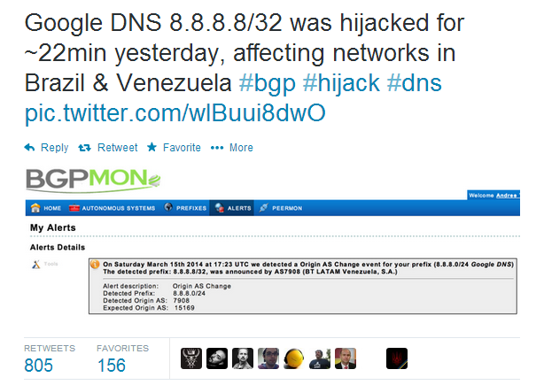
March 16, 2014
It is suspected that hackers exploited a well-known vulnerability in the so-called Border Gateway Protocol (BGP)
slide <number>

Slide 48
DNS Amplification Attack
x50 amplification
EDNS response
(3000 bytes)
DNS query
SrcIP: DoS Target
(60 bytes)
DoS
Source
DNS
Server
DoS
Target
2006: 0.58M open resolvers on Internet (Kaminsky-Shiffman)
2013: 21.7M open resolvers (openresolverproject.org)
March 2013: 300 Gbps DDoS attack on Spamhaus
slide <number>

Slide 49
DNS Caching
DNS responses are cached
  Quick response for repeated translations
  Other queries may reuse some parts of lookup
    NS records identify name servers responsible for a domain
DNS negative queries are cached
  Don’t have to repeat past mistakes (misspellings, etc.)
Cached data periodically times out
  Lifetime (TTL) of data controlled by owner of data, passed with every record
slide <number>

Slide 50
Cached Lookup Example
root & edu
DNS server
ftp.cs.utexas.edu
utexas.edu
DNS server
Local
DNS recursive
resolver
ftp.cs.utexas.edu
Client
ftp=IPaddr
cs.utexas.edu
DNS server
slide <number>

Slide 51
DNS “Authentication”
Request contains random 16-bit TXID
root & edu
DNS server
www.cs.utexas.edu
www.cs.utexas.edu
NS utexas.edu
utexas.edu
DNS server
Response accepted if TXID is the same,
stays in cache for a long time (TTL)
Local
DNS recursive
resolver
NS cs.utexas.edu
Client
www=IPaddr
cs.utexas.edu
DNS server
slide <number>

Slide 52
DNS Spoofing
6.6.6.6
Trick client into looking up host1.foo.com (how?)
Guess TXID, host1.foo.com is at 6.6.6.6
Another guess, host1.foo.com is at 6.6.6.6
Another guess, host1.foo.com is at 6.6.6.6
host1.foo.com
TXID, host1.foo.com
Local
resolver
ns.foo.com
DNS server
Client
host1.foo.com is at 1.2.3.4
Several opportunities to win the race.
If attacker loses, has to wait until TTL expires…
… but can try again with host2.foo.com, host3.foo.com, etc.
… but what’s the point of hijacking host3.foo.com?
slide <number>

Slide 53
Exploiting Recursive Resolving
[Kaminsky]
6.6.6.6
Trick client into looking up host1.foo.com
Guessed TXID, very long TTL
I don’t know where host1.foo.com is, but
ask the authoritative server at ns2.foo.com
It lives at 6.6.6.6
host2.foo.com
host1.foo.com
TXID, host1.foo.com
Local
resolver
ns.foo.com
DNS server
Client
host1.foo.com is at 1.2.3.4
If win the race, any request for XXX.foo.com will go to 6.6.6.6
The cache is poisoned… for a very long time!
No need to win future races!
If lose, try again with <ANYTHING>.foo.com
slide <number>

Slide 54
Triggering a Race
Any link, any image, any ad, anything can cause a DNS lookup
  No JavaScript required, though it helps
Mail servers will look up what bad guy wants
  On first greeting: HELO
  On first learning who they’re talking to: MAIL FROM
  On spam check (oops!)
  When trying to deliver a bounce
  When trying to deliver a newsletter
  When trying to deliver an actual response from an actual employee
slide <number>

Slide 55
Reverse DNS Spoofing
Trusted access is often based on host names
  Example: permit all hosts in .rhosts to run remote shell
Network requests such as rsh or rlogin arrive from numeric source addresses
  System performs reverse DNS lookup to determine requester’s host name and checks if it’s in .rhosts
If attacker can spoof the answer to reverse DNS query, he can fool target machine into thinking that request comes from an authorized host
  No authentication for DNS responses and typically no double-checking (numeric → symbolic → numeric)
slide <number>

Slide 56
Pharming
Many anti-phishing defenses rely on DNS
Can bypass them by poisoning DNS cache and/or forging DNS responses
  Browser: “give me the address of www.paypal.com”
  Attacker: “sure, it’s 6.6.6.6” (attacker-controlled site)
Dynamic pharming
  Provide bogus DNS mapping for a trusted server, trick user into downloading a malicious script
  Force user to download content from the real server, temporarily provide correct DNS mapping
  Malicious script and content have the same origin!
slide <number>

Slide 57
Other DNS Vulnerabilities
DNS implementations have vulnerabilities
  Reverse query buffer overrun in old releases of BIND
  MS DNS for NT 4.0 crashes on chargen stream
Denial of service
  Oct ’02: ICMP flood took out 9 root servers for 1 hour
Can use “zone transfer” requests to download DNS database and map out the network
  “The Art of Intrusion”: NYTimes.com and Excite@Home
  Solution: block port 53 on corporate name servers
See http://cr.yp.to/djbdns/notes.html
slide <number>
Notes:
DNS zone transfer, also sometimes known by the inducing DNS query type AXFR, is a type of DNS transaction. It is one of the many mechanisms available for administrators to replicate DNS databases across a set of DNS servers.
A zone transfer uses the Transmission Control Protocol (TCP) for transport, and takes the form of a client–server transaction. The client requesting a zone transfer may be a slave server or secondary server, requesting data from a master server, sometimes called a primary server. The portion of the database that is replicated is a zone.

Slide 58
DNS Vulnerabilities: Summary
Cache impersonation
Corrupting data
Impersonating master
Zone
administrator
master
resolver
Zone file
Dynamic
updates
slaves
stub
resolver
Cache pollution by
data spoofing
Unauthorized updates
slide <number>

Slide 59
Solving the DNS Spoofing Problem
Long TTL for legitimate responses
  Does it really help?
Randomize port in addition to TXID
  32 bits of randomness, makes it harder for attacker to guess TXID+port
DNSSEC
  Cryptographic authentication of host-address mappings
slide <number>

Slide 60
DNSSEC
Goals: authentication and integrity of DNS requests and responses
PK-DNSSEC (public key)
  DNS server signs its data (can be done in advance)
  How do other servers learn the public key?
SK-DNSSEC (symmetric key)
  Encryption and MAC: E_{k}(m, MAC(m))
  Each message contains a nonce to avoid replay
  Each DNS node shares a symmetric key with its parent
  Zone root server has a public key (hybrid approach)
slide <number>

