Slide 1

Item Based Collaborative Filtering Recommendation Algorithms
Yanbo Sun
Wenliang Sun
Notes:
hello everyone, today we are going to talk about the item based collaborative filtering recommendation algorithms.

Slide 2
Overview
Introduction
Related work
Background
Recommender Systems
Item-Based CF Algorithm
Experimental work
Conclusion
Notes:
Our presentation includes six parts. the first part is introduction and the second part is related work, and then we will talk about the background of the algorithm. the fourth part is recommender systems; the fifth part is the most important one-item based CF algorithm and finally we will talk about the experimental work and conclusion.

Slide 3
Introduction
Recommender Systems
Two approaches
Improvements
Scalability & Quality
Problems
Recommend the “best” items
Bottleneck
Search too many neighbors
Notes:
Let’s go to the introduction part. First I want to talk about the recommender systems.
Recommender systems are used to recommend information, products or services to users. There are two main approaches. The first one is item-based and the second one is user-based. We will know the basic idea from the two name. The user-based means the recommendation is from interests among users and the item-based method is based on the similarity among items.
And the paper point out the disadvantages of user-based approaches. When the dimensions of data become larger, there will be scalability and quality problems. These are the paper’s motivation. The CF algorithms focus on the problem that recommend the “best” items to right users. But the traditional approach bottleneck is that we should search many neighbors when the systems include a large number of users.

Slide 4
Related Work
Tapestry
Bayesian Networks
Clustering
Horting
Notes:
There are four related approaches of the recommendation systems. The tapestry is one of the earliest CF-based recommender system. It relies on explicit opinions of people from a community; The Baysian Networks is based on the training set with a decision tree. In the tree, each node and edge represent user information. The third one, clustering we have already learned in class. The last method horting is a graph based technique to make recommendation.

Slide 5
Background
Aims of CF algorithms:
Predict the opinions
Recommend best items to user based on the previous likings and opinions of other similar users
CF algorithms divided:
Memory-based
Model-based
Notes:
The background of the paper is that people want to predict the opinions, recommend best items to user based on the previous likings and opinions of other similar users
Researchers have invented a number of CF algorithms. They can be divided into two main categories.

Slide 6
The CF Algorithm Process
List of m users and a list of n Items
Each user has a list of items
Explicit opinion - a rating score
Implicit opinion-purchase records
Active user for whom the CF task is performed
Notes:
The cf algorithms process is as below:
List of m users and a list of n Items .
Each user has a list of items he/she expressed their opinion about (can be a null set).
To express the user’s opinion we can use 2 methods.
Explicit opinion - a rating score (numerical scale).
Implicit opinion – purchase records.
Active user for whom the CF task is performed.

Slide 7
The CF Process – cont.
Find item likeness of two forms :
Prediction – the predicted likeliness of an item the user hasn’t expressed his/her opinion about
Recommendation – a list of N items the active user will like the most
Notes:
The task of a CF algorithm is to find item likeliness of two forms :
Prediction – a numerical value, expressing the predicted likeliness of an item the user hasn’t expressed his/her opinion about.
Recommendation – a list of N items the active user will like the most (Top-N recommendations).

Slide 8
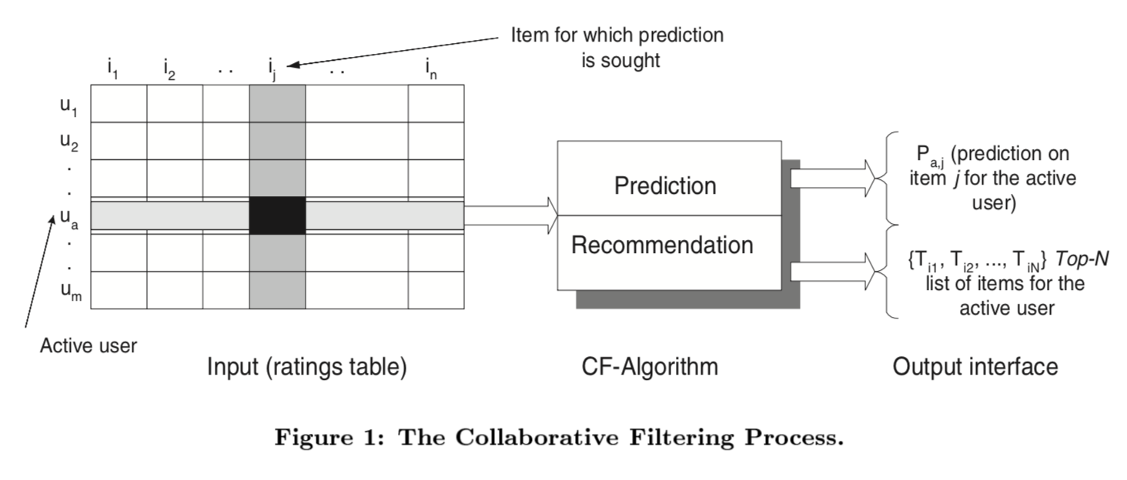
The CF Process – cont.
The CF process :
Notes:
The figure shows the details of the CF process. The row stand for users and the column stands for the items. We should fill in the rating table and then use CF algorithm to make prediction and recommendation. And got these output.

Slide 9
Memory Based CF Algorithms -
Utilize the entire user-item database to generate a prediction.
Use the statistical techniques to find the neighbors – nearest-neighbor.
Notes:
There are two main CF algorithms. The first one is memory based CF algorithm. It means utilize the entire user-item database to generate a prediction and Use the statistical techniques to find the neighbors – nearest-neighbor.

Slide 10
Model Based CF Algorithms -
Develop models
Compute prediction
Build the model –
Bayesian network (probabilistic)
clustering (classification)
rule-based approaches
Notes:
Another approach is model based CF algorithms. There are 3 steps.
First developing a model of user ratings.
Computing the expected value of a user prediction , given his/her ratings on other items.
To build the model – Bayesian network (probabilistic), clustering (classification), rule-based approaches (association rules between co-purchased items).

Slide 11
Challenges Of User-based CF Algorithms -
Sparsity – evaluation of large itemsets, users purchases are under 1%
Difficult to make predictions based on nearest neighbor algorithms
=> Accuracy of recommendation may be poor.
Notes:
There are some challenges about user based CF algorithm. The first one is the sparsity. The evaluation of large itemsets, users purchases are under 1%. And the second one is that difficult to make predictions based on nearest neighbor algorithms. Thus the accuracy of recommendation may be poor.

Slide 12
Challenges Of User-based CF Algorithms –cont.
Scalability
Poor relationship among like minded but sparse-rating users.
Solution
The Model-based approach
Analyze user-item matrix
Calculate prediction
Notes:
The third challenge is scalability. When the dataset become larger, it’s hard to compute the nearest neighbors.
The last challenge is that poor relationship among like minded but sparse-rating users.
Luckily, we have solutions. The Model-based approach, Analyze user-item matrix and Calculate prediction can help us.

Slide 13
Item Based CF Algorithm -
Looks into the set of items the target user has rated & computes how similar they are to the target item and then selects k most similar items
Prediction is computed by taking a weighted average on the target user’s ratings on the most similar items
Notes:
Let’s talk about the item based CF algorithm. The algorithms includes that
Looks into the set of items the target user has rated & computes how similar they are to the target item and then selects k most similar items.
Prediction is computed by taking a weighted average on the target user’s ratings on the most similar items.

Slide 14


Similarity Computation
Cosine Similarity
Correlation-based Similarity
Notes:
We have many choices to compute similarity. The consine similarity and correlation-based similarity we have learn in class. And these are their formulas.
Similarity between items i & j is computed by isolating the users who have rated them and then applying a similarity computation technique.
Cosine-based Similarity – items are vectors in the m dimensional user space (difference in rating scale between users is not taken into account).

Slide 15

Item Similarity Computation – cont.
Adjusted Cosine Similarity – each pair in the co-rated set corresponds to a different user. ( takes care of difference in rating scale).
Notes:
We can also use adjusted cosine similarity formula. Each pair in the co-rated set corresponds to a different user.

Slide 16
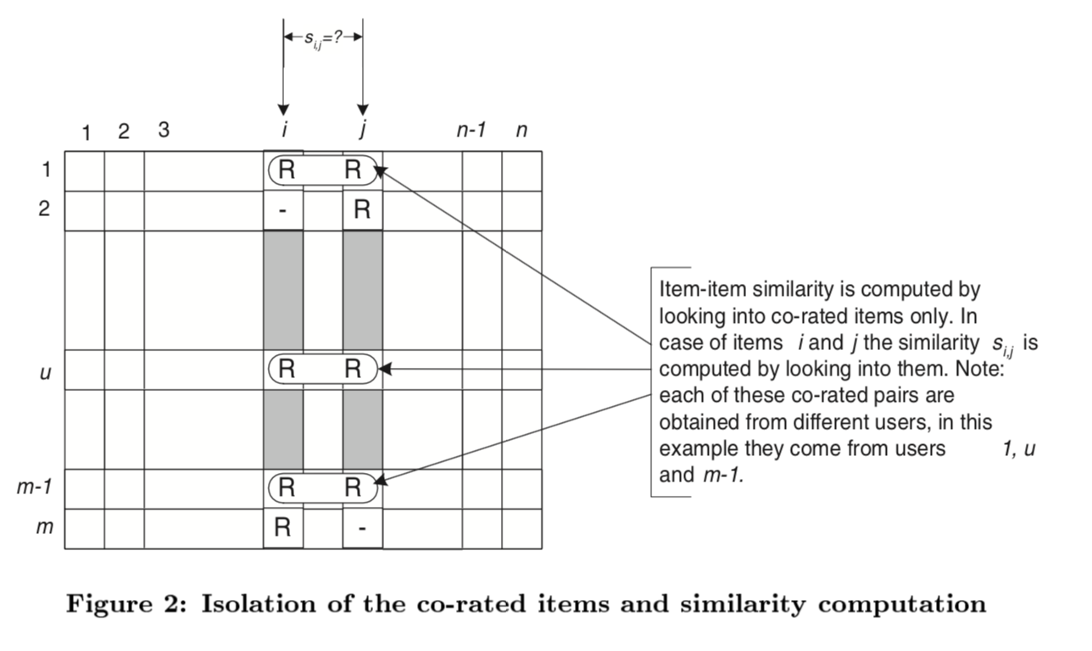
Item Similarity Computation – cont.
Notes:
In this figure, item-item similarity is computed by looking into co-rated items only. In case of items i and j the similarity s i,j is computed by looking into them. We should be careful that each of these co-rated pairs are obtained from different users, in this example they come from users 1,u and m minus 1.

Slide 17
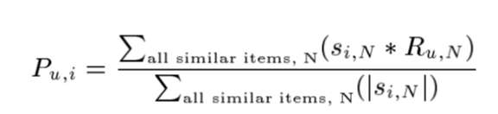
Prediction Computation
Generating the prediction – look into the target users ratings and use techniques to obtain predictions.
Weighted Sum – how the active user rates the similar items.
Notes:
Then we can compute the prediction. Looking into the target users ratings and use techniques to obtain predictions. The weighted Sum is the most popular tech. It shows how the active user rates the similar items.

Slide 18
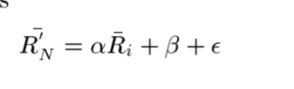
Prediction Computation –cont.
Regression – an approximation of the ratings based on a regression model instead of using directly the ratings of similar items. (Euclidean distance between rating vectors).
- R’(N) = ratings based on regression.
- ε: Error.
- α,β：Regression model parameters.
Notes:
We can also use the regression to calculate the prediction. Regression is an approximation of the ratings based on a regression model instead of using directly the rating of similar items.
In this formula, R prim N stands for ratings based on regression. And epsilon stands error. The α,β stand for regression model parameters.

Slide 19
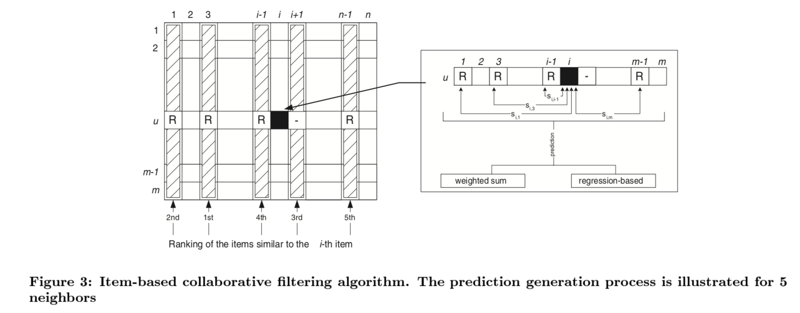
Prediction Computation –cont.
The prediction generation process -
Notes:
And this figure shows the prediction generation process. The prediction generation process is described for 5 neighbors.

Slide 20
Performance Implications -
Bottleneck - Similarity computation.
Time complexity - , highly time consuming with millions of users and items in the database.
Isolate the neighborhood generation and prediction steps.
“off-line component” / “model” – similarity computation, done earlier & stored in memory.
“on-line component” – prediction generation process.

Slide 21
Performance Implications -
User-based CF –
similarity between users is dynamic
Item-based CF –
similarity between items is static.
prediction process involves only a table lookup for the similarity values & computation of the weighted sum
Notes:
Interpretation for the performance is that the precomputing of user-based algorithm of will lead to poor predictions
However, similarity between items is static so it enables precomputing of item-item similarity because prediction process involves only a table lookup for the similarity values & computation of the weighted sum.

Slide 22
Experiments : The Data Set
MovieLens – a web-based movies recommender system with 43,000 users & over 3500 movies
100,000 ratings from the DB
80% of the data - training set
20% 0f the data - test set
Data is in the form of user-item matrix
Sparsity level of the data set –
1- (nonzero entries/total entries) => 0.9369 for the movie data set
Notes:
Then we go to the dataset they use.
In the experiment, they used the data of movies recommender system and there are 10 thousands of ratings.
They split 80% of the data to training set and 20% to test set.

Slide 23
Evaluation Metrics -
Statistical accuracy metrics
Decision support accuracy metrics
Notes:
How do we measure the quality of a recommender system?
There are two metrics for evaluating the quality
Statistical accuracy metrics – comparing numerical recommendation scores against the actual user ratings for the user-item pairs in the test data set.
Decision support accuracy metrics – how effective a prediction engine is at helping a user select high-quality items from the set of all items.

Slide 24

Evaluation Metrics – cont.
MAE – Mean Absolute Error : deviation of recommendations from their true user-specified values.
MAE is the most commonly used and is the easiest to interpret.
Notes:
Another useful evaluation metrics is the MAE: mean absolute error, which the paper used to measure the performance of the prediction.

Slide 25
Experimental Procedure -
Experimental steps
Assessment of quality of recommendations
Using only the training data & further subdivision of it into a train and test portion.
10-fold cross validation - randomly choosing different train & test sets
Comparison to user-based systems
Experimental Platform
Notes:
Next we are going to show the procedure of the experiment
The experimental steps are
Experimental steps – division into train and test portion.
Assessment of quality of recommendations - determining the sensitivity of the neighborhood size, train/test ratio & the effect of different similarity measures.
Using only the training data & further subdivision of it into a train and test portion.
10-fold cross validation - randomly choosing different train & test sets, taking the average of the MAE values.
And compare to user-based systems which uses nearest neighbor algorithm
Finally for each similarity algorithm the neighborhood was computed and prediction weighted sum algorithm was made to make predictions

Slide 26
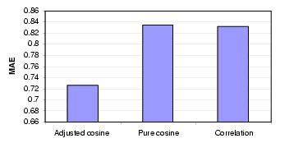
Experimental Results
Effect of similarity Algorithms
Impact of similarity computation measures on item-based CF algorithm.
Notes:
Next we are going to show the results of experimental. Results are divided into two parts:
Quality and performance. They determine the sensitivity of some parameters before running experiments. Parameters include neighborhood size, value of training and test ratio, effects of different similarity measures. They divided data to training and test portion and used them to learn parameters.
The first part of the experimental results is the effect of similarity algorithms. They compute the neighbor and used weighted sum algorithm to generate the prediction. After running experiment on training data, they got and calculate MAE from test data. We can see those results.

Slide 27
Experimental Results – cont.
Sensitivity of Train/Test Ratio –
Varied the value from 0.2 to 0.9 in an increment of 0.1
Weighted sum & regression prediction generation techniques
Use adjusted cosine similarity algorithm
Notes:
Next they find out the optimal ratio of training over test, they varied the value from 0.2 to 0.9 in an increment of 0.1 For each of these training test ratio values they ran experiments using two prediction generation techniques

Slide 28
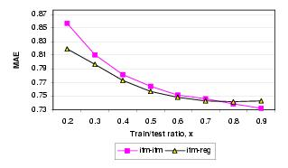
Sensitivity of Train/Test Ratio -
Train/Test ratio – the more we train the system the quality of prediction increases.
Notes:
They observed that the quality of prediction increase as we increase the ratio. Moreover, we can see that the regression method has better quality when x is less than 0.8 however when increase x the quality tends to fall below the basic method.

Slide 29
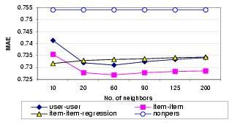
Quality Experiments -
Item vs. user based at selected neighborhood sizes.
(train/test ratio = 0.8)
Notes:
Then we go to the quality experiments part
We can see that those quality experiments

Slide 30
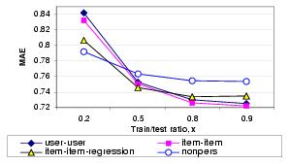
Quality Experiments – cont.
Item vs. user based at selected density levels.
(number of neighbors = 30)

Slide 31
Quality Experiments – cont.
item-based provides better quality than user-based at all sparsity levels – we may focus on scalability
Regression algorithms perform better in sparse data (data overfitting at high density levels)
Notes:
From those results, they have two conclusions, first is that item-based algorithms provide better quality than the user-based algorithms at all sparsity levels. Second is that regression-based algorithms perform better with very sparse data set but as we add more data the quality goes down.
It may happen because of the overfitting.

Slide 32
Scalability Challenges
Sensitivity of the model size
Model size of l
consider only the l best similarity values for the model building and later on we use
k<l of the values to generate the prediction.
Varied the number of items
Notes:
In the paper, they also meet some scalability challenges
Sensitivity of the model size – impact of number of items on the quality of the prediction.
Model size of l = we consider only the l best similarity values for the model building and later on we use
k<l of the values to generate the prediction.
Varied the number of items to be used for similarity computation from 25 to 200.

Slide 33
Scalability Challenges – cont.
Precompute items similarities on different model sizes using the weighted sum prediction.
MAE is computed from the test data.
Process repeated for 3 different train/test ratios.

Slide 34
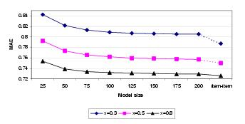
Scalability Challenges – cont.
Sensitivity of model size on selected train/test ratio.

Slide 35
Scalability Challenges – cont.
MAE values get better as we increase the model size but gradually slows down
For train/test ratio of 0.8 we are within 96% - 98.3% item-item scheme’s accuracy using only 1.9% - 3% of items.
High accuracy can be achieved by using a fraction of items – precomputing the item similarity is useful.
Notes:
MAE values get better as we increase the model size but gradually slows down.
for train/test ratio of 0.8 we are within 96% - 98.3% item-item scheme’s accuracy using only 1.9% - 3% of items.
High accuracy can be achieved by using a fraction of items – precomputing the item similarity is useful.

Slide 36
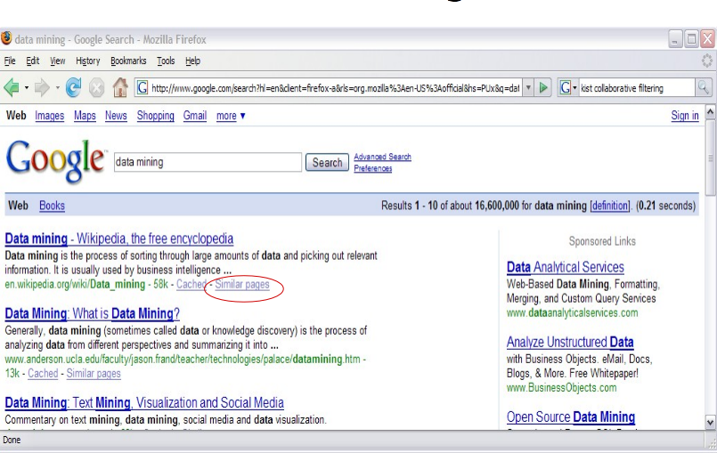
Collaborative Filtering in our life

Slide 37

Collaborative Filtering in our life

Slide 38
Conclusions
item-item CF provides better quality of predictions than the user-user CF
Improvement is consistent over different neighborhood sizes and train/test ratio.
Improvement is not significantly large
Item neighborhood is fairly static which improves online performance.
Two most important challenges of recommender systems – quality of prediction & High performance

Slide 39
References
Goldberg D, Nichols D, Oki B M, et al. Using collaborative filtering to weave an information tapestry[J]. Communications of the ACM, 1992, 35(12): 61-70.
Aggarwal C C, Wolf J L, Wu K L, et al. Horting hatches an egg: A new graph-theoretic approach to collaborative filtering[C]//Proceedings of the fifth ACM SIGKDD international conference on Knowledge discovery and data mining. ACM, 1999: 201-212.
Billsus D, Pazzani M J. Learning Collaborative Information Filters[C]//Icml. 1998, 98: 46-54.
Resnick P, Iacovou N, Suchak M, et al. GroupLens: an open architecture for collaborative filtering of netnews[C]//Proceedings of the 1994 ACM conference on Computer supported cooperative work. ACM, 1994: 175-186.
Good N, Schafer J B, Konstan J A, et al. Combining collaborative filtering with personal agents for better recommendations[C]//AAAI/IAAI. 1999: 439-446.
Konstan J A, Miller B N, Maltz D, et al. GroupLens: applying collaborative filtering to Usenet news[J]. Communications of the ACM, 1997, 40(3): 77-87.
Schafer J B, Konstan J, Riedl J. Recommender systems in e-commerce[C]//Proceedings of the 1st ACM conference on Electronic commerce. ACM, 1999: 158-166.
Ungar L H, Foster D P. Clustering methods for collaborative filtering[C]//AAAI workshop on recommendation systems. 1998, 1: 114-129.
Sarwar B M, Konstan J A, Borchers A, et al. Using filtering agents to improve prediction quality in the grouplens research collaborative filtering system[C]//Proceedings of the 1998 ACM conference on Computer supported cooperative work. ACM, 1998: 345-354.
Basu C, Hirsh H, Cohen W. Recommendation as classification: Using social and content-based information in recommendation[C]//Aaai/iaai. 1998: 714-720.
Brachman R J, Khabaza T, Kloesgen W, et al. Mining business databases[J]. Communications of the ACM, 1996, 39(11): 42-48.
Ling C X, Li C. Data mining for direct marketing: Problems and solutions[C]//KDD. 1998, 98: 73-79.
Notes:
=>
Item–based approach addresses the two most important challenges of recommender systems – quality of prediction & High performance.

Slide 40
Thank You
☺

