Slide 1
房價預測
機器學習概論第三組-
組長 : 土木三A黃柏諺
組員 : 土木三A郭歡與
電機二A邱承亞
土木二B陳靖淳
土木二B莊雅茹
機械一C陳俊瑋

Slide 2
TABLE OF CONTENTS
01
04
更正後之結果
02
05
模型與Kaggle比賽
未更正之結果
03
06
相關係數
結論
介面介紹

Slide 3
介面介紹
網頁主程式
<!DOCTYPE html>​
<html>​
<head>​
<meta charset="utf-8"/>​
<title>房價預測</title>​
</head>​
<body style="background-color: rgba(65, 241, 79, 0.459);" >​
<h1>房價預測</h1> ​
<img src="static/building.jpg" style="position: absolute;top:80px;left:300px"></img>​
<h3>房屋特色</h3>​
<form action="/submit" method="post">​
<div class="box">地上居住面積(ft^2)</div>​
<input name="GrLivArea" type="text"></input>​
<label name="GrLivArea" type="text"></label>​
<div>地下室總面積(ft^2)</div>

Slide 4
介面介紹
​
<input name="TotalBsmtSF" type="text"></input>​
<label name="TotalBsmtSF" type="text"></label>​
<div>建造年份(西元)</div>​
<input name="YearBuilt" type="text"></input>​
<label name="YearBuilt" type="text"></label>​
<div>整體房屋品質(1~10)</div>​
<input name="OverallQual" type="text"></input>​
<label name="OverallQual" type="text"></label>​
<div>車庫車位(個)</div>​
<input name="GarageCars" type="text"></input>​
<label name="GarageCars" type="text"></label>​
<div>一樓面積(ft^2)</div>​
<input name="1stFlrSF" type="text"></input>​
<label name="1stFlrSF" type="text"></label>​
<div>全套衛浴(個)</div>​
<input name="FullBath" type="text"></input>​
<label name="FullBath" type="text"></label>​
<input type="submit" value="送出">​
</form>​

Slide 5
介面介紹
​<div>預測房價:</div>
<p>${{prediction}}</p>
</body>
</html>

Slide 6
介面介紹
app=Flask(__name__)
run_with_ngrok(app)
model=joblib.load('clf.pkl') #匯入model
def get_form_to_result(form):
form=pd.DataFrame(form,index=[0]) #將data dictionary轉為dataframe
prediction=model.predict(form) #run model
return prediction
@app.route("/")
def formPage():
return render_template('House_Feature_Form.html')
@app.route('/submit',methods=['POST'])
def submit():
if request.method=='POST':
global form_dct
form_dct=request.values.to_dict() #取得使用者上傳的表單並轉換成字典形式
prediction=get_form_to_result(form_dct) #預測取得的資料
return render_template('House_Feature_Form.html',prediction=prediction)
if __name__ == "__main__":
app.run()

Slide 7

介面介紹
網頁產出圖

Slide 8
未更正預測
data = df_data[["GrLivArea","TotalBsmtSF","EnclosedPorch","HouseStyle","YearBuilt","RoofStyle","OverallQual","GarageCars","Id","1stFlrSF",​
"FullBath","LowQualFinSF","SalePrice"]]​
​
data2 = data.drop(["OverallQual" ,"GriLivArea" ]axis=1)​
​
隨機drop參數:
OverallQual
GrLivArea

Slide 9
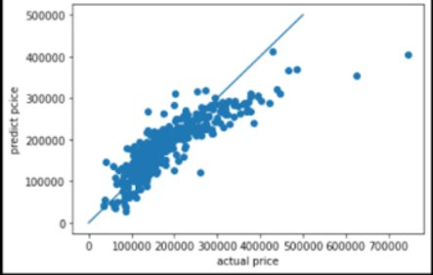
初始預測
0.6674041718609915

Slide 10
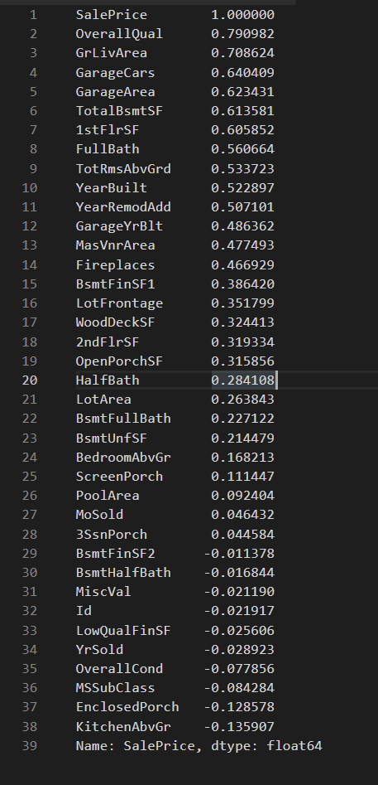
相關係數
df_data = pd.read_csv("Price.csv")
#相關係數
corr = df_data.corr()["SalePrice"]
corr[np.argsort(corr, axis=0)[::-1]]

Slide 11
熱力圖
data2.corr(method="pearson")
data2.head()
plt.figure(figsize= (13,13)) # 圖形大小
sns.heatmap(data.corr(),annot = True) # 塗顏色
plt.show() # 顯示圖形

Slide 12
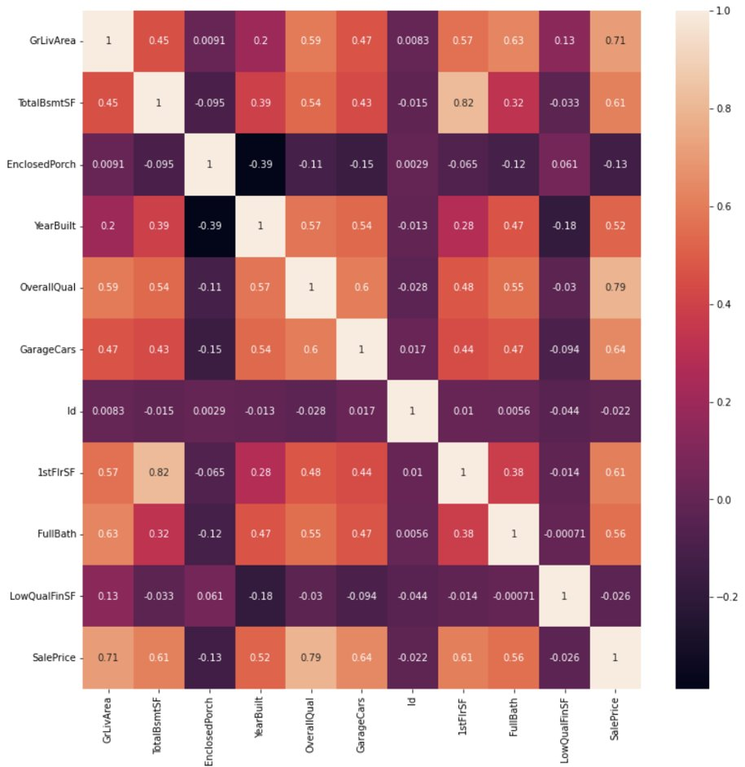

Slide 13
EnclosedPorch

Slide 14
TotalBsmtSF

Slide 16
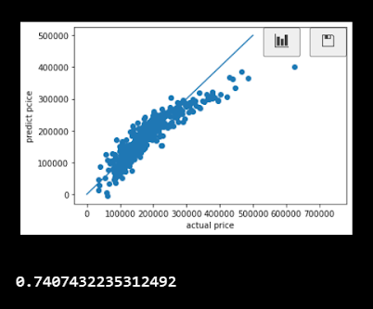
調整後數據
data=df_data[["GrLivArea","TotalBsmtSF","EnclosedPorch","HouseStyle","YearBuilt","RoofStyle","OverallQual","GarageCars","Id","1stFlrSF",
"FullBath","LowQualFinSF","SalePrice"]]
data2=data.drop(["Id","HouseStyle","RoofStyle","LowQualFinSF","EnclosedPorch"],axis=1)

Slide 17
程式說明
df_data = pd.read_csv("Price.csv")
df_data1 =pd.read_csv("Houseprise.csv")
#相關係數
corr = df.corr()["SalePrice"]
corr[np.argsort(corr, axis=0)[::-1]]
data=df_data[["GrLivArea","TotalBsmtSF","EnclosedPorch","HouseStyle","YearBuilt","RoofStyle","OverallQual","GarageCars","Id","1stFlrSF","FullBath","LowQualFinSF","SalePrice"]]
從一開始的引入資料到進行相關性分析來看哪幾筆是比較有用的資料，-1~1是最佳的，0則是最無相關性，我們這組選了其中12筆資料來進行分析。

Slide 18
程式說明
#填補缺失值
data=df_data[["GrLivArea","TotalBsmtSF","EnclosedPorch","HouseStyle","YearBuilt","RoofStyle","OverallQual","GarageCars","Id","1stFlrSF","FullBath","LowQualFinSF","SalePrice"]]
data2 = data.drop(["Id","HouseStyle","RoofStyle","LowQualFinSF","EnclosedPorch"],axis=1)
data2.corr(method="pearson")
Data=df_data1[["GrLivArea","TotalBsmtSF","EnclosedPorch","HouseStyle","YearBuilt","RoofStyle","OverallQual","GarageCars","Id","1stFlrSF","FullBath","LowQualFinSF"]]
Data.info()
#使用中位數來填補GarageCars
Data['GarageCars'].fillna(2,inplace=True)
#運用平均數填補TotalBsmtSF
Data['TotalBsmtSF'].fillna(1046,inplace=True

Slide 19
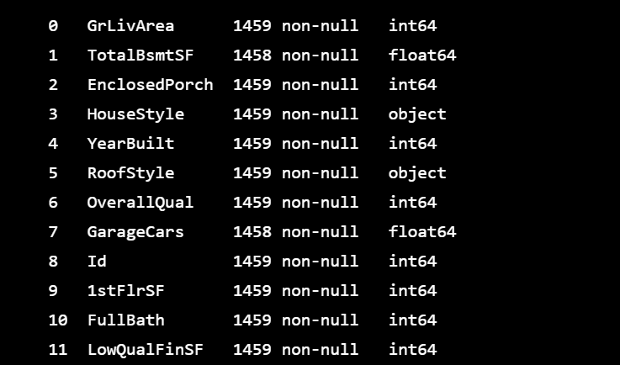

Slide 20
程式說明
from sklearn.linear_model import LinearRegression # 引入LinearRegression
from sklearn.model_selection import train_test_split # 引入train_test_split
import matplotlib.pyplot as plt # 引入pyplot
y = data2["SalePrice"] # 房價數據
data3 = data2.drop(["SalePrice"],axis=1)
x = data3
x_train, x_test, y_train, y_test = train_test_split(x, y, test_size = 0.3, random_state = 1) # 將數據分成73比
lnregr = LinearRegression()
lnregr.fit(x_train, y_train) # 將資料拿去訓練
y_predict = lnregr.predict(x_test) # 北test的資料用訓練出來的模型去預測
plt.xlabel("actual price") # x軸的標題
plt.ylabel("predict pcice") # y軸的標題
plt.plot([0,500000], [0,500000]) # 劃一條基準線
plt.scatter(y_test, y_predict) # 比對預測跟實際的差別
plt.show() # 察看結果
lnregr.score(x_train, y_train)

Slide 21
程式說明
import joblib
joblib.dump(lnregr, 'clf.pkl')
#读取Model
clf3 = joblib.load('clf.pkl')
x_test.head()
#测试读取后的Model
Data2[0:1]
print(clf3.predict(Data2[0:1459]))
Price = {"ID":Data["Id"],
"PredictPrice": clf3.predict(Data2[0:1459])}
PriceResult = pd.DataFrame(Price)
PriceResult.to_csv("midterm.csv", index=False)

Slide 22
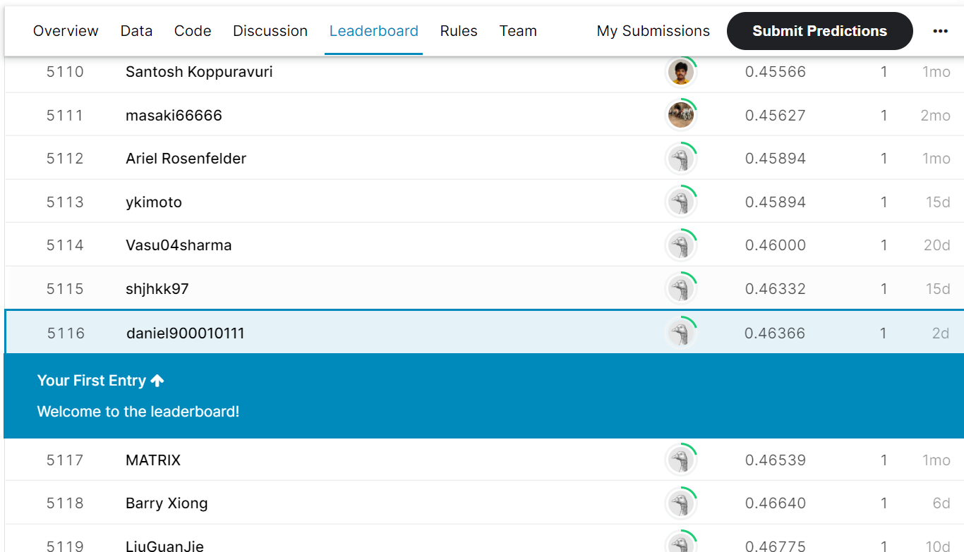

Slide 23
OUR TEAM
 | 黃柏諺 | 郭歡與 | 陳靖淳 | 陳俊瑋 | 莊雅茹 | 邱承亞
負責工作 | 程式撰寫、簡報製作、 Kaggle比賽 | 程式撰寫、簡報製作、 缺失值填補 | 程式撰寫、簡報製作、 缺失值填補 | 程式撰寫、簡報製作、 相關係數圖表 | 介面架設、簡報製作、網頁參數設置 | 介面架設、簡報製作、網頁參數設置

Slide 24
謝謝大家~
Q&A

