Slide 1
SQL Server
Chapter 7
BASIC Functions & Procedures
If else, Case, While

Slide 2
There are 3 types of blocks:
Anonymous unnamed block, can save as .sql file, kind of like an sql script (more detail slides entitled “Ch07-functions-procedures)
Stored Function
Stored Procedure

Slide 3
The idea behind block, sql functions, parameters and procedures is:
---- You can call them directly from C#, Php, Java, sql and other languages
----- send in parameter values and have function procedure return value(s) and tables

Slide 4
functions and procedures

Slide 5
Procedure VS Function
Procedure can return zero or n values
  function can return one value/table which is mandatory.
Procedures can have input and output parameters,
  functions can have only input parameters.

Slide 6
Procedure VS Function
procedures cannot be called from function.
  Functions can be called from procedure whereas
Exception can be handled by try-catch block in a procedure
  try-catch block cannot be used in a function.

Slide 7
Creating Functions, they can return a scalar value or a table

Slide 8
Function (scalar) Format
CREATE FUNCTION function-name
(parameters)
RETURNS datatype
BEGIN sql code return
END;
Let’s take a look at an example, the example is to print the age of an agent

Slide 9
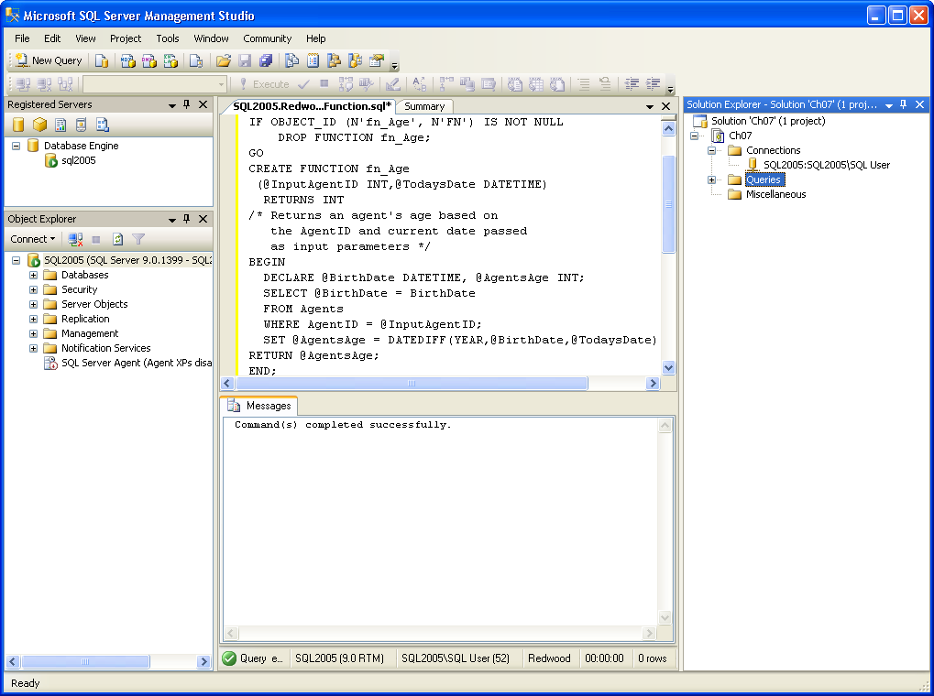
scalar function
Compute the agents age
FunctionName
Parameters
Return type
BirthDate one of the column names in the Agent table
Return value is the agents age

Slide 10
How do you call the function once you have created it ??? Next slide
Select functionname(parameters) … make sure to use dbo.functionname
dbo – database owner

Slide 11
You can call the function with …. select dbo.fn_age(10041,’10/11/2025’); or select dbo.fn_age(10041,GetDate());
Select functionname(parameters) … make sure to use dbo.functionname
FunctionCall Parameters

Slide 12
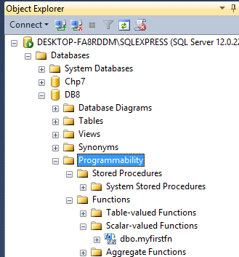

Slide 13
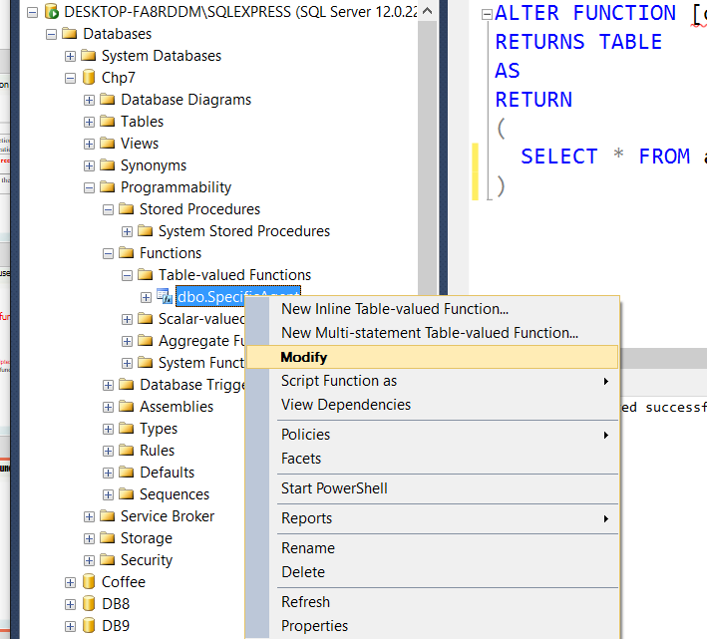
How do I Modify the function ?

Slide 14
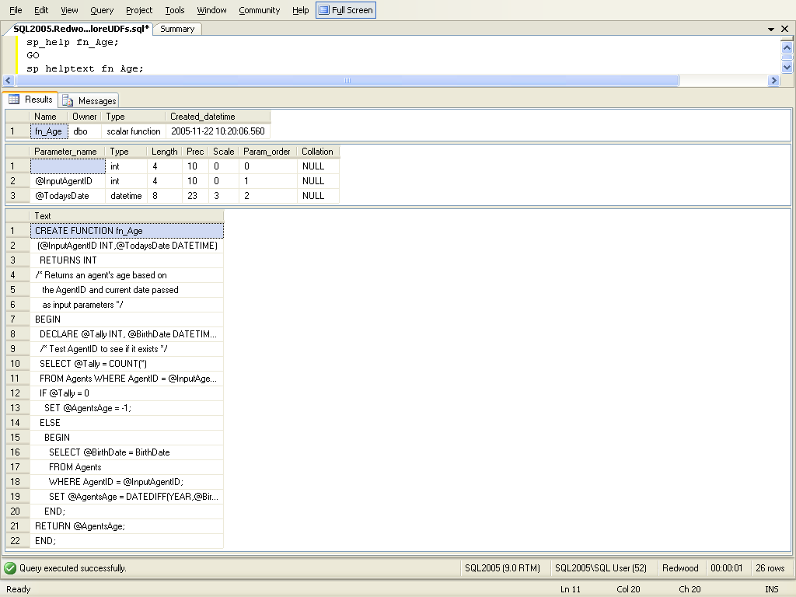
Displaying detailed information about a user-defined function
Type this in a new query window
sp_helptext function_name
produced by
sp_helptext fn_Age displays the function code

Slide 15
Now you try to create a function by following these steps,
YOU CAN ALSO USE NEW QUERY IF YOU KNOW THE FORMAT OF A FUNCTION/PROCEDURE ALREADY

Slide 16
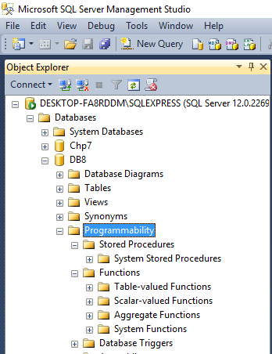
0bject explorer GUI
-- Go to object explorer (GUI left hand side)
-- Go to programmability – under the DB you want to create a function for, steps next slide
Procedures Functions

Slide 17
Under Programmability - Right click under Function – Scalar Valued
CREATE FUNCTION <FunctionName>
(
-- Add the parameters for the function here
<@Param1Name> <Param1Name-datatype>, …
)
RETURNS <datatype or table>
AS
BEGIN
-- Declare the return variable here
DECLARE <@ResultVar, sysname, @Result> <Function_Data_Type, ,int>
-- Add the T-SQL statements to compute the return value here
SELECT <@ResultVar, sysname, @Result> = <@Param1, sysname, @p1>
-- Return the result of the function
RETURN <@ResultVar>
END

Slide 18
Steps to create and execute a function, follow the steps and give it a try
Go to object explorer (GUI left hand side) or use new query
Go to programmability – under the DB you want to create a function for
Go to functions
Right click, pick new (scalar-valued, table-valued)
Write the function code
create function myfirstfn ( )
returns int
begin
declare @retvalue int;
select @retvalue=sum(bedrooms) from properties;
return @retvalue
end
Click Parse
Click !Execute ---- this will create the function
Click in Object Explorer to see the function you just created
To run it – open new query
example:
Declare @x int;
Set @x = dbo.myfirstfn();
print @x;
10. Then !Execute the query
I want you to create a fn and execute it, problem next page
Returns the sum of all the values in the bedrooms column

Slide 19
Now you create a function where the input is the agent’s first and last name and the output is the agent’s Title. Once you create the function test it, I picked Bruce Voss.
Answer next slide

Slide 20
Function Code:
  CREATE FUNCTION agentsTitle
  ( @fn nvarchar(30), @ln nvarchar(30) )
  RETURNS nvarchar(30)
  AS
  BEGIN
  DECLARE @agentTitle nvarchar(20)
  select @agentTitle=Title from agents where FirstName = @fn and lastname = @ln
  RETURN @agentTitle
  END
Test query:
  declare @titlereturned nvarchar(20);
  set @titlereturned = dbo.agentsTitle('Bruce','Voss');
  print @titlereturned;

Slide 21
Can only do this next problem if you know Join command. Now you create a function where the input is the agent’s first and last name and the output is the agent’s base salary. Once you create the function test it, I picked Bruce Voss.
Let’s take a quick look at a join (it will help with your projects) Answer next slide

Slide 22
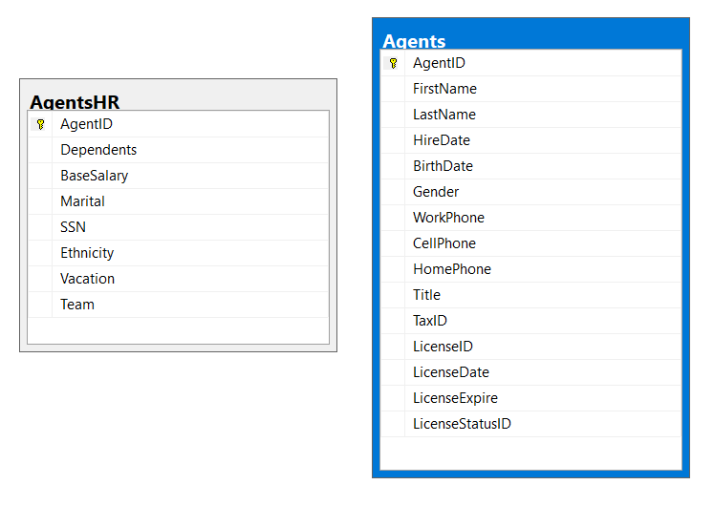
Join two tables in order to get the answer you want
select basesalary from agents join agentshr on agents.AgentID = AgentsHR.AgentID where FirstName = ‘Bruce’ and lastname = ‘Voss’
What you are saying is … I want to join these 2 tables together because I only know the agents first and last name but I want to know his base salary, the only way to get that is to join the tables together. NOW TRY TO CREATE THE FUNCTION

Slide 23
CREATE FUNCTION agentsSalary
( @fn nvarchar(30), @ln nvarchar(30) )
RETURNS int
AS
BEGIN
DECLARE @agentSalary int
select @agentSalary=basesalary from agents join agentshr on agents.AgentID = AgentsHR.AgentID where FirstName = @fn and lastname = @ln
RETURN @agentSalary
END
Commands to call function next slide

Slide 24
declare @salaryreturned int;
set @salaryreturned = dbo.agentsSalary('Bruce','Voss');
print @salaryreturned;

Slide 25
Creating a function that returns a table

Slide 26
Creating a function that returns a table … for example return a table that only contains the agents from a specific team (input parameter). Team numbers range from 10-15
Example next slide

Slide 27
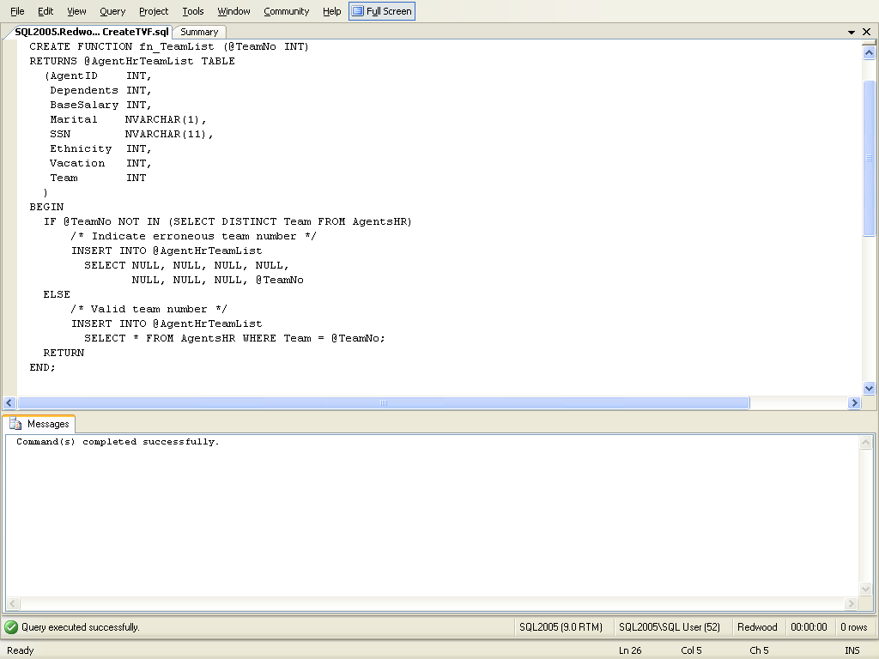
Functions can return a single table
table columns returned by the table-valued function, in the code you can use sql command insert into @AgentHrTeamList
.
.
.
Return
END
Code next slide

Slide 28
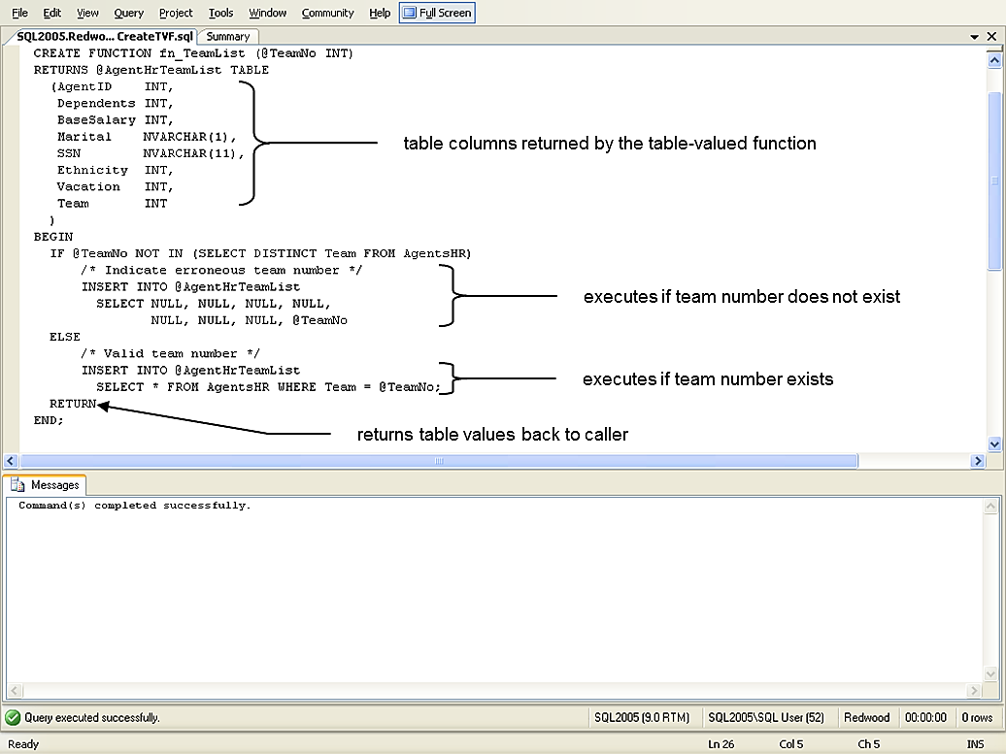
Code inside of begin-end block
Input parameter
If team does not exist
If team does exist

Slide 29
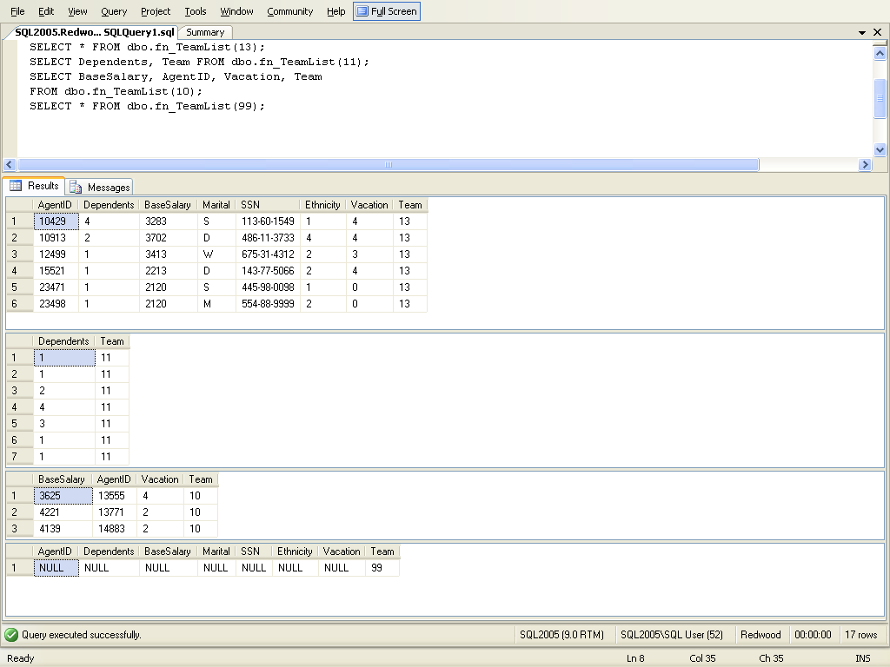
Different ways to call the function
invalid team number (99) causes null row with team number shown in result

Slide 30
I could also just put the word table
CREATE FUNCTION SpecificTeam(@Team int)
RETURNS TABLE
AS
RETURN
(
SELECT * FROM agentshr WHERE Team = @Team
);
To run the function
select * from SpecificTeam(10)

Slide 31
Now you create a function that returns a table
Create a function called listingOver that returns a table containing the: listing ID, listing agent’s ID and the asking price for listings that are over the input parameter value put the results in ascending order by price, put the results in a table called listingsoverAmount
Solution next slide

Slide 32
Function Code:
CREATE FUNCTION listingOver (@asking money)
RETURNS @listingOverAmount TABLE
(
listingid int,
listingagentid int,
askingprice money
)
begin
insert into @listingOverAmount select listingid, listingagentid, askingprice from listings where askingprice > @asking order by askingprice
return
end;
Create the table code:
create table ListingOverAmount
(
listingid int,
listingagentid int,
askingprice money
)
Call the function and return the table code:
insert into ListingOverAmount select * from dbo.ListingOver(150000)

Slide 33
Procedures
It is pretty much the same thing, just more flexible

Slide 34
Procedures
CREATE PROCEDURES procedure-name
(parameters)
AS
BEGIN sql code return
END;
Example: @firstname varchar(30), @lastname varchar(30) output

Slide 35
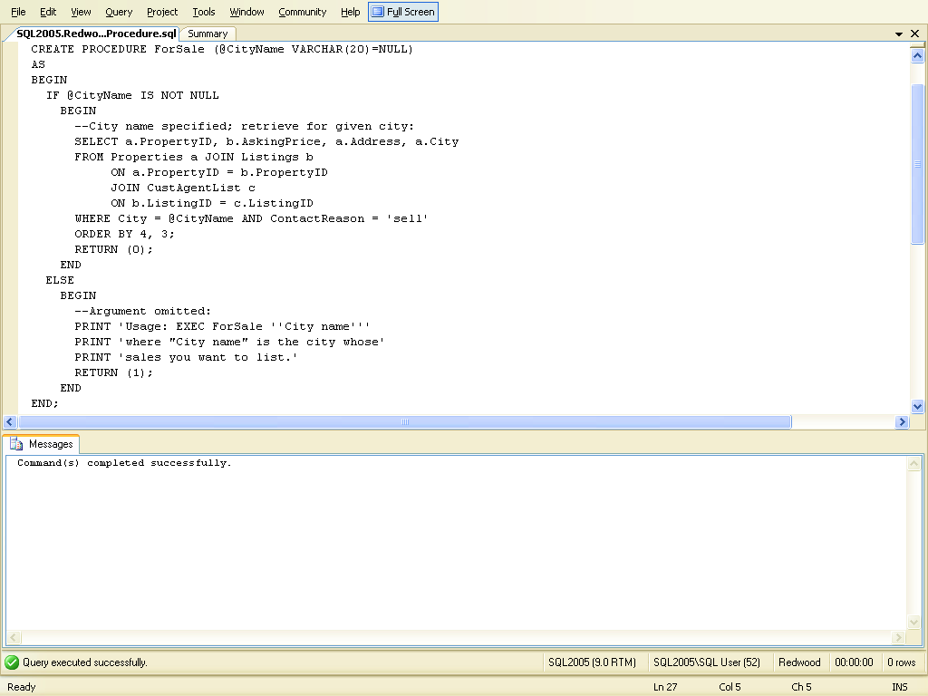
List of properties for sale in a given city and return 0 if city is null.
Note: the default value is used if no other value has been specified
ProcName Parameters
this code is executed if the procedure is called with a city name
this code is executed if the procedure is called without specifying a city name

Slide 36
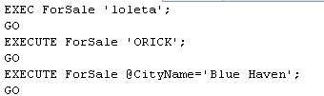
Executing a procedure

Slide 37
Steps to create and execute a procedure, you can also use new query

Slide 39
Steps to create and execute a procedure
Go to object explorer, it is the GUI on the left hand side
Go to programmability under the Database name that you want to create the procedure for, pick stored procedure, stored procedure or Just use New Query
Write the procedure code
CREATE PROCEDURE myfirstprocedure
--- parameters if you have them
AS
BEGIN
SELECT * FROM Agents;
END
4. PARSE, !EXECUTE (you might have to refresh the object explorer to
see the procedure)
5. Right click on the stored procedure name, click on ‘execute stored
procedure’, then just click ok
or
New query exec dbo.myfirstprocedure; Execute it
Now you try to create one, you can also just use New Query to create it if
You remember the format of the procedure

Slide 40
Using Parameters
CREATE PROCEDURE <Procedure_Name>
-- Add the parameters for the stored procedure here
(
<@Param1in DataType, @Param2in DataType, …. @Param1out
Datatype output, …>
)
AS
BEGIN
-- SET NOCOUNT ON added to prevent extra result sets from
-- interfering with SELECT statements.
SET NOCOUNT ON;
-- Insert statements for procedure here
-- return;
END

Slide 41
Here is an example with input and output parameters
The following procedure shows a procedure where the Input is a agents first name and the output from the procedure is the agents last name, answer next slide

Slide 42
SET ANSI_NULLS ON
SET QUOTED_IDENTIFIER ON
Follow SQL-92 standard
Causes SQL Server to follow the ISO rules regarding quotation mark delimiting identifiers and literal strings, identifiers can be delimited by double quotation marks, and literals must be delimited by single quotation marks

Slide 43
SET ANSI_NULLS ON
GO
SET QUOTED_IDENTIFIER ON
GO
Create Procedure myfirst (@agent nvarchar(30), @lastname nvarchar(30) output)
AS
begin
set @lastname = (Select lastname from Agents where FirstName = @agent)
--return;
end
GO
the Input is a agents first name and the Output from the procedure is the agents last name
How to run it next slide

Slide 44
declare @lastname1 as nvarchar(30);
exec myfirst 'nancy', @lastname = @lastname1 output;
print @lastname1
Output (@lastname is the output variable from the function and you are setting that equal @lastname1
input

Slide 45
You Try another one
Input AgentID (from AgentsHR table)
output: agent’s marital value, number of dependents and base salary
You can use agent id 10235 to test it
Answer next slide

Slide 46
CREATE PROCEDURE threeoutputs
-- Add the parameters for the stored procedure here
(@AgentID int, @M nvarchar(1) output, @D nvarchar(1) output, @S int output )
AS
BEGIN
-- SET NOCOUNT ON added to prevent extra result sets from
-- interfering with SELECT statements.
SET NOCOUNT ON;
select @M = Marital, @D=Dependents, @S= BaseSalary from AgentsHR where agentid = @AgentID
END
Calling the procedure:
declare @M1 as nvarchar(1);
declare @D1 as nvarchar(1);
declare @S1 as int;
exec threeoutputs 10235, @M = @M1 output, @D = @D1 output, @S = @S1 output;
print @M1
print @D1
print @S1

Slide 47
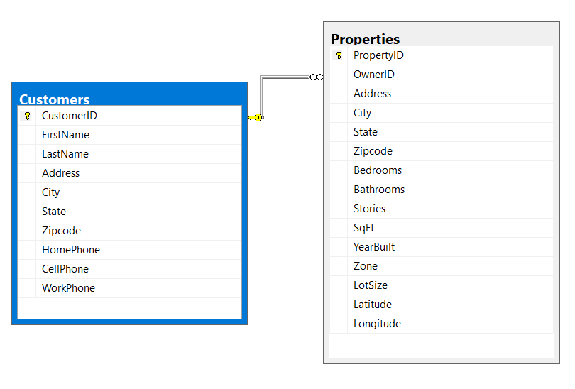
Need to know how to do joins to do the next example
The only thing you know is the customerid which is 31941, you want to know the customer’s firstname, lastname and the property id
select firstname, lastname, propertyid from customers join properties on customers.customerid = properties.ownerid where customerid = 31941

Slide 48
You try this one
Input customerid, output customers first name, lastname, propertyid
You can use customer id 31941 to test it
Answer next slide

Slide 49
CREATE PROCEDURE threeoutputs
-- Add the parameters for the stored procedure here
(@CustomerID int, @FirstName nvarchar(30) output, @LastName nvarchar(30) output, @propertyid int output )
AS
BEGIN
-- SET NOCOUNT ON added to prevent extra result sets from
-- interfering with SELECT statements.
SET NOCOUNT ON;
select @FirstName = firstname, @LastName=lastname, @propertyid=propertyid from customers join properties on customers.customerid = properties.ownerid where customerid = @CustomerID
END
GO
How to run procedure next slide

Slide 50
declare @lastname1 as nvarchar(30);
declare @firstname1 as nvarchar(30);
declare @propertyid1 as int;
exec threeoutputs 31941, @firstname = @firstname1 output, @lastname = @lastname1 output, @propertyid = @propertyid1 output;
print @firstname1
print @lastname1
print @propertyid1
Tony
Ly
191

Slide 51
Sql Server and other Programming Languages

Slide 52
sqlcommand mycommand = new sqlcomand(“[dbo].[usp_abc]”, connectionstring); mycommand.ComandType=Commondtype.storedprocedure; mycommand.parameters.add(“@chosenIncident”,sqldbytpe.int).value = x; connectionstring.open() mydatareader = mycomand.executereader(); while (mydatareader.read())
{
}
Functions and procedures are mostly used to interface with programming languages like: c#, asp.net, java, Php, embedded in sql commands, etc
Command type stored procedure
Procedure name
parameters
Execute the procedure
Read the results of the procedure call a row at a time

Slide 53
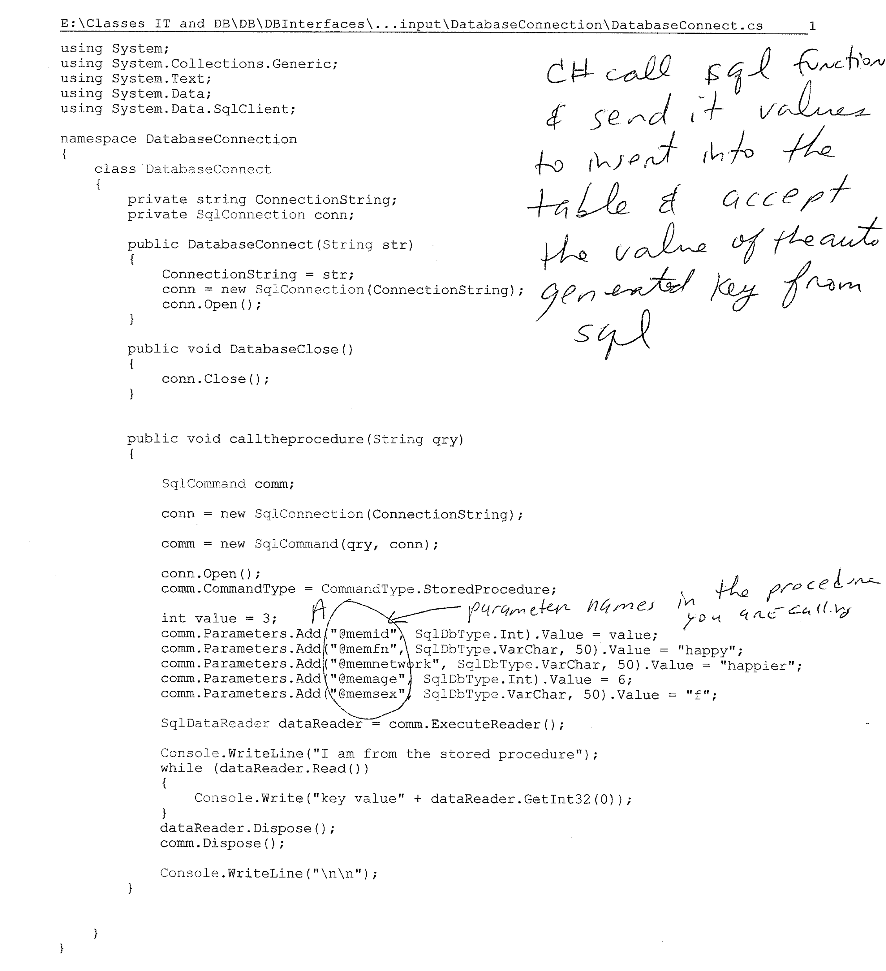

Send the values from C# to the sql procedure
Get values back from sql procedure

Slide 54
If time try to have a programming language ask sql server to select * from agents
https://www.youtube.com/watch?v=EiUSK5-sv4Q
If time try to have a programming language ask sql server to run a procedure or function
create mysql database, tables and insert data using php functions
https://www.youtube.com/watch?v=5QHBj4brHNM
http://stackoverflow.com/questions/14631988/trying-to-install-mssql-drivers-with-easyphp-12

Slide 55
General Problem: you cannot use join command
You only have the listingID but you need to find the first name, last name and working phone number of the agent listing the property
Use a function (that is called by a procedure) that you sent the listingID to and let that function return the listingagentID
The procedure that called the function above uses the listingagentID to get the info from the agents table and displays the requested info (last name, first name, work phone number)
I sent the procedure listingID 14998 (input parameter to the procedure) and the procedure returned David Gagnon (707) 555-8668
Answer following slides

Slide 56
CREATE FUNCTION getAgentID
(
@listingID int
)
RETURNS int
BEGIN
declare @agentID int;
select @agentID=ListingagentID from Listings
where ListingID = @listingID
RETURN @agentID
END

Slide 57
USE [Chp7]
GO
SET ANSI_NULLS ON
GO
SET QUOTED_IDENTIFIER ON
GO
ALTER PROCEDURE [dbo].[getAgentInfo]
(@listingID int, @firstname nvarchar(30) output, @lastname nvarchar(30) output, @workphone nvarchar(20) output)
AS
BEGIN
SET NOCOUNT ON;
declare @agentid nvarchar(30);
set @agentID = dbo.getAgentID(@listingID);
select @firstname = firstname, @lastname = LastName, @workphone = workphone from Agents where agentid = @AgentID
END

Slide 58
declare @FN as nvarchar(30);
declare @LN as nvarchar(30);
declare @WP as nvarchar(20);
exec getAgentInfo 14998, @FirstName = @FN output,
@Lastname = @LN output, @WorkPhone = @WP output;
print @FN
print @LN
print @WP
Output:
David
Gagnon
(707) 555-8668

Slide 59
Return to chapter 5

