Slide 1
SQL Server
Chapter 7
Blocks, Stored Functions & Procedures
If else, Case, While

Slide 2
There are 3 types of blocks:
Anonymous unnamed block, can save as .sql file, kind of like an sql script
Stored Function
Stored Procedure

Slide 3
The idea behind block, sql functions, parameters and procedures is:
---- You can call them directly from C#, Php, Java, sql and other languages
----- send in parameter values and have function procedure return value(s) and tables

Slide 4
Anonymous
-- are not stored in database, usually stored with .sql extension in a directory
-- they can have a DECLARE section and a body section

Slide 5
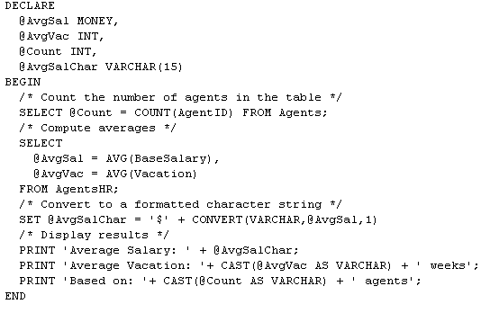
An anonymous SQL block

Slide 6
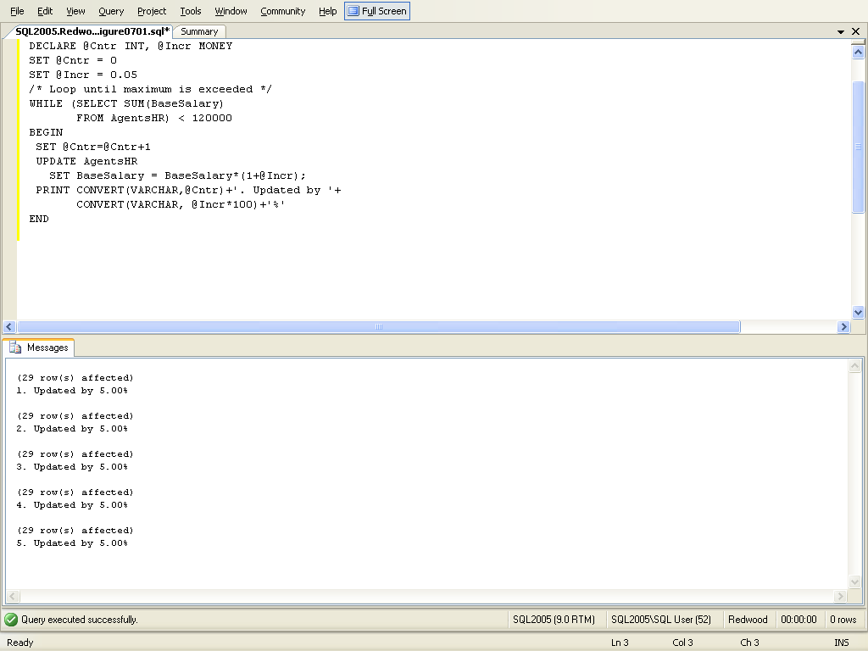
anonymous code block
declare variables
initialize variables
The code increases the base salary values of each Agent in steps of 5% until the sum of all salaries
Exceeds the year’s max 120k

Slide 7
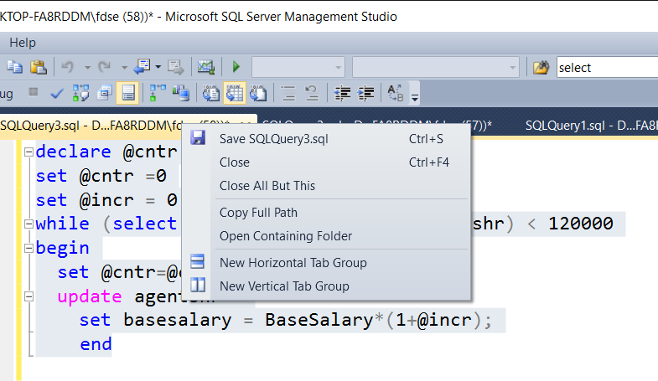
Save Anonymous block as .sql extension
Right click on query and save it (SQLQuery3.sql) or File open to get it
It puts it in “SQL Server Management Studio” directory

Slide 8
What if we want to create these script files and call them from the command window

Slide 9
Running the sql script
Lets say we just want to write a script that will list the agents table, below is the script file, I’ll just call the file sqlscript.sql
  use Chp7
  select * from agents
Now Open a command prompt window to run the sql script
Some info you need to know first:
My server name is DESKTOP-FA8RDDM\SQLEXPRESS (you see this name when you first bring up Microsoft SL server Management Studio
File location C:\Users\fdse\Documents\SQL Server Management Studio\sqlscript.sql
-S servername, -I input file, -o outputfile
sqlcmd -S servername -i scriptname.sql –o outputfilename.txt

Slide 10
Running the sql script
My server name is DESKTOP-FA8RDDM\SQLEXPRESS
File location C:\Users\fdse\Documents\SQL Server Management Studio\sqlscript.sql
sqlcmd -S servername -i scriptname.sql –o outputfilename.txt
Examples:
Sqlcmd –S DESKTOP-FA8RDDM\SQLEXPRESS –i “C:\Users\fdse\Documents\SQL Server Management Studio\sqlscript.sql”
Sqlcmd –S DESKTOP-FA8RDDM\SQLEXPRESS –i “C:\Users\fdse\Documents\SQL Server Management Studio\sqlscript.sql” –o “C:\Users\fdse\Documents\SQL Server Management Studio\agentTable.txt”
Can also add –d for name of database

Slide 11
Your try it
Create an sql script that you can run from the command prompt window
The script should do the following output list the listing ID, listing agent’s ID and the asking price for listings that are over 150000 put the results in ascending order by price, put the results in a file called listingsover150000.txt

Slide 12
listingsOver150000.sql file:
use Chp7
select listingid, listingagentid, askingprice from listings where askingprice > 150000 order by askingprice
Sqlcmd –S DESKTOP-FA8RDDM\SQLEXPRESS –i “C:\Users\fdse\Documents\SQL Server Management Studio\listingsOver150000.sql” –o “C:\Users\fdse\Documents\SQL Server Management Studio\listingsOver150000.txt”

Slide 13
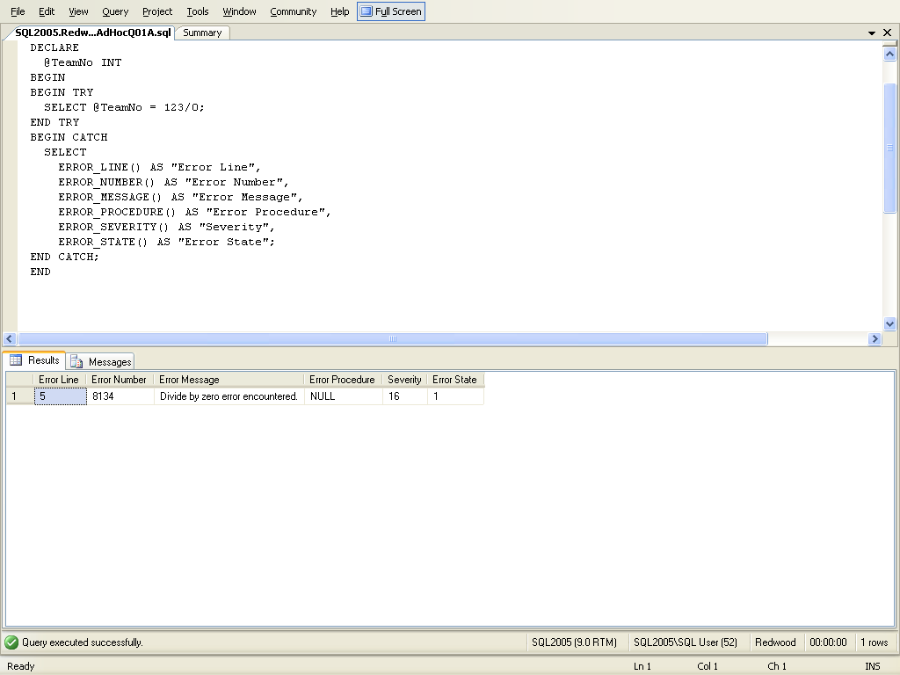
TRY...CATCH structure
a divide by zero error sends control to the top of the CATCH block
Next slide has error code meaning

Slide 14
SQL Server error functions
Error Function | Description
ERROR_LINE | Returns the line number inside the routine that caused the error.
ERROR_MESSAGE | Returns the complete error message text. Included in the text are any values supplied for any substitute parameters.
ERROR_NUMBER | Returns the error number.
ERROR_PROCEDURE | Returns the name of the stored procedure or trigger where the error occurred.
ERROR_SEVERITY | Returns the error severity. (next slide)
ERROR_STATE | Returns the error state number.

Slide 15
Severity Information
0 Messages with Level 0 are purely informational. A PRINT statement produces a message on severity level 0. These messages do not set @@error. Most query tools prints only the text part of a level 0 message.
1-9 These levels, too, are for informational messages/warnings. Query Analyzer and SQL Management Studio prints the message number, the level and the state, but not the procedure and line number for these messages.
10 This level does not really exist. It appears that SQL Server internally converts level 10 to level 0, both for its own messages when you use level 10 in RAISERROR.
11-16 These levels indicate a regular programming error of some sort. But it is not the case that level 16 is more serious than level 11.
11 – Specified Database Object Not Found
12 – Unused
13 – User Transaction Syntax Error
14 – Insufficient Permission
15 – Syntax Error in SQL Statements
16 – Miscellaneous User Error
Deadlock, for instance is level 13
17-25 Messages with any of these severity levels indicate some sort of resource problem (for instance running out of disk space), or internal error in SQL Server, or a problem with the operating system or hardware. The higher the severity, the more serious problems.
19-25 To use level 19 or higher in RAISERROR you must use the WITH LOG option, and you must have sysadmin rights.
20-25 Errors with these severity levels are so fatal, that they always terminate the connection.

Slide 16
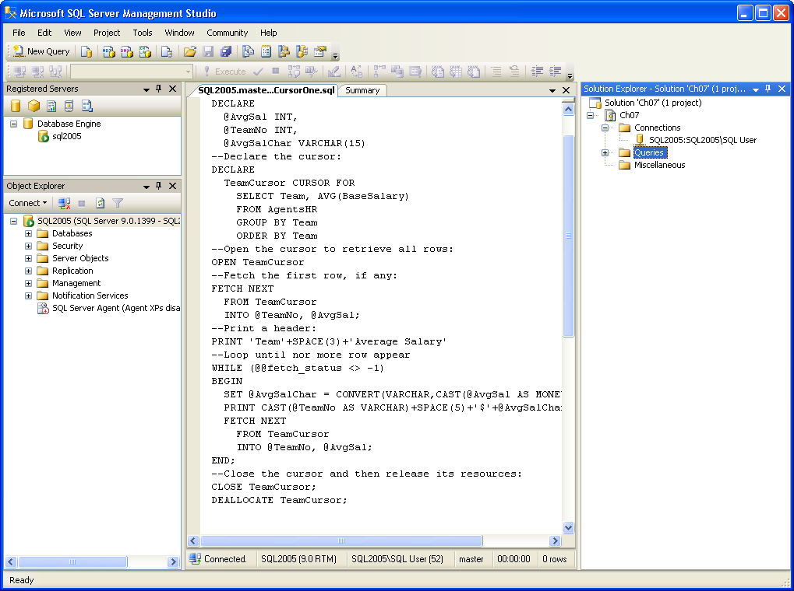
Access a row from a table, sort of like file I/O
Name of the pointer to the data
Allows you to scroll, deal with a row at a time
Rows of data TeamCursor points to
Like opening a file
Get a row of data
Get the data from what this pointer (TeamCursor) points to, put the answer into the variables
Print @TeamNo
Print @AvgSal

Slide 17
@@FETCH_STATUS - Returns the status of the last cursor FETCH statement
How do we read in multiple rows of data, answer next slide

Slide 18
DECLARE
@AvgSal INT,
@TeamNo INT,
@AvgSalChar VARCHAR(15)
DECLARE
TeamCursor CURSOR FOR
Select Team, AVG(BaseSalary)
from AGENTSHR
Group by Team
Order by Team
Open TeamCursor
Fetch Next From TeamCursor
INTO @TeamNo, @AvgSal
while (@@fetch_status <> -1)
begin
Print @TeamNo
print @AvgSal
Fetch Next From TeamCursor INTO
@TeamNo, @AvgSal
end
close TeamCursor
DEALLOCATE TeamCursor
Team (No column name)
10 4719
11 4084
12 3042
13 3841
14 4277
22 3894
55 17
While loop to retrieve each row
0 | FETCH statement was successful.
-1 | FETCH statement failed or the row was beyond the result set.

Slide 19
You try an Anonymous block, a simple one would be read a row at a time through the agent table, print the row number along with the row of data (just display some of the data in the row, agentid is good)
I picked agentid and row number, solution next side

Slide 20
DECLARE
@agentid INT,
@rownum INT
Declare AgentCursor CURSOR FOR
Select Agentid
from AGENTSHR
Open AgentCursor
Fetch Next From AgentCursor INTO @agentid
SET @rownum = 1;
Print convert(varchar(10),@agentid)+' ‘
+convert(varchar(10),@rownum)
while (@@fetch_status <> -1)
begin
Fetch Next From AgentCursor INTO @agentid
SET @rownum = @rownum+1;
Print convert(varchar(10),@agentid)+' ‘
+convert(varchar(10),@rownum)
End
close AgentCursor
DEALLOCATE AgentCursor

Slide 21
Has basic control structures: while, if else, case, try catch,

Slide 22
if else

Slide 23
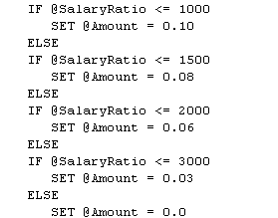
IF Else … case style

Slide 24
If with begin end
If …
BEGIN
sql_statement | statement_block
END;

Slide 25
case

Slide 26
CASE
Format:
CASE input_expression
WHEN when_expression THEN result_expression [ ...n ]
[ ELSE else_result_expression ]
END
Example ….
SELECT ProductNumber, Name, "Price Range" =
CASE
WHEN ListPrice = 0 THEN 'Mfg item - not for resale'
WHEN ListPrice < 50 THEN 'Under $50'
WHEN ListPrice >= 50 and ListPrice < 250 THEN 'Under $250'
WHEN ListPrice >= 250 and ListPrice < 1000 THEN 'Under $1000'
ELSE 'Over $1000'
END
FROM Production.Product

Slide 27
functions and procedures

Slide 28
Procedure VS Function
Procedure can return zero or n values
  function can return one value/table which is mandatory.
Procedures can have input and output parameters,
  functions can have only input parameters.

Slide 29
Procedure VS Function
procedures cannot be called from function.
  Functions can be called from procedure whereas
Exception can be handled by try-catch block in a procedure
  try-catch block cannot be used in a function.

Slide 30
Creating Functions, they can return a scalar value or a table

Slide 31
Function (scalar) Format
CREATE FUNCTION function-name
(parameters)
RETURNS datatype
BEGIN sql code return
END;
Let’s take a look at an example, the example is to print the age of an agent

Slide 32
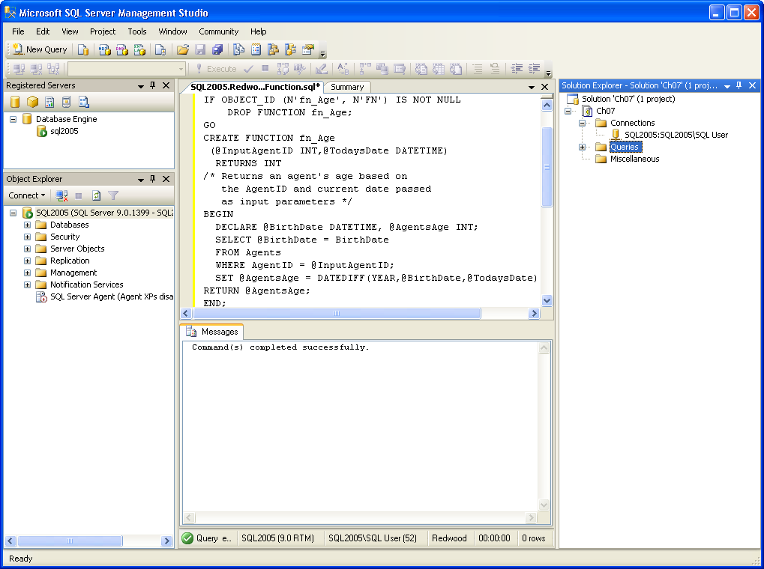
scalar function
Compute the agents age
FunctionName
Parameters
Return type
BirthDate one of the column names in the Agent table
Return value

Slide 33
How do you call the function once you have created it ??? Next slide
Select functionname(parameters) … make sure to use dbo.functionname
dbo – database owner

Slide 34
You can call the function with …. select dbo.fn_age(10041,’10/11/2025’); or select dbo.fn_age(10041,GetDate());
Select functionname(parameters) … make sure to use dbo.functionname
FunctionCall Parameters

Slide 35
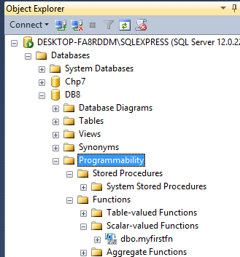

Slide 36
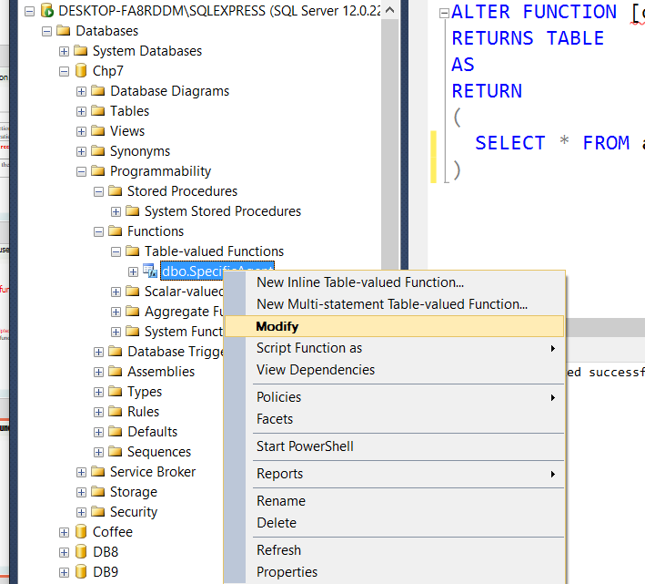
How do I Modify the function ?

Slide 37
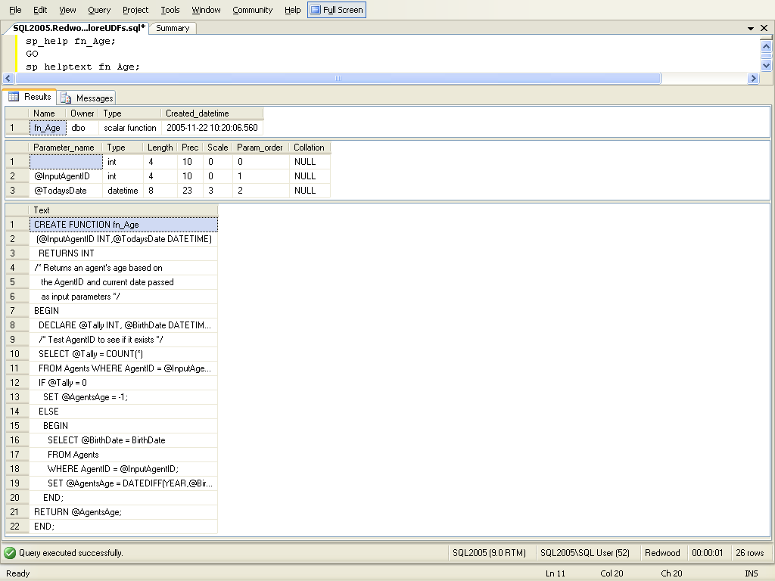
Displaying detailed information about a user-defined function
Type this in a new query window
sp_helptext function_name
produced by
sp_helptext fn_Age displays the function code

Slide 38
Now you try to create a function by following these steps,
YOU CAN ALSO USE NEW QUERY IF YOU KNOW THE FORMAT OF A FUNCTION/PROCEDURE ALREADY

Slide 39
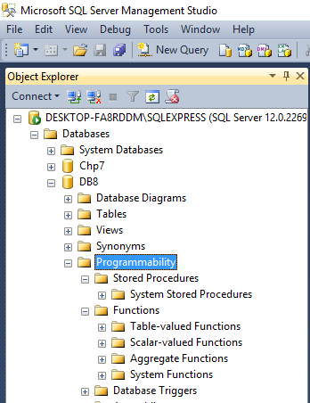
0bject explorer GUI
-- Go to object explorer (GUI left hand side)
-- Go to programmability – under the DB you want to create a function for, steps next slide
Procedures Functions

Slide 40
Under Programmability - Right click under Function – Scalar Valued
CREATE FUNCTION <FunctionName>
(
-- Add the parameters for the function here
<@Param1Name> <Param1Name-datatype>, …
)
RETURNS <datatype or table>
AS
BEGIN
-- Declare the return variable here
DECLARE <@ResultVar, sysname, @Result> <Function_Data_Type, ,int>
-- Add the T-SQL statements to compute the return value here
SELECT <@ResultVar, sysname, @Result> = <@Param1, sysname, @p1>
-- Return the result of the function
RETURN <@ResultVar>
END

Slide 41
Steps to create and execute a function
Go to object explorer (GUI left hand side) or use new query
Go to programmability – under the DB you want to create a function for
Go to functions
Right click, pick new (scalar-valued, table-valued)
Write the function code
create function myfirstfn ( )
returns int
begin
declare @retvalue int;
select @retvalue=sum(bedrooms) from properties;
return @retvalue
end
Click Parse
Click !Execute ---- this will create the function
Click in Object Explorer to see the function you just created
To run it – open new query
example:
Declare @x int;
Set @x = dbo.myfirstfn();
print @x;
10. Then !Execute the query
I want you to create a fn and execute it, problem next page
Returns the sum of all the values in the bedrooms column

Slide 42
Now you create a function where the input is the agent’s first and last name and the output is the agent’s Title. Once you create the function test it, I picked Bruce Voss.
Answer next slide

Slide 43
Function Code:
  CREATE FUNCTION agentsTitle
  ( @fn nvarchar(30), @ln nvarchar(30) )
  RETURNS nvarchar(30)
  AS
  BEGIN
  DECLARE @agentTitle nvarchar(20)
  select @agentTitle=Title from agents where FirstName = @fn and lastname = @ln
  RETURN @agentTitle
  END
Test query:
  declare @titlereturned nvarchar(20);
  set @titlereturned = dbo.agentsTitle('Bruce','Voss');
  print @titlereturned;

Slide 44
Can only do this next problem if you know Join command. Now you create a function where the input is the agent’s first and last name and the output is the agent’s base salary. Once you create the function test it, I picked Bruce Voss.
Answer next slide

Slide 45
CREATE FUNCTION agentsSalary
( @fn nvarchar(30), @ln nvarchar(30) )
RETURNS int
AS
BEGIN
DECLARE @agentSalary int
select @agentSalary=basesalary from agents join agentshr on agents.AgentID = AgentsHR.AgentID where FirstName = @fn and lastname = @ln
RETURN @agentSalary
END
Commands to call function next slide

Slide 46
declare @salaryreturned int;
set @salaryreturned = dbo.agentsSalary('Bruce','Voss');
print @salaryreturned;

Slide 47
Creating a function that returns a table

Slide 48
Creating a function that returns a table … for example return a table that only contains the agents from a specific team (input parameter). Team numbers range from 10-15
Example next slide

Slide 49
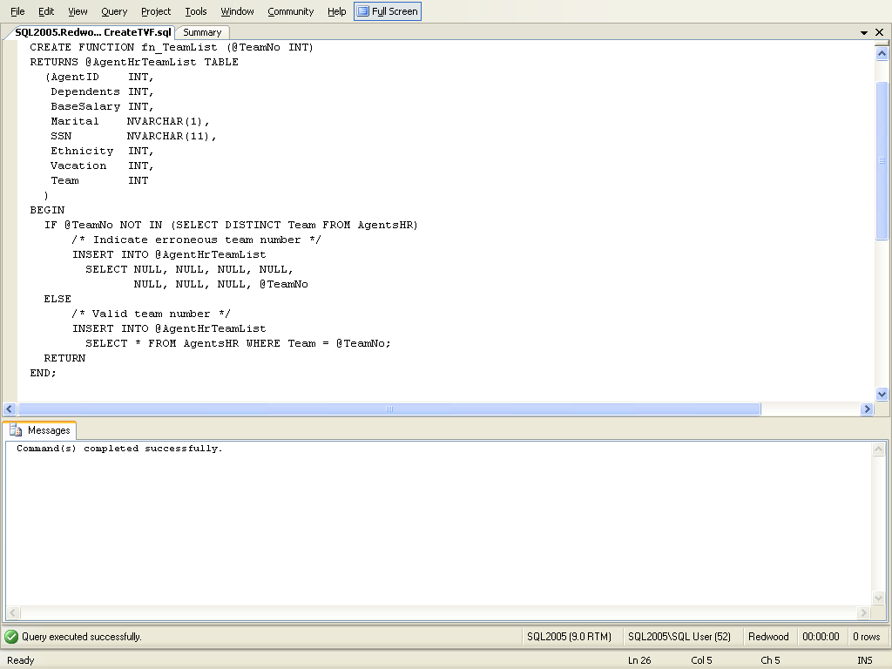
Functions can return a single table
table columns returned by the table-valued function, in the code you can use sql command insert into @AgentHrTeamList
.
.
.
Return
END
Code next slide

Slide 50
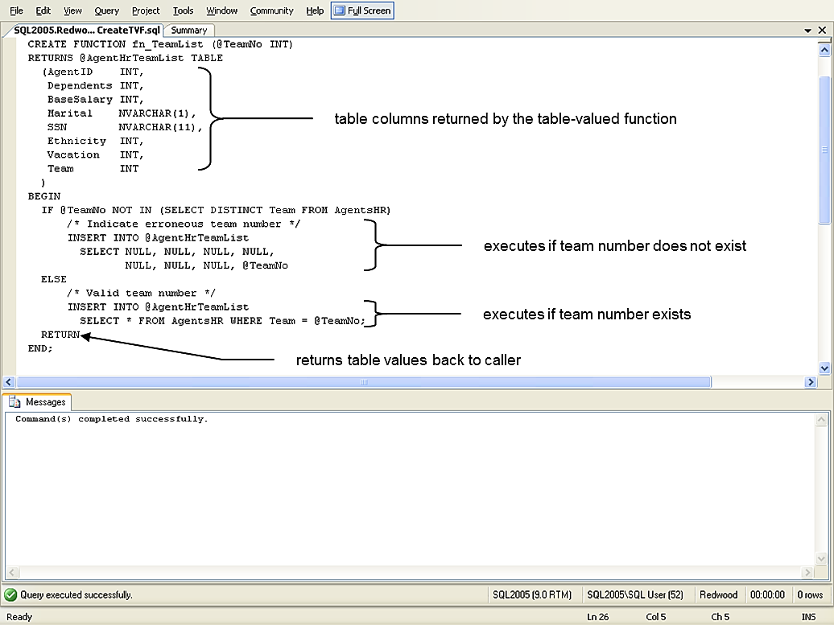
Code inside of begin-end block
Input parameter
If team does not exist
If team does exist

Slide 51
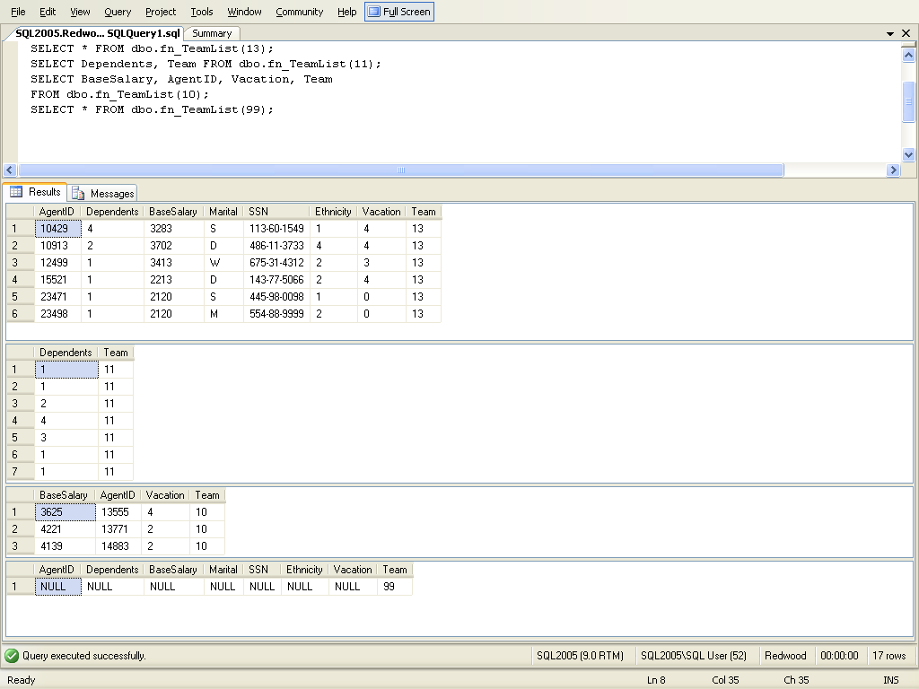
Different ways to call the function
invalid team number (99) causes null row with team number shown in result

Slide 52
I could also just put the word table
CREATE FUNCTION SpecificTeam(@Team int)
RETURNS TABLE
AS
RETURN
(
SELECT * FROM agentshr WHERE Team = @Team
);
To run the function
select * from SpecificTeam(10)

Slide 53
Now you create a function that returns a table
Create a function called listingOver that returns a table containing the: listing ID, listing agent’s ID and the asking price for listings that are over the input parameter value put the results in ascending order by price, put the results in a table called listingsoverAmount
Solution next slide

Slide 54
Function Code:
CREATE FUNCTION listingOver (@asking money)
RETURNS @listingOverAmount TABLE
(
listingid int,
listingagentid int,
askingprice money
)
begin
insert into @listingOverAmount select listingid, listingagentid, askingprice from listings where askingprice > @asking order by askingprice
return
end;
Create the table code:
create table ListingOverAmount
(
listingid int,
listingagentid int,
askingprice money
)
Call the function and return the table code:
insert into ListingOverAmount select * from dbo.ListingOver(150000)

Slide 55
Sql command to display function information
Examples next slide
Function and argument | Meaning
sp_help <function_name> | Displays the function’s owner and the function’s creation date.
sp_helptext <function_name> | Displays the source code for the function.
sp_depends <function_name> | Lists objects that the function references.

Slide 56
Procedures
It is pretty much the same thing, just more flexible

Slide 57
Procedures
CREATE PROCEDURES procedure-name
(parameters)
AS
BEGIN sql code return
END;
Example: @firstname varchar(30), @lastname varchar(30) output

Slide 58
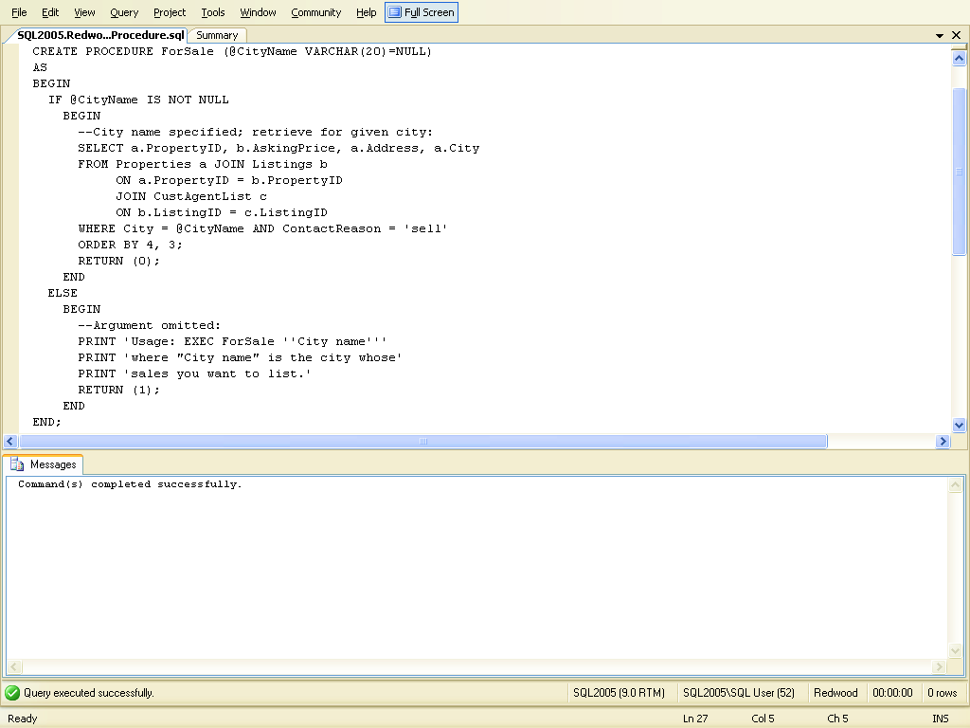
List of properties for sale in a given city and return 0 if city is null.
Note: the default value is used if no other value has been specified
ProcName Parameters
this code is executed if the procedure is called with a city name
this code is executed if the procedure is called without specifying a city name

Slide 59
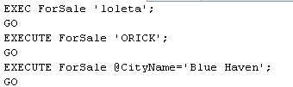
Executing a procedure

Slide 60
Steps to create and execute a procedure, you can also use new query

Slide 62
Steps to create and execute a procedure
Go to object explorer, it is the GUI on the left hand side
Go to programmability under the Database name that you want to create the procedure for, pick stored procedure, stored procedure or Just use New Query
Write the procedure code
CREATE PROCEDURE myfirstprocedure
--- parameters if you have them
AS
BEGIN
SELECT * FROM Agents;
END
4. PARSE, !EXECUTE (you might have to refresh the object explorer to
see the procedure)
5. Right click on the stored procedure name, click on ‘execute stored
procedure’, then just click ok
or
New query exec dbo.myfirstprocedure; Execute it
Now you try to create one, you can also just use New Query to create it if
You remember the format of the procedure

Slide 63
Using Parameters
CREATE PROCEDURE <Procedure_Name>
-- Add the parameters for the stored procedure here
(
<@Param1in DataType, @Param2in DataType, …. @Param1out
Datatype output, …>
)
AS
BEGIN
-- SET NOCOUNT ON added to prevent extra result sets from
-- interfering with SELECT statements.
SET NOCOUNT ON;
-- Insert statements for procedure here
-- return;
END

Slide 64
declare @lastname1 as nvarchar(30);
exec myfirst 'nancy', @lastname = @lastname1 output;
print @lastname1
Output (@lastname is the output variable from the function and you are setting that equal @lastname1
input

Slide 65
Here is one with input and output parameters
Input is a agents first name the output should be the agents last name, answer next slide

Slide 66
SET ANSI_NULLS ON
GO
SET QUOTED_IDENTIFIER ON
GO
Create Procedure myfirst (@agent nvarchar(30), @lastname nvarchar(30) output)
AS
begin
set @lastname = (Select lastname from Agents where FirstName = @agent)
--return;
end
GO
How to run it next slide

Slide 67
declare @lastname1 as nvarchar(30);
exec myfirst 'nancy', @lastname = @lastname1 output;
print @lastname1
Output (@lastname is the output variable from the function and you are setting that equal @lastname1
input

Slide 68
Try another one
Input AgentID (from AgentsHR table)
output: agent’s marital value, number of dependents and base salary
You can use agent id 10235 to test it
Answer next slide

Slide 69
CREATE PROCEDURE threeoutputs
-- Add the parameters for the stored procedure here
(@AgentID int, @M nvarchar(1) output, @D nvarchar(1) output, @S int output )
AS
BEGIN
-- SET NOCOUNT ON added to prevent extra result sets from
-- interfering with SELECT statements.
SET NOCOUNT ON;
select @M = Marital, @D=Dependents, @S= BaseSalary from AgentsHR where agentid = @AgentID
END
Calling the procedure:
declare @M1 as nvarchar(1);
declare @D1 as nvarchar(1);
declare @S1 as int;
exec threeoutputs 10235, @M = @M1 output, @D = @D1 output, @S = @S1 output;
print @M1
print @D1
print @S1

Slide 70
Need to know how to do joins to do the next example

Slide 71
You try one
Input customerid, output customers first name, lastname, propertyid
You can use customer id 31941 to test it
Answer next slide

Slide 72
CREATE PROCEDURE threeoutputs
-- Add the parameters for the stored procedure here
(@CustomerID int, @FirstName nvarchar(30) output, @LastName nvarchar(30) output, @propertyid int output )
AS
BEGIN
-- SET NOCOUNT ON added to prevent extra result sets from
-- interfering with SELECT statements.
SET NOCOUNT ON;
select @FirstName = firstname, @LastName=lastname, @propertyid=propertyid from customers join properties on customers.customerid = properties.ownerid where customerid = @CustomerID
END
GO
How to run procedure next slide

Slide 73
declare @lastname1 as nvarchar(30);
declare @firstname1 as nvarchar(30);
declare @propertyid1 as int;
exec threeoutputs 31941, @firstname = @firstname1 output, @lastname = @lastname1 output, @propertyid = @propertyid1 output;
print @firstname1
print @lastname1
print @propertyid1
Tony
Ly
191

Slide 74
What if you wanted to have a function create a table and put data in it

Slide 75
create procedure p_x
as
begin
declare @t table(col1 varchar(10), col2 float, col3 float, col4 float)
insert @t values('a', 1,1,1)
insert @t values('b', 2,2,2)
select * from @t
end
go
declare @t table(col1 varchar(10), col2 float, col3 float, col4 float)
insert @t
exec p_x
SELECT * INTO TableReturnedFromProcedure FROM @t;
select * from @t
select * from TableReturnedFromProcedure

Slide 76
Back to an old problem
Input is a agents first name the output should be the agents last name
declare @lastname1 as nvarchar(30);
exec myfirst 'nancy', @lastname = @lastname1 output;
print @lastname1
What would happen if more then one nancy ???
Msg 512, Level 16, State 1, Procedure myfirst, Line 33
Subquery returned more than 1 value.

Slide 77
What can you do in this case, try creating function, remember it can return a table, first edit the table so that you have 2 nancy’s answer next slide

Slide 78
ALTER FUNCTION [dbo].[tryit] (@agent nvarchar(30))
Returns @mytable Table (lastname nvarchar(30), firstname nvarchar(30))
AS
BEGIN
insert into @mytable Select lastname, firstname from Agents where FirstName = @agent;
RETURN
END
How to run the function next slide

Slide 79
Declare @holdanswer Table (lastname nvarchar(30), firstname nvarchar(30))
insert into @holdanswer select * from dbo.tryit('nancy');
select * from @holdanswer
Lastname firstname
Robinson Nancy
Piperova Nancy

Slide 80
Sql Server and other Programming Languages

Slide 81
sqlcommand mycommand = new sqlcomand(“[dbo].[usp_abc]”, connectionstring); mycommand.ComandType=Commondtype.storedprocedure; mycommand.parameters.add(“@chosenIncident”,sqldbytpe.int).value = x; connectionstring.open() mydatareader = mycomand.executereader(); while (mydatareader.read())
{
}
Functions and procedures are mostly used to interface with programming languages like: c#, asp.net, java, Php, embedded in sql commands, etc
Command type stored procedure
Procedure name
parameters
Execute the procedure
Read the results of the procedure call a row at a time

Slide 82
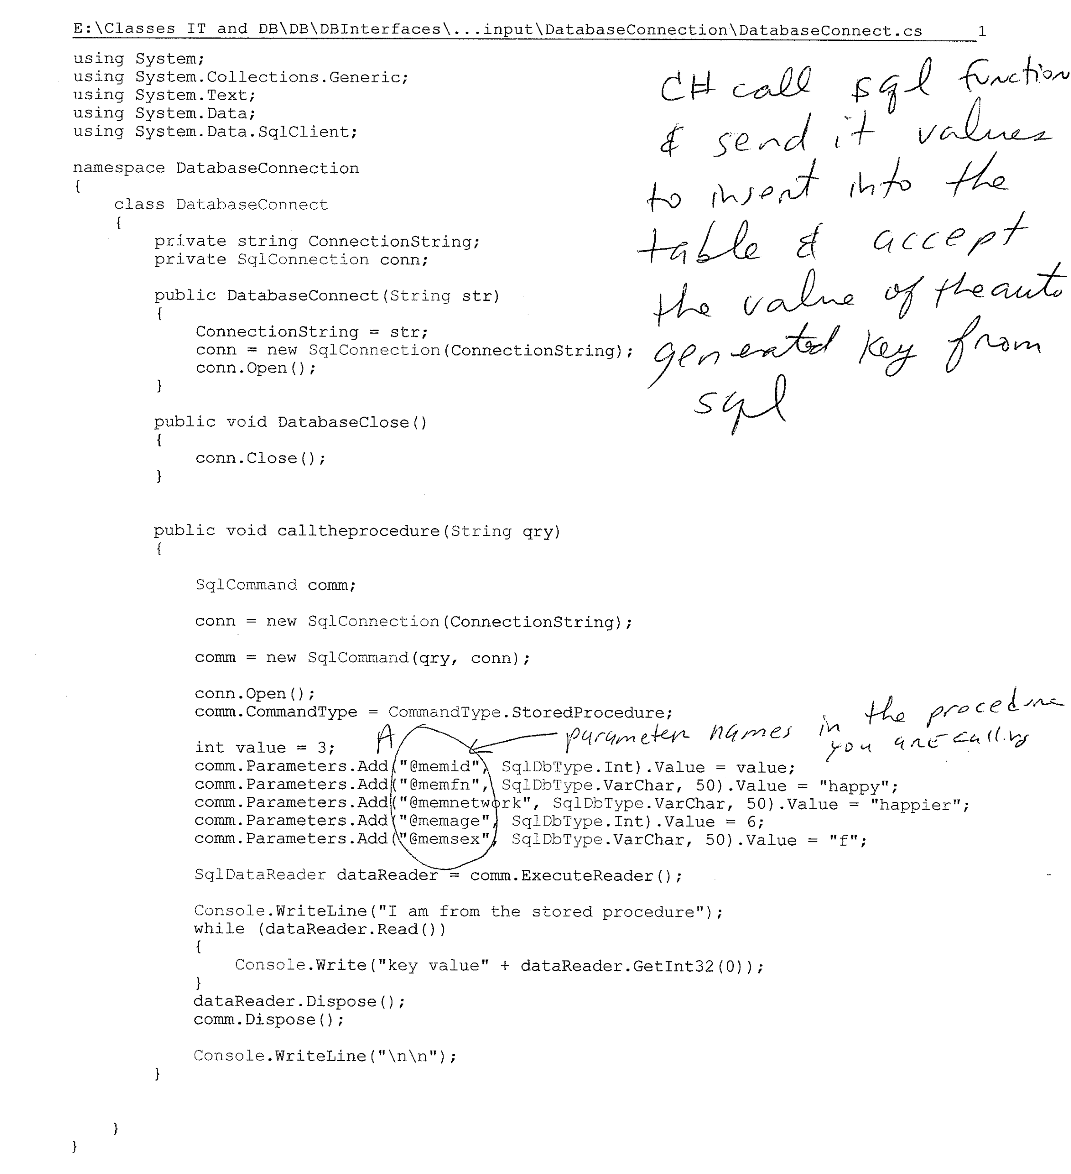

Send the values from C# to the sql procedure
Get values back from sql procedure

Slide 83
If time try to have a programming language ask sql server to select * from agents
https://www.youtube.com/watch?v=EiUSK5-sv4Q
If time try to have a programming language ask sql server to run a procedure or function
create mysql database, tables and insert data using php functions
https://www.youtube.com/watch?v=5QHBj4brHNM
http://stackoverflow.com/questions/14631988/trying-to-install-mssql-drivers-with-easyphp-12

Slide 84
General Problem: you cannot use join command
You only have the listingID but you need to find the first name, last name and working phone number of the agent listing the property
Use a function (that is called by a procedure) that you sent the listingID to and let that function return the listingagentID
The procedure that called the function above uses the listingagentID to get the info from the agents table and displays the requested info (last name, first name, work phone number)
I sent the procedure listingID 14998 (input parameter to the procedure) and the procedure returned David Gagnon (707) 555-8668
Answer following slides

Slide 85
CREATE FUNCTION getAgentID
(
@listingID int
)
RETURNS int
BEGIN
declare @agentID int;
select @agentID=ListingagentID from Listings
where ListingID = @listingID
RETURN @agentID
END

Slide 86
USE [Chp7]
GO
SET ANSI_NULLS ON
GO
SET QUOTED_IDENTIFIER ON
GO
ALTER PROCEDURE [dbo].[getAgentInfo]
(@listingID int, @firstname nvarchar(30) output, @lastname nvarchar(30) output, @workphone nvarchar(20) output)
AS
BEGIN
SET NOCOUNT ON;
declare @agentid nvarchar(30);
set @agentID = dbo.getAgentID(@listingID);
select @firstname = firstname, @lastname = LastName, @workphone = workphone from Agents where agentid = @AgentID
END

Slide 87
declare @FN as nvarchar(30);
declare @LN as nvarchar(30);
declare @WP as nvarchar(20);
exec getAgentInfo 14998, @FirstName = @FN output,
@Lastname = @LN output, @WorkPhone = @WP output;
print @FN
print @LN
print @WP
Output:
David
Gagnon
(707) 555-8668

