Slide 1
Let’s practice joins on the Coffee Database
6-<number>

Slide 2
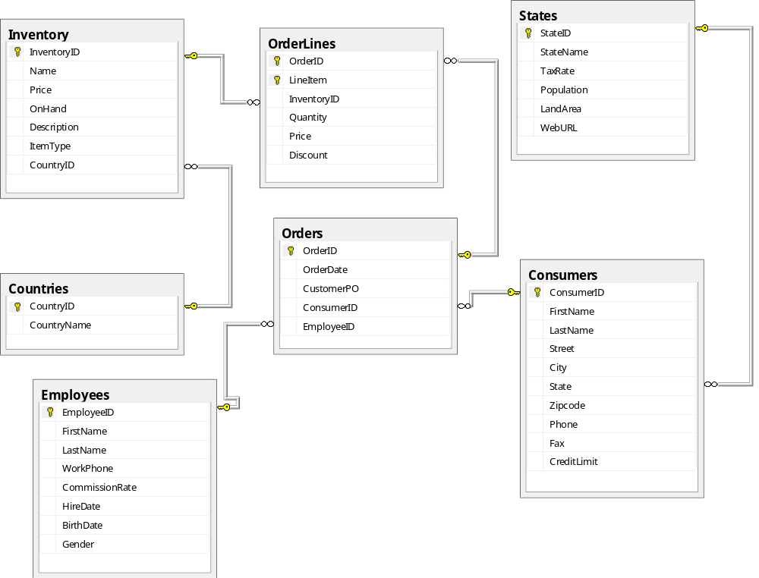
more joins lets use the Coffee DB, try these Coffee DB and loading out instructions on D2l in folder called “Loading Coffee DB into Sql Server’ and ‘Coffee Database Chapter 7
6-<number>

Slide 3
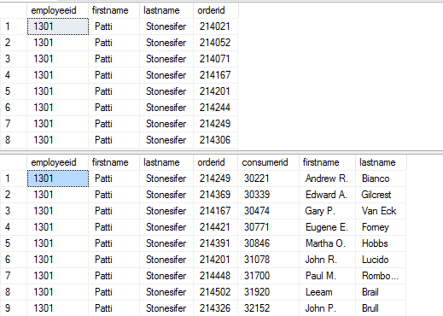
--1-- employees and the orders they are responsible for
--2-- same as above but include the name of the customer, the employee sold products to
Answer
next
slide
6-<number>

Slide 4
-- employees and the orders they are responsible for
select employees.employeeid, firstname, lastname, orderid
from employees
join orders on employees.employeeid = orders.employeeid
order by 1
-- same as above but include the name of the customer, the employee sold products to
select employees.employeeid, employees.firstname, employees.lastname, orderid, consumers.consumerid, consumers.firstname, consumers.lastname
from employees
join orders on employees.employeeid = orders.employeeid
join consumers on consumers.consumerid = orders.consumerID
order by 1
6-<number>

Slide 5
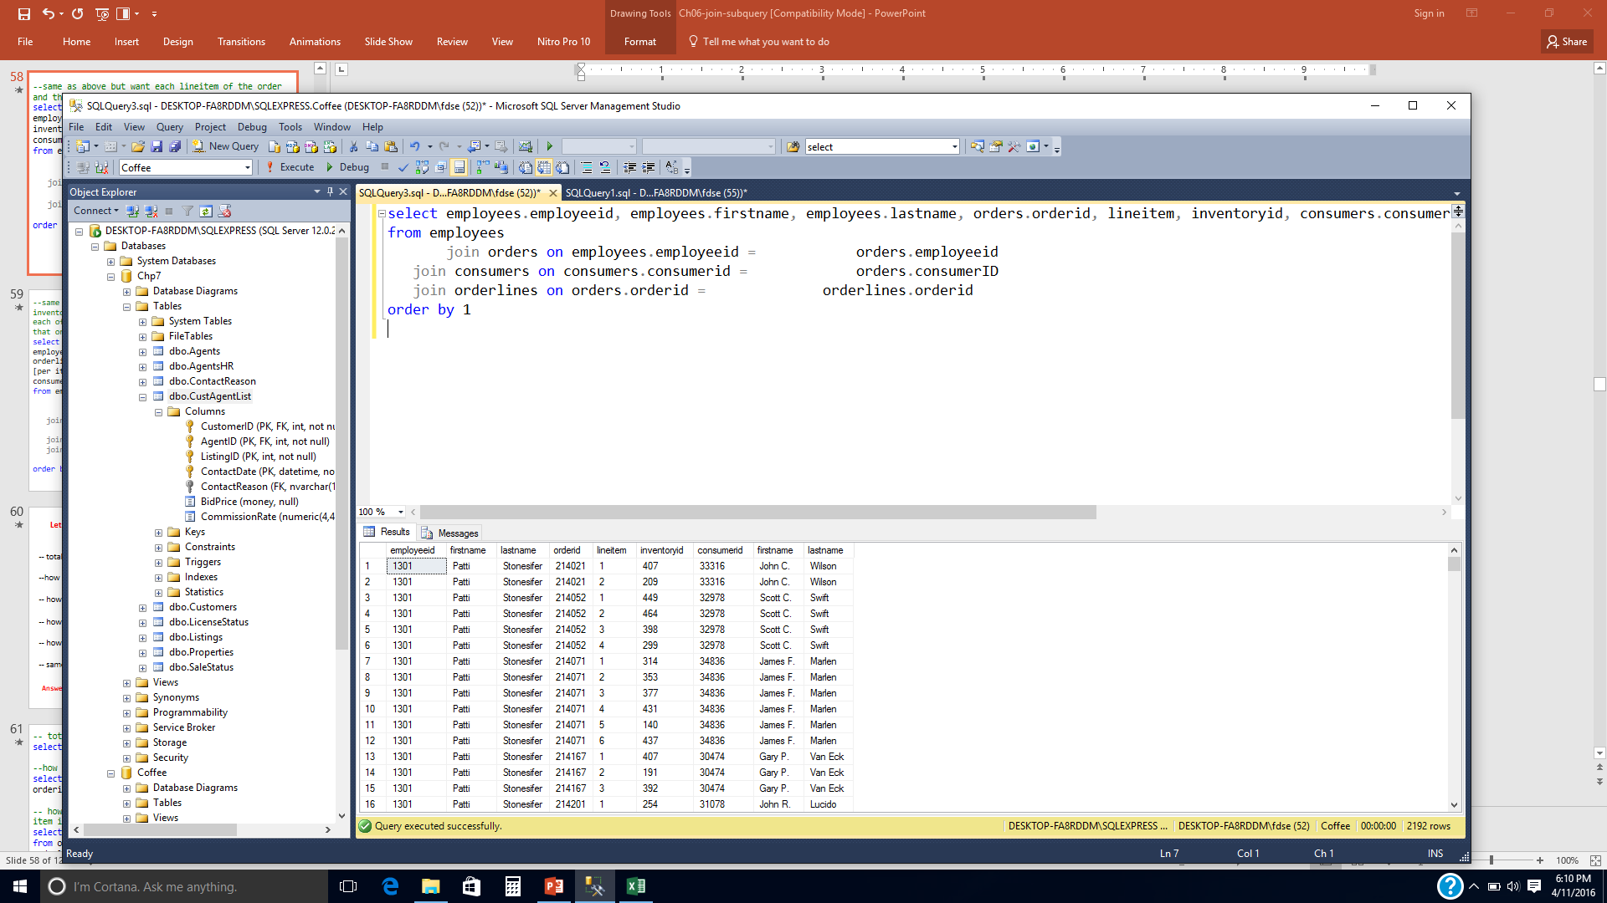
--3--same as above but want each lineitem of the order and the inventoryID for that lineitem
Answer next slide
6-<number>

Slide 6
--same as above but want each lineitem of the order and the inventoryID for that lineitem
select employees.employeeid, employees.firstname, employees.lastname, orders.orderid, lineitem, inventoryid, consumers.consumerid, consumers.firstname, consumers.lastname
from employees
join orders on employees.employeeid = orders.employeeid
join consumers on consumers.consumerid = orders.consumerID
join orderlines on orders.orderid = orderlines.orderid
order by 1
6-<number>

Slide 7
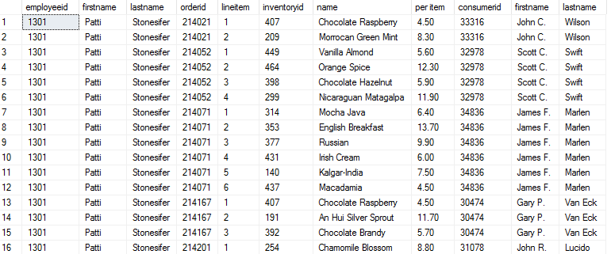
--4--same as above but want each lineitem of the order and the inventoryID for that lineitem and the name and price for each of the items in inventory that is being purchased for that order
Answer next slide
6-<number>

Slide 8
--same as above but want each lineitem of the order and the inventoryID for that lineitem and the name and price for each of the items in inventory that is being purchased for that order
select employees.employeeid, employees.firstname, employees.lastname, orders.orderid, lineitem, orderlines.inventoryid, inventory.name, inventory.price as [per item], consumers.consumerid, consumers.firstname, consumers.lastname
from employees
join orders on employees.employeeid = orders.employeeid
join consumers on consumers.consumerid = orders.consumerID
join orderlines on orders.orderid = orderlines.orderid
join inventory on inventory.inventoryid = orderlines.inventoryid
order by 1
6-<number>

Slide 9
Lets use the Coffee DB and try some old stuff that we learned
-- total num of lineitems
answer 2192
--how many different items are in each order
  (No column ) orderid
  2192 NULL
  5 214010
  5 214011
  5 214012
  6 214013
  4 214014
  6 214015
  5 214016
Answers next slide
6-<number>

Slide 10
-- total num of lineitems
select count(lineitem) from orderlines
--how many different items are in each order
select count(*), orderid from orderlines group by orderid with rollup order by orderid
6-<number>

Slide 11
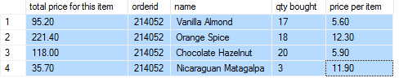
Lets use the Coffee DB and try some old stuff that we learned
-- how much was order 214052 (total cost for each item in the order)
For Now do not worry about discounts, the below is just sample output
-- how much was the total cost of order 214052
total
470.30
Answers next slide
6-<number>

Slide 12
-- how much was order 214052 (total cost for each item in the order)
select orderlines.price*orderlines.quantity as
[total price for this item], orderid,
name, quantity as [qty bought], orderlines.price
as [price per item] from orderlines join inventory on inventory.inventoryid = orderlines.inventoryid where orderid = 214052
-- how much was the total cost of order 214052
select sum(orderlines.price*orderlines.quantity) from orderlines where orderid = 214052
6-<number>

Slide 13
Lets use the Coffee DB and try some old stuff that we learned
-- how much was the total cost for each of the orders, just sample output
  (No column name) total order price
  688.70 214010
-- same as above but want the total cost for all orders, just sample output
195708.40 NULL
Answers next slide
6-<number>

Slide 14
-- who much was the total cost for each of the orders
select sum(orderlines.price*orderlines.quantity), orderid as [total order price] from orderlines group by orderlines.orderid
-- same as above but want the total cost for all orders
select sum(orderlines.price*orderlines.quantity), orderid as [total order price] from OrderLines group by orderlines.orderid with rollup
6-<number>

Slide 15
Let’s try a few more joins (left, right, full) using the Coffee DB
Your boss wants to set up training class for all of the employees that do not have any customers, he wants you to get him that list
Sample: Melinda English
write the sql command, solution next slide
6-<number>

Slide 16
select * from employees left join orders on employees.EmployeeID = orders.EmployeeID where orders.orderid IS NULL order by employees.employeeID
6-<number>

Slide 17
Let’s try another one
Your boss wants a list of all of the customers that have no employees helping them; so that he can give them to the employees with no customers.
First insert the sql command below.
insert into orders values (5678, getdate(), '7878', 33316, NULL)
Answer next slide
6-<number>

Slide 18
select * from orders left join employees on employees.EmployeeID = orders.EmployeeID where orders.employeeid IS NULL order by employees.employeeID or select * from orders where employeeID IS NULL
6-<number>

