Slide 1
XML: Import and Exporting Bulk Data in SQL Server
Nick Totero, edits DeVito

Slide 2
XML: What and Why
XML stands for EXtensible Markup Language
As is in the title, very similar to HTML
Design is primarily for storing and transporting data
Has the ability to be self descriptive about its parts
Designed to be both machine and human readable
XML does not DO anything!

Slide 3
What Does it Look Like
<note> <to>Tom</to>
<from>Nick</from>
<heading>Reminder</heading>
<body>Don’t forget to bring the stuff, I got the money</body>
</note>
Notice the similarities to HTML and the overall readability
*A key difference between the two is tags are not predefined*

Slide 4
IMPORTING XML DATA INTO AN SQL SERVER TABLE

Slide 5
Let’s look at the XML file we want to read into a table
A piece of the xml file about games
<CATALOG>
<GAME>
<ID>1</ID>
<TITLE>Rocket League</TITLE>
<DEVELOPER>Psyonix</DEVELOPER>
<RELEASEYEAR>2015</RELEASEYEAR>
<PRICE>19.99</PRICE>
</GAME>

Slide 6
Steps to read in bulk XML files into a DB table
Point to where the XML file is
Use the sql server built-in stored procedure that knows how to read/parse XML files
Extract data from the XML file and create a table to put in the data in from XML file

Slide 7
Utilizing XML with SQL
Two main uses for XML with SQL
Import – we are doing this first
Export
This is generally done in bulk using a .xml file
Please find the Games.xml file on D2L
Open up SQL Server and create a new Database.
Follow along on the next few slides.

Slide 8
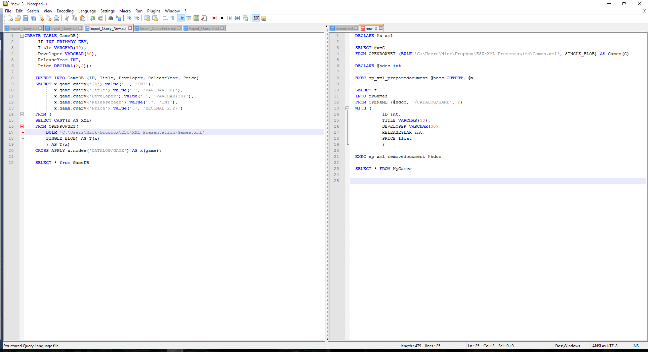
Starting Import As Bulk – file on D2L import_query_new
allows you to access remote data by connecting to a remote data source, such as a data file
File location
alias
Read in the file
A built in stored procedure that returns handle to XML data
Document handle will be returned
SELECT INTO statement is used to create a table by copying the existing table's columns, creates and populates the table MyGames with the data from the XML files
Map flag
What will be processed, what the XML data looks like, look
In file names games.xml <CATALOG>
<GAME>
Extract the XML data
Note: table column name upper/lower case must match XML file

Slide 9
Once you run the query – the table MyGames is created
ID TITLE DEVELOPER RELEASEYEAR PRICE
1 Rocket League Psyonix 2015 19.99
2 Mass Effect Bioware 2007 59.99
3 Stardew Valley ConcernedApe 2016 14.99
4 Dark Souls From Software 2011 59.99
5 Minecraft Mojang 2011 26.95

Slide 10
Now you try one
Create an XML file that contains the first name and last name of people read it into a SQL table called Names
Answer Next slide

Slide 11
XML file
<ALLNAMES>
<NAME>
<FIRSTNAME>mary</FIRSTNAME>
<LASTNAME>smith</LASTNAME>
</NAME>
<NAME>
<FIRSTNAME>john</FIRSTNAME>
<LASTNAME>doe</LASTNAME>
</NAME>
<NAME>
<FIRSTNAME>jane</FIRSTNAME>
<LASTNAME>lewis</LASTNAME>
</NAME>
</ALLNAMES>
Sql query next slide

Slide 12
DECLARE @x xml
SELECT @x=G
FROM OPENROWSET (BULK 'E:\ESU\Classes IT and DB\DB\DB Class\sQL Server\PerryPost_SQLServer_PPT\Class\SQL 2016\XML 2017\Names.xml', SINGLE_BLOB) AS Names(G)
DECLARE @hdoc int
EXEC sp_xml_preparedocument @hdoc OUTPUT, @x
SELECT *
INTO Names
FROM OPENXML (@hdoc, '/ALLNAMES/NAME', 2)
WITH (
FIRSTNAME VARCHAR(30),
LASTNAME VARCHAR(30)
)
EXEC sp_xml_removedocument @hdoc
SELECT * FROM Names

Slide 13
Exporting Table Into an XML FILE

Slide 14
Exporting Tables Into XML
SQL is well integrated with XML and has methods to generate XML files.
Tags for each item is predefined to <row>
All items are fragments: they have no root tag

Slide 15
Exporting Continued, file on D2L Export_Query
You want to put it in XML format
It will create a file that looks like
<CATALOG>
<GAMES>
<ID>1</ID>
<TITLE>Rocket League</TITLE>
SELECT * FROM MyGames
FOR XML PATH ('GAMES'), ROOT ('CATALOG')
Result of select command next slide

Slide 16
The previous command produces
<CATALOG>
<GAMES>
<ID>1</ID>
<TITLE>Rocket League</TITLE>
<DEVELOPER>Psyonix</DEVELOPER>
<RELEASEYEAR>2015</RELEASEYEAR>
<PRICE>1.999000000000000e+001</PRICE>
</GAMES>
<GAMES>
<ID>2</ID>
<TITLE>Mass Effect</TITLE>
<DEVELOPER>Bioware</DEVELOPER>
<RELEASEYEAR>2007</RELEASEYEAR>
<PRICE>5.999000000000000e+001</PRICE> ……

Slide 17
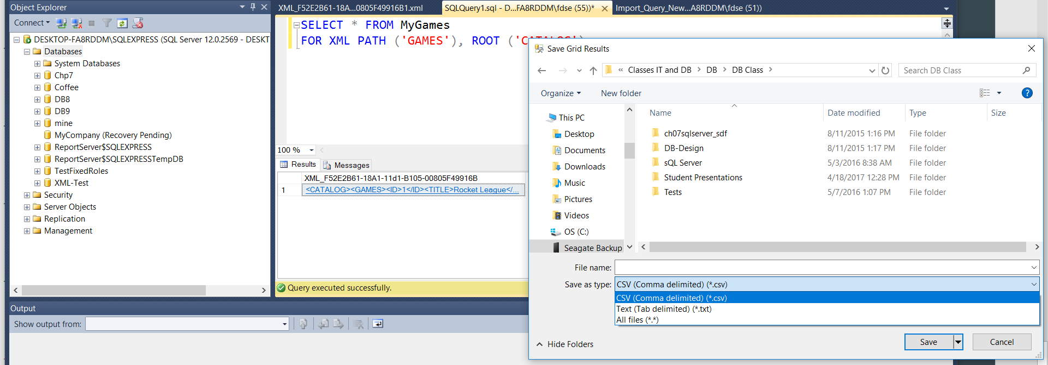
You can click on the file and expand it or right click and save the output in a file

Slide 18
What if you just want some of the data from the table to be output in XML format – example next slide

Slide 19
Exporting Continued – you can use where clause etc.
SELECT (select TITLE, RELEASEYEAR, DEVELOPER
FROM MyGames
WHERE RELEASEYEAR < 2015
FOR XML PATH('Not_Recent_Game'), ROOT('OlderGames'), TYPE)
<OlderGames>
<Not_Recent_Game>
<TITLE>Mass Effect</TITLE>
<RELEASEYEAR>2007</RELEASEYEAR>
<DEVELOPER>Bioware</DEVELOPER>
</Not_Recent_Game>

Slide 20
You try one, put the results in an XML file called Owners
What customers Own properties ? You want to know: the customer’s firstname
the customer’s last name the address of the property the city the property is in
select firstname, lastname, properties.address, properties.city from customers join properties on customers.customerid=properties.ownerid

Slide 21
Result should produce
<Property>
<Owner>
<firstname>Murray</firstname>
<lastname>Lichtman</lastname>
<address>5879 Walnut Dr</address>
<city>Eureka</city>
</Owner>
<Owner>
<firstname>Monte</firstname>
<lastname>Harmer</lastname>
<address>1625 Bayview St</address>
<city>Arcata</city>
</Owner>
… answer - sql query next slide

Slide 22
Answer
DECLARE @x xml
SET @x =
(
SELECT (
select firstname, lastname, properties.address, properties.city
from customers join properties on customers.customerid=properties.ownerid
FOR XML PATH('Owner'), ROOT('Property'), TYPE))
SELECT @x

Slide 23
Conclusion
XML will let you let you import/export large volumes of data
Is not exclusive to a particular piece of software and can be utilized efficiently within different departments of a company using the same data
The ability to select and filter through elements or attributes allows more flexibility when utilizing the data or creating new data sets of specific information

