Slide 1
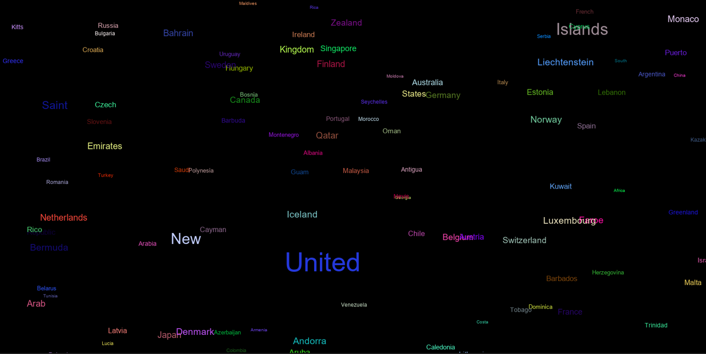
Find New Users
Can data help find new user bases or marketplaces?

Slide 2
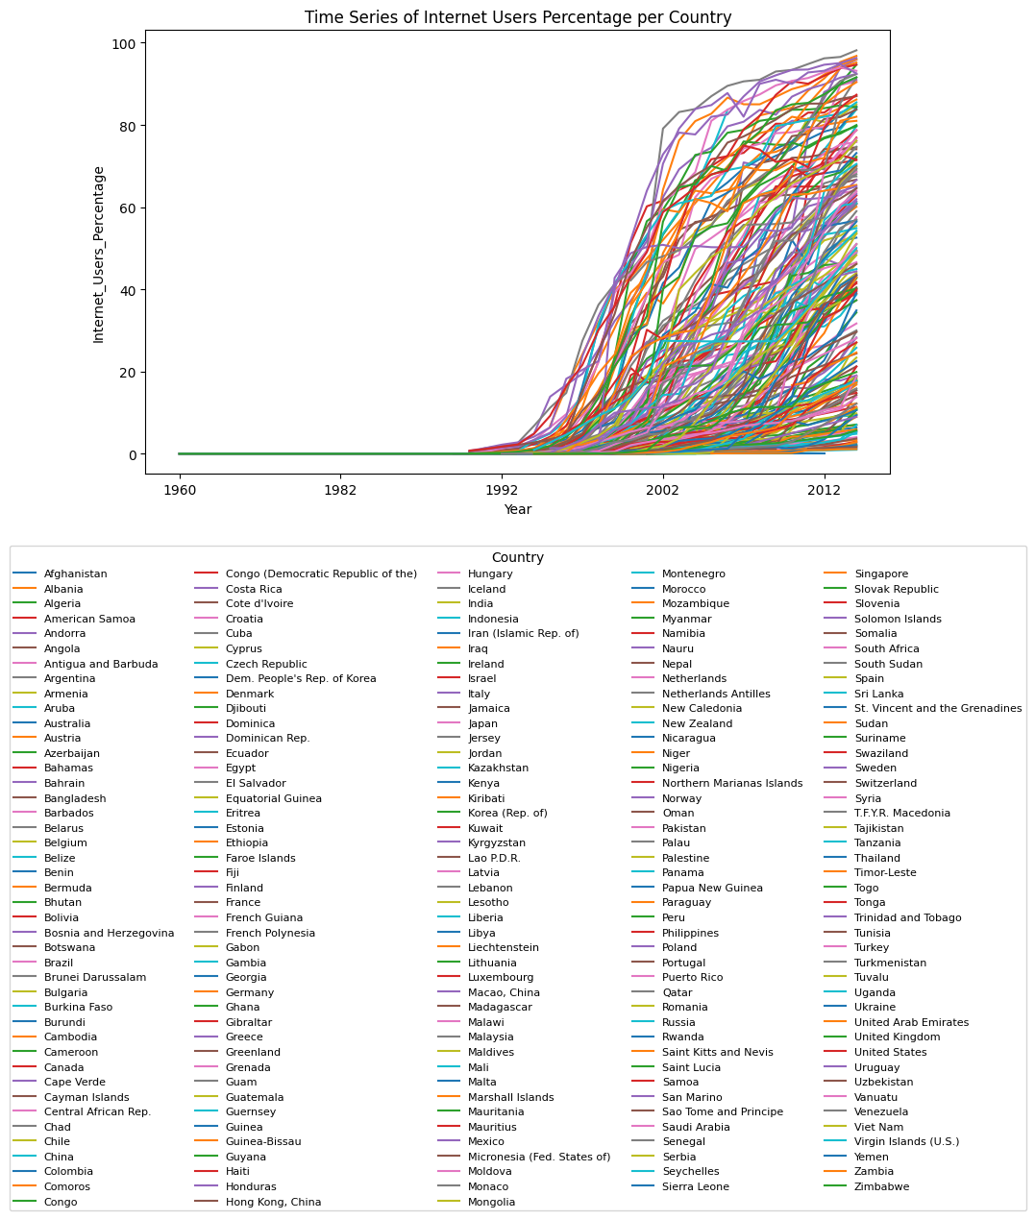
In the first step I analyzed the percentage of internet users per-captia. This taught me two things, basically the whole world is on an upward trend in terms of internet access, and I was going to have to do more to make sense of graphs with this many data points, or in this case countries, this looks like fruit loop spaghetti.

Slide 3
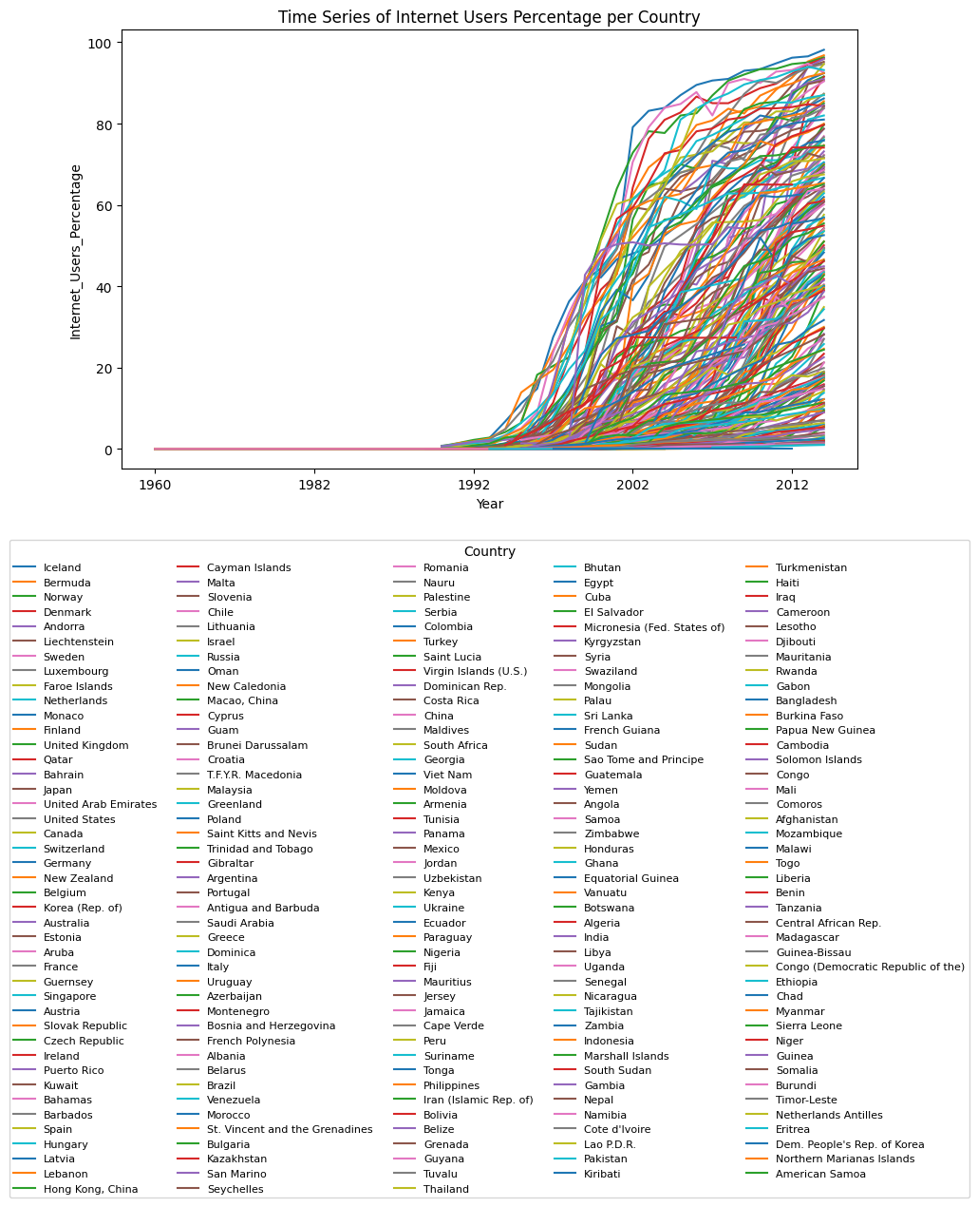
Step 2
Reorganization
To be able to read this graph I reorganized the legend, so it would be sorted by value in the most recent year. I found most of the top spots where filled with normal contenders, but there were some sunrises Iceland, Bermuda, Norway, Monaco and more.

Slide 4
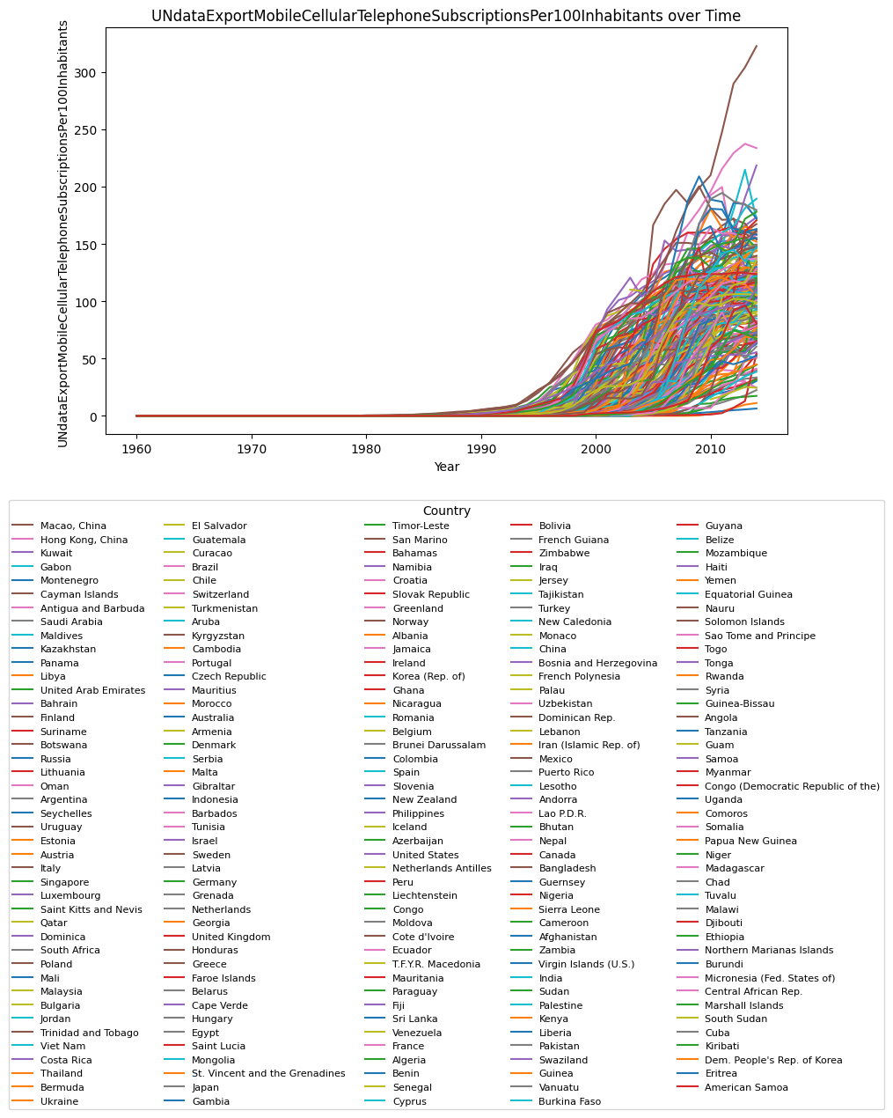
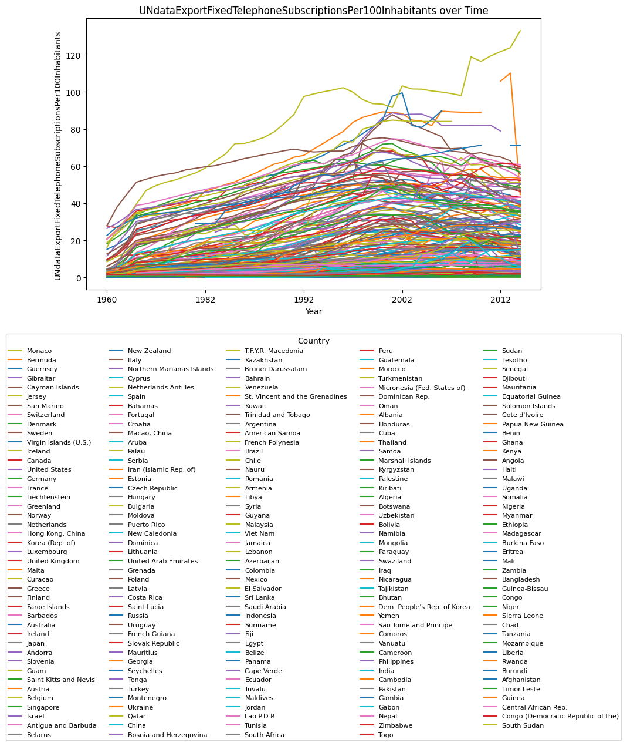
Step 3
Step 3
To see if a country is also making investments in it’s infrastructure, is to check mobile and fixed telephone subscriptions per 100 inhabitants

Slide 5
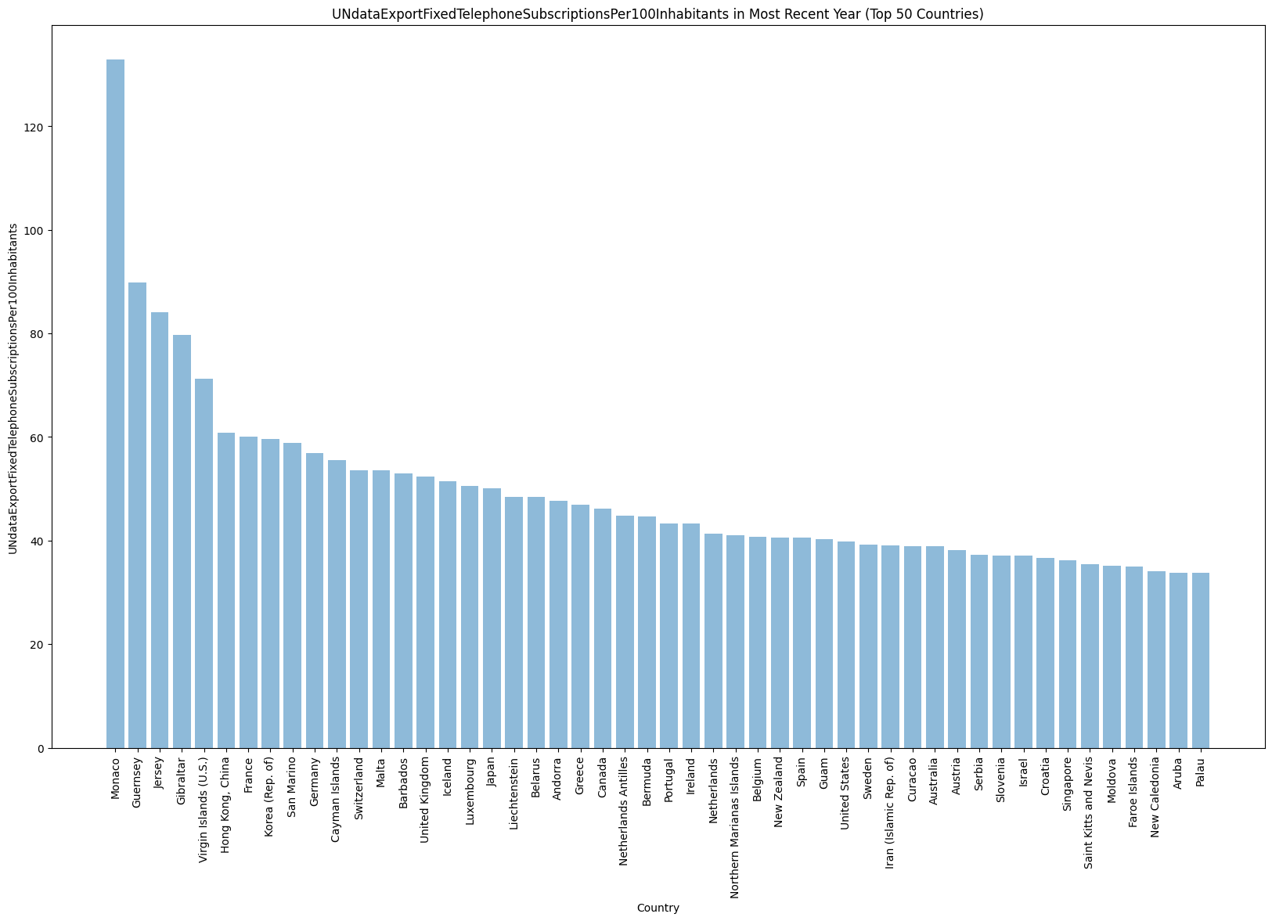
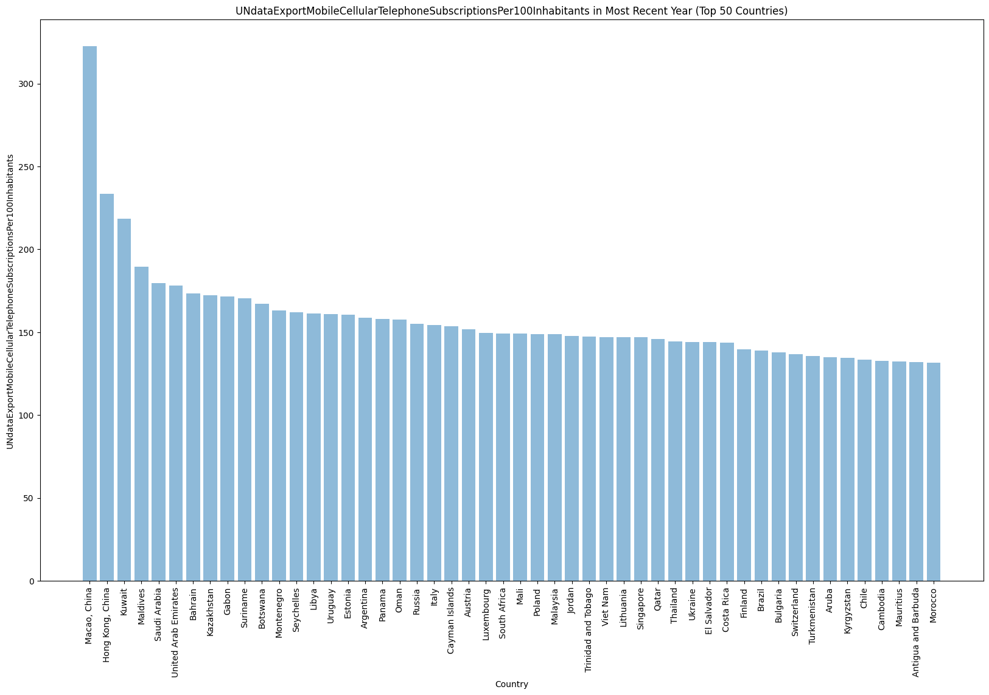
Step 4
Step 4
I wanted to just check out the top 50 coutries in both top per 100 lists and look for similarities.

Slide 6
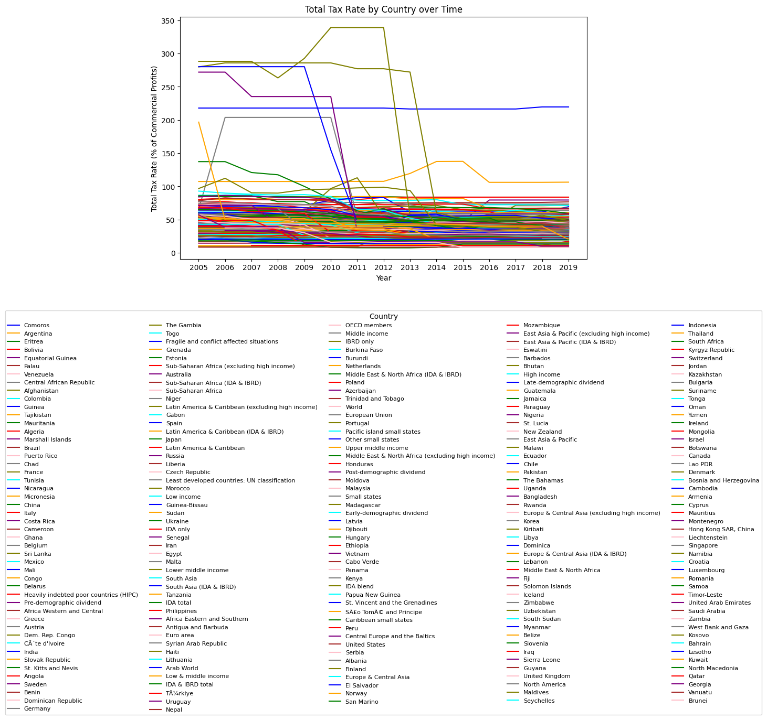
Step 5
I went through a csv of each countries tax rates on corporate profits. Interestingly enough some countries over 100% tax, Comoros and Argentina, on corporate profits. I did learn most countries stay consistent in this regard, there are mostly straight lines on this graph.

Slide 7
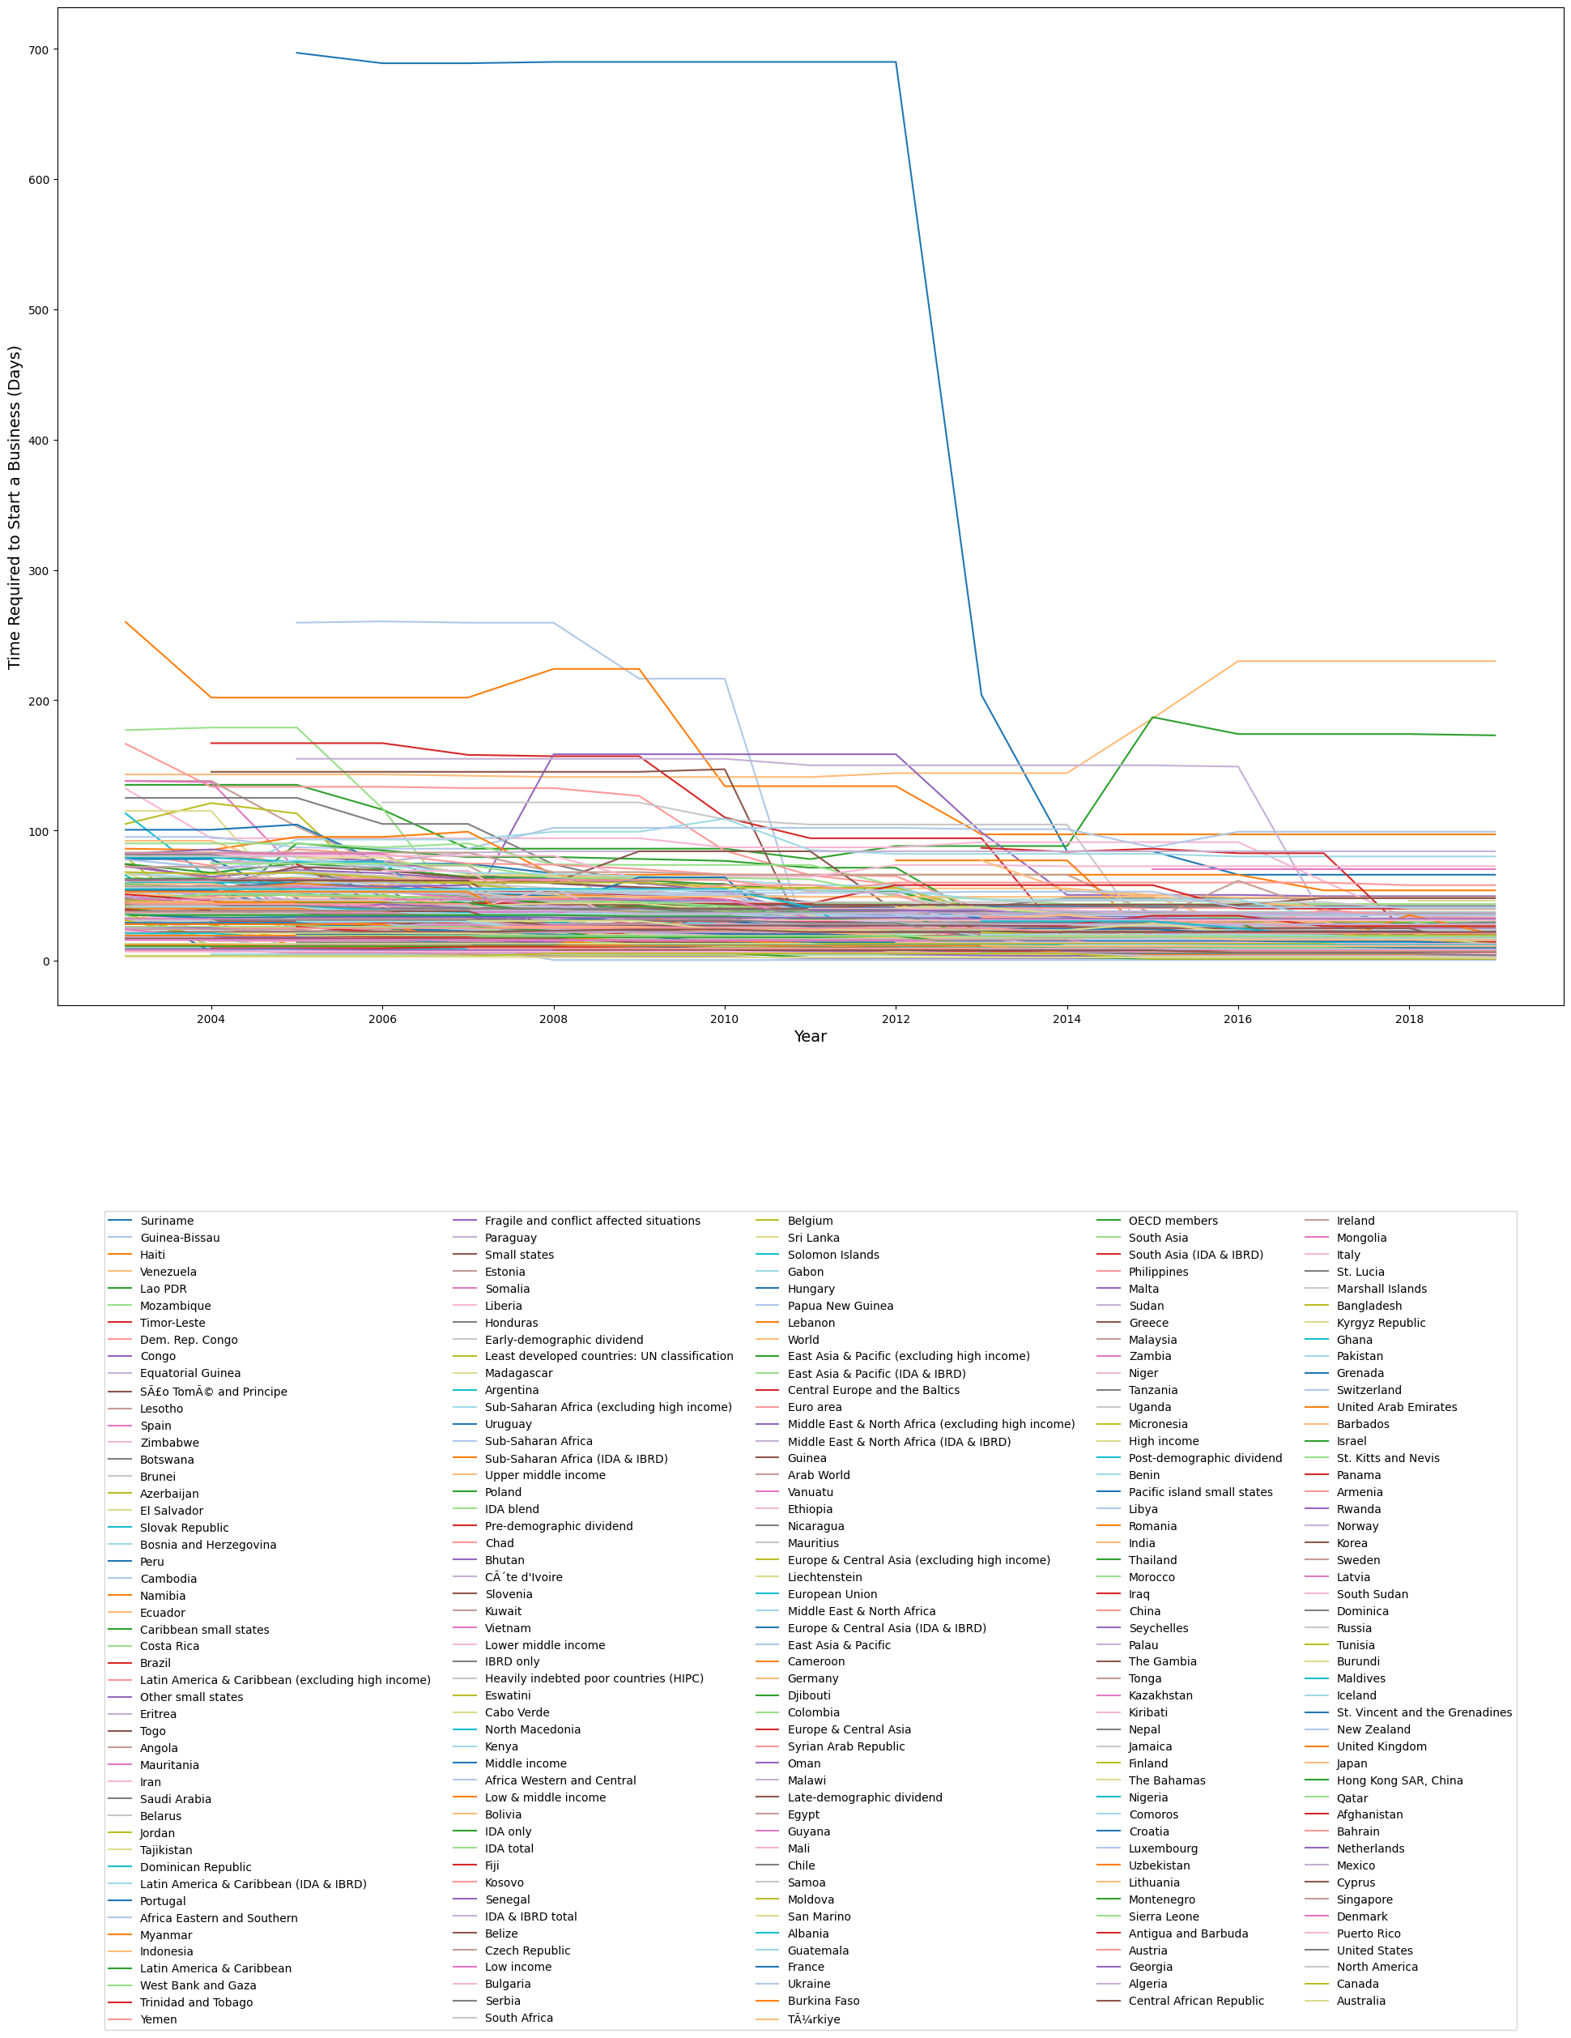
Step 6
Here I looked At how long it takes to start a new business in a given country, again here the outliers tend to give us no new surprises, and every country seems to at least stay pretty consistent.

Slide 8
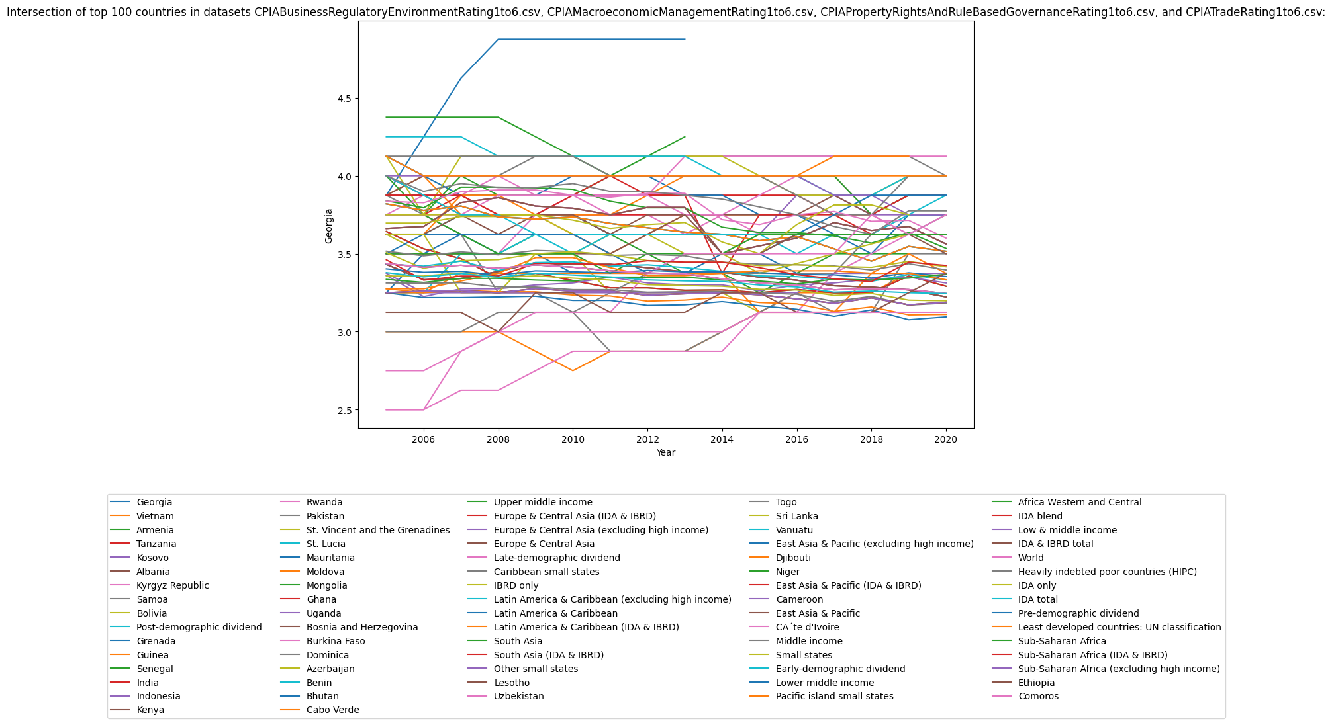
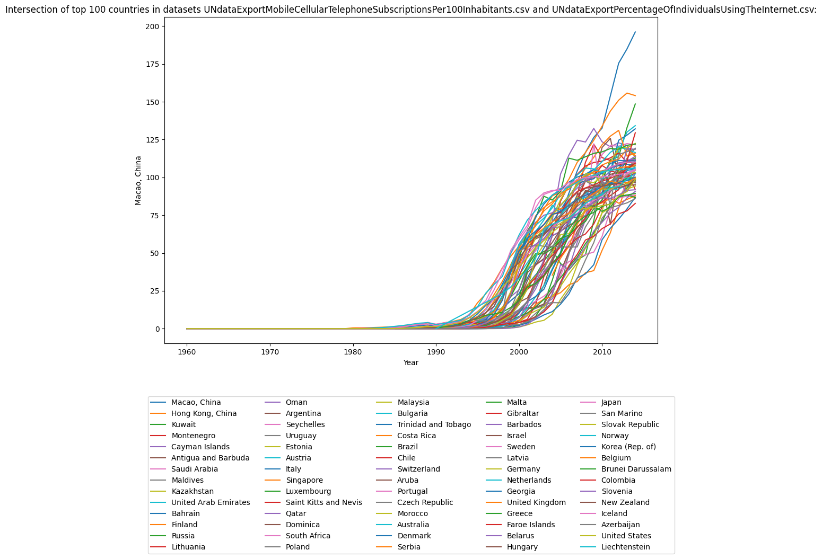
Final Step
Here I looked at the intersections of Countries ratings in trade, regulations, governance, and property rights. Then I took the intersection of Internet percentage and mobile users. These two graphs gave the most surprises.

Slide 9
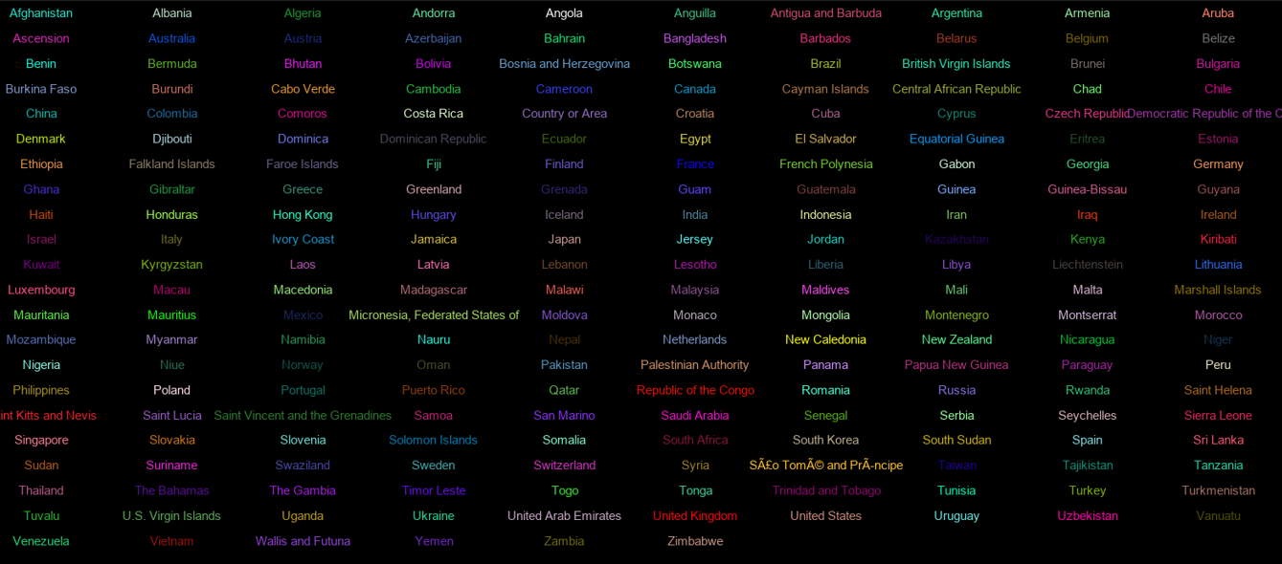
Conclusion
I seems like software is definitely a good business to be in. User bases are growing. The world is becoming more connected. Basically, while it does seem like traditional markets still proved strong, there were definitely some surprises. Surprises are good. Surprises mean more markets to possibly share your products with.

