Slide 1
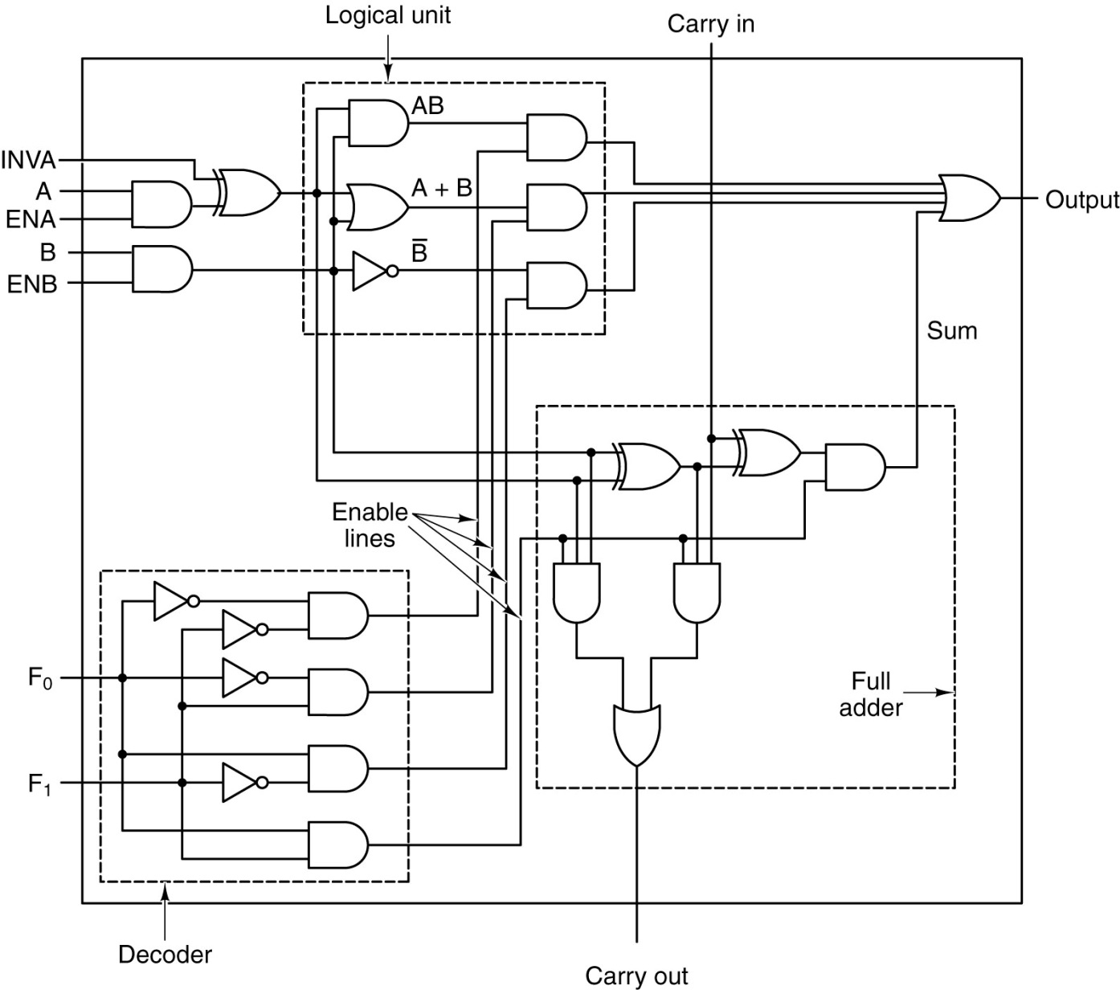
#1 - [20%] Consider the ALU in the Chapter 3 Lecture slides. What input settings would ensure the circuit outputs the inverse of input A? Likewise, what settings would insure outputting the inverse of Input B? Fully explain the difference in settings between the two. For each case, be sure to specify the value of the full set of inputs, including those inputs which are “don’t care”.

Slide 2
To invert A:
Answer: Use the OR function (F₀=0, F₁=1), set INVA=1, ENA=1, and ENB=0.
Poor Answer: Use the AND function (F₀=0, F₁=0), set INVA=1, ENA=1, and ENB=1, B=1.
To invert B:
Answer: Choose the Invert B function (F₀=1 F₁=0), set ENB=1.
Things to note:
For all of the above, Carry In is D/C.
To invert A, INVA must be set to 1.
You must specify F0 and F1 to select the proper function
The ALU operations are being performed on inputs A, B and Carry In. Therefore, any solution must work when any of these inputs are 0 or 1 (e.g., don’t care). So requiring B=1 to invert A is not a good solution.

Slide 3
#2 - Text, page 215, #63
Current |  |  |  | Next |  | Notes
A | B | X | B (XOR) X | A | B
0 | 0 | 0 | 0 | 0 | 0
0 | 0 | 1 | 1 | 1 | 0
0 | 1 | 0 | 1 | 1 | 0
0 | 1 | 1 | 0 | 0 | 0
1 | 0 | 0 | 0 | 0 | 1
1 | 0 | 1 | 1 | 1 | 1
1 | 1 | 0 | 1 | 1 | 1
1 | 1 | 1 | 0 | 0 | 1
The next A is always B XORed with X
The JK flipflop is either set or reset because its inputs are Q and Q’ of the D flipflop
See the included MML file to verify this table

Slide 4
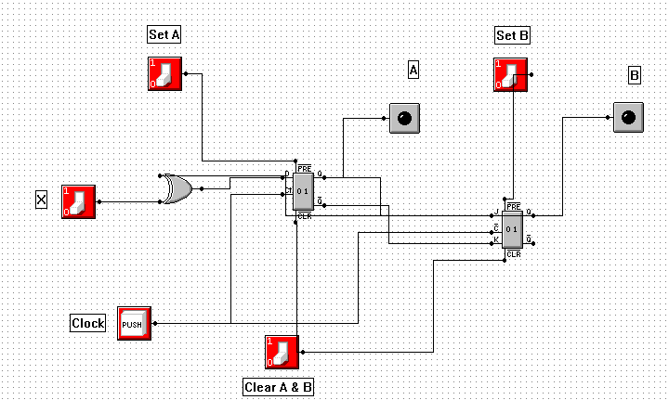
#2 - Text, page 215, #63

Slide 5
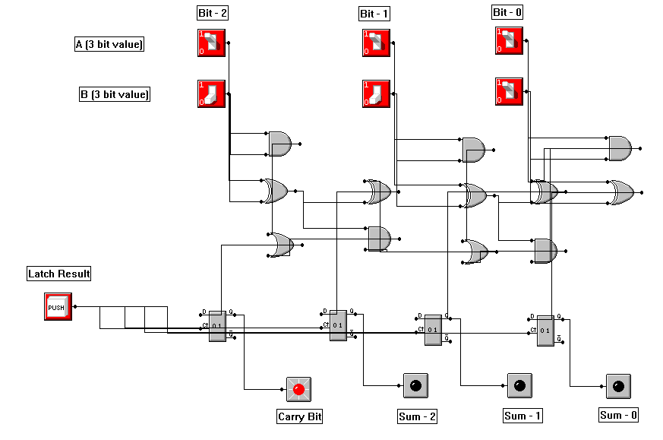
#3 – Three-bit Adder Circuit
Also see the *.lgi file

Slide 6
#4 – Sorter Circuit
Sorter Truth Table with Flip-flop and Select
S | A | B | F1 | F2
0 | 0 | 0 | 0 | 0
0 | 0 | 1 | 1 | 0
0 | 1 | 0 | 1 | 0
0 | 1 | 1 | 1 | 1
1 | 0 | 0 | 0 | 0
1 | 0 | 1 | 0 | 1
1 | 1 | 0 | 0 | 1
1 | 1 | 1 | 1 | 1
CLK
A
Sorter
Circuit
F1
B
F2
S

Slide 7
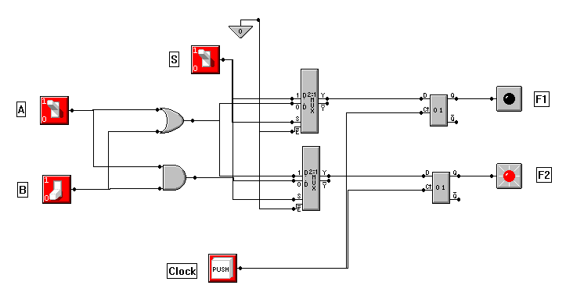
Sorter Circuit with Flip-flop and Select

