Slide 1
Small Project 2
Hotel Dominic Parks
William Faisal M

Slide 2





Tolls yang Digunakan

Slide 3
Testing Flow
Brainstorming
Planning
Setting up environment
Testing
Reporting
Evaluating

Slide 4
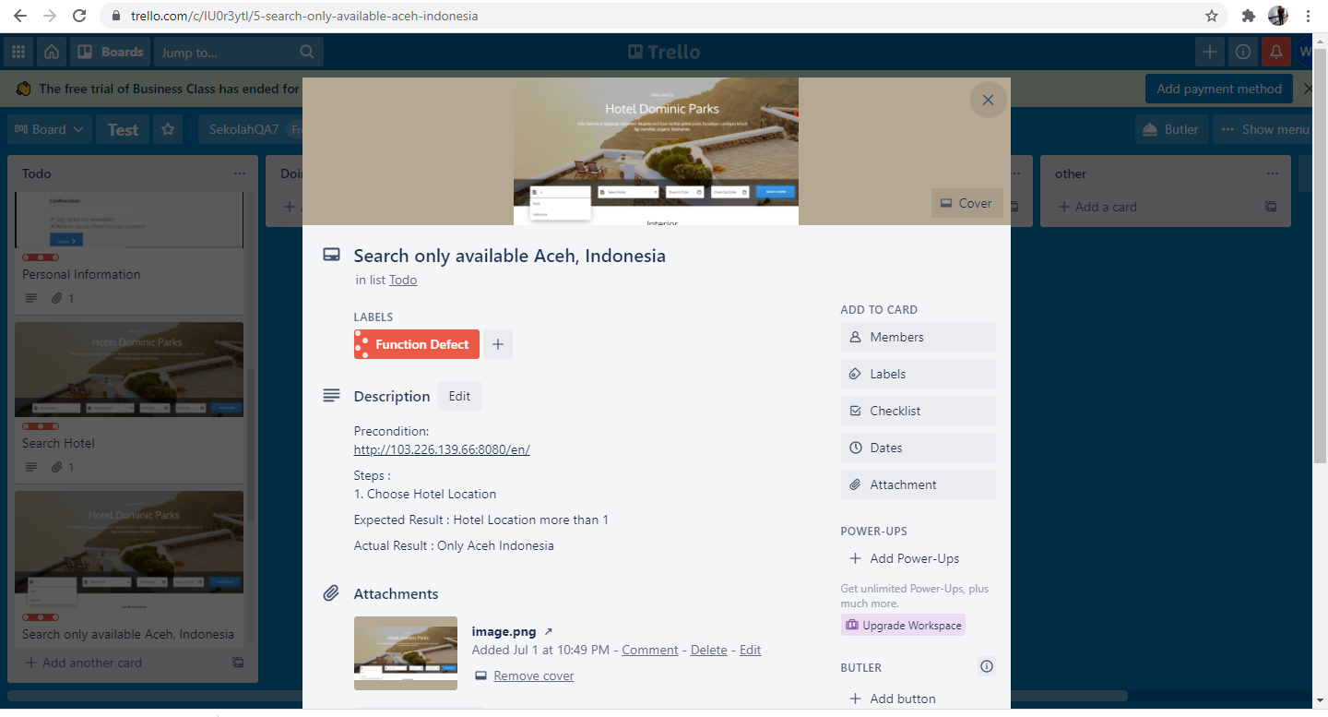
Defect
You can simply impress your audience and add a unique zing and appeal to your Presentations. Get a modern PowerPoint Presentation that is beautifully designed.

Slide 5
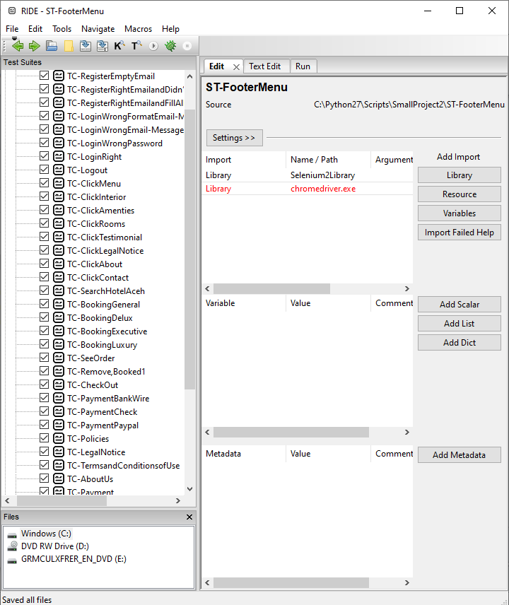
Test

Slide 6
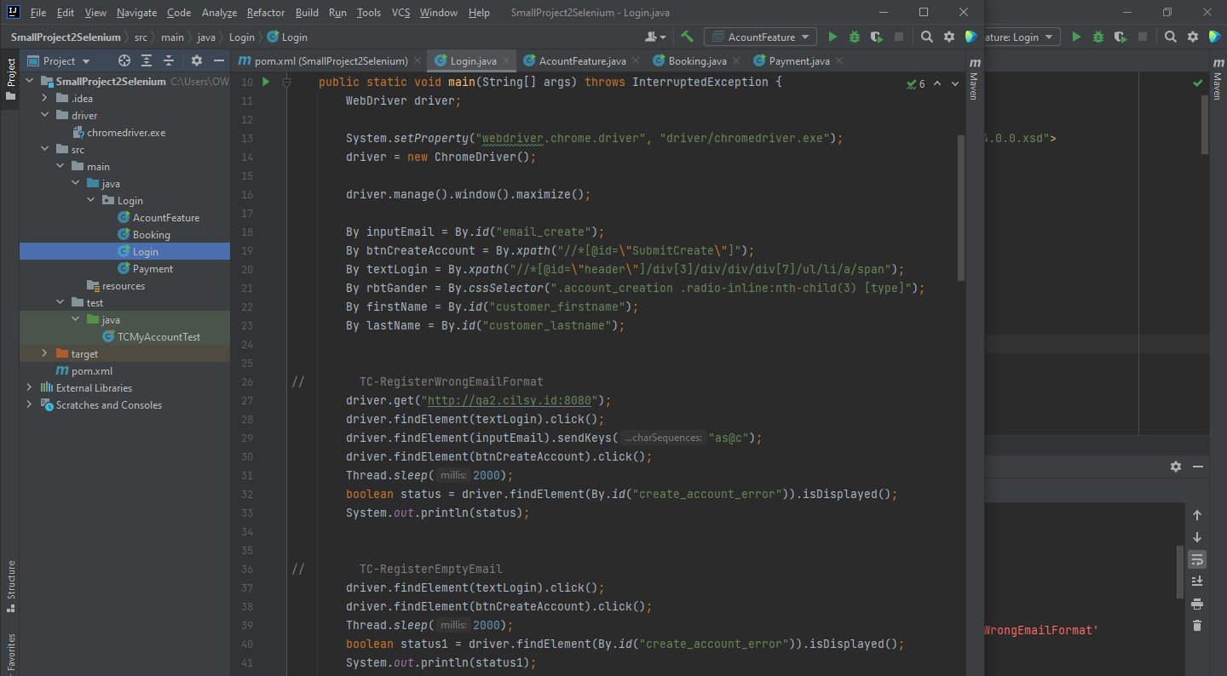
Test

Slide 7
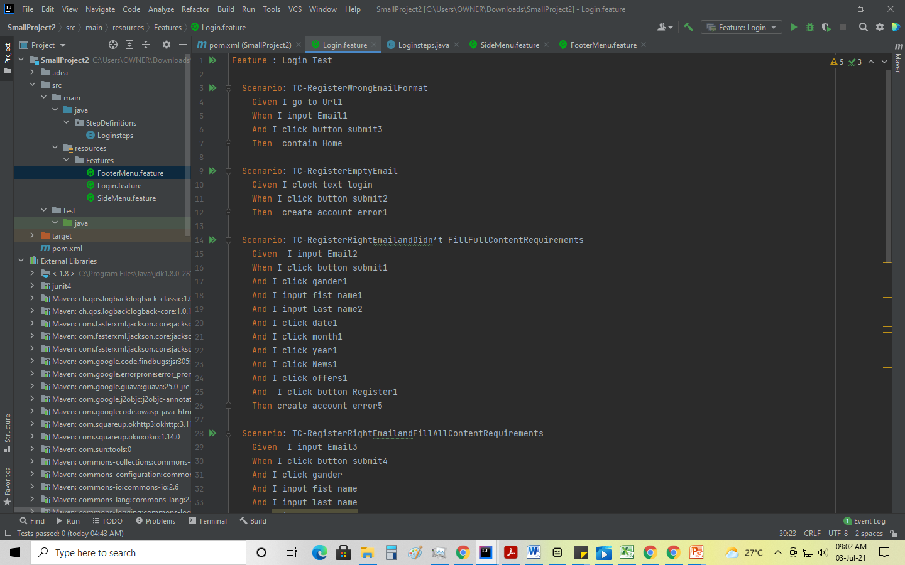
Test

Slide 8
Report

Slide 9
Thank You

