Slide 1
Hypernymy-Detection
Group 11

Slide 2
Introduction
we've focused on the common hypernym relation between nouns (and noun phrases).
We developed a method that given a pair of nouns (x, y) (e.g. (cat, animal), (abbey road, record), (apple, animal)) predicts whether y is a hypernym of x - or in other words, whether x is a subclass of y (e.g. cats are a subclass of animals) or an instance of y (e.g. abbey road is an instance of record).

Slide 3
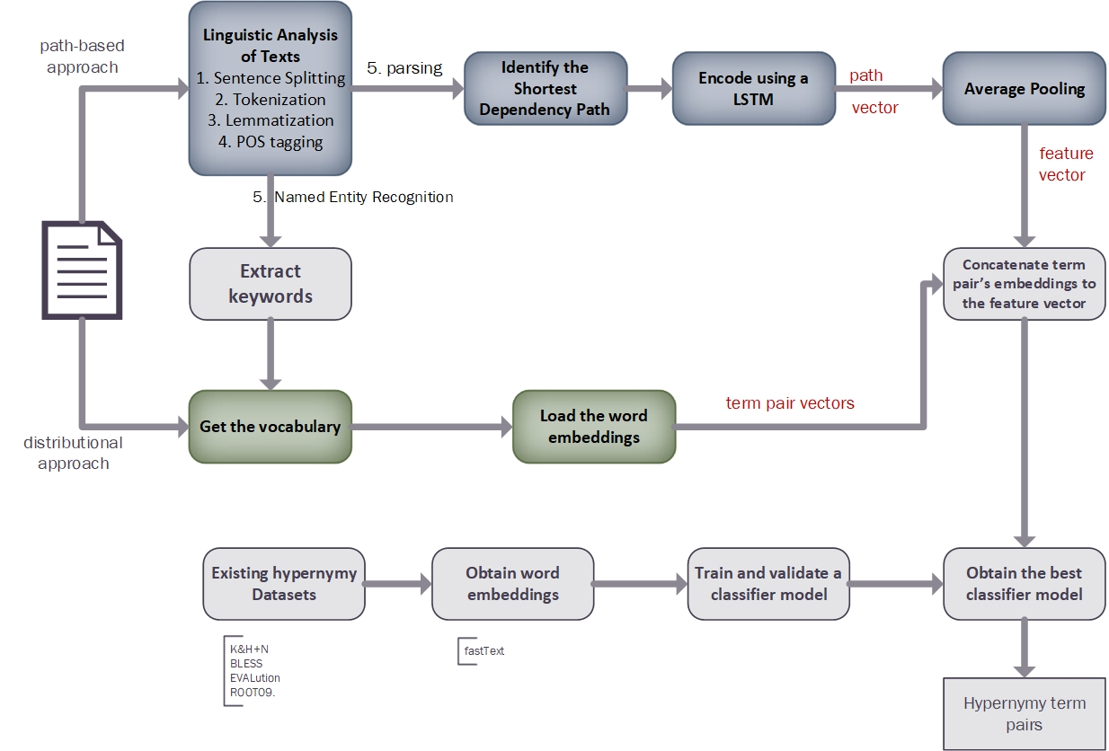
Methodology

Slide 4
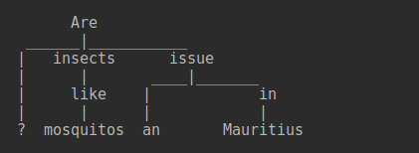
Results and Analysis

Slide 5
Conclusion
we combined the complementary path-based and distributional approaches.
To add distributional information to our model (the information on the separate occurrences of each term x and y), we simply added the word embedding vectors of x and y to the model, allowing it to rely on this information as well.
With this simple change we achieve significant improvement in performance compared to prior methods in each approach

Slide 6
Thank You

