Slide 1

Project Title Secure Chat-Based Environment Using AI-Based IDS
Presented By: William Rateb Albeni
Supervised By: Dr. Wassim Aljuneidi

Slide 2
Introduction
Project Overview: A secure web-based chat application designed to protect communication privacy and study cryptographic defenses.
Core Architecture: Built using a Secure Centralized broker server combined with a robust N-Tier Architecture.
The Security Focus: Rather than just building a functional chat, this project is designed to implement, analyze, and test multi-layered cryptographic boundaries against network and storage threats.

Slide 3
Project Objectives
Implement Hybrid Cryptography: Use both asymmetric (RSA) and symmetric (AES) encryption to secure data transmission and key exchange.
Enforce Storage Confidentiality (Encryption at Rest): Protect historical message payloads within the database using server-managed master keys.
Establish Multi-Layered Isolation: Use an N-Tier architecture to prevent direct logical access to database files from the presentation layer.
Emulate Network Threats: Create a platform capable of analyzing system behavior under simulated Man-in-the-Middle (MITM) conditions.

Slide 4
The Core Problem & The Proposed Solution
The Problem:
Standard chat applications transmit messages in plain text or rely just on basic transport security. This leaves data vulnerable to network sniffing (MITM) and database exposures.
The Proposed Solution:
A cryptographic chat architecture where the server acts as a trusted secure broker. All data transmitted over the wire is absolutely encrypted, and data stored at rest is completely obfuscated.
Integration of a threat emulation environment to evaluate how encryption holds up against interception attempts.

Slide 5
Architectural Design Phases
Authentication Design Phase: Implementing secure identity verification using salted hashing at the business logic layer.
Client Key Management Phase: Generating asymmetric key pairs locally in the browser context for secure key distribution.
Transport Security Phase: Protecting the real-time data stream using two layers of encryption.
Storage Security Phase: Developing an encryption mechanism to secure payloads inside the database.

Slide 6
Tools and Technologies Used
Client Cryptography: Web Crypto API (window.crypto.subtle) for secure local RSA key pair generation; CryptoJS and JSEncrypt for AES-CBC and PKCS1 padding.
Server Security: System.Security.Cryptography for server-side RSA decryption, AES generation, and database master-wrapping.
Password Defense: BCrypt.Net to protect authentication structures against Rainbow Table and Brute-Force attacks.
Real-time Engine & Database: SignalR running over WSS (WebSocket Secure) for encrypted real-time delivery, monitored via SQL Server Management Studio (SSMS).

Slide 7
Practical Achievements (What was Executed)
Secured Passwords Storage: Verified that all users passwords are being hashed using BCrypt algorithm with unique Salt for each user.
Secured Storage Environment: Verified that direct access to the database by any unauthorized party gives only unreadable ciphertext encrypted by the DbMasterKey.
Secured Transmission Data: Verified that all messages are encrypted using hybrid encryption (AES + RSA), and using HTTPS for transport layer.
Secure Session Handling: Implemented defensive logging structures that destroy transport keys after user logout, preventing session hijacking.

Slide 8
Cryptographic Flow (How Data Moves Safely)
Phase 1: Registration & Hashing
The client browser generates a 2048-bit RSA-OAEP key pair. The Public Key is sent to the database.
User passwords are combined with a hidden server-side Pepper and a random Salt, then hashed using BCrypt (with an adaptive work factor).
Phase 2: Message Transmission (Sender to Server)
The sender generates a random 256-bit AES session key, encrypts the message, and encrypts the AES key using the Server’s RSA Public Key.

Slide 9
Cryptographic Flow (How Data Moves Safely)
Phase 3: Server Processing & Storage
The server decrypts the session key using its Server Private Key, and encrypts the payload with a DbMasterKey before storing it in the database.
Phase 4: Server to Receiver Delivery
When delivering a message, the server generates a new AES session key, encrypts the message, encrypts this new key using the Receiver's RSA Public Key, and pushes it via SignalR.

Slide 10
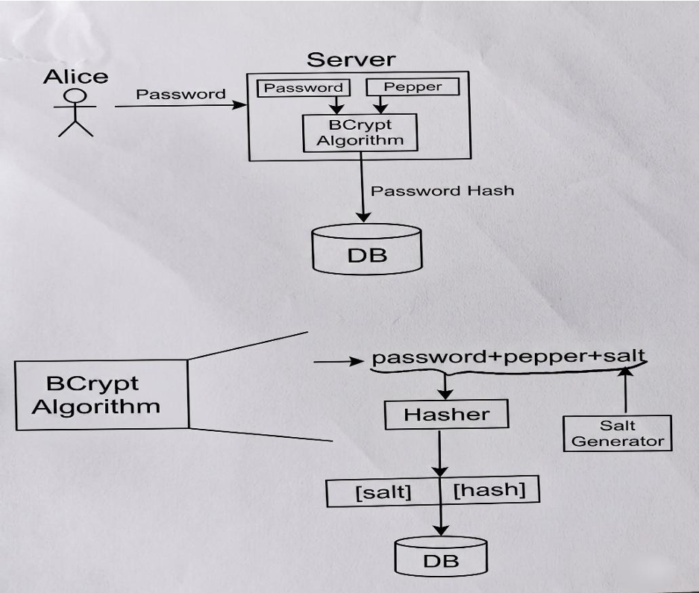
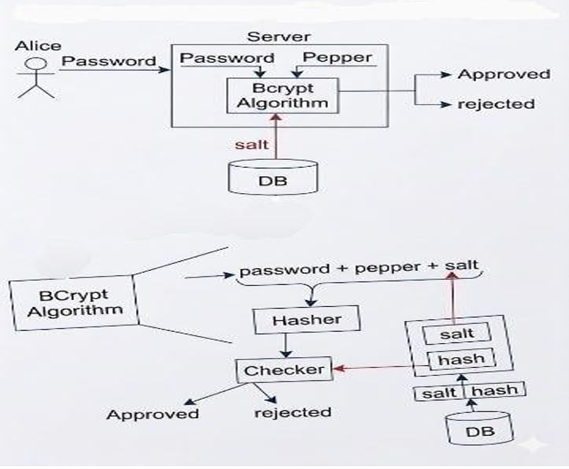
Registration
Logging in

Slide 11
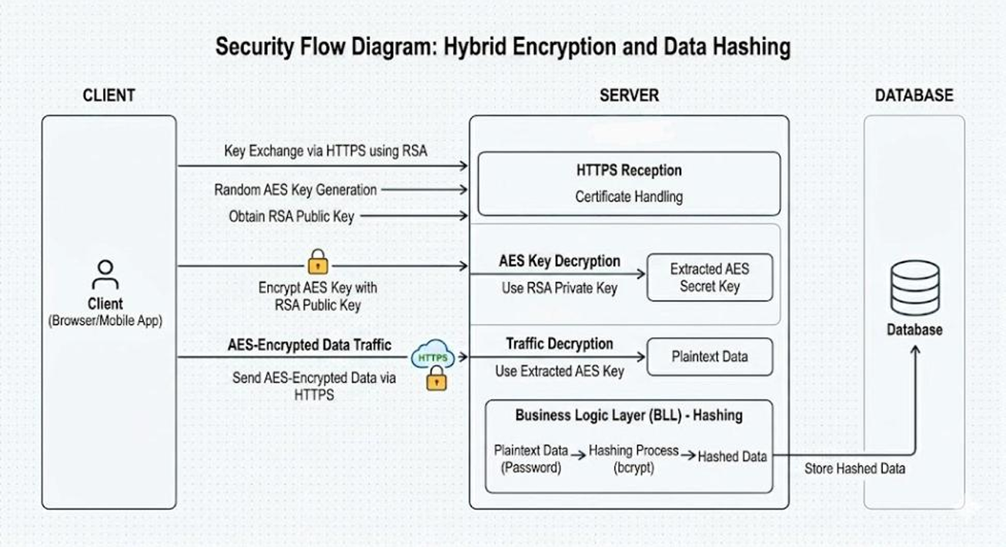

Slide 12
Future Horizons (Next Steps)
Token-Based Authentication: Implementing and strictly validating JSON Web Tokens (JWT) to replace basic identity checks and enforce cryptographic session state.
Server-Side MITM Emulation: implementing the attack code that will automatically do the attack on the server side when it is being enabled.
AI-Based Intrusion Detection System (IDS): for monitoring real-time SignalR packet behaviors and automatically detect anomalies and attack (MITM).
Visualization: generating real-time security alerts and visualizing attack patterns to study defense efficiency.

Slide 13
THANK YOU

