Slide 1

Group 4 (Achos): Sagar, William, Tommy, Khide, David
Notes:
Intro for everyone.

Slide 2
Responsibilities
David | Tommy | Khide
Project Manager, Game Developer 2 Game Designer Presenter QA Tester 4 | Web Development Manager QA Tester 2 Game Developer 3 Artist 4 | Game Development Manager Game Designer 2 Artist 4
William | Sagar
Graphic, Story Design Manager QA Tester 3 | Media, Ad Manager QA Tester 1 Artist 2
Notes:
David

Slide 3
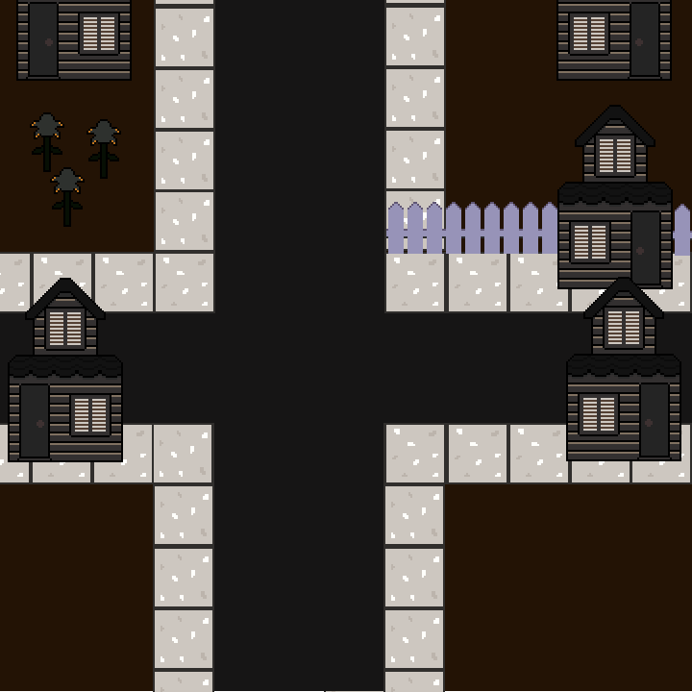
Raise the awareness through game?
Starts from this town, dark and gloomy.

Slide 4

Brain that is always tired
Code that no one knows what it does
Stand Coffee
Typical CST student

Slide 5



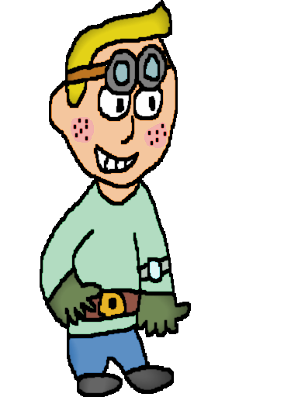



Place towers!
They are real life examples which lets the user learn
Water Tower
Recycle Tower
Animal Farm
Donation Tower
Compost Tower
Fuel Plant

Slide 6
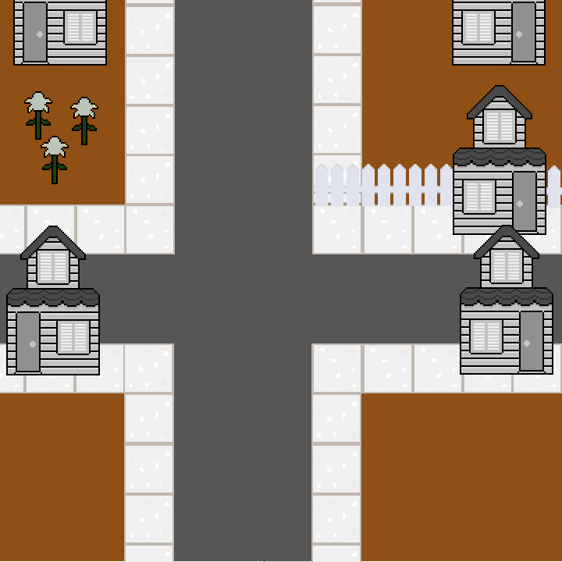

Slide 7
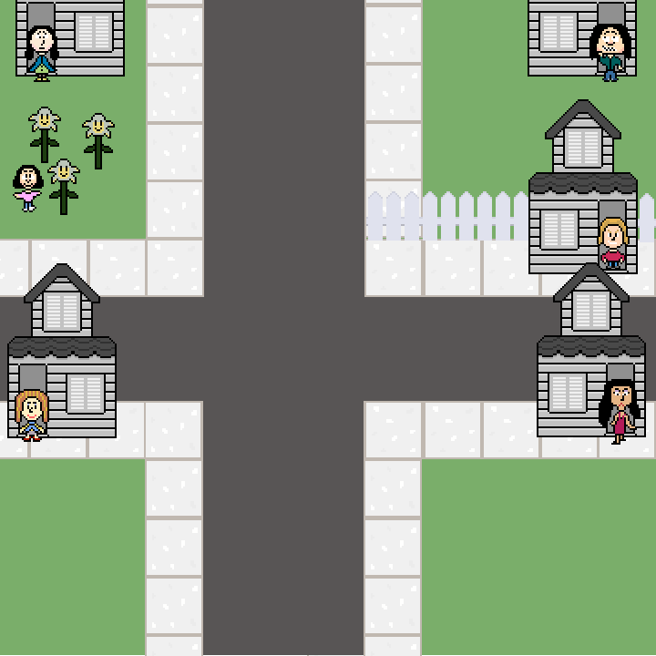

Slide 8
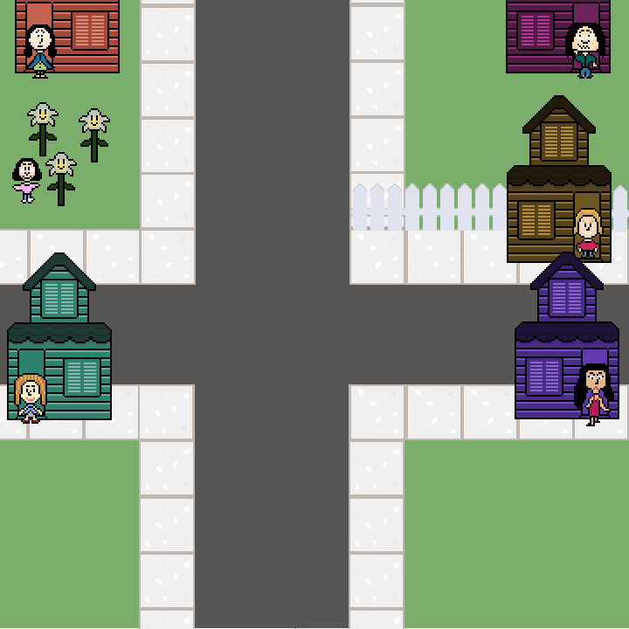

Slide 9



Slide 11
That’s not the end of fun!

Slide 12
Find out the real towers!

Slide 13
Go to the hosted site and start the demo. (So far took 1.8 minutes)

Slide 14
API Demo
David, (0.3 minutes)

Slide 15
Easter Egg Demo
Sagar and William, (1.2 minutes)

Slide 16
Features Added this week (Demo)
Khide (1.3 minutes)

Slide 17
Website (Demo)
Tommy (1.3 minutes)
Explain new template
Azure SQL server
Responsiveness
End of demo, come back to ppt.

Slide 18
End of demo, come back to ppt.

Slide 19

Questions ?
Notes:
David
That is the end of our presentation, do you guys have any question?

