Slide 1

Group 4 (Achos): Sagar, William, Tommy, Khide, David
Notes:
Intro for everyone.

Slide 2
Responsibilities
David | Tommy | Khide
Project Manager, Game Developer 2 Game Designer Presenter QA Tester 4 | Web Development Manager QA Tester 2 Game Developer 3 Artist 4 | Game Development Manager Game Designer 2 Artist 4
William | Sagar
Graphic, Story Design Manager QA Tester 3 | Media, Ad Manager QA Tester 1 Artist 2
Notes:
David

Slide 3

What is our application ?
Operation Compost
Tower defense game which run on the mobile web browser (also on PC) which raise awareness about food waste reduction.
The boy invents towers to prevent foods from going straight into the ‘Waste’ bin.
Towers are the real-life examples of food waste reduction and it is to teach the users different ways of reducing food.
‘Boy Genius’
Notes:
William.

Slide 4
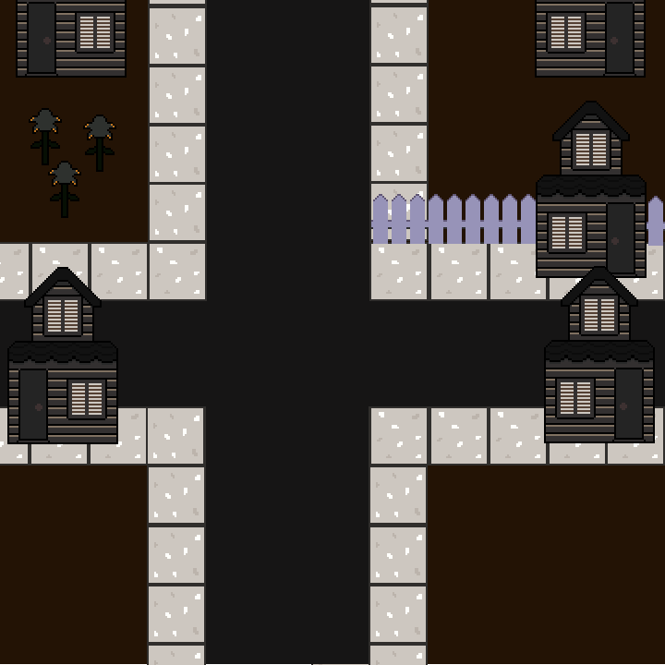
How does it raise awareness?

Slide 6
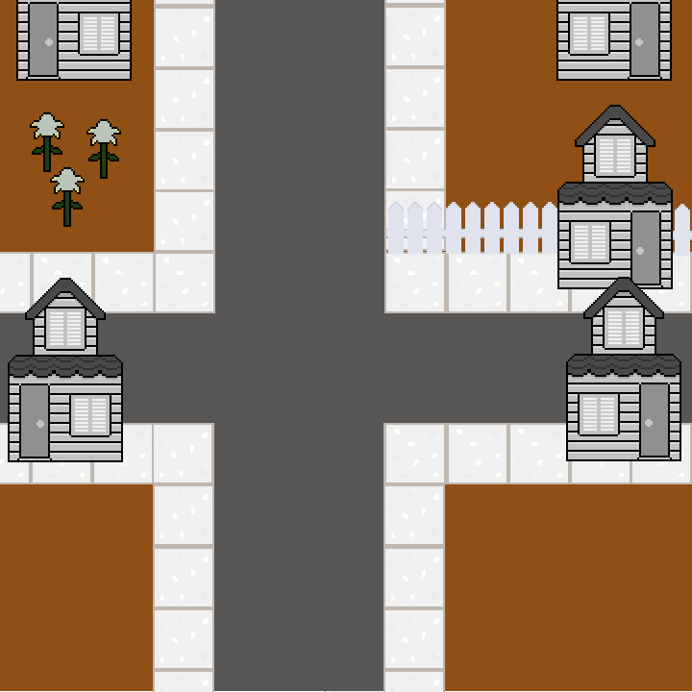

Slide 7
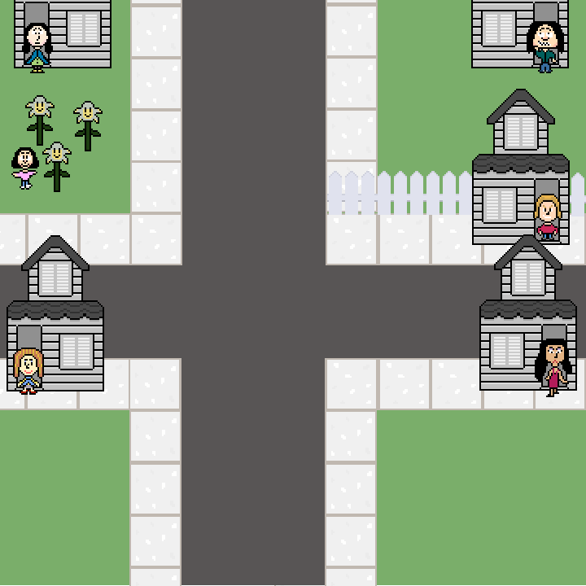

Slide 8

Questions ?
Notes:
David

