Slide 1
Nutrition and Diet Management System
NDMA - Designed and Prototype by William Carey
Interim Presentation Demonstration

Slide 2
Personal Background
Student Number: C16315253
Course: Computer Science DT228 – 4
Prototype Source Code Link: https://github.com/WilliamCareySemiColon/DietaryAssistanceSystem

Slide 3
Final Year Project Idea
The idea behind the Final year project, known as Nutrition and Dietary Management System (NDMA) is to develop a mobile application which assists people in managing their dietary needs

Slide 4
Main Domain and Focus Area
The main purpose of any application in the nutrition area is to ensure the users’ health is optimised towards their overall goal, normally combining the use of exercise and dietary recommendations.
The domain of the system is to allow the user to access the logging feature of the application, to log their diet, and the advisor system to get automated advice regarding their diet. This will be personalised to each individual needs and desires, such as vegetarian diet.

Slide 5
Advisor System
According to the source https://link.springer.com/chapter/10.1007/978-3-540-48713-5_24 (there is an underscore between the 5 and 24),
Expert systems are used to solve problems in well defined, narrowly focused problem domains, whereas advisory systems are designed to support decision making in more unstructured situations which have no single correct answer.

Slide 6
Food Logger
According to the site https://www.techopedia.com/definition/596/data-logging ,
Data logging is the process of collecting and storing data over a period of time in order to analyse specific trends or record the data-based events/actions of a system, network or IT environment.

Slide 7
Examples of Industry Solutions

Slide 8
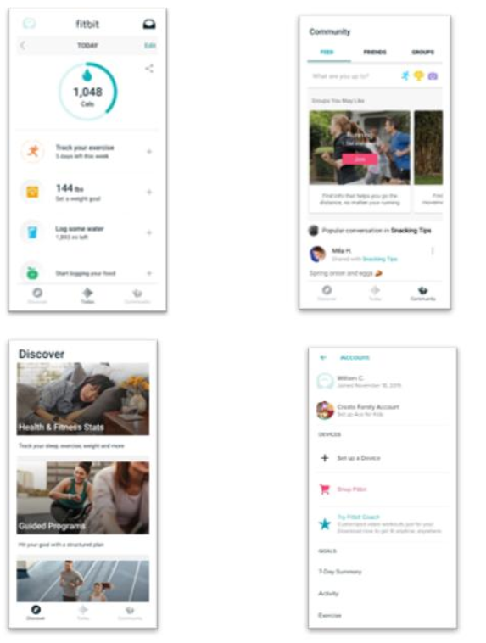
Fitbit

Slide 9
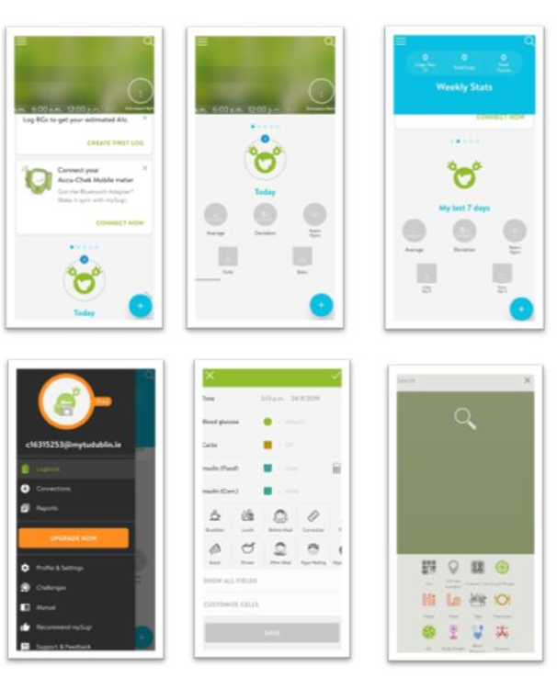
MySugr

Slide 10
System Design
For overall descriptive detail of the system design, refer to the project design document which contains textual descriptions and diagrams, such as UML and ER diagrams
The development priority focus is capturing the user logged data in the most personalised way possible, such as capturing their diet decisions and the logged diet
These will be captured using a combination of the technologies Xamarin Framework, .NET Framework and Azure Cloud Services with both Remote and Local Storage

Slide 11
Technologies Used
Xamarin’s Form
.NET Framework
Azure Cloud Services
Azure SQL DB
SQLite DB
Python Machine Learning Classifier with Datasets

Slide 12
Research
The main issues with the technology is a combination of the unfamiliarity with the new technology from a self-perspective, occurring in creating resources believed to come free as a result of the Student Subscription from using Azure Cloud Services when they are charging credit for them.
From a technical point of view, creating enough resources so many people can access the same tools simultaneously without crashing the software will be one of the biggest hurdles to overcome

Slide 13
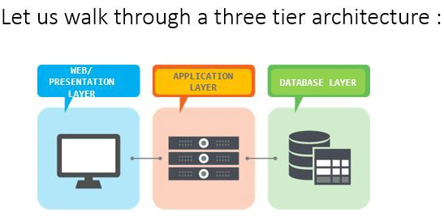
System Architecture

Slide 14
Project Complexity
The project complexity is to create a User Experience in such that the person only needs to know what they eat for logging usages
This will be through using graphical elements and buttons for the person to use rather then textual input. Approximate details will also be used in combination to ensure the UX is simpler

Slide 15
Project Complexity Approach
Datasets (Containing Food, universally average intake recommendations)
Algorithms
Data Structures
Imagery and Graphs
Simple User Interface and Design
Performance Metrics
System’s Heuristics Metrics

Slide 16

Prototype Demo

Slide 17
Software Testing and Evaluation
Software Testing Method
Testing Frameworks – Selenium, Nunit, Dbfit
Testing Methods – Black Box, White Box, Grey Box
Testing Approach – Integration Testing, Acceptance Testing
Unit Testing and Test Driven Development
Evaluation Method
Evaluation Metric – Design questions for evaluation (by self and peers)
Performance Analytics and Benchmarking Metrics

Slide 18
Future Work for Second Semester
Normalise and Clean datasets for optimal application performance
Develop the advisor and application logging system
Import libraries for graphical usage with the NuGet package manager
Create the simple UI for the user
Continue on design document
Research the optimal algorithms for generating both the logging food feasibility and the advisor decision making

Slide 19

Questions for the project

