Slide 1
Schemaless data with Postgres
Michele Capra

Slide 2
Who I am
Michele Capra
Remote Software Engineer @ Portchain
Master Informatics Engineering @ UniBs
Master thesis @ Trinity College

Slide 3
Why this lesson
Share my experience as software developer
Show a good solution that I found
My view on Postgres

Slide 4
What to expect
Explore the boundaries between SQL and NoSQL databases
Know a little bit more about postgres

Slide 5
My background
Used both “traditional” SQL db:
MySQL, MS SQL Server, Postgres, MS Access, SQLite
and NoSQL db:
MongoDb, Redis

Slide 6
Postgres
1986: University of California at Berkeley sponsored project
1996: SQL language added
Open source and free since the start
Multi platform (Windows, Mac, Linux, FreeBSD, Solaris, AIX…)
Latest: v11.1

Slide 7
Postgres
Object Relational Database Management System
User defined type and operator, inheritance, function

Slide 8
How to get it
Go to:
https://www.postgresql.org/download/
or from your favorite os package manager:
[linux] apt-get install postgres
[mac] brew install postgres
[windows] choco install postgresql

Slide 9
PgAdmin
Posgres has only psql command
Default UI for Postgres
Multi platform
Go To:
https://www.pgadmin.org/download/

Slide 10
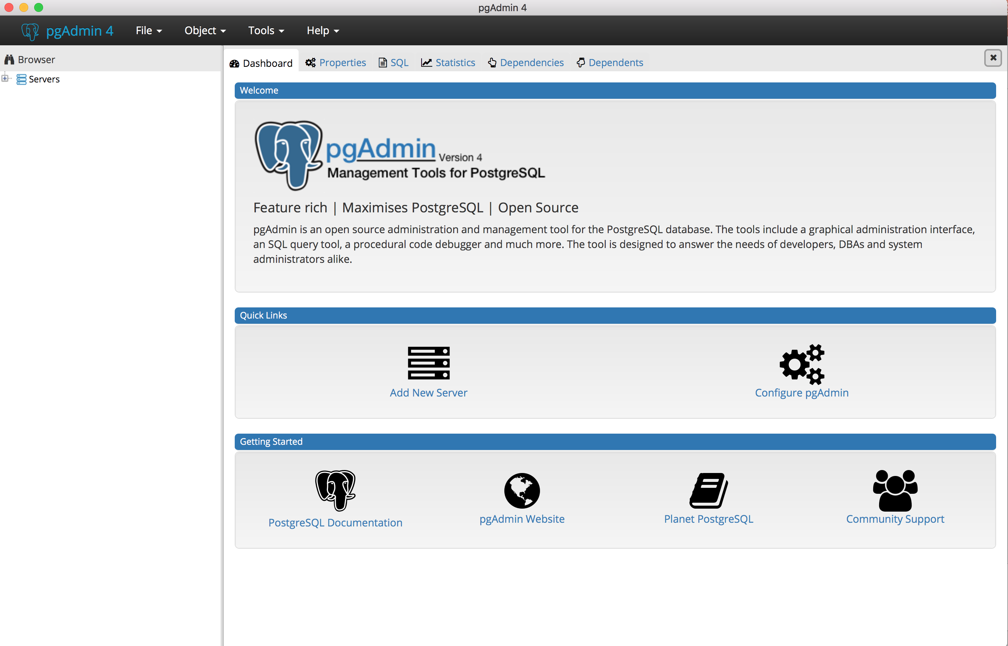
PgAdmin

Slide 11
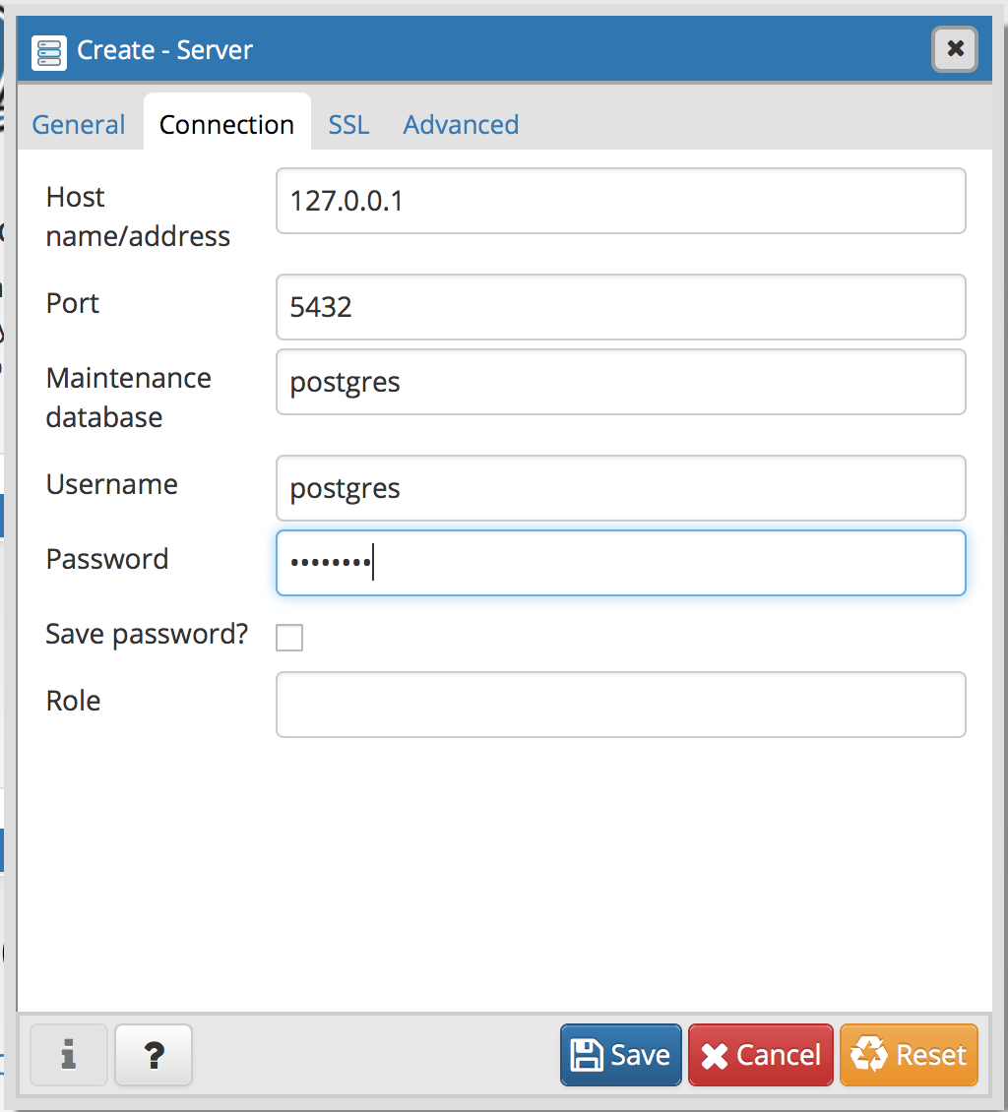
PgAdmin - Connection
New server

Slide 12
SQL vs NoSQL
SQL:
Relational model
Normalize data as much as possible
Row in a table have the same schema

Slide 13
SQL vs NoSQL
NoSQL
Document-oriented database
Data semi structured
No schema enforced over documents
Metadata attached to documents
Notes:
https://en.wikipedia.org/wiki/Document-oriented_database

Slide 14
Postgres Indexes
btree: self-balancing tree data structure
Works only with certain data type
Hash: hash function
GiST: Generalized Search Tree
Can handle all data types
GIN: Generalized Inverted Index
Good for full text search
Notes:
https://www.postgresql.org/docs/9.1/static/indexes-types.html

Slide 15
Postgres
Object Relational Database Management System
Support for some schemaless datatype.

Slide 16
First schemaless data: Hstore

Slide 17
HStore
Key-Value data structure
GiST and GIN index support for some operators
Used in rows with many attributes that are rarely examined

Slide 18
HStore
"name"=>"michele"
"surname"=>"capra"
"age"=> 18
"city"=>"Brescia"
"state"=>"Italy"

Slide 19
Hstore Demo
Go to
https://github.com/piccoloaiutante/schemaless-postgres/hstore
Notes:
http://www.postgresqltutorial.com/postgresql-hstore/

Slide 20
JSON data
Javascript Object Notation
Two type of field json/jsonb
More flexible than hstore: nesting, data validation

Slide 21
JSON data
Store the exact copy of the input
Spaces and keys (even duplicated) order are preserved
Reparse on each processing

Slide 22
JSONB
Json parsed on insert and stored in binary format
Keys order and spaces are lost
When duplicated keys, only last value is saved
Supports indexing

Slide 23
JSON Demo
Go to
https://github.com/piccoloaiutante/schemaless-postgres/json
Notes:
http://www.postgresqltutorial.com/postgresql-hstore/

Slide 24
Modeling Demo
Go to
https://github.com/piccoloaiutante/schemaless-postgres/blob/master/json/model.md
Notes:
http://www.postgresqltutorial.com/postgresql-hstore/

Slide 25
Solution
Leave data that we use for join into value type field.
All the rest should go to jsonb data.

Slide 26
GIS
Geographic information system
Storing, manipulate, analyze location information.
x,y,z axis -> longitude, latitude, elevation

Slide 27
Postgis
Spatial database extender for postgres
Add support for geographic object
Support for location queries in SQL

Slide 28
Desktop tool
pgAdmin supports spatial data but not rendering
QGIS favorite cross platform client
You can get it from here http://qgis.org/en/site/

Slide 29
Basic concept
OpenGIS Consortium for 2D data
Two data format representation:
Well-Known Text (WKT)
Well-Known Binary (WKB)

Slide 30
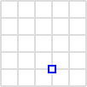
Data type - Point
A point in a Cartesian plane
POINT(0,30)

Slide 31
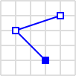
Data type - LineString
A polygonal chain is a connected series of line segments
LINESTRING (30 10, 10 30, 40 40)

Slide 32
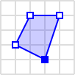
Data type - Polygon
a plane figure that is bounded by a finite chain of straight line segments closing in a loop to form a closed polygonal chain or circuit
POLYGON ((30 10, 40 40, 20 40, 10 20, 30 10))

Slide 33
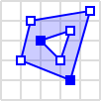
Data type - Polygon
POLYGON ((35 10, 45 45, 15 40, 10 20, 35 10), (20 30, 35 35, 30 20, 20 30))

Slide 34
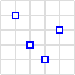
Data type - Multipoint
A series of points
MULTIPOINT ((10 40), (40 30), (20 20), (30 10))

Slide 35
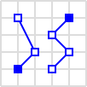
Data type – Multiline string
A series of line strings
MULTILINESTRING ((10 10, 20 20, 10 40), (40 40, 30 30, 40 20, 30 10))

Slide 36
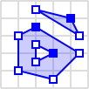
Data type – Multi polygon
A collection of polygon
MULTIPOLYGON (((40 40, 20 45, 45 30, 40 40)),((20 35, 10 30, 10 10, 30 5, 45 20, 20 35),(30 20, 20 15, 20 25, 30 20)))

Slide 37
Postgis data type
Geography:
ellipsoidal spatial data type
unit measure is meter
Geometry:
euclidean coordinate system
planar spatial data type

Slide 38
Dataset examples 1
New York subway stations (point)
name | Name of the station
borough | Name of the New York borough.
routes | Subway lines that run through this station
transfers | Lines you can transfer to via this station
express | Stations where express trains stop
geom | Point location of the station

Slide 39
Dataset examples 2
New York streets (multiline)
name | Name of the street
oneway | Is the street one-way? “yes” = yes, “” = no
type | Road type. Eg. primary, secondary, residential, motorway
geom | Linear centerline of the street

Slide 40
Dataset examples 1
New York neighborhood (polygon)
name | Name of the neighborhood
boroname | Name of the New York borough. Manhattan, The Bronx, Brooklyn, Staten Island, Queens
geom | Polygon boundary of the neighborhood

Slide 41
Postgis Demo
Go to
https://github.com/piccoloaiutante/schemaless-postgres/postgis
Notes:
http://www.postgresqltutorial.com/postgresql-hstore/

Slide 42
PostGis in production
Port Call Plan
Coordinate port calls digitally through one application.
Postgres + Node.JS + Marko.JS

Slide 43
Vessel live tracking
Showing where vessel is in Antwerp port.
Showing some specific point on vessel path.

Slide 44
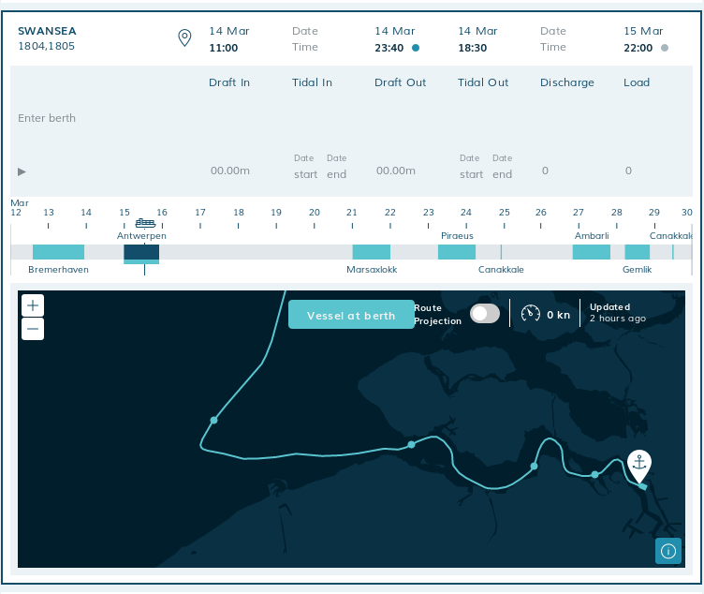
Example

Slide 45
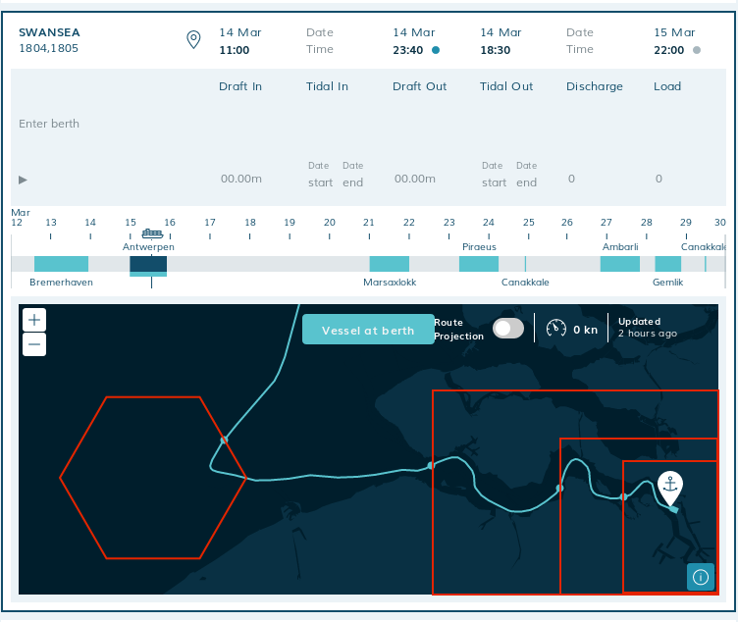
Polygon

Slide 46
Ltree data
Labels of data stored in a hierarchical tree-like structure
Support indexing

Slide 47
Ltree data
Label: sequence of alphanumeric characters and underscores
Path: sequence of zero or more labels separated by dots
Operators to manipulate labels and paths

Slide 48
Ltree Demo
Go to
https://github.com/piccoloaiutante/schemaless-postgres/ltree
Notes:
http://www.postgresqltutorial.com/postgresql-hstore/

Slide 49
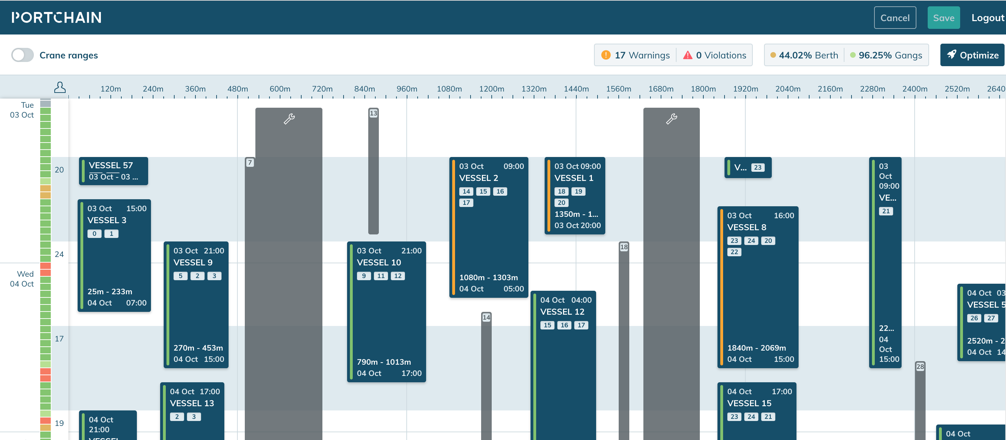
Example

Slide 50
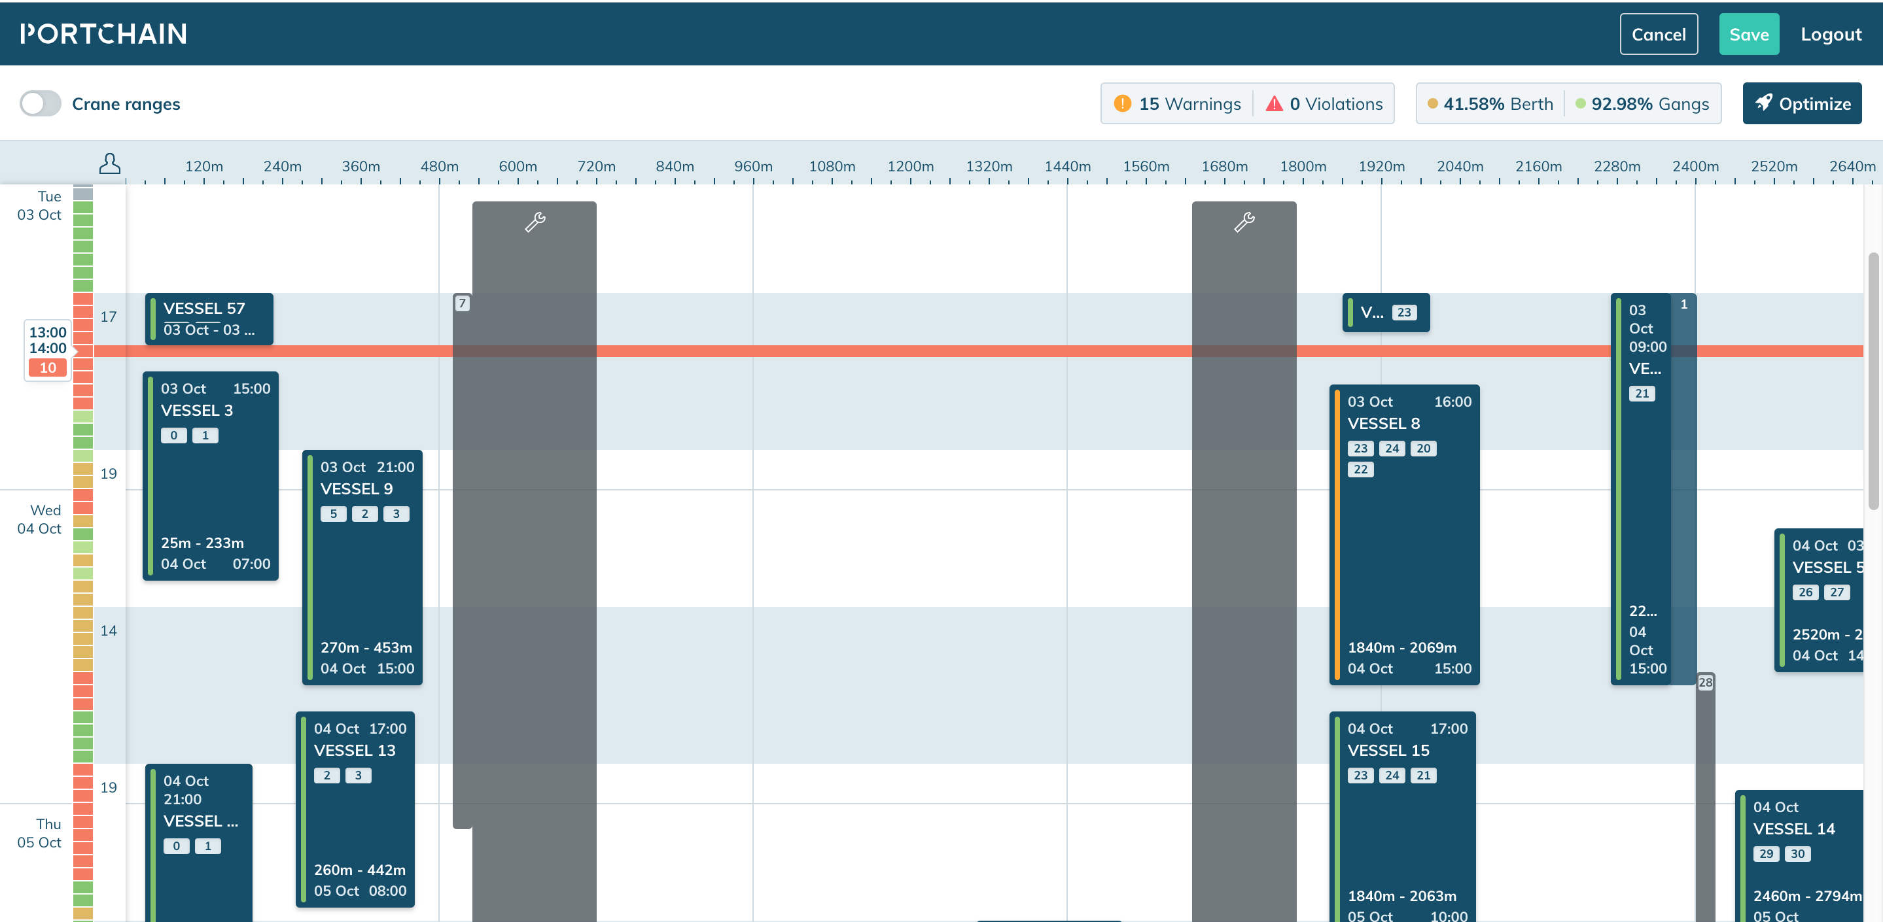
Example

Slide 51
Example
Root User
User A changes
User B changes
User C Changes
User B Changes
User A
Changes

Slide 52
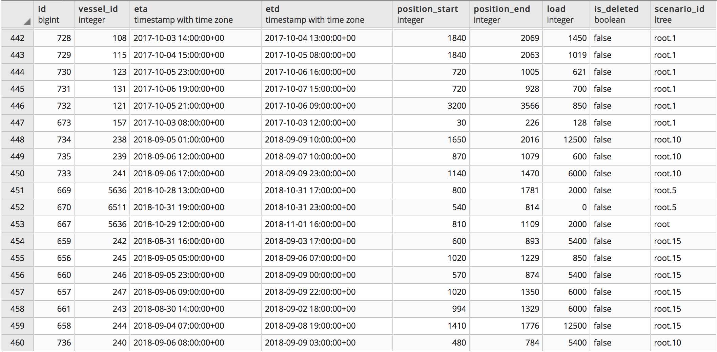
Example

Slide 53
Recap
Schemaless data in postgres:
Hstore
Json/jsonb
Geography/geometry
Ltree
Old data type:
array

Slide 54
Thank you Ciao!

